Slide 1
Profit Analysis
Report
Presented By :
PTID-CDA-DEC-24-257
Saumya Verma
Trisha Gupta
Khagendra Patil

Slide 2
Data Overview
Dataset Summary :
Number of Records: 50 observations
Variables Analyzed
R&D Spend
Marketing Spend
Administration Spend
Profit (Target Variable)

Slide 3
Goals
1 . To analyze profit trends and identify strategies to enhance business profitability using data insights from Excel and Power BI.
2 . Leverage insights from Excel regression and Power BI dashboards for data-driven decision-making.

Slide 4
Tools Used in the Project
SQL
Used to extract data from the team’s database for analysis.
Microsoft Excel
Used for data analysis and regression calculations. Excel's built-in functions, such as the Data Analysis Toolpak, were utilized to perform linear regression, identify correlations, and analyze profit-driving variables.
Power BI
Used to create interactive dashboards and visualizations for better insights into profit trends. Power BI helped in visualizing sales performance, expenses, and operational efficiency across various business segments.

Slide 5
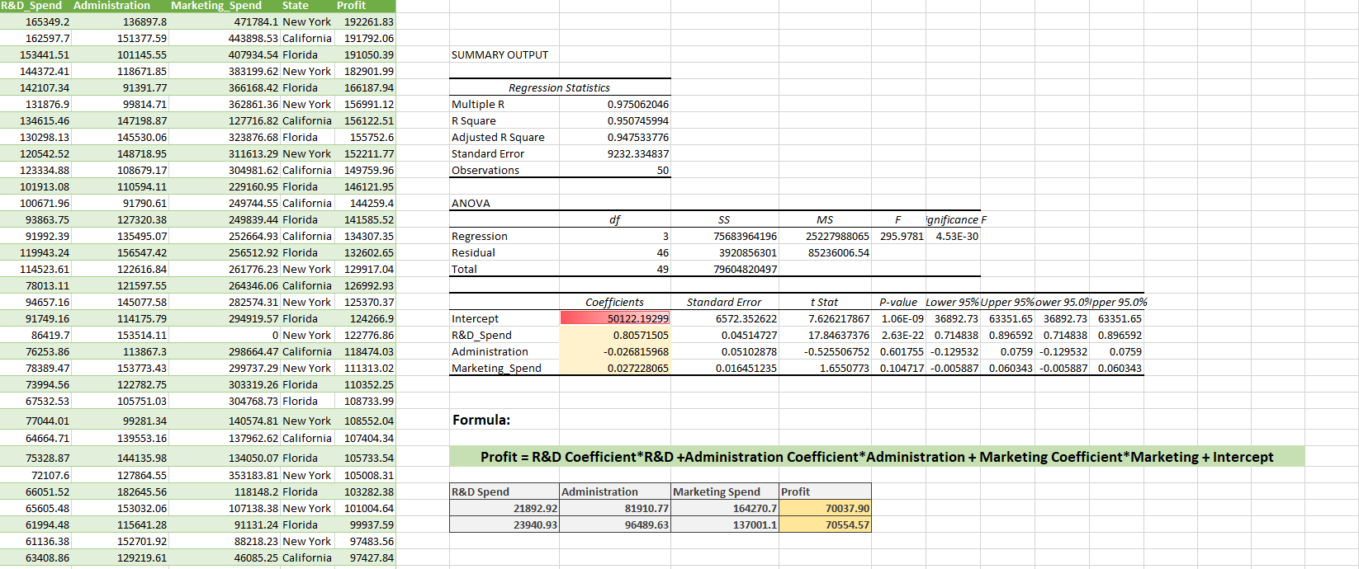
Regression Analysis Results
In this section, we performed a multiple regression analysis to identify the key factors influencing profits.
The analysis was conducted using Excel, which provided us with the following key outputs:
Regression Statistics
ANOVA Results
Coefficients and P-Values
Model Equation

Slide 6
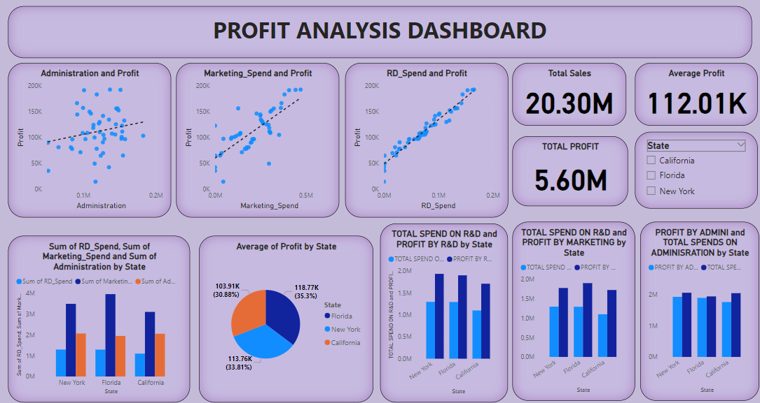
Power BI Dashboard:

Slide 7
Actionable Insights
In Scatter Plots, the points clusters are closely around the trendline in R&D, which tells that there is a strong correlation with profit among all spending categories.
In Bar Chart, it Compares state-wise spending across all categories.
In Pie Chart, it shows that Florida has the highest average profit, so the startups should expand or focus more resources in Florida.
Total sales and profit, total sales is $20.30M, total Profit is $5.60M and the average profit is $112.01K.
State-Wise Analysis, Florida has the highest average profit of $118.77K (35.3%), followed by New York at $113.76K (33.81%). California records the lowest average profit at $103.91K (30.88%).
R&D significantly contributes in predicting profit, because p-value of R&D is 2.63×10−222.63 which is less than 0.05.

Slide 8
Thank You

