Slide 1
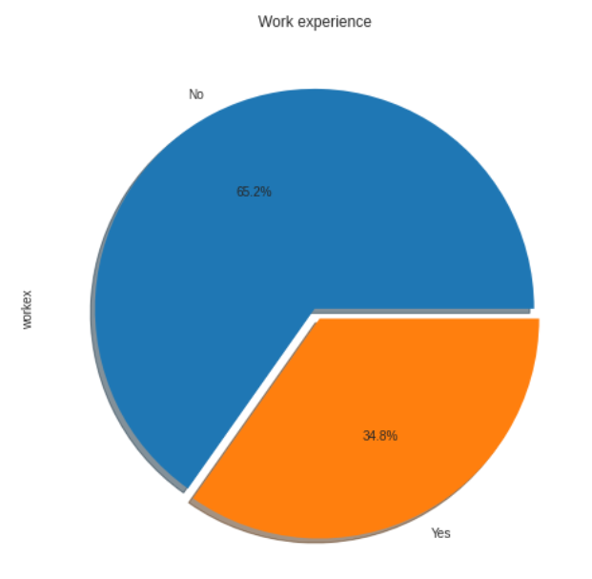
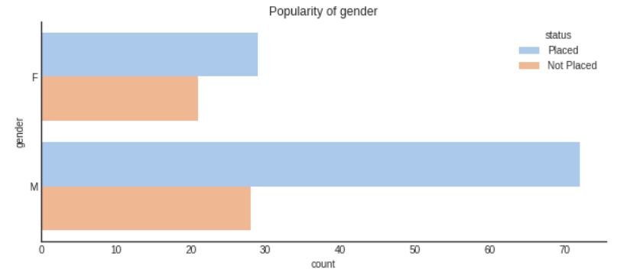
Team Name: Code_aceion
Team Members:
Saumya Gaur
Pranshul Atri

Slide 2
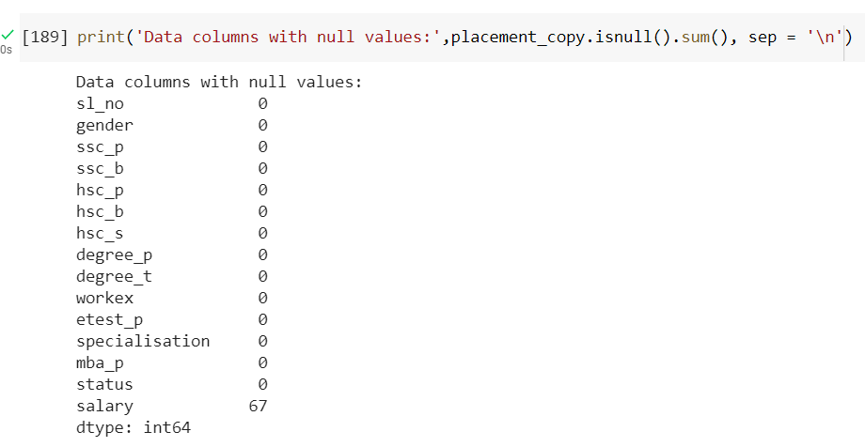
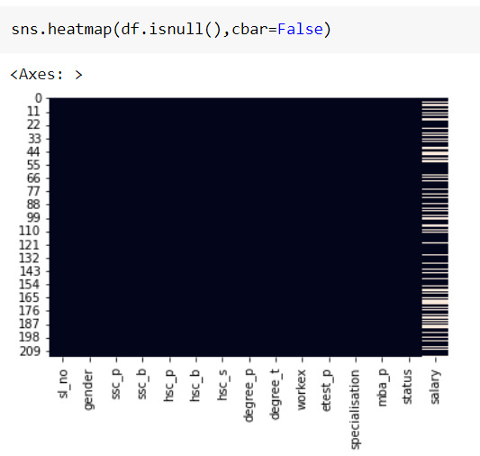
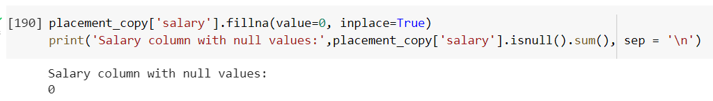
Problem 1
Data Cleaning
We have plotted the heatmap for showing the NULL values present in our dataset.
As we can see here that we have (67) NULL values in salary column.
Here we have replaced all the empty places with 0 in salary column.

Slide 3
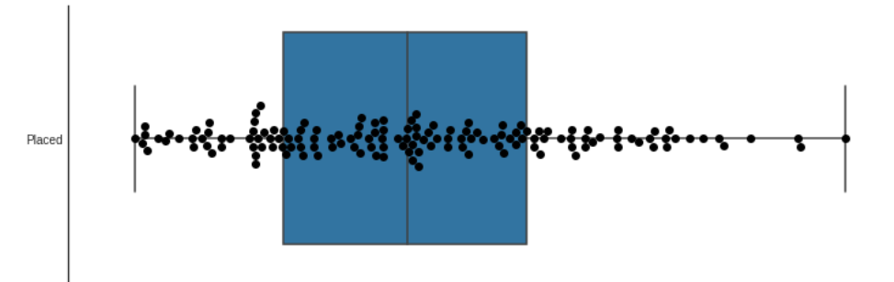
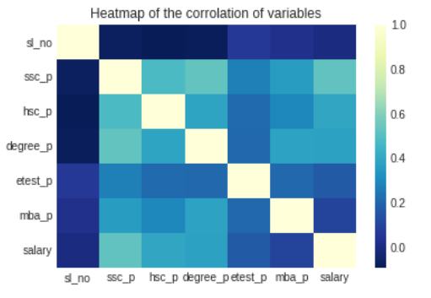
Inferences

Slide 4
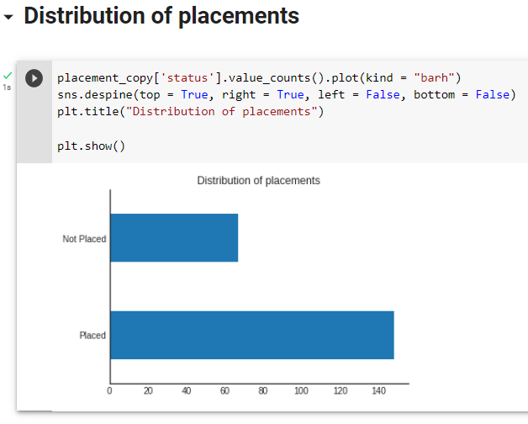
Distribution of placements
1st Inference:
In general, the programme has been effective, with about 70% of students receiving placements through it.

Slide 5
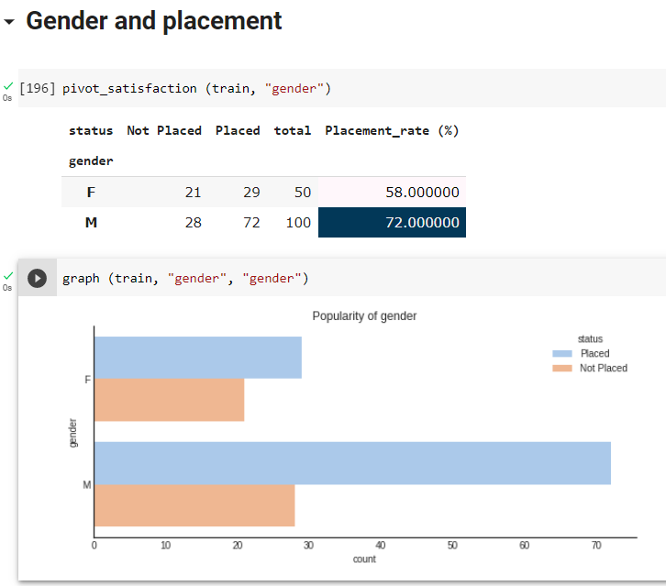
Gender V/S placement
2nd Inference:
Regrettably, it appears that there is a gender gap between the students who are male and female. Men have twice as many participants in the system as their female counterparts. Also, they had a higher success rate, with 72% of male students getting accepted as opposed to 58% of female students. Therefore, it is advised that the university recruits more women to participate in the programme.

Slide 6
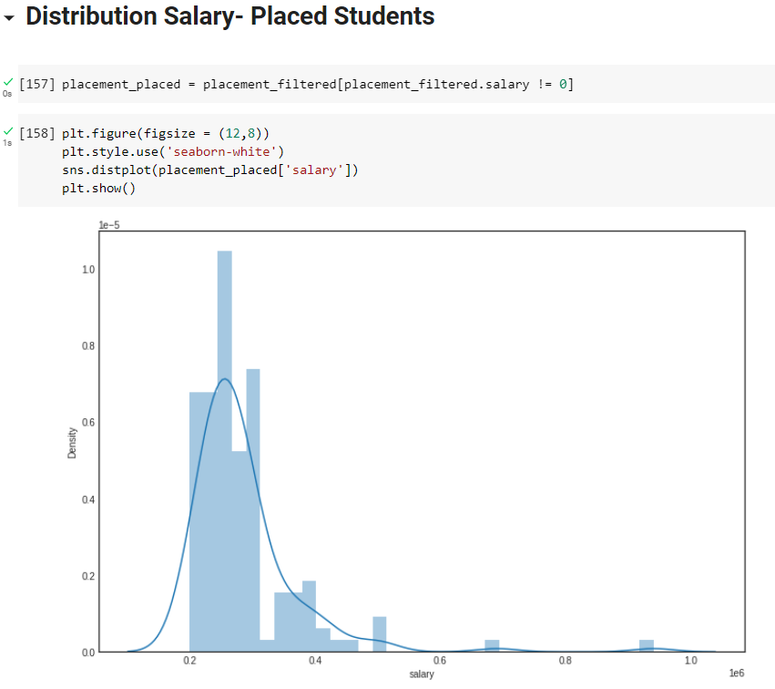
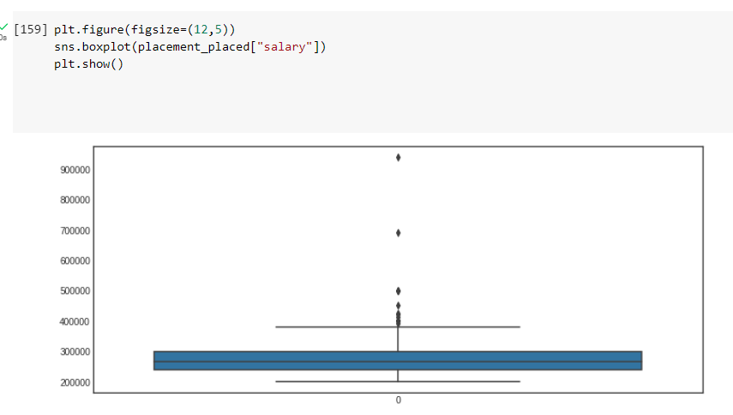
Distribution Salary V/S Placed Students
3rd Inference:
Numerous candidates who were hired received packages ranging from 2L to 4L PA.
Only one candidate got around 10L PA
The typical salary is little higher than 2LPA.

Slide 7
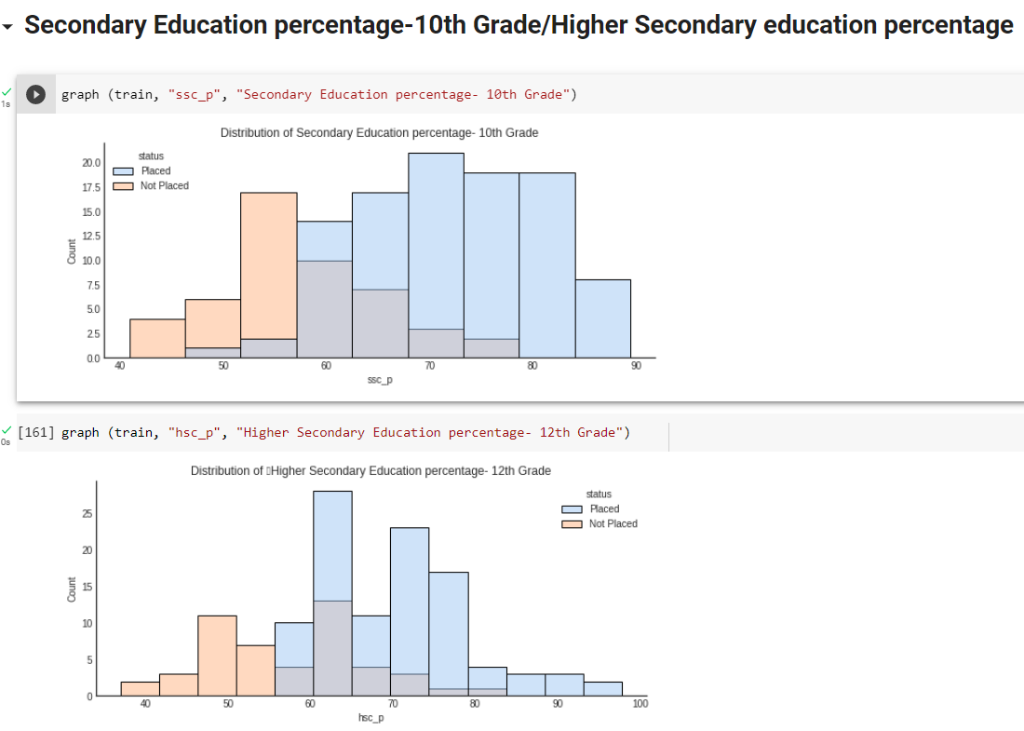
Secondary Education percentage-10th Grade/Higher Secondary education percentage
4th Inference:
Individuals with lower exam scores in the tenth grade seem to have trouble getting a job. This is hardly a definitive declaration, though. Several people who received scores in the range between 45 and 60% were also successful in finding employment.
Yet, if a student's progress is measured in grade 10, the value of further education for the programme is constrained. This may discourage kids who performed poorly and cause them to believe that their possibilities are already constrained as a result of the grade 10 exam.
With the examination in grade 12, the effect of this becomes harsher. Once more, the role of the institution is diminished or constrained if the successful placement is determined by circumstances outside of the university.

Slide 8

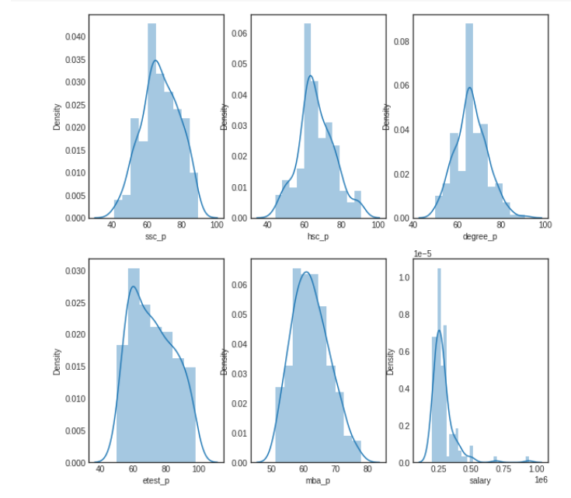
Distribution of all percentages
5th Inference:
Except for the salary feature, all distributions follow the normal distribution.
The majority of candidates' educational achievements fall between 60 and 80%.
Distribution of pay a few outliers with salaries of 7.5L and 10L PA.

Slide 9
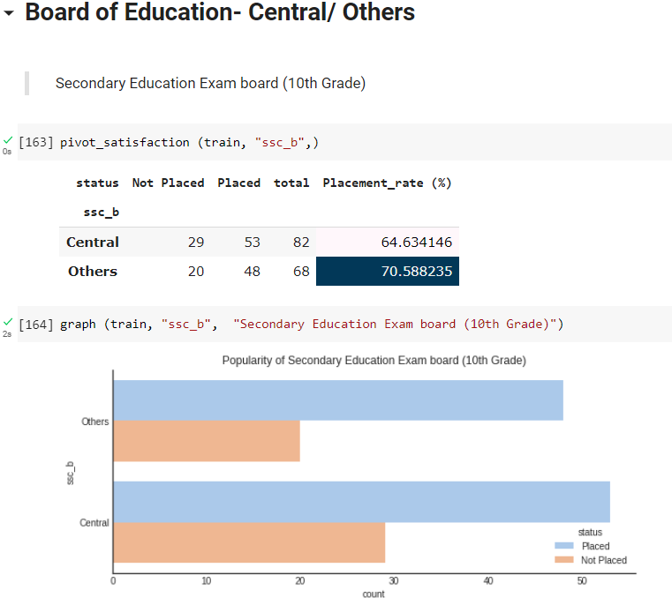
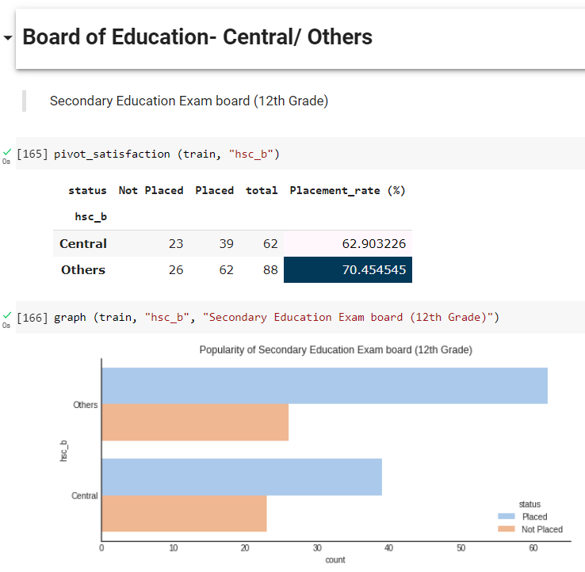
Board of Education- Central/ Others
6th Inference:
The examination boards' influence is little. Even though the variables are divided into central and other, the succuss rate only varies by 6-8%. With regard to both the 10th and 12th grade exams, this percentage is rather steady.

Slide 10
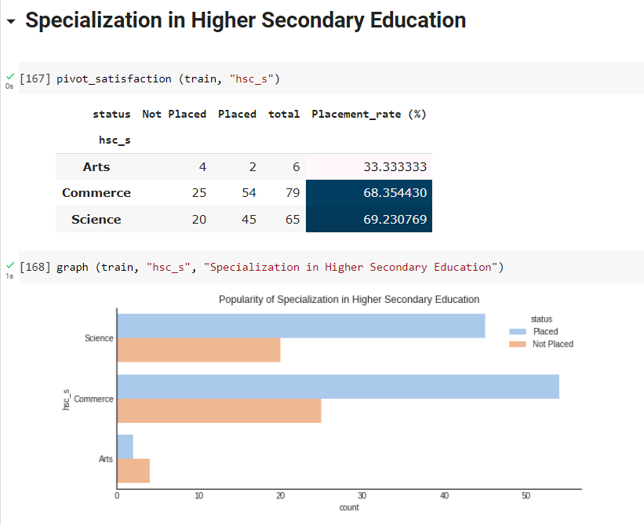
Specialization in Higher Secondary Education
7th Inference:
Students in this programme have chosen to specialise in either science, business, or the arts. We may observe that more candidates with a background in science and business attended the placement drive. Only 5.12% of candidates come from Art's background.
The success percentage was higher—around 60%—for students majoring in science and business than it was for students majoring in the arts.

Slide 11
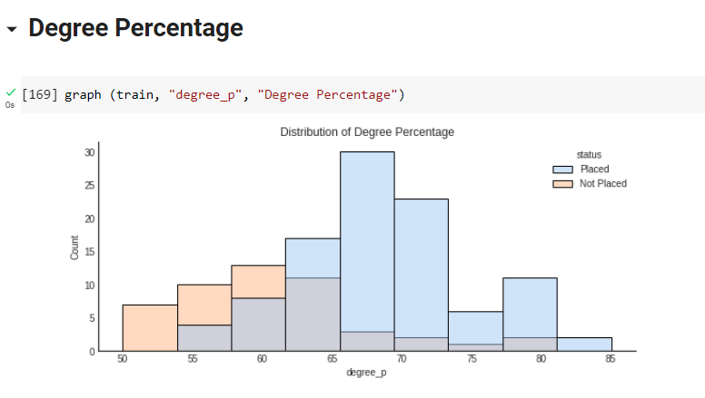
Degree Percentage
8th Inference:
Similar to high school accomplishments, kids who scored higher were more likely to receive a placement. Nonetheless, the relevance of this highlights the benefits of putting in extra effort while in college.

Slide 12
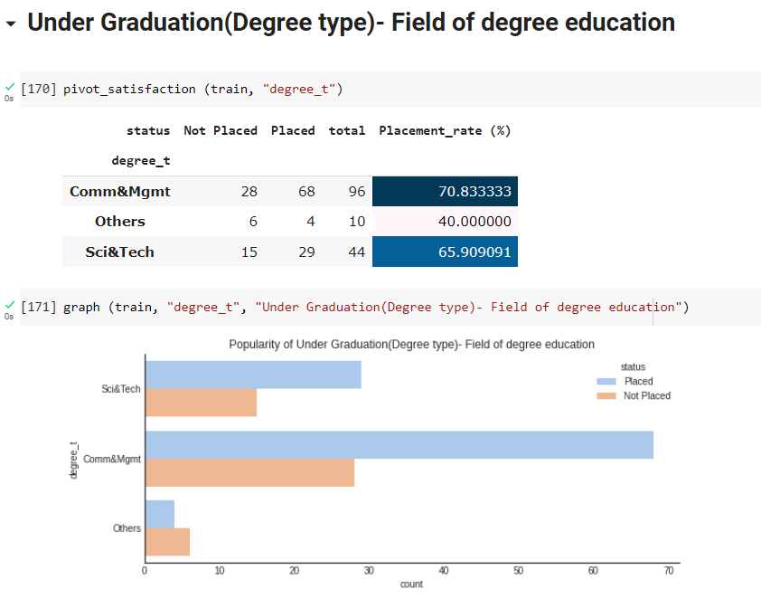
Under Graduation(Degree type)- Field of degree education
9th Inference:
The results of higher secondary specialisation are mirrored by degree type. Students with a focus on science, technology, engineering, or business and management dominated the programme and are more likely to secure a placement. Nonetheless, it appears that the college offers little benefit to those who are categorised as others.
Those students had lower application rates and even worse placement rates for the programme. In order for people studying other topics to succeed in the placement plan, further support is required, similar to the steps indicated for higher secondary specialisation.

Slide 13
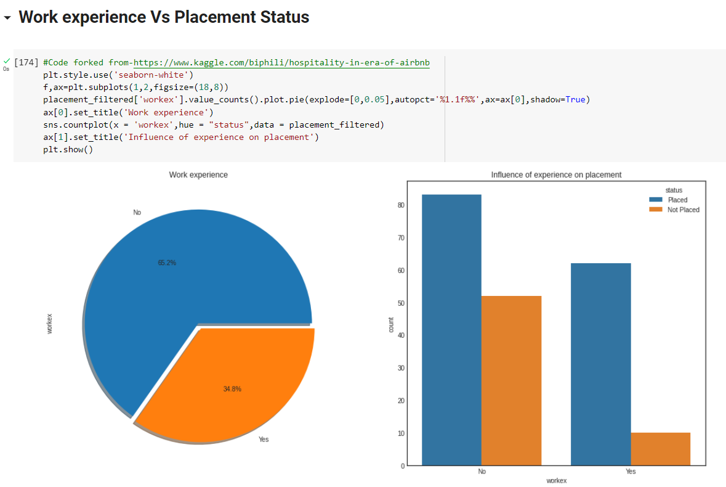
Work experience Vs Placement Status
10th Inference:
Around 66.2% of our applicants have no prior work experience.
Applicants with no prior work experience have received more job offers than those with experience.
We can infer that a candidate's employment history has no bearing on the hiring decision.

Slide 14
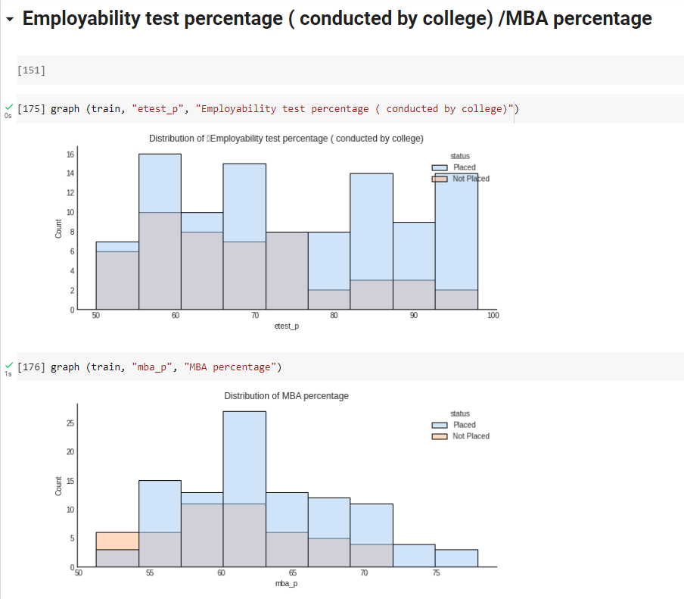
Employability test percentage ( conducted by college) /MBA percentage
11th Inference:
Contrary to other metrics previously examined, it seems that the proportion of employability test results had no effect on students' chances of landing a job. Students with a range of scores, including those between 50 and 55 percent, were able to find employment.
The MBA percentage reveals a similar result. The proportion has a negligible effect on getting a job. Nonetheless, it was difficult for individuals who received between 50 and 55 percent to get a spot.

Slide 15
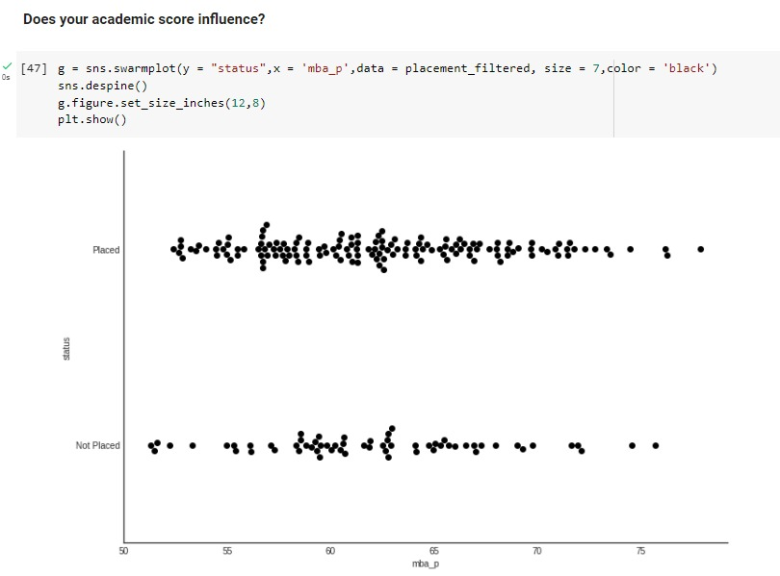
MBA marks vs Placement Status
12th Inference:
From the graph, we can infer that
Few students below 55 MBA percentage got placed.
Whereas there are just a few students who had above 70 MBA percentage but didn't get placed.
Most students having MBA percentage above 55 got placed.
Hence MBA percentage directly affects placements.

Slide 16
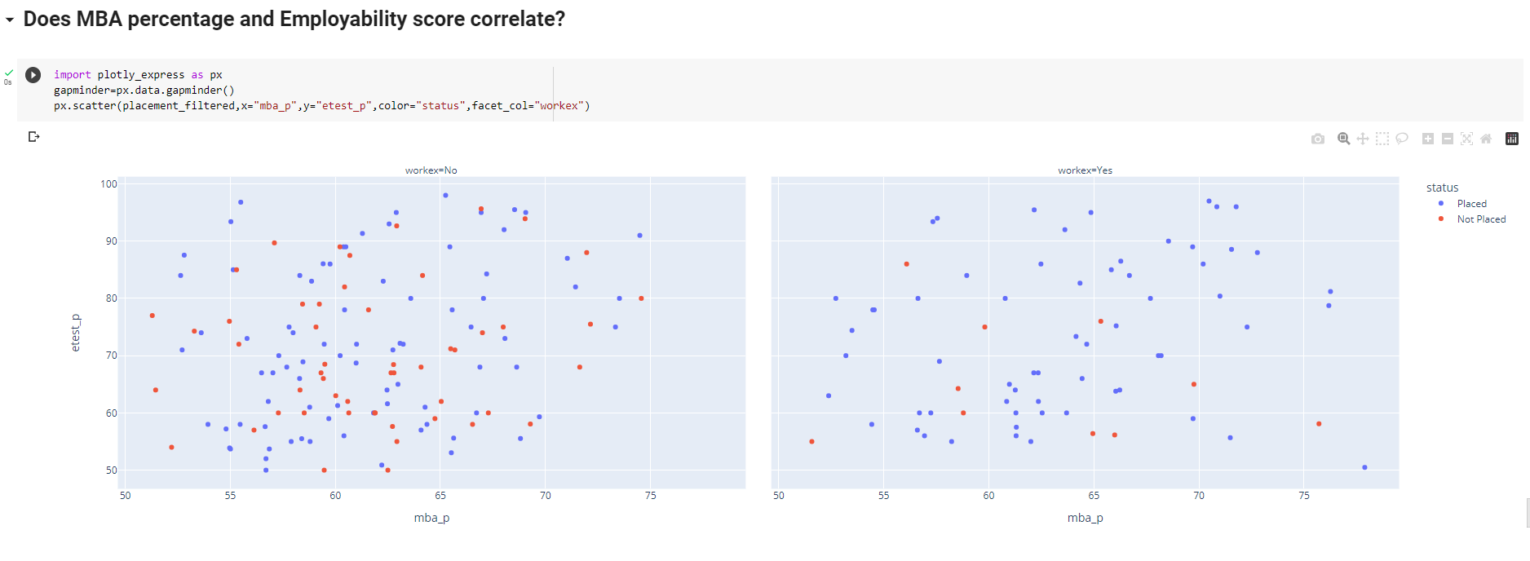
Does MBA percentage and Employability score correlate
13th Inference:
We can deduce from the graph that students with work experience who had high etedt_p scores were placed more often than those without work experience.
This demonstrates that, in contrast to work etest_p has no impact on forecasting the placement status of students.

Slide 17
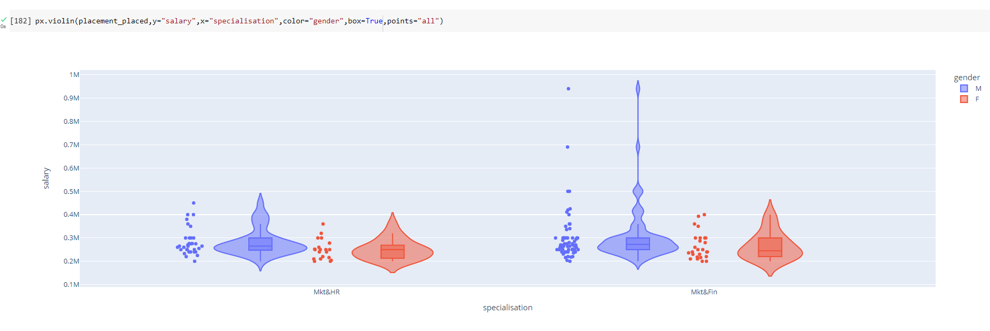
Specialization V/S Placement for Male/Female
14th Inference:
We can deduce from the data that most guys received more pay than females for the same specialisation.
Some male students in Mkt&Fin received greater packages ranging from 7 lakhs to 10 lakhs than students having specialisation in Mkt&HR.
Average salary in Mkt&Fin is more than in Mkt&HR for both male and female

Slide 18
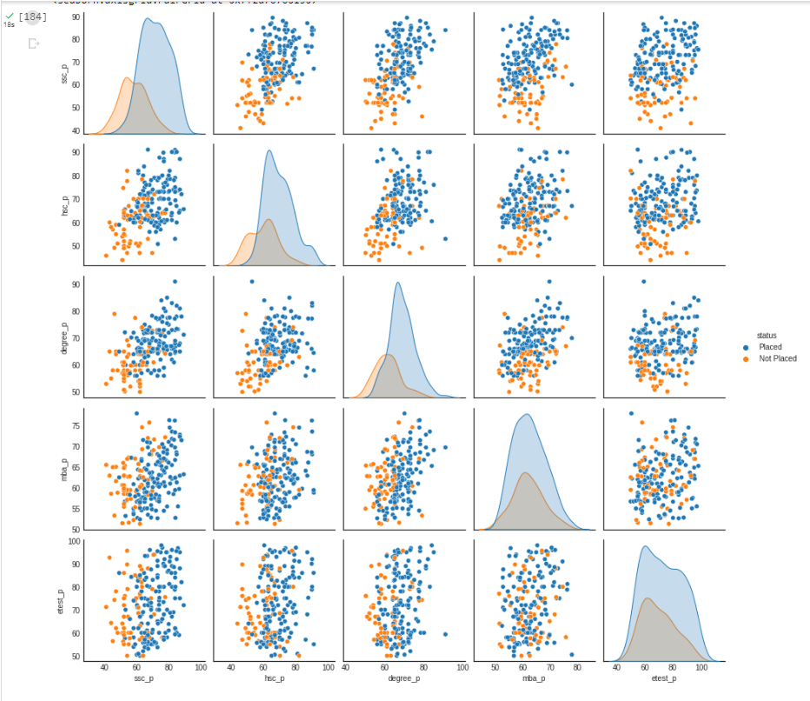
Distribution of our data
Candidates who received high marks in their secondary and undergraduate studies were placed.
Those who performed well in school were placed.
comparing the proportion of students that were matched with applicants who scored well on the mba test and the employability test

Slide 19
Summary
A few unsettling trends have been observed in the student success rates. Universities are recommended to invest in underrepresented groups, such as female students and those who have studied subjects other than their field of study.
Higher percentages of secondary and higher education students had a better chance of placement. Thus, the placement of students is influenced by the ssc_p and hsc p.
We can draw the conclusion that students with employment experience had a higher likelihood of being hired than those without experience thanks to our data visualization.
Variable workex have an impact on where students are placed.
In higher secondary education, students who studied science and commerce did better than those who studied art. It is advised that universities give art students more assistance.
Students who choose to specialize in finance for their degrees did better than those who chose HR during placement. More student chose finance over HR course making Mkt&Fin high demand in the industry.
A placement is not strongly influenced by an MBA percentage. Nonetheless, it was difficult for individuals who received between 50 and 55 percent to get a spot.

Slide 20
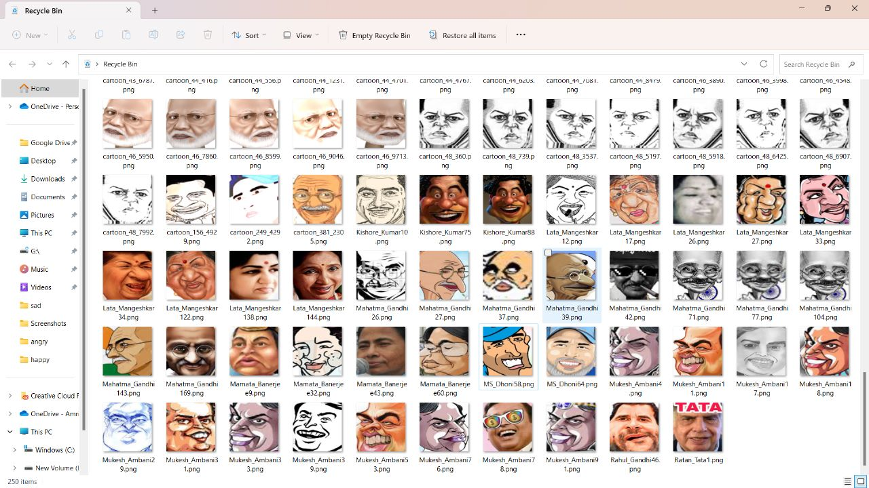
Problem 2
Data Exploration
Data Cleaning
We cleaned the wrong classified training data

Slide 21
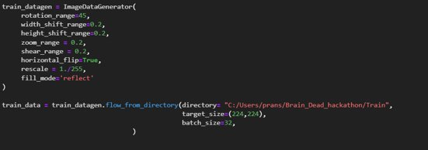
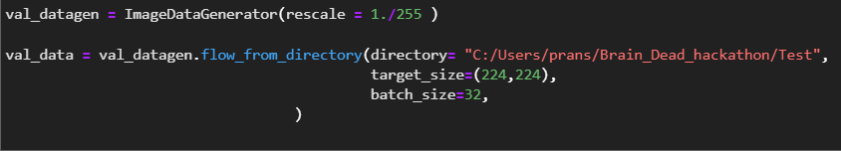
Image Augmentation
Generating synthetic images using any image generation techniques to augment the dataset and increase its size

Slide 22
Methodology:
Building our Model To train the data
Working with pre trained model(MobileNet)
Creating our model.
Visualizing the data that is fed to train data gen
To visualize the images in the training data generator
Function when called will plot the images
Having early stopping and model check point
Loading the best fit model
Just to map o/p values
Path for the image to see if it predicts correct class
Plot the confusion matrix. Set Normalize = True/False

Slide 23
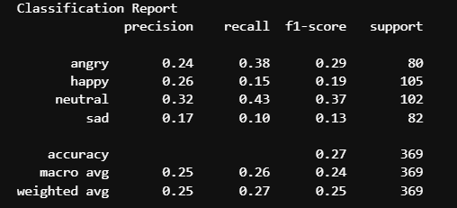
Results of analysis
Classification Accuracy: 64.23%
F1 score:
Precision:
Recall:

Slide 24
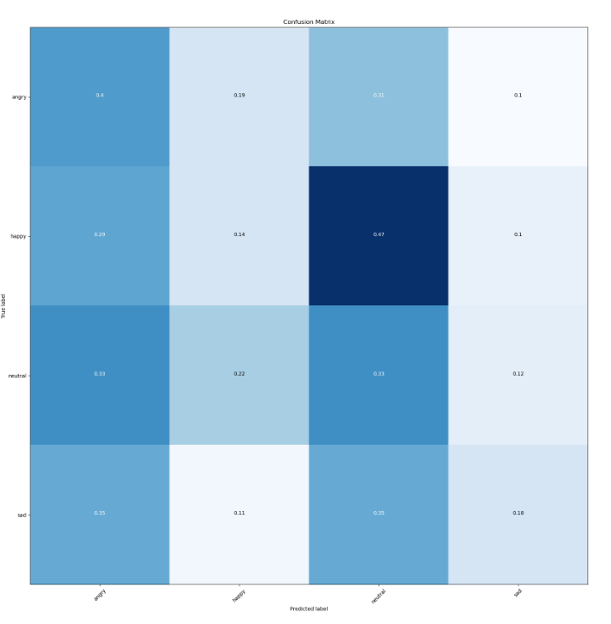
Confusion Matrix:

Slide 25





Pipeline architecture
COLLECT
STORE
ENRICH
TRAIN/APPLY
VISUALIZE

Slide 26
Conclusion
After using the provided dataset to train our model to identify emotions, we obtained a classification accuracy of 64.28 percent. We received low precision and recall for the sad category since the dataset for that category had many images from other categories.
The ROC curve could only be generated for binary classification issues, and since our problem has multiclass labels, we are unable to construct the ROC curve for the provided dataset.
The value of the AUC score is also unavailable because we are unable to generate the ROC curve.

Slide 27
Python Code for Problem 1(.ipynb) file path Click Here
Python Code for Problem 2(.ipynb) file path Click Here

Slide 28

THANK YOU
Saumya Gaur
saumyagauran@gmail.com
LinkedIn (click here to see linkedIN page)
Pranshul Atri
pranshul19109193@gmail.com
LinkedIn (click here to see linkedIn page)

