Slide 1
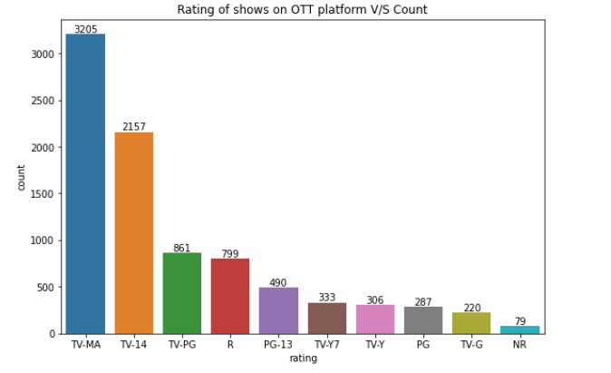
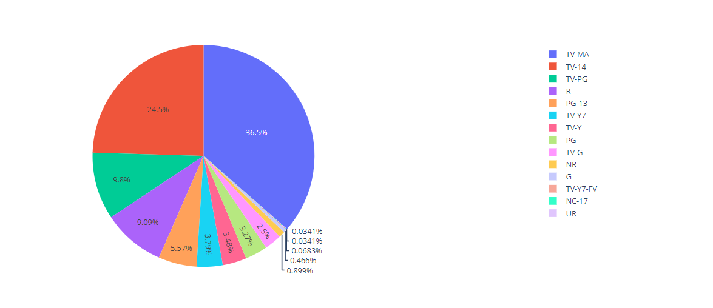
Team Name: 623328-UJ227L2P
Team Members:
Saumya Gaur
Pranshul Atri

Slide 2
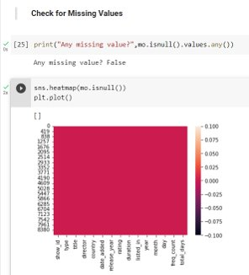
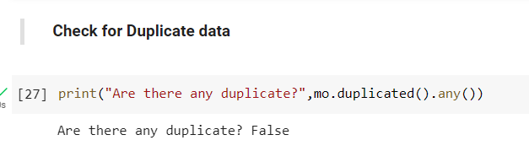
Data Cleaning
In the given dataset we checked for missing values and plotted a heatmap for the same.
We were able to infer that were no missing values in our dataset.
In the given dataset we checked for duplicate values .
We were able to infer that were no duplicate values in our dataset.

Slide 3
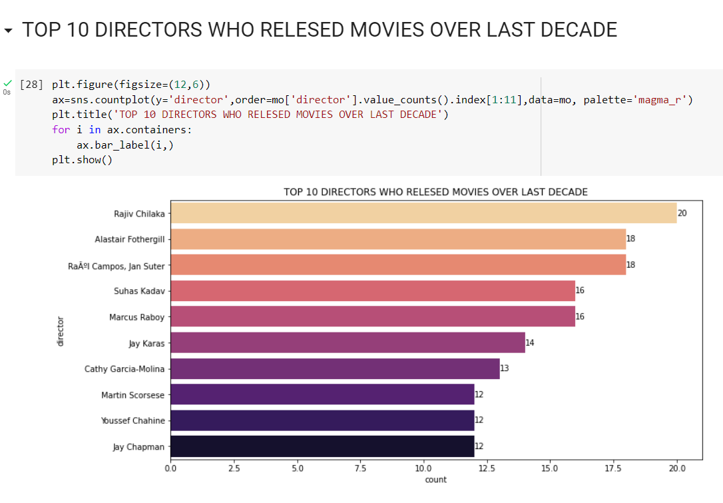
TOP 10 DIRECTORS WHO RELESED MOVIES OVER LAST DECADE
1st Inference:
We can infer from the dataset that Rajiv Chilaka directed the greatest number of movies followed by Alastair Fothergill over the last Decade.

Slide 4
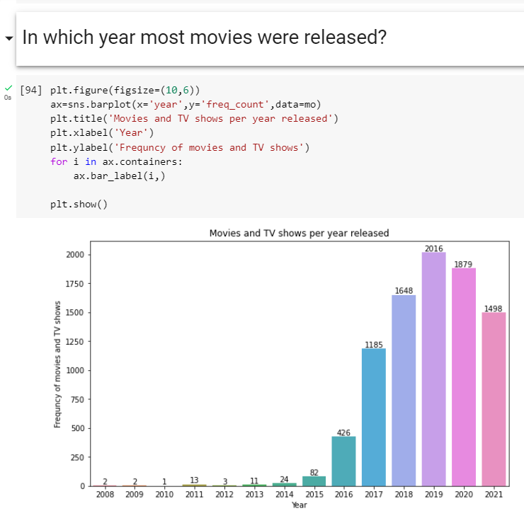
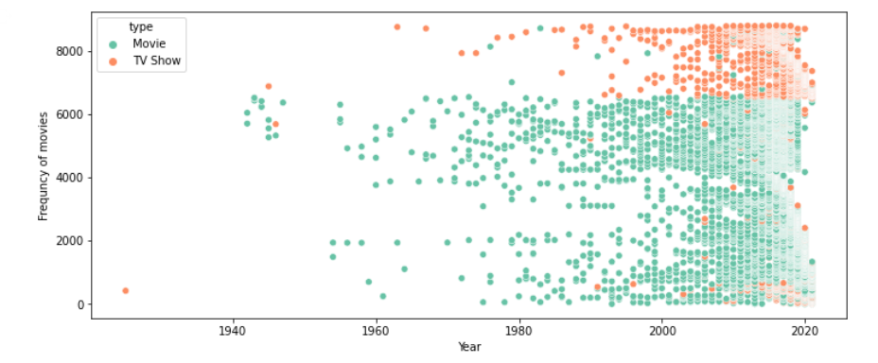
In which year most movies were released?
2nd Inference:
We can infer from the plots that maximum number of (movies and TV shows) collectively were released in 2019 that is 2016.

Slide 5
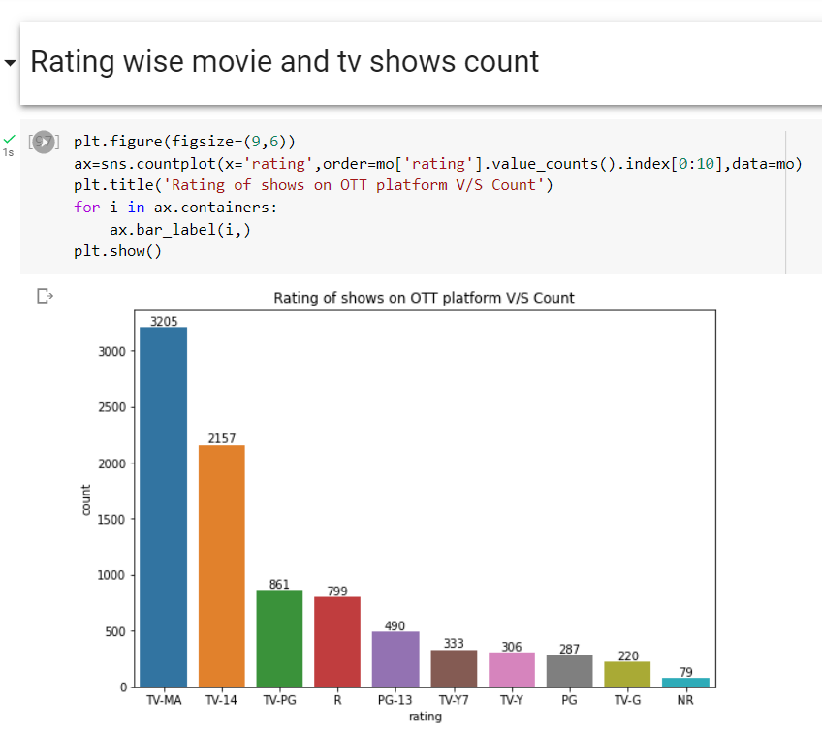
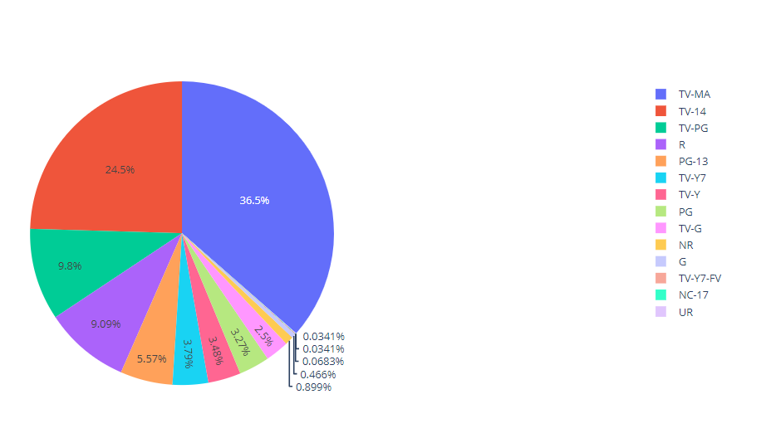
Rating wise movie and tv shows count
3rd Inference:
Maximum number of TV Shows belongs to TV-MA rating.
Maximum number of Movies belongs to R rating.
We can infer that most of the content is meant for mature Audience.

Slide 6
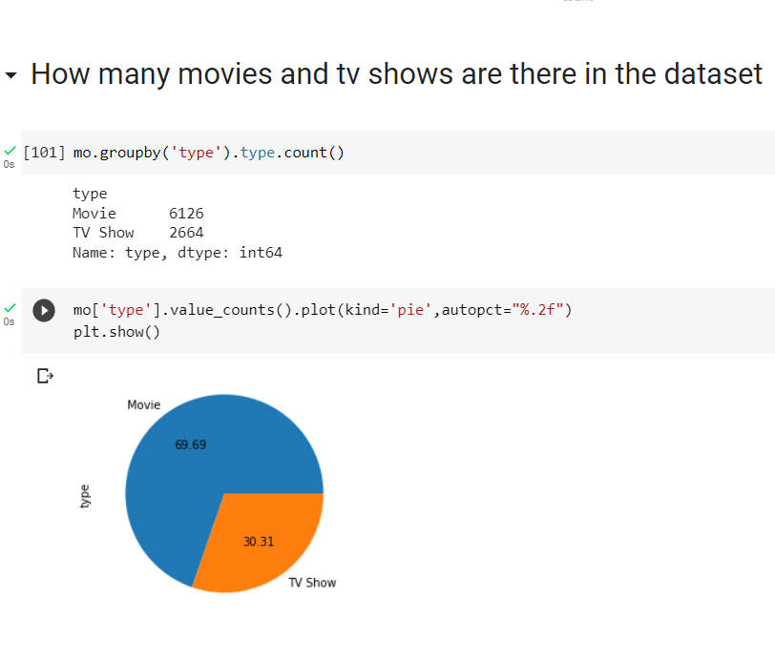
How many movies and tv shows are there in the dataset
4th Inference:
We can infer that 69.69 percent of content is movies
30.31 percent of content is TV Shows.

Slide 7
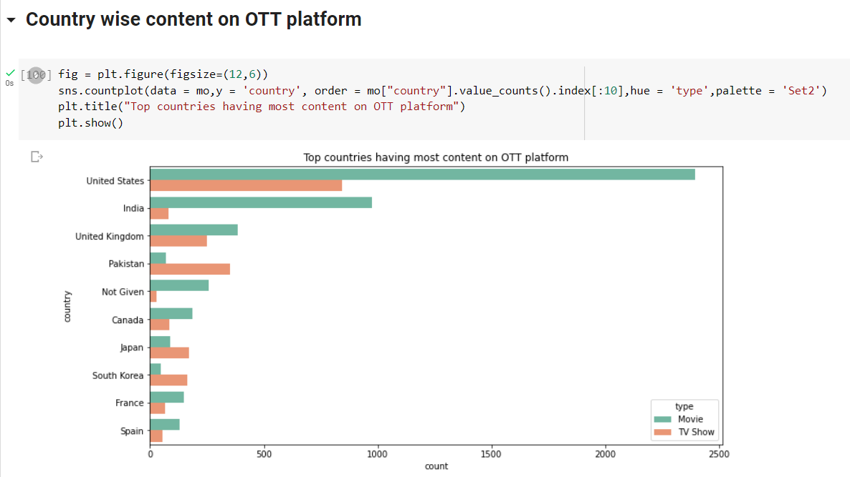
Rating wise movie and tv shows count
5th Inference:
Most number of Movies and Tv-Shows are from country United States.
We can infer that most of the audience comes from The United States.

Slide 8
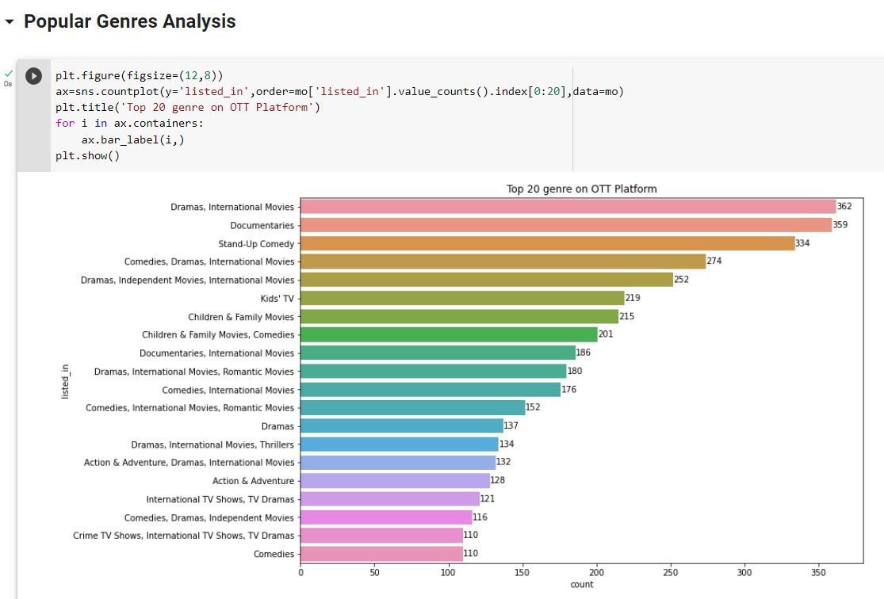
Popular Genres Analysis
6th Inference:
The most popular Genre is Dramas, International Movies with a 36.2% of total audience watching this genre.
The second most popular Genre is Documentaries with a 35.9% of total audience watching this genre.
We infer that audience prefer watching Movies and TV shows in the above two mentioned Genre.

Slide 9
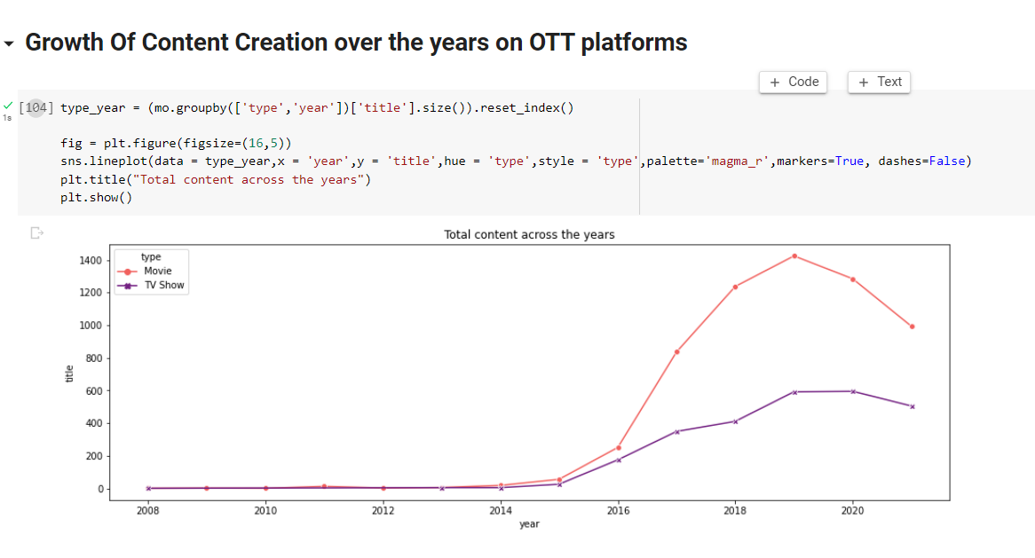
Growth Of Content Creation over the years on OTT platforms
7th Inference:
We infer that in year 2019 number of content created in both movies and Tv Show had a sudden increase.

Slide 10
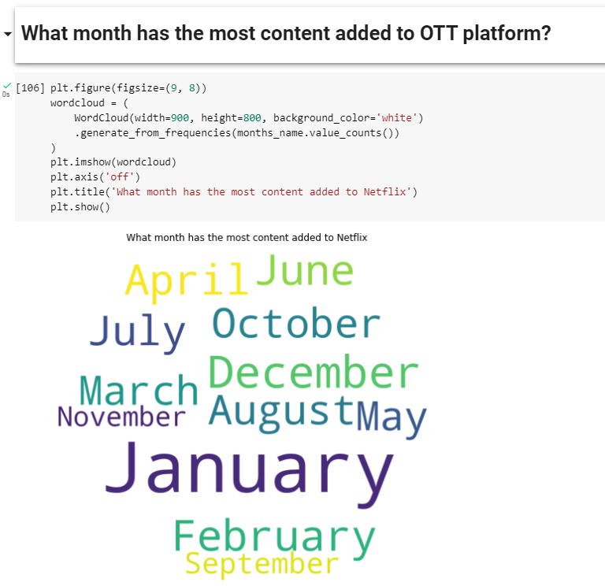
What month has the most content added to OTT platform?
8th Inference:
From the Wordcloud plot we can infer that most content added to OTT platform is in the month of January.
Followed By April

Slide 11
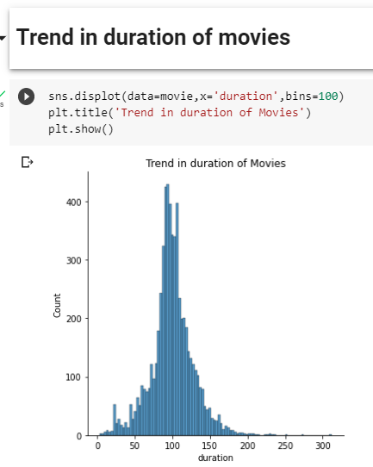
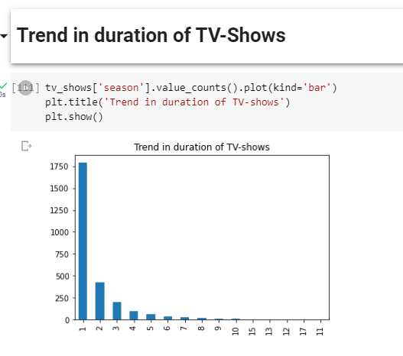
Trend in duration of TV-Shows and Movies
9th Inference:
We can infer that most of the movies have time duration between 90 mins to 120 mins.
Whereas most of the TV-Shows have 1 Season .

Slide 12
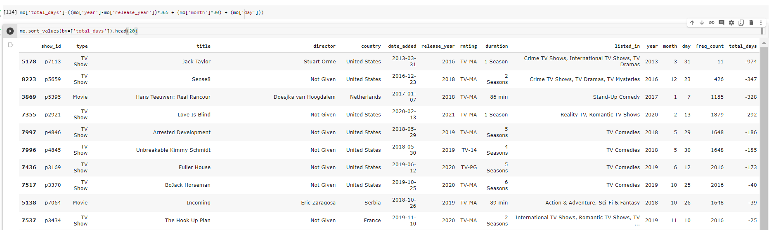
Entry Time of the Movies/TV-Shows on the OTT platform
10th Inference:
We can infer from the –ve days values in total_days column that few of the movies/TV-shows were added to the OTT platform even before they were released

Slide 13
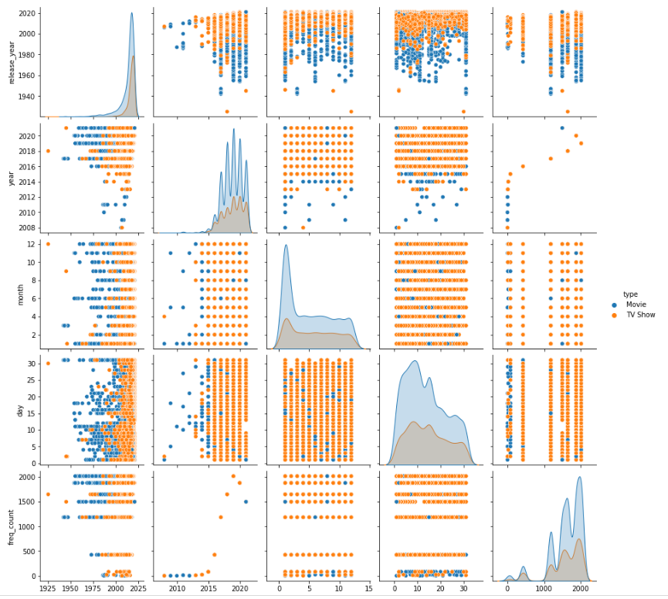
This is a Pair wise plot for Movies and TV_show based of release-date and entry-date,etc

Slide 14
Summary
We can infer from the dataset that Rajiv Chilaka directed the greatest number of movies followed by Alastair Fothergill over the last Decade.​
We can infer from the plots that maximum number of (movies and TV shows) collectively were released in 2019 that is 2016.
Maximum number of TV Shows belongs to TV-MA rating.
Maximum number of Movies belongs to R rating.
We can infer that most of the content is meant for mature Audience.

Slide 15
THANK YOU

