Slide 1



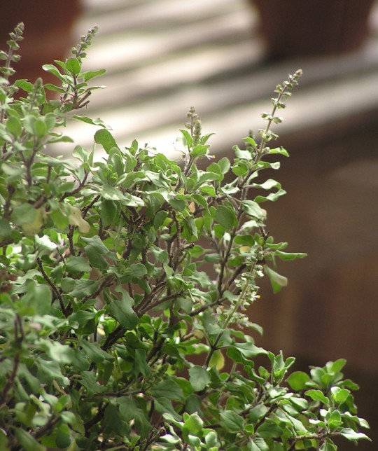
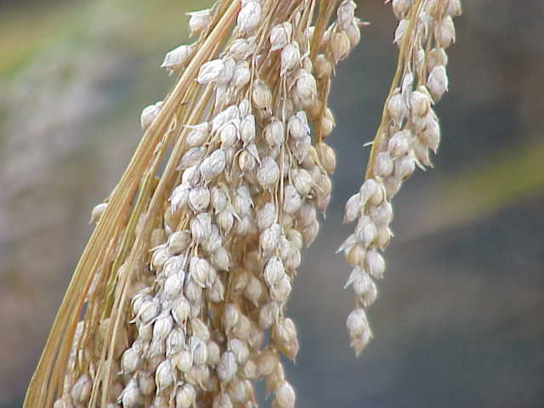
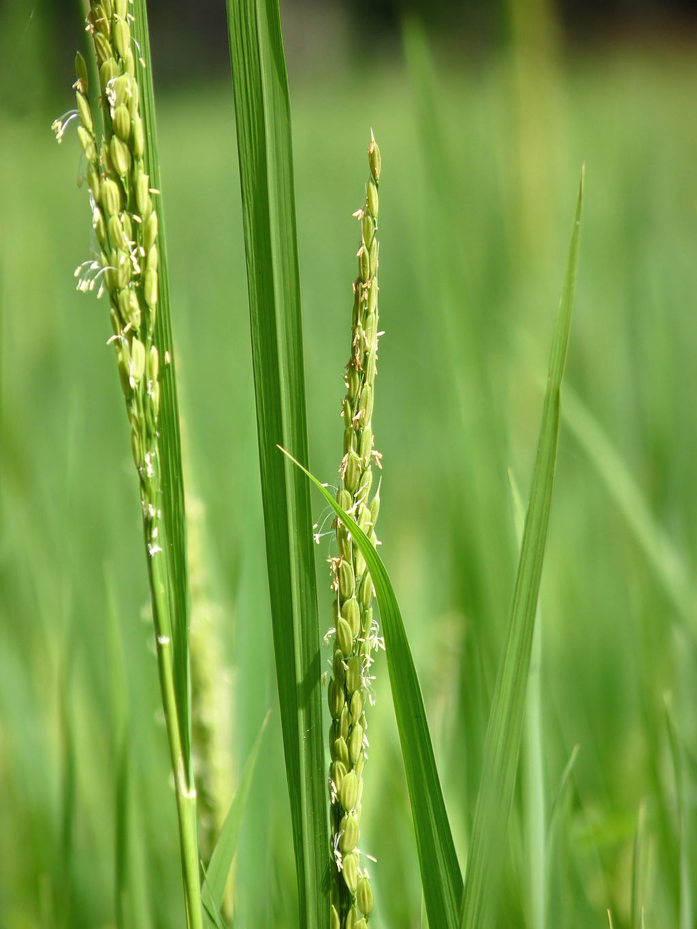
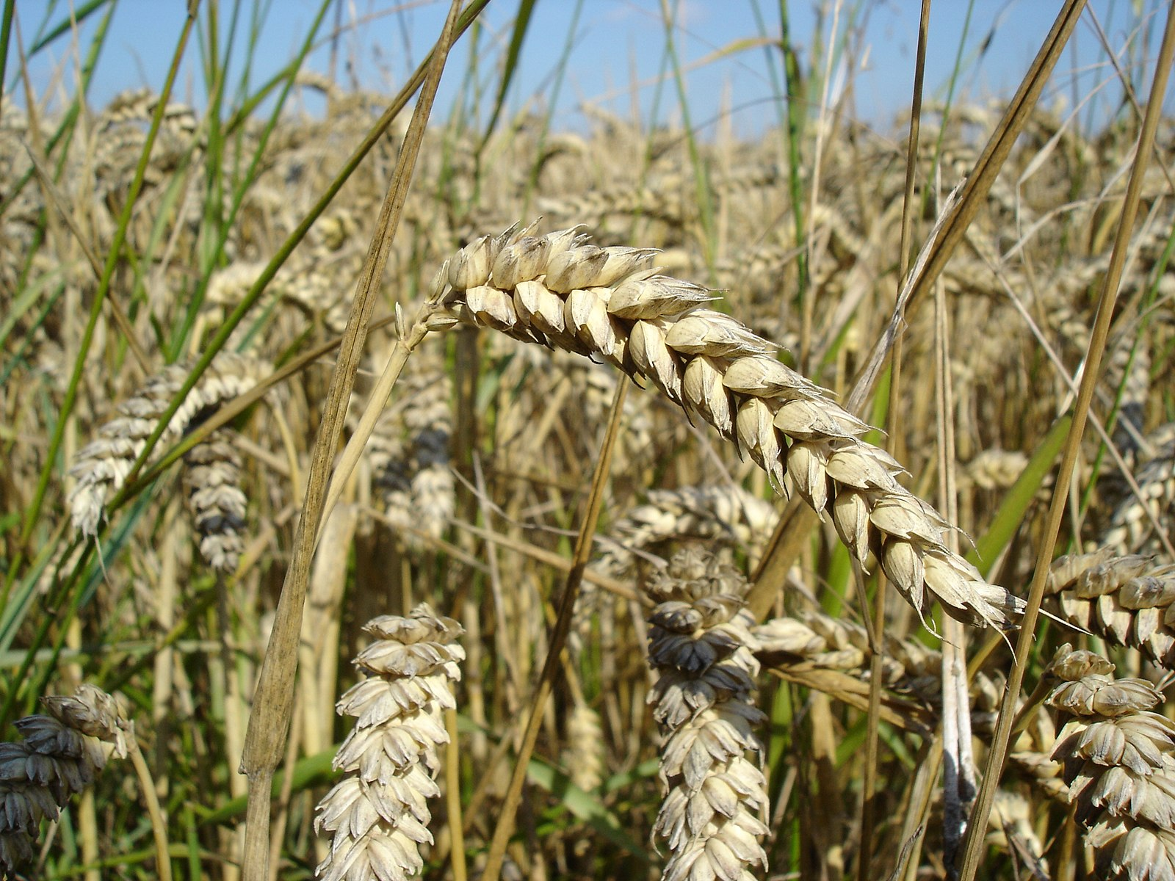

https://github.com/petermr/tigr2ess
Workshop: Mining the Scholarly Literature for Crop Knowledge
Images from wikidata.org (CC BY-SA)
Instructors
Ambarish Kumar (NIPGR)
Amit Yadav (NIPGR)
Gita Yadav (Cambridge/NIPGR)
Peter Murray-Rust (Cambridge/ContentMine)
Vinita Lamba (NIPGR)
Tools and Resources
EuropePMC
getpapers
AMI
Wikipedia
wikidata.org
https://public.etherpad-mozilla.org/p/tigr2ess
https://www.globalfood.cam.ac.uk/keyprogs/TIGR2ESS
https://contentmine.org

