Slide 1

Smart Blind Stick
Project Submitted By:
Lipsalina Giri [2101229092]
Nitish Kumar [2101229104]
Santanu Kumar Mohapatra [2101229132]
Sashibhusan Khatua [2101229137]
Saumya Subham Mishra [2101229147]
[CSE]
[CSE]
[CSE]
[CSE]
[CSE]
Guided By: Prof. Raghunath Rout

Slide 2
INTRODUCTION
Assistive technologies play a vital role in empowering visually impaired individuals, promoting independence and mobility. From simple tools like traditional white canes to modern electronic systems, these technologies constantly evolve to meet diverse needs. This evolution reflects the ongoing effort to integrate technology and enhance the daily lives of visually impaired people.

Slide 3

The Problem
Visually impaired individuals face significant challenges in navigating their surroundings safely and independently. Traditional mobility aids like canes provide limited feedback, mainly through physical contact with obstacles. However, they do not offer proactive detection of hazards such as potholes, moving objects, or elevated obstacles.

Slide 4
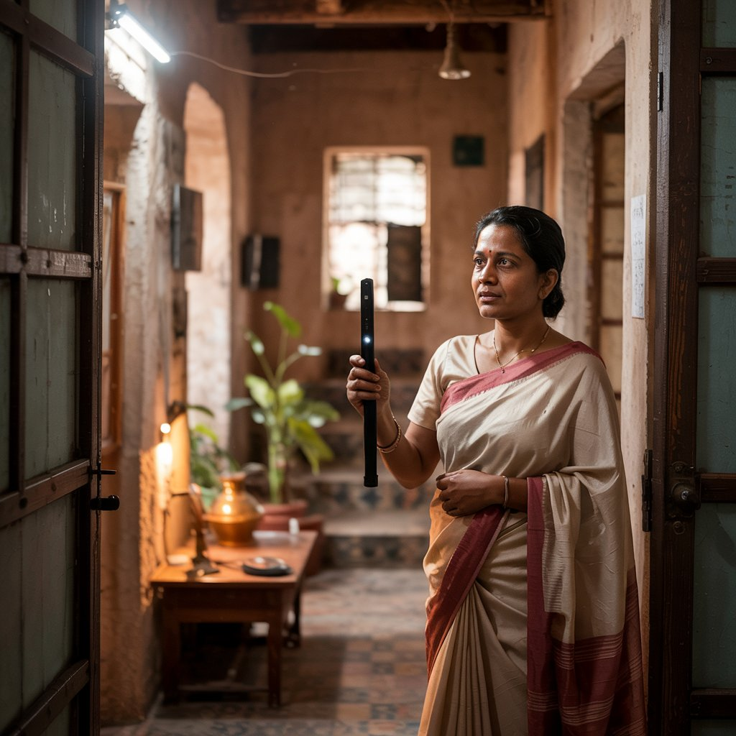
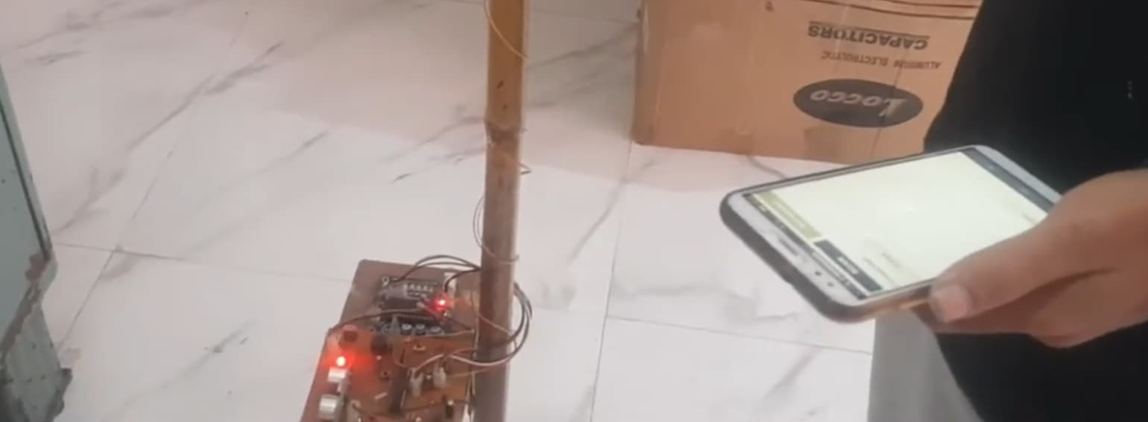
The Solution:
Overview:
The Smart Blind Stick is an innovative assistive device designed to enhance the mobility, safety, and independence of visually impaired individuals.
Key Features:
Ultra Sonic Sensors
Real-time Feedback
Water Sensor
Non-GPS

Slide 5
Project Objective
01
02
03
04
05
06
Enhance Mobility
Integrate Advanced Features
Focus on Accessibility
Prioritize Safety
Durability
Real-World Testing

Slide 6
Scope of Study
01
06
02
05
03
04
1. Technology Research and Selection
2. Prototyping and Design
3. Software Implementation
4. Testing Across Scenarios
5. User Feedback and Optimization
6. Future Enhancements Exploration

Slide 7
Methodology Overview
Component Selection and Design
Software Development and Integration
Testing and Validation
Evaluate the prototype's performance through comprehensive testing in diverse environments, including indoor and outdoor spaces, low-light conditions, and crowded areas. Fine-tune the sensitivity of sensors and feedback mechanisms based on test results.
Select appropriate hardware components, such as ultrasonic sensors, microcontrollers, and alert mechanisms, based on functionality, cost, and compatibility. Design a compact, ergonomic prototype that ensures optimal sensor placement for enhanced obstacle detection.
Develop algorithms to process sensor data, implement obstacle detection logic, and trigger timely feedback mechanisms. Use efficient programming techniques to optimize energy usage and system responsiveness.

Slide 8
System Design and Architecture
The Smart Blind Stick functions as an integrated system combining sensors, a microcontroller, and feedback mechanisms to provide real-time obstacle detection and navigation assistance for visually impaired users.
Ultrasonic sensors detect obstacles by emitting sound waves and calculating the distance based on reflection time.
A microcontroller processes sensor inputs, employs decision-making algorithms, and triggers vibrations and sound alerts based on obstacle proximity.
Power management ensures efficient battery usage, with an energy-saving mode during inactivity.
The rechargeable battery is optimized for extended operation to support prolonged use.
The stick follows ergonomic design principles, offering a lightweight yet durable structure for easy handling and daily usability.
The architecture supports modular enhancements, allowing future integration of AI-based object recognition and IoT capabilities.

Slide 9
Hardware Components
Ultrasonic Sensors | Emit sound waves and measure reflection time to detect obstacles within a range of 2 cm to 400 cm.
Infrared Sensors | Utilized to detect surface variations like stairs or potholes, ensuring smoother navigation for users.
Microcontroller | Processes sensor data and executes feedback algorithms for enhanced safety and mobility (e.g., Arduino Uno, ATmega328-PU)
Vibration Motors and Buzzer | Deliver tactile or auditory feedback based on obstacle proximity for quick user response.
Water Sensor | Detects water on the ground to alert users about potential hazards.
Sound Detector | Measures ambient noise levels or detects specific sounds for added functionality
GPS Module | Track location for additional navigational support.
Switches and Buttons | Enable user interactions for controlling the stick's functionalities.
HC-05 Bluetooth Module | Allows for wireless communication with other devices.
Rechargeable Battery | Ensures prolonged operation with energy-efficient circuitry and a low-power mode.

Slide 10
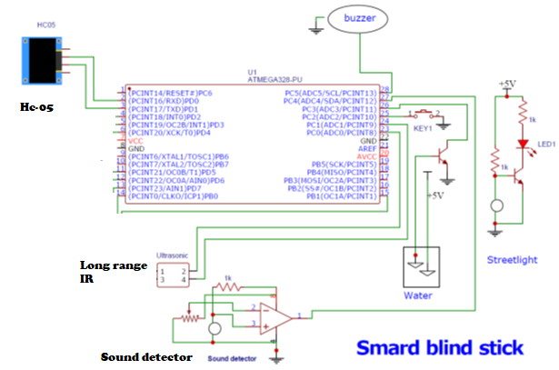
Circuit Design and Hardware Implementations
Circuit Framework
Signal Flow
Power Management
Hardware Assembly
Testing Procedures
Calibration and Stability

Slide 11
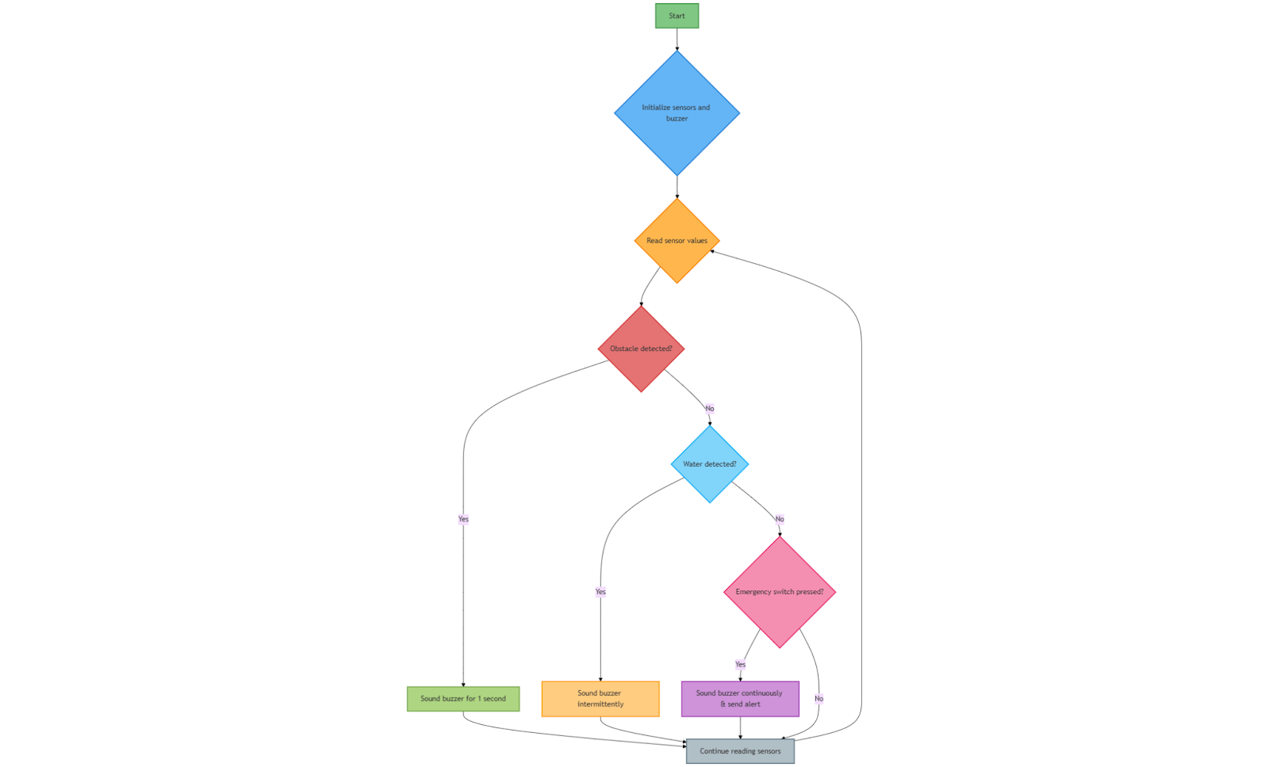
Flow Chart of Software Logic
The software for the Smart Blind Stick leverages embedded programming to ensure real-time obstacle detection, feedback activation, and efficient system operation.

Slide 12
Software Algorithms
01
02
Obstacle Detection Algorithm
Threshold-based Feedback System
03
04
Water Detection Logic
Emergency Alert Mechanism
05
06
Battery Optimization Algorithm
Loop-based Execution Cycle

Slide 13
User Experience and Accessibility
i) User-Centered Design ii) Ease of Navigation iii) Reliability and Safety Measures iv) Accessible Design v) Enhancements for Inclusivity

Slide 14
Testing and Calibiration Procedures
30%
40%
30%
Component-Level Testing
System and Environmental Testing
User-Centric Field Testing
Individual testing of sensors, microcontroller, buzzer, and vibration motor to verify functionality.
Ensuring each component operates correctly before integration into the system.
System Integration Testing to confirm seamless communication between hardware components.
Environment Testing to assess performance in varied conditions like indoors, outdoors, and crowded areas.
Calibration of sensors to optimize obstacle detection accuracy and minimize false positives.
Real-world testing with visually impaired users to validate usability and effectiveness.
Gathering feedback for refinements to improve comfort, accuracy, and overall user experience.

Slide 15
Results and Discussion
01
02
03
Key Outcomes
System Strengths
Identified Areas for Improvement
The device achieved over 90% accuracy in obstacle detection across varied environments, with a response time of 0.5 to 1 second. Users noted reliable performance in indoor, outdoor, and low-light conditions. However, transparent and reflective surfaces posed occasional challenges
Affordable, lightweight, and user-friendly design ensures high usability and portability. The device's extended battery life supports 8–10 hours of operation, making it suitable for daily use.
Enhancing detection for reflective surfaces, extending obstacle range, and improving energy efficiency were noted as potential areas for refinement

Slide 16
Future Scope and Improvements
AI-Powered Object Recognition: Future iterations can integrate artificial intelligence (AI) for advanced object recognition, enabling the device to distinguish between static and moving obstacles, recognize traffic signs, and provide detailed contextual feedback to the user.
IoT Connectivity for Enhanced Functionality: Incorporating Internet of Things (IoT) technology can allow real-time location tracking, remote monitoring by caregivers, and cloud-based data analysis to enhance navigation efficiency and user safety.
Voice Assistance Integration: Adding voice-enabled guidance systems will offer verbal feedback and instructions to the user, improving overall accessibility and ensuring easier interaction with the device.
Improved Energy Efficiency: Future designs can include advanced power management techniques, renewable energy options like solar panels, and fast-charging capabilities to extend battery life and operational hours.
Durability and Weather Resistance: Enhancing the device's build quality with waterproof and weather-resistant materials will increase its reliability in adverse environmental conditions, such as heavy rain or extreme heat.

Slide 17
CONCLUSION
The Smart Blind Stick represents a significant advancement in assistive technology, enhancing mobility, safety, and independence for visually impaired individuals. Through rigorous research and testing, it has demonstrated reliable obstacle detection, real-time feedback, and adaptability to diverse environments. Its cost-effective design and energy-efficient system make it an accessible solution for daily use. While challenges like transparent obstacle detection persist, future enhancements such as AI integration and IoT connectivity can further improve functionality. Overall, the Smart Blind Stick bridges affordability and innovation, empowering visually impaired users and promoting inclusivity in technology.

Slide 18
References
World Health Organization (2022): "Global Data on Visual Impairment." Available at: https://www.who.int
Smith, J., & Doe, R. (2021): "Smart Assistive Technologies for the Visually Impaired." Journal of Accessibility Research, 15(3), 45-67.
Brown, T., & Green, K. (2020): "The Role of Ultrasonic Sensors in Assistive Devices." IEEE Transactions on Biomedical Engineering, 68(9), 1234-1246.
Sharma, P., & Gupta, R. (2019): "Innovative Mobility Solutions for the Visually Impaired." International Journal of Engineering Innovations, 24(2), 87-99.
Ahmed, S., & Patel, N. (2022): "IoT-Enabled Assistive Devices: A Future Perspective." International Conference on Emerging Technologies, 54-60.
Khan, M., & Lee, H. (2023): "Machine Learning for Enhanced Obstacle Detection." Advances in AI & Robotics, 29(5), 201-214.
Bose, R., & Kumar, S. (2021): "Energy Optimization Strategies for Assistive Devices." Renewable Energy Research Journal, 14(1), 98-112.
Government of India (2023): "Disability and Assistive Technology Policies." Available at: https://www.disabilityaffairs.gov.in
Arduino Official Website (2024): "Arduino Uno Technical Specifications." Available at: https://www.arduino.cc
Raspberry Pi Foundation (2023): "Using Raspberry Pi for Embedded Vision." Available at: https://www.raspberrypi.org

Slide 19

Thanks!

