Slide 1

Understanding Asynchronous Programming

Slide 2
Consider the following..
Chess master Judit Polgár hosts a chess exhibition in which she plays multiple amateur players. She has two ways of conducting the exhibition: synchronously and asynchronously. Assumptions:
24 opponents
Judit makes each chess move in 5 seconds
Opponents each take 55 seconds to make a move
Games average 30 pair-moves (60 moves total)
https://realpython.com/async-io-python/

Slide 3
Synchronous / Asynchronous
Synchronous version: Judit plays one game at a time, until the game is complete. Each game takes (55 + 5) * 30 = 1800 seconds, or 30 minutes. The entire exhibition takes 24 * 30 == 720 minutes, or 12 hours.
Asynchronous version: Judit moves from table to table, making one move at each table. She leaves the table and lets the opponent make their next move during the wait time. One move on all 24 games takes Judit 24 * 5 = 120 seconds, or 2 minutes. The entire exhibition is now cut down to 120 * 30 = 3600 seconds, or just 1 hour.
https://realpython.com/async-io-python/

Slide 4
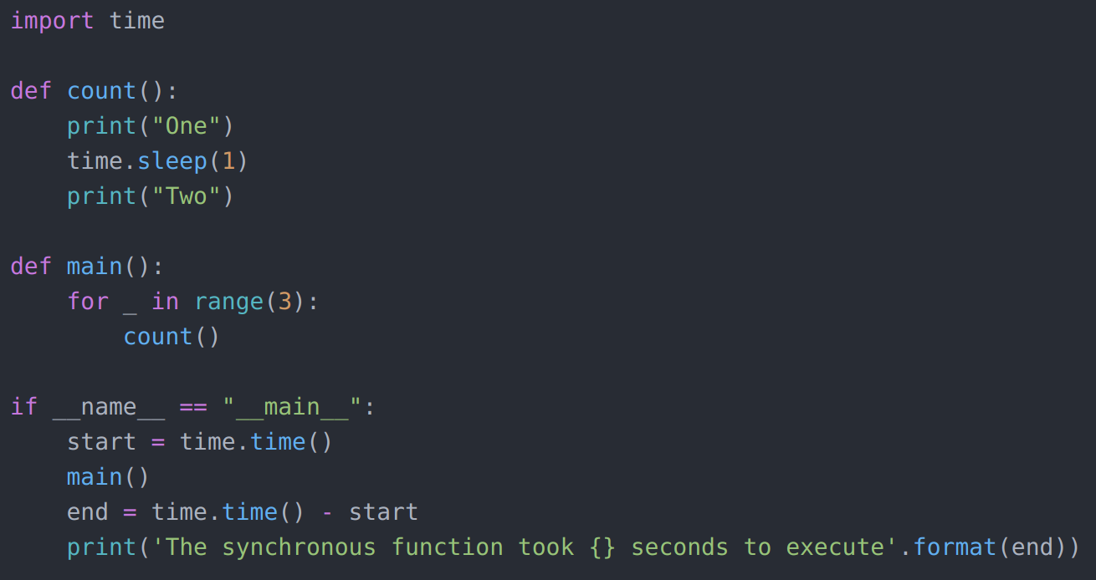
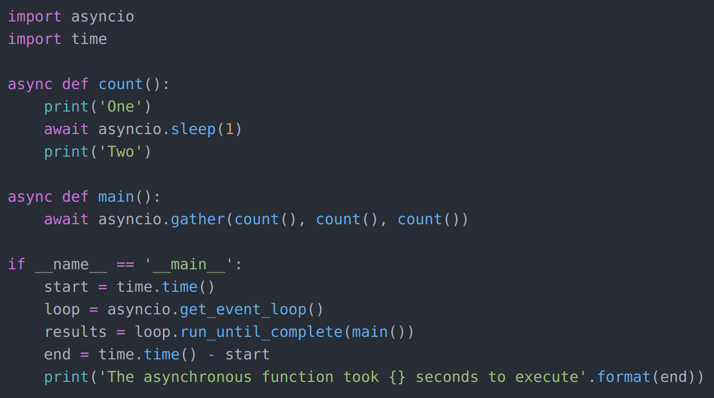
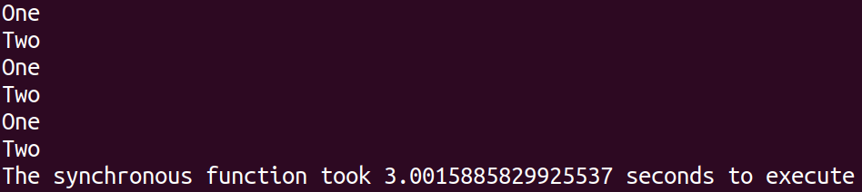
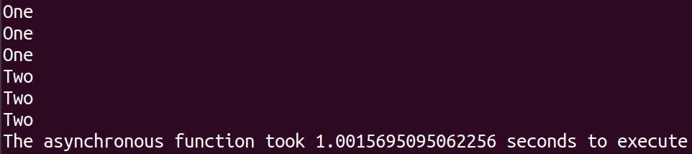
async/await Syntax
The async/await syntax will almost always reduce execution time!
https://realpython.com/async-io-python/

Slide 5
Calling using aiohttp
Python won’t like await requests.get(url) because .get() is not awaitable.
In contrast, almost everything in aiohttp is an awaitable coroutine, such as session.request() and response.text().
https://realpython.com/async-io-python/

Slide 6
Saundarya Badhrinathan

