Slide 1

Zustand
A small, fast, and scalable bear bones state management solution

Slide 2
What is Zustand ?
Zustand is a small, fast and scalable status management solution. Its state management is centralized and action-based.
Zustand was developed by Jotai and React-spring's creators.
You can use Zustand in both React and some other technology like Angular, Vue JS or even vanilla JavaScript.
Zustand is an alternative to other state managers like Redux, Jotai Recoil, etc.

Slide 3
Why Zustand ?
Less repeated code (compared to Redux).
Easy to understand documentation.
Flexibility
You can use Zustand the simple way, with TypeScript, you can integrate immer for immutability or you can even write code similar to the Redux pattern (reducers and dispatch).
It does not wrap the application in a provider as is commonly done in Redux.
Renders components only when there are changes.

Slide 4
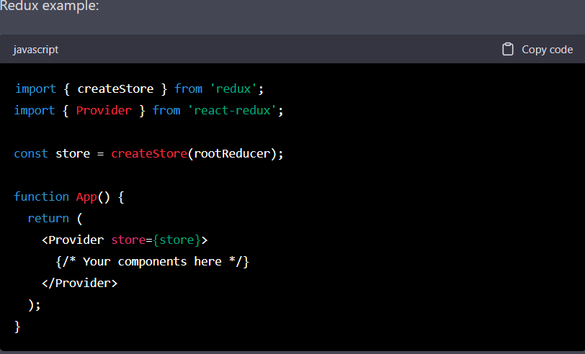
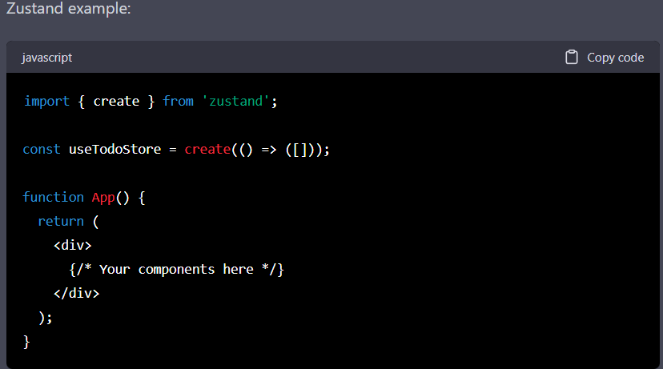
Redux requires you to wrap your app in context providers in order to access the state and dispatch actions, while Zustand does not.
With Zustand, you can simply use the hook useTodoStore within your components to access the state, without having to wrap the entire app in a provider. This can make Zustand a more convenient and lightweight choice for state management in some cases.

Slide 5
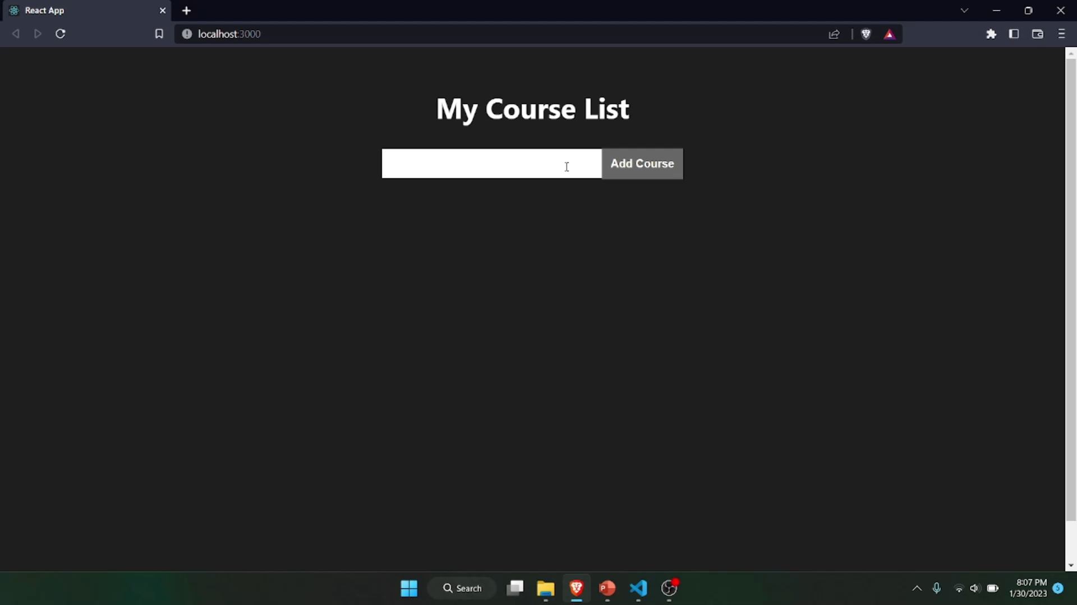
What we will be making ?
We are making a simple course listing app.

Slide 6
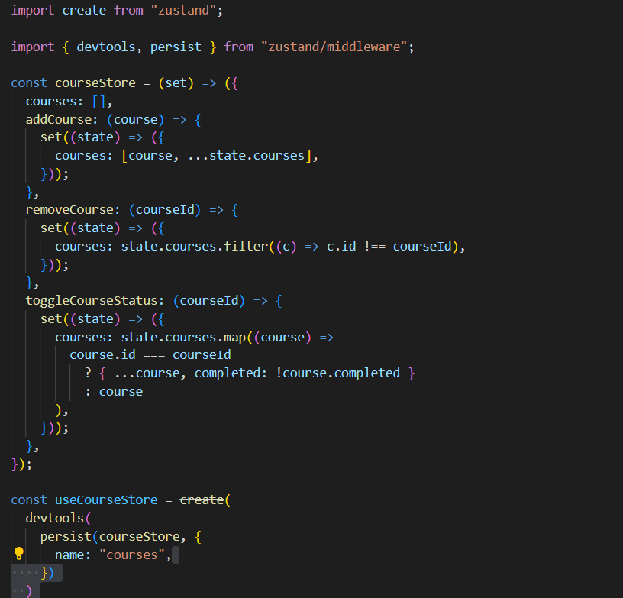
At, first lets create a store...

Slide 7
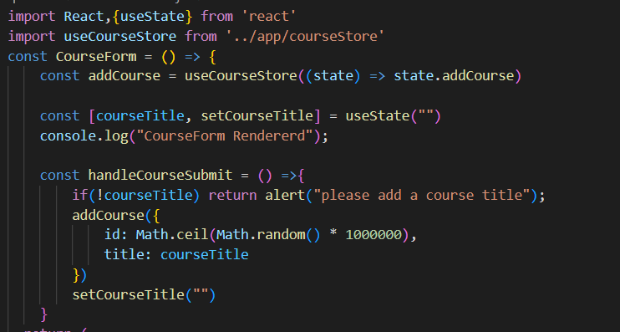
Lets create a component

Slide 8
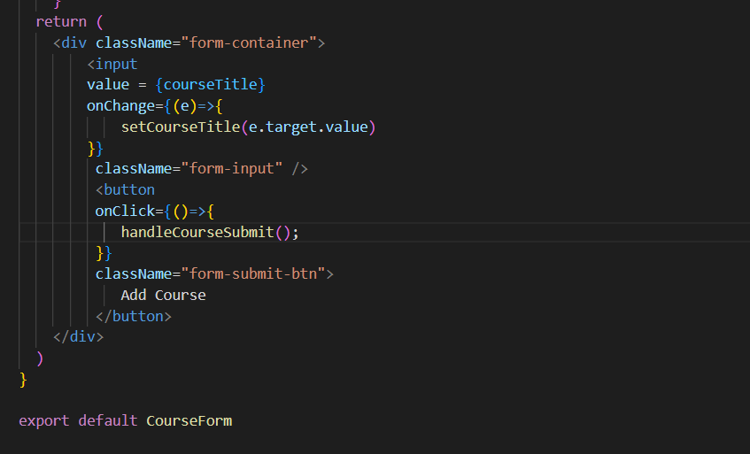

Slide 9
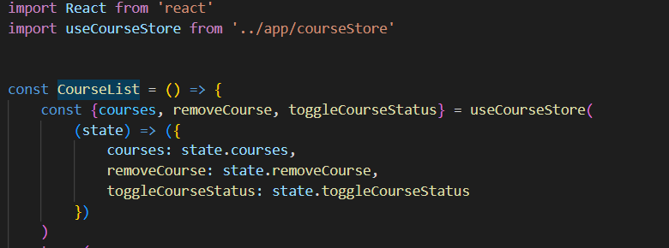
Lets create another component

Slide 10
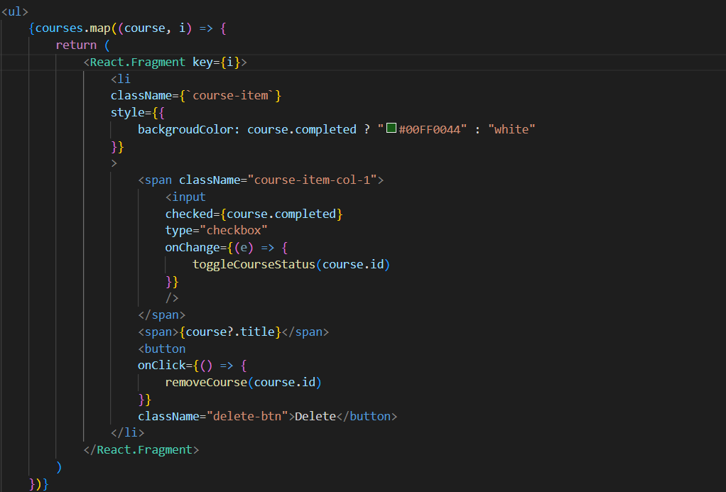

Slide 11
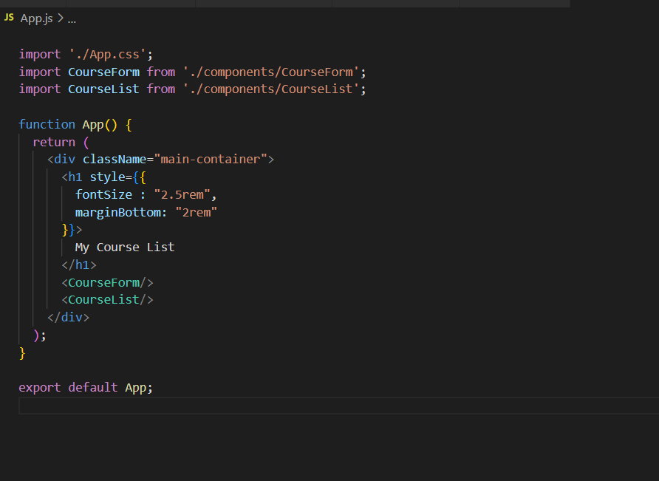
App component

Slide 12
Thank you !

