Slide 1
TECHNICAL INTERVIEW / PROJECT WALKTHROUGH
EU AI ACT
RAG ASSISTANT
160
document chunks
384
embedding dimensions
From a 1.3 MB legal PDF to evidence-grounded answers
12
evaluation questions
Python • PyMuPDF • Sentence Transformers • FAISS • Groq
Notes:
SPEAKER NOTES — suggested explanation (not a script to memorize)
Introduce this as an end-to-end engineering project. I built a retrieval-augmented generation assistant that finds relevant Articles from the EU AI Act and uses them as evidence for a generated answer. It is a portfolio and learning project, not a legal advisory system.

Slide 2
01 / OVERVIEW
The project in 60 seconds
One problem, one architecture, one measurable outcome.
PROBLEM
SOLUTION
RESULT
The EU AI Act is long. A reader needs to find the right Article, and a general chatbot may answer without evidence.
Convert the Act into searchable chunks; retrieve relevant passages; give them to a language model to explain.
BGE reached Hit@3 = 12/12 on a small curated set; the RAG run mentioned the expected Article in 12/12 answers.
Not fine-tuning • Retrieval first • Source references • Honest evaluation
EU AI ACT • RAG ENGINEERING PORTFOLIO
02
Notes:
SPEAKER NOTES — suggested explanation (not a script to memorize)
A concise interview answer: I built a Python RAG assistant for the EU AI Act. I extracted the official consolidated PDF, chunked it by Articles and Annexes, compared two embedding models, indexed the vectors with FAISS, and connected retrieval to a Groq-hosted language model. I evaluated retrieval and whether expected Article references appeared in generated answers. The dataset is small, so I do not claim general accuracy.

Slide 3
02 / MOTIVATION
Why build a RAG assistant?
The real engineering problem is evidence discovery, not just text generation.
Long document
DESIGN QUESTION
Relevant rules are spread across many Articles and Annexes.
Can we find the right Article first — then answer from that evidence?
Exact wording varies
A question can use different words from the legal text.
LLMs can overstate
A fluent answer is not necessarily supported by the source.
EU AI ACT • RAG ENGINEERING PORTFOLIO
03
Notes:
SPEAKER NOTES — suggested explanation (not a script to memorize)
Explain the difference between keyword search and semantic search. Users might ask for “rules about AI safety,” but the legislation could use terms such as accuracy, robustness and cybersecurity. We want a search system that understands related meaning, while preserving references to the legal source.

Slide 4
03 / CORE CONCEPT
RAG is not fine-tuning
Think of a student using an open book rather than memorizing the whole book.
RETRIEVAL
GENERATION
Find useful pages in the book before answering. In our system: BGE creates vectors; FAISS finds similar chunks.
Give the selected pages to the LLM. The model writes an explanation and references the relevant Articles.
No model weights are retrained on the EU AI Act
EU AI ACT • RAG ENGINEERING PORTFOLIO
04
Notes:
SPEAKER NOTES — suggested explanation (not a script to memorize)
Define RAG in plain language: retrieval augmented generation. The LLM does not learn the Act by updating its weights. Instead, each time a question arrives, the system searches a prepared index and passes the most relevant text into the prompt. This makes evidence visible and allows the source document to be updated separately.

Slide 5
04 / SYSTEM DESIGN
End-to-end architecture
Two paths meet at retrieval: offline preparation and online question answering.
OFFLINE — PREPARE THE KNOWLEDGE
EU AI Act
PDF
Extract +
clean
160 labelled
chunks
BGE
embeddings
FAISS
index
Saved index supplies retrieval
ONLINE — ANSWER THE QUESTION
User
question
BGE
query vector
Top-5 +
expand
Groq
LLM
Answer +
Articles
EU AI ACT • RAG ENGINEERING PORTFOLIO
05
Notes:
SPEAKER NOTES — suggested explanation (not a script to memorize)
Walk left to right. Offline: download the PDF, extract and clean text, create Article-aware chunks, generate BGE embeddings, save them in FAISS. Online: a question becomes a BGE vector, FAISS returns top matches, we expand related Article sections, assemble a limited context, and ask Groq to generate an answer.

Slide 6
05 / DATA ENGINEERING
Step 1–2 | Acquire, extract and clean
Source: consolidated EU AI Act, EUR-Lex version dated 27 July 2026.
1
Collect
2
Extract
3
Clean
Download the ~1.3 MB consolidated EU AI Act PDF from EUR-Lex.
Use PyMuPDF to read PDF text into a plain-text file.
Fix layout artefacts, whitespace and split words before chunking.
raw PDF → extracted .txt → cleaned .txt
EU AI ACT • RAG ENGINEERING PORTFOLIO
06
Notes:
SPEAKER NOTES — suggested explanation (not a script to memorize)
The PDF is the consolidated text from EUR-Lex, not a live API. PyMuPDF gave cleaner extraction than our first attempt. Cleaning matters because PDF layout can create broken words, strange spaces, or line breaks, which can hurt chunking and retrieval. The consolidated text is a reference tool; legal users should check the authentic Official Journal texts.

Slide 7
06 / TEXT SEGMENTATION
Step 3 | Chunk by Article, not by accident
Preserve the legal structure so a retrieved result is understandable.
119
14
160
Article sections identified
Annex sections identified
Final searchable chunks
Example chunk metadata
WHY IT MATTERS
section_type: Article
section: Article 15
chunk_number: 1
text: <legal passage>
Large Articles are split with overlap, but the Article label stays attached. This enables section expansion and citations.
EU AI ACT • RAG ENGINEERING PORTFOLIO
07
Notes:
SPEAKER NOTES — suggested explanation (not a script to memorize)
We identified 119 Article sections and 14 Annex sections, then split large ones into smaller overlapping chunks. The output was 160 chunks, including 141 Article chunks and 19 Annex chunks. Each chunk stores its section label and chunk number. This is better than blindly cutting the document every fixed number of characters because legal boundaries carry meaning.

Slide 8
07 / EMBEDDINGS
Step 4 | Turn language into vectors
An embedding is a numeric fingerprint of a text passage.
MiniLM baseline
“accuracy, robustness and cybersecurity”
sentence-transformers/all-MiniLM-L6-v2
↓ BGE sentence encoder
[ 0.12, −0.07, 0.31, ... ]
Selected BGE model
BAAI/bge-small-en-v1.5 • 384 dimensions
384 numbers per chunk
EU AI ACT • RAG ENGINEERING PORTFOLIO
08
Notes:
SPEAKER NOTES — suggested explanation (not a script to memorize)
The sentence-transformers model converts both chunks and questions into vectors. Similar meaning should produce vectors that point in similar directions. We tried MiniLM first, then BGE. Both produced 384-dimensional vectors. These are not probabilities or facts; they are numerical representations for similarity search.

Slide 9
08 / VECTOR RETRIEVAL
Step 5 | Search with FAISS
Normalized vectors + inner product approximate cosine similarity.
TOP-K = 5
QUERY VECTOR
Return five highest-scoring chunk matches.
[ q₁, q₂, ... q₃₈₄ ]
SIMILARITY ≠ ACCURACY
FAISS IndexFlatIP
0.8835 is a relevance signal, not an 88.35% correctness claim.
160 stored document vectors
WHY FAISS?
Fast, local similarity search over precomputed vectors.
EU AI ACT • RAG ENGINEERING PORTFOLIO
09
Notes:
SPEAKER NOTES — suggested explanation (not a script to memorize)
FAISS is a vector-search library, not the language model. We normalize the embeddings and use IndexFlatIP, an exact inner-product index. For normalized vectors, inner product corresponds to cosine similarity. Top K equals five. The highest score only tells us which chunk is most similar to the question; it cannot certify factual correctness.

Slide 10
09 / EMBEDDING EVALUATION
Why we selected BGE
Hit@K: did the expected Article appear among the first K results?
Hit@1
75.0%
75.0%
Hit@3
75.0%
100.0%
Hit@5
83.3%
100.0%
MiniLM
BGE
12 curated questions • not a general benchmark
EU AI ACT • RAG ENGINEERING PORTFOLIO
10
Notes:
SPEAKER NOTES — suggested explanation (not a script to memorize)
We used 12 questions with expected Article references. MiniLM got Hit@1 9/12, Hit@3 9/12, Hit@5 10/12. BGE got Hit@1 9/12, Hit@3 12/12, Hit@5 12/12. BGE therefore gave better top-three coverage on our small test set. It is important to say this is a local experiment with curated questions, not a general performance guarantee.

Slide 11
10 / CONTEXT ENGINEERING
Step 6 | Expand sections before generation
A top chunk may not contain the whole legal rule.
1
Retrieve top five
2
Choose top three sections
Rank chunks by semantic similarity.
Deduplicate by Article / Annex label.
3
Expand all chunks
4
Cap context
Bring in other chunks from those sections.
Limit the text to 12,000 characters.
Example: Article 50 chunks 1–2 + Article 13 chunk 1 + Article 3 chunks 1–4
EU AI ACT • RAG ENGINEERING PORTFOLIO
11
Notes:
SPEAKER NOTES — suggested explanation (not a script to memorize)
This was one of the key debugging lessons. Article 5 was split into multiple chunks, and retrieving only chunk one could miss information. Another case had Article 11 ranked second, so expanding only the top section was insufficient. We changed to expanding the top three unique sections. Later, a Groq request exceeded the token-per-minute request size, so we added a 12,000-character context cap. That cap can still omit details; it is a trade-off.

Slide 12
11 / LLM INTEGRATION
Step 7 | Grounded answer generation
The LLM explains the retrieved evidence; it does not choose the source document.
PROMPT CONTENT
GENERATION MODEL
openai/gpt-oss-20b through the Groq API
1
User question
2
Selected Article text
3
Instruction: use only this context
SAFETY OF CLAIMS
4
Ask for relevant Article references
The response is a reading aid. Source references must still be checked against current legislation.
5
Admit when context is insufficient
EU AI ACT • RAG ENGINEERING PORTFOLIO
12
Notes:
SPEAKER NOTES — suggested explanation (not a script to memorize)
The Groq API runs the language model openai/gpt-oss-20b. The prompt includes the user question and the selected context, with instructions to use only the provided text, cite Articles, and state when the evidence is insufficient. This is grounding by prompting, not a mathematical guarantee against hallucination. No API key is hardcoded; it is loaded from a local .env file.

Slide 13
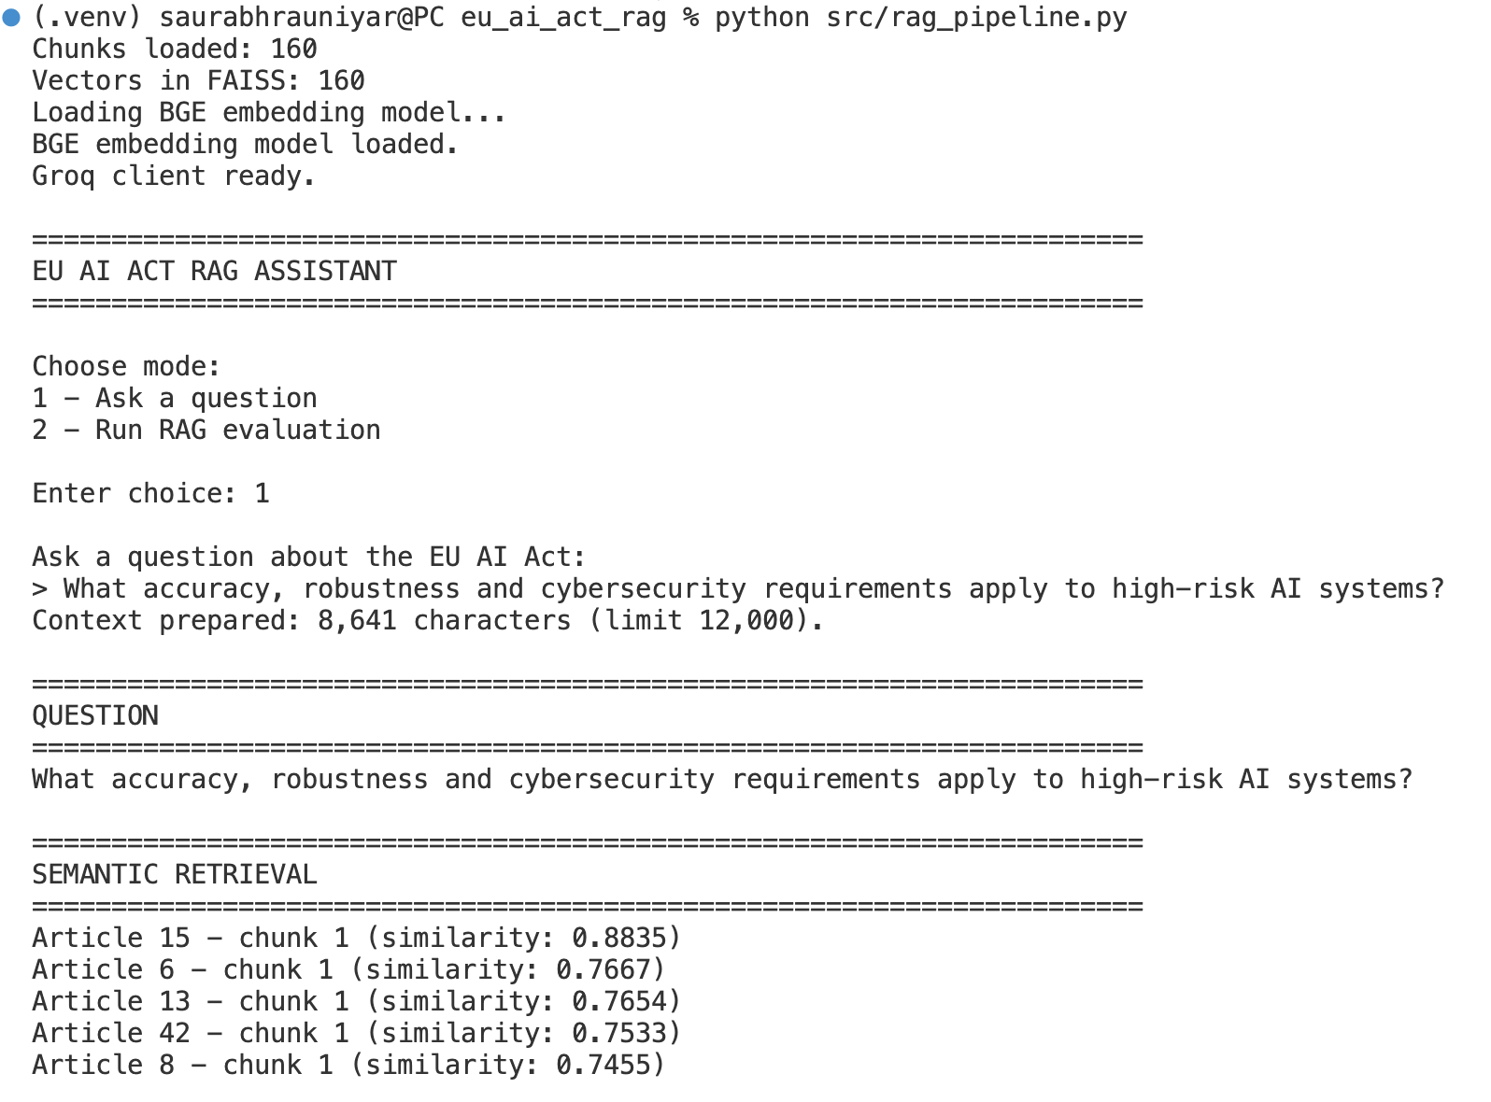
12 / REAL APPLICATION OUTPUT
Live demo 1 | High-risk AI requirements
Question: accuracy, robustness and cybersecurity for high-risk systems.
TOP MATCH
Article 15
Similarity 0.8835
Expanded context also included Articles 6 and 13.
Real terminal run: query and ranked retrieval
What this proves: the right Article was retrieved and used as context — not that every legal statement was verified.
EU AI ACT • RAG ENGINEERING PORTFOLIO
13
Notes:
SPEAKER NOTES — suggested explanation (not a script to memorize)
Use the real screenshot to demonstrate retrieval. Article 15 ranked first at 0.8835. Articles 6 and 13 were also selected for context. The generated answer discussed accuracy, resilience and cybersecurity. In the interview, explain why a similarity score is not answer confidence. Avoid claiming legal correctness without a manual audit.

Slide 14
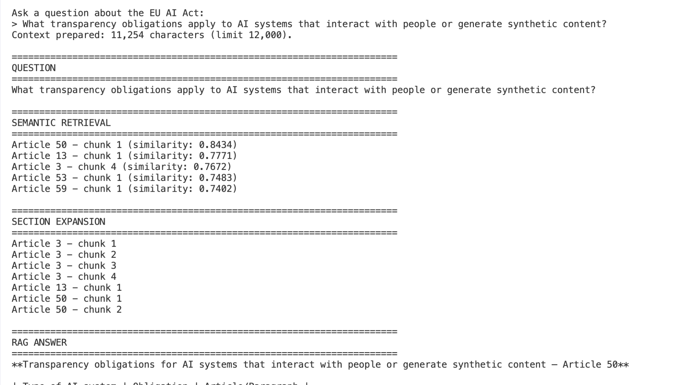
13 / REAL APPLICATION OUTPUT
Live demo 2 | Transparency obligations
Question: what must people be told about AI interactions and synthetic content?
TOP MATCH
Article 50
Similarity 0.8434
Seven expanded chunks across Articles 3, 13 and 50.
Real terminal run: Article 50 retrieved first
What this demonstrates: a broad question can be grounded in a specific Article plus supporting context.
EU AI ACT • RAG ENGINEERING PORTFOLIO
14
Notes:
SPEAKER NOTES — suggested explanation (not a script to memorize)
Article 50 ranked first with similarity 0.8434. The top-three unique sections were Articles 50, 13 and 3; expansion collected seven chunks, using 11,254 characters of context. The generated answer organized obligations for providers and deployers. This is an example of retrieval plus structured explanation, not independent legal review.

Slide 15
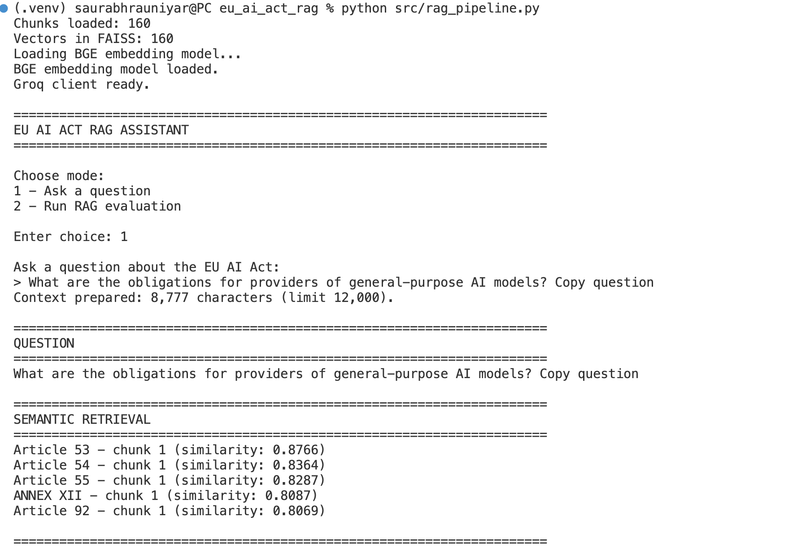
14 / REAL APPLICATION OUTPUT
Live demo 3 | General-purpose AI models
Question: what obligations apply to providers of general-purpose AI models?
TOP MATCH
Article 53
Similarity 0.8766
Article 55 adds duties for systemic-risk models.
Real terminal run: Articles 53, 54 and 55
Why related sections matter: the model can distinguish general duties from additional systemic-risk duties.
EU AI ACT • RAG ENGINEERING PORTFOLIO
15
Notes:
SPEAKER NOTES — suggested explanation (not a script to memorize)
Article 53 ranked first at 0.8766; Articles 54 and 55 were next. The final prompt context had 8,777 characters. Article 53 is about general provider obligations, while Article 55 concerns additional duties for models with systemic risk. The screenshot accidentally includes “Copy question” in the input; explain this if someone notices, or replace the screenshot before a formal presentation.

Slide 16
15 / HOW TO DEMONSTRATE
Two modes in the CLI
One mode answers a question. The other runs a 12-question test.
OPTION 1 — ASK A QUESTION
OPTION 2 — RUN EVALUATION
One question → BGE → FAISS → section expansion → Groq → answer.
Best for a live interview demo.
12 saved questions → expected Article checks → summary of coverage and mentions.
Best for discussing validation.
python src/rag_pipeline.py
EU AI ACT • RAG ENGINEERING PORTFOLIO
16
Notes:
SPEAKER NOTES — suggested explanation (not a script to memorize)
Explain the two menu choices simply. Option one is like asking a librarian one question and getting a source-based answer. Option two is like giving the librarian a 12-question quiz and checking whether the expected Article is found and mentioned. The evaluation does not grade all the legal content for truthfulness.

Slide 17
16 / EVALUATION METHODOLOGY
How we evaluated the full RAG pipeline
Different questions require different metrics.
RETRIEVAL CHECK
END-TO-END CHECK
Question + expected Article → retrieve top K chunks.
Metric: Hit@1, Hit@3, Hit@5.
Question: “Did search find the correct Article?”
Run retrieval and Groq answer generation.
Checks: expected Article in context? Mentioned in answer?
Not a factual correctness metric.
12/12 context coverage • 12/12 Article mention • manual answer review still needed
EU AI ACT • RAG ENGINEERING PORTFOLIO
17
Notes:
SPEAKER NOTES — suggested explanation (not a script to memorize)
We have two evaluation layers. The embedding benchmark measures whether the expected Article appears among top-K results. The end-to-end script asks all 12 questions, checks whether the expected Article is in the expanded context, and whether the generated answer mentions it. Both were 12 out of 12. The first nine answers were saved before the final context cap; the last three were generated afterward, so this is not one controlled run. We did not manually grade every legal statement.

Slide 18
17 / DEBUGGING & RELIABILITY
Engineering problems and fixes
A credible project explains what failed and what changed.
Incomplete Article coverage
Expand all chunks for top three sections
Relevant Article ranked second
Do not rely only on the first result
Oversized Groq request (413)
Limit context to 12,000 characters
Rate limits / timeouts
Retry with backoff and save progress
Unicode whitespace in evaluation
Normalize text before Article matching
ISSUE
ENGINEERING RESPONSE
EU AI ACT • RAG ENGINEERING PORTFOLIO
18
Notes:
SPEAKER NOTES — suggested explanation (not a script to memorize)
This slide is valuable in an interview. Explain the concrete failures: an Article could be split across chunks, and selecting only the first section missed relevant content. Groq requests hit rate limits, timeouts, and once a request was too large. We added section expansion, a context cap, retries, and resumable evaluation. An initial Article mention check failed because the generated text used unusual whitespace, so we normalized whitespace before matching.

Slide 19
18 / LIMITATIONS
What the numbers do — and do not — prove
Good evaluation is as much about stating limits as showing scores.
Small test set
Coverage ≠ correctness
12 curated questions do not represent all possible questions.
Mentioning Article 53 does not prove every sentence is supported.
Mixed-run evaluation
Context can be truncated
Nine cached answers predate the final context-size cap.
12,000 characters reduces request size but may omit legal detail.
EU AI ACT • RAG ENGINEERING PORTFOLIO
19
Notes:
SPEAKER NOTES — suggested explanation (not a script to memorize)
Acknowledge limitations before the interviewer asks. The 12 questions are small and curated. Hit@K measures Article retrieval, not full semantic relevance. Article mention rate is not factual accuracy. The evaluation reused saved answers from two code settings, so a controlled rerun is needed. A future version should manually grade factual support, assess unanswerable questions, and provide exact source citations.

Slide 20
19 / ROADMAP
Next iteration: from prototype to trustworthy tool
The priority is evaluation quality, then usability.
01
Controlled rerun
02
Human answer audit
Re-evaluate all 12 with one fixed pipeline configuration.
Check each claim against the source and mark unsupported statements.
03
Better citations
04
Simple web UI
Link to exact Article text and show supporting excerpts.
Optional interface for nontechnical users after quality checks.
EU AI ACT • RAG ENGINEERING PORTFOLIO
20
Notes:
SPEAKER NOTES — suggested explanation (not a script to memorize)
If asked what I would improve, prioritize stronger evaluation, not just a flashy interface. Run all 12 questions again under the same final code and rate-limit settings. Have a person judge factual support and completeness. Add passage-level citations and tests for questions that the document cannot answer. Then consider a simple Streamlit or FastAPI interface.

Slide 21
INTERVIEW TAKEAWAY
I built, tested and debugged
an end-to-end RAG system.
DATA
RETRIEVAL
GENERATION
EVALUATION
PDF → clean text → 160 chunks
BGE → FAISS → expanded context
Groq → Article-grounded answer
Hit@K + context and mention checks
Project repository: github.com/SaurabRauniyar/eu-ai-act-rag-assistant
Notes:
SPEAKER NOTES — suggested explanation (not a script to memorize)
Close in 20 seconds: This project taught me how to build a complete RAG workflow, evaluate the retrieval model instead of guessing, control the context sent to an LLM, and debug real API limitations. I can explain every step and the limitations of the evaluation. I would next strengthen answer-level factual verification.

Slide 22
BACKUP / REPRODUCIBILITY
Appendix | Repository map
Core scripts are included for a reproducible local demonstration.
src/text_extraction.py
PDF → text with PyMuPDF
src/text_cleaning.py
Clean formatting artefacts
src/text_chunking.py
Article / Annex-aware chunks
src/create_bge_embeddings.py
160 × 384 embedding matrix
src/create_bge_faiss_index.py
Normalized FAISS index
src/rag_pipeline.py
Retrieve, expand, generate, evaluate
EU AI ACT • RAG ENGINEERING PORTFOLIO
22
Notes:
SPEAKER NOTES — suggested explanation (not a script to memorize)
If an interviewer asks for code structure, point to these scripts. The GitHub repository also contains baseline MiniLM scripts and retrieval evaluation scripts. Processed chunks and indexes are included so the demo can start without rebuilding embeddings.

Slide 23
BACKUP / LIVE DEMO
Appendix | How to run it
Prepare the environment before an interview; do not expose your API key.
DEPENDENCIES
cd ~/Desktop/eu_ai_act_rag
source .venv/bin/activate
PyMuPDF, sentence-transformers, numpy<2, faiss-cpu, groq, python-dotenv
python src/rag_pipeline.py
SECURITY
1 - Ask a question
GROQ_API_KEY in .env; .env is excluded from GitHub.
2 - Run RAG evaluation
EU AI ACT • RAG ENGINEERING PORTFOLIO
23
Notes:
SPEAKER NOTES — suggested explanation (not a script to memorize)
For a live demo, activate the virtual environment and run the pipeline. Choose option one and use the Article 15 question. Verify the Groq API key is configured privately in .env. Do not open .env or show its contents during screen sharing. The application can hit API rate limits, so have screenshots ready as backup.

Slide 24
BACKUP / QUICK DEFINITIONS
Appendix | Technical glossary
Short explanations for non-specialist interviewers.
Chunk
A smaller labelled piece of a longer document.
Embedding
A vector of numbers representing text meaning.
FAISS
A library for finding similar vectors quickly.
Top-K
The K highest-ranked search matches.
Section expansion
Adding the rest of a retrieved Article’s chunks.
Context
The evidence text supplied to the LLM.
Hit@K
Whether the expected Article appears in the first K results.
Grounding
Instructing the LLM to base its answer on supplied sources.
EU AI ACT • RAG ENGINEERING PORTFOLIO
24
Notes:
SPEAKER NOTES — suggested explanation (not a script to memorize)
Use these definitions only if the interviewer asks. Focus on explaining the architecture and your decisions rather than memorizing technical jargon.

