Slide 1


Business Process Outsourcing (BPO) Services
By Unicorn Ops ( A division of Cylsys Software Solution)

Slide 2
DISCLAIMER
This document and the information in it are provided in confidence for the sole purpose of exploring a business opportunity between the disclosing party Cylsys Software Solution Pvt. Ltd. and the receiving party concerning crowd sourcing of certain operational projects as mentioned herein (“Services”). This document and the information contained herein in any form must not be disclosed to any third party or be used for any other purposes other than to evaluate the Services offered by Cylsys Software Solution Pvt. Ltd. to the receiving party without the express written permission of Cylsys Software Solution Pvt. Ltd.

Slide 3

CYLSYS INTRODUCTION
CYLSYS SOFTWARE
Founded in 2010, Cylsys is a software development and voice solutions organization committed to catalyzing the competence and competitiveness of its clients by helping them succeed through the power of information technology.

Slide 4
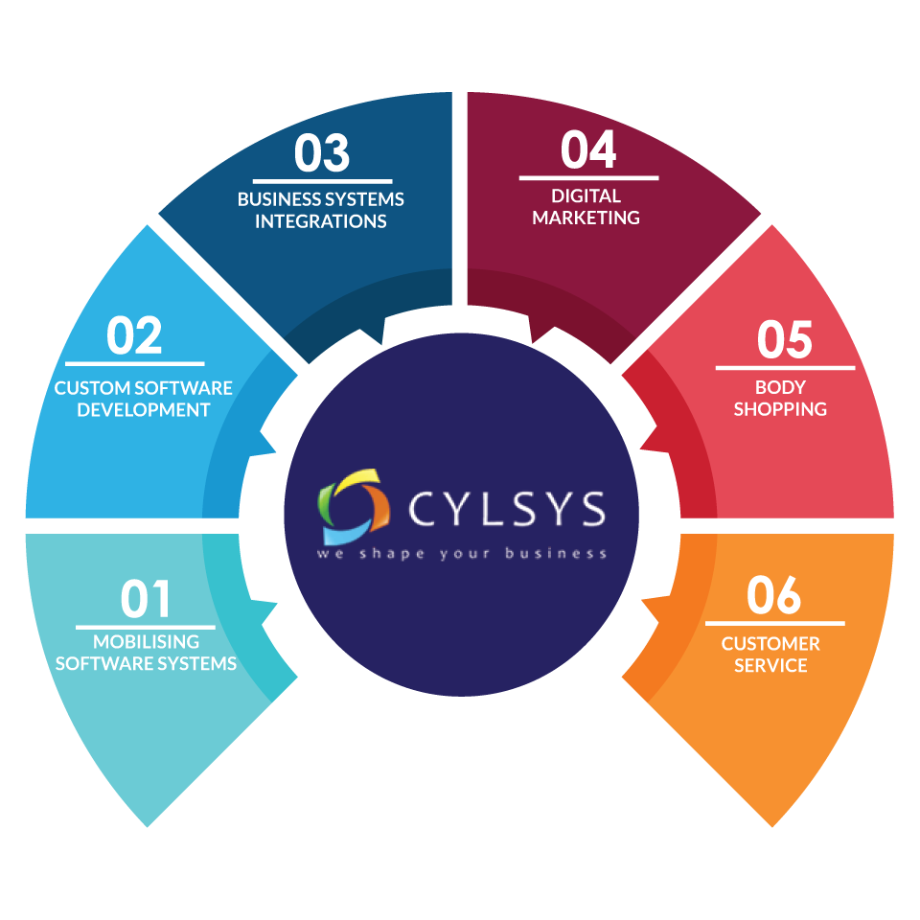
OUR SOLUTION STACK

Slide 5










































OUR CLIENTS

Slide 6

OUR WORK

Slide 7

Voice Solution-MFB
MyFundBucket is an Online aggregation platform for credit cards ,saving accounts, secured and unsecured loans
Voice powers their lead
qualification process, delivering
hourly reports with detailed
Analysis with below facilities.
Call Recordings
Dialers
PRI Line
Seats per hour available
TAT 1 hour | Language Support Hindi/Marathi/English
Daily Calls 8000+ | Impact 22.4% lead conversion rate

Slide 8


Non Voice Solutions- Form Development
We are doing form creation and data filling for SIP forms for customer’s education and training.
We have to create forms as per the given instruction via UTI, and also send them filling all the fields of form for customer knowledge perspective.
TAT 3 days | Location MP

Slide 9


Document Collections
/Verification and FOS
We get customer information in excel and then we call to the customers and fill those information into CRM. After this we verify customer details and send our FOS to collect all the documents.
FOS 13 | Language Support Hindi/Marathi/English
Daily Calls 300+ | Location Mumbai/Pune/Delhi

Slide 10

PAYTM- EKYC
Paytm’s EKYC process wherein we have a sales force which will provide daily enquires or customer’s requests for their EKYC, and consequently we would send our filed executive per our fixed calls. FOS need to complete EKYC via smartphones along with biometric.
FOS 10 | Language Support Hindi/Marathi/English
Daily EKYC 100+ | Location Mumbai/Pune/Delhi

Slide 11


Common Floor- Real Estate
We get customer information in excel and then we call to the customers and fill those information into CRM. After this we verify customer details and send our FOS to collect all the documents.
FOS 80+ | Language Support Hindi/English/Kannad/Tamil/Malayalam
Daily Calls flow 1000+ | Location PAN INDIA

Slide 12
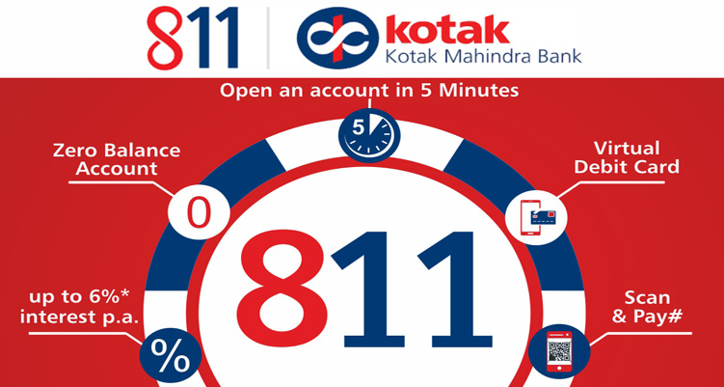
Kotak 811 Digital account
The 811 Savings account is the Digital savings account offering of Kotak Mahindra Bank. The Team ran hugely successful Pan India campaigns to educate the customers about the benefits of the 811 account and convincing them to download and open the account on their smartphones. Run rate of 2500 + accounts month on month were some of the benchmarks the team achieved.
AC Open Monthly 2000 | Language Support Hindi/Marathi/English
Daily Calls 8000+ | Location- PAN INDIA

Slide 13


Lead Generation Activity for Cylsys
The team ran various successful campaigns on Facebook, Linkedin and other social media to generate leads for the all Business verticals of Cylsys Software – Software Development, IT Staffing and Digital Marketing. This was pin point marketing to the target audience resulting in qualified leads, New and challenging projects and finally exponential jump in revenue for the Client.
Lead Generate 5000+ | Revenue $264052+
Agents 16 | Location-US,INDIA,DUBAI

Slide 14


HR support for Recruitment services
The Team does end to end support for HR services like Co-ordinating with Clients, understanding JD’s. finding suitable candidates with matching skill sets through Job portals, and other sources, scheduling various rounds of interviews. Making sure the Candidate turns up for the interview/ Takes the Tele/ Skype interview and Finally making sure the selected Candidate joins the company.
Candidates 270+ | Clients 12
Agents 10 | Location-US,INDIA

Slide 15






Some of the amazing services Unicorn Ops
currently offers to some of our Esteemed clients are
Back office Operations
SMS / Email campaigns
Lead Generation
Data Entry
Call Center Ops
Appointment Settings

Slide 16


Current CYLSYS Delivery Locations
MP – Near Jabalpur
MH-Mumbai
Krishan Kunj,Govt Hospital Road Indraward, Gadarwara
MP ,487551
Sitting Capacity :140 Agents
Language Support: Hindi/English/Marathi
Current Process:
Voice -MFB
Non Voice- PayTM
Data Filling – Axis/UTI MF
02
Delhi-Noida
Address:
85/86, First Floor, Harmony Mall, Link Road, Goregaon West, Mumbai 400104.
Sitting Capacity :60 Agents
Language Support: Hindi/English/Marathi
Current Process:
Voice -MFB / Tata Capital
03
Plot No –E2,office No –LL2
Sector 63 Noida 201301
Sitting Capacity :50 Agents
Language Support: Hindi/English/Marathi/Tamil/Punjabi
Current Process:
Voice -MFB / Pharma Company (US ) / Technical Chat Support (UK)
01

Slide 17

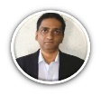
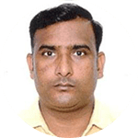
Who – Organization Structure
CYLSYS
BGPML :
Pawas Goyal
Head Global Delivery
Sachit Agrawal
Client Partner
Exec Sponsor
Service Desk
CoE
Rajesh Chandran
Head – CEM COE Services
BRM
Program
Manager
Transformation
Domain
Support
Harish Yadav
Project Manager
Process Owners/
Leads
Technology
Project Supervisors(4)
Risk Management
Process
SMEs
Team Lead ( 10)
Human
Resources
Associates
( 100 FTEs)
Audit/QA
FOS( 15)
Trainer (1)
DIP Checker (6)
QC(3)

Slide 18

Our understanding-Sample
Lead to BGPML CRM
Leads funnel
All the endorsed leads for particular location come toBGPML CRM via APIs’ or email in real time. Here we shall get all of the required fields viz. telephone numbers, address and pin code.
02
Take appointment
Through various sources we will collect Leads (Digital Marketing/ Buy Data / Cold Calling) and submit these leads into BGPML CRM.
03
Once leads come in CRM, executive will make calls to the customers and fix their appointments, and would update to the Fos’
01
MIS
Product Advisory
05
After following this entire process , all details will be updated in BGPML CRM at EOD.
Details to be filled in CRM are as follows-
- submitted
- on ground
- Re-process
- NI
FOS will also call to the customers as per scheduled time and advise them about the product and if customer is convencened then FOS will close this lead. FOS will collect below documents from customer and submit to BGPML.
- Niche form
- annexure form
- Customer KYC( address proof)
- Cheques
Product USPs
04
06
Accumulate Gold on monthly basis
BGP can be subscribed for tenure of 11 months
Part Payment Facility
Easy & multiple subscription options are available for the customer through Online and Offline medium.
The plan has no lock in period
Door step service ( no need to visit branch)

Slide 19

Technology

Slide 20
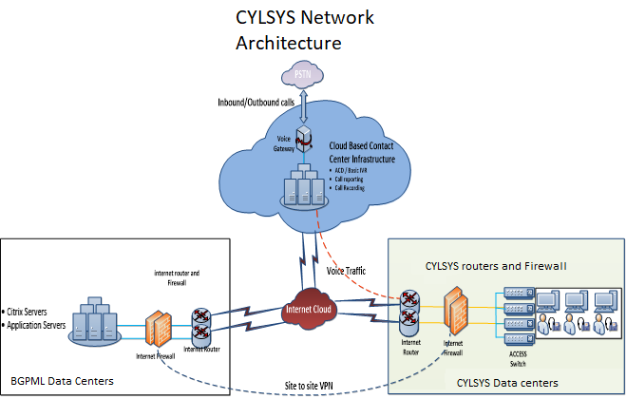
Technology Infrastructure Solution--Sample
Cylsys Users at Mumbai Delivery Center will connect to BGPML Data Center, INDIA via site to site VPN over shared internet.
All applications in-scope required for data processing will be accessed through Citrix/internet environment, hosted and managed by BGPML at their Data Center.
Cloud hosted contact center is proposed for in scope voice requirements (inbound, manual outbound, call reports and call recording) over shared internet.

Slide 21
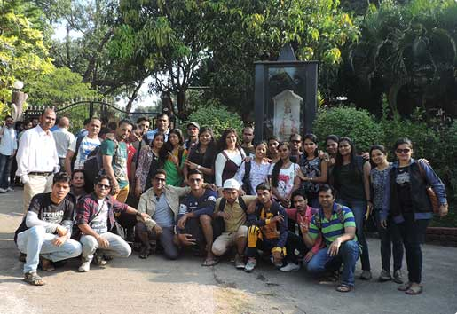
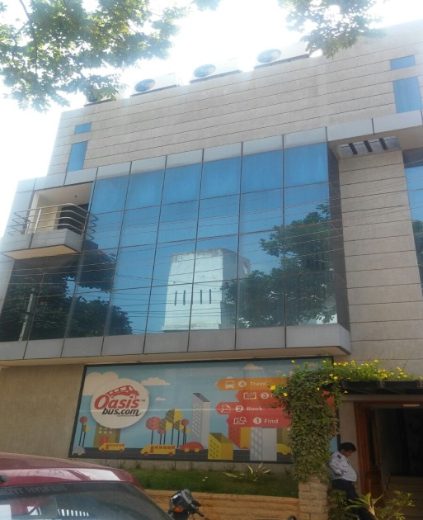
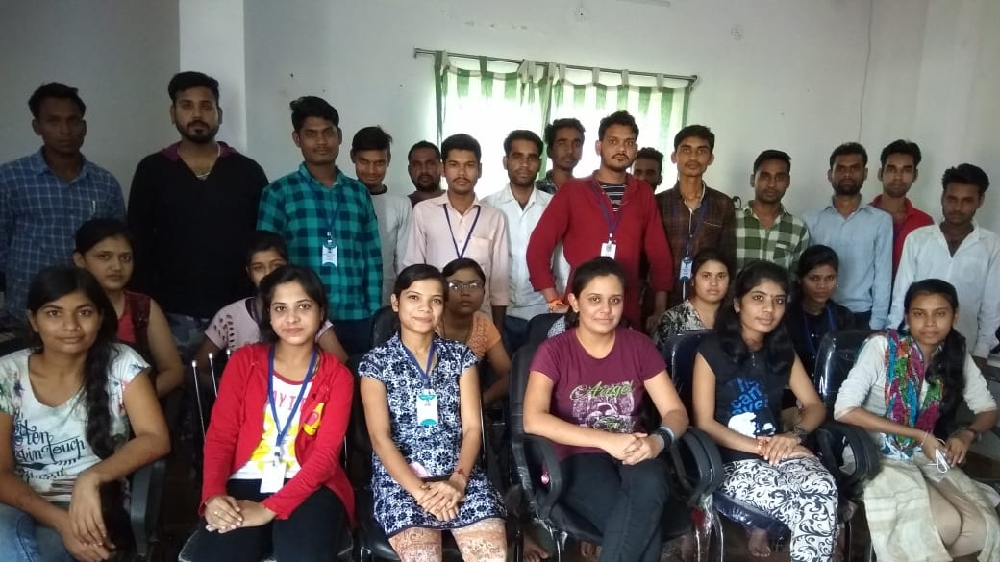
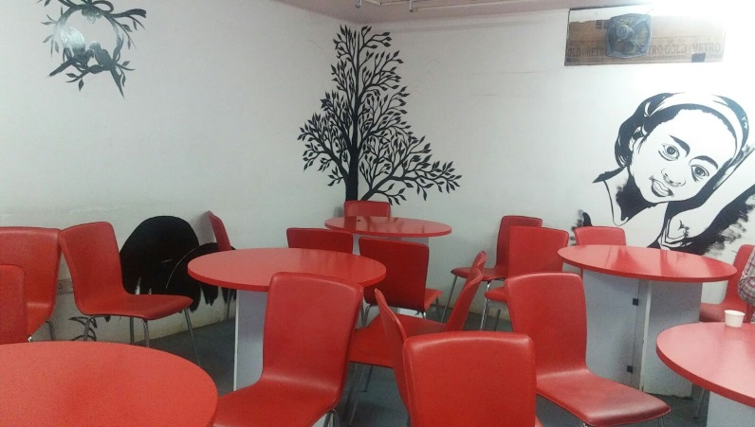
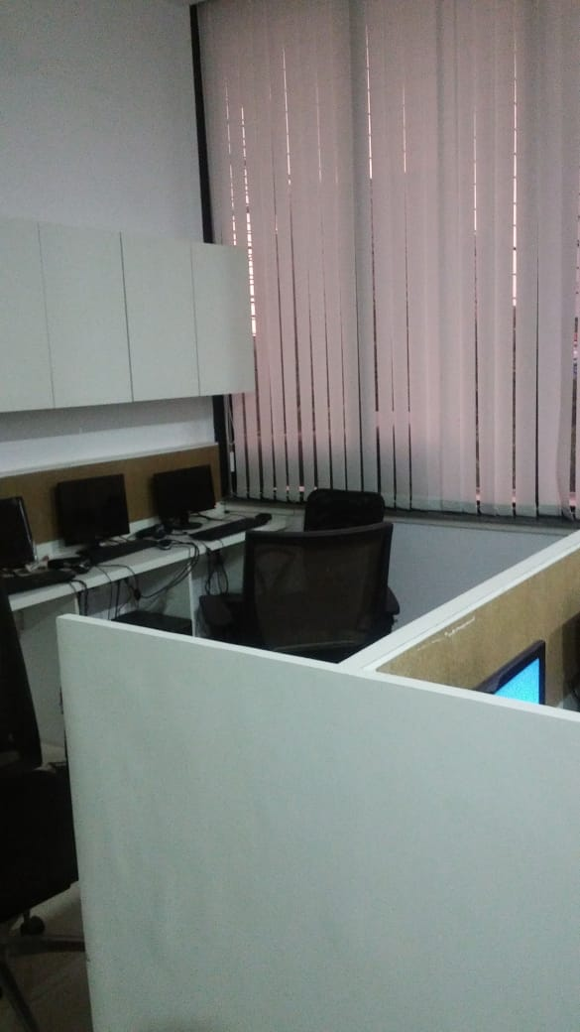
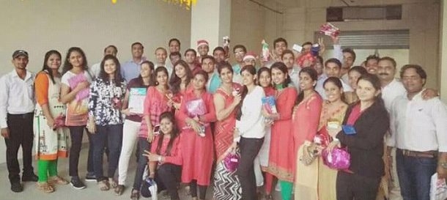
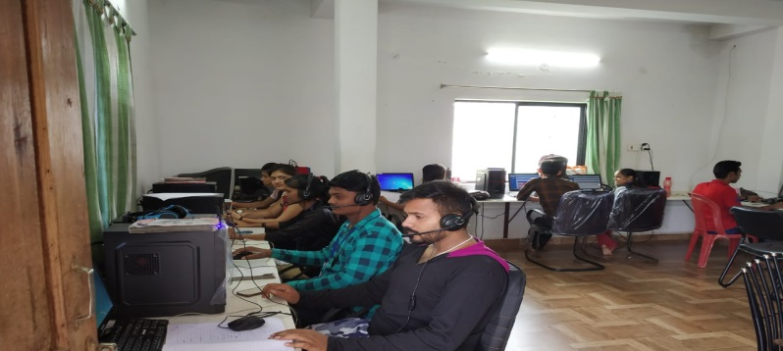
Gallery

Slide 22
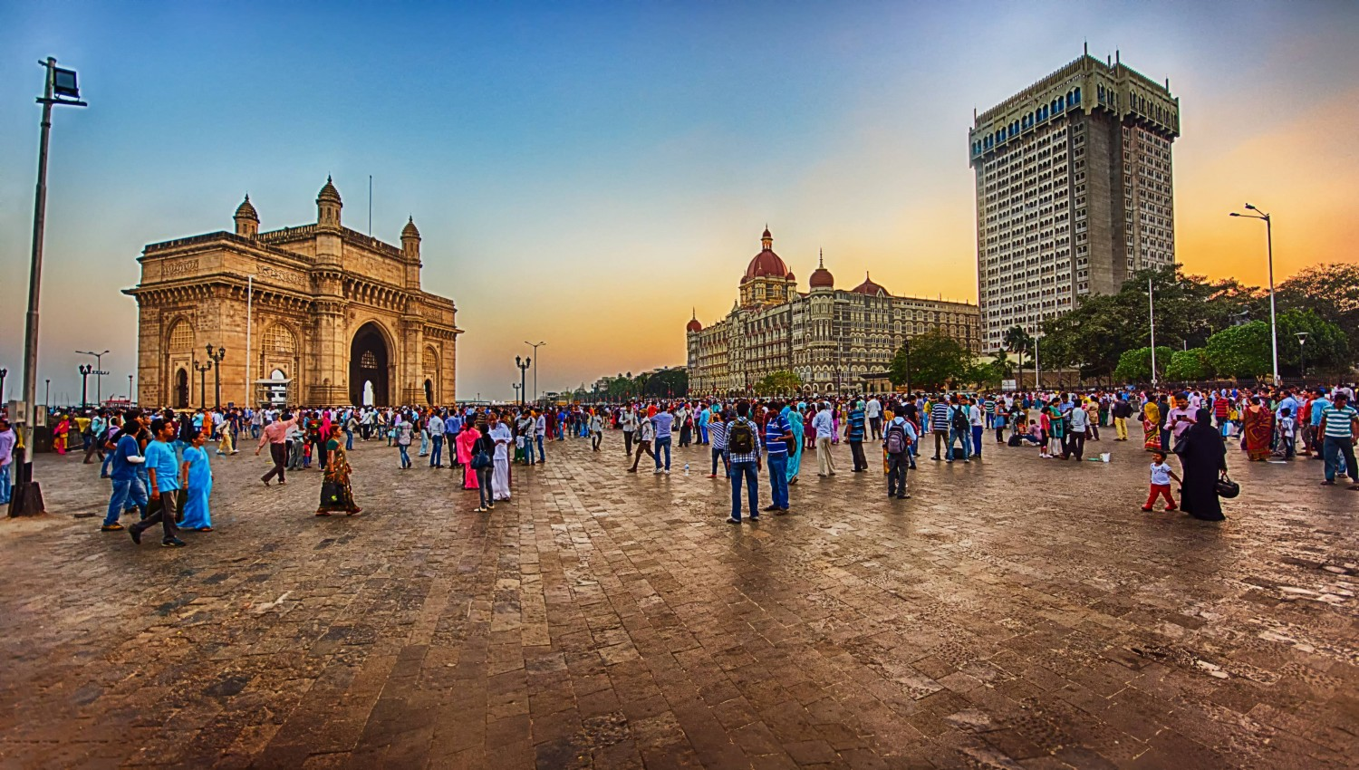



CONTACT US
WE’RE BASED IN MUMBAI, MH
We would love to engage and understand your business need and discuss areas in which we can work together. Please feel to contact us at your convenience on the given below contact details.
CONTACT
E-MAIL
VISIT US
+919967502429
reachus@cylsys.com
85/86, First Floor, Harmony Mall, Link road, Goregaon(W), MUMBAI - 400104

