Slide 1
WALCHAND COLLEGE OF ENGINEERING, SANGLI
Department of Electrical ENGINEERING
Project on:
UNDERGROUND CABLE FAULT DETECTION SYSTEM
Presented by:
Yogiraj Belsare (2018BTEEL00004)
Sangram Gore (2018BTEEL00043)
Saurabh Patil (2018BTEEL00074)
Sabzar Kumhhar (2019BTEEL00201)
Shrikant Birajdar (2019BTEEL00208)
Under the guidance of:
MRS. SABA SHAIKH (MAM)
(Electrical Department)

Slide 2
CONTENTS
Introduction
Present theories and practices
METHODS USED FOR LOCATING UNDERGROUND CABLE FAULTS
OUR APPROACH
BLOCK DIAGRAM
SIMULATION RESULTS
ADVANTAGES
FUTURE SCOPE
Conclusion
REFERENCES

Slide 3
Problem statement :-
Normally in urban areas electrical cable runs in underground instead of overhead line. Whenever some issues occur in underground cable it is very difficult to determine the exact location of fault. The underground cable system is important one for distribution especially metropolitan cities, airport and defence service, because underground cable is not affected by bad weather condition such as snowfall, heavy rainfall, storm. But when any fault occur in cable, then it is difficult to find out the fault. The cable fault detecting equipment presently being used is comparatively heavy. Further in some cases, only one method is not sufficient and assume fault determination may require more than one method together.
In view of the above, this project is a method of underground cable fault detection using Arduino, where it intended to calculate correct and the exact location of a cable fault.

Slide 4
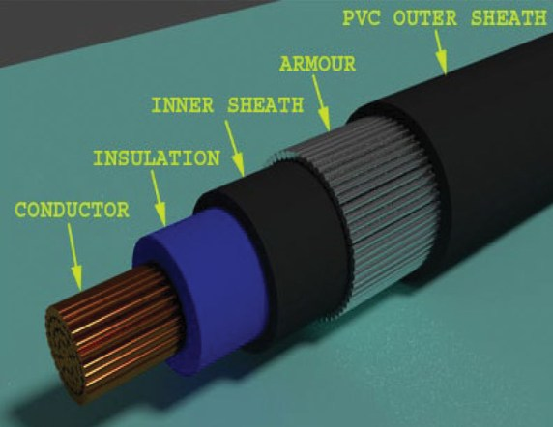
Underground cables
Construction
• Conductor
• Insulation
• Beading
• Armouring (optional)
• Outer sheath

Slide 5
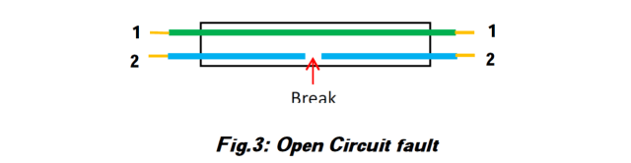
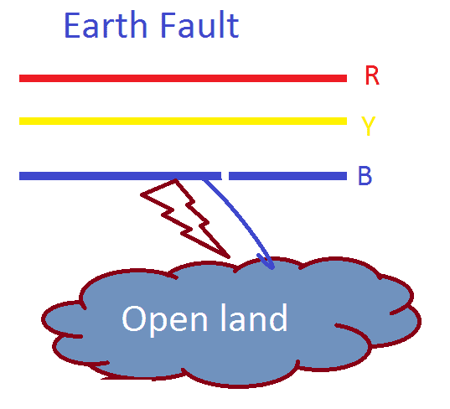
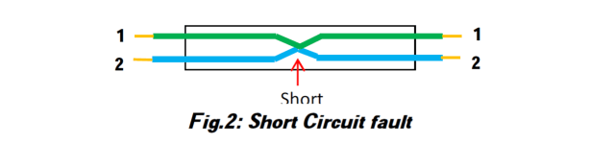
Faults in underground cable
Open Circuit Fault :-
3) Earth Fault :-
2) Short Circuit Fault :-

Slide 6
Objective:-
1) To study and develop a single device as solution to detect the faults in underground-cable.
2) To precisely calculate and detect the exact location of the fault.

Slide 7
Classification Of Underground Cables:-
Number of conductors in the cable
Voltage rating of the cable
Construction of cable
Type and thickness of insulation used
Installation and Laying of the cables

Slide 8
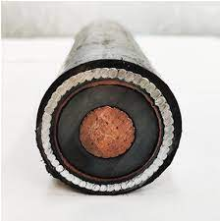
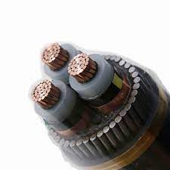
Number of conductors in the cable
Single core cable
2 Three core cable

Slide 9
Methodology:-
This project uses the standard concept of Ohms law
This system uses an Arduino board and a rectified power supply
fault creation
16x2 LCD display

Slide 10
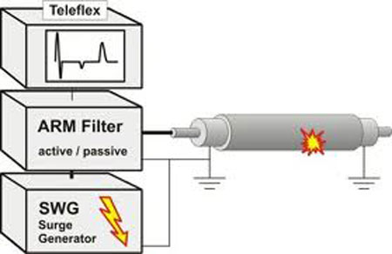
Present theories and practices:-
1-Cable thumping method:-

Slide 11
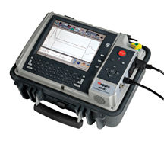
2-Time domain Reflectometer:-

Slide 12

3- Megger:-

Slide 13
4-High-voltage Radar Method:-
Arc Reflection
Surge Pulse Reflection Method
The Voltage Pulse Reflection Method

Slide 14
Why choose Arduino based fault detection:-
Low Maintenance
Improved Public Safety
Less Consumption of Power
Easy to Handle

Slide 15
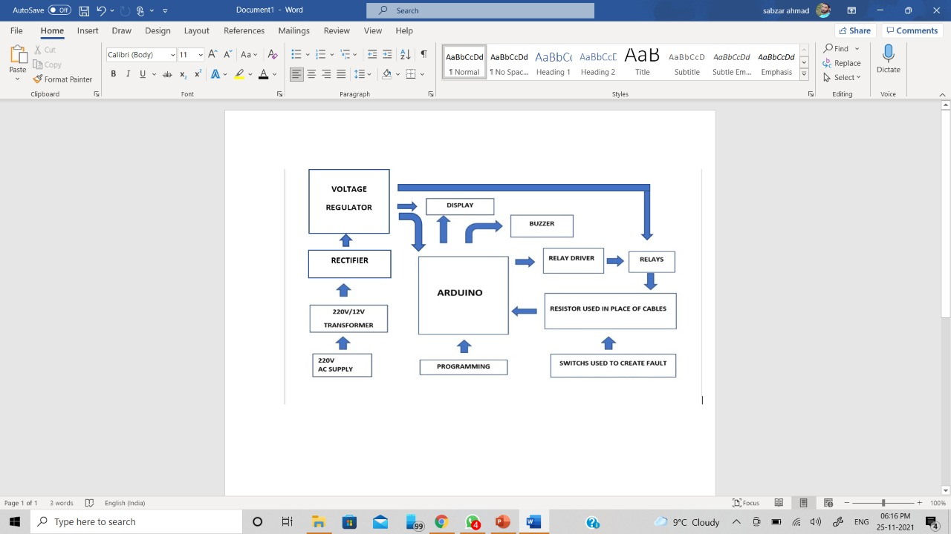
BLOCK DIAGRAM:-

Slide 16
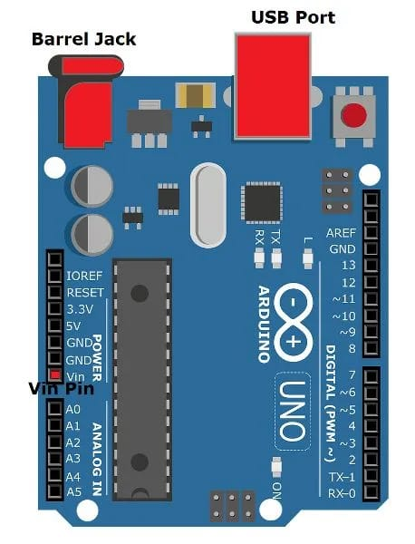
Components Used:- 1- Arduino Uno:-

Slide 17
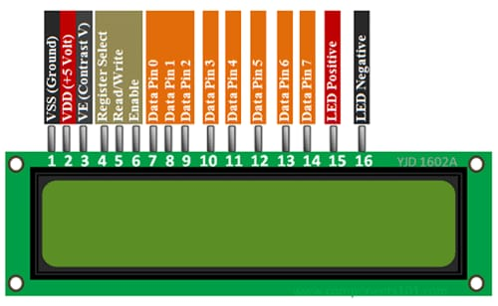
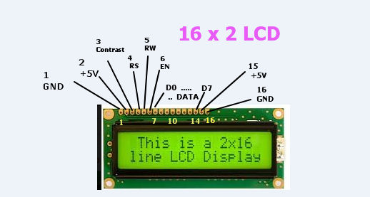
2-LCD Display

Slide 18
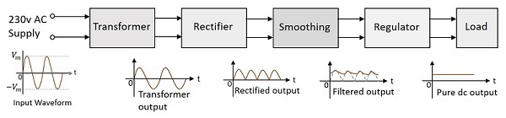
3-Power Supply Unit:-
Block Diagram of Power Supply Unit

Slide 19
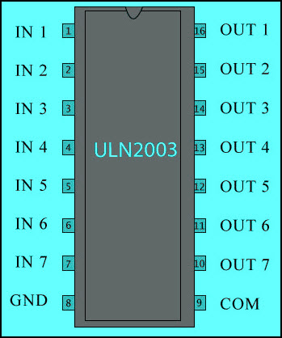
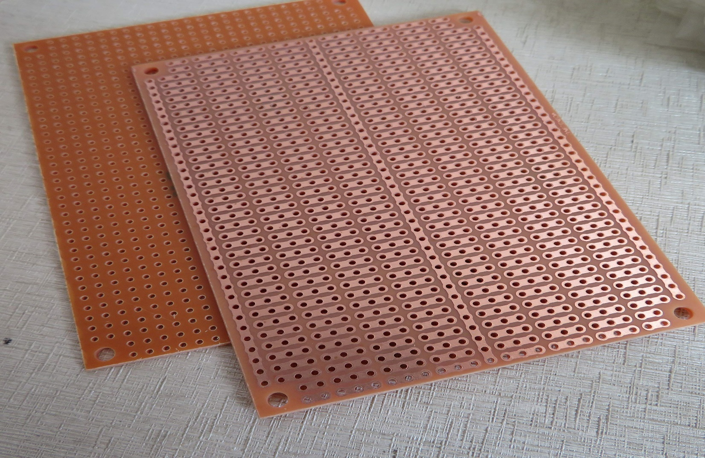
Relay Driver Circuit
Veroboard

Slide 20
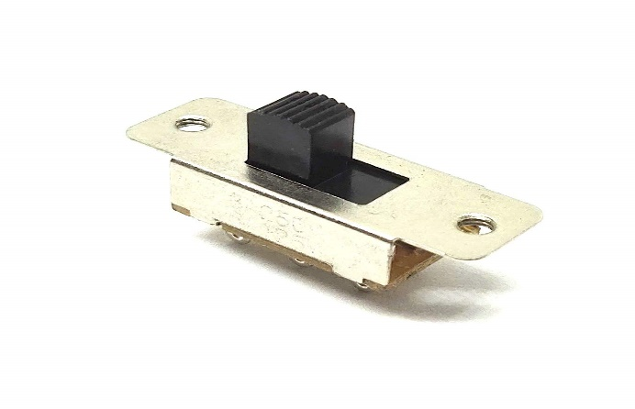
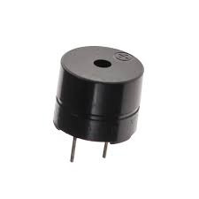
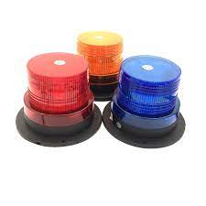
Slide Switch
Buzzer
Red, Yellow and Blue LED

Slide 21
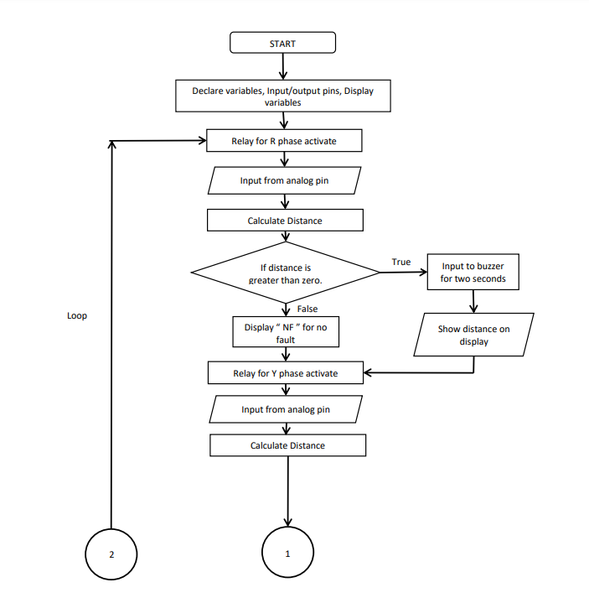
Flow Chart:-

Slide 22
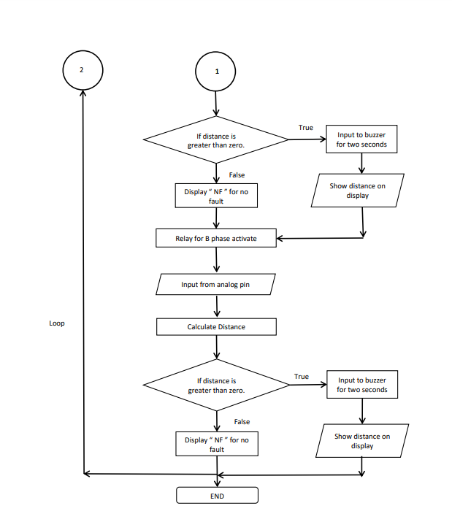

Slide 23
Algorithm
Import the header file of Liquid Crystal display which contains pre-defined functions related to LCD.
Assignment of variables to the pins.
A0 => sensor
8 => relay1
9 => relay2
10 => relay3
13 => buzzer
Variable declaration.
read_ADC => Integer variable
Distance => Integer variable
Setting up pins as input/output.
sensor => input
relay1 => output
relay2 => output
relay3 => output
buzzer => output
Setting up LCD.
Declaration of 16 column, 2 rows display.
Clear screen.
Display message at the beginning by setting cursor to appropriate position.
Clear display after some time by giving delay.
Clear screen.

Slide 24
6) Define the function to calculate the distance (data()).
Taking analog input form sensor.
Arduino’s inbuilt ADC will scale the input between 0 to 1023 according to the strength of the input.
Divide the input of the sensor with a constant which is taken according to distance in which the input is scaled.
If there is fault it will give distance.
If distance is greater then 0, that means fault occurred, then give buzzer pin will be high for 2 seconds.
After 2 seconds it will turn low.
7) Main loop.
Setting cursor and printing appropriate letters on display.
Setting cursor to column 1, row 1 and write letter ‘R’ to represent R phase.
Similarly print letter ‘Y’ at column and “B” at column 13 to represent Y and B phases respectively.
Taking input from "R” phase by giving high value to that relay pin and giving low value to remaining two phase relay pins.
Delay of 500 micro-seconds for smooth functioning.
Call the function defined earlier to calculate distance. If there is any fault, It will give the value of distance in Kilometres and gives input to buzzer for 2 seconds. If there is no fault it will give value of distance 0.
Set the cursor to column 0, row 2.

Slide 25
e) If distance is greater than zero, print distance along with suffix “KM”. Else, print “ NF ” to represent no fault.
f) Similarly, for Y phase, give high signal to relay2 and low signal to remaining two relays.
g) Calling the “data()” function to calculate distance and get that value.
h) Set the cursor to column 6, row 2.
i) If distance is greater than zero, print distance along with suffix “KM”. Else, print “ NF ” to represent no fault.
j) Similarly, for B phase, give high signal to relay2 and low signal to remaining two relays.
k) Calling the “data()” function to calculate distance and get that value.
l) Set the cursor to column 12, row 2.
m) If distance is greater than zero, print distance along with suffix “KM”. Else, print “ NF ” to represent no fault.
8) Void loop() function continuously iterate over the code written in the function and it will alternately check for the fault and if there is fault it will give value of distance in kilometers.

Slide 26
Operating Code:-
#include <LiquidCrystal.h>
LiquidCrystal lcd(2,3,4,5,6,7);
#define sensor A0
#define relay1 8
#define relay2 9
#define relay3 10
#define buzzer 13
int read_ADC;
int distance;
byte symbol[8] = {
B00000,
B00100,
B00100,
B00100,
B11111,
B01110,
B00100,
B00000};
void setup()

Slide 27
{
pinMode(sensor,INPUT);
pinMode(relay1, OUTPUT);
pinMode(relay2, OUTPUT);
pinMode(relay3, OUTPUT);
pinMode(buzzer, OUTPUT);
lcd.createChar(1, symbol);
lcd.begin(16, 2);
lcd.clear();
lcd.setCursor(0, 0);
// set the cursor to column 0, line 1lcd.print("Welcome to Cable");
lcd.setCursor(0, 1); // set the cursor to column 0, line 2lcd.print("Fault Detection");
delay(2000);
lcd.clear();
}

Slide 28
void loop(){lcd.setCursor(1,0);
lcd.print("R");
lcd.write(1);
lcd.setCursor(7,0);
lcd.print("Y");
lcd.write(1);
lcd.setCursor(13,0);
lcd.print("B");
lcd.write(1);
digitalWrite(relay1,HIGH);
digitalWrite(relay2,LOW);
digitalWrite(relay3,LOW); delay(500);data();
lcd.setCursor(0,1);
If(distance>0){lcd.print(distance);
lcd.print("KM ");}
else{lcd.print(" NF ");}
digitalWrite(relay1,LOW);
digitalWrite(relay2,HIGH);
digitalWrite(relay3,LOW); delay(500);

Slide 29
data();
lcd.setCursor(6,1);
If(distance>0){lcd.print(distance); lcd.print("KM ");}
else{lcd.print(" NF ");}
digitalWrite(relay1,LOW);
digitalWrite(relay2,LOW);
digitalWrite(relay3,HIGH);
delay(500);
data();
lcd.setCursor(12,1);
If(distance>0){lcd.print(distance); lcd.print("KM ");}
else{lcd.print(" NF ");}}
void data(){read_ADC = analogRead(sensor);
distance = read_ADC/100;
if(distance>9)distance = 0;
if(distance>0){digitalWrite(buzzer,HIGH);
delay(2000);
digitalWrite(buzzer,LOW);
delay(200); }}

Slide 30
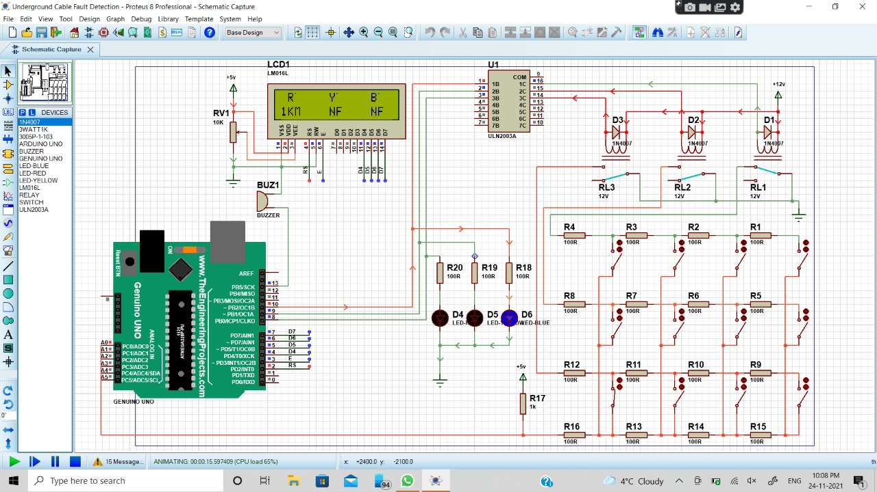
FAULT OCCUR AT R PHASE:-

Slide 31
ADVANTAGES OF UNDERGROUND CABLE FAULT DETECTION SYSTEM:-
High efficiency.
LESS MAINTENANCE.
no need of expertise.
Cheap.
Reduces time to locate faults hence improves system performance.

Slide 32
CONCLUSION:-
We designed, implemented a Arduino based underground cable fault detection system.
We have successfully tested underground cable fault detector on Proteus Software.
Our proposed system can detect fault in underground cables very efficiently.

Slide 33
REFERENCES:-
T. S. Sidhu and Z. Xu, “Detection of incipient faults in distribution underground cables”, IEEE Trans. Power Del., vol. 25, no. 3, pp. 1363–1371, Jul. 2010.
Tarlochan S. Sidhu, Zhihan Xu, “Detection of Incipient Faults in Distribution Underground Cables”, IEEE Transactions on Power Delivery, Vol. 25, NO. 3, JULY 2010.
Raghu Raja Kalia, Preeti Abrol, ’Design and implementation of wireless live wire fault detector and protection in remote areas’, IEEE,(2014),vol. 97,No.17
http://www.academicscience.co.in/admin/resources/project/paper/f201605071462612122.pdf

Slide 34
THANK YOU

