Slide 1
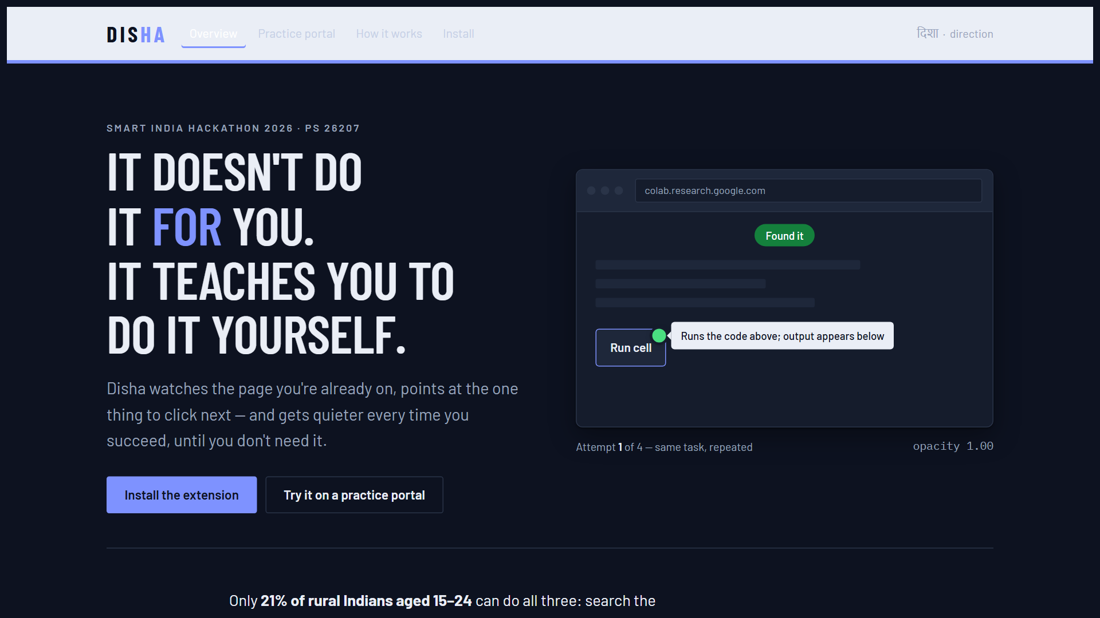
Code Blooded
TITLE PAGE
SIH 2026 logo
(from the official template)
Problem Statement ID - 26207
Problem Statement Title - Student Innovation (bring-your-own idea)
Theme - Smart Education
PS Category - Software
Team ID - issued after the intercollege round
Team Name - Code Blooded
@SIH Idea submission- Template
1
Notes:
Opening line: Only 21% of rural Indians aged 15-24 can search online, use email and bank online (MoSPI CAMS 2022-23). The services exist. People fail at the interface. Team ID stays blank until the intercollege SIH round is cleared.

Slide 2
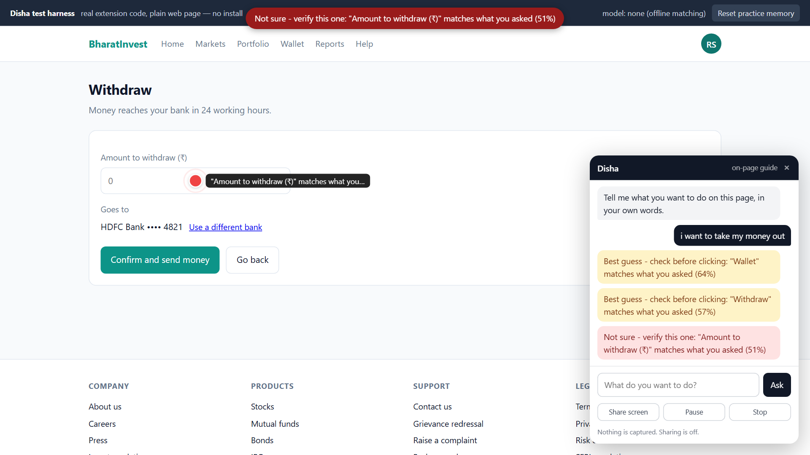
Code Blooded
Disha - it points, you click, and then it fades
SIH 2026 logo
(from the official template)
IDEA / SOLUTION :
Problem Resolution :
Disha reads the page's own controls and their accessible names, then marks the ONE next step with a colour-coded dot.
You click. Disha never can. At an OTP or payment step it pauses and hands control back.
Every success dims the dot; five clean repetitions remove it entirely.
Runs on any portal - nothing is scripted in advance.
A citizen who does not know the word 'withdraw' still finishes the task - and finishes it themselves.
No paid intermediary, no travel, no 'come back next week'.
It points instead of clicking, so it is safe where an autopilot agent is not.
Unique Value Propositions (UVP) :
Confidence you can see - the dot's colour is not the model's self-report; page evidence is scored separately and both must agree.
It teaches, then leaves - guidance fades on success, returns after a mistake.
Zero integration cost - no ministry rebuilds anything.
Closest shipped product: Microsoft Copilot Vision "Highlights". We do not claim to have invented on-screen pointing. Ours is the combination - exposed confidence, DOM + ARIA grounding, a fading scaffold, and India-specific task packs.
@SIH Idea submission- Template
2
Notes:
The screenshot is a real run, not a mock-up: red dot on the amount field, and the panel shows all four steps - 64%, 57%, 51% red, 75%. Slide 2 is the only slide whose title we choose - 'IDEA TITLE' is a placeholder for the idea's name.

Slide 3
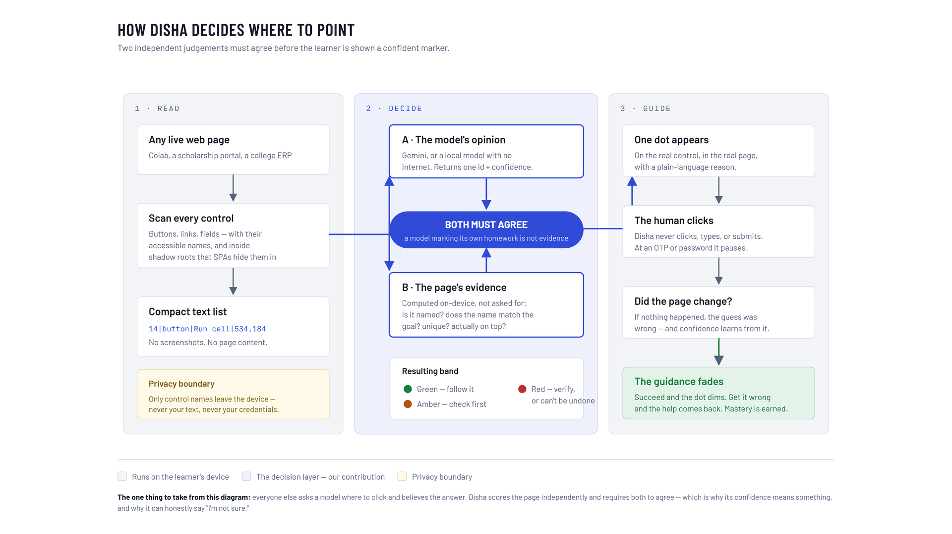
Code Blooded
TECHNICAL APPROACH
SIH 2026 logo
(from the official template)
Technologies used
Manifest V3 Chrome extension, vanilla JavaScript, no build step.
Model is pluggable - Gemini free tier, Anthropic, or a local Ollama model with no internet.
DOM + ARIA, not Chrome's accessibility tree - that needs the debugger permission and breaks on old government markup.
Vision grounding (GUI-Actor, MIT) is the documented fallback.
Methodology and process for implementation
Green needs 0.80 model AND 0.75 page evidence.
We display the weaker of the two numbers, never the average - so the number can never contradict the colour.
Working prototype, verified end-to-end in a browser.
page > enumerate interactive elements + ARIA names > compact text list > model returns {id, confidence} > on-device grounding score > colour band > draw dot > human clicks > wait for DOM to settle > next step
@SIH Idea submission- Template
3
Notes:
Two decisions worth defending out loud: 1. DOM + ARIA, not Chrome's accessibility tree - the computed AX tree needs the debugger permission; DOM traversal is cheaper and more robust on older government markup. 2. Text-first, vision only on failure - we send control names, not screenshots. The vision fallback is documented and NOT built in this version.

Slide 4
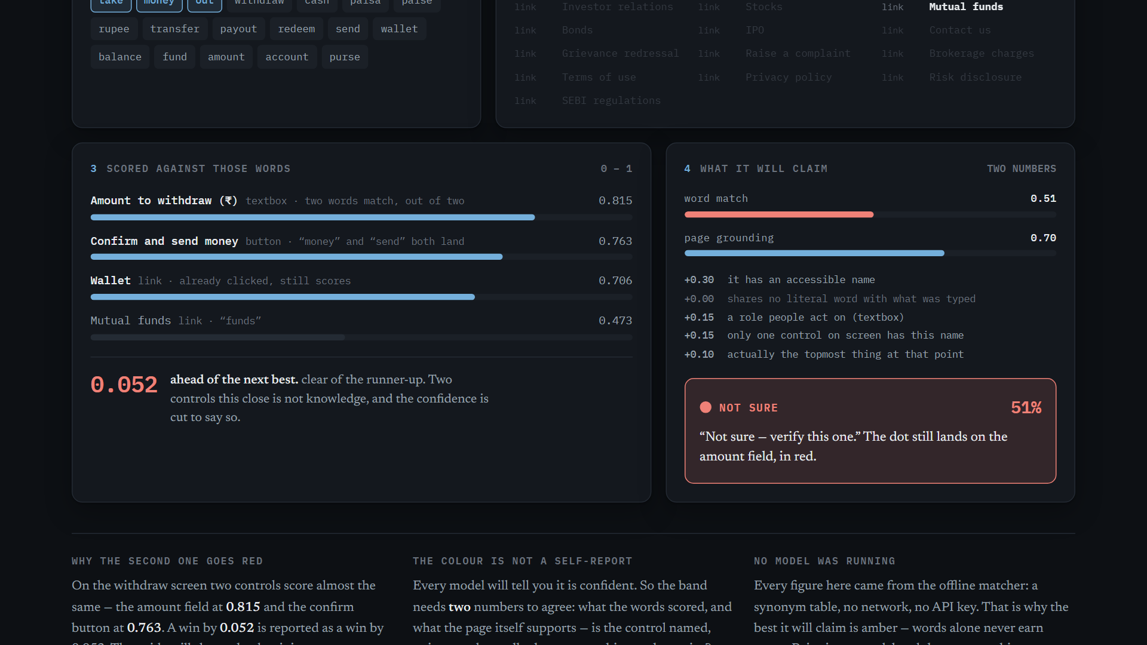
Code Blooded
FEASIBILITY AND VIABILITY
SIH 2026 logo
(from the official template)
Analysis of the feasibility of the idea
Potential challenges and risks
Strategies for overcoming these challenges
Technical, Financial, Market, Operational
Technical: built and running today; DOM + ARIA works on portals we do not control.
Financial: a compact text request per step on a free-tier model; local model = zero.
Operational: installs as an extension. No ministry integration, no portal changes.
Technical, Financial, Market, Operational
Unlabelled / icon-only controls - our weakest case.
Model picks the wrong element.
Trust: users may over-rely on a confident-looking dot.
Market: Copilot Vision already points at things.
Methods, principle, Strategies, Algorithms
Unlabelled controls drop the page score, so the dot goes red - never a silent guess; vision grounding is the fallback.
A wrong pick costs a glance, not a transaction - the human always clicks.
Over-reliance is answered by the fade itself.
Measured run: "i want to take my money out" produced 64% > 57% > 51% RED > 75% on our practice portal. The amount field scored 0.815 and the confirm button 0.763 - a win by 0.052 is reported as a win by 0.052.
That run used the offline matcher with no model, which is capped below green by design. We have not yet recorded a green dot on stage, and we have not measured accuracy.
@SIH Idea submission- Template
4
Notes:
If a judge pushes on the numbers, the honest answer is the red line: offline matcher, no model, capped below green by design, accuracy unmeasured.

Slide 5
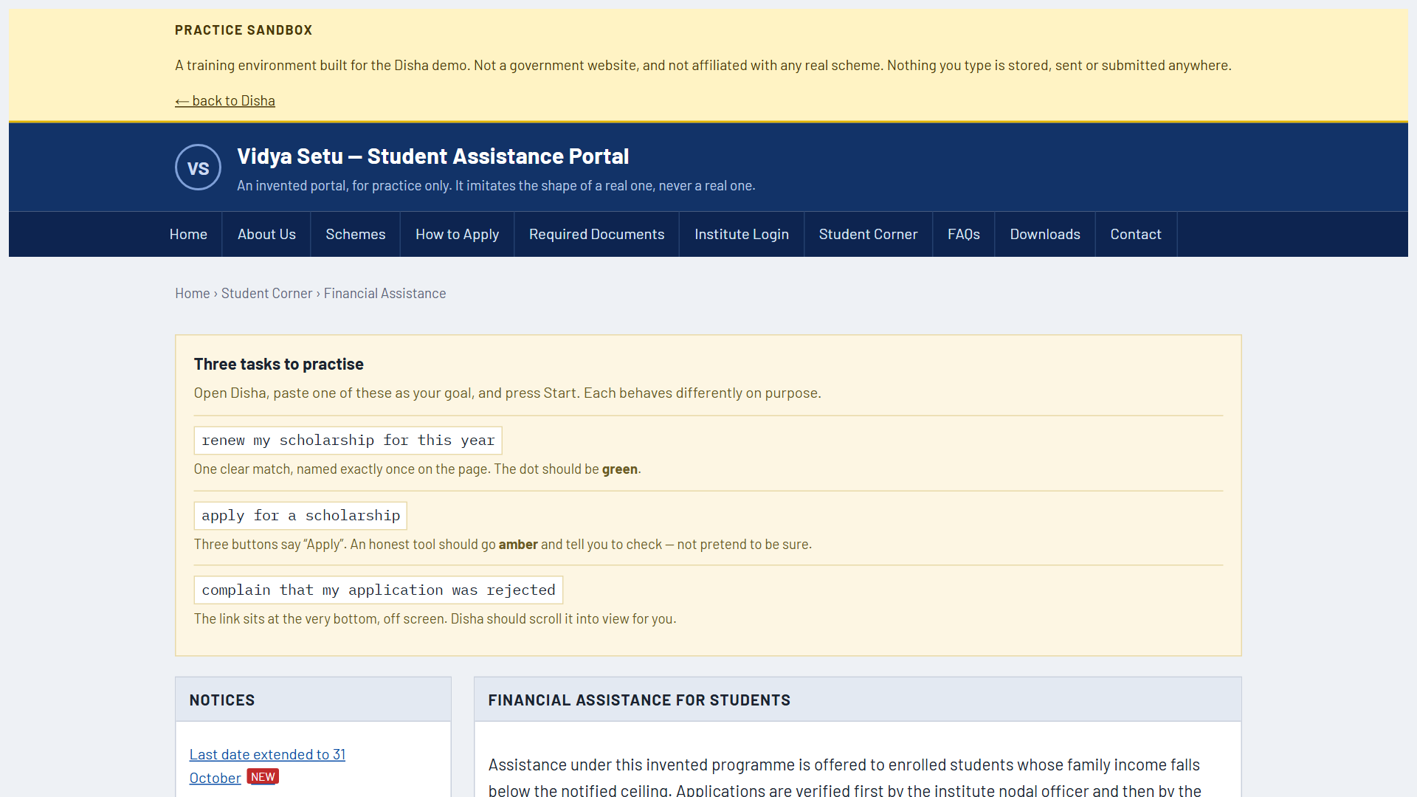
Code Blooded
IMPACT AND BENEFITS
SIH 2026 logo
(from the official template)
Potential impact on the target audience
Benefits of the solution (social, economic, environmental, etc.)
Positive - improvement: the citizen completes the task alone instead of paying someone to click.
New opportunities: a teacher or NGO worker walks a task once and it becomes a pack others reuse.
Negative - technology adoption: it needs a browser and a first install.
Social - improved access, empowerment: independence on services people are already entitled to.
Economic - cost: avoids the per-visit intermediary and travel documented in the CSC studies.
Educational: guidance fades on demonstrated success - active learning +0.47 SD, spaced retrieval g = 0.74.
Only 11.4% of connected households use the internet for government services, and one in five households using digital services depends on help from outside the household (NCAER, June 2026). A Maharashtra study recorded Rs 47 in service charges plus travel; a Jharkhand study recorded Rs 101 actually paid against a Rs 30 official fee.
Both learning figures validate the mechanism, not our product. Say that out loud.
@SIH Idea submission- Template
5
Notes:
Say 'a Maharashtra study recorded Rs 47', never 'Indians pay Rs 47' - it is a local benchmark, not a national fee. 57% of urban internet users preferred Indic-language content in 2024 (IAMAI-Kantar) - guidance can be spoken in the mother tongue through BHASHINI.

Slide 6
Code Blooded
RESEARCH AND REFERENCES
SIH 2026 logo
(from the official template)
Details / Links of the reference and research work
MoSPI, Comprehensive Annual Modular Survey 2022-23 - the 21% combined ICT-skill figure.
NSS 78th Round (2020-21) - computer literacy 24.7% national, 18.1% rural.
NCAER, The Evolving Landscape of Digital Inclusion in India, June 2026.
PIB / MeitY - CSC network: 48.54 crore transactions, 5,01,731 centres, FY 2025-26.
Freeman et al., PNAS 2014 - active learning, +0.47 SD across 225 studies.
Adesope et al. 2017 (retrieval, g = 0.51); Latimier et al. 2021 (spacing, g = 0.74).
Renkl et al. - guidance fading triggered by mastery evidence, not elapsed time.
Microsoft Copilot Vision release notes - the closest shipped prior art.
IAMAI-Kantar, Internet in India 2024; BHASHINI metrics dashboard.
microsoft/GUI-Actor (MIT) - the vision-grounding fallback on our roadmap.
Every figure on this deck is traced to an exact source line in deck/numbers.md.
@SIH Idea submission- Template
6
Notes:
Both winner decks put clickable links here and on slides 2-3 (Video, Website, Report, GitHub). We have nothing public to link yet - no git remote, demo on localhost, explainer is a private artifact. Fix that before submitting, or carry the prototype open in a tab instead.

