Slide 1


SMART INDIA HACKATHON 2025
TITLE PAGE
Problem Statement ID – 26202
Problem Statement Title- Student Innovation (Open Innovation) — Ideas focused on the intelligent use of resources for transforming and advancements of technology with combining the artificial intelligence to explore more various sources and get valuable insights.
Theme- Smart Automation
PS Category- Software/Hardware Software
Team ID-
Team Name (Registered on portal) Code Blooded

Slide 2
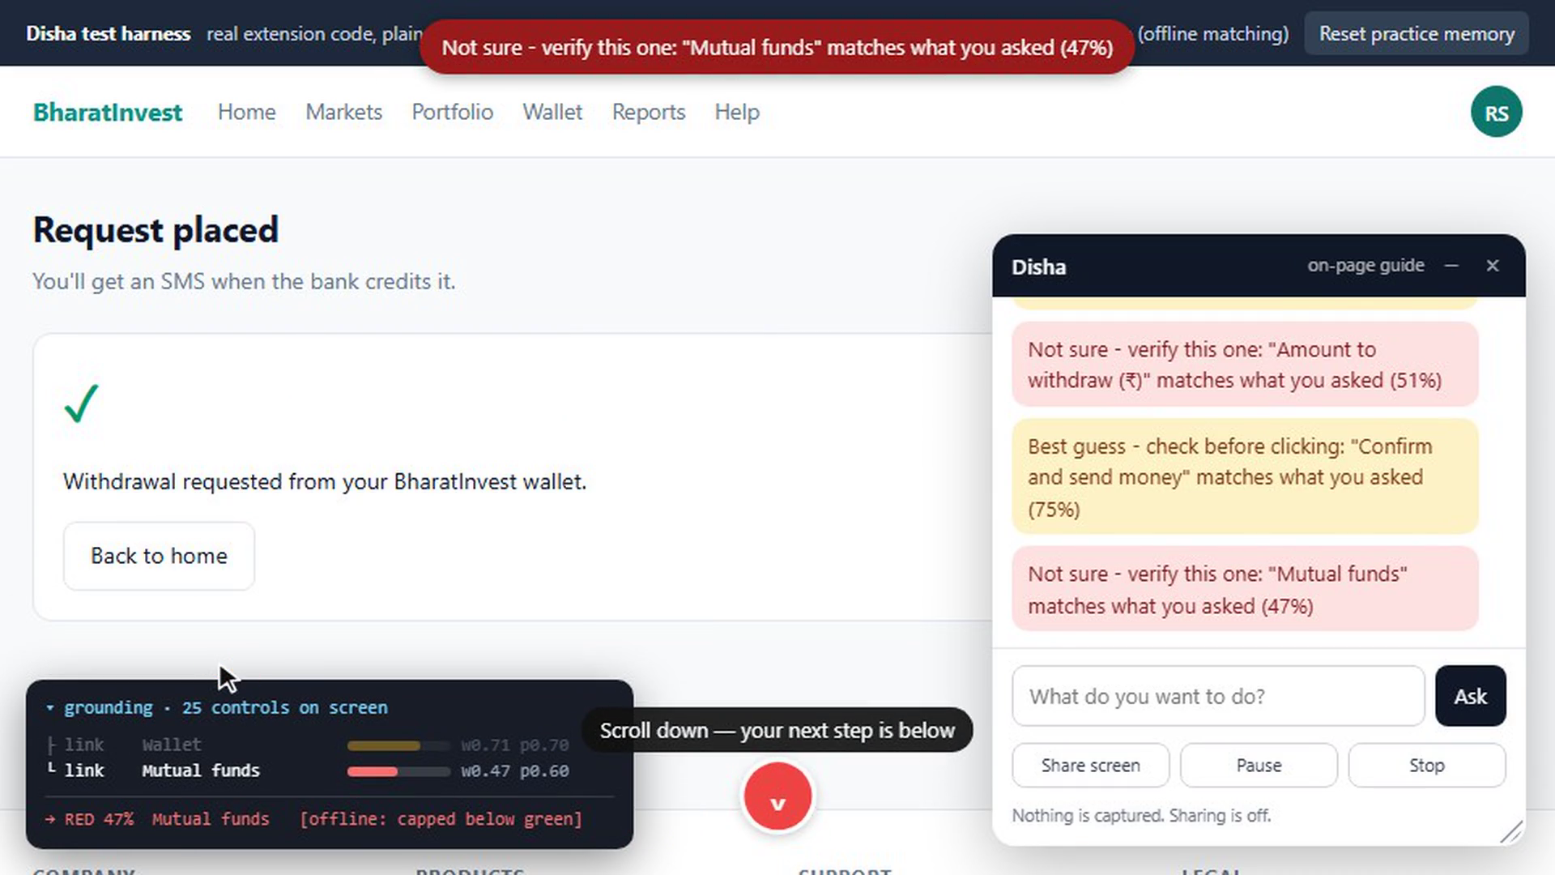
Disha — it points, you click, and then it fades
Code Blooded
Proposed Solution · Detailed explanation of the proposed solution
1
2
3
4
5
Open any portal
nothing installed on their side
Disha reads the controls
names and roles, not your text
One dot appears
its colour is the confidence
You click
Disha never can
The dot fades
gone after five clean runs
How it addresses the problem
Finishes the task without knowing the word “withdraw”.
No paid intermediary, no travel, no second visit.
Points instead of clicking — safe on Aadhaar and banking.
Innovation and uniqueness of the solution
Two independent judgements must agree before you see green:
GREEN model ≥ 0.80 and page ≥ 0.75
AMBER best guess — check before clicking
RED not sure — verify this one
Live capture — four dots, three screens, one goal typed in plain words.
Microsoft Copilot Vision already points at things. We do not claim to have invented that. Ours is the combination — exposed confidence, DOM + ARIA grounding, a scaffold that removes itself.

Slide 3
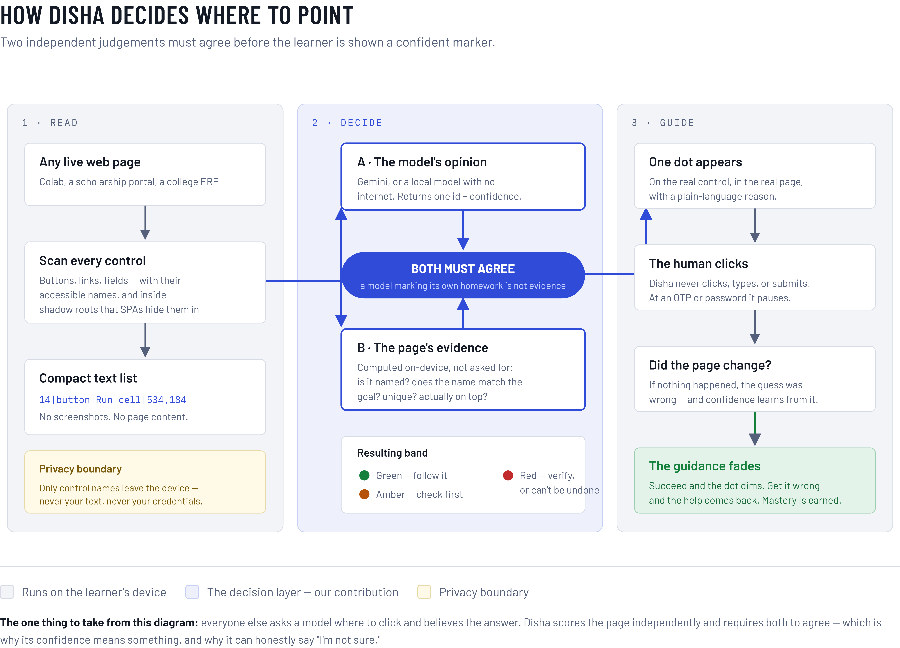
TECHNICAL APPROACH
Code Blooded
Technologies to be used
Manifest V3 extension
Vanilla JS · no build
DOM + ARIA
not the a11y tree
Model is pluggable
Gemini · OpenRouter · local
Vision fallback
GUI-Actor (MIT), documented
Methodology and process for implementation
1
Read the page
every control, its name and role
2
Ask the model
a compact text list, never a screenshot
3
Score it ourselves
on-device, from the page evidence
4
Both must agree
the weaker number becomes the colour
5
Draw one dot
the human clicks; we wait for the DOM
Two independent judgements, and the boundary nothing crosses: only control names leave the device.
Working prototype, verified in a browser
live grounding, colour bands, contingent fading, on-page ask bar, screen share with a real pause, offline mode. Vision fallback and the live-model green dot are next.

Slide 4
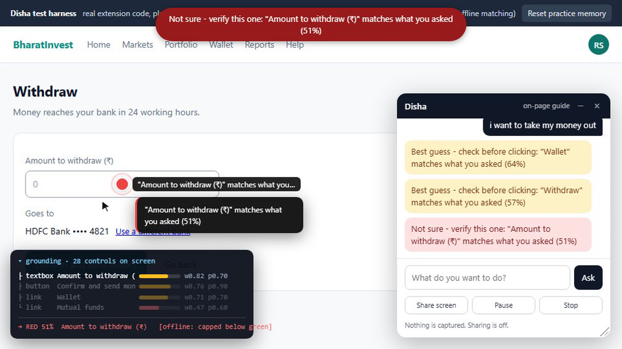
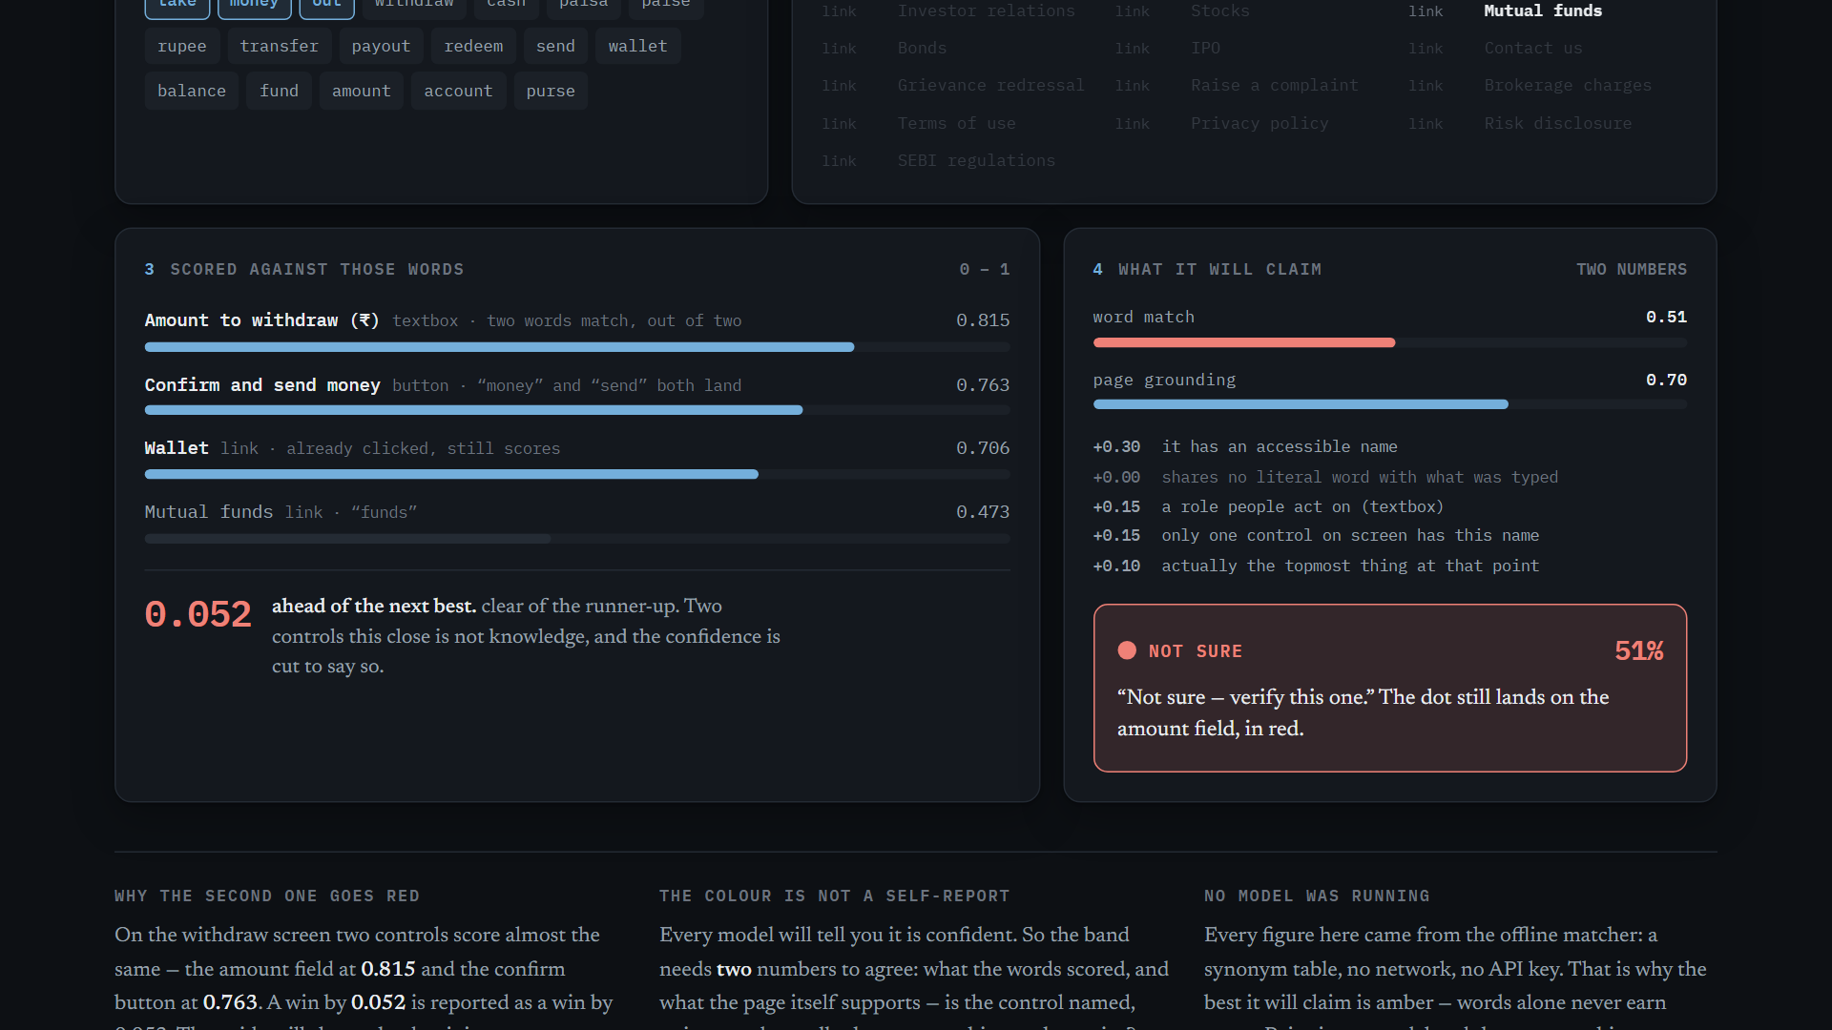
FEASIBILITY AND VIABILITY
Code Blooded
Analysis of the feasibility of the idea
Technical
running today, on portals
we do not control
Financial
free-tier model;
a local one costs zero
Operational
an extension — no ministry
integration, no portal change
Market
$1,000 Azure credits
already in hand
Potential challenges and risks → Strategies for overcoming these challenges
Unlabelled / icon-only controls
page score drops → the dot goes red, never a silent guess
The model picks the wrong element
a glance wasted, not a transaction — the human always clicks
Users over-trust a confident dot
the fade removes the dot once they can do it alone
Copilot Vision already points
The near-tie it refuses to guess — red at 51%, and the card saying why.
nobody else shows the confidence, or takes it away
The measured run · “i want to take my money out”
64%
57%
51%
75%
Wallet
Withdraw
Amount field
Confirm
Offline matcher, no model — capped below green by design. Accuracy is unmeasured; these four numbers are the only ones we quote.

Slide 5
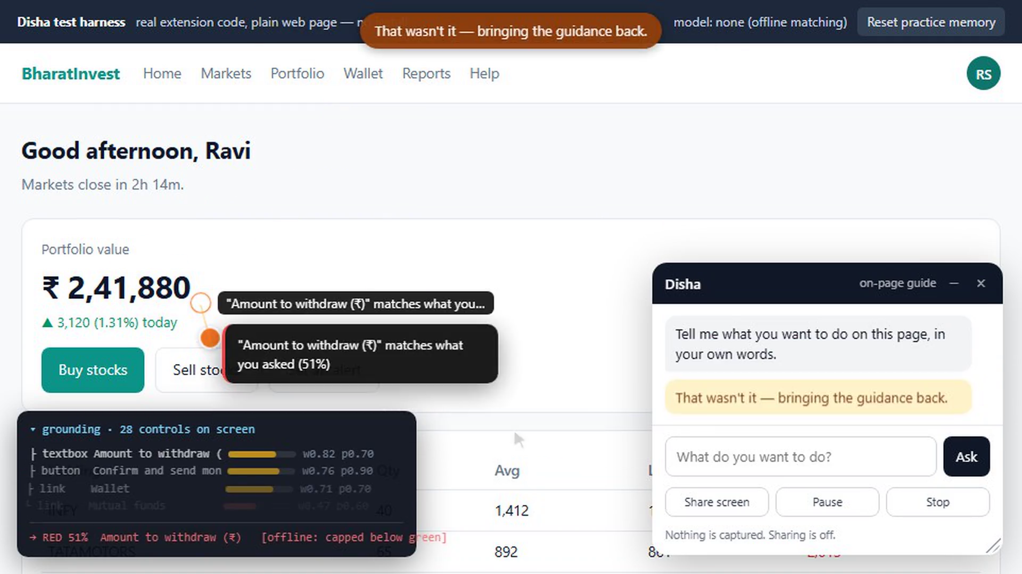
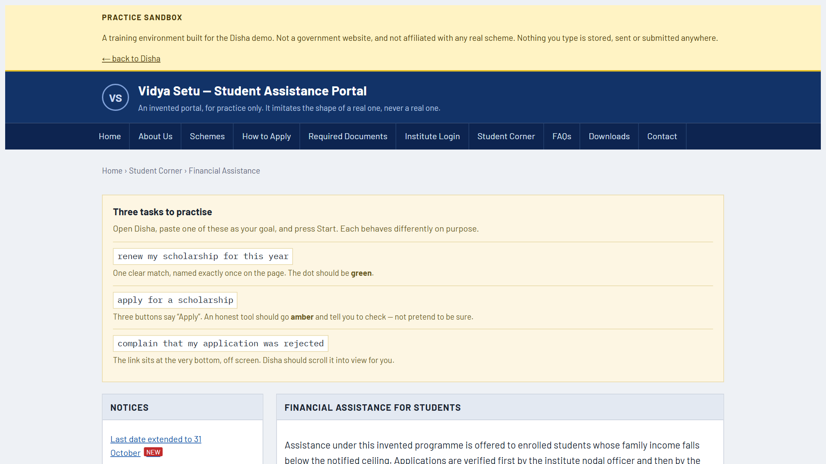
IMPACT AND BENEFITS
Code Blooded
21%
of rural Indians 15–24 can
search, email and bank online
MoSPI CAMS 2022–23
11.4%
of connected households use
the internet for gov services
NCAER, June 2026
1 in 5
households using digital services
depend on help from outside
NCAER, June 2026
Potential impact on the target audience
Today
Pays someone at a shop to click
Travels, waits, comes back next week
Learns nothing — same again next time
With Disha
Finishes it themselves, at home
One dot, in their own words
After five clean runs the dot is gone
The same task three times until the dot is gone.
Benefits of the solution (social, economic, environmental, etc.)
Social
independence on services
people already qualify for
Economic
no per-visit intermediary,
no travel (CSC studies)
Educational
+0.47 SD active learning,
g = 0.74 spaced retrieval
Both learning figures validate the mechanism, not our product. It needs a browser and one install — that is the adoption cost.
Vidya Setu — the student practice portal, safe to fail in.

Slide 6
RESEARCH AND REFERENCES
Code Blooded
Details / Links of the reference and research work
1
2
3
4
The problem is real
The mechanism works
The prior art
Our own evidence
MoSPI CAMS 2022–23
Freeman, PNAS 2014
MS Copilot Vision
github.com/Saurabh0003M/SIH
NSS 78th Round
Adesope 2017 · Latimier 2021
microsoft/GUI-Actor (MIT)
deck/real-site-run.md
NCAER, June 2026
Renkl et al. — fading
SeeClick · CogAgent · OSWorld
Red Bull Basement 2026
PIB · MeitY
Fitts 1954 · Wobbrock 2009
Lazar 2015 · Trewin 2014
Code, recorded runs, licences — including the ones we got wrong.
21% ICT-skill · 1 in 5 households need outside help
+0.47 SD · g = 0.74 — validates the mechanism, not our product
Pointing already ships. Exposed confidence does not.
What these sources do NOT say
Accuracy is unmeasured. 48.54 crore counts transactions, not citizens. 21% is a combined ICT-skill measure, not “cannot use a government website”. The learning figures validate the mechanism.
github.com/Saurabh0003M/SIH
the working prototype, the practice portal, every recorded run, and ATTRIBUTION.md — every borrowed repository with its licence and commit hash

Slide 7
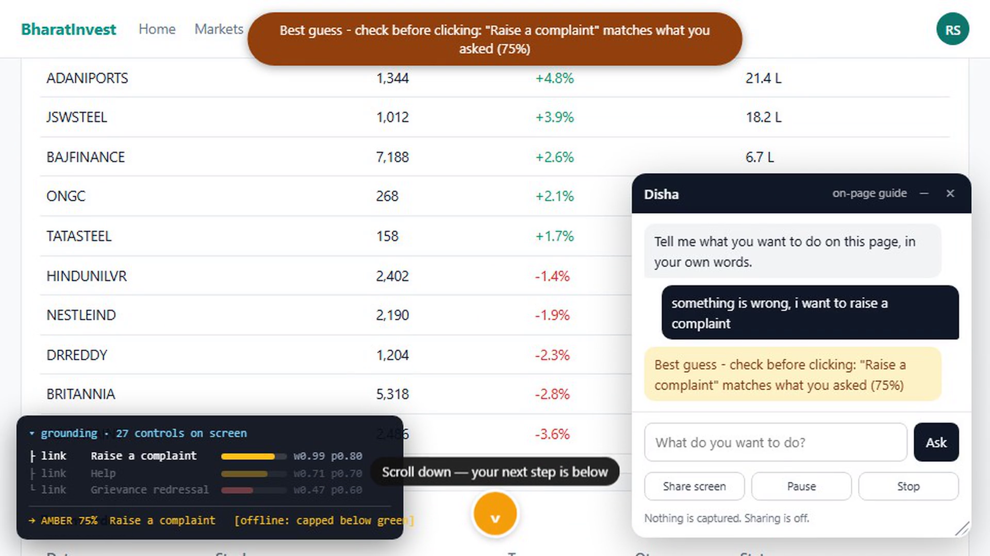
Disha is running. Ask us anything.
Four dots, three screens
one goal, typed in plain words
The near-tie it refuses to guess
red at 51%, and the card saying why
Every navigation state
two arrowheads, then one, then the dot
What you are looking at
Measured on our practice portal: “i want to take my money out” gave 64% → 57% → 51% red → 75%. That run used the offline matcher with no model, which is capped below green by design.
Green needs two numbers to agree: model ≥ 0.80 AND page evidence ≥ 0.75. We display the weaker of the two, never the average, so the number can never contradict the colour.
Read-only runs on live public portals: scholarships.gov.in, swayam.gov.in, aicte-india.org — including the ones it got wrong and reported red. Nothing was clicked on any of them.
What we do not claim: accuracy is unmeasured, the vision fallback is documented but not built, and Microsoft Copilot Vision already points at things — we say so on slide 2.
Why not let the AI click? On an Aadhaar or a banking page a wrong click is a transaction, not a glance. And the moment it clicks for you, you have learned nothing. The human clicking is the product.
Who pays for it? Nobody has to. Free-tier model, or a local one at zero cost that never leaves the machine. Installs as an extension — no ministry integration, no portal changes.

