Slide 1
Comprehensive Healthcare System
using ML
Group No. : 37
Samyak Vaidya (405C030)
Abhijit Shendage (405C033)
Yash Patil (405C025)
Saurabh Gore (405C008)
Project Guide :
Prof. Aparna Kalaskar
1

Slide 2
Problem Statement
To build a system which would provide hand hold support to users in their healthcare matters by analysing their symptoms using Machine Learning techniques.
2

Slide 3
Motivation
Sometimes we need the help of doctors, but due to our helter-skelter lifestyle we choose to ignore it or sometimes we may overvalue it. But it might lead to some serious concerns.
In rural areas, doctors are available but they are not specialists, so they may not give a thought to considering seriousness of disease.
There isn’t any existing system which connects all the medical system.
This is when the proposed system will help you !!
3

Slide 4
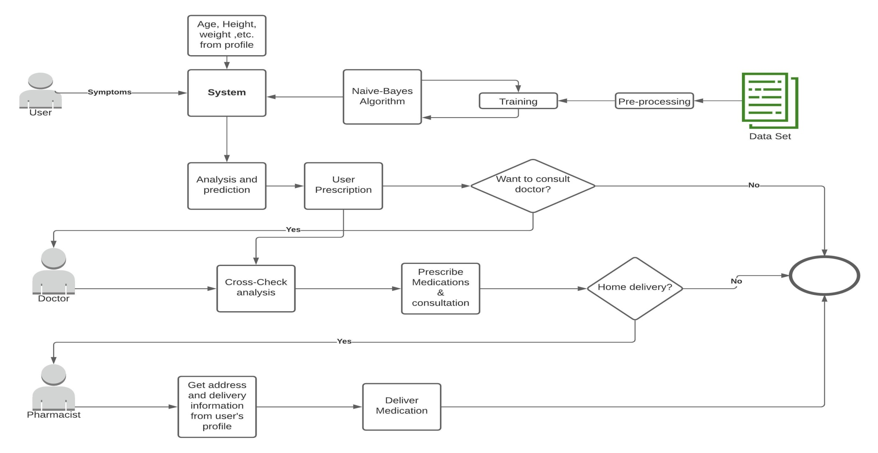
System Flow
4

Slide 5
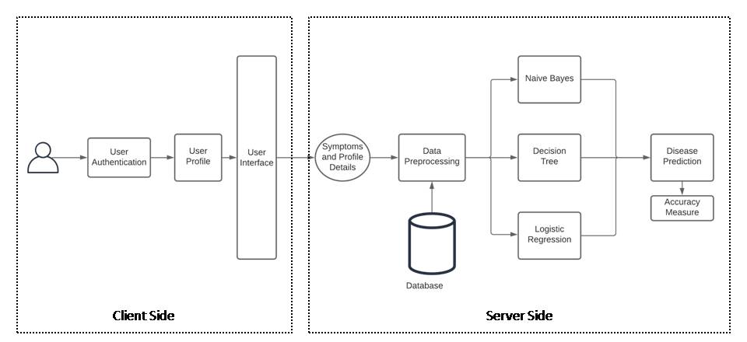
System Architecture
5

Slide 6
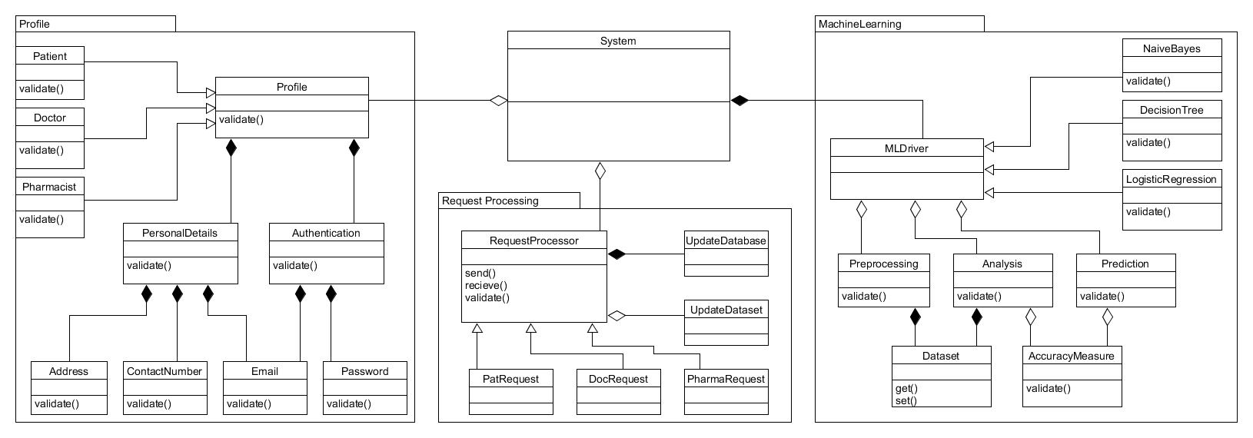
Class Diagram
6

Slide 7
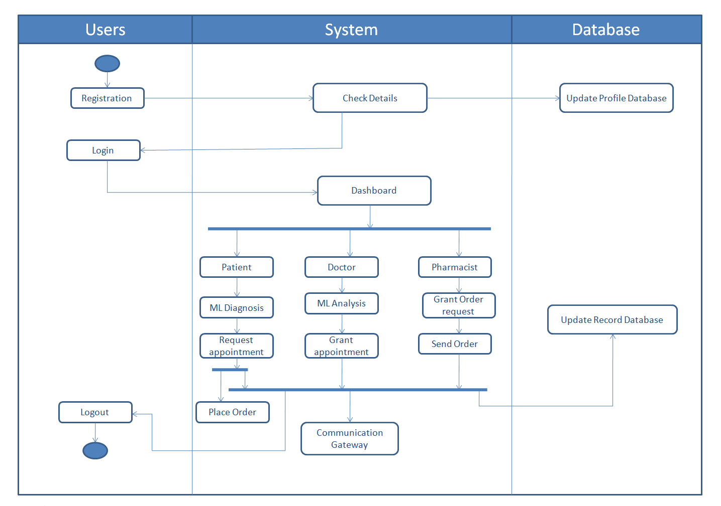
Activity Diagram
7
Notes:
7

Slide 8
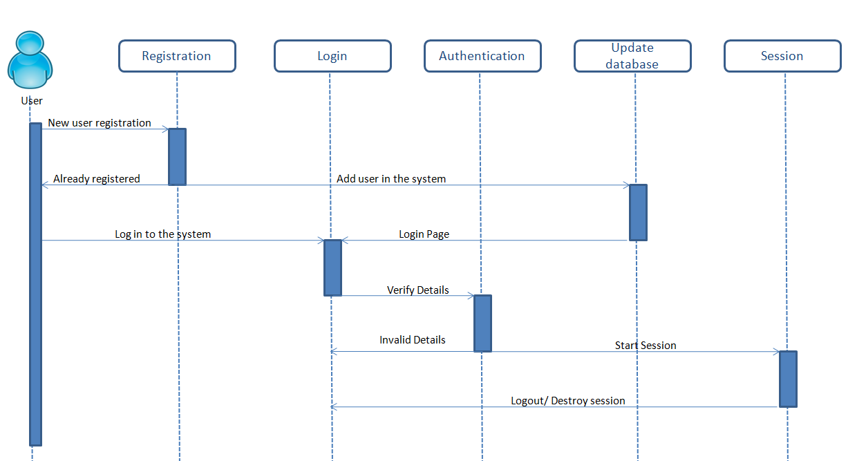
Sequence Diagram
Login
8

Slide 9
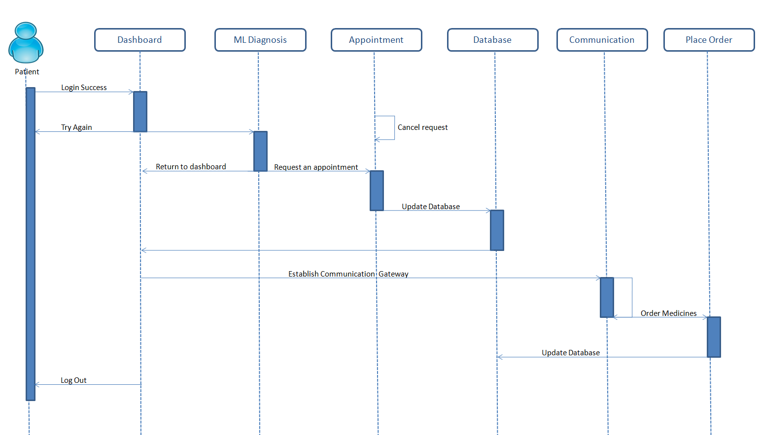
Sequence Diagram
Patient
9

Slide 10
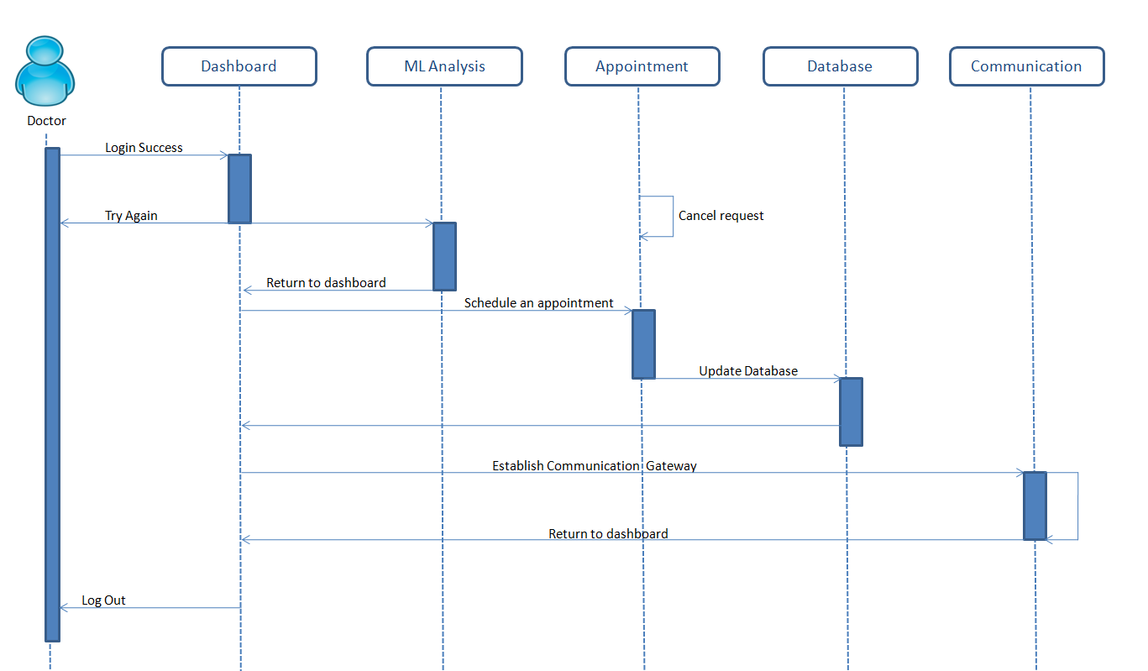
Sequence Diagram
Doctor
10

Slide 11
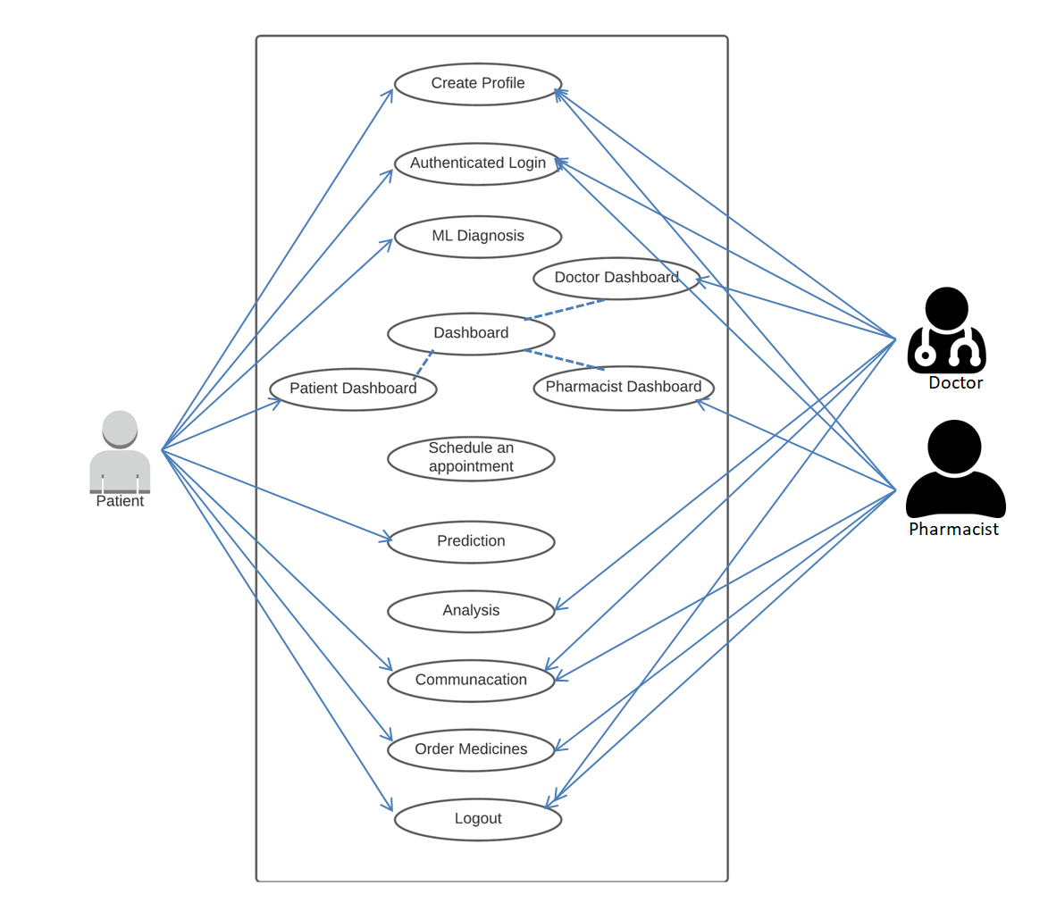
Use Case Diagram
11

Slide 12
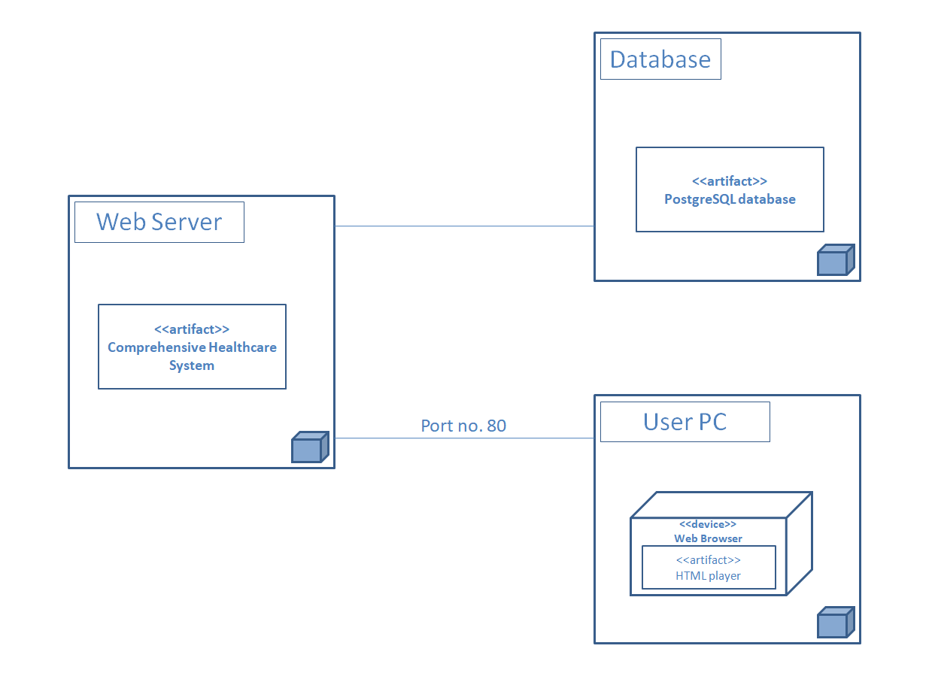
Deployment Diagram
12

Slide 13
IDEA matrix
Idea | Deliverables | Parameters affected
increase | User convenience | Application design
increase | Security | User authentication
avoid | Human negligence and confusion | Negligence and confusion
advance | There is no single platform that houses all the features in one place | Usability
develop | A system housing all the features needed in the healthcare process | Usability
increase | Classification accuracy | Algorithm choice
deliver | A product that provides more efficient healthcare process | Speed
13

Slide 14
Risk prioritization
Sr No | Risk identification | Risk analysis | Risk prioritization | Risk management
1 | Project risk | Change of requirements | Medium | We need to consider this situation.
2 | Technical risk | Patient may get confused while providing Symptoms as input | Low | Raise an alert box as provide specific symtom .
3 | Testing risk | Difficulty or bug in any module. | High | Ensure to design product as a user requirement.
4 | Project risk | Delay in earlier Project phases | High | Ensure project plan is as accurate as possible using scheduling work and time to time meetings.
14

Slide 15
Requirements
Functional Requirements:
User details.
Patient records.
Disease-Symtom database.
15

Slide 16
Requirements
Non-Functional Requirements:
Security : User Authentication.
Usability : Interactive User Interface.
Serviceability : Real-time Communication among different stakeholders.
Reliability : Two-layer Verification.
16

Slide 17
Requirements
Software Requirements:
Python-Django Web Development Framework(version 2.2+).
Web Development Kit - (HTML, CSS, Javascript)
Database : PostgresQL
Operating System : Windows / Linux
Hardware Requirements:
RAM - Minimum 8 GB
Processor – atleast Quad-Core
Space Requirement – Minimum 50 GB Free
17

Slide 18
Implementation and coding
def naïve_baues(df,inp): firstdic={} dfl=len(df) probsum=0 for s in df.iloc[:,-1].unique(): dis=df.loc[ df['prognosis']==s] dis=dis.iloc[:,:-1] dislen=len(dis) pdis=[] flag=0 for i in dis: | count=0 for j in dis[i]: if(j==inp[j]): count+=1 if(count==0): flag=1 pdis.append(count) final_prob=1 asach=0 # print(s) if(flag==0): for i in range(len(pdis)): x=pdis[i]/dislen final_prob*=x | else: dislen+=1 for i in range(len(pdis)): x=(pdis[i]+1)/dislen final_prob*=dislen/dfl firstdic[s]=final_prob probsum+=final_prob firstdic=dict(sorted(firstdic.items(), key=operator.itemgetter(1), reverse=True)) print(firstdic) return firstdic

Slide 19
def knn(countdic,ans,k): anslen=0 for key,v in countdic.items(): v=dict(sorted(v.items(), key=operator.itemgetter(1), reverse=True)) total=0 for i in v.values(): total+=i unique=list(v.keys()) if(total+anslen<=k): | for s in unique: ans[s]+=v[s] v[s]=0 anslen+=total else: while(anslen<k): diff=(k-anslen)//len(unique) if(diff==0): for i in range(k-anslen): if(v[unique[i]]>0): ans[unique[i]]+=1 v[unique[i]]-=1 anslen+=1 else: | for s in unique: ans[s]+=v[s] v[s]=0 anslen+=total else: while(anslen<k): diff=(k-anslen)//len(unique) if(diff==0): for i in range(k-anslen): if(v[unique[i]]>0): ans[unique[i]]+=1 v[unique[i]]-=1 anslen+=1 else:

Slide 20
Testing
Client-side Unit Testing
Test Case | Input | Expected Output
Display/UI module | Server response | Correct fields shown in the UI.
User Authentication | User Login Credentials | Login in the system on correct credentials or reject the request.
User Module | Patient Details or symptoms | Appropriate analysis and prediction of diseases.
Appointment Module | User convenient date and time | User should be able to schedule an appointment on their convenient time.
Doctor Module | Server Request | All patient requests and analyzed symptoms
Doctor Prescription | Doctor’s medicinal input | Generate expected prescription and send that to the patient.
Place Order | Doctors Prescription | Place order to nearest pharmacist as per user request.
Pharmacist Module | Server Request | All incoming medication requests and preferable time of delivery.
Orthopedic Analysis | Biomechanical Values | Doctor should be able to see the apt analysis.
Communication | Intended User and message | Establish a communication path between those users and should be able to send and receive messages.
Analysis | Server Request | Show respected graphs and charts with apt analysis.

Slide 21
2. Server-side Unit Testing
Test Case | Input | Expected Output
HTTP Server | Requests | Responses
Page request | HTTP GET/POST request | Properly rendered dynamic html page response
User Authentication | User login credentials | Credentials validity fetched from database records.
Appointment Module | User convenient date and time | Slot should be booked for those particular users and database should be updated.
Doctor Module | Client Request | All patient requests and analyzed symptoms fetched from database and render in a dynamic HTML page.
Doctor Prescription | Doctor’s medicinal input | Generate expected prescription and update the database accordingly.
Place Order | Patient Request | Search and show nearest pharmacists available and updated the database when order is confirmed.
Pharmacist Module | Client Request | All incoming medication requests along preferable time of delivery and render a proper page with updated database.
Orthopedic Analysis | Biomechanical Values | Analysis of provided values using already trained ML algorithms and properly rendered age with apt result as response.
Communication | Intended User and message | Establish a communication path between those users and should be able to send and receive messages while updating the database for future use.
Analysis | Client Request | Serve respected graphs and charts with apt analysis by using pre-fed data and using ML algorithms.

Slide 22
3. Integration Testing
Integration Testing is defined as a type of testing where software modules are integrated logically and tested as a group. All the pre-tested modules which are already tested as mentioned in unit testing above. These all individual units are then combined one by one and integrated together to make the complete system. The system has been thus ensured to be error free and can sustain even if any single unit fails to cope with the live environment. Integration test cases differed from other test cases in the sense they focused mainly on the interfaces & flow of data/information between the modules. Here priority was given for the integrating links rather than the unit functions which are already tested.

Slide 23
4. Acceptance Testing
Test Case | Expected Output
Accuracy Of the System | High
Ease of use | High
Ease of installation | High
Difficulty in interpreting results | Low
Overall performance/responsiveness | High

Slide 24
Conclusion
As our lifestyle is way to complex and almost everyone gets confused when it comes to health, it should be considered on priority.
In this situation, our proposed system would be a pioneer step to digitalize healthcare system and help common people to understand and take necessary steps.
It would also help increase awareness of healthcare among citizens.
18

Slide 25
References
2020 IEEE International Students’ Conference on Electrical, Electronics and Computer Science "Disease Symptom Analysis Based Department Selection Using Machine Learning for Medical" by Md. Latifur Rahman, Rahad Arman Nabid, and Md. Farhad Hossain.
2020 International Conference for Emerging Technology (INCET) Belgaum, India. Jun 5-7, 2020 "Disease Prediction using Machine Learning Algorithms" by Sneha Grampurohit and Chetan Sagarnal.
2018 International Conference on Computational Science and Computational Intelligence (CSCI) "An Implementation of Naive Bayes Classifier " by Feng-Jen Yang.
19

Slide 26
References
Proceedings of the Second International Conference on Intelligent Computing and Control Systems (ICICCS 2018) "Analysis of Symptoms Wise Disease Inference System Using Data Mining Technique" by Tejal P. Burange and Dr. P. N. Chatur
20

Slide 27
Thank You!

