Slide 1

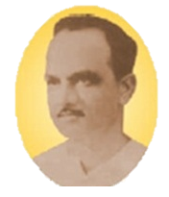
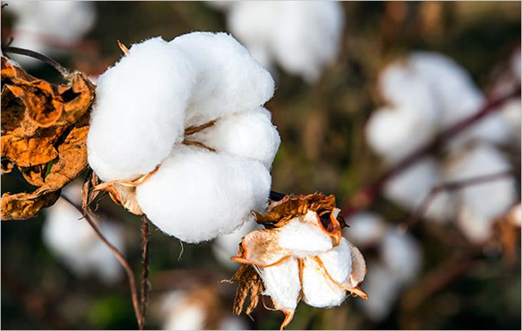
Detection and Identification of cotton pests Using Pytorch
Anantrao Pawar College of Engineering & Research Pune.
Department of Computer Engineering
Internship Presentation
on
Suyog Magar
Suraj Katariya
Saurabh Madake
Aakif Khan
Internship Guide :
Prof. Anil Lohar
Prof.Pranjali More

Slide 2
Contents
Introduction
Problem Statement
Proposed Model
Software Requirements Specifications
Methodology
Architecture
Implementation Work
Technology(Backend Frontend Deployment)
Results/Analysis
Screenshots
Conclusion
References

Slide 3
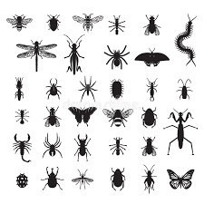
Introduction
Cotton is name given to four species of plants in the genus Gossypium: Gossypium hirsutism for the fluffy fibre which protects the seeds of the plant.
Various pests attack the roots, leaves, stems or fruit of cotton. Growers must be vigilant in locating
these pest outbreaks so that timely control measures can
be undertaken.
For the Correct identification of the Pest, We employed Image Recognition Algorithms specifically CNN of Machine and Deep Learning to train our Module in a Pytorch Environment.

Slide 4
Problem statement & Objectives
Problem statement:
Detection and identification of Cotton Pests using Image Recognition Algorithms
Objectives:
To develop a system that is capable of detecting and identifying the type of pest on cotton crop.
To provide an efficient and accurate methodology for prevention of Cotton Pests.
To provide organic and inorganic information for eradication of cotton pests.

Slide 5
Proposed Model
Use of Deep Learning to Identify Cotton Pests using Pytorch
Creation of Cotton Pest’s Database and loading the Dataset
Creation of Convolutional Neural Network for Pre-Processing and Classification of Pest
Training and Testing of Data to find training loss and Accuracy
Taking Input Image from User
The model will compare the new image with other images in database and recognize it as pest from one of categories.

Slide 6
Software requirement specification
PyTorch: version 1.8.1 and up
Django Framework
Libraries: torch, torchvision, torchtext, Numpy, OpenCV2
Python: version 3.6 and up
NVIDIA CUDA: versions 10.2 and 11.1. or CPU
Operating systems: Windows 10/11, Debian 9, Debian 10, Ubuntu 16.04.7 LTS, and Ubuntu 18.04.5 LTS (x86_64 architecture only)
Web Browser

Slide 7


METHODOLOGICAL DETAILS :
COLLECTION OF DATA
Data and images of different species of cotton pests will be collected and stored in a database. Preventive Measures for each cotton pest will be assembled.
ORGANIZE IN CATEGORIES
DATA TRAINING
The test data will be fed to the model. The model then iterates over the data multiple times and automatically learns the most important features relevant to the images.
Data training:
All the gathered raw data will be processed and organized into different categories based upon type of species and management method.
I/P image:
IMAGE COMPARISON AND CHECK
The image of the pest obtained from the user will be compared with the image database using image recognition algorithms to identify the type of cotton pest.
O/P as CATEGORY
Based upon result from the software model, it’ll suggest the accurate and efficient method for prevention of specific cotton pest.
I/P IMAGE
The image of the pest from the user will be taken as input by the model.

Slide 8
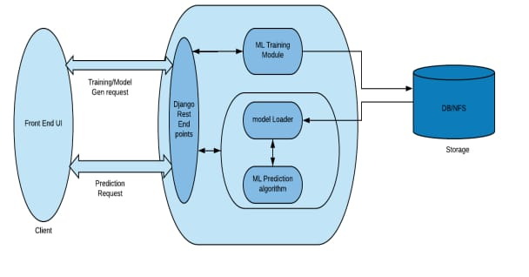
ARCHITCTURE :

Slide 9
IMPLEMENTATION WORK
PHASE 1:Assess the project plan
In this phase, we started by creating a roadmap of the complete project including all the requirements and specifications.
PHASE 2:Execute the plan
Next, we started with Developing a CNN Machine Learning Model to Classify Images into Pests and then Deploying it on a local host as a web app.
PHASE 3:Making changes
Next, we presented our web app to internship Guide and got suggestions to make it more interactive.
PHASE 4:Analyzing project work
We got our work analyzed by the Internship Guide and got their Approval.
PHASE 5:Provide final reports
In this Phase, we Provided final reports, submissions to the concerned people in the form of Presentation, Report Hard Copy and Website Source Code.

Slide 10
TECHNOLOGY
Front-end :
HTML(Hyper Text Markup Language): It is easy to learn and easy to use. It is platform-independent. Images, videos, and audio can be added to a web page. Hypertext can be added to the text. It is a markup language. | Cascading Style Sheets(CSS): Solves a big problem Saves a lot of time Provide more attributes Pages load faster Easier Website maintenance Multiple device compatibility | Javascript(JS): Web pages with interactive elements Developing online and mobile applications Creating web servers and server applications

Slide 11

Back-End :
PYTORCH
PyTorch is a scientific computing framework that offers broad support for machine learning algorithms. It is a Lua based deep learning framework and is used widely amongst industry giants such as Facebook, Twitter, and Google.
Its two primary purpose are :
Replacing Numpy to use the power of GPUs for faster computation.
Calculating gradients to perform backpropagation on neural networks.

Slide 12
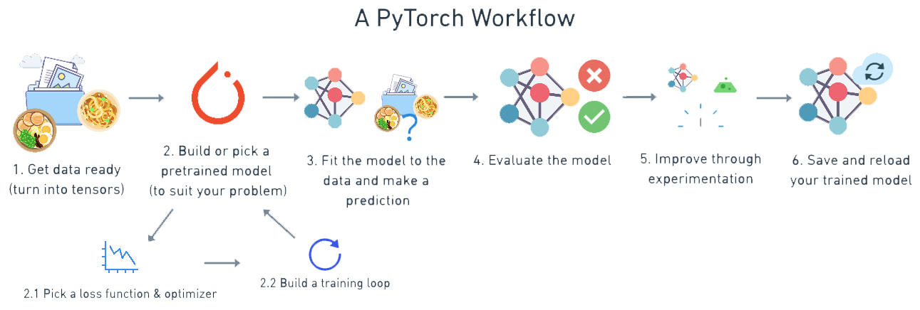
Why PYTORCH ?
Excellent at rapid prototyping
Strong support for GPUs as parallel programs can be implemented on multiple GPUs
Provides cleaner interface and is easier to use and learn.
Facilitates the exchange of data with external libraries
Useful Libraries
Easy to Debug

Slide 13
PYTORCH
Limitations:
It has been released in 2016, so it’s new compared to others and has fewer users, and is not widely known.
Absence of monitoring and visualization tools like a tensor board.
The developer community is small compared to other frameworks
Advantages:
Rich set of powerful APIs to extend the Pytorch Libraries.
It is flexible, faster, and provides optimizations.
It has support for GPU and CPU.
It supports cloud platforms.
Applications:
Computer Vision
Reinforcement Learning
Natural Language Processing

Slide 14
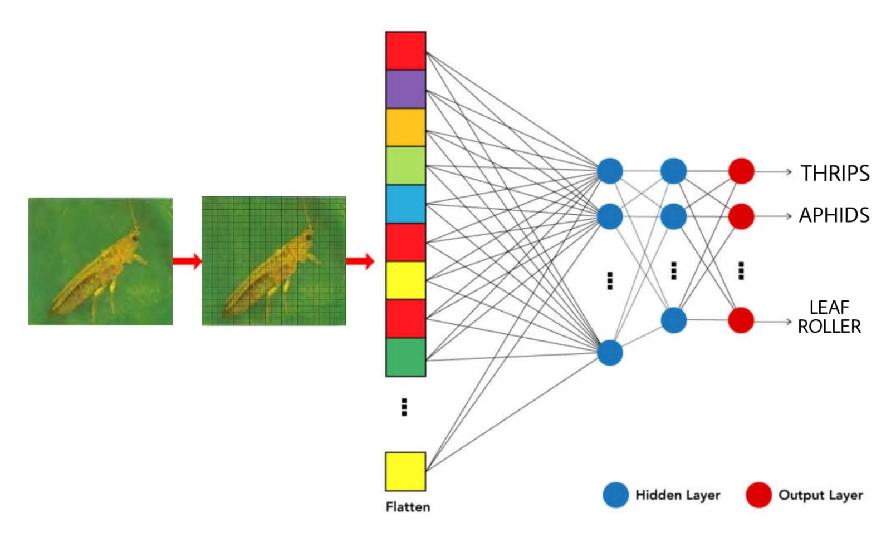
Convolutional Neural Network (CNN):
How does Convolutional Layer work?
The convolutional layer’s parameters consist of a set of learnable filters (or kernels), which have a small receptive field. These filters scan through image pixels and gather information in the batch of pictures/photos. Convolutional layers convolve the input and pass its result to the next layer. This is like the response of a neuron in the visual cortex to a specific stimulus.
CNN LAYER STRUCTURE

Slide 15
Applications
Analyzing documents
Predicting Climate change, Earthquakes and Natural Disasters
Decoding Facial Recognition
Advantages:
Powerful and accurate way of solving classification problems.
Automatically detects the important features without any human supervision
Limitations:
Lots of training data is required
It does not encode the position and orientation of objects

Slide 16
DEPLOYMENT:
Django
It is a Python-based web framework that allows you to quickly create efficient web applications. When you’re building a website, you always need a similar set of components: a way to handle user authentication, a management panel for your website, forms, a way to upload files, etc. Django gives you ready-made components to use and that too for rapid development.
Why Django?
Django is a rapid web development framework.
Django is fully functional framework that requires nothing else.
Excellent documentation and high scalability.
Used by Top MNCs and Companies, such as Instagram, Disqus, Spotify, YouTube, Bitbucket, Dropbox, etc.
Easiest Framework to learn, rapid development and Batteries fully included.

Slide 17
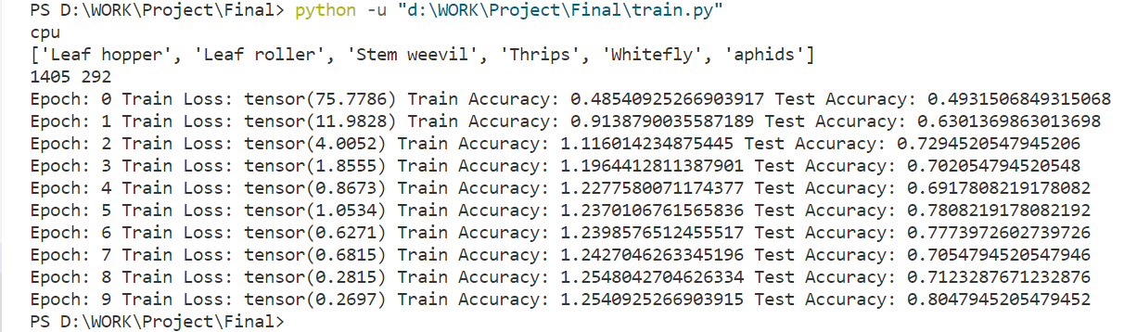
Results/Analysis
A CNN-based image classifier is ready, and it gives 80% accuracy. As per the graph below, training loss decrease exponentially as the epochs increase. The losses are in line with each other as seen in the figure, which proves that the model is reliable and there is no underfitting or overfitting of the model.

Slide 19

SCREENSHOTS
Click here to choose an image

Slide 20
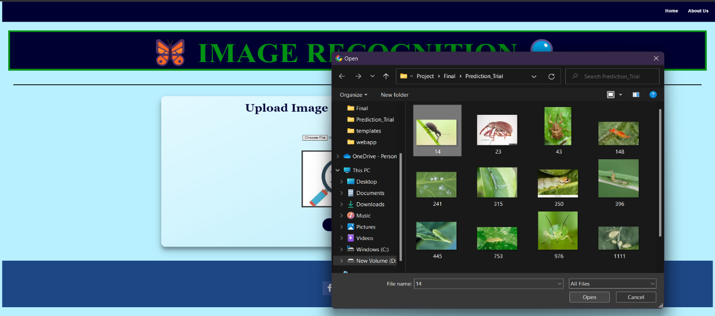
Browse the image from your device for prediction

Slide 21

After selecting image, it comes into view
Submit the image to get prediction

Slide 22
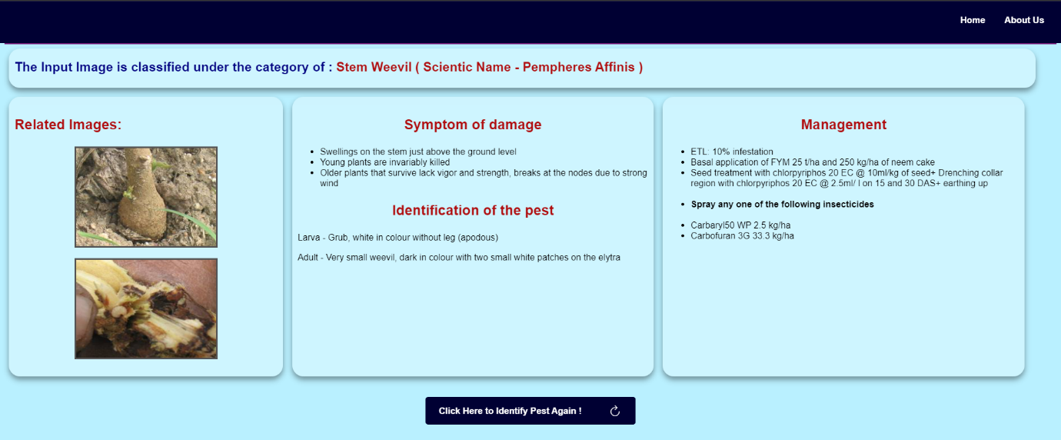
Click here to identify another pest

Slide 23

Conclusion
We have learnt about image processing, image recognition techniques and web designing.
This project has paved a way for problem identification, its management and providing a reliable solution for the same.

Slide 24
References
[1] M Manoj krishna, M Neelima, Harshali Mane( K L University), Gopala Rao Matcha(K L University) – “Image classification using Deep learning”(March 2018)
[2 ] Z. Yan, V. Jagadeesh, D. Decoste, et al., HD-CNN: hierarchical deep convolutional neural network for image classification. Eprint Arxiv 4321-4329 (2014).
[3] C. Zhang, X. Pan, H. Li, et al., A hybrid MLP-CNN classifier for very fine resolution remotely sensed image classification. Isprs Journal of Photogrammetry & Remote Sensing 140, 133–144 (2018).
[4] S. Roychowdhury, J. Ren, Non-deep CNN for multi-modal image classification and feature learning: an azure-based model (IEEE international conference on big data. IEEE, Washington, D.C., 2017), pp. 2893–2812.
[5] The Research of Intelligent Image Recognition Technology Based on Neural Network LI Huanliang1,a1 Yishui Campus of Linyi University, Yishui 276400, China
[6] Adam Paszke ,Sam Gross ,Francisco Massa ,Adam Lerer(Meta) - PyTorch: An Imperative Style, High-Performance Deep Learning Library (December 2019)[6]https://www.educba.com/what-is-pytorch/
[7]https://www.analyticsvidhya.com/blog/2021/06/image-processing-using-cnn-a-beginners-guide/
[8]https://nanonets.com/image-recognition
[9]https://www.geeksforgeeks.org/image-classifier-using-cnn/
[10]https://www.analyticsvidhya.com/blog/2021/06/image-classification-using-convolutional-neural-network-with-python/
[11]https://docs.microsoft.com/en-us/windows/ai/windows-ml/tutorials/pytorch-train-model
[12]https://www.pluralsight.com/guides/image-classification-with-pytorch
[13]https://github.com/bentrevett/pytorch-image-classification

Slide 25
THANK YOU!
Any questions?

