Slide 1

Visual Question Answering With Scene Graphs
By
Saurabh Madake
712352023
Guided by
Prof. A. B. Patil
COEP Tech Pune
COEP Technological University
A Unitary Public University of Govt. of Maharashtra
Formerly College of Engineering Pune

Slide 2
Index
Introduction
Objectives
Limitations Of Traditional VQA Models
Scene Graph And Their Role In VQA
Dataset Used
Model Architecture
Implementation
Results
Timeline
COEP Technological University
A Unitary Public University of Govt. of Maharashtra
Formerly College of Engineering Pune

Slide 3
Introduction
Visual Question Answering (VQA) is a challenging task at the intersection of computer vision and natural language processing (NLP) that enables machines to understand and respond to questions about visual content. As an AI-complete problem, VQA requires deep reasoning over both textual and visual modalities, making it a crucial benchmark for evaluating advanced AI models.
VQA has significant applications across various domains, including assistive AI for visually impaired individuals, enhancing human-computer interaction, and medical imaging analysis. By enabling AI models to answer questions about images, VQA plays a key role in autonomous systems, educational tools, and intelligent surveillance.
Traditional approaches to VQA relied on separate pipelines for processing textual and visual data, often leading to suboptimal integration and limited reasoning capabilities. However, recent advancements in transformer-based architectures, such as LXMERT, have revolutionized this process by effectively learning joint representations of image and text, improving contextual understanding and reasoning abilities.
COEP Technological University
A Unitary Public University of Govt. of Maharashtra
Formerly College of Engineering Pune

Slide 4
Objectives
To enhance the capabilities of visual question answering (VQA) systems
Improving their accuracy and efficiency through the exploration of advanced multimodal transformer architectures, while providing insights and guidelines for handling multimodal data that can inform future research in VQA and related fields
To investigate the impact of combining VQA v2.0 with Visual Genome data, specifically focusing on how enriched object relationships and attributes from Visual Genome improve question-answering performance.
To evaluate the performance of the LXMERT model on the both dataset and compare it with other baseline models in terms of accuracy and efficiency.
COEP Technological University
A Unitary Public University of Govt. of Maharashtra
Formerly College of Engineering Pune

Slide 5
Limitations of Traditional VQA Models
Lack of Explicit Relational Reasoning: Existing models primarily rely on deep learning but struggle to explicitly capture relationships between objects.
Difficulty with Object Relationships: Questions requiring understanding of spatial and semantic relationships (e.g., "Who is holding the umbrella?") remain challenging.
Dependence on Large-Scale Datasets: Models rely heavily on vast datasets to learn implicit reasoning, often lacking true generalization.
Challenges in Understanding Object Relationships: AI models find it difficult to grasp complex spatial and contextual associations.
Struggles with Complex Reasoning: Many questions demand multi-step logical inference and external knowledge, which current models fail to handle effectively.
COEP Technological University
A Unitary Public University of Govt. of Maharashtra
Formerly College of Engineering Pune

Slide 6
Scene Graphs & Their Role in VQA
What Are Scene Graphs?
A structured representation of an image where:
Objects (Nodes) → e.g., dog, ball, man
Relationships (Edges) → e.g., "dog chasing ball", "man holding umbrella“
How Scene Graphs Improve VQA?
Explicit Relationship Understanding – Instead of inferring from raw pixels, the model directly processes object interactions. Better Question-Answer Mapping – Questions like "What is under the table?" are directly linked to object relationships. Reduced Data Dependency – Structured knowledge minimizes reliance on massive datasets. Improved Generalization – The model learns reusable object-relation structures rather than memorizing patterns.
Efficient Attention Mechanisms – Focuses on relevant objects and interactions, reducing computational overhead.
COEP Technological University
A Unitary Public University of Govt. of Maharashtra
Formerly College of Engineering Pune

Slide 7
Dataset Used
Visual Genome
VQA v2.0 Dataset
Answers | List of 10 human annotated answers
Question ID | Unique identifier for each question
Image ID | Unique identifier for each image
Question | The natural language question about the image
Image Features | Extracted image feature vectors from Faster R-CNN Array of shape (N, 4), N varies
Answers | 1 human annotated answer
Question ID | Unique identifier for each question
Image ID | Unique identifier for each image
Question | The natural language question about the image
Image Features | Extracted image feature vectors from Faster R-CNN Array of shape (N, 4), N varies
Total Entries | Number of QA pairs per image 3-5 Number of unique images in Train: 82783 Validation: 40504 Total: Training: 443744 Validation: 214336
Total Entries | Number of QA pairs per image ~17 avg Number of unique images in Train: 64346 Validation: 43903 Total Used: Training: 443744 Validation: 214336
COEP Technological University
A Unitary Public University of Govt. of Maharashtra
Formerly College of Engineering Pune

Slide 8
JSON File | Key Fields
Attributes | Image id: ID of the image objects: List of objects with attributes object id: Unique ID for each object names: List of object names attributes: List of attribute labels for the object Bounding box (coordinates defining object location)
Relationships | Image id: ID of the image relationships: List of relationships subject: Object initiating the relationship predicate: Relationship type (e.g., "on", "next to") object: Object receiving the relationship Bounding boxes for both subject and object
COEP Technological University
A Unitary Public University of Govt. of Maharashtra
Formerly College of Engineering Pune

Slide 9
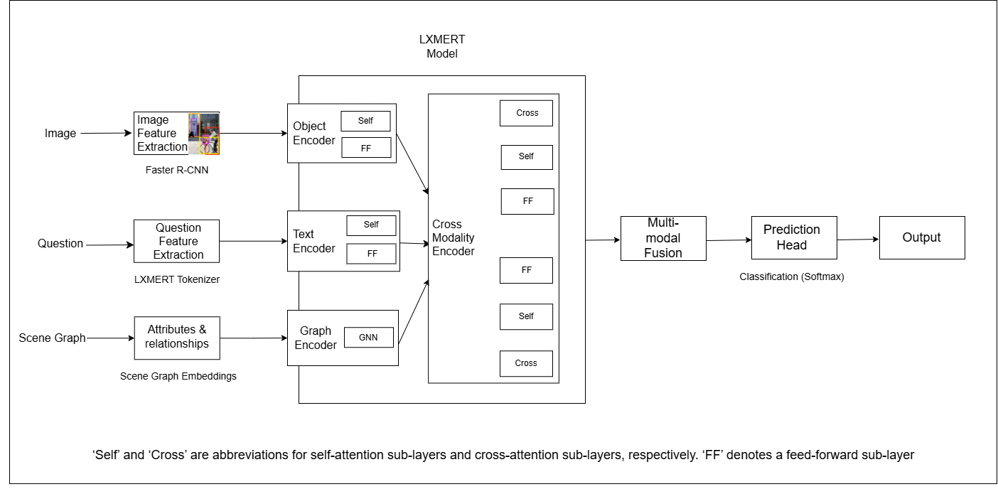
Model Architecture
LXMERT Model with Scene Graphs
COEP Technological University
A Unitary Public University of Govt. of Maharashtra
Formerly College of Engineering Pune

Slide 10
Implementation
The model is trained in two phases before combining them using CBMS
Model Combination Strategy
Confidence-Based Model Selection (CBMS) for VQA & Scene Graph (SG) Models
How It Works:
Compute Confidence Scores
Each model generates logits (raw prediction scores before SoftMax).
Convert logits to probabilities using SoftMax.
Extract the highest probability as the confidence score.
Select the More Confident Model for Final Prediction
If Confidence_VQA > Confidence_SG, use the VQA model’s answer.
Otherwise, use the Scene Graph model’s answer.
Why This Approach?
The VQA model performs better on direct visual questions (e.g., "What colour is the car?").
The Scene Graph model is superior for relational queries (e.g., "Who is sitting next to the woman?").
By dynamically selecting the more confident model per question, we get the best of both models.
COEP Technological University
A Unitary Public University of Govt. of Maharashtra
Formerly College of Engineering Pune

Slide 11
Results
Dataset | Input | Training
VQAv2.0 | Q + A + I | 28%
VG | Q + A + I | 29%
VG + SG | Q + A + I + A + R | 39%
Observations:
Baseline Performance (VQA v2.0 & VG)
Training accuracy for VQA v2.0 and Visual Genome remained close (~28-29%), showing similar learning capacity.
Validation accuracy was lower (24-25%), indicating overfitting on training data.
Impact of Scene Graphs (VG + Scene Graph)
Training accuracy jumped to 39%, proving that structured relationships help the model learn object dependencies better.
However, validation accuracy remained similar (23%), suggesting a need for better generalization strategies.
COEP Technological University
A Unitary Public University of Govt. of Maharashtra
Formerly College of Engineering Pune

Slide 12
Results
Dataset | Accuracy
VQAv2.0 Sample1k | ~43%
Visual Genome Sample1k | ~59%
Final Model Performance (VQA + Scene Graph Model)
Accuracy Improvement
The final VQA + Scene Graph model outperformed the standalone models on both datasets.
VQA v2.0 accuracy increased from 25% → 43%, proving that scene graphs enhance reasoning capabilities.
Visual Genome accuracy improved significantly (59%), showing that scene graphs are highly effective in datasets rich in relational information.
Generalization & Challenges
While accuracy increased, validation accuracy did not improve drastically (23%), indicating potential domain shift issues.
This suggests that while scene graphs help in understanding relationships, there is a need for better fine-tuning strategies for diverse question types.
COEP Technological University
A Unitary Public University of Govt. of Maharashtra
Formerly College of Engineering Pune

Slide 13
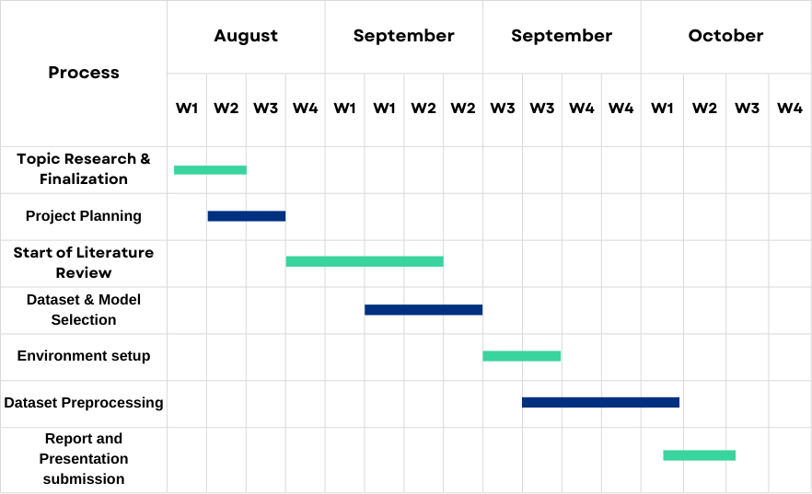
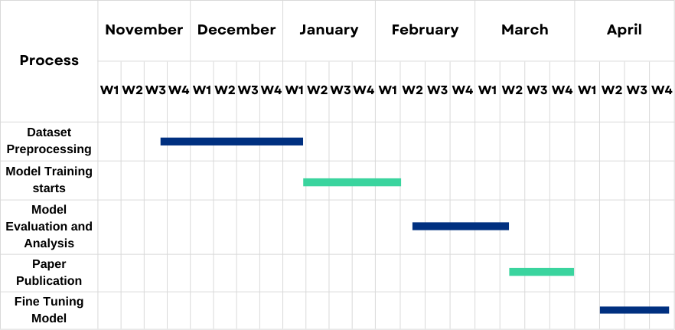
Timeline
COEP Technological University
A Unitary Public University of Govt. of Maharashtra
Formerly College of Engineering Pune

Slide 14
References:
Tan, H. and Bansal, M., 2019. Lxmert: Learning cross-modality encoder representations from transformers. arXiv preprint arXiv:1908.07490.
Li, L.H., Yatskar, M., Yin, D., Hsieh, C.J. and Chang, K.W., 2019. Visualbert: A simple and performant baseline for vision and language. arXiv preprint arXiv:1908.03557.
Lu, J., Batra, D., Parikh, D. and Lee, S., 2019. Vilbert: Pretraining task-agnostic visiolinguistic representations for vision-and-language tasks. Advances in neural information processing systems, 32.
Rekanar, K., Hayes, M., Sistu, G. and Eising, C., 2024. Optimizing Visual Question Answering Models for Driving: Bridging the Gap Between Human and Machine Attention Patterns. arXiv preprint arXiv:2406.09203.
Huang, Z., Zeng, Z., Liu, B., Fu, D. and Fu, J., 2020. Pixel-bert: Aligning image pixels with text by deep multi-modal transformers. arXiv preprint arXiv:2004.00849.
Wang, Jianfeng & Seng, Kah & Shen, Yi & Ang, Li-Minn & Huang, Difeng. (2024). Image to Label to Answer: An Efficient Framework for Enhanced Clinical Applications in Medical Visual Question Answering. Electronics. 13. 2273. 10.3390/electronics13122273.
Tito, R., Karatzas, D. and Valveny, E., 2023. Hierarchical multimodal transformers for multipage docvqa. Pattern Recognition, 144, p.109834.
COEP Technological University
A Unitary Public University of Govt. of Maharashtra
Formerly College of Engineering Pune

Slide 15
Khan, A.U., Mazaheri, A., Lobo, N.D.V. and Shah, M., 2020. Mmft-bert: Multimodal fusion transformer with bert encodings for visual question answering. arXiv preprint arXiv:2010.14095.
Kim, W., Son, B. and Kim, I., 2021, July. Vilt: Vision-and-language transformer without convolution or region supervision. In International conference on machine learning (pp. 5583-5594). PMLR.
Siebert, T., Clasen, K.N., Ravanbakhsh, M. and Demir, B., 2022, October. Multi-modal fusion transformer for visual question answering in remote sensing. In Image and Signal Processing for Remote Sensing XXVIII (Vol. 12267, pp. 162-170). SPIE.
J. Wu, F. Ge, P. Shu, L. Ma and Y. Hao, "Question-Driven Multiple Attention(DQMA) Model for Visual Question Answer," 2022 International Conference on Artificial Intelligence and Computer Information Technology (AICIT), Yichang, China, 2022, pp. 1-4, doi: 10.1109/AICIT55386.2022.9930294.
Z. Shao et al., "Visual Explanation for Open-Domain Question Answering With BERT," in IEEE Transactions on Visualization and Computer Graphics, vol. 30, no. 7, pp. 3779-3797, July 2024, doi: 10.1109/TVCG.2023.3243676.
S. Ravi, A. Chinchure, L. Sigal, R. Liao and V. Shwartz, "VLC-BERT: Visual Question Answering with Contextualized Commonsense Knowledge," 2023 IEEE/CVF Winter Conference on Applications of Computer Vision (WACV), Waikoloa, HI, USA, 2023, pp. 1155-1165, doi: 10.1109/WACV56688.2023.00121.
D. Amin, S. Govilkar and S. Kulkarni, "Visual Question Answering System for Indian Regional Languages," 2022 5th International Conference on Advances in Science and Technology (ICAST), Mumbai, India, 2022, pp. 22-27, doi: 10.1109/ICAST55766.2022.10039528.
COEP Technological University
A Unitary Public University of Govt. of Maharashtra
Formerly College of Engineering Pune

Slide 16
Kodali, V. and Berleant, D., 2022, May. Recent, rapid advancement in visual question answering: a review. In 2022 IEEE International Conference on Electro Information Technology (eIT) (pp. 139-146). IEEE.
Chen, Y.C., Li, L., Yu, L., El Kholy, A., Ahmed, F., Gan, Z., Cheng, Y. and Liu, J., 2020, August. Uniter: Universal image-text representation learning. In European conference on computer vision (pp. 104-120). Cham: Springer International Publishing.
Kim, W., Son, B. and Kim, I., 2021, July. Vilt: Vision-and-language transformer without convolution or region supervision. In International conference on machine learning (pp. 5583-5594). PMLR
COEP Technological University
A Unitary Public University of Govt. of Maharashtra
Formerly College of Engineering Pune

Slide 17
THANK YOU !
COEP Technological University
A Unitary Public University of Govt. of Maharashtra
Formerly College of Engineering Pune

