Slide 1
Enhancing Visual Question Answering through Bi-Modal Feature Fusion: Performance Analysis
IPMV 2024
Reporter: MAO KEYU
Fudan University
School of Data Science

Slide 2
01
Introduction
02
Methodology
CONTENTS
03
Training and Experiment
04
Results and Conclusion

Slide 3
Part 01
Introduction

Slide 4
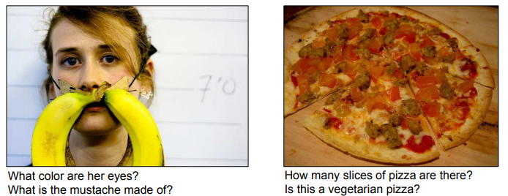
1.1 Topic Introduction: Vision Question Answering
01
01
In general, VQA is a unique focus in computer vision and natural language processing. It involves developing models that understand visual content well enough to provide responses resembling human understanding.
02
In a more specific situation, VQA involves comparing a picture and a related question in everyday language, making the computer generate a precise answer. Clearly, this setup is a typical challenge that combines techniques from computer vision and language understanding. The computer system needs to be good at understanding both pictures and written language at the same time.
03
VQA remains an inherently novel realm of research. Many research focus on the enhancement of feature extractor and fusion strategy.
Antol S, Agrawal A, Lu J, et al. Vqa: Visual question answering[C]//Proceedings of the IEEE international conference on computer vision. 2015: 2425-2433.

Slide 5
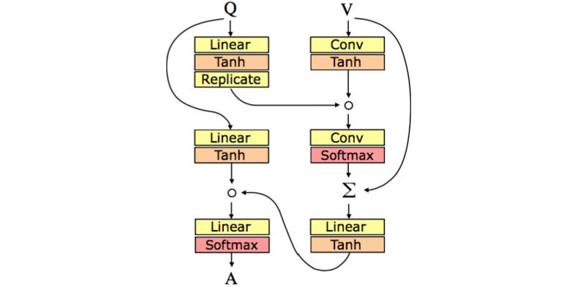
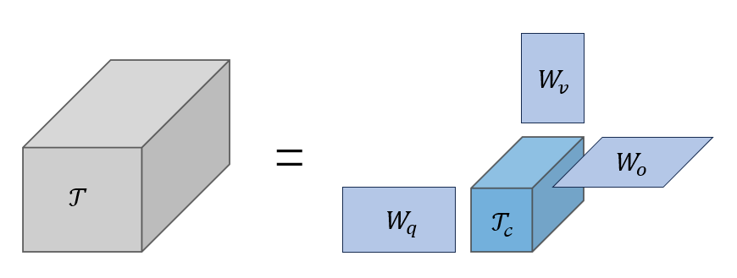
1.2 Research Background
01
While many researchers focus on understanding the basic structures of models, a significant group also acknowledges the crucial importance of fusion strategies in the VQA task.
Starting with the influential work of Kim et al., who introduced a simple but effective fusion method in their work, several researchers have followed their lead, elaborating on and improving fusion concepts.
For example, Hedi Ben-younes et al. explore tensor decomposition, resulting in an exceptional fusion technique named MUTAN(Multimodal Tucker Fusion for VQA), which makes use of Tucker Decomposition, and a modified version called BLOCK.
Hadamard Product for Bilinear Pooling
Kim J H, On K W, Lim W, et al. Hadamard product for low-rank bilinear pooling[J]. arXiv preprint arXiv:1610.04325, 2016.
Tucker Decomposition for Bilinear Pooling
Ben-Younes H, Cadene R, Cord M, et al. Mutan: Multimodal tucker fusion for visual question answering[C]//Proceedings of the IEEE international conference on computer vision. 2017: 2612-2620.

Slide 6
1.3 Main Contributions
01
In our research project, we outline our contributions as follows:
1. Strategic Model Foundation:
Our model's architecture is based on a strong baseline in the VQA domain, established by Kazemi et al. We modify the baseline and integrate some new components in to the basic structure.
2. Fusion Methodology Exploration:
A key focus of our investigation is the exploration of fusion methods that bring together two modalities: textual and visual. We examine a variety of fusion techniques and, through careful analysis, highlight the unique strengths inherent in each approach.
3. Benchmarking and Comparative Evaluation:
To conclude our study, we conduct a thorough benchmarking process. This involves selecting high-performing models from the VQA landscape as our baselines. We then perform comprehensive comparisons based on VQA task metrics. These evaluations cover three question categories: binary responses, numerical solutions, and general responses. Through this comparative analysis, we aim to clarify the nuanced performance differences across these diverse question types.

Slide 7
Part 02
Methodology

Slide 8
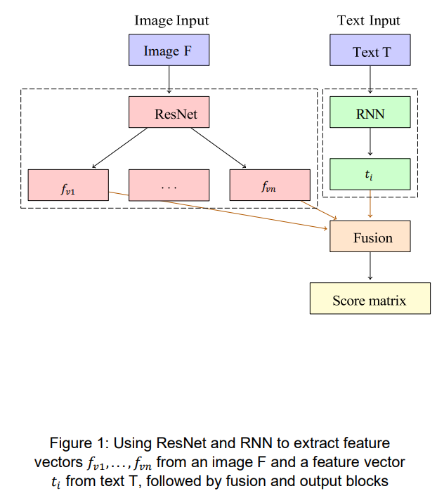
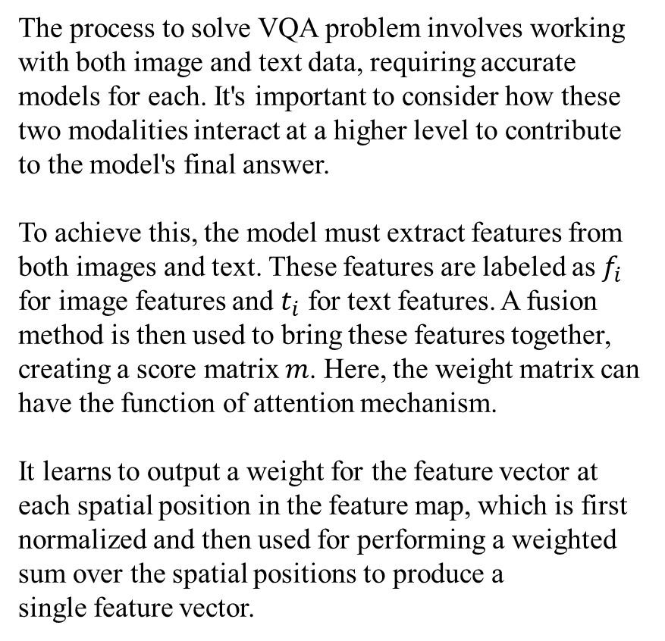
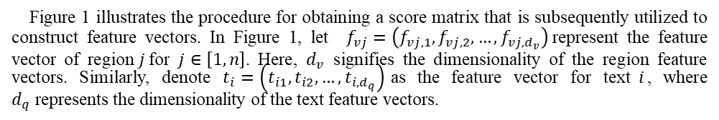
2.1 Task Definition
02
The process to solve VQA problem involves working with both image and text data, requiring accurate models for each. It's important to consider how these two modalities interact at a higher level to contribute to the model's final answer.
To achieve this, the model must extract features from both images and text. These features are labeled as $f_{i}$ for image features and $t_{i}$ for text features. A fusion method is then used to bring these features together, creating a score matrix $m$. Here, the weight matrix can have the function of attention mechanism.
It learns to output a weight for the feature vector at each spatial position in the feature map, which is first
normalized and then used for performing a weighted sum over the spatial positions to produce a
single feature vector.
Figure 1 illustrates the procedure for obtaining a score matrix that is subsequently utilized to construct feature vectors. In Figure 1, let $f_{vj}=\left(f_{vj,1},f_{vj,2},…,f_{vj,d_{v}}\right)$represent the feature vector of region$j$for $j∈\left[1,n\right]$. Here, $d_{v}$ signifies the dimensionality of the region feature vectors. Similarly, denote $t_{i}=\left(t_{i1},t_{i2},…,t_{i,d_{q}}\right)$as the feature vector for text$i$, where $d_{q}$represents the dimensionality of the text feature vectors.

Slide 9
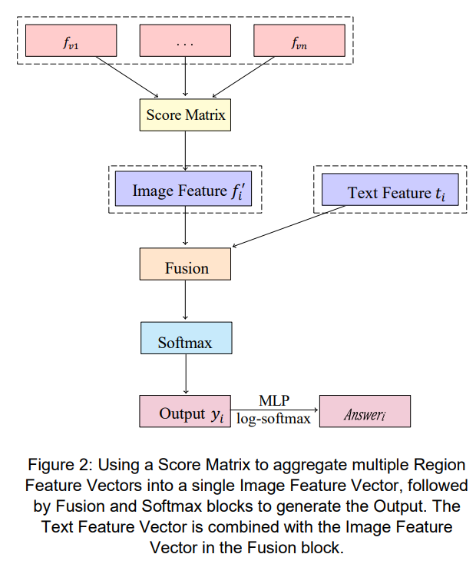
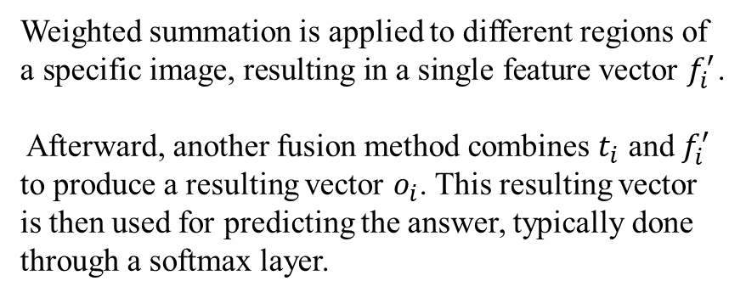
2.1 Task Definition
02
Weighted summation is applied to different regions of a specific image, resulting in a single feature vector $f_{i}^{′}$.
Afterward, another fusion method combines $t_{i}$ and $f_{i}^{′}$ to produce a resulting vector $o_{i}$. This resulting vector is then used for predicting the answer, typically done through a softmax layer.
In Figure 2, the final output is obtained by passing the input through a softmax layer followed by an MLP and a log-softmax function. This process allows us to obtain a predicted answer. The predicted answer can then be compared with the ground truth, and the model can be modified accordingly based on this comparison.

Slide 10
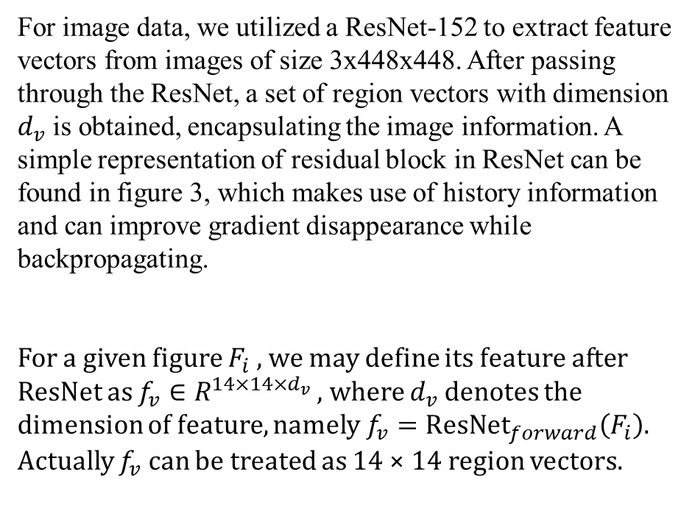
2.2 Image Feature Extraction
02
For image data, we utilized a ResNet-152 to extract feature vectors from images of size 3x448x448. After passing through the ResNet, a set of region vectors with dimension $d_{v}$ is obtained, encapsulating the image information. A simple representation of residual block in ResNet can be found in figure 3, which makes use of history information and can improve gradient disappearance while backpropagating.
For a given figure $F_{i}$, we may define its feature after ResNet as $f_{v}∈R^{14×14×d_{v}}$, where $d_{v}$ denotes the dimension of feature, namely$f_{v}={\text{ResNet}}_{forward}\left(F_{i}\right)$. Actually $f_{v}$ can be treated as 14 × 14 region vectors.
Input
Conv1
Conv2
+
Output
Figure 3: Residual block structure

Slide 11
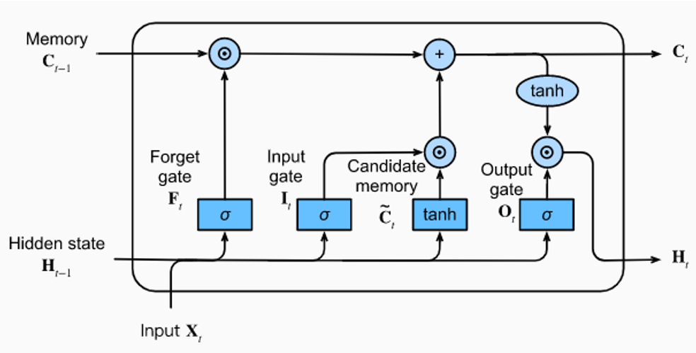

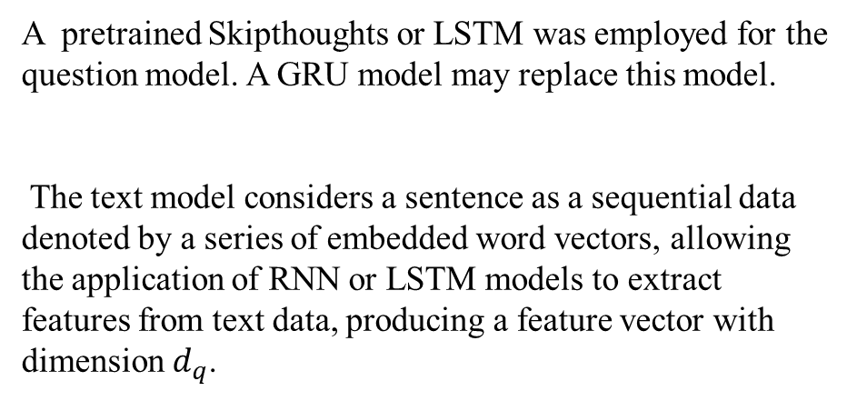
2.3 Text Feature Extraction
02
LSTM:
Where:
$F_{t}=σ\left(W_{f}X_{t}+U_{f}H_{t−1}+b_{F}\right)$
$I_{t}=σ\left(W_{i}X_{t}+U_{i}H_{t−1}+b_{I}\right)$
$O_{t}=σ\left(W_{o}X_{t}+U_{o}H_{t−1}+b_{O}\right)$
$\tilde{C_{t}}=\text{tanh}\left(W_{c}X_{t}+U_{c}H_{t−1}+b_{C}\right)$
$C_{t}=F_{t}⊙C_{t−1}+I_{t}⊙\tilde{C_{t}}$
$H_{t}=O_{t}⊙\text{tanh}\left(C_{t}\right)$
A pretrained Skipthoughts or LSTM was employed for the question model. A GRU model may replace this model.
The text model considers a sentence as a sequential data denoted by a series of embedded word vectors, allowing the application of RNN or LSTM models to extract features from text data, producing a feature vector with dimension $d_{q}$.

Slide 12
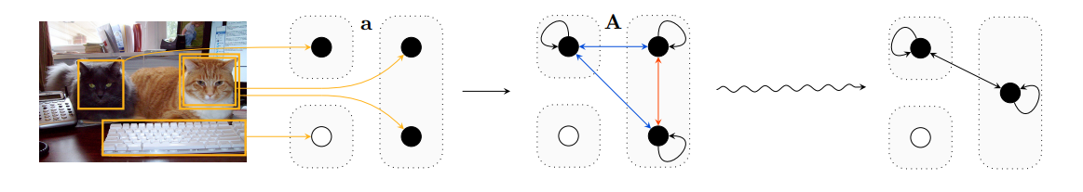
2.4 Counting Component
02
We've incorporated the counting component suggested by Yan Zhang and colleagues in their study titled "Learning To Count Objects In Natural Images For Visual Question Answering."
Professor Zhang highlights that relying solely on spatial attention can restrict a model's counting ability. To address this limitation, they introduced a differentiable counting mechanism based on attention weights. Additionally, they tackled the issue of overlapping object proposals to minimize the risk of double-counting objects.
Zhang Y, Hare J, Prügel-Bennett A. Learning to count objects in natural images for visual question answering[J]. arXiv preprint arXiv:1802.05766, 2018.

Slide 13
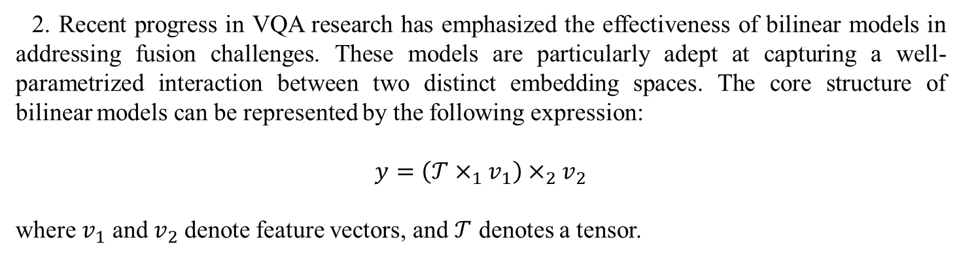
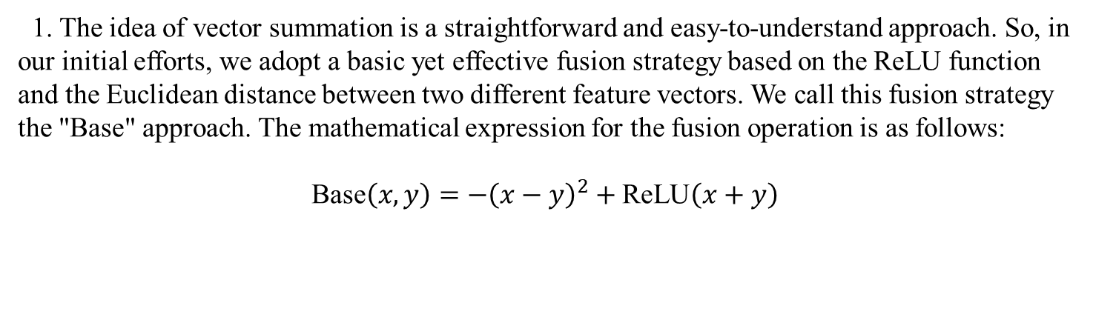
2.5 Fusion Strategy
02
1. The idea of vector summation is a straightforward and easy-to-understand approach. So, in our initial efforts, we adopt a basic yet effective fusion strategy based on the ReLU function and the Euclidean distance between two different feature vectors. We call this fusion strategy the "Base" approach. The mathematical expression for the fusion operation is as follows:
$$\text{Base}\left(x,y\right)=−{\left(x−y\right)}^{2}+\text{ReLU}\left(x+y\right)$$
2. Recent progress in VQA research has emphasized the effectiveness of bilinear models in addressing fusion challenges. These models are particularly adept at capturing a well-parametrized interaction between two distinct embedding spaces. The core structure of bilinear models can be represented by the following expression:
$$y=\left(𝒯×_{1}v_{1}\right)×_{2}v_{2}$$
where $v_{1}$ and $v_{2}$ denote feature vectors, and $𝒯$ denotes a tensor.

Slide 14

2.5.2 Bilinear Fusion Strategy Based on Tucker Decomposition
02
Tucker Decomposition helps to break down the tensor into several components: Core Tensor and Factor Matrices. The Core Tensor serves as a concise portrayal of the primary relationships and inter-connections among the dimensions within the original tensor.
$$𝒯_{i,j,k}=\sum_{a,b,c}{𝒯_{c}\left[a,b,c\right]W_{q}\left[i,a\right]W_{v}\left[j,b\right]W_{o}\left[k,c\right]}$$

Slide 15

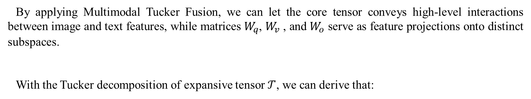
2.5.2 Bilinear Fusion Strategy Based on Tucker Decomposition
02
By applying Multimodal Tucker Fusion, we can let the core tensor conveys high-level interactions between image and text features, while matrices $W_{q}$, $W_{v}$ , and $W_{o}$ serve as feature projections onto distinct subspaces.
With the Tucker decomposition of expansive tensor $𝒯$, we can derive that:
$$\tilde{z}=\left(𝒯_{𝒸}×_{1}W_{q}v_{1}\right)×_{2}W_{v}v_{2}$$
$y=W_{o}\tilde{z}∈R^{\left|𝒜\right|}$
Where $v_{1}$ and $v_{2}$denote the feature vector of texts and images. $\left|𝒜\right|$ denotes the dimension of the Answer space.

Slide 16
Part 03
Training and Experiment

Slide 17
3.1 Dataset and Metric
03
Dataset Selection For our research project, we rely on the VQA v2 dataset as our primary source of information. The VQA v2 dataset is an updated version of the well-known VQA dataset series. The earlier version, VQA v1, featured an open-ended question-answering format but unfortunately showed some linguistic biases. In the transition to VQA v2, deliberate efforts were made to reduce these biases by linking each question to corresponding images, creating a more balanced linguistic landscape, although some residual biases still remain.
Evaluation Metric Our evaluation metric is primarily based on the approach outlined by Goyal et al.. Recognizing the diverse nature of responses, questions in the dataset are categorized into three distinct types:
yes/no (binary responses)
number (numerical solutions)
other (general responses).
Following the evaluation of our model, the accuracy for each of these categories will be determined separately.

Slide 18
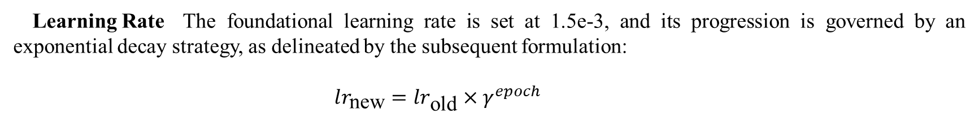
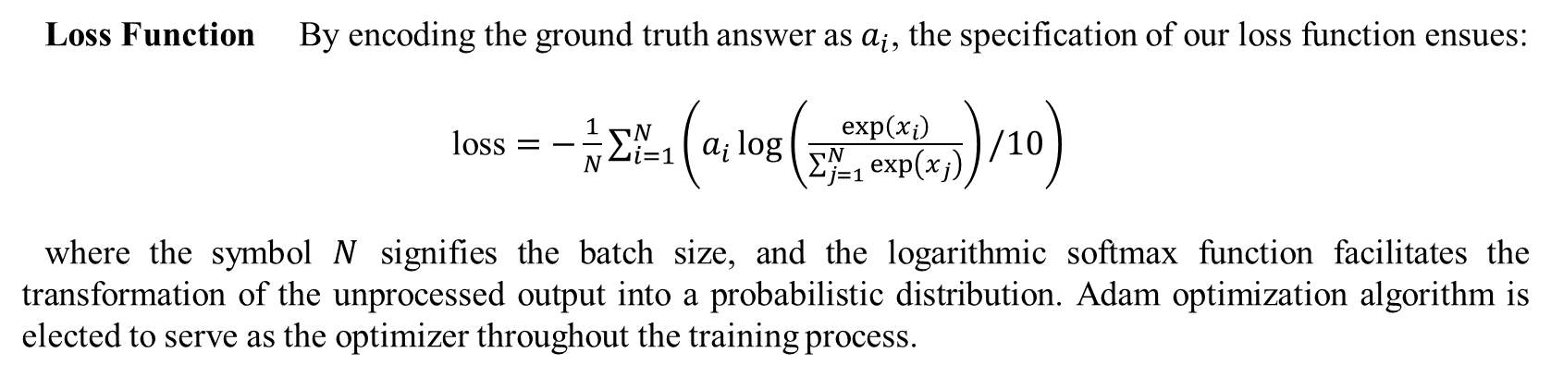
3.2 Loss Function and Implement Details
03
Loss Function By encoding the ground truth answer as $a_{i}$, the specification of our loss function ensues:
$\text{loss}=−\frac{1}{N}\sum_{i=1}^{N}{\left(a_{i}\log\left(\frac{\exp\left(x_{i}\right)}{\sum_{j=1}^{N}{\exp\left(x_{j}\right)}}\right)/10\right)}$
where the symbol $N$ signifies the batch size, and the logarithmic softmax function facilitates the transformation of the unprocessed output into a probabilistic distribution. Adam optimization algorithm is elected to serve as the optimizer throughout the training process.
Learning Rate The foundational learning rate is set at 1.5e-3, and its progression is governed by an exponential decay strategy, as delineated by the subsequent formulation:
$lr_{\text{new}}=lr_{\text{old}}×γ^{epoch}$
Other Hyper-parameters:
Embedding dimension: 300 Batch size: 256
Number of region vectors: 100 Region vector dimension: 2048
Image/Text feature: 1024
Integrated feature: 512

Slide 19
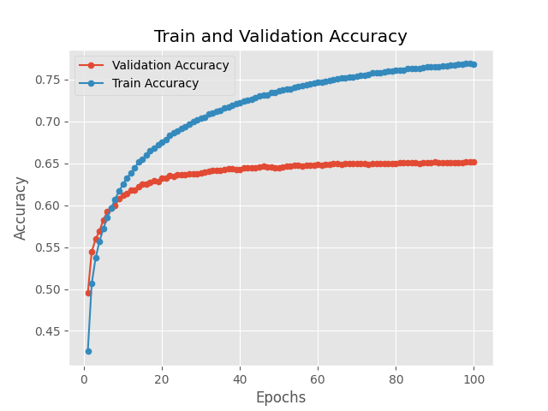
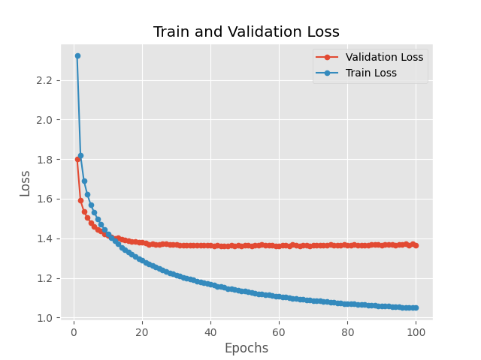
3.3 Training Procedure
03
Training/Val Accuracy
Training/Val Loss

Slide 20
Part 04
Results and Conclusion

Slide 21
4.1 Main Results
04
First, we selected two prominent existing models to serve as our benchmarks. A seminal work by Vahid Kazemi et al. which presents a novel baseline approach in the realm of VQA and the notable contributions made by Damien Teney et al., who conducted an extensive analysis of the influence of various choices on model efficacy.
Furthermore, we draw inspiration from the Multimodal Factorized High-order (MFH) pooling method proposed by Yu et al., which introduces a compelling concept of higher-order fusion. Over the past few years, this approach has consistently maintained its status as the state-of-the-art solution.
Table 1: Comparison results regarding baselines
Model | Fusion | VQA Task Score
 |  | Yes/No | Number | Other | All | Balanced Pair1
Teney et al. 2018 [19] | - | 80.33% | 43.02% | 55.86% | 63.30% | 34.69%
Kazemi et al. 2017 [5] | - | 77.45% | 38.46% | 51.76% | 59.67% | 36.44%
Yu et al. 2018 [17] | - | 82.82% | 40.39% | 56.94% | 65.72% | -
 | Base | 81.78% | 48.64% | 56.10% | 65.09% | 36.83%
Ours | MLB | 79.26% | 40.79% | 45.89% | 57.76% | 28.32%
 | Block | 81.39% | 48.35% | 55.73% | 64.40% | 36.32%
 | MUTAN | 81.76% | 47.40% | 57.19% | 65.74% | 36.85%
1 Balanced Pair calculation follows the methodology proposed by Teney et al. [19]

Slide 22
4.1 Main Results
04
we delve into comparisons with models that specifically address innovation or enhancement in fusion strategy. In particular, we reference the works of Duy-Kien Nguyen et al., Yanwei Fu et al., and Liqing Chen et al. for comparison. These studies respectively employ the Dense Symmetric Co-Attention (DCN), Stacked Self-Attention Networks (SSAN), and the Variational Autoencoder method (VAE) in their fusion strategies.
Table 2: Comparison results regarding other strategies
Model | Fusion | VQA Task Score
 |  | Yes/No | Number | Other | All
Liqing Chen et al. [20] | VAE | 80.92% | 39.69% | 50.92% | 61.48%
Duy-Kien Nguyen et al. [21] | DCN1 | 83.70% | 46.65% | 56.77% | 66.72%
Yanwei Fu et al. [22] | SSAN | 82.81% | 42.60% | 56.58% | 65.80%
 | Base | 81.78% | 48.64% | 56.10% | 65.09%
Ours | MLB | 79.26% | 40.79% | 45.89% | 57.76%
 | Block | 81.39% | 48.35% | 55.73% | 64.40%
 | MUTAN | 81.76% | 47.40% | 57.19% | 65.74%
1 Here we cite the results of the second method employed for result prediction in Nguyen et al.’s publication

Slide 23
4.2 Conclusion
04
This study involves constructing a baseline model based on existing research, followed by modifying the fusion strategy within the model framework to evaluate the effectiveness of various fusion methodologies. We make adjustments to the baseline model structure and introduce some new components.
Our exploration includes intuitive fusion concepts such as the integration block using the ReLU function and the Euclidean distance metric, as well as several bilinear models like MLB, MUTAN, and BLOCK. Notably, the MUTAN-based fusion model stands out as the most promising candidate during the evaluation on the VQA v2 dataset, achieving a remarkable overall accuracy of 65.74%. This performance surpasses all our baseline models and notably achieves an accuracy of 36.85% on balanced pairs of the VQA v2 dataset.
This result emphasizes the crucial role of fusion strategies in influencing VQA performance and underscores the need for careful integration as feature extraction mechanisms.

Slide 24
4.3 Limitations
04
1. The experimental framework exclusively examines a single baseline model. To enhance the generality of our findings, a broader spectrum of baseline model structures should be considered, thereby enabling a comprehensive exploration of fusion method impact.
2. The current study’s training and testing procedures are confined to the VQA v2 dataset. To bolster the robustness of our conclusions, an extension to alternative datasets, such as vgenome, could yield more comprehensive insights.
3. Concerning certain fusion techniques, there is a range of crucial hyperparameters that require adjustment. For MUTAN and MLB, for example, incorporating a linear layer on image and text features before fusion introduces tunable parameters. Similarly, the choice of activation functions within the fusion block can be variable. While we generally follow default parameter values outlined in the original literature, an optimal approach involves a thorough investigation into determining the most effective settings.

Slide 25
Reference
04
[1] Kim, J.-H., On, K.-W., Lim, W., Kim, J., Ha, J.-W., & Zhang, B.-T. (2016). Hadamard product for low-rank bilinear pooling. arXiv preprint arXiv:1610.04325.
[2] Ben-Younes, H., Cadene, R., Cord, M., & Thome, N. (2017). Mutan: Multimodal tucker fusion for visual question answering. In Proceedings of the IEEE International Conference on Computer Vision (pp. 2612–2620).
[3] Ben-Younes, H., Cadene, R., Thome, N., & Cord, M. (2019). Block: Bilinear superdiagonal fusion for visual question answering and visual relationship detection. In Proceedings of the AAAI Conference on Artificial Intelligence (Vol. 33, pp. 8102–8109).
[4] Xu, K., Ba, J., Kiros, R., Cho, K., Courville, A., Salakhudinov, R., Zemel, R., & Bengio, Y. (2015). Show, attend and tell: Neural image caption generation with visual attention. In International conference on machine learning (pp. 2048–2057). PMLR.
[5] Kazemi, V., & Elqursh, A. (2017). Show, ask, attend, and answer: A strong baseline for visual question answering. arXiv preprint arXiv:1704.03162.
[6] Xu, H., & Saenko, K. (2016). Ask, attend and answer: Exploring question-guided spatial attention for visual question answering. In Computer Vision–ECCV 2016: 14th European Conference, Amsterdam, The Netherlands, October 11–14, 2016, Proceedings, Part VII (pp. 451–466). Springer.
[7] Zhu, C., Zhao, Y., Huang, S., Tu, K., & Ma, Y. (2017). Structured attentions for visual question answering. In Proceedings of the IEEE International Conference on Computer Vision (pp. 1291–1300).
[8] Rennie, S. J., Marcheret, E., Mroueh, Y., Ross, J., & Goel, V. (2017). Self-critical sequence training for image captioning. In Proceedings of the IEEE conference on computer vision and pattern recognition (pp. 7008–7024).
[9] Wang, Z., & Ji, S. (2018). Learning convolutional text representations for visual question answering. In Proceedings of the 2018 SIAM International Conference on Data Mining (pp. 594–602). SIAM.
[10] Seo, M., Kembhavi, A., Farhadi, A., & Hajishirzi, H. (2016). Bidirectional attention flow for machine comprehension. arXiv preprint arXiv:1611.01603.
[11] Cornia, M., Stefanini, M., Baraldi, L., & Cucchiara, R. (2020). Meshed-memory transformer for image captioning. In Proceedings of the IEEE/CVF conference on computer vision and pattern recognition (pp. 10578–10587).
[12] Pan, Y., Yao, T., Li, Y., & Mei, T. (2020). X-linear attention networks for image captioning. In Proceedings of the IEEE/CVF conference on computer vision and pattern recognition (pp. 10971–10980).
[13] Messina, N., Coccomini, D. A., Esuli, A., & Falchi, F. (2022). Transformer-Based Multi-modal Proposal and Re-Rank for Wikipedia Image-Caption Matching. arXiv preprint arXiv:2206.10436.
[14] Lin, T.-Y., Maire, M., Belongie, S., Hays, J., Perona, P., Ramanan, D., Dollár, P., & Zitnick, C. L. (2014). Microsoft coco: Common objects in context. In Computer Vision–ECCV 2014: 13th European Conference, Zurich, Switzerland, September 6-12, 2014, Proceedings, Part V (pp. 740–755). Springer.
[15] Xu, Y., Xu, Y., Lv, T., Cui, L., Wei, F., Wang, G., Lu, Y., Florencio, D., Zhang, C., Che, W., et al. (2020). Layoutlmv2: Multi-modal pre-training for visually-rich document understanding. arXiv preprint arXiv:2012.14740.
[16] Kuo, C.-W., & Kira, Z. (2022). Beyond a pre-trained object detector: Cross-modal textual and visual context for image captioning. In Proceedings of the IEEE/CVF Conference on Computer Vision and Pattern Recognition (pp. 17969–17979).
[17] Yu, Z., Yu, J., Xiang, C., Fan, J., & Tao, D. (2018). Beyond bilinear: Generalized multimodal factorized high-order pooling for visual question answering. IEEE transactions on neural networks and learning systems, 29(12), 5947–5959.
[18] Goyal, Y., Khot, T., Summers-Stay, D., Batra, D., & Parikh, D. (2017). Making the v in vqa matter: Elevating the role of image understanding in visual question answering. In Proceedings of the IEEE conference on computer vision and pattern recognition (pp. 6904–6913).
[19] Teney, D., Anderson, P., He, X., & Van Den Hengel, A. (2018). Tips and tricks for visual question answering: Learnings from the 2017 challenge. In Proceedings of the IEEE conference on computer vision and pattern recognition (pp. 4223–4232).
[20] Chen, L., Zhuo, Y., Wu, Y., Wang, Y., & Zheng, X. (2019). Multi-modal Feature Fusion Based on Variational Autoencoder for Visual Question Answering. In Chinese Conference on Pattern Recognition and Computer Vision (PRCV) (pp. 657–669). Springer.
[21] Nguyen, D.-K., & Okatani, T. (2018). Improved fusion of visual and language representations by dense symmetric co-attention for visual question answering. In Proceedings of the IEEE conference on computer vision and pattern recognition (pp. 6087–6096).
[22] Sun, Q., & Fu, Y. (2019). Stacked self-attention networks for visual question answering. In Proceedings of the 2019 on International Conference on Multimedia Retrieval (pp. 207–211).

Slide 26
Thanks!
MAO KEYU

