Slide 1
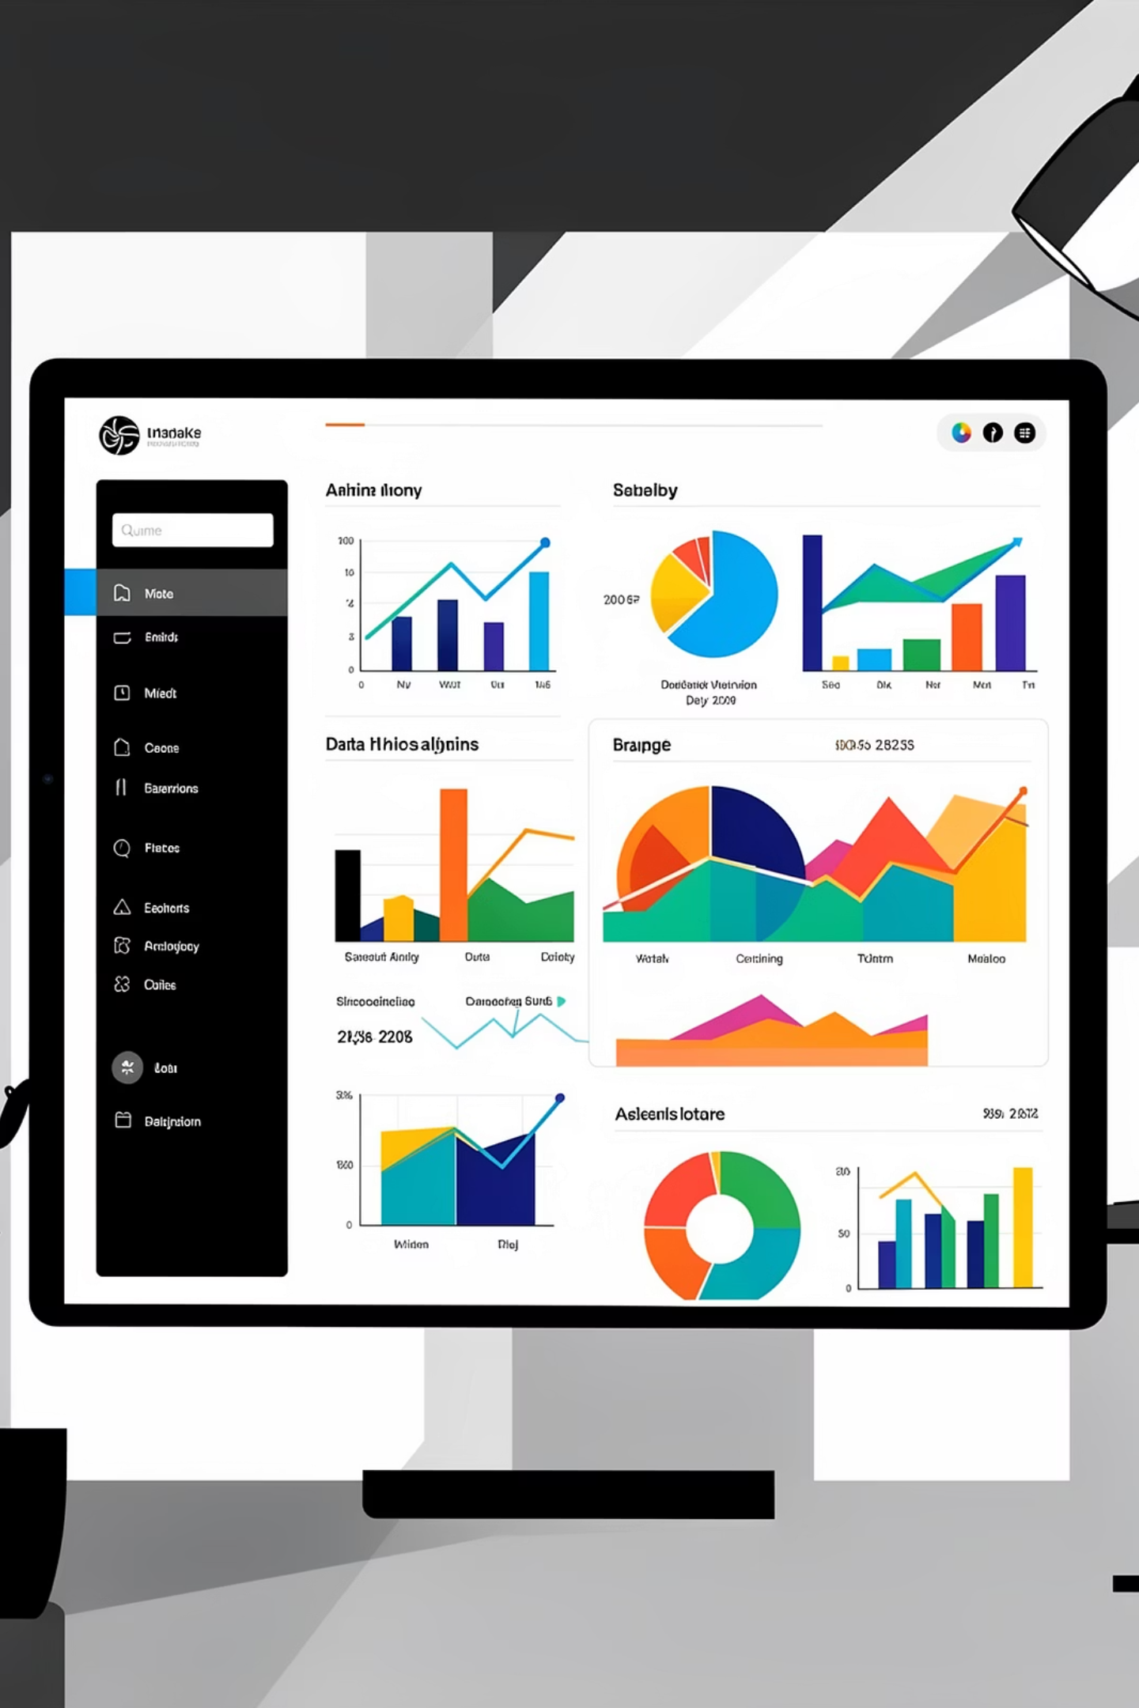
Customer Shopping Behavior Analysis
Uncovering insights from 3,900 purchases to guide strategic business decisions through data-driven analysis of spending patterns, customer segments, and product preferences.

Slide 2
DATASET OVERVIEW
The Foundation: Our Data
3,900
18
50
Total Purchases
Data Points
Locations
Transactions analyzed
Features per customer
Geographic coverage
Key Features Tracked
Customer demographics: Age, Gender, Location, Subscription Status
Purchase details: Item, Category, Amount, Season, Size, Color
Shopping behavior: Discounts, Promo Codes, Previous Purchases, Review Ratings

Slide 3

PYTHON ANALYSIS
Data Preparation & Cleaning
01
02
Data Loading & Exploration
Missing Data Handling
Imported dataset using pandas, checked structure with df.info() and summary statistics
Imputed 37 missing Review Rating values using median rating per product category
03
04
Feature Engineering
Database Integration
Created age_group bins and purchase_frequency_days columns for deeper analysis
Connected to PostgreSQL and loaded cleaned data for SQL business analysis

Slide 4

SQL ANALYSIS
Key Business Questions
Structured analysis in PostgreSQL revealed critical insights across revenue, customer behavior, and product performance to drive strategic decisions.

Slide 5
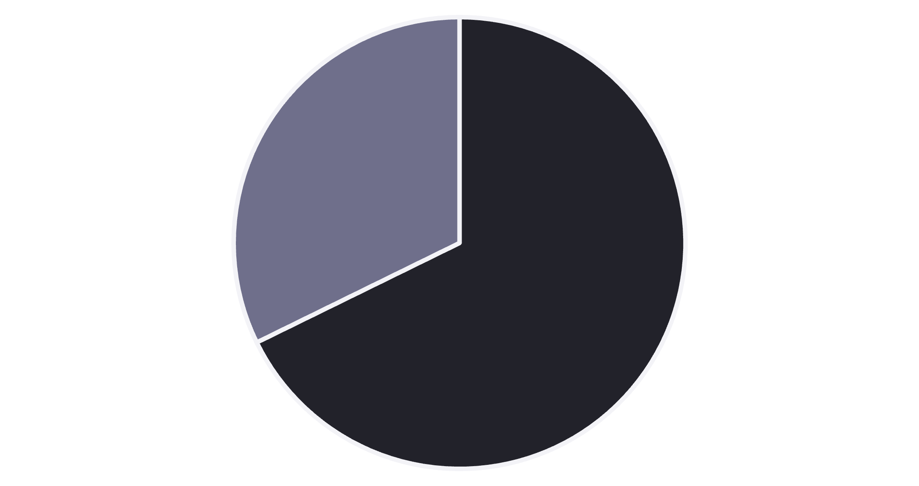
Revenue & Customer Insights
Gender Revenue Split
Male customers generate 68% of total revenue ($157,890) compared to female customers at 32% ($75,191).
High-Spending Discount Users
839 customers used discounts but still spent above average—indicating price-conscious yet valuable segments.
Male
Female

Slide 6
Product Performance Leaders
Top 5 Products by Rating
77%
77%
76%
Gloves
Sandals
Boots
3.86 average rating
3.84 average rating
3.82 average rating
76%
76%
Hat
Skirt
3.80 average rating
3.78 average rating

Slide 7



Customer Segmentation Analysis
New Customers
Returning Buyers
Loyal Advocates
83 customers making their first purchase—opportunity for onboarding campaigns
701 customers with 2-5 purchases—prime targets for loyalty programs
3,116 customers with 5+ purchases—our most valuable segment driving repeat revenue

Slide 8
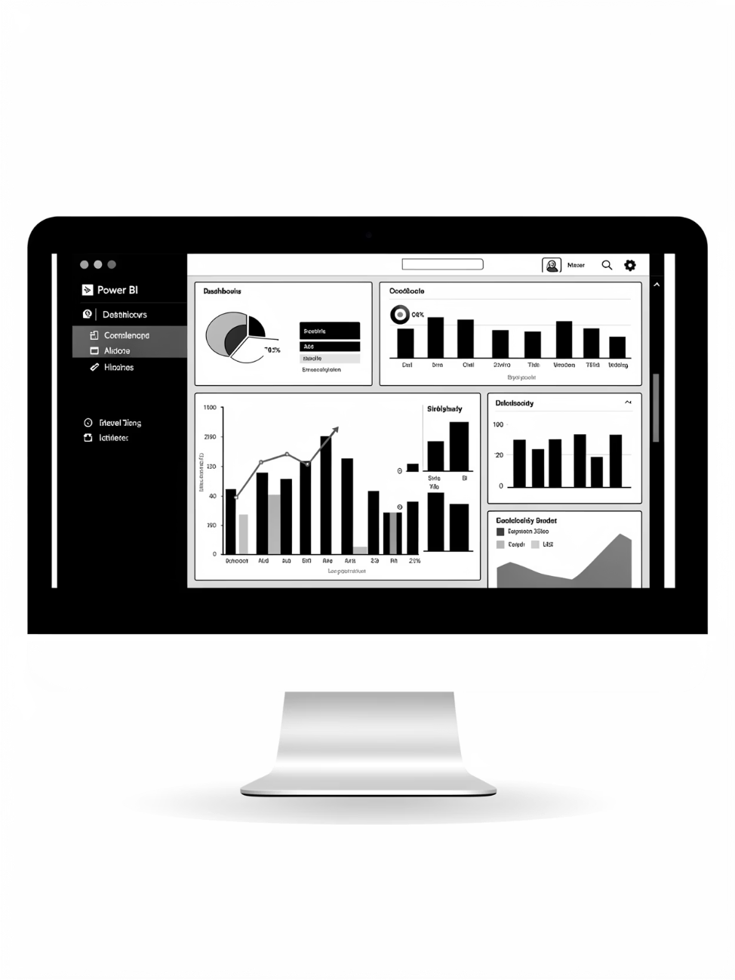
POWER BI DASHBOARD
Visual Analytics Dashboard
Key Metrics at a Glance
Interactive filters enable deep-dive analysis by gender, category, shipping type, and subscription status.
$59.76
3.75
27%
Average purchase amount
Average review rating
Subscription rate

Slide 9
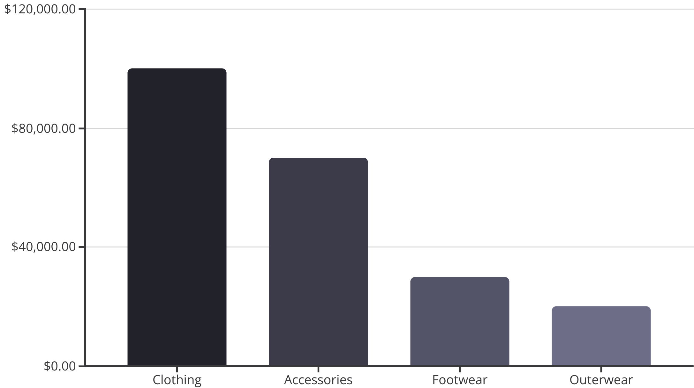
Revenue Distribution Insights
Category Performance
Clothing dominates with $100K revenue (45%), followed by Accessories at $70K (32%). Young Adults lead age groups with $62K total revenue.
Shipping Preferences
Express shipping users spend $60.48 on average vs. $58.46 for Standard—indicating willingness to pay premium for speed.

Slide 10

Strategic Recommendations
Boost Subscriptions
Loyalty Programs
Promote exclusive benefits to convert the 73% non-subscribers—potential for significant recurring revenue growth
Reward repeat buyers to accelerate movement from Returning (701) to Loyal (3,116) segments
Optimize Discounts
Targeted Marketing
Balance promotional sales with margin control—839 high-spenders use discounts strategically
Focus campaigns on Young Adults, express-shipping users, and top-rated products like Gloves and Sandals

