Slide 1

Vendor Performance Analysis
Strategic insights from 2.3M+ transactions across 50+ vendors to optimize profitability and operational efficiency.

Slide 2
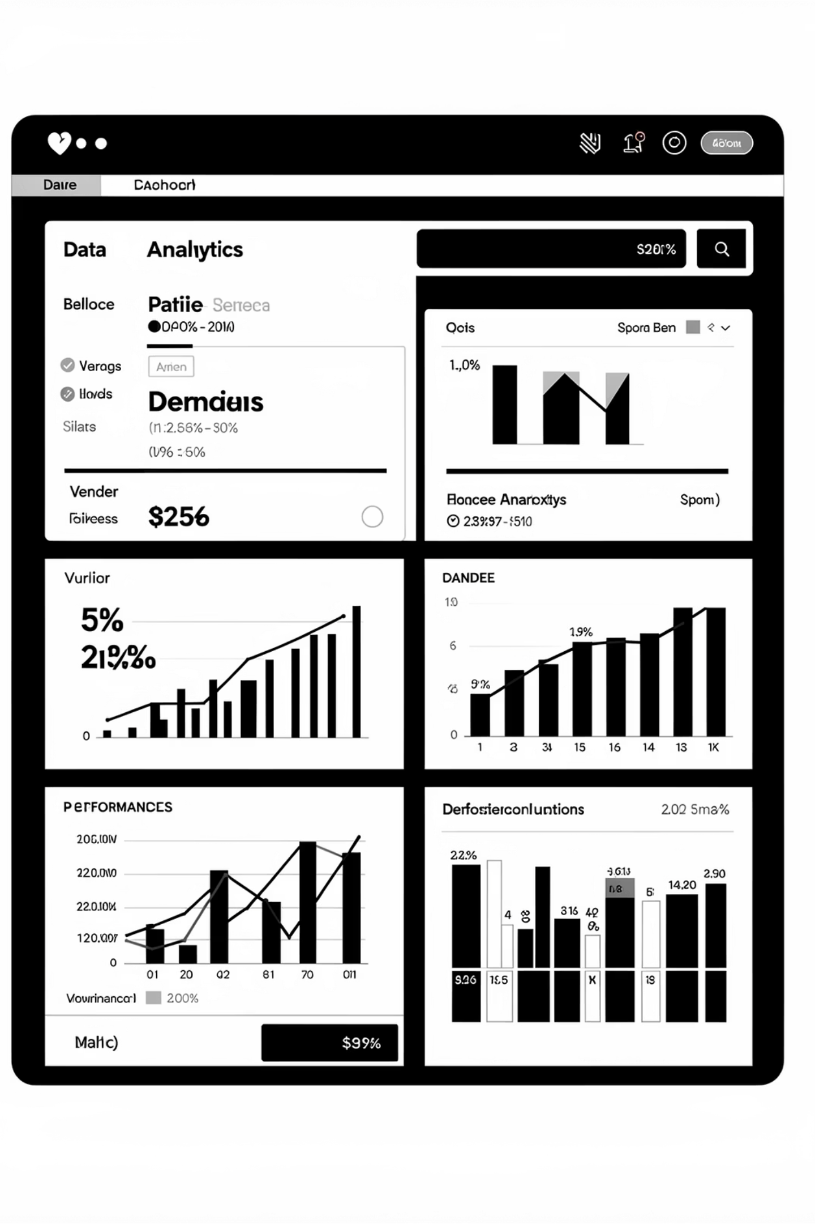
OVERVIEW
Project at a Glance
Objective
Scope
Timeline
Optimize vendor relationships and maximize profitability through data-driven insights.
Performance metrics, profitability analysis, and seasonal demand forecasting.
5-week implementation from data exploration to strategic recommendations.

Slide 3
Key Results
70%
60%
14
60%
Market Concentration
Margin Variance
Delivery Gap
Seasonal Swing
Top 10 vendors represent 70-80% of total sales volume.
Significant profitability gaps of 30-60% across vendor pool.
Performance ranges from 5 to 14 days average delivery time.
Peak-to-low volume variance during seasons.

Slide 4

INFRASTRUCTURE
Data & Technical Stack
Data Sources
2.37M purchase records with pricing and delivery dates
Sales transactions and product performance data
Vendor invoices with payment terms and freight costs
Technology
SQLite database with Python (Pandas) processing. Query optimization reduced processing time from 40 minutes to under 1 minute.

Slide 5
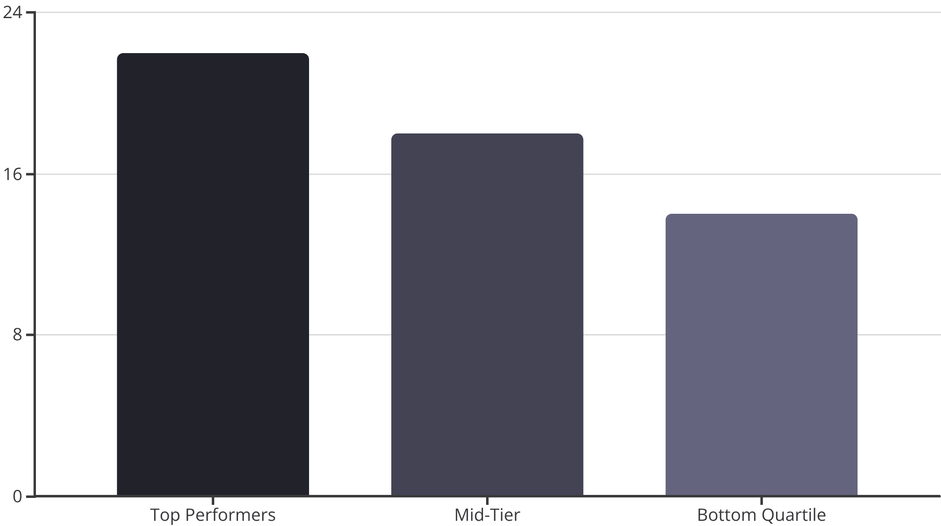
Vendor Profit Margins
The Gap
Top performers maintain 20%+ margins while some have high margins.
Critical Insight
Volume doesn't always correlate with margin. High-volume vendors may have outdated contract terms, presenting renegotiation opportunities.

Slide 6

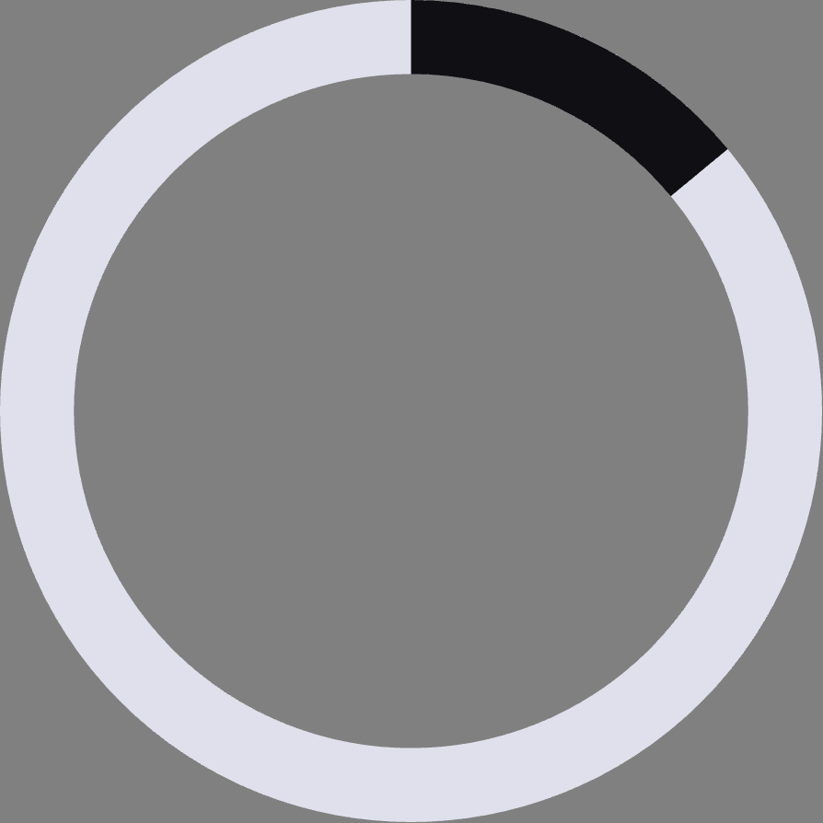
Delivery Reliability Challenge
30%
14
Vendors Over Target
Maximum Days
Exceed the 7-day delivery standard
Longest delivery time recorded
Inconsistent delivery performance leads to stockouts in high-turnover categories, directly impacting revenue and customer satisfaction.

Slide 7
Strategic Roadmap
Phase 1: Immediate (0-30 Days)
1
Negotiate with top 10 vendors for volume discounts
Identify vendors under $5k annual spend for consolidation
2
Phase 2: Short-Term (30-90 Days)
Shift 10-15% volume to high-efficiency vendors
Expand premium wine and spirits portfolio

Slide 8


SUCCESS METRICS
Key Performance Indicators
Financial KPIs
Operational KPIs
Reliability KPIs
Gross Margin %, Freight Cost %, Working Capital Days
Vendor Scorecard Compliance, Order Consolidation Rate
Average Lead Time per Vendor, On-Time Delivery Rate

