Slide 1
Loan Case Study
By - Mr. Saurabh kr. Dubey & Mr. Rohan Sen

Slide 2
Data Cleaning

Slide 3
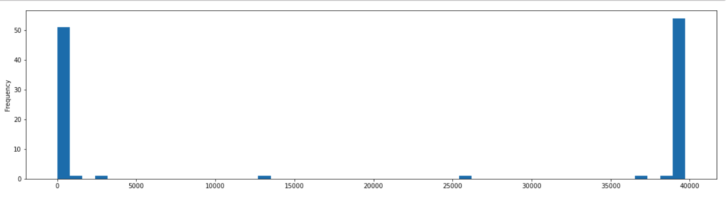
Data Cleaning
Removing null or nan value from dataset
In picture, we have plotted nan or null values. We do not need null and nun value for further analysis

Slide 4
Data Cleaning
Removed columns those are not useful for analysis
Dropped single value since they will not be effective in analysis
Modified column values so we can do analysis easily
For Example - We have removed ‘%’ symbol from ‘int_rate’ column.

Slide 5
Univariate analysis

Slide 6
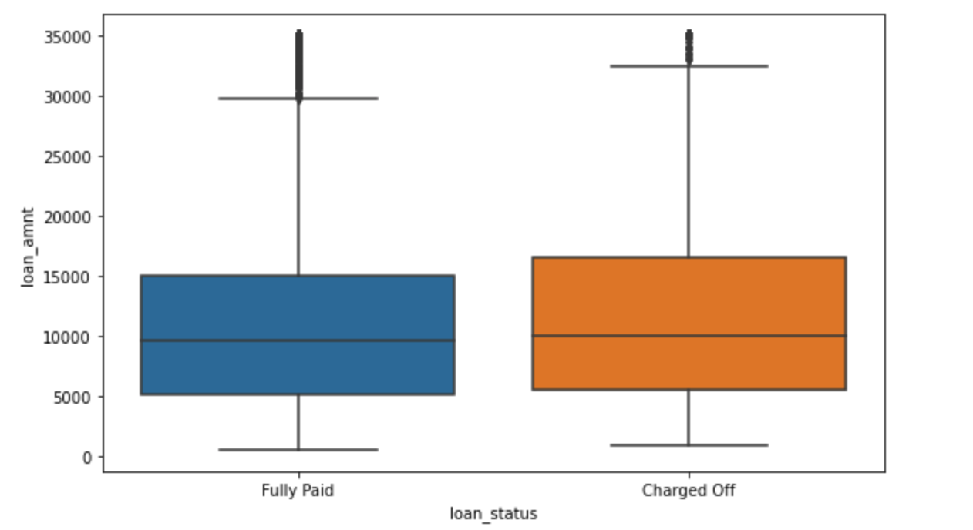
Full Paid & Charged Off
Plotted box plot with respect of loan status column and loan amount
In picture, as we can see outliers are there in full paid and
charged off.

Slide 7
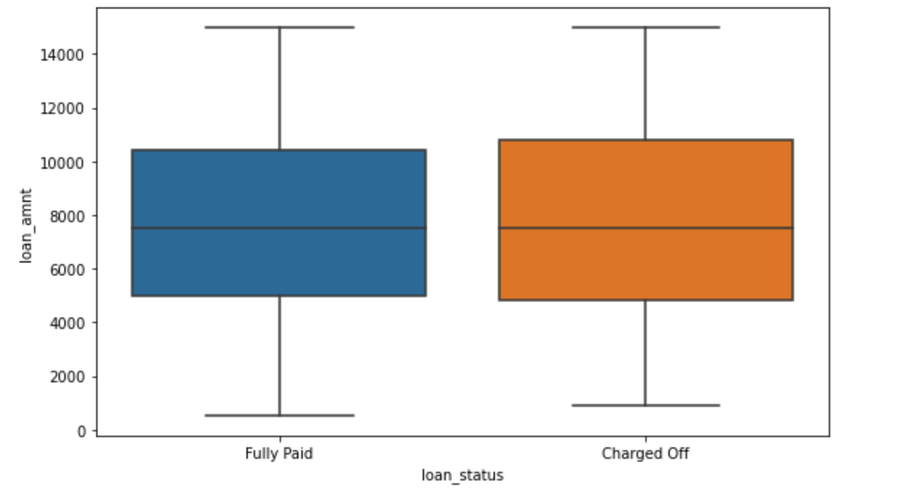
Full Paid & Charged Off
Plotted box plot with respect of loan status column and loan amount without outliers
In picture, This shows that higher amount tends to more
Charged off and lower loan amount the charged off
Chances are less.

Slide 8
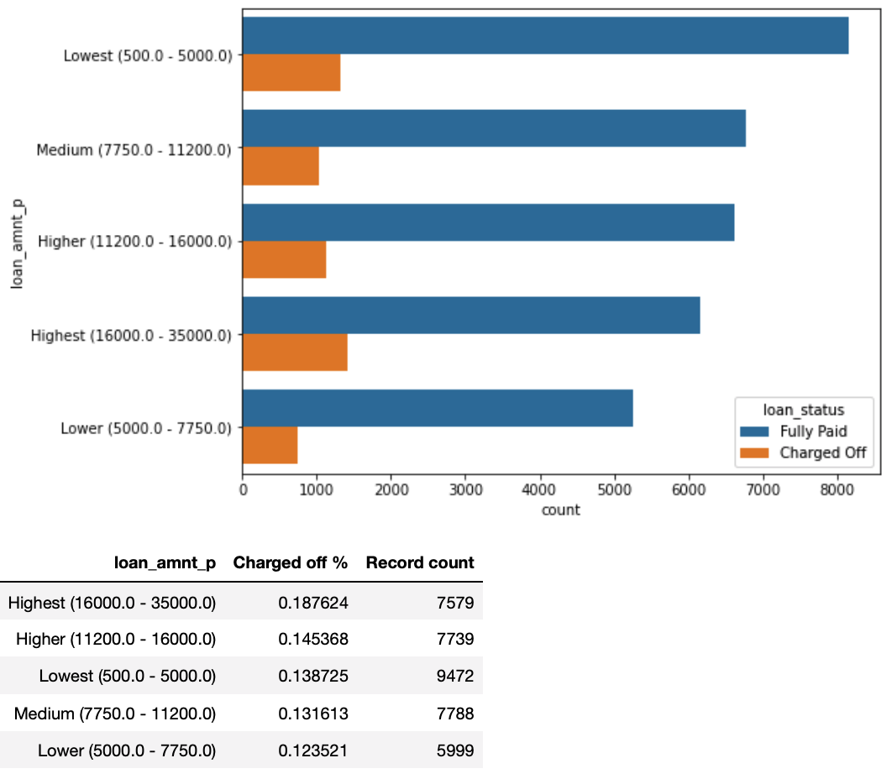
Analysis On loan amount
As we can see Fully Paid percentage is more when loan amount is less.
We can say loan amount is inversely proportional to fully paid.

Slide 9
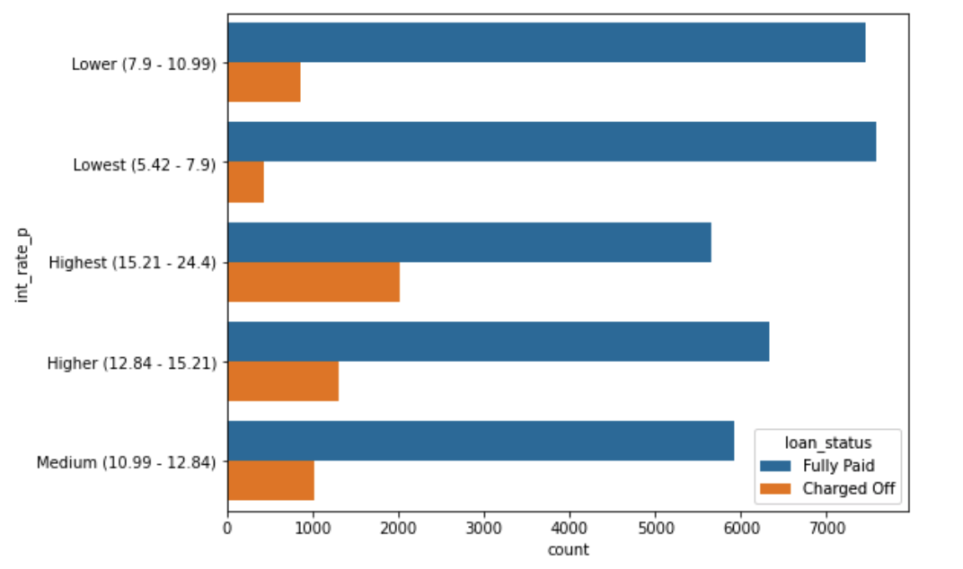
Analysis On interest percentage
Here also we can see the Charged Off percentage is higher for the higher interest rate.
As we can see when interest rate is low then charged off is also low.
More Customer are able to pay amount when interest rate is low.

Slide 10
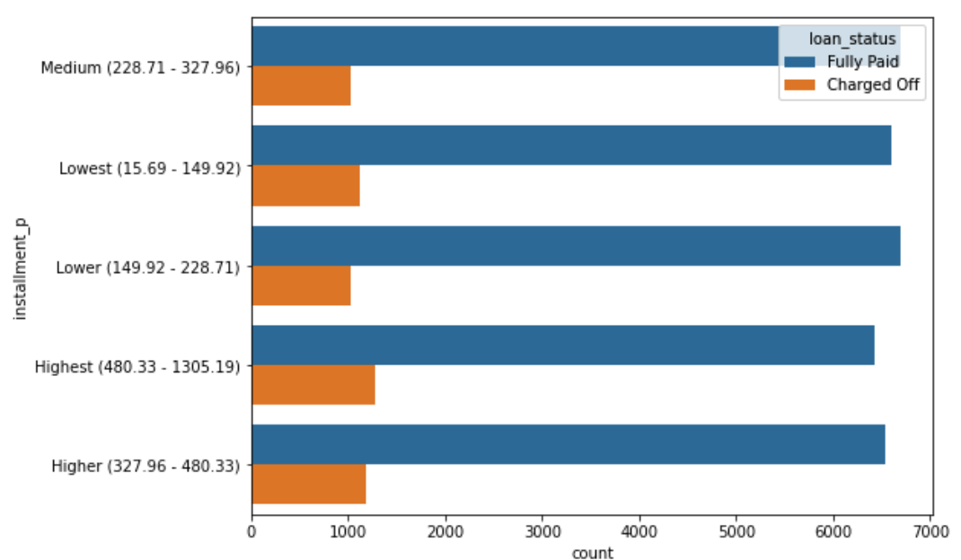
Analysis On Installment_p
Charged off percentage steadily rises with higher installment amount.

Slide 11
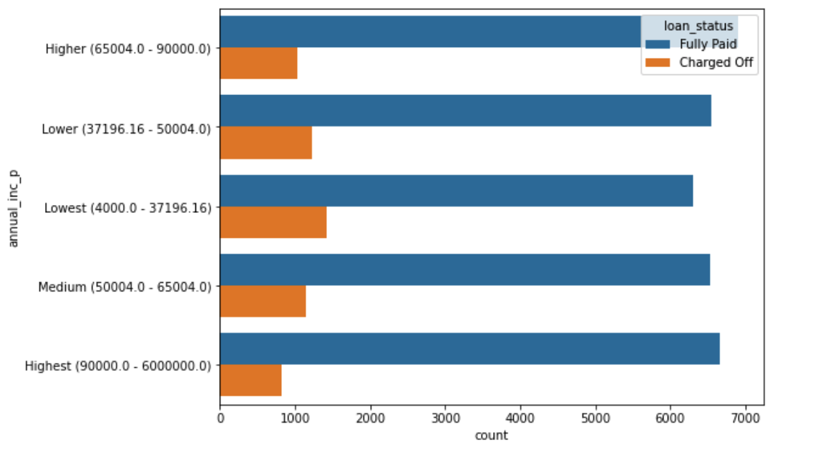
Analysis On annual_inc_p
In this the lowest annual income group is more likely to get Charged Off

Slide 12
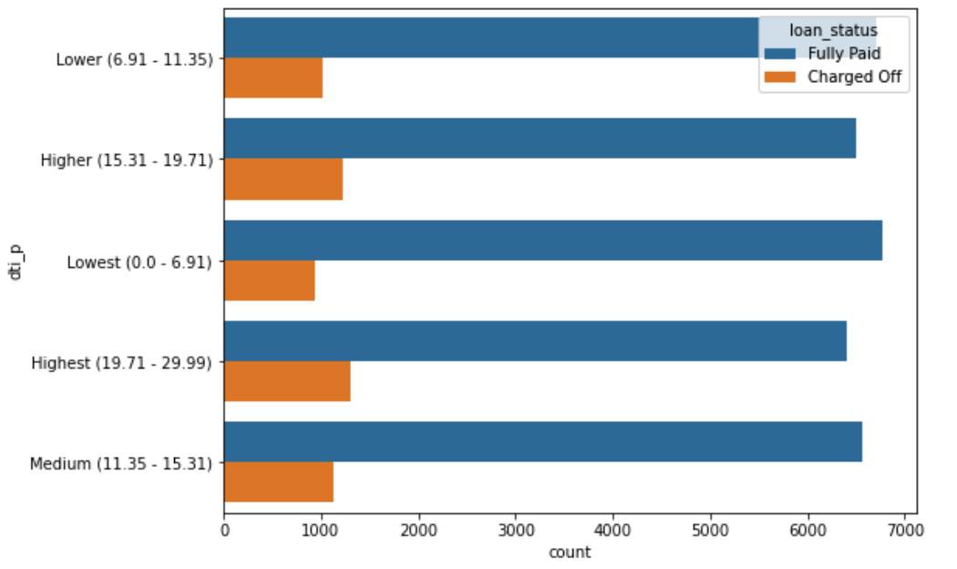
Analysis On dti_p
We see that high debt to income ratio results in more chances of Charged Off

Slide 13
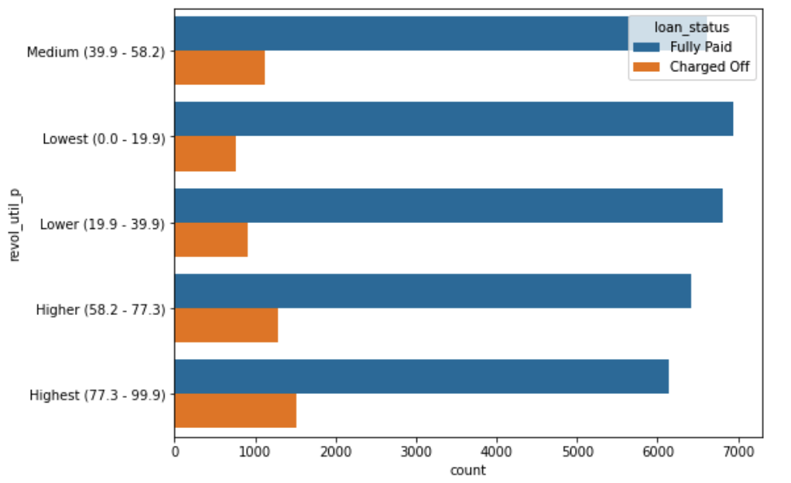
Analysis On revol_util_p
Its clear that revolving line utilisation rate has a large impact to the chance of Charged Off

Slide 14
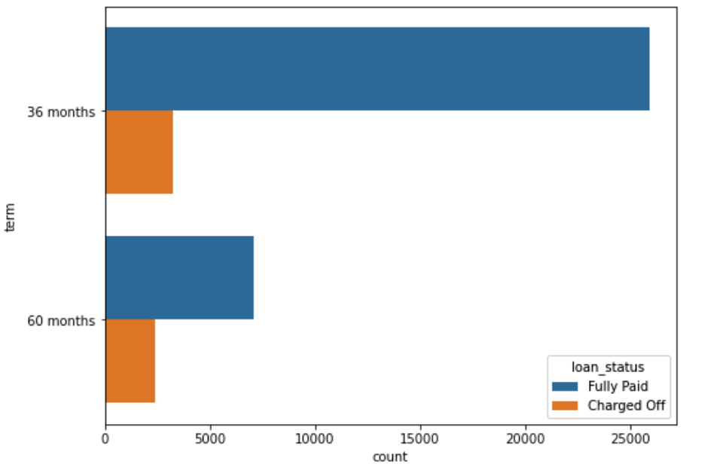
Analysis On term
Simply put higher the tenure higher the chances that the loan is fully paid.

Slide 15
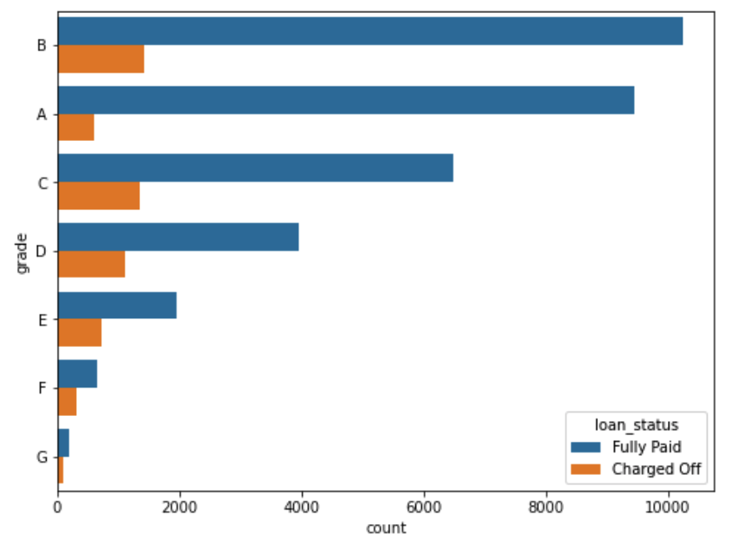
Analysis On grade
This varies hugely with grade and does not follow a pattern.

Slide 16
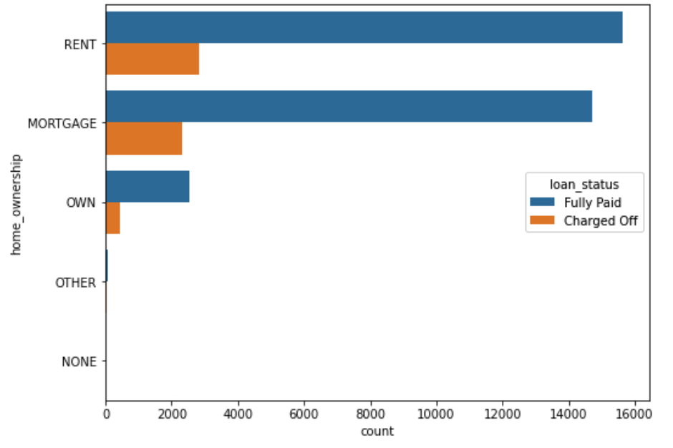
Analysis On home_ownership
It is clear that owning a house has very less chances of being Charged Off

Slide 17
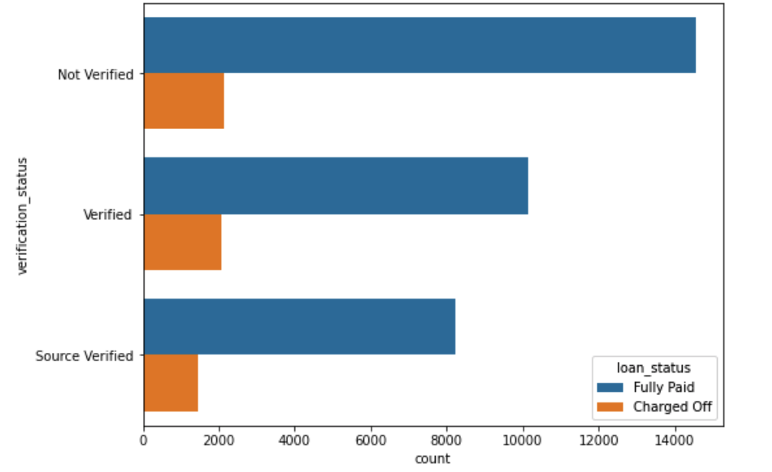
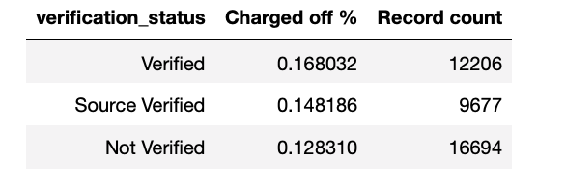
Analysis On verification_status
verified applicants have more defaulted % which means the verification process is not correct.

Slide 18
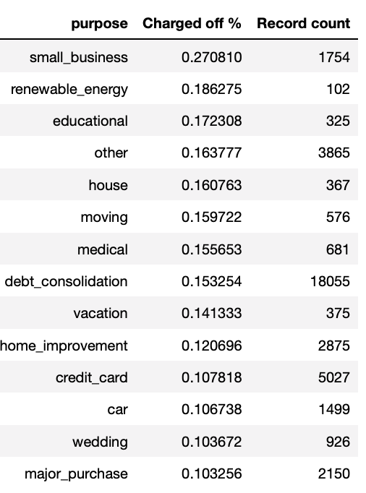
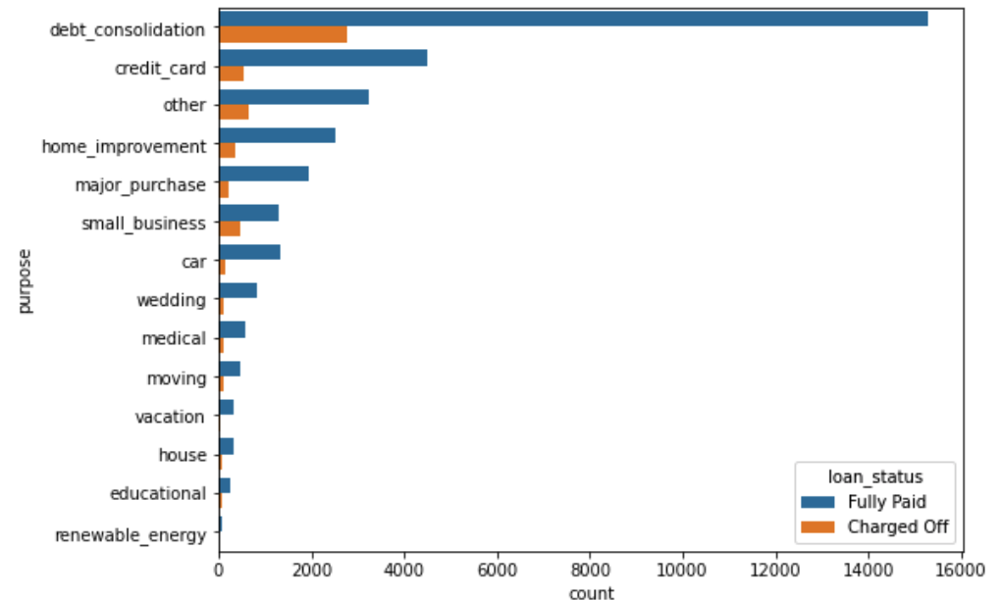
Analysis On purpose
The table makes it clear that loans taken for small_business, renewable_energy and educational are the riskier ones.

Slide 19
Bivariate analysis

Slide 20
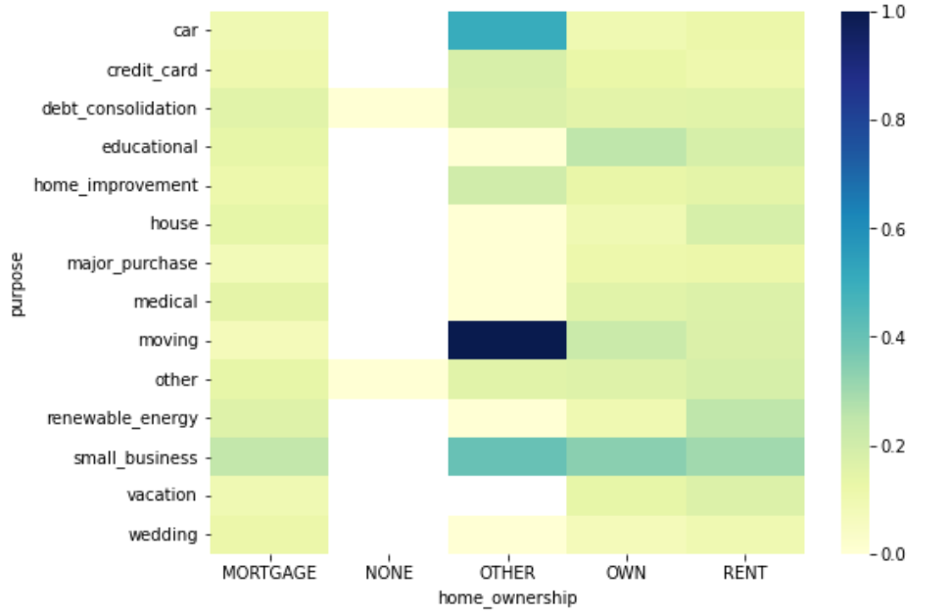
Analysis between home_ownership & Purpose
From this it is clear that for other category of home_ownership it is most risky when the loan purpose is Moving and Car

Slide 21
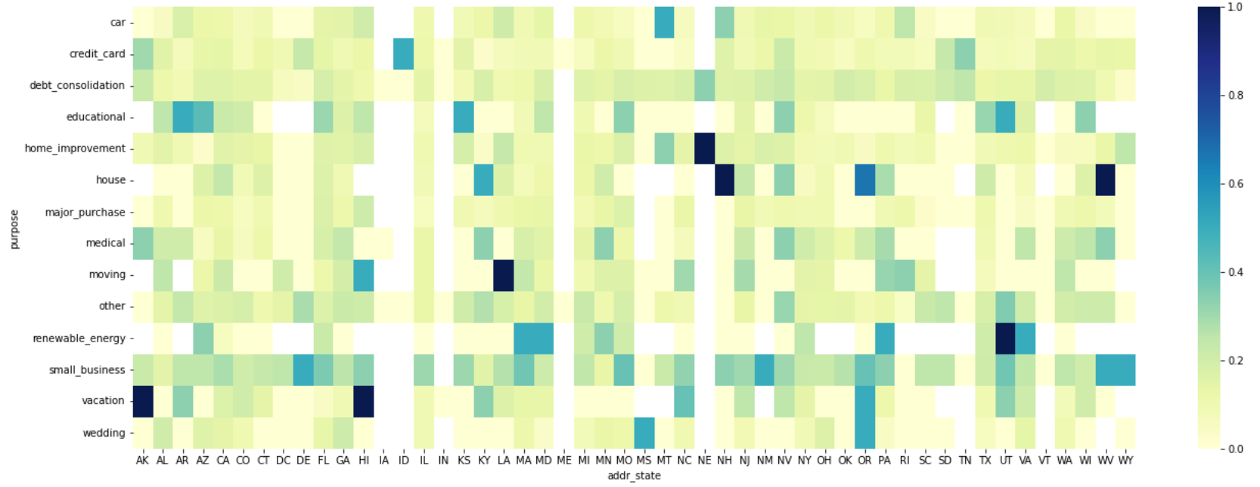
Analysis between addr_state & Purpose
From this it is clear that for certain states,
loan taken for vacation is the most risky, for some states NE and NH house and home improvement loans are risky.
For NE state, mostly the loans across different purpose are not that risky. Loans taken in the states of IA, ID, IN, ME, VT are not that risky.
Loans taken for small business is consistently mildly risky across all states. Renewable energy, credit card and wedding loans are comparably safer than others

Slide 22
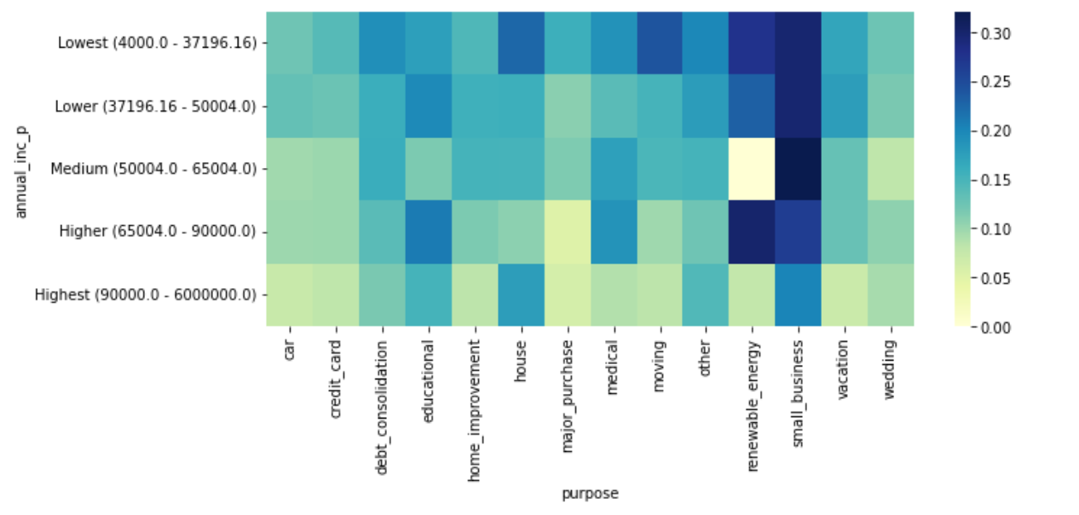
Analysis between annual_inc_p & Purpose
we can clearly see that, small_business and renewable energy are the riskiest among all annual income categories.

Slide 23
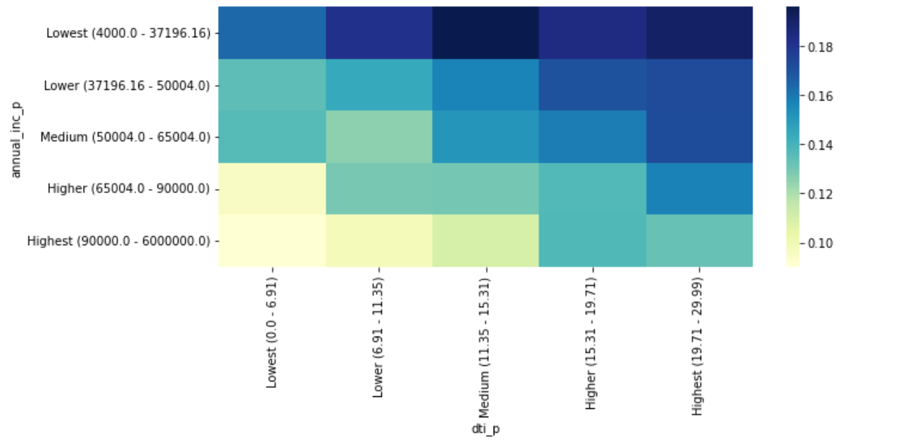
Analysis between annual_inc_p & dti_p
Very obvious that the lowest annual income category is the most risky among all debt to income ratio categories

Slide 24
Conclusion
Hence now we have arrived at some great conclusions after the analysis.
Below are listed some of the important factors according to me but there can be other factors also.
These factors have minor impact on loan being Charged Off:
These factors have minor impact on loan being Charged Off:
Higher Loan amount, Higher installment amount, Lower annual income, Higher dti ratio, Applicant's addressed state
The following factors are mostly the major impact on loan being Charged Off:
Higher interest Rate, Repayment term, Loan purpose, Derogatory public records, public bankruptcy records, loan grade
These are the combined impacts on loan being Charged Off:
High loan amount and interest rate for lower income group, High installment and longer repayment term,
home ownership and loan purpose, Residential State and loan purpose, Income group and loan purpose

