Slide 1
What is Azure Data Factory(ADF)
.
Azure Data Factory (ADF) is a Cloud-based PaaS data integration service offered by the Azure platform for integrating different data sources.
ADF allows you to create, schedule, and manage data pipelines that can move and transform data from various sources to different destinations.
ADF provides a Graphical User Interface (GUI) that allows drag-and-drop features to create a Data Integration pipeline with ease.

Slide 2
Key Benefits of Azure Data Factory
.
No-Code data workflows.
Large collection of data collectors
Easy SSIS migration
Scalability and Flexibility
Hybrid Data Integration
Built-in monitoring and alerting
Consumption-based pricing

Slide 3
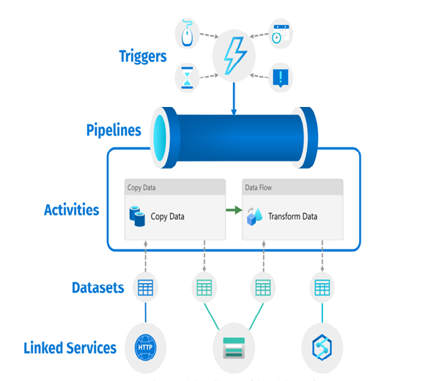
Components of ADF
.

Slide 4
Key Features of Azure Data Factory
Data Integration:
ADF supports data integration from a wide range of data sources. ADF Supports on-premises databases( SQL server, file system) and cloud-based data stores (like Azure SQL Database, Azure Blob Storage, Azure Data Lake Storage, etc.).
Data Transformation:
ADF allows users to apply data transformation activities during data movement, such as data cleansing, mapping, aggregation, and other transformations.
Azure Data Factory allows users to visually design data transformation logic in data flows
Orchestration:
With ADF, users primarily create data pipelines that orchestrate the movement and transformation of data in a structured and organized manner.
Pipelines are designed to execute predefined tasks in a specific
.

Slide 5
Key Features of Azure Data Factory
.
Scheduling and Monitoring:
ADF offers built-in scheduling capabilities to execute pipelines at specific times or intervals.
Hybrid Data Movement:
Azure Data Factory supports hybrid data movement scenarios, enabling data integration between on-premises data sources and cloud-based data stores.
ADF primary purpose is to automate data movement and transformation tasks
Integration with Other Azure Services:
ADF seamlessly integrates with various Azure services like Azure Logic Apps, Azure Databricks, Azure key vaults, and more

Slide 6
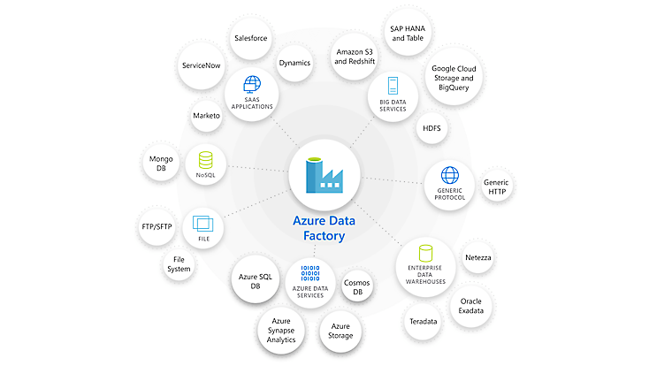
Types of Data Sources and Destinations ADF Supports
.
ADF supports a wide range of data sources and destinations, including:
Azure Blob Storage
Azure SQL Database
Azure Cosmos DB
Azure Data Lake Storage
Azure Table Storage
FTP
SFTP
Amazon S3
Oracle Database
MySQL Database
PostgreSQL Database
Teradata Database
IBM DB2 Database

Slide 7
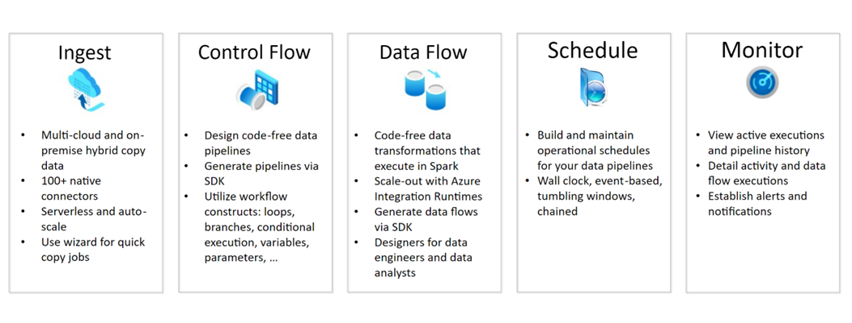
How does ADF works

Slide 8
Best Practices
Set up a code repository Toggle between different environment set-ups Go for good naming conventions Link Azure Key Vault for security Implement automated deployments (CI/CD)

