Slide 1

Gesture Controlled Virtual Mouse
SRM INSTITUTE OF SCIENCE AND TECHNOLOGY
SCHOOL OF COMPUTING
DEPARTMENT OF COMPUTING TECHNOLOGIES
18CSP107L / 18CSP108L - MINOR PROJECT / INTERNSHIP
Batch ID:
Student 1 Reg. No: RA2011003010207
Student 1 Name: Saurabh Pandey
Student 2 Reg. No: RA2011003010151
Student 2 Name: Shashwat Chaturvedi
Guide name: Mrs. S.S. Saranya
Designation: Assistant Professor Department: CTECH

Slide 2
Abstract
Aims to create an innovative human-computer interaction system by enabling users to control a computer's cursor and perform mouse actions using hand gestures.
By employing a camera to capture live video input of the user's hand movements, the system accurately detects and interprets predefined gestures, translating them into corresponding cursor movements and mouse actions.

Slide 3
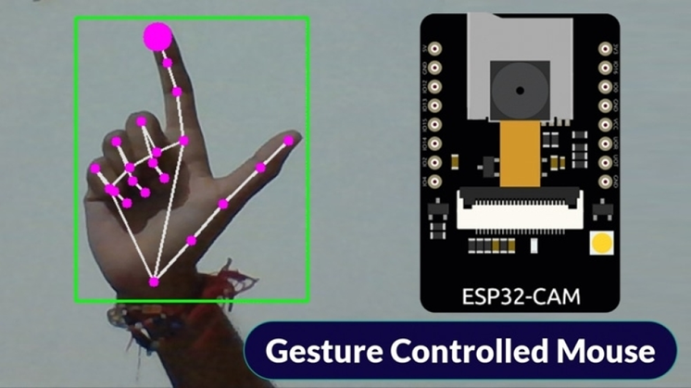
Introduction
The project involves using a camera to track hand gestures and translate them into mouse movements and clicks. Here's a general outline of how you could approach this project:

Slide 4
Existing System
Gesture-Controlled Presentations: Various presentation software and devices incorporate gesture control for advancing slides or interacting with digital content during presentations.
Smart TVs and Set-Top Boxes: Some smart TVs and set-top boxes offer gesture control features that allow users to navigate menus and control playback with hand gestures.

Slide 5
Problem Statement
In today's digital age, traditional computer input devices, such as the mouse, can be limiting in terms of mobility, accessibility, and intuitiveness. Users often require a more natural and versatile means of interacting with digital interfaces.
This project aims to:
Enable Gesture-Based Interaction
Enhance Accessibility
Optimize User Experience
Scalability and Adaptability

Slide 6
Proposed System
The proposed Gesture Controlled Virtual Mouse System aims to provide users with an intuitive and efficient means of interacting with digital devices and applications by utilizing hand gestures for cursor control and actions.
Key Features and Components:
Gesture Recognition
Virtual Cursor Control
Gesture Actions:
Compatibility:

Slide 7
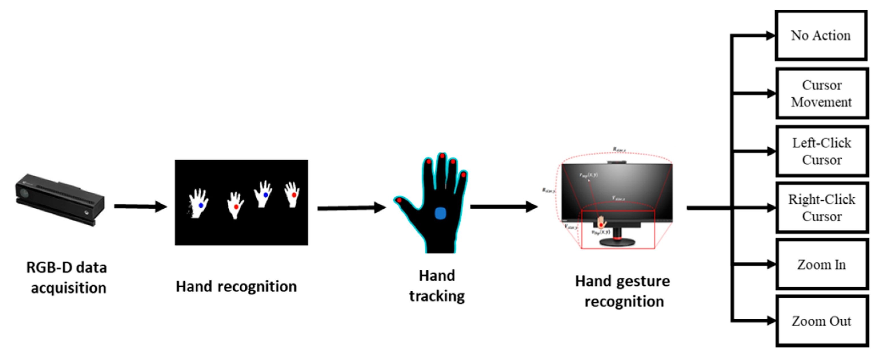
Flow Diagram

Slide 8
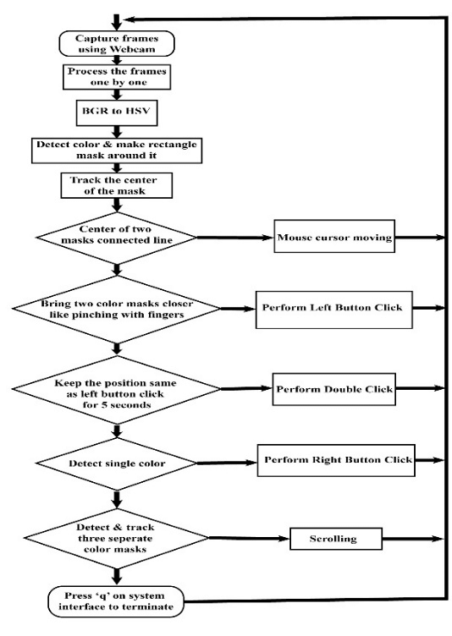
Architecture Diagram

Slide 9
Module Description
Creating a gesture-controlled virtual mouse involves the integration of several modules and components to detect and interpret hand gestures and translate them into actions on a computer or digital device.
Gesture Detection Module
Data Preprocessing Module
Gesture Recognition and Classification Module

Slide 10
Intermediate Result
The development of the gesture-controlled virtual mouse system has reached a significant milestone, with several key achievements and challenges encountered along the way. This section provides an overview of the intermediate results and a discussion of their implications.
Gesture Recognition Accuracy
Latency and Responsiveness

Slide 11
References
https://ieeexplore.ieee.org/document/9673251
https://ijariie.com/AdminUploadPdf/Hand_Gesture_Controlled_Virtual_Mouse_Using_OpenCV__ijariie19380.pdf
https://how2electronics.com/gesture-controlled-virtual-mouse-with-esp32-cam-opencv/

Slide 12
Thank You

