Slide 1
Citi Bike Rentals – Analytics and Forecasting

Slide 2
Introduction
Citi Bike is the largest bike-share program in the United states, with 20,000+ bikes and over 1,300 pick-up stations across Manhattan, Brooklyn, Queens, the Bronx and Jersey city.
Like most organization, Citi bike is constantly looking for ways to improve their business model and provide an even better experience for their customers.

Slide 3
Motivation
Analyzing and forecasting bike rentals can help address several key challenges:
Optimized Operations: By understanding rental patterns, operators can optimize bike deployment, ensuring bikes are available where and when they are needed most.
User Experience: Anticipating demand allows for better service planning, leading to improved user experience and satisfaction.
Infrastructure Planning: Insights from rental data can inform decisions about expanding bike infrastructure, such as adding new stations or bike lanes.
By harnessing the power of data analytics and forecasting, we will address key inquiries posed by Citi Bike such as Where do Citi Bikers ride? When do they ride? How far do they go? Which stations are most popular? What days of the week are most rides taken on?

Slide 4
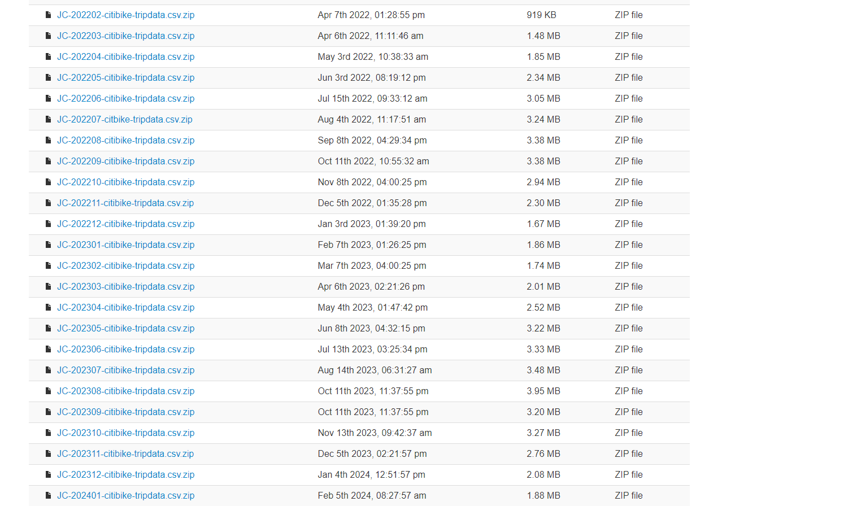
Dataset Citi Bike System Data
Ride ID
Rideable type
Started at
Ended at
Start station name
Start station ID
End station name
End station ID
Start latitude
Start longitude
End latitude
End Longitude
Member or casual ride

Slide 5
Implementation
Data Preprocessing with Apache Spark:
Apache Spark will be used for efficient data preprocessing tasks, such as cleaning, transformation and feature engineering.
Spark's distributed computing capabilities allow us to handle large volumes of data efficiently.
Data Analysis with Apache Spark:
Exploratory Data Analysis (EDA): Visualizing and exploring the rental data to understand patterns, trends, and anomalies.
Forecasting with Prophet:
Training the Prophet model using the pre-processed data.
Adjusting model parameters such as seasonality and holidays to optimize forecast accuracy.
If time permits, we will also explore Flint: A time-series library for Apache Spark.

Slide 6
Why Prophet?
Capturing Complex Seasonal Patterns: Prophet excels at capturing intricate seasonal variations present in time series data, making it ideal for forecasting tasks with inherent periodicity.
Incorporating Holidays: It allows for the incorporation of holiday effects into forecasts, ensuring that special occasions are accounted for in predictions. This helps capture the unique rental patterns associated with holidays and improves forecast accuracy.
Uncertainty Estimation: Prophet provides uncertainty estimation in forecasts, indicating the reliability and confidence levels associated with predictions. This transparency helps users understand the reliability of forecasts.

Slide 7
Evaluation
The primary success metric will be the Mean Absolute Percentage Error (MAPE) of the forecasts compared to actual values.
Other metrics such as RMSE (Root Mean Square Error), MAE (Mean Absolute Error) will be used for assessing performance in prediction.
We'll employ two parallel approaches for analysis:
With Apache Spark: Utilizing Apache Spark for data preprocessing, analysis, and model training. This approach is expected to enhance scalability and computational efficiency.
Traditional Methods without Spark: Implementing traditional methods without Spark to compare performance and assess the impact of Spark on scalability.

Slide 8
THANK YOU

