Slide 1
Decision Trees CART

Slide 2
Decision Trees
Classification and Regression Trees or CART for short is a term introduced by Leo Breiman to refer to Decision Tree algorithms that can be used for classification or regression predictive modelling problems.
This algorithm is referred to as decision trees, but on some platforms like R they are referred to by the more modern term CART.
CART algorithm provides a foundation for important algorithms like bagged decision trees, random forest and boosted decision trees.

Slide 3
Decision Trees
You can have decision trees for both numerical and categorical values of the predictor variable
At the same time the output variable or the response variable can be real valued number in which case it is called Decision Tree Regression and a categorical value in which case it is called Classification Decision Trees

Slide 4
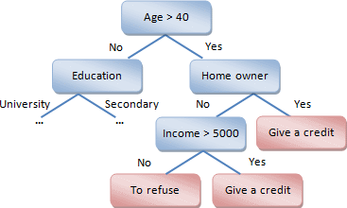

Slide 5
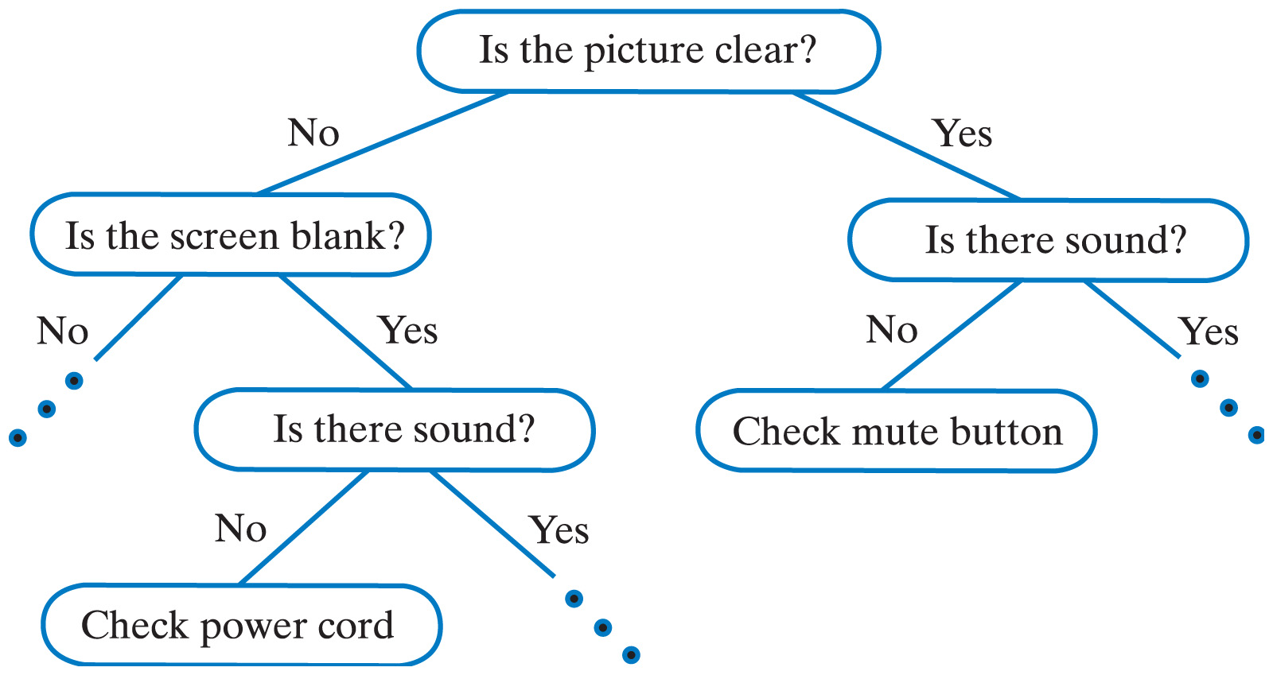

Slide 6
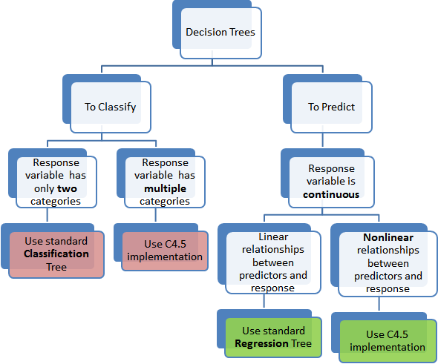

Slide 7
How to store a decision tree
The tree can be stored as a
File or
graph or
a set of rules
For example, this is a decision tree as a set of rules
If Height > 180 cm Then Male
If Height <= 180 cm AND Weight > 80 kg Then Male
If Height <= 180 cm AND Weight <= 80 kg Then Female

Slide 8
How to create a decision tree
Creating a binary decision tree is actually a process of dividing up the input space. A greedy approach is used called recursive binary splitting.
This is a numerical procedure where all the values are lined up and different split points are tried and tested using a cost function.
The split with the best cost (lowest cost because we minimize cost) is selected.
All input variables and all possible split points are evaluated and chosen in a greedy manner based on the cost function.

Slide 9
Regression or Classification?
Regression: The cost function that is minimized to choose split points is the sum squared error across all training samples that fall within the rectangle.
Classification: The Gini cost function is used which provides an indication of how pure the nodes are, where node purity refers to how mixed the training data assigned to each node is.
Splitting continues until nodes contain a minimum number of training examples or a maximum tree depth is reached.

Slide 10
What does Gini stand for?
It was developed by an Italian statistician and sociologist Corrado Gini and published in his 1912 paper Variability and Mutability
Italian name of the publication Variabilità e mutabilità

Slide 11
Gini dataset

Slide 12

X1 X2 Y
2.771244718 1.784783929 0
1.728571309 1.169761413 0
3.678319846 2.81281357 0
3.961043357 2.61995032 0
2.999208922 2.209014212 0
7.497545867 3.162953546 1
9.00220326 3.339047188 1
7.444542326 0.476683375 1
10.12493903 3.234550982 1
6.642287351 3.319983761 1

Slide 13
Algorithm for doing the gini split
1 st step is to choose a split that will become the stump or root node of our decision tree.
start with the rst candidate split point which is the X1 attribute and the value of X1
in the 1st instance: X1 = 2:771244718.
IF X1 < 2:771244718 THEN LEFT
IF X1 >= 2:771244718 THEN RIGHT
Apply this rule to each X1 value in our training dataset. Below is the answer we get for each numbered instance in the dataset

Slide 14
Gini index of any split point in our dataset as the sum of:
Gini(split) = (left(0) (1 - left(0))) + (right(0) (1 - right(0)) +
(left(1) (1 - left(1))) + (right(1) (1 - right(1))
Where left(0) is the proportion of data instances in the left group with class 0, right(0) is the proportion of data instances in the right group with class 0, and so on.
The proportion of data instances of a class is easy to calculate. If a LEFT group has 3 instances with class 0 and 4 instances with class 1, then the proportion of data instances with class 0 would be 3 / 7 or 0.428571429.
Here are 7 different scenarios for mixes of 0 and 1 classes in a single group

Slide 15
Class 0 Class 1 Count Class 0/Count Class 1/Count Gini
10 10 20 0.5 0.5 0.5
19 1 20 0.95 0.05 0.095
1 19 20 0.05 0.95 0.095
15 5 20 0.75 0.25 0.375
5 15 20 0.25 0.75 0.375
11 9 20 0.55 0.45 0.495
20 0 20 1 0 0

Slide 16
Gini Calculations
X1 Y Group
2.771244718 0 RIGHT
1.728571309 0 LEFT
3.678319846 0 RIGHT
3.961043357 0 RIGHT
2.999208922 0 RIGHT
7.497545867 1 RIGHT
9.00220326 1 RIGHT
7.444542326 1 RIGHT
10.12493903 1 RIGHT
6.642287351 1 RIGHT

Slide 17
How good was this split? We can evaluate the mixture of the classes in each of the LEFT and RIGHT nodes as a single cost of choosing this split point for our root node. The LEFT group only has one member, where as the RIGHT group has 9 members. Starting with the LEFT group, we can calculate the proportion of training instances that have each class:
Y = 0: 1 / 1 1.0
Y = 1: 0 / 1 0.0
The RIGHT group is more interesting as it is comprised of a mix of classes (we are probably going to get a high Gini index).
Y = 0: 4 / 9 or 0.444444444
Y = 1: 5 /9 or 0.555555556

Slide 18
Gini index for this split is
Gini(X1 = 2:7712) = (1.0 (1 -1.0)) + (0.0 (1 – 0.0)) + (0.444444444 (1 – 0.444444444) +
(0.555555556 (1 – 0.555555556))
or
Gini(X1 = 2.771244718) = 0.49382716

Slide 19
That is why this table is like this
X1 Y Group
2.771244718 0 RIGHT
1.728571309 0 LEFT
3.678319846 0 RIGHT
3.961043357 0 RIGHT
2.999208922 0 RIGHT
7.497545867 1 RIGHT
9.00220326 1 RIGHT
7.444542326 1 RIGHT
10.12493903 1 RIGHT
6.642287351 1 RIGHT

Slide 20
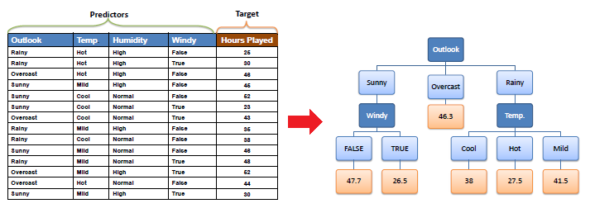

Slide 21
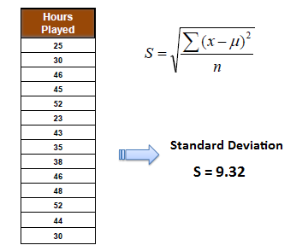

Slide 22
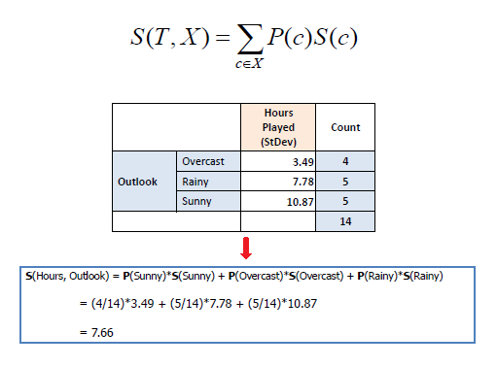

Slide 23
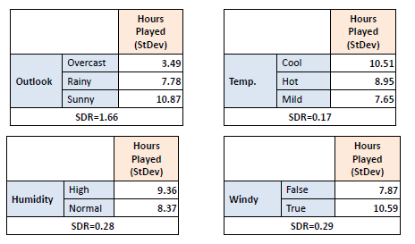

Slide 24
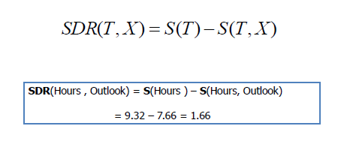

Slide 25
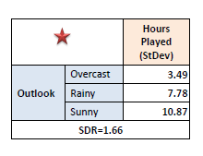

Slide 26
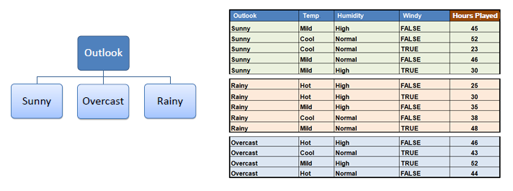

Slide 27
