Slide 1
The Battle of Neighborhoods
Finding a Better Place in Scarborough, Toronto

Slide 2
Introduction
This Project aim to create an analysis of features for a people migrating to Scarborough to search a best neighborhood as a comparative analysis between neighborhoods.
The features include median housing price and better school according to ratings, crime rates of that particular area, road connectivity, weather conditions, good management for emergency, water resources both fresh and waste water and excrement conveyed in sewers and recreational facilities.

Slide 3
Data Section
Data Link: https://en.wikipedia.org/wiki/List_of_postal_codes_of_Canada:_M
Will use Scarborough dataset which we scrapped from wikipedia on Week 3. Dataset consisting of latitude and longitude, zip codes.

Slide 4
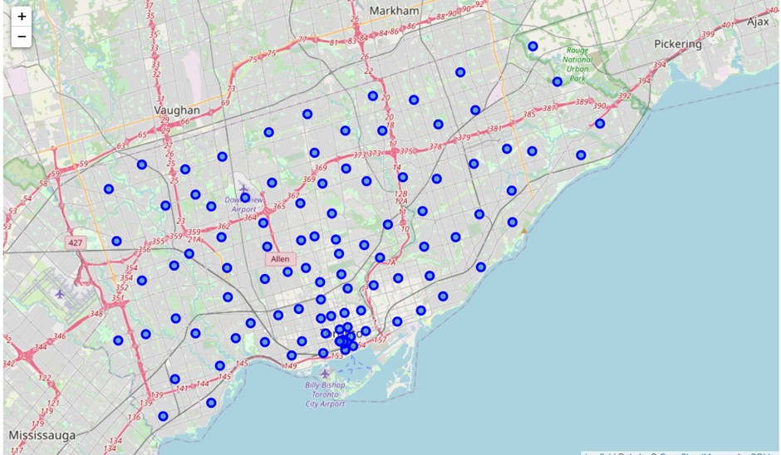
Map of Scarborough

Slide 5
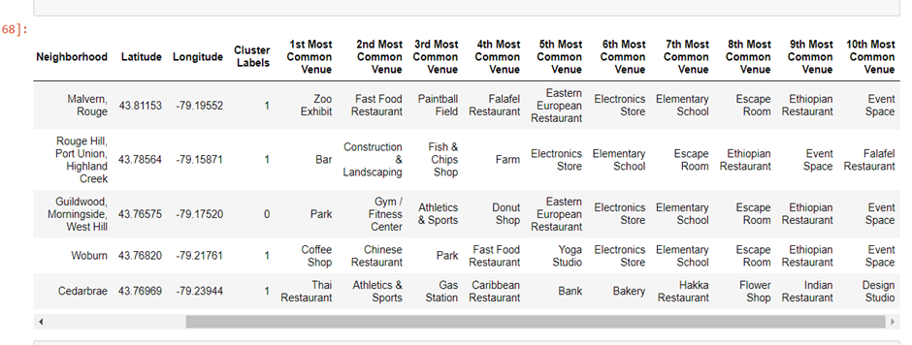
K-Means Clustering Approach

Slide 6
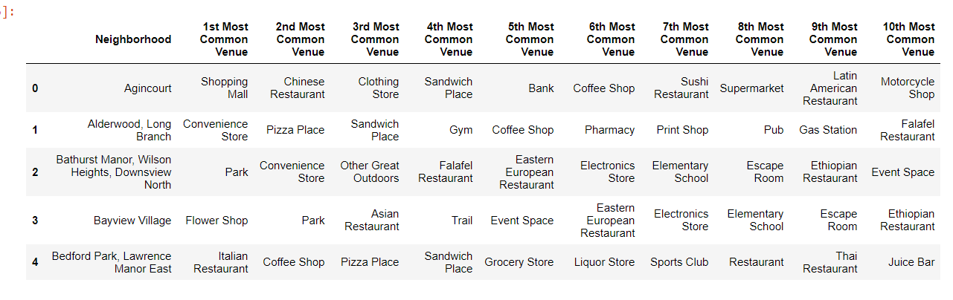
Most Common venues near Neighborhood

Slide 7
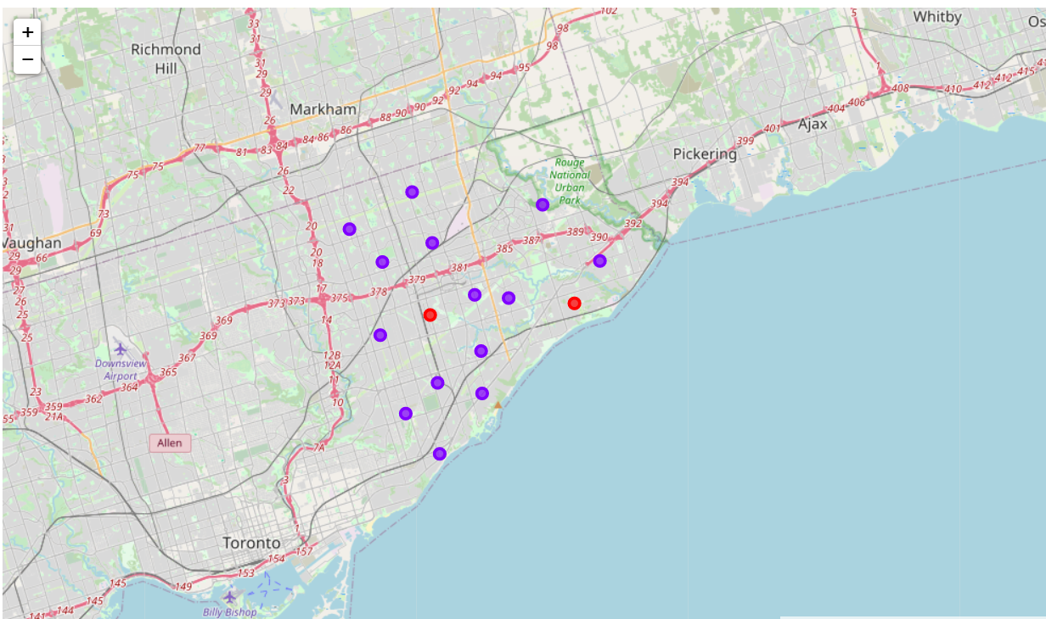
Map of Clusters in Scarborough

Slide 8
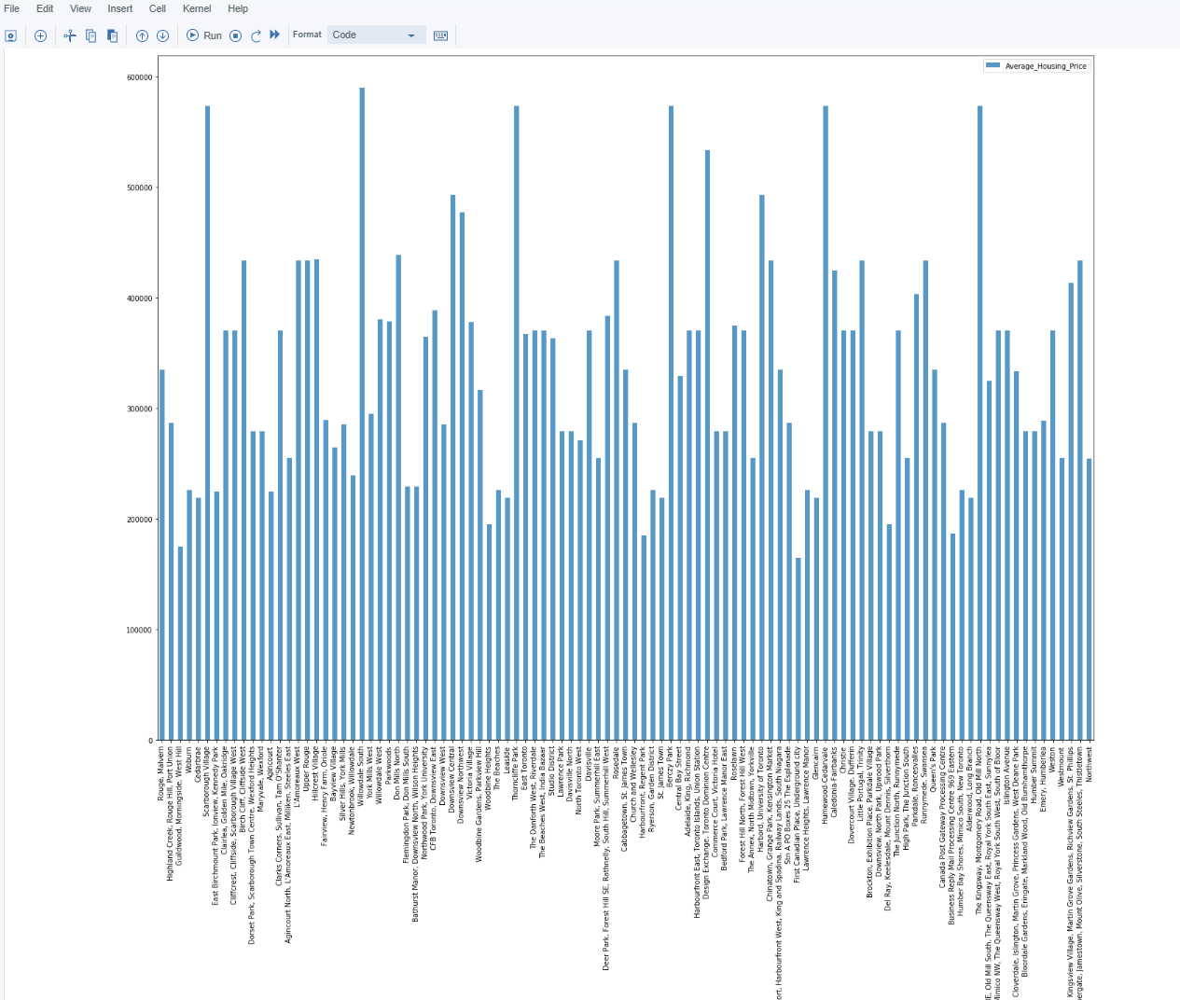
Average Housing Price

Slide 9
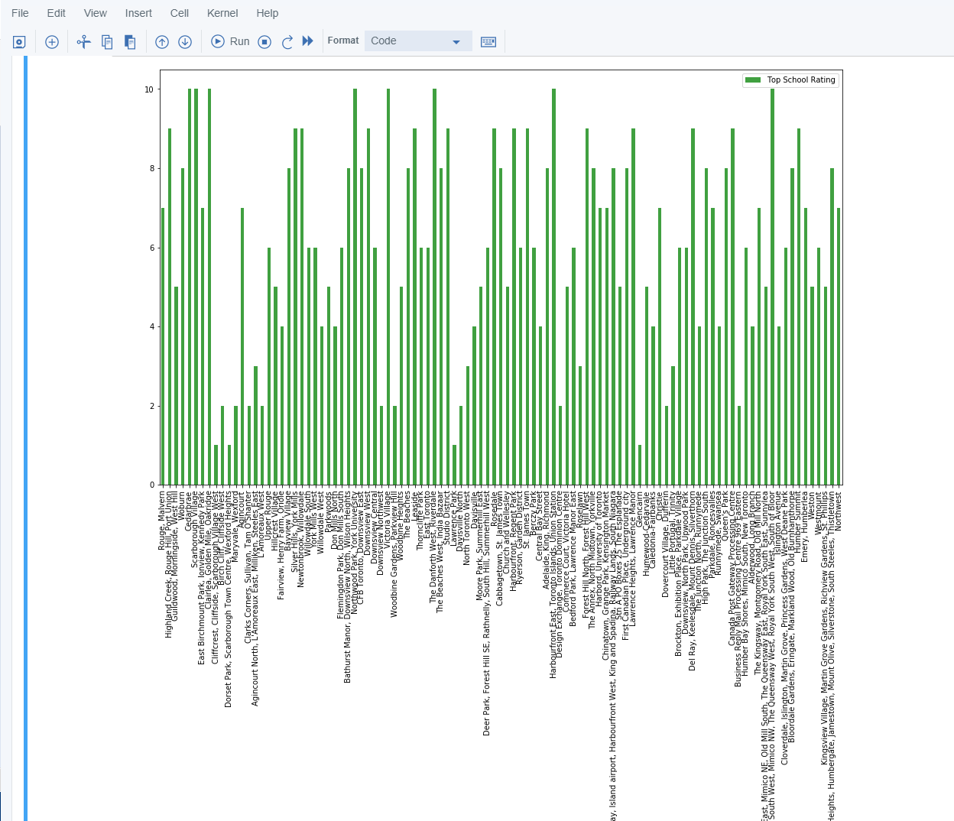
School Ratings

Slide 10
CONCLUSION
In this project, using k-means cluster algorithm I separated the neighborhood into 10(Ten) different clusters and for 103 different lattitude and logitude from dataset, which have very-similar neighborhoods around them. Using the charts above results presented to a particular neighborhood based on average house prices and school rating have been made.

