Slide 1
Insurance Fraud Detection System

Slide 2
Problem Statement
Insurance companies take risks over customers. Risk management is a very important aspect of the insurance industry. Insurers consider every quantifiable factor to develop profiles of high and low insurance risks.

Slide 3
Why solve this problem? To solve the problem of wrong claims. To save the company from wrong lawsuits. Control Fraud. To Avoid Losses.

Slide 4
Dataset Information
The dataset consists of data corresponding to 50553 customers and the test dataset consists of 12661 customers. Following are the features of the dataset
ID | Numerical | Insurance ID
Agency | Categorical | Name of agency
Agency Type | Categorical | Type of travel insurance agencies
Distribution Channel | Categorical | Distribution channel of travel insurance agencies
Product Name | Categorical | Name of the travel insurance products
Claim | Numerical | Target: Claim Status
Duration | Numerical | Duration of travel
Destination | Categorical | Destination of travel
Net Sales | Categorical | Amount of sales of travel insurance policies
Commision (in value) | Categorical | The commission received for travel insurance agency
Gender | Categorical | Gender of insured
Age | Numerical | Age of insured

Slide 5
Evaluation Metric
The evaluation metric for this project is precision score.
Precision Score checks the ratio of True Positive with respect to True Positive and False Positives that is The True Values predicted with respect to Overall True Values

Slide 6
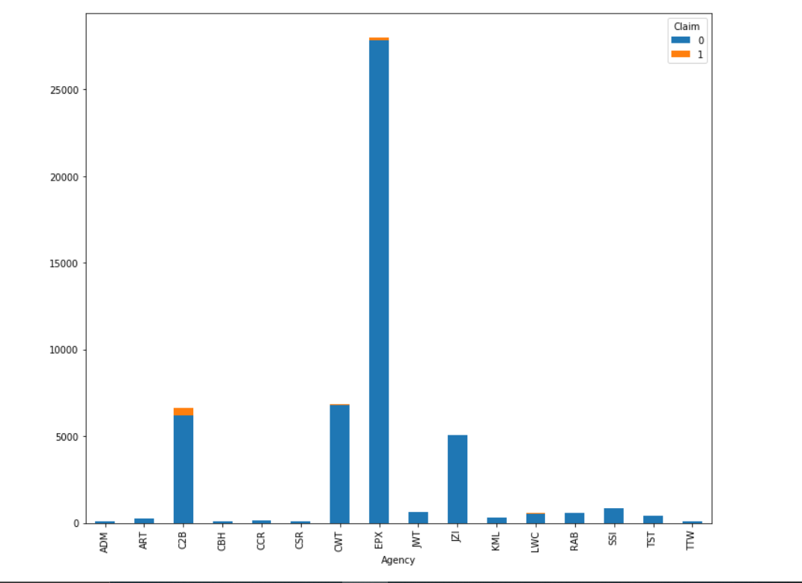
Univariate Analysis Agency Distribution

Slide 7
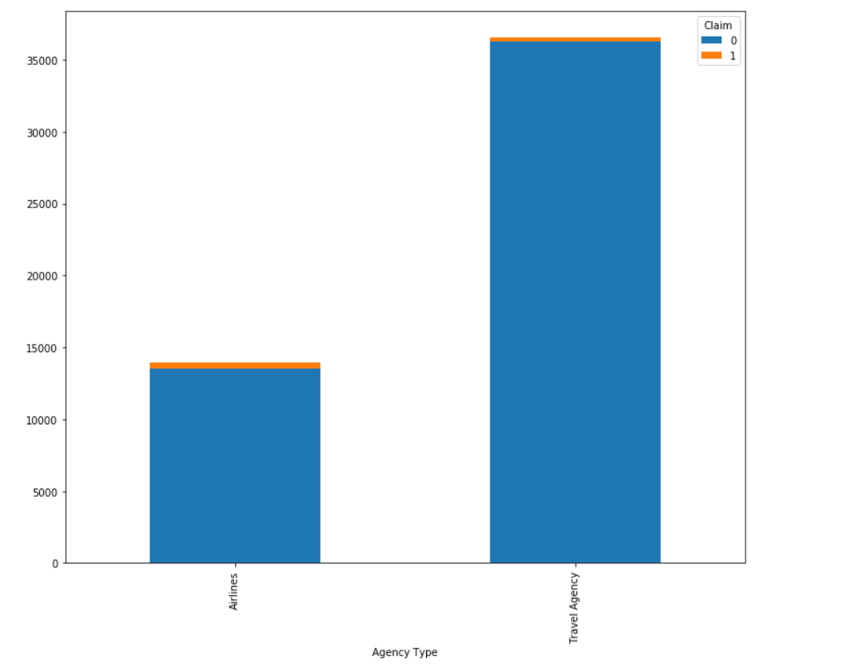
Agency Type Distribution

Slide 8
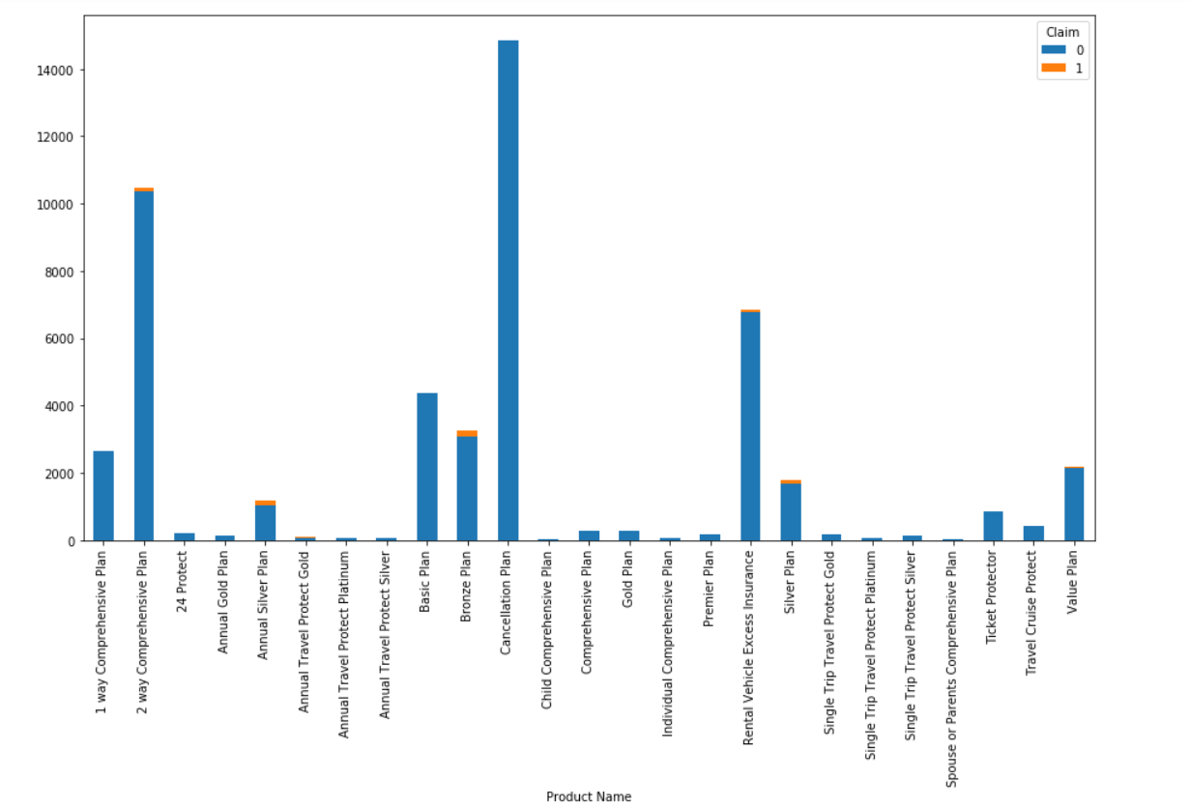
Product Name Distribution

Slide 9
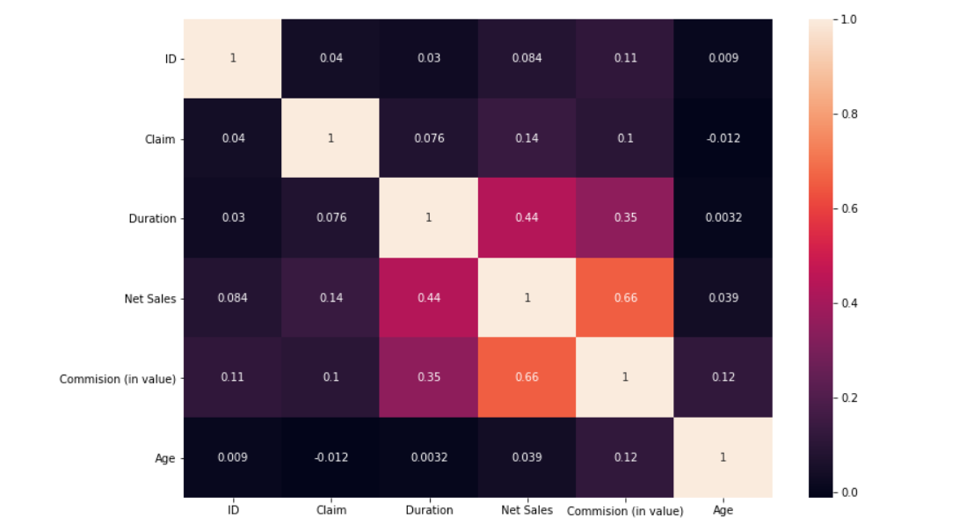
Numerical Data Correlation

Slide 10
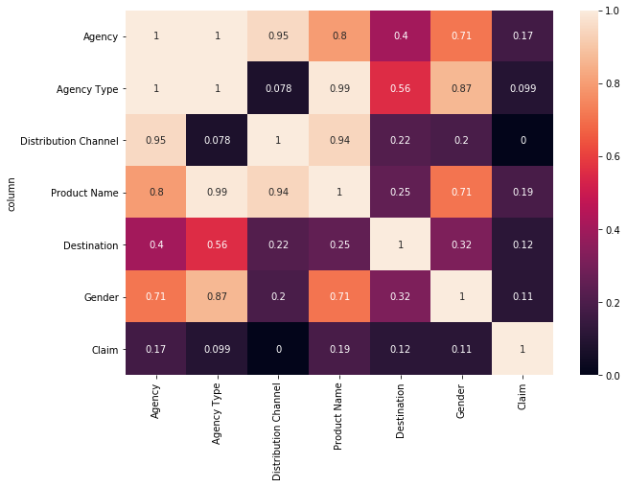
Categorical Variable Correlation
Observation:
We can see the Co-relation between the Categorical columns.
So , we can conclude that the column "Agency Type' have high correlation with some of the columns like "Agency“ , “Product Name" thus we can drop "Agency Type".

Slide 11
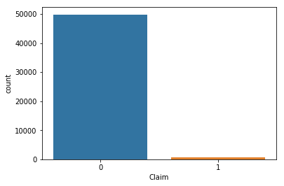
Imbalance in Dataset
Observation : From the graph we can say that there is high imbalance in the target variable. We will see how to deal with that a little later.

Slide 12
Feature Selection
Following methods were used for feature selection :-
Correlation
RFE and Chi Squared Test
After estimating Pearson Correlation coefficients between continuous features, following features were dropped
Agency Type
Distribution Channel

Slide 13
Feature Selection
Recursive feature elimination was performed using Logistic Regression as the estimators. Below are the feature importance obtained using both the methods
Agency, Destination came out to be most important features

Slide 14
Models and Approaches
The models were - Logistic Regression - Random Forest Classifier – Decision Tree all of the three models were able to give an Precision_score above 60%.
We treated class imbalance using SMOTE for further improvement of the Precision_score .

Slide 15
Models and Approaches
Models Assessed : The models with SMOTE used yielded the following results below.
Modelling Methods | Precision | Recall | Auc Roc Score | Accuracy
LogisticRegression | 0.64 | 0.65 | 0.74 | 0.72
RandomForestClassifier | 0.75 | 0.62 | 0.70 | 0.78
DecisionTreeClassifier | 0.72 | 0.67 | 0.65 | 0.74

Slide 16
Insights & Decisions
Customers to be targeted ○ Age : 21 – 40
Destination is an important factor.
Agengy C2B has higher percentage of insurance claim with a ratio of around 0.2 .

Slide 17
Next Steps
If time permitted, could have tried the following :
Better feature engineering
An ensemble of different models
GridSearch CV and Model Tuning
Reasons of Claim Data

