Slide 1


TRANSORG AGENTIQ DATATHON · TRACK 1
UPI Transaction Anomaly & Risk Intelligence
TR-1: UPI Fraud & Merchant Risk Intelligence
TEAM: THE CLOVE MIX

Slide 2
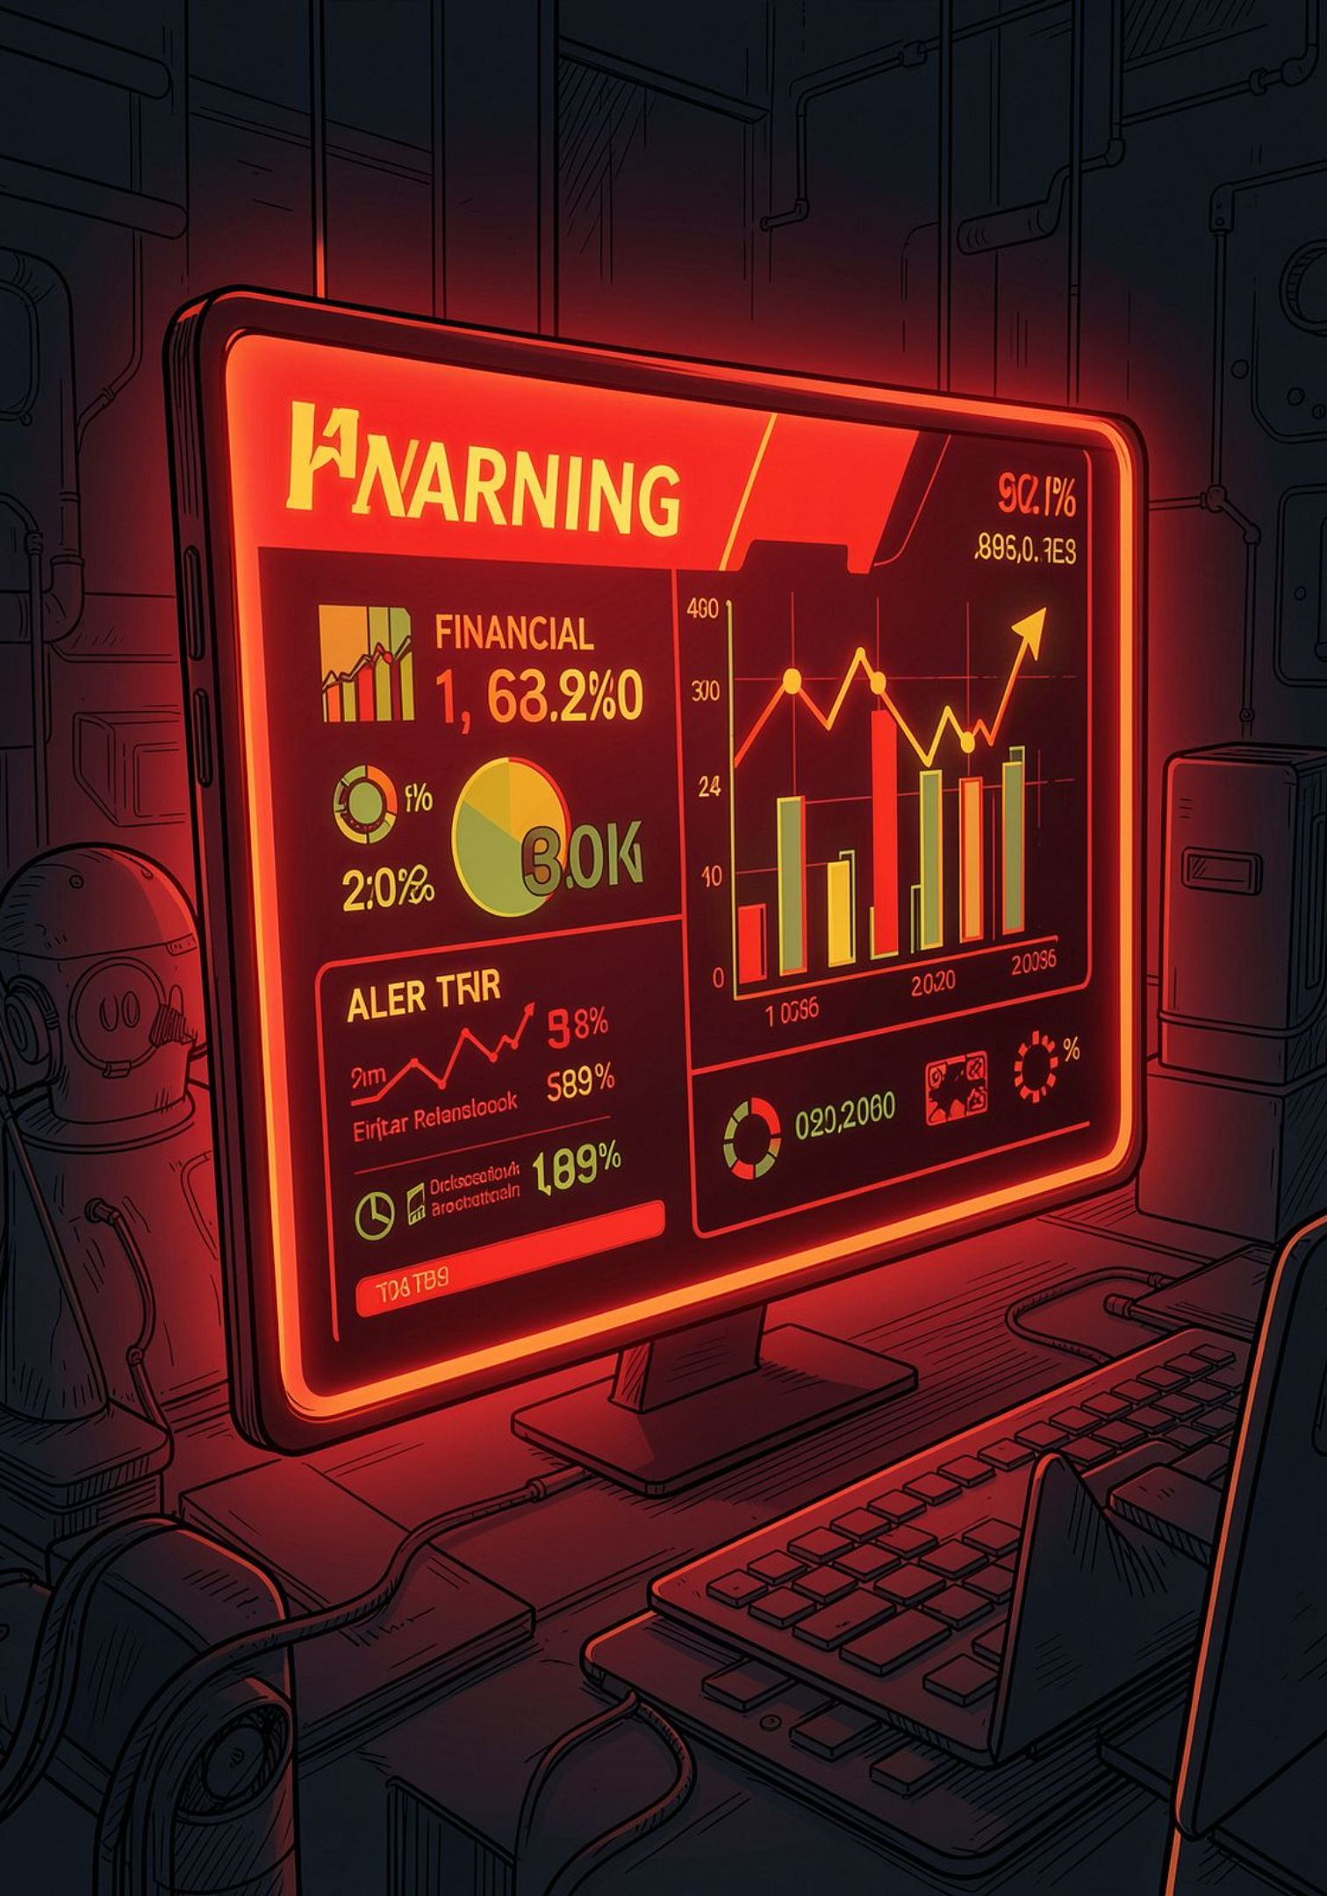
THE CHALLENGE
The Problem We're Solving
Scale
UPI volumes are massive and growing — manual review cannot keep up
Fraud & Disputes
Fraudulent transactions, disputed chargebacks, and incomplete KYC records create real financial and compliance risk
The Gap
No single, reliable view of transaction health, merchant risk, and dispute patterns
Accessibility
Non-technical stakeholders need plain-English access to data insights

Slide 3

OUR APPROACH
Objective & Scope
Build an end-to-end analytics pipeline — from raw UPI data to a live, interactive platform.
Raw UPI Data
BI Dashboard
Cleaned Analytics
Track 1 Focus: Fraud detection · Merchant risk scoring · Data-quality transparency

Slide 4
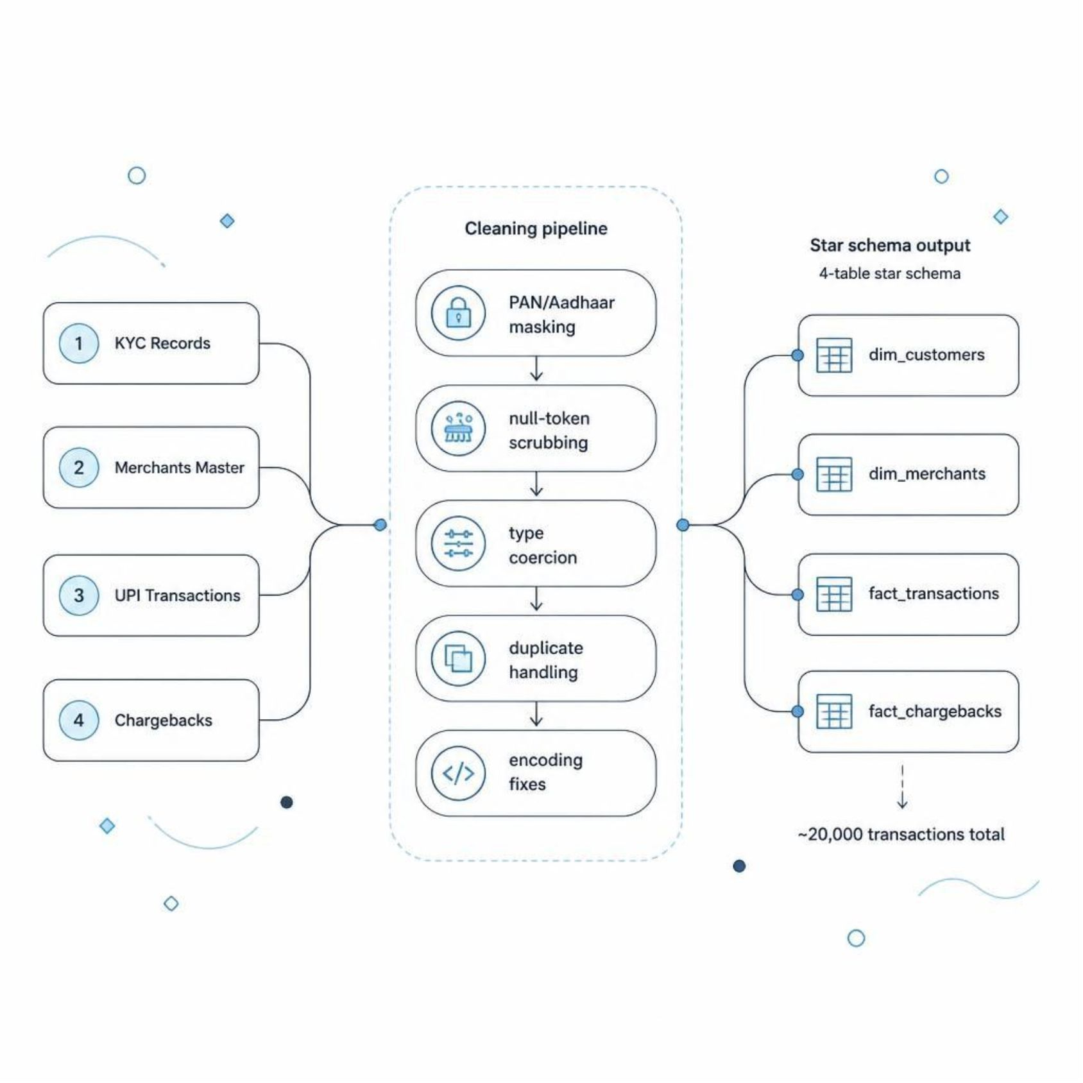
DATA ENGINEERING
Data & Cleaning Pipeline
4 Raw Sources
KYC records
Merchants master
UPI transactions
Chargebacks
Cleaning Pipeline (clean_pipeline.py)
PAN/Aadhaar masking (PII protection)
Null-token scrubbing (unknown, n/a)
Type coercion & duplicate handling
Encoding fixes
Output: 4-table star schema · ~20,000 transactions

Slide 5
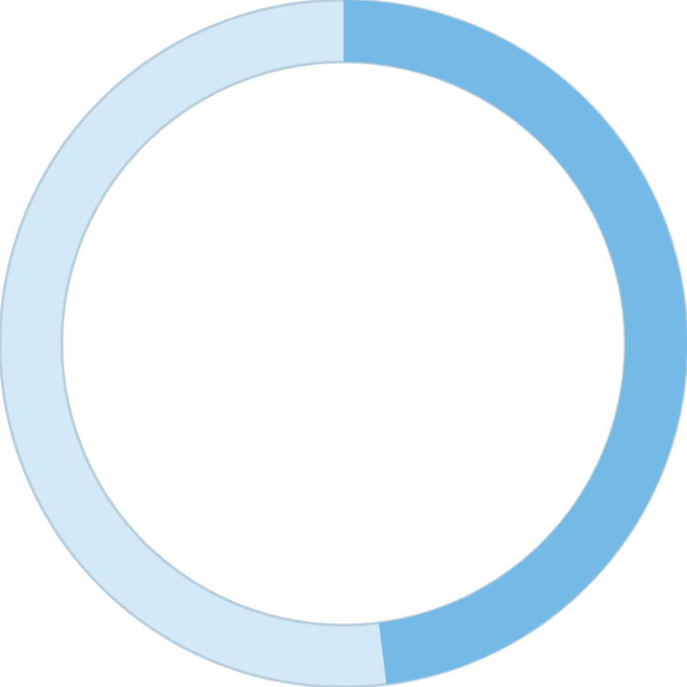
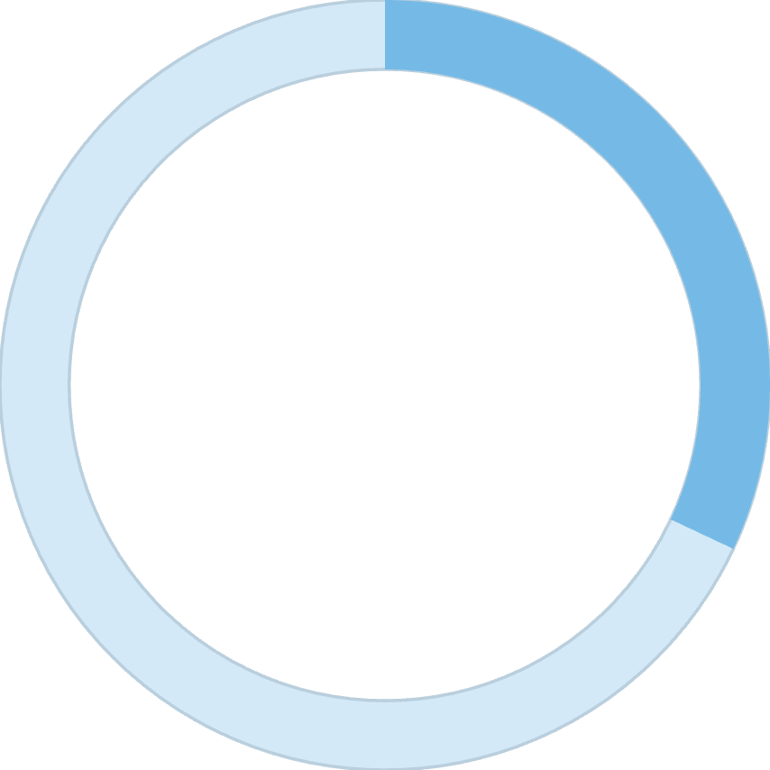
DATA QUALITY
Data Quality as a First-Class Feature
48%
32%
Merchant Match Rate
Customer Match Rate
Transactions linked to a real merchant record
Transactions linked to a real customer record
Unmatched records are labelled as "No Matching Merchant/Customer" — never silently dropped. Match-rate KPIs appear on every relevant chart, making data quality visible rather than hidden.

Slide 6
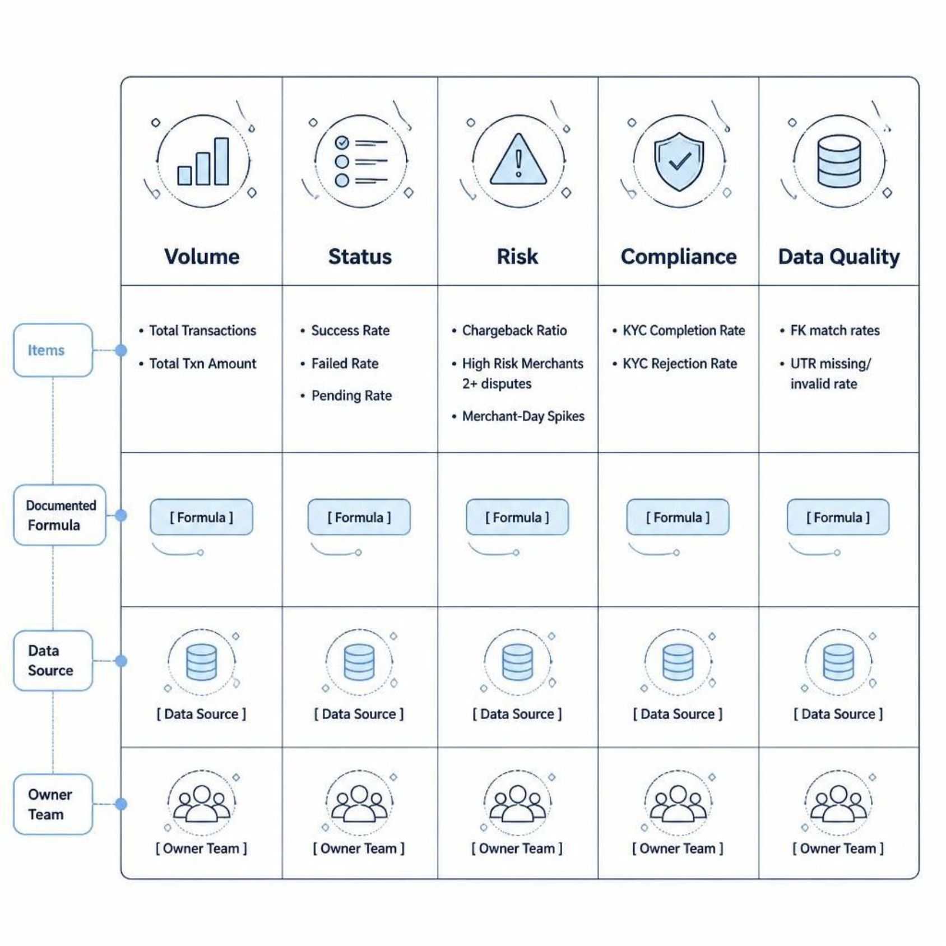
METRICS
KPI Framework: 18 Core KPIs
Five Categories
Volume — Total Transactions, Total Txn Amount
Status — Success / Failed / Pending Rate
Risk — Chargeback Ratio, High-Risk Merchants, Merchant-Day Spikes
Compliance — KYC Completion / Rejection Rate
Data Quality — FK match rates, UTR missing/invalid rate
Every KPI has a documented formula, data source, and owner team.

Slide 7
BI DASHBOARD
Power BI Dashboard
Overview
Fraud & Dispute Analysis
Customer Risk & Data Quality
High-level transaction health & KPIs
Chargebacks, patterns & anomalies
FK match rates, unmatched records
Fraud-Ring Spotlight
KPI Reference
Clustered suspicious activity
FAQ, full KPI dictionary & chatbot link
Native page navigator · Drill-down by merchant category, state, and city · Published via Power BI "Publish to Web"

Slide 8

AI CHATBOT
AI Chatbot: Text-to-SQL
Architecture
FastAPI backend — read-only by design
is_read_only() guardrail on every query path
21 hand-vetted SQL templates for instant answers
LLM fallback (OpenRouter) for complex queries
Answers cite actual query results — never from memory
Same 4 cleaned CSVs as the dashboard

Slide 9
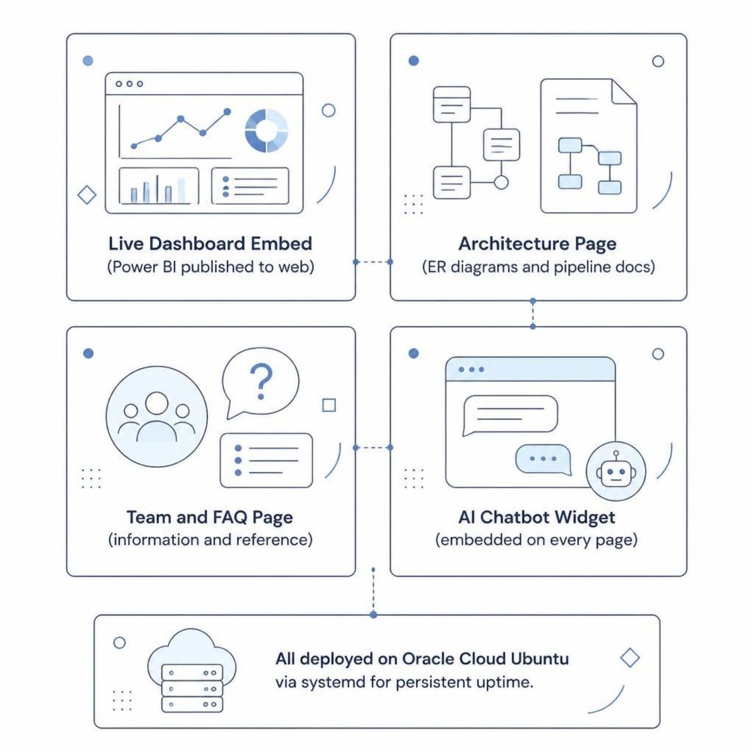
DEPLOYMENT
Web Platform & Deployment
Public Website
Live Power BI dashboard embed
Workflow & architecture page (ER diagrams)
Team page & information/FAQ section
Chatbot widget embedded on every page
Infrastructure
Oracle Cloud — Ubuntu instance
systemd services for always-on access
One link for the entire project

Slide 10


TEAM & IMPACT
Team: the clove mix
5
20K
Team Members
Transactions Processed
M.Tech, TransOrg AgentIQ Datathon
Cleaned, labelled, and analytics-ready
18
Core KPIs
Documented, sourced, and owned
A messy, real-world UPI dataset → a single, trustworthy source of truth. Usable by analysts via Power BI and by anyone via plain-English chat.
Future Work: Real fraud-scoring model · Live data refresh · Automated alerting

