Slide 1

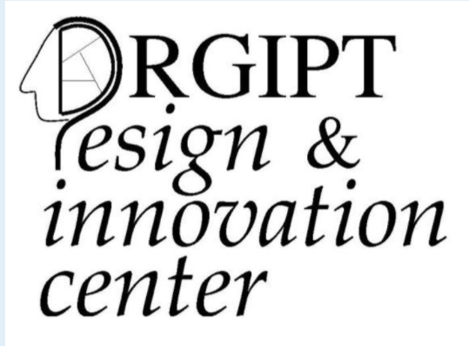
Blockchain in Healthcare Domain
Under the guidance of:
Dr. Daya Sagar Gupta
Assistant Professor , RGIPT
By :-Saurabh Jaiswal 20CS3058

Slide 2

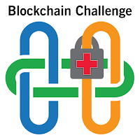

INTRODUCTION :
Blockchain has many applications in healthcare, and can improve mobile health applications, monitoring devices, sharing and storing of electronic medical records, clinical trial data, and insurance information storage.

Slide 3

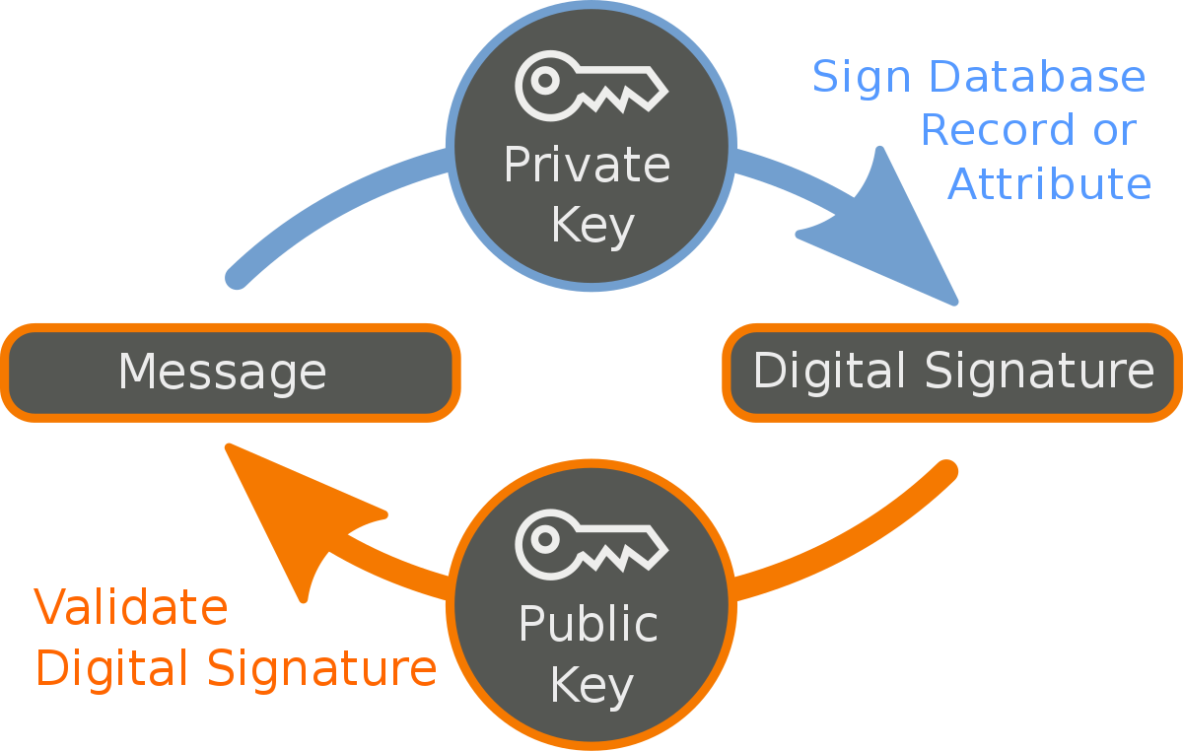
Continued…
Blockchain can be a transparent and auditable means for people to provide others access to their sensitive health data by utilizing their unique credentials and encryption key. This includes granting access to your medical records to healthcare professionals, service providers, and other relevant actors to provide direct healthcare or enable research, statistics, or other secondary data uses.

Slide 4
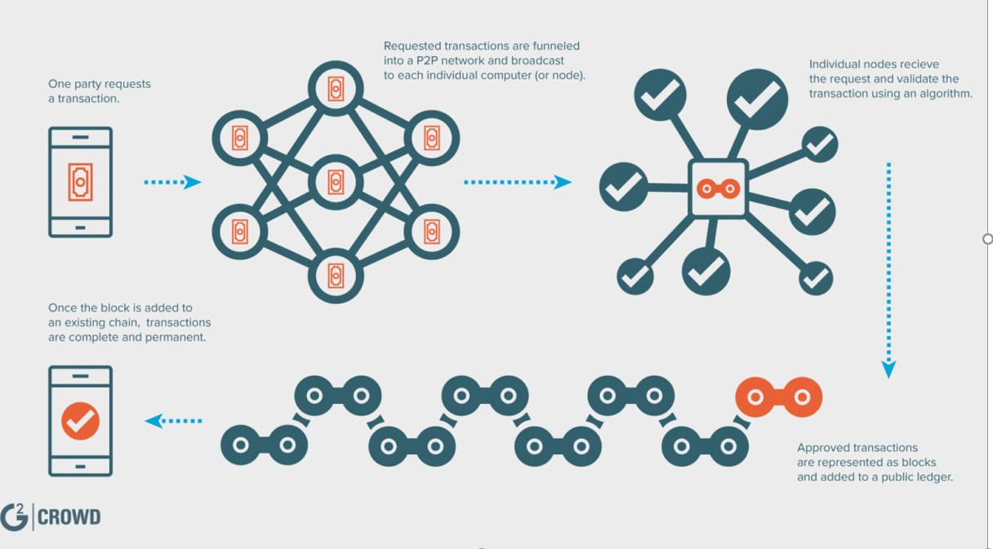
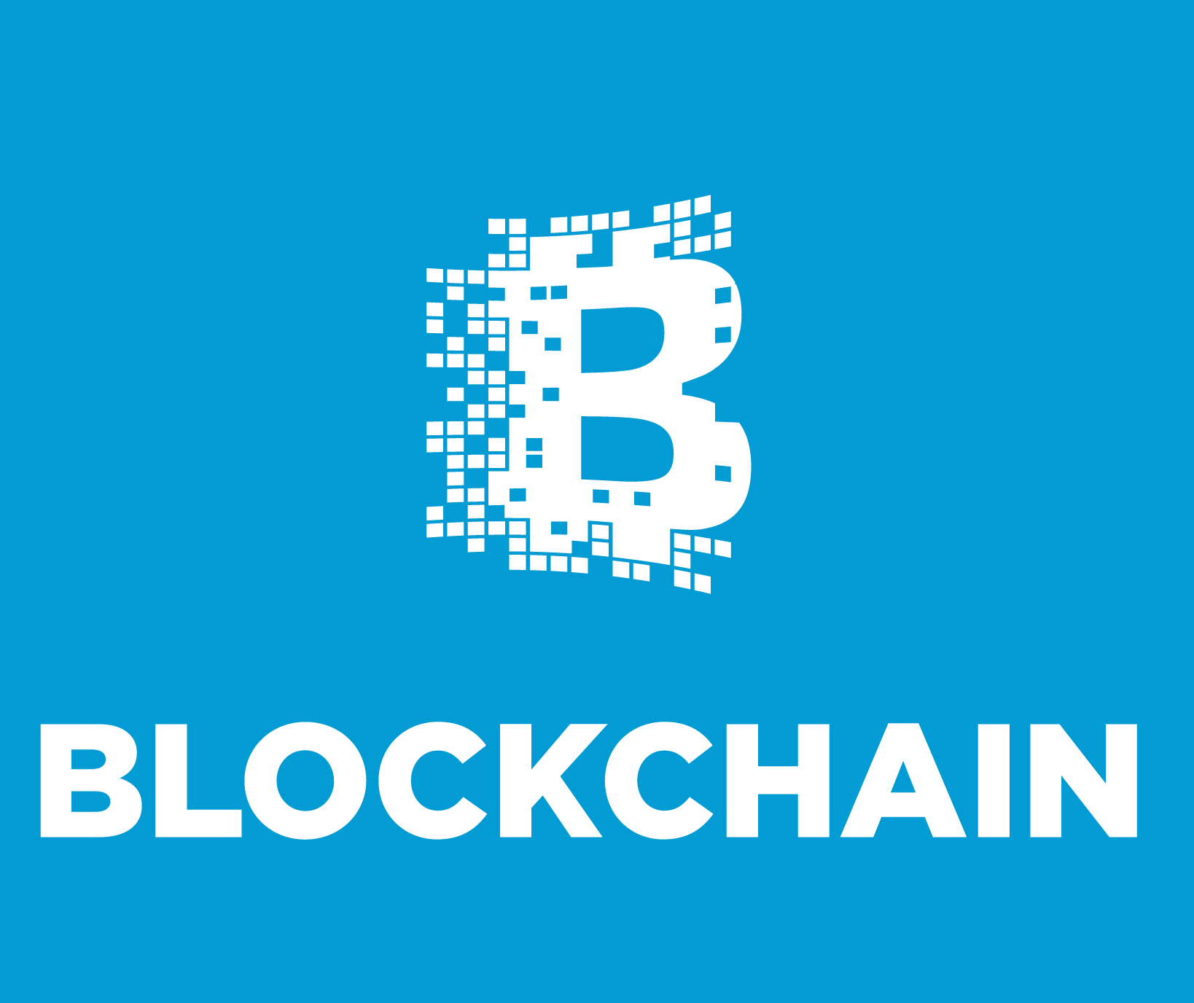
Continued…
Peer to peer networks is defined as the group of devices that are connected together to create a network that is often known as peer to peer network (P2P) network.
This Photo by Unknown Author is licensed under CC BY-NC

Slide 5
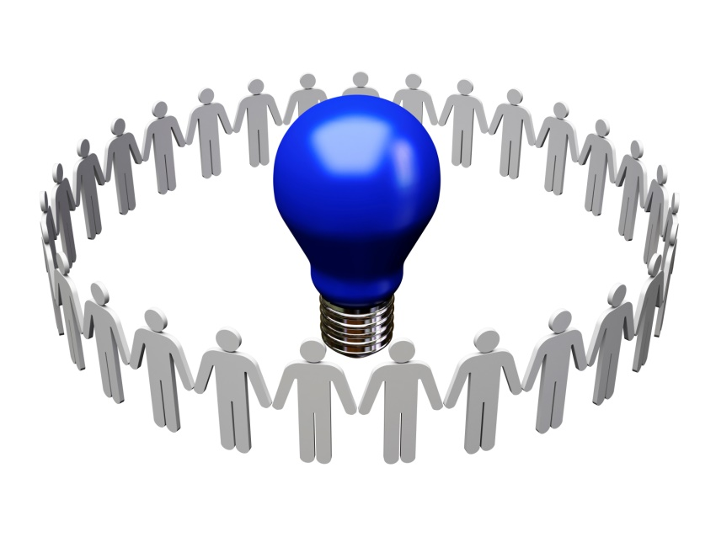

Design & Innovation :
This will improve in maintaining access control, scalability and the content or transactions information stays secure. Further research is also needed to supplement ongoing efforts to address the challenges of better scalability, latency, interoperability, security and privacy in relation to the use of blockchain technology in healthcare.

Slide 6
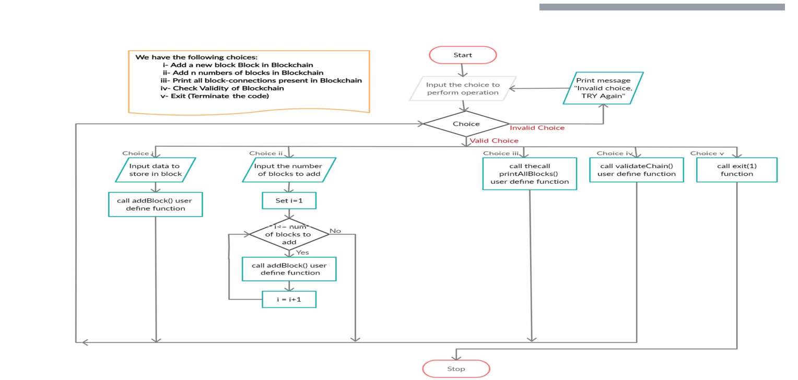
Flowchart for this problem

Slide 7

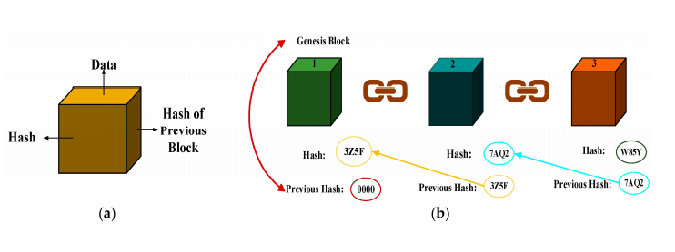

Result & Discussion :

Slide 8


Continued…
The objective of the this study during our project is to understand the scope of blockchain in health care domain. Blockchain has capability to face the challenges of healthcare industry . Healthcare industry is facing problem in adapting growing technical infrastructure . As such technology enable the healthcare industry to be more better .

Slide 9

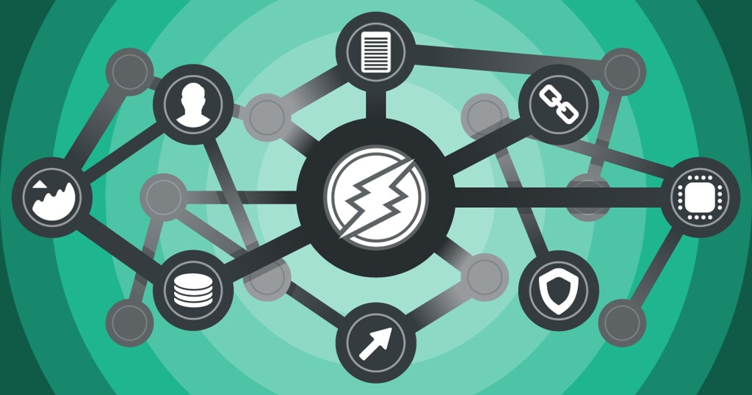
Continued…
Blockchain-study’s findings can be utilized by multiple stakeholders including healthcare providers , managers and policy makers . Increased adoption of Blockchain technology will lead to disruptive changes in the current healthcare system

Slide 10


Continued…
With some proper studies , administration can take decision after evaluating the potential disruptiveness . It can resolve the problem related to information storage , exchange and management issue in healthcare domain.

Slide 11

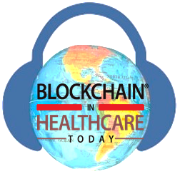

Current Scope :
Currently we have to more work on the data security features . We have to make some ethically and logically changes to make blockchain more useful .

Slide 12
References :
www.academy.binance.com/en/glossary/blockchain?utm_campaign=googleadsxacademy&utm_source=bing&utm_medium=cpc&msclkid=df59b3082c141f7d4819d143016dec91
www.ncbi.nlm.nih.gov/pmc/articles/PMC6764776/#:~:text=Table%201%3A%20%20%20%20Name%20%20,notifications%20to%20...%20%2014%20more%20rows%20
Blockchain%20in%20healthcare%20applications_%20Research%20challenges%20and%20opportunities.pdf
Blockchain%20in%20healthcare_%20A%20systematic%20literature%20review,%20synthesizing%20framework%20and%20future%20research%20agenda%20_%20Elsevier%20Enhanced%20Reader.pdf

Slide 13



Acknowledgement :
This study is supported by our mentor Dr. Daya Sagar Gupta and our college Rajiv Gandhi Institute of Petroleum Technology ( An Institute of national Importance).

Slide 14
THANK YOU
HOPE YOU LIKED THE PROJECT

