Slide 1
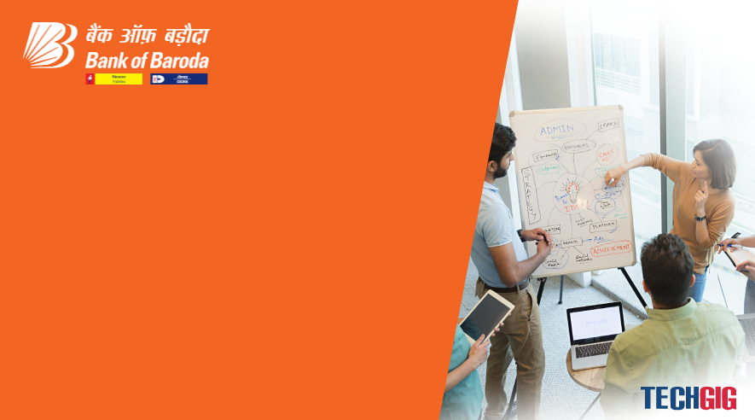

Bank of Baroda Hackathon - 2022
Technology Partner
Your Team Name : MASS
Your team bio : Undergraduates willing to solve real-world Problems through hands on experience with Projects.
Date : 18 September, 2022

Slide 2
Problem Statement?
Why did you decide to solve this Problem statement?
Bank is doing alot of manual, time taking, tedious task in order to verify single cheque.
Sometimes human manual verification is not that much effective and has high possiblity of error in case when a lot of people are waiting in long Queue.
People of older age especially find it alot more difficult to verify their cheque as their signature changes with time and hence not matches with bank database.
Being Student of computer Science we are thrilled to address this problem and provide an effective and efficient solution to prevent frauds and increse throughput of check processing.

Slide 3
User Segment & Pain Points
Which user /advertiser segment would be early adopter of your product & why?
For older citizen : As their signature changes with time.
Middle class : Waste a lot of time in long queue due to long manual processing time of individual cheque.
Uneducated person :Don’t have knowledge to operate ATM or online services and hence they had to rely on cheque.

Slide 4
Pre-Requisite
What are the alternatives/competitive products for the problem you are solving?
Net banking: Significantly reduce cheque but only operable by educated sector of society.
Debit Card: Not all people are eligble for KYC, there are various services charge which are debited from account on annual basis.

Slide 5
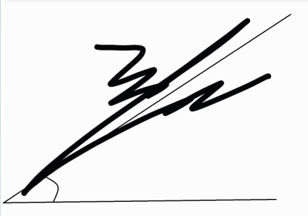
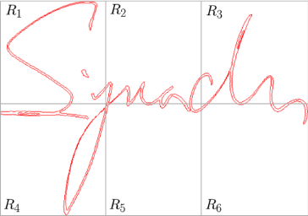
Any Supporting Documents
Present your solution, talk about methodology, architecture & scalability.
Sign verification by measuring slope of sign.
Space ratio of alternate character

Slide 6
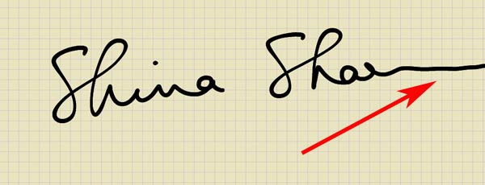
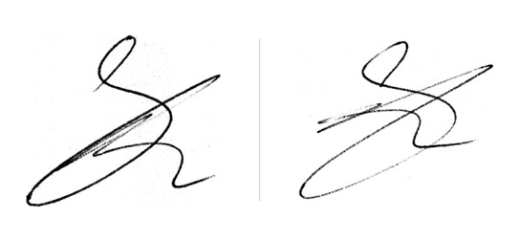
Ending flow of signature
Pressure with which signature is done & ink pixel verification.

Slide 7
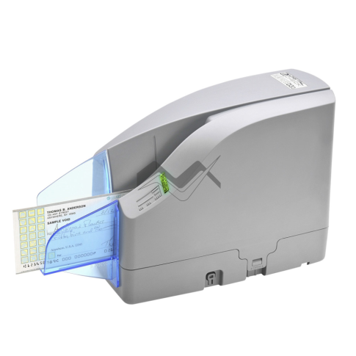
Automatic data entry from cheque no. & account no. Using OCR.
Better hardware like in vending machine to directly proceess cheque without human intervention.

Slide 8
Scalability
Provide cloud solution for our problem.
Can be implemented by other bank.

Slide 9
Azure tools or resources
Azure tools or resources which are likely to be used by you for the prototype, if your idea gets selected. Need cloud server to host out pototype.

Slide 10
Key Differentiators & Adoption Plan
How is your solution better than alternatives and how do you plan to build adoption?
Dataset keeps on updating as more & more users use our service and hence enhance the security.
Gets better as more and more pattern is identified and eventually able to recognize older people signature.
Uneducated people will also find it easy to use as they only need to fill cheque and model will instantly process it within fractions of second.

Slide 11
GitHub Repository Link & supporting diagrams, screenshots, if any
How far it can go?
We are planning to build hardware which uses high quality sensors to scan the check and read its characters using OCR techniques, our model is going to authenticate the check and once it get verified the data is going to be updated in the dataset atomatically.
GitHub-Repository

Slide 12
Thank You
Team member names:
Asad Shoyeb Khan
Deepanshu Goel
Pranav Jadhav
Saurabh Jaiswal

