Slide 1
Loan Default Prediction: A Data-Driven Approach
Customer behavior analysis for loan granting
Prepared by: Saurabh Pandey
Poluri Leela Shankar

Slide 2
Objective
Study customer behavior for loan granting
01
Predict likelihood of default
02
Support decision-making: loan denial, amount adjustment, or higher interest rates for risky applicants
03

Slide 3
Case Study Understanding
This case study aims to provide insights into solving business problem through exploratory data analysis (EDA), focusing on risk analytics in banking and financial services. It highlights how data is used to minimize financial risk when lending to customers.
Business Understanding
You are working for a consumer finance company that lends various types of loans to urban customers. The company must decide on loan approvals based on applicants' profiles, facing two main risks:
Not approving a loan may result in lost business if the applicant can repay. Approving a loan may lead to financial loss if the applicant is likely to default. The dataset includes information on past loan applicants, indicating whether they defaulted. The goal is to identify patterns that predict loan defaults, which can guide decisions like denying loans, reducing loan amounts, or adjusting interest rates for risky applicants.
Decision Scenarios: When a loan is applied for, the company can either:
Approve the Loan: Fully paid: The applicant repays the loan completely. Current: The applicant is still paying installments. Charged-off: The applicant defaults on the loan. Reject the Loan: No data is available for these applicants since they did not proceed with the loan.
Business Objectives
As the largest online loan marketplace, the company seeks to minimize credit loss, which occurs when borrowers default on loans. The aim is to identify risky applicants labeled as 'charged-off' to reduce potential losses.
By understanding the key variables influencing loan defaults, the company can enhance its risk assessment and portfolio management. Additionally, conducting independent research on risk analytics is recommended to deepen your understanding of the relevant variables and their significance.

Slide 4
Data Preparation - Steps
Handling Missing Values
Step 1: Identifying Missing Values
- Analyze and drop columns with excessive null values
- Ensure no null columns are left after processing
Step 2: Removing Duplicates
- Check for duplicates in the dataset and remove if found
Dropping Unnecessary Columns
Step 1: Remove Unique/Descriptive Columns
- Columns with unique or text-based descriptions contribute little to analysis
- Focus on relevant columns for better accuracy
Step 2: Limit Analysis to Loan Grade Level
- Subgrade level detail removed
Correct Data Types & Derived Columns
- Convert columns to appropriate data types
- Generate derived columns for enhanced insights

Slide 5
Key Variables For Analysis
Customer Demographics
Annual Income (annual_inc)
Home Ownership (home_ownership)
Employment Length (emp_length)
Debt to Income (dti)
State (addr_state)
Loan Characteristics
Loan Amount (loan_amt)
Grade (grade)
Term (term)
Loan Date (issue_d)
Purpose of Loan (purpose)
Verification Status (verification_status)
Interest Rate (int_rate)
Installment (installment)
Public Records (public_rec)

Slide 6
Univariate Analysis
Purpose: Understand individual features of the data
- Graphical overview of all columns
- Handle outliers and create appropriate buckets for continuous variables
Observations
Loan Amount:
- Majority in range: 5.5k - 15k
- Max: ~35k
Funded Amount:
- Most in range: 5.4k - 15k
- Max funded amount: ~35k
Interest Rate:
- Average: 11.8%
- Min: 5.4%, Max: 24.4%
- Common range: 8.9% - 14.52%

Slide 7
Categorical Variable Analysis
Observations
Experience: Majority of applicants have 10+ years of experience
Living Situation: Most applicants are either renting or have a mortgage
Loan Purpose: Debt consolidation is the primary reason for applying
Location: Most applicants are from California (CA)
Loan Grade: Majority of loans are of Grade B
Verification Status: 'Verified' applicants have a higher likelihood of default

Slide 8
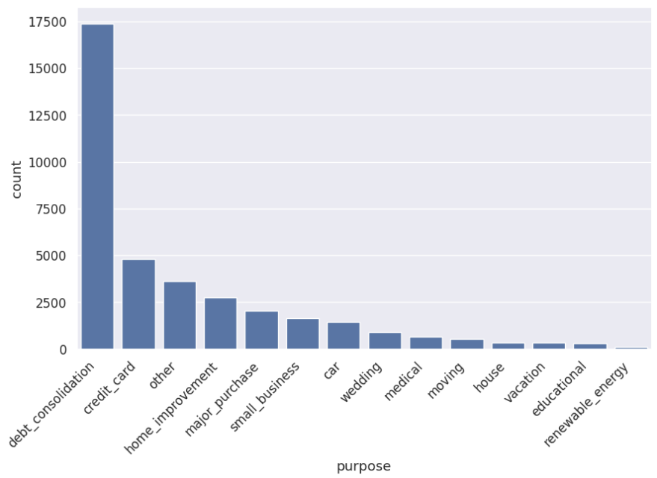
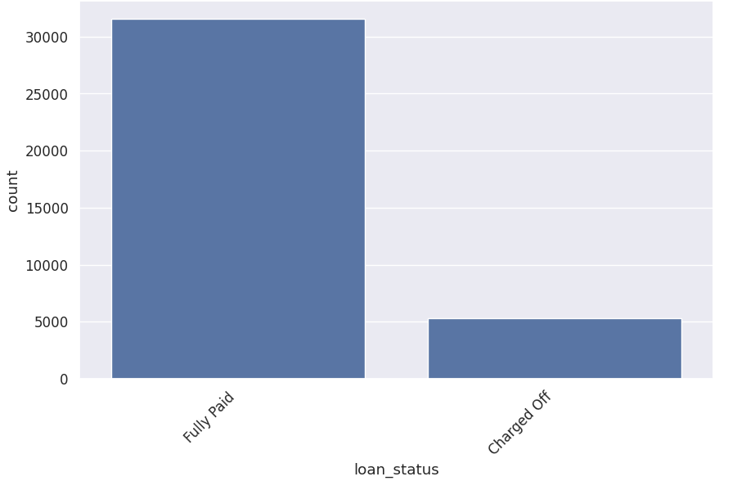
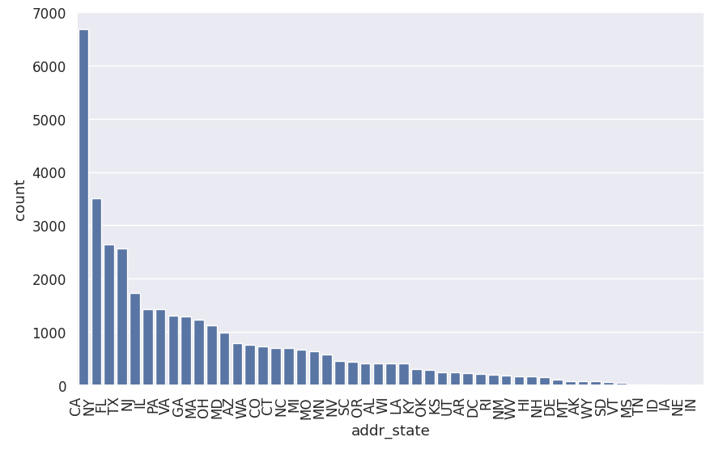
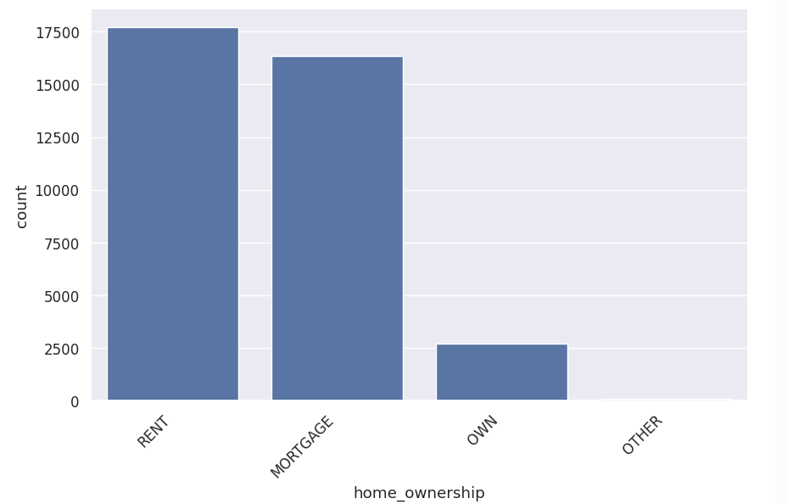
Variables Analysis

Slide 9
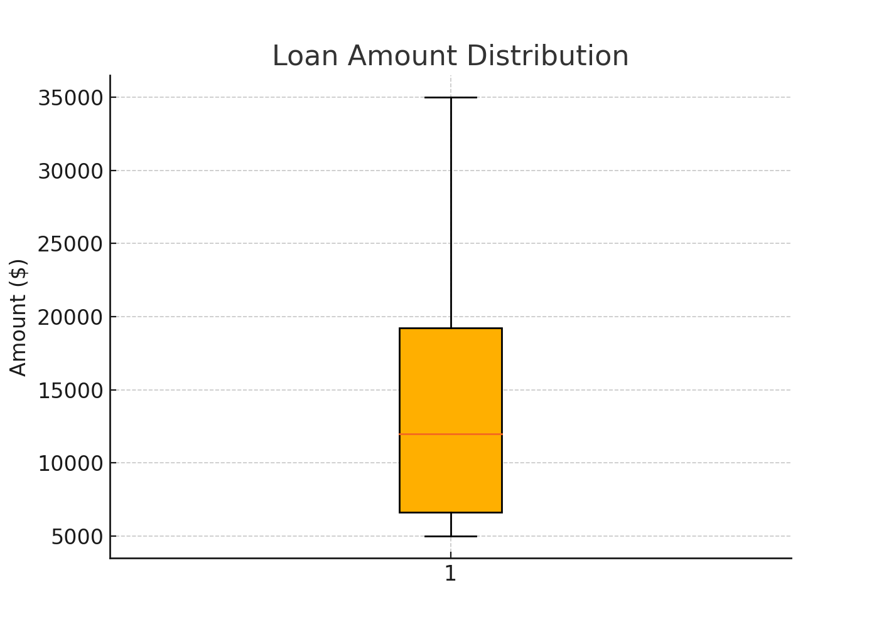
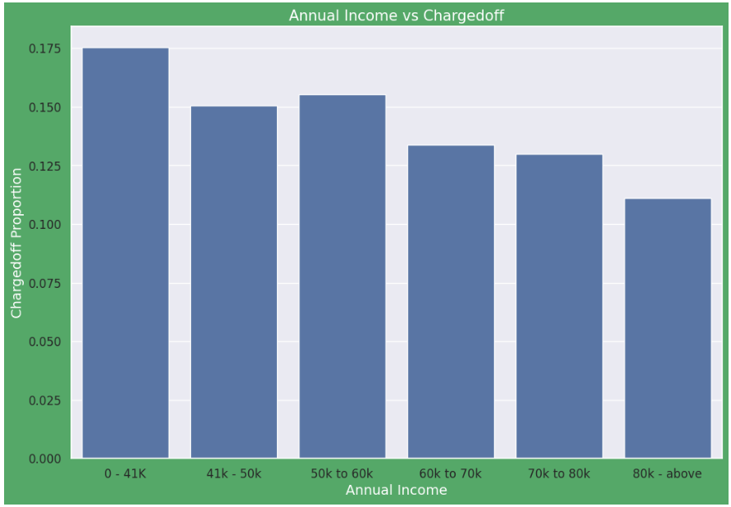
Annual Income Vs Charged off
Observations: 1. Income range 80000+ has less chances of charged off. 2. Income range 0-80000 has high chances of charged off. 3. Increase in annual income decreases charged off proportion.

Slide 10
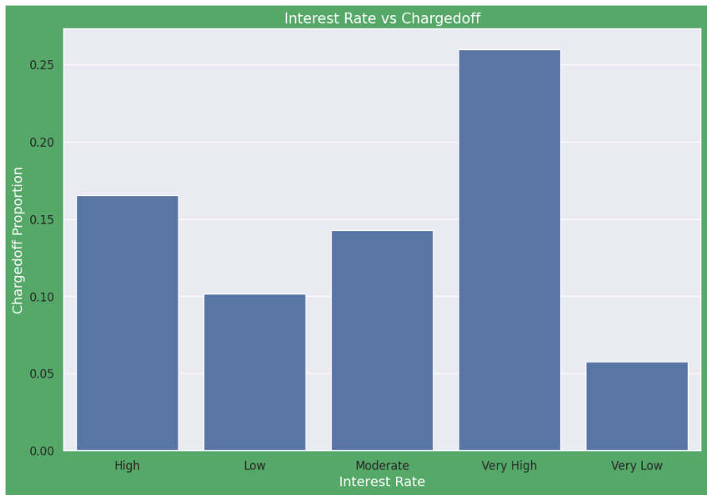
Interest Rate Vs Charged off
Observations: 1. Interest rate less than 10% or very low has very less chances of charged off. Interest rates are starting from minimum 5 %. 2. Interest rate more than 15% or very high has good chances of charged off as compared to other category interest rates. 3. Reason could be they might be failing to pay the installments with higher interest rate. 4. Charged off proportion is increasing with higher interest rates.

Slide 11
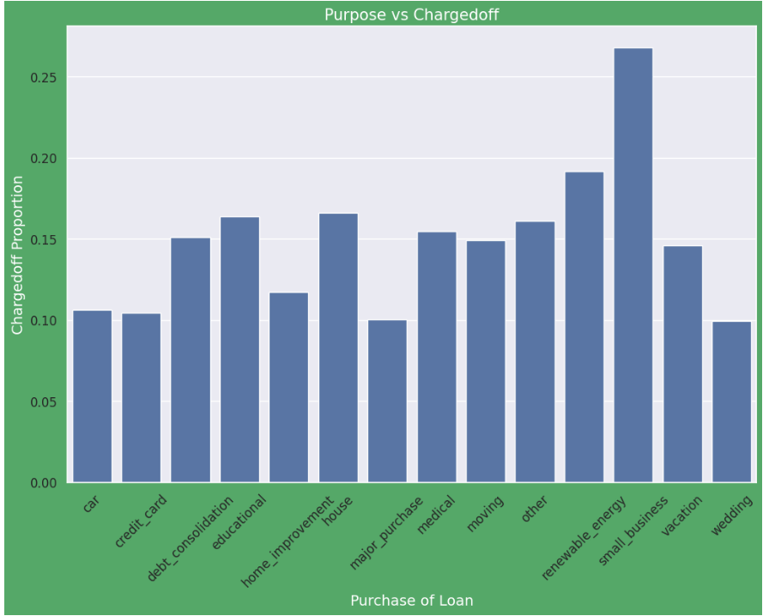
Purpose Vs Charged off
Observations: 1. Those applicants who is having home loan is having low chances of loan defaults.
2. Those applicants having loan for small business is having high chances for loan defaults.

Slide 12
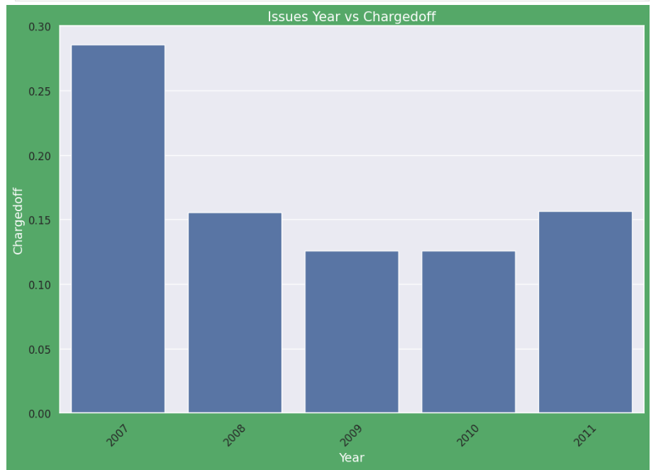
Issue Year Vs Charged off
Observations: 1. Year 2007 is having highest loan defaults.
2. Year 2009 is having lowest loan defaults.

Slide 13
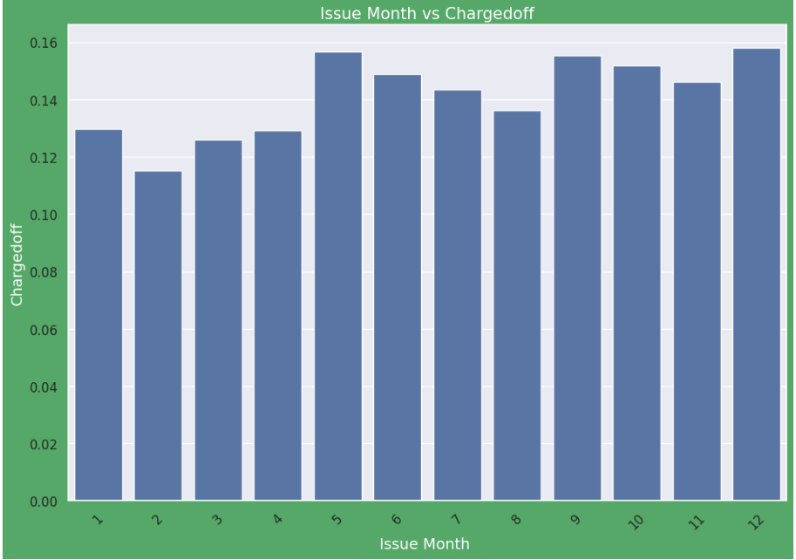
Issue Month Vs Charged off
Observations: 1. Those loan has been issued in May, September and December is having high number of loan defaults. 2. Those loan has been issued in month of February is having high number of loan defaults. 3. Majority of loan defaults coming from applicants whose loan has been approved from September to December.

Slide 14
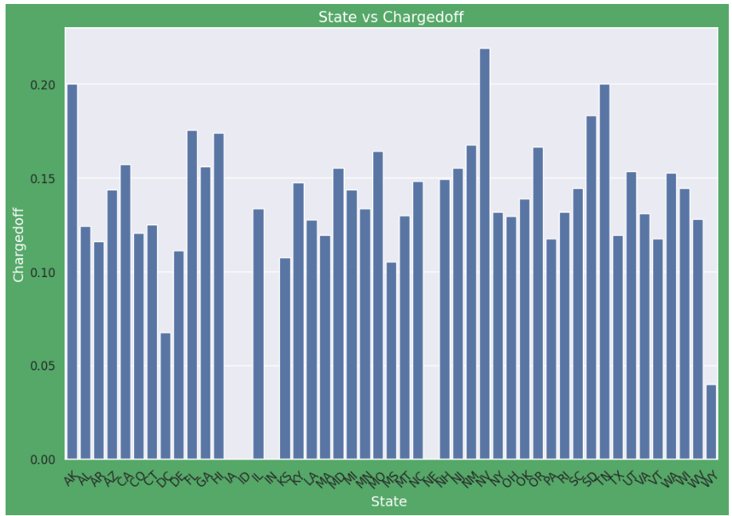
State Vs Charged off
Observations: 1. NV States is holding highest number of loan defaults.
2. WY is having low number of loan defaults

Slide 15
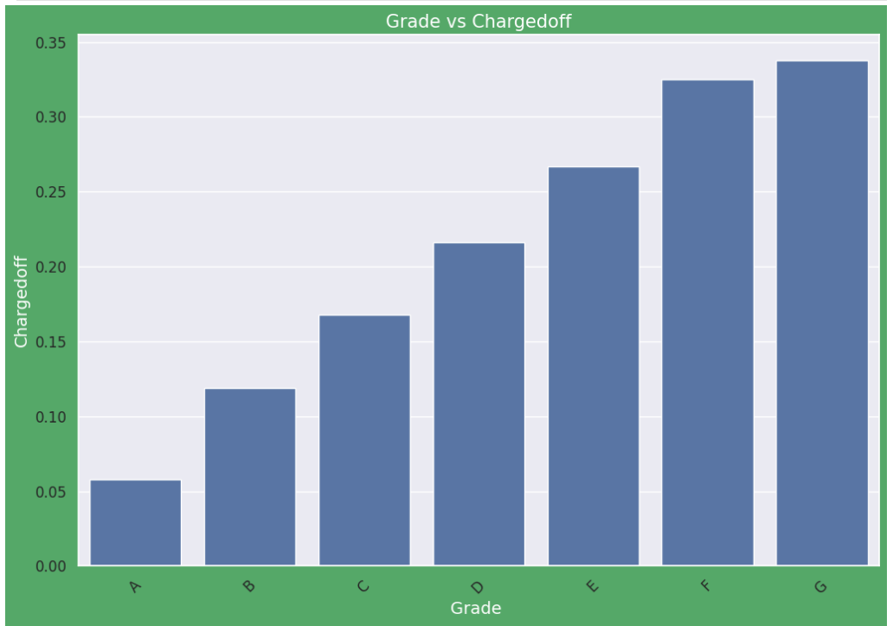
Grade Vs Charged off
Observations : 1. The Loan applicants with loan Grade G is having highest Loan Defaults. 2. The Loan applicants with loan A is having lowest Loan Defaults.

Slide 16
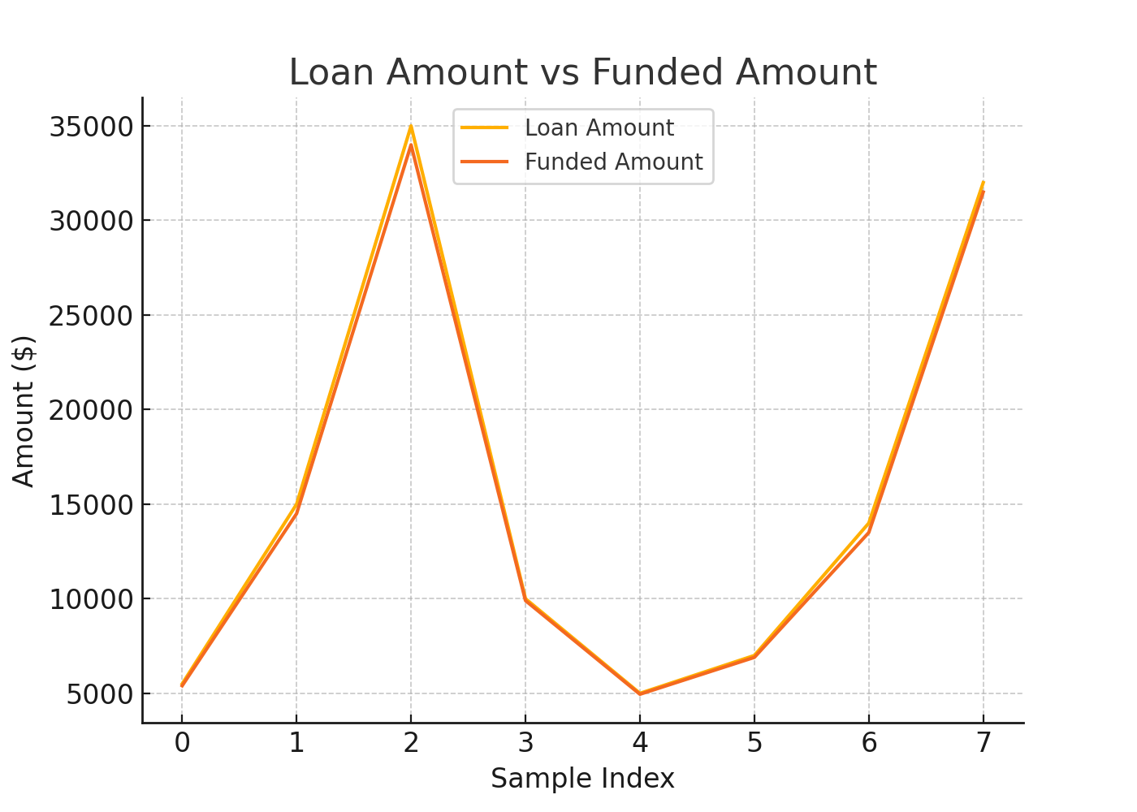
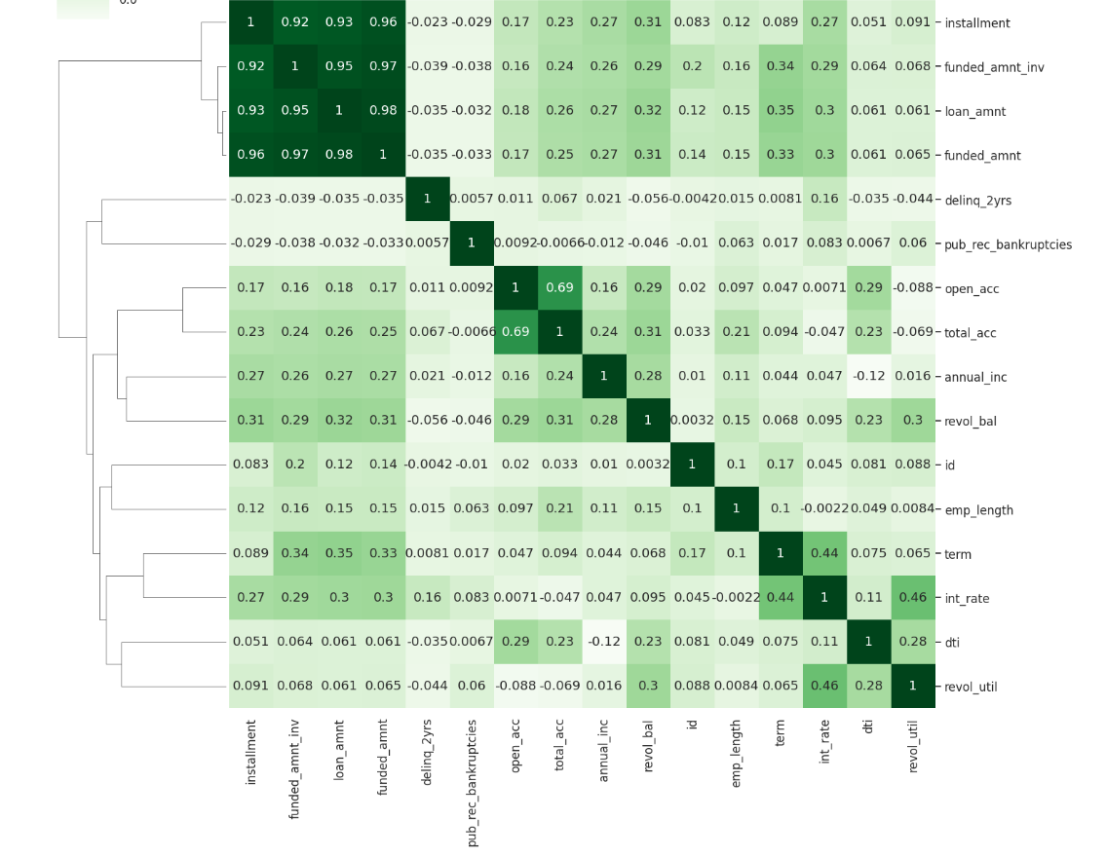
Positive Correlation: 1.Term has a positive correlation with loan amount. 2.Term has a positive correlation with interest rate. 3.Annual income has a positive correlation with loan_amount. 4. loan_amnt has strong positive correlation with Installment, funded_amnt, funded_amnt_inv.
Negative Correlation: 1.loan_amnt has negative correlation with pub_rec_bankrupticies. 2.annual income has a negative correlation with dti. 3.loan_amnt has negative correlation with delinq_2yrs

