Slide 1
3,900 PURCHASES
REVEAL A REPEAT-LED RETAIL BUSINESS
Customer behavior is strongest where repeat buying, product demand, and targeted offers reinforce one another.
SOURCE · CUSTOMER SHOPPING BEHAVIOR ANALYSIS
Notes:
Open with the central read: this is a repeat-led retail business. The analysis connects purchase behavior, product demand, and targeted offers across 3,900 purchases.

Slide 2
THE DATASET IS BROAD ENOUGH TO CONNECT BEHAVIOR TO ACTION
CUSTOMERS
Who buys
PRODUCTS
A wide behavioral view, not a single sales cut.
What they choose
LOCATIONS
Where demand sits
3,900 transactions across 18 columns cover demographics, products, spend, shipping, discounts, ratings, subscriptions, and purchase frequency.
BEHAVIOR SIGNALS
How they return
SOURCE · CUSTOMER SHOPPING BEHAVIOR ANALYSIS
37 REVIEW RATINGS MISSING · IMPUTED BY PRODUCT-CATEGORY MEDIAN
02
Notes:
The dataset is broad enough to connect behavior to action: it includes the customer, the product, the location, and the signals that describe the relationship. Thirty-seven missing review ratings were imputed by product-category median.

Slide 3

THE CORE OPPORTUNITY IS RETENTION, NOT AVERAGE ORDER VALUE
Subscribers are not spending more per purchase today.
LOYAL
SUBSCRIBERS
AVG SPEND GAP
3,116
27%
$0.38
CUSTOMERS
OF CUSTOMERS
NON-SUBSCRIBERS HIGHER
Build the growth case around frequency, benefits, and loyalty—not basket size alone.
CONTEXT · LOYALTY AND SUBSCRIPTION SIGNALS
03
Notes:
Retention is the clearer opportunity. There are 3,116 loyal customers, but subscribers are only 27% of customers. Average spend is almost identical: $59.49 for subscribers and $59.87 for non-subscribers.

Slide 4
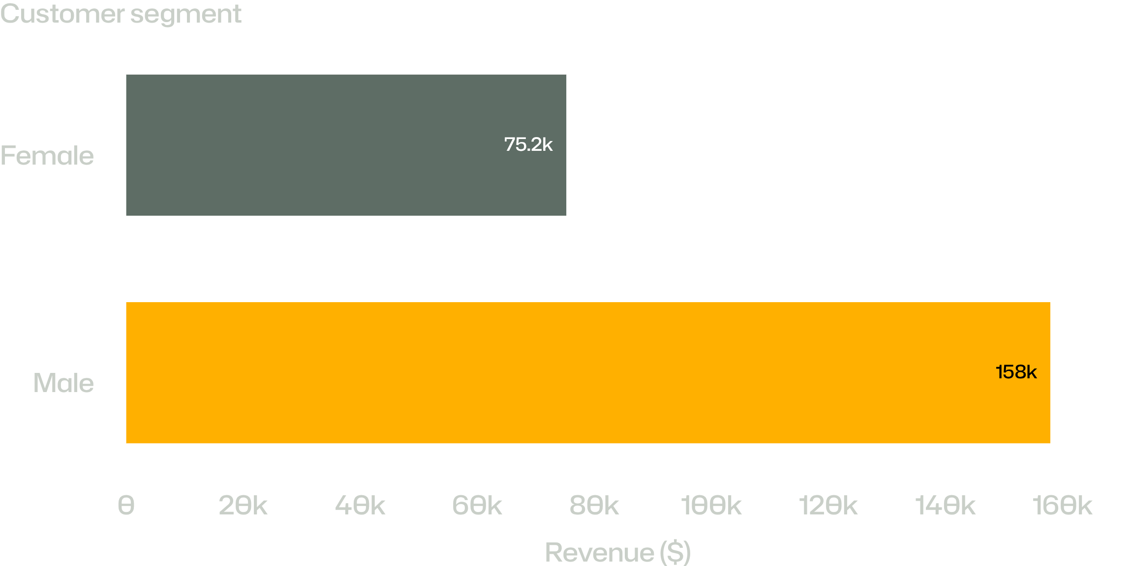
MALE CUSTOMERS DRIVE 68% OF OBSERVED REVENUE
REVENUE COMPARISON · OBSERVED PURCHASES
GAP
$82,699
The dataset shows the gap; it does not explain its cause.
TOTAL OBSERVED REVENUE · $233,081
04
Notes:
Male customers account for $157,890 of observed revenue versus $75,191 from female customers—a difference of $82,699. This is a descriptive finding, not a causal explanation.

Slide 5
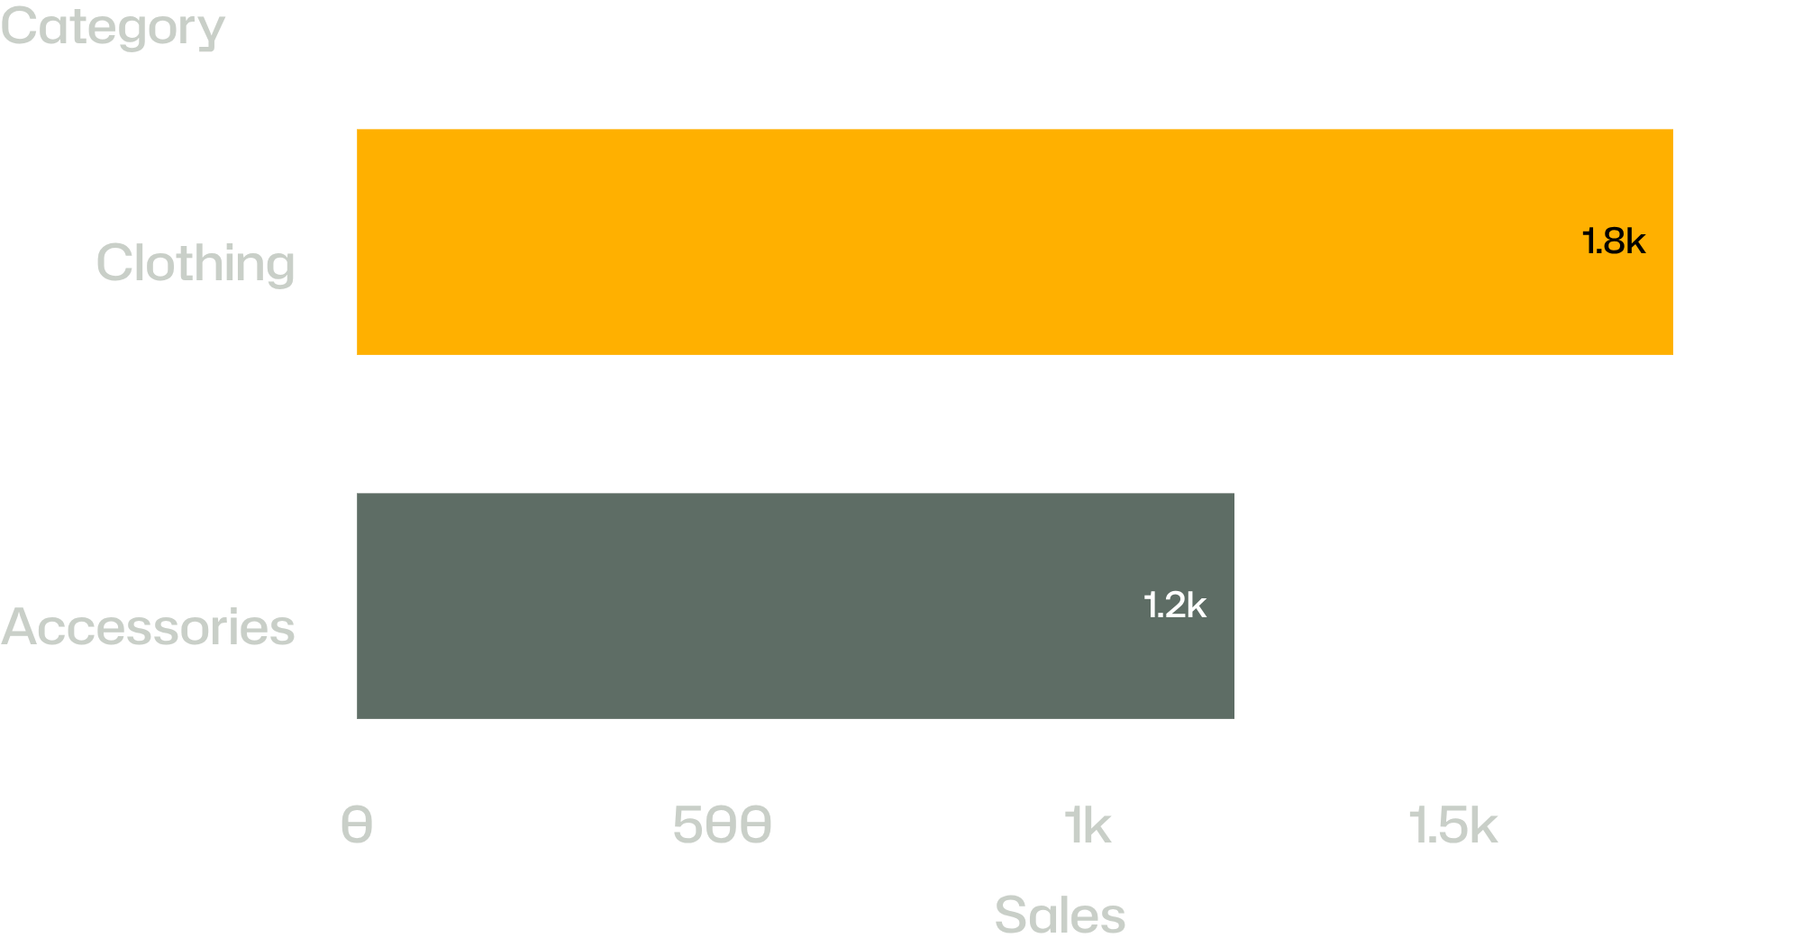
CLOTHING IS THE COMMERCIAL CENTER OF GRAVITY
TOP PRODUCTS BY CATEGORY
Accessories
Jewelry
ESTIMATED CATEGORY REVENUE AND SALES
Clothing
Blouse · Pants
Footwear
Sandals
DASHBOARD ESTIMATES · CLOTHING ≈ $100K · ACCESSORIES ≈ $75K
Outerwear
Jacket
05
Notes:
Clothing is the commercial center of gravity, at roughly $100K and 1,800 sales. Accessories follow at roughly $75K and 1,200 sales. The leading named products are Jewelry, Blouse, Pants, Sandals, and Jacket.

Slide 6
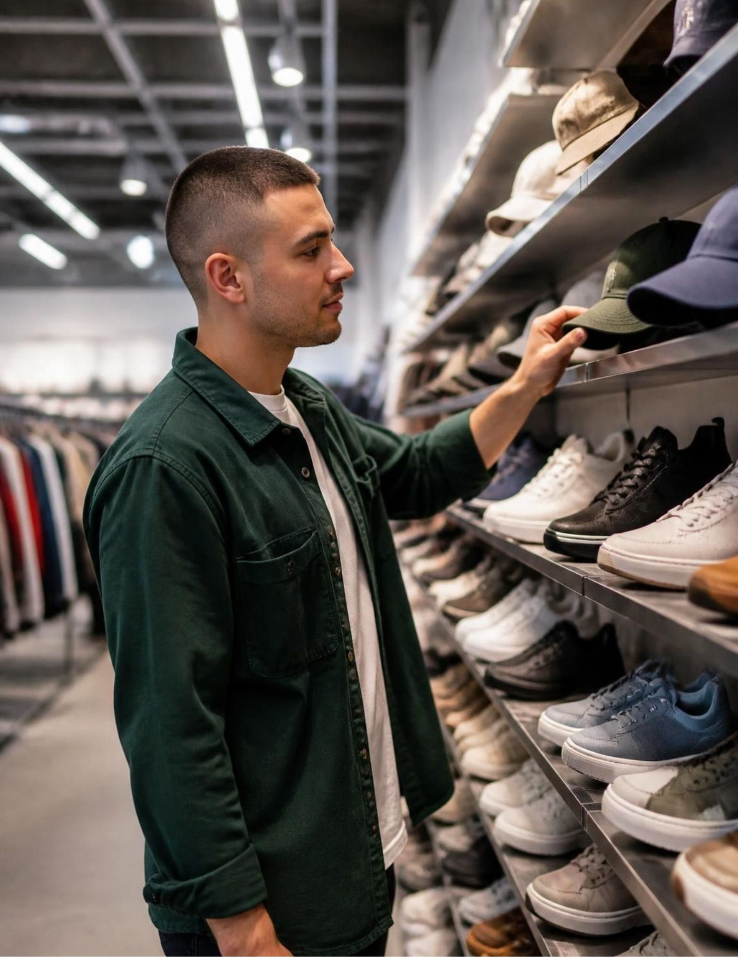
DISCOUNTS ATTRACT SPEND—BUT MAY ALSO TRAIN DEPENDENCE
839 customers used discounts while still spending above the average purchase amount.
HAT
50.00%
SNEAKERS
49.66%
COAT
49.07%
SWEATER · PANTS
48.17% · 47.37%
INTERPRETATION · PROTECT HIGH-DEMAND PRODUCTS FROM PERMANENT PROMOTION
06
EVIDENCE · DISCOUNTED PURCHASE BEHAVIOR
Notes:
Discounting is attracting meaningful spend, but it is also a margin question. Hats, sneakers, coats, sweaters, and pants show the highest discount rates. The recommendation is to protect high-demand products from becoming permanently promotion-led.

Slide 7
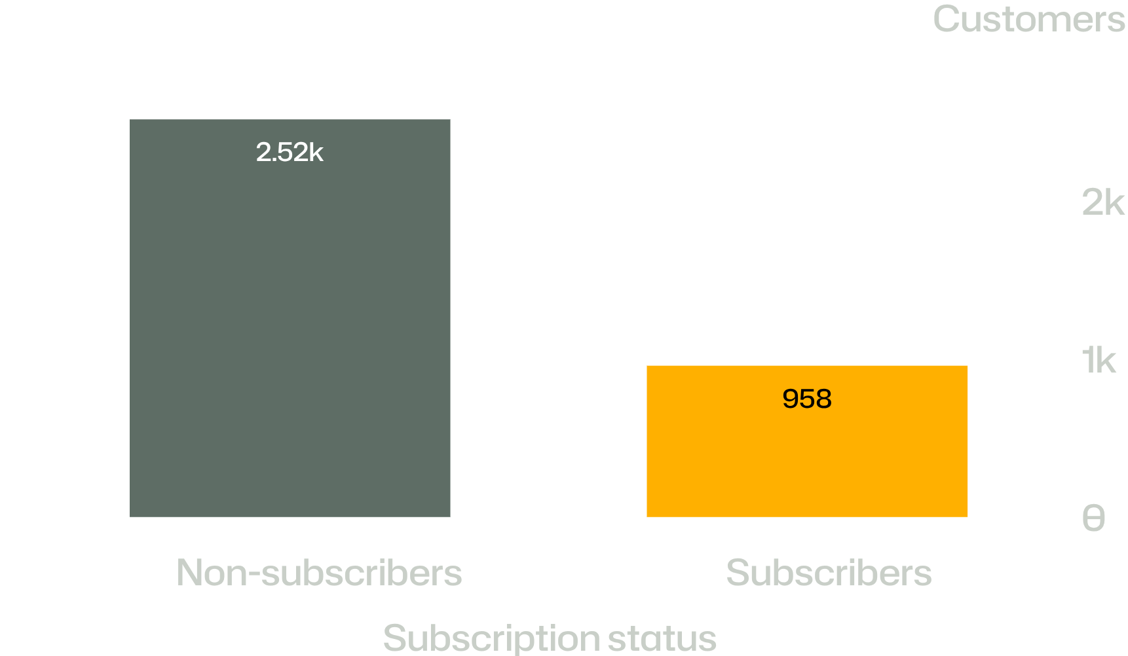
THE LOYALTY BASE IS LARGE, BUT SUBSCRIPTION ADOPTION IS LAGGING IT
CUSTOMER SEGMENT LADDER
REPEAT BUYERS · MORE THAN FIVE PURCHASES
Segment | Customers
Loyal | 3,116
Returning | 701
New | 83
The highest-propensity customers are not automatically converting into the formal relationship.
07
Notes:
Among repeat buyers with more than five purchases, 2,518 are non-subscribers and 958 are subscribers. The gap suggests loyalty alone is not converting customers into the paid or formal relationship.

Slide 8
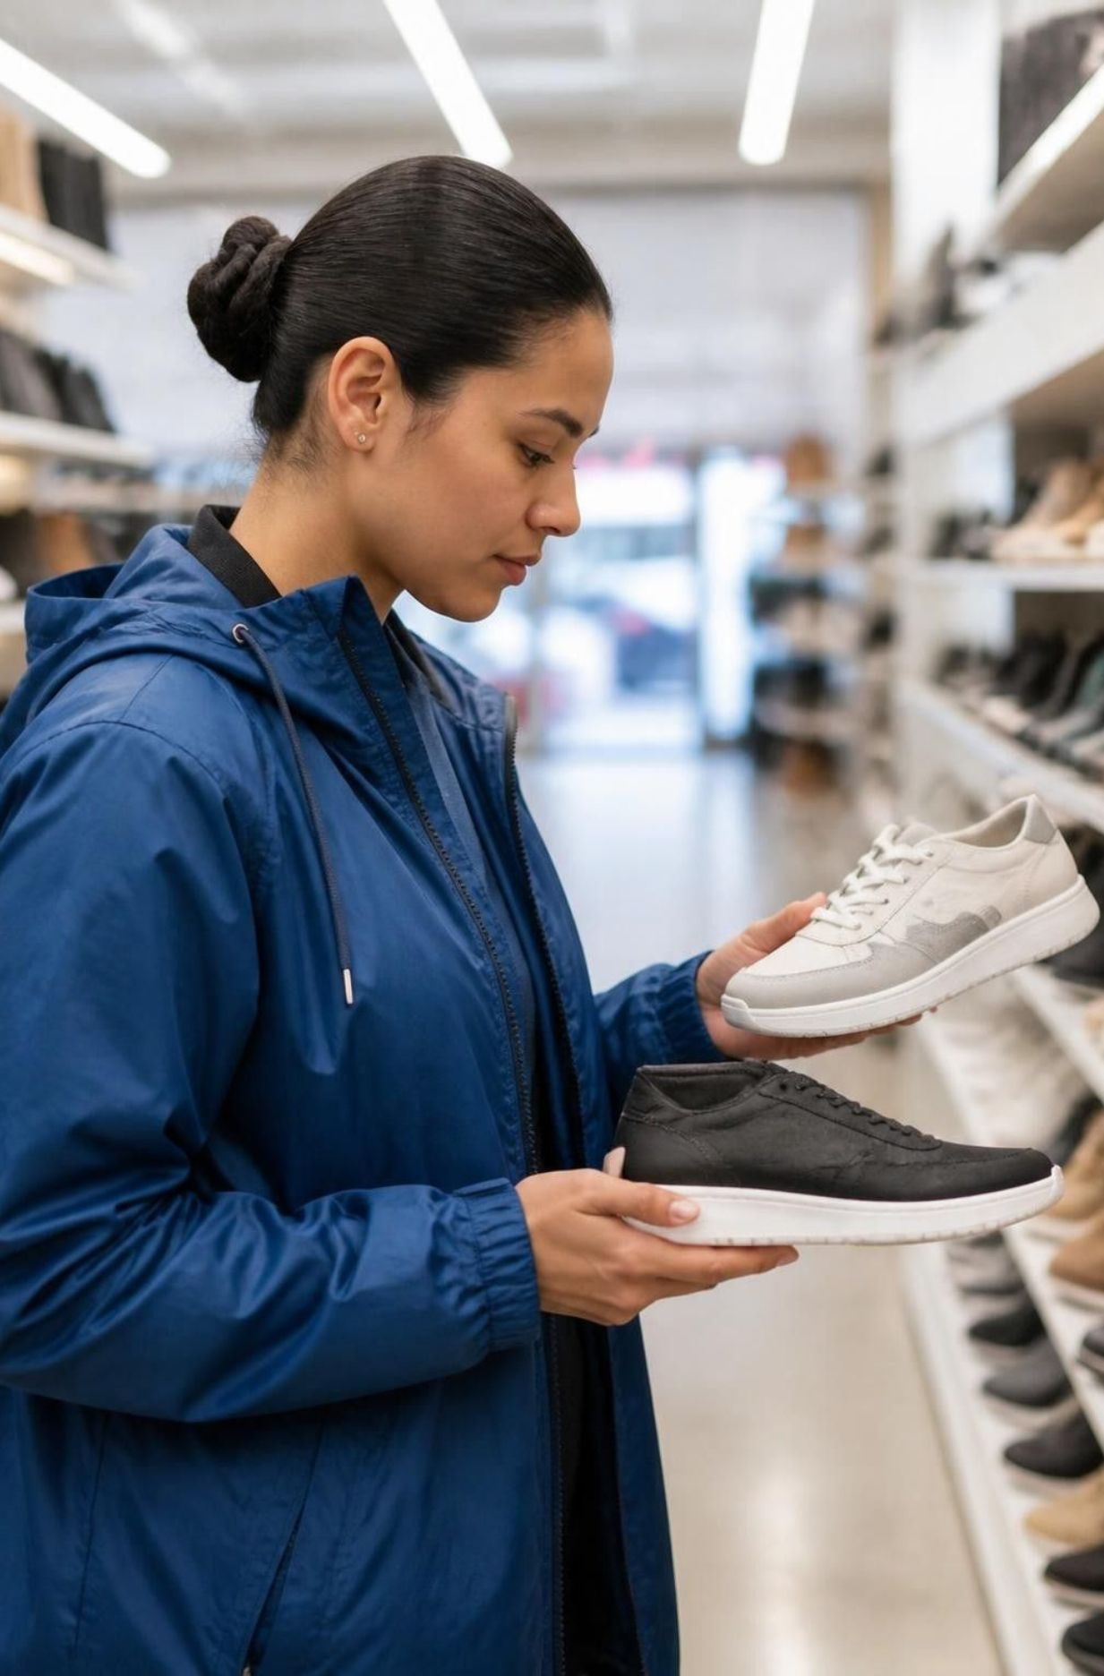
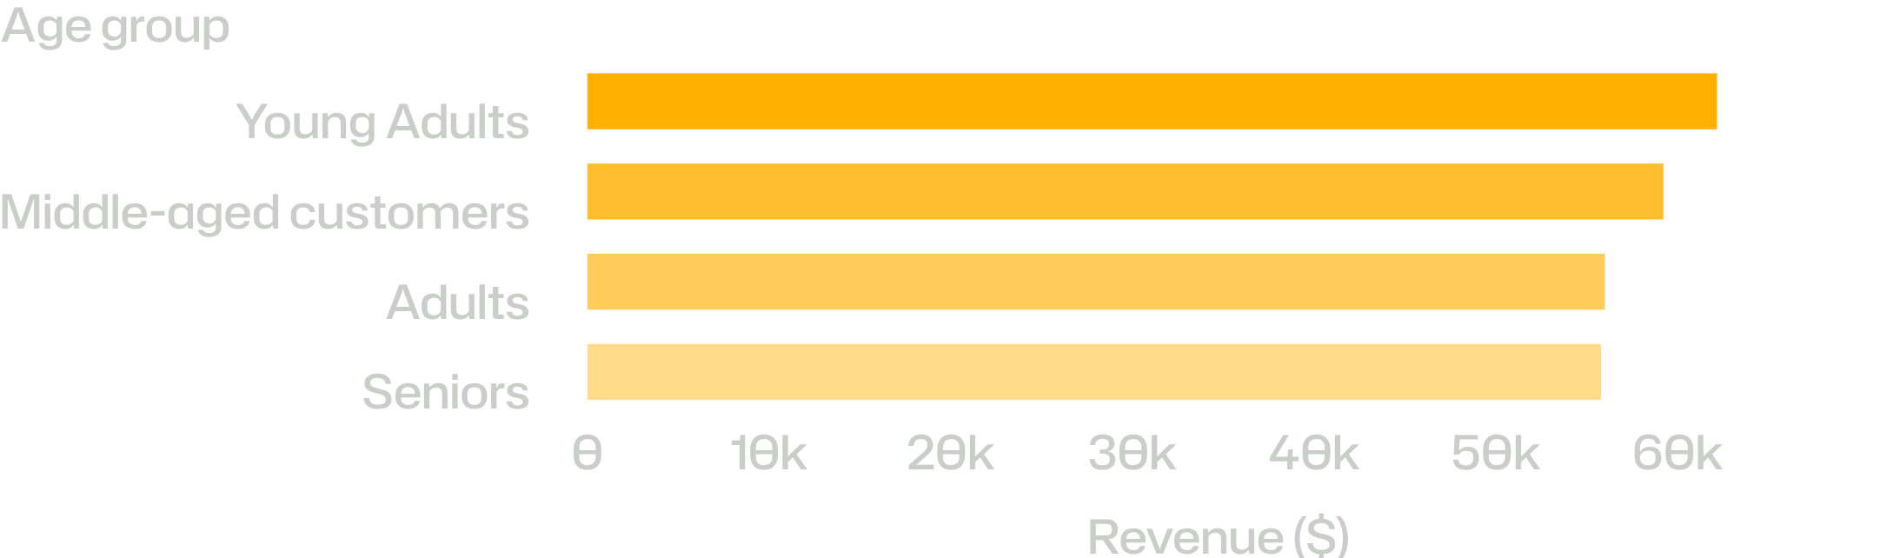
YOUNG ADULTS LEAD REVENUE; AGE GROUPS REMAIN CLOSE
REVENUE BY AGE GROUP
Shipping | Average per purchase
Express | $60.48
Standard | $58.46
Prioritize young adults, but avoid a single-segment strategy: all four groups contribute within a relatively narrow band.
PRIORITY SEGMENT · YOUNG ADULTS
08
Notes:
Young adults lead at $62,143, but the curve is relatively balanced: middle-aged customers contribute $59,197, adults $55,978, and seniors $55,763. Express shipping averages $60.48 versus $58.46 for standard shipping. Interpretation: prioritize young adults, but avoid building a single-segment strategy; the four groups contribute within a relatively narrow band.

Slide 9
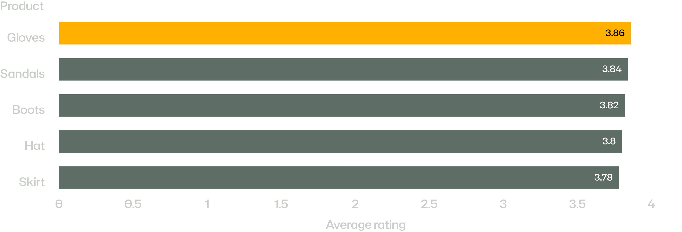
PRODUCT SATISFACTION IS STRONGEST IN ACCESSORIES AND FOOTWEAR
AVERAGE PRODUCT RATINGS · OVERALL AVERAGE 3.75
Use the strongest-rated products as proof points in campaigns—then investigate what holds the broader rating at 3.75.
09
Notes:
Gloves lead at 3.86, followed by Sandals at 3.84, Boots at 3.82, Hat at 3.80, and Skirt at 3.78. These products can serve as proof points in campaign creative while the broader rating remains a question to investigate.

Slide 10
FIVE MOVES TO CONVERT ANALYSIS INTO GROWTH
EXECUTIVE READ
RETENTION FIRST
01
02
03
Reward frequency
Protect margin
Activate loyalty
Give subscribers benefits that reward frequency, not just a discount.
Review discount depth on hats, sneakers, coats, sweaters, and pants.
Build loyalty mechanics around the 3,116-customer loyal segment.
04
05
Prove with product
Target with nuance
Feature top-rated and best-selling products in campaign creative.
Target young adults first, then tailor messages by age group and shipping preference.
Notes:
Close on the operating agenda: reward frequency, activate the loyal base, protect margin, use strong products as proof, and target young adults without ignoring the balanced age curve. The central priority is retention first.

