Slide 1

INSIGHTS TO THE MARKETING TEAM OF ‘CodeX’
CodeX
Saurabh Manohar Kelkar……
CodeX

Slide 2
CONTENT
CodeX
Objectives
Demographic Insights
Preliminary Research
Recommendations
CodeX

Slide 3
OBJECTIVES
The objective of the project is to analyze the survey results from the 10,000 respondents in 10 cities, identify key insights, and provide actionable recommendations to CodeX's Marketing team. These insights will guide strategic decisions to increase brand awareness, capture market share, and drive product development in the Indian market.

Slide 4
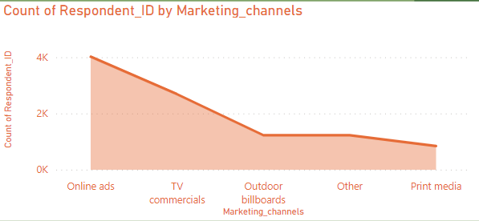
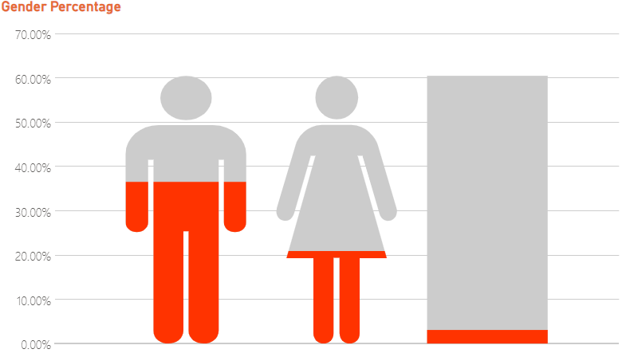
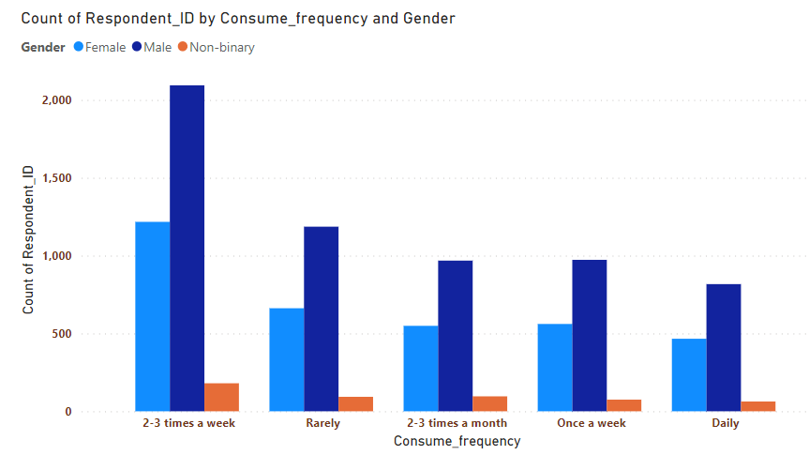
Demographic Insights
Online ads are an effective marketing channel for reaching the audience.
Consume frequency among the respondents prefer the energy drink 2-3 times a week.
The consumers in the age group 19-30 top the list of energy drink consumers.
Energy drinks are common among males.

Slide 5
Preliminary Research
As a Data Analyst I did preliminary research based on following metrics :-
Expected Ingredients
Packaging Preferences
Market Leaders
Overall Rating
Purchase Behavior
Consumption Reason
Brand Penetration

Slide 6
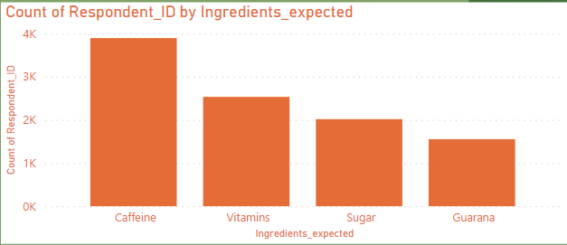
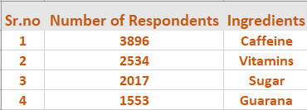
Expected Ingredients
I recommend the company to develop an energy drink with a balanced blend of natural caffeine from guarana, fortified with essential vitamins, and sweetened with a minimal amount of sugar to provide a sustained and healthier energy boost.

Slide 7
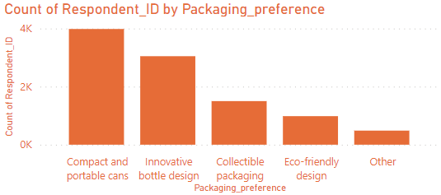
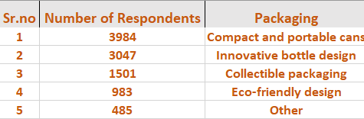
Packaging Preferences
Based on the survey data, I recommend the company prioritize producing compact and portable cans with innovative designs, incorporating collectible packaging options, while also considering eco-friendly designs to meet customer preferences.

Slide 8
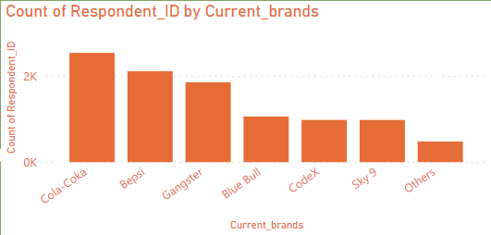
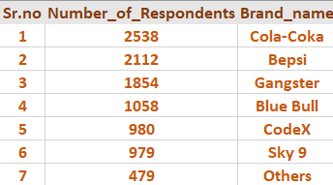
Market leaders
Significant presence and customer base
Consumer Preference
Ability to attract consumers

Slide 9
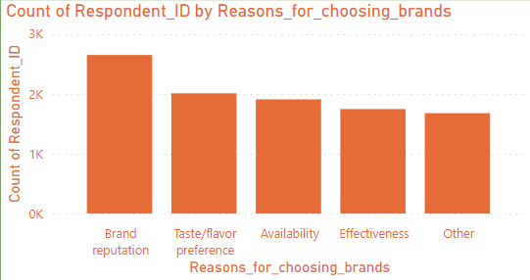
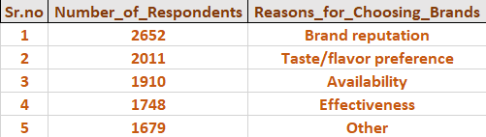
Why Those Brands
The recommendation I would like to give based on this result is to increase the market share, CodeX should focus on building a strong reputation, enhancing taste/flavor, improving accessibility, highlighting effectiveness, and addressing other factors that influence customer preferences for other brands.

Slide 10
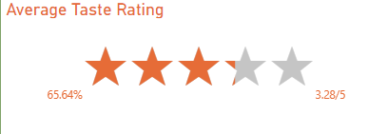
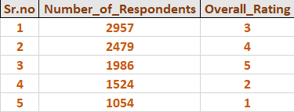
Overall Rating
An average rating of 10K respondents of 3.28 out of 5 can be considered as moderately good.
While it falls slightly below the midpoint of 3.5, It still indicates a positive perception of the product.
This rating suggests that there is room for improvement.
So it is advisable for the company to work on factors like customer feedback, market trends and competitors ratings to gain a comprehensive understanding of the products performance.

Slide 11
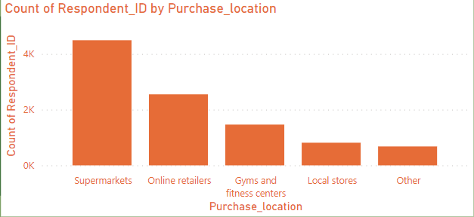
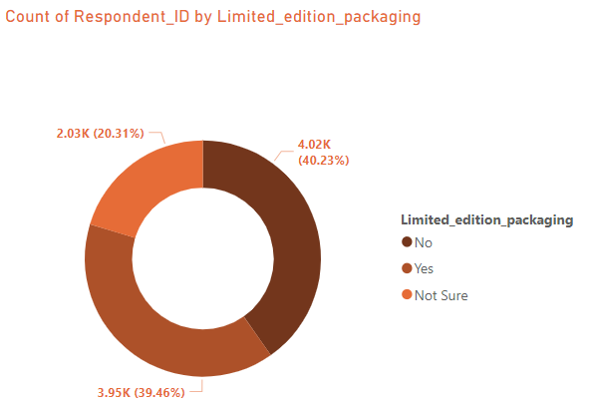
Purchase Behavior
Among the 10K respondents 45% of the respondents purchase the drink from Supermarkets.
An Interesting Point is that people have a neutral perspective about limited edition packaging.

Slide 12
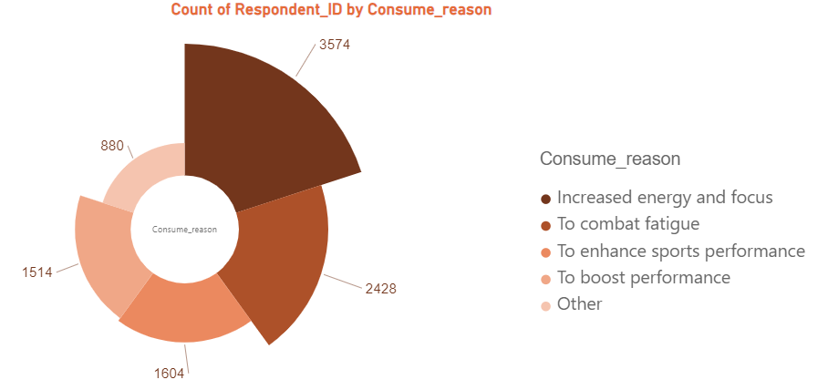
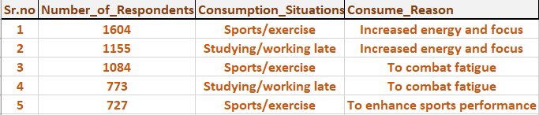
Consumption Reason
Out of 10K people, 35.74% respondents prefer the drink to increased their energy and focus.
While out of 3.5K respondents there are 44% of the respondents who take the energy drink while doing sport activity or exercise to increase the energy.
SO to make an impact on the Indian market, CodeX should focus on promoting the energy drink as a way to boost energy and foucs. Emphasize its benefits during sports activities and exercise. This will appeal to the preferences of Indian consumers and effectively resonate with them.

Slide 13
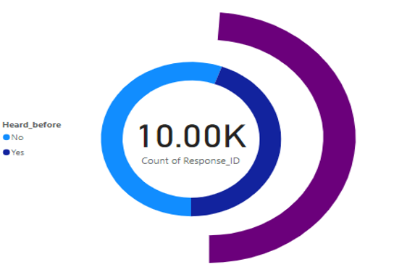
Brand Penetration
Out of 10K people who responded to survey, only 44.5% have heard about the energy drink from CodeX.
Out of 4.4K, only 48% people have Tried the energy drink.

Slide 14
Recommendations
The company should prioritize online ads targeting males aged 19-30, highlighting the energy drink's appeal for frequent consumption (2-3 times a week) to effectively reach the desired audience.
Collaborate with fitness centers, sports teams, and health influencers to promote your energy drink as a vital companion for active lifestyles in India. As Collaborating with fitness centers, sports teams, and health influencers boosts brand visibility and positions the energy drink as a preferred choice for active individuals in India.
The ideal price for the energy drink would be in the range of 100-150 rupees. This price range aligns with the highest number of respondents, maximizing potential sales while remaining competitive in the market.
A perfect brand ambassador for the energy drink product would be a famous athlete or fitness influencer like someone from cricket or any kind of sports. They live a healthy and active lifestyle, which matches the brand's image and values. Their support can inspire and connect with the target audience, building trust and credibility for the brand.

Slide 15
Recommendations
The marketing of the product must be improved, as more than 50% people who surveyed were not aware of CodeX energy drink.
Target the larger customer base in Bangalore, Hyderabad, and Mumbai by increasing marketing efforts, expanding distribution networks, and partnering with local influencers and fitness centers to promote CodeX energy drink effectively.

Slide 16

Thank You!

