Slide 1

TTS-GAN: A Transformer-Based Time-Series Generative Adversarial Network
IE – 643 COURSE PROJECT
ENDTERM REVIEW
Submitted To :
PROF. P Balamurugan
IEOR, IIT BOMBAY
Submitted By :
Team Name: Sigma Enigma
Saurabh Kumar Khandelwal (22M0574)
Samagra Vijaywargiya (22M0570)

Slide 2
OUTLINE
Problem Statement
Work Done before Mid-term Review
Comments received during Mid-term Review
Addressal of Comments
Work Done after Mid-term Review
Experiments and Results
Conclusions
Scope for Future Work
References

Slide 3
Problem Statement
In this project report, we address the common challenge of limited data in medical machine learning applications, particularly when dealing with time series datasets such as electrocardiogram (ECG) signals.
Conventional RNN-based time-series GANs have limitations in modeling long sequences as they fail to capture the long-term dependencies of time-series data.
Acknowledging the transformative capabilities of transformer architectures, there exists an untapped potential for their application in time-series GAN research, promising breakthroughs across healthcare, finance, language processing, and beyond.
To overcome this limitation, we propose TTS-GAN, a novel approach leveraging a transformer-based Generative Adversarial Network (GAN) for the generation of realistic synthetic time-series data sequences to overcome data scarcity challenges.

Slide 4
Work Done before Mid-term Review
Understanding the basic concepts of GAN and Transformer based Models and a thorough study of the paper and other relevant major works done in the last few years was done, which helped in understanding the direction this paper can be taken towards.
The topics involving mathematical background like data Pre-processing, loss functions for parameter updatation, similarity scores for evaluation.
The code for TTS-GAN provided was implemented and the synthetic results were obtained.

Slide 5
Comments received during Mid-term Review
Lack of clarity about Past Works and detail of the architecture.
Though synthetic samples were obtained, no proper comparison was made with the original data to quantitatively validate the fidelity of the synthetic data and affirm the effectiveness of TTS-GAN.
To implement a working code on ECG dataset and make sure learning happens during the training process.
Must have better understandability of the code.

Slide 6
Addressal of Comments
M1 and M2 undertook an extensive review of both Generative Adversarial Networks (GANs) and transformer architectures and elucidated how GANs could be effectively applied to time-series data and subsequently integrated the transformer architecture into the GAN framework to obtain synthetic data records for ECG dataset.
In response to the need for a proper quantitative validation of the synthetic data, M1 calculated the Shannon Jansen distance and cosine similarity scores, providing quantitative metrics to assess the fidelity of the synthetic data. Also, this score is used to assure that learning is happening through the epochs, as visually its difficult to analyse the patterns.
Additionally, to enhance interpretability, t-SNE for visualization is employed by M2, offering an insightful comparison of the synthetic and original data patterns. The emphasis on code implementation and clarity contributes to a more comprehensive and transparent presentation of the research work.

Slide 7
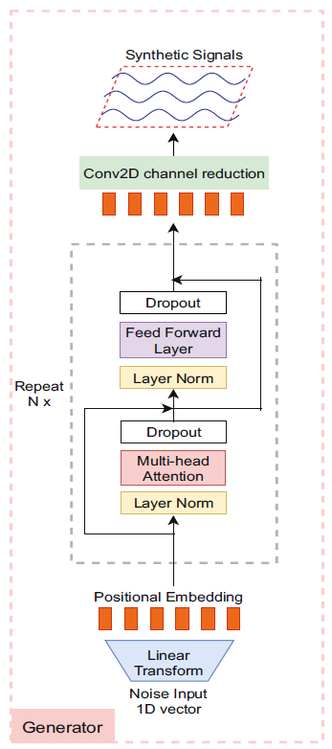
Work Done after Mid-term Review
Along with enhancing the clarity of past works and providing a more detailed insight into the architecture. We delved into the implementation phase, incorporating the transformer architecture into both the Generator and Discriminator of the GAN.
To offer a comprehensive understanding of the codebase, we have compiled visual representations that highlight key transformer features integrated into the GAN framework. These include Multi-Head Attention, Layer Normalization, Positional Encoding, and other critical components that contribute to the model's effectiveness in generating synthetic time-series data.
This section ends with some formulas regarding Shannon Jansen distance and cosine similarity scores used in the study.

Slide 8
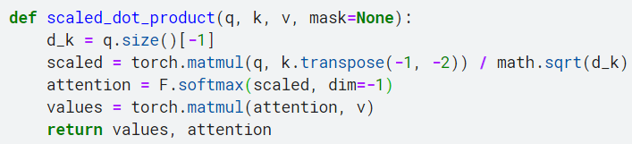
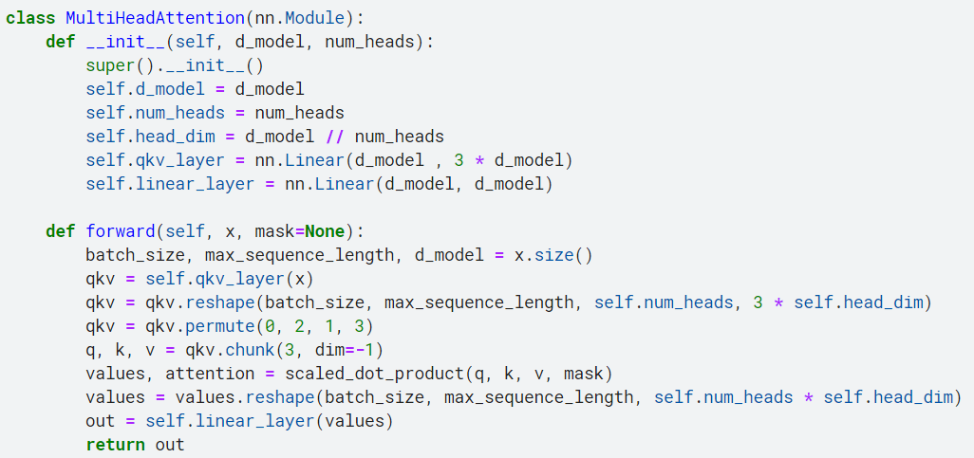
Work Done after Mid-term Review
Multi-head self-attention: This module is designed to process sequences of data, capturing dependencies and relationships between different elements in the sequence.

Slide 9
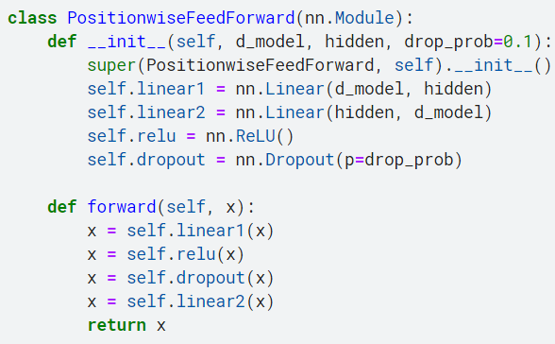
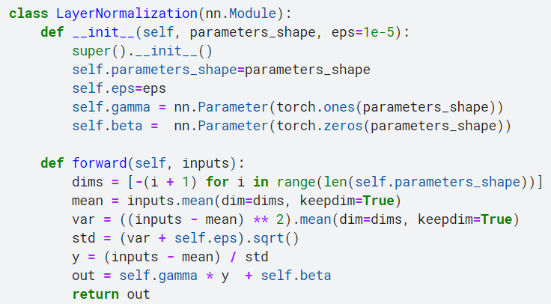
Work Done after Mid-term Review
Position-wise feedforward neural network module:
Layer normalization: It is a technique to normalize the inputs of a layer across a specific set of dimensions.

Slide 10
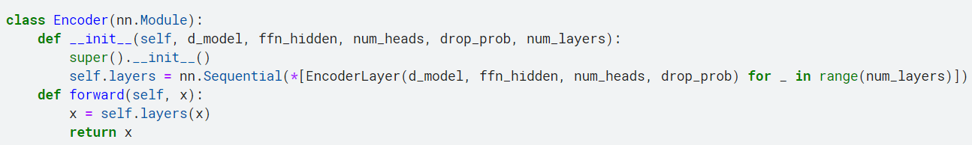
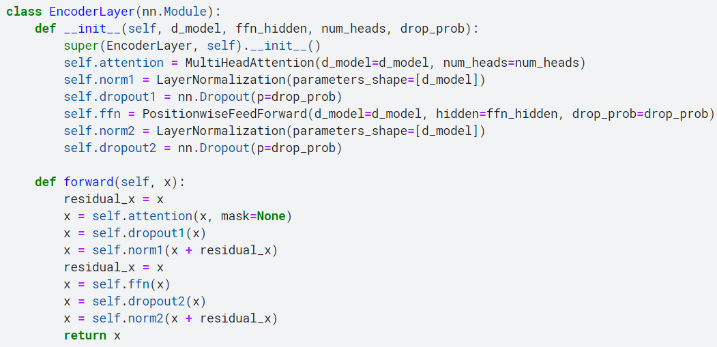
Work Done after Mid-term Review
Encoder: An encoder for a transformer model, composed of multiple stacked Encoder-Layers.

Slide 11
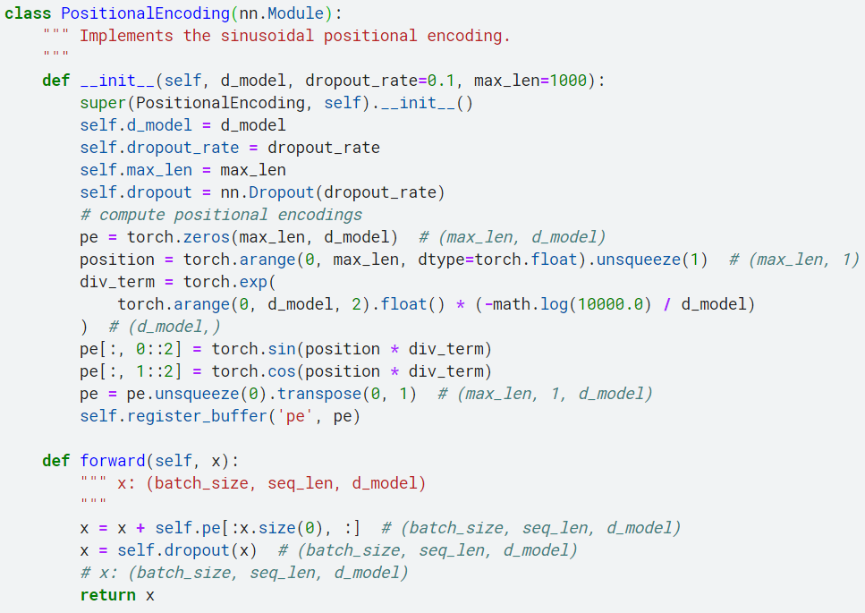
Work Done after Mid-term Review
Positional encoding: It is added to the input embeddings to provide information about the relative or absolute position of the tokens in the input sequence.

Slide 12
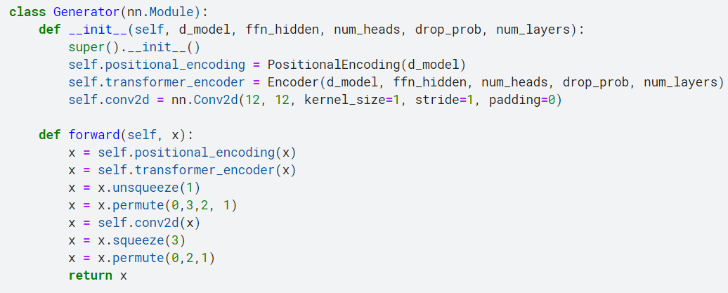
Work Done after Mid-term Review
Generator module that incorporates a transformer encoder followed by a convolution operation.

Slide 13
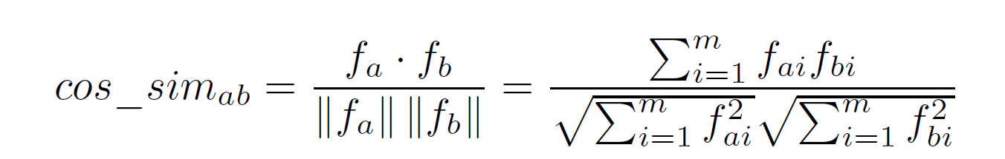
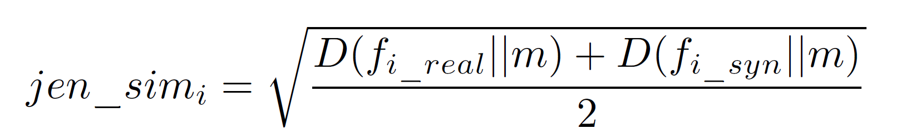
Work Done after Mid-term Review
For a quantitative analysis of similarity, we introduced two metrics: average cosine similarity (avg_cos_sim) and average Jensen-Shannon distance (avg_jen_dis). These metrics were applied to signal features from each signal channel, forming a feature vector for each sequence.
Average Cosine Similarity: When calculating the average cosine similarity between two feature vectors f_{a} and f_{b}, each of size m, the cosine similarity is computed using the following formula:
Average Jensen-Shannon distance: It is determined by calculating the Jensen-Shannon distance for each feature pair from real signals f_{i_real} and synthetic signals f_{i_syn}.

Slide 14
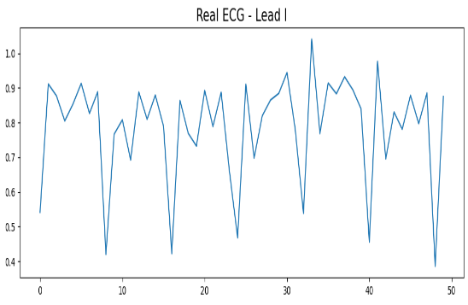
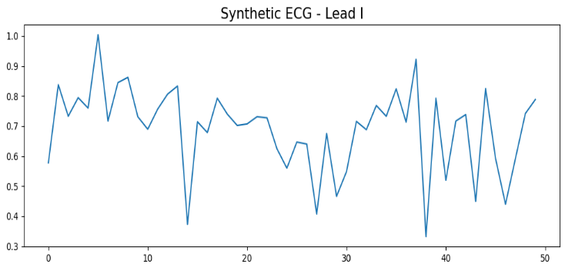
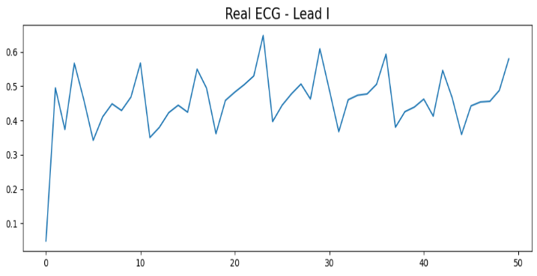
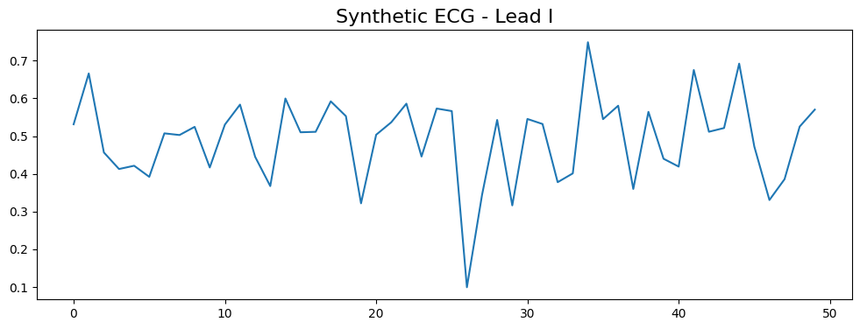
Experiments and Results
Synthetic data samples generated by TTS-GAN are displayed alongside real data, showcasing visually similar signal patterns.
Voltage
Voltage
Timesteps
Timesteps

Slide 15
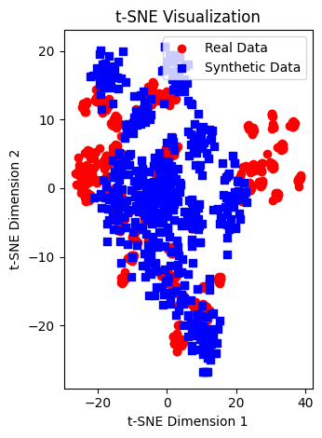
Experiments and Results
To further illustrate the resemblance between real and synthetic data, we employed t-SNE visualizations, along with average cosine similarity and Jensen-Shannon distance
Score | Value
Average cosine similarity | 0.64
Average Jensen-Shannon distance | 0.058

Slide 16
Conclusions
In this study, we have developed a transformer-based Generative Adversarial Network model, denoted as TTS-GAN, with the capability to generate multi-dimensional time-series data of diverse lengths.
Visual comparisons of the two-dimensional mappings of data point distributions two distinct similarity scores reveal a remarkable similarity between the original and synthetic data.
The experimental findings collectively affirm the effectiveness of TTS-GAN as a robust generator of realistic time-series data, particularly when trained on authentic samples.

Slide 17
Scope for Future Work
Further exploration and validation of the TTS-GAN model should include testing on a more extensive array of datasets exhibiting diverse characteristics. This will enable a comprehensive assessment of the model's robustness and generalization capabilities across various medical contexts.
Investigating methods to enhance the interpretability and explainability of the TTS-GAN model's synthetic outputs. This could involve attention visualization techniques or developing interpretability tools to provide insights into the model's decision-making process.
In addressing the current limitation of TTS-GAN, which assumes a unimodal data distribution and generates samples based on this expected pattern, a promising future research could involves exploring the integration of a conditional generative adversarial network (c-GAN) framework.

Slide 18
References
Li, X., Metsis, V., Wang, H., Ngu, A.H.H. TTS-GAN: A Transformer-Based Time-Series Generative Adversarial Network. 20th International Conference on Artificial Intelligence in Medicine, AIME 2022, Halifax, Canada. vol 13263. Springer, Cham. (2022) https://arxiv.org/abs/2202.02691 ,
E. Brophy, Z. Wang, Q. She, and T. Ward, “Generative adversarial networks in time series: A survey and taxonomy,” https://arxiv.org/abs/2107.11098 (2021)
Vaswani, A., et al.: Attention is all you need. In: Advances in Neural Information Processing Systems, pp. 5998–6008. https://arxiv.org/abs/1706.03762 (2017)
Dosovitskiy, A., et al.: An image is worth 16 × 16 words: transformers for image recognition at scale. https://arxiv.org/abs/2010.11929 (2020)
Jiang, Y., Chang, S., Wang, Z.: TransGAN: two pure transformers can make one strong GAN, and that can scale up. In: Thirty-Fifth Conference on Neural Information Processing Systems https://arxiv.org/abs/2102.07074 (2021)

Slide 19
References
Xiaomin-Li, Vangelis Metsis, TTS-GAN: A Transformer-based Time-Series Generative Adversarial Network (2022). Code link- https://github.com/imics-lab/tts-gan
Jay Alammar, The Illustrated Transformer (2018). https://jalammar.github.io/illustrated-transformer/

Slide 20
THANK YOU

