Slide 1
Algorithmic Trading of Financial Instruments
DDP phase-II project
-Under the guidance of Prof. Alankar Alankar
-by Saurabh Kumar(16d100018)

Slide 2
What is Algorithmic Trading
Financial Instruments:
Equity: scrips like Reliance, TCS, SBIN, etc
Commodities like gold and silver
Bonds & debts
Derivatives like futures and options
Why algo trading:
Adventurous and huge potential to learn & reap profit
Algorithm
Set of rules for solving a problem in a finite number of steps
Trade
Act of process of buying, selling, or exchanging stuff
Algorithmic Trading
Set of rules for buying, selling or exchanging stuff
Rules are best followed by machines and not humans
Humans have both IQ and EQ!
Computers don’t let emotions come in their way of decision making process

Slide 3
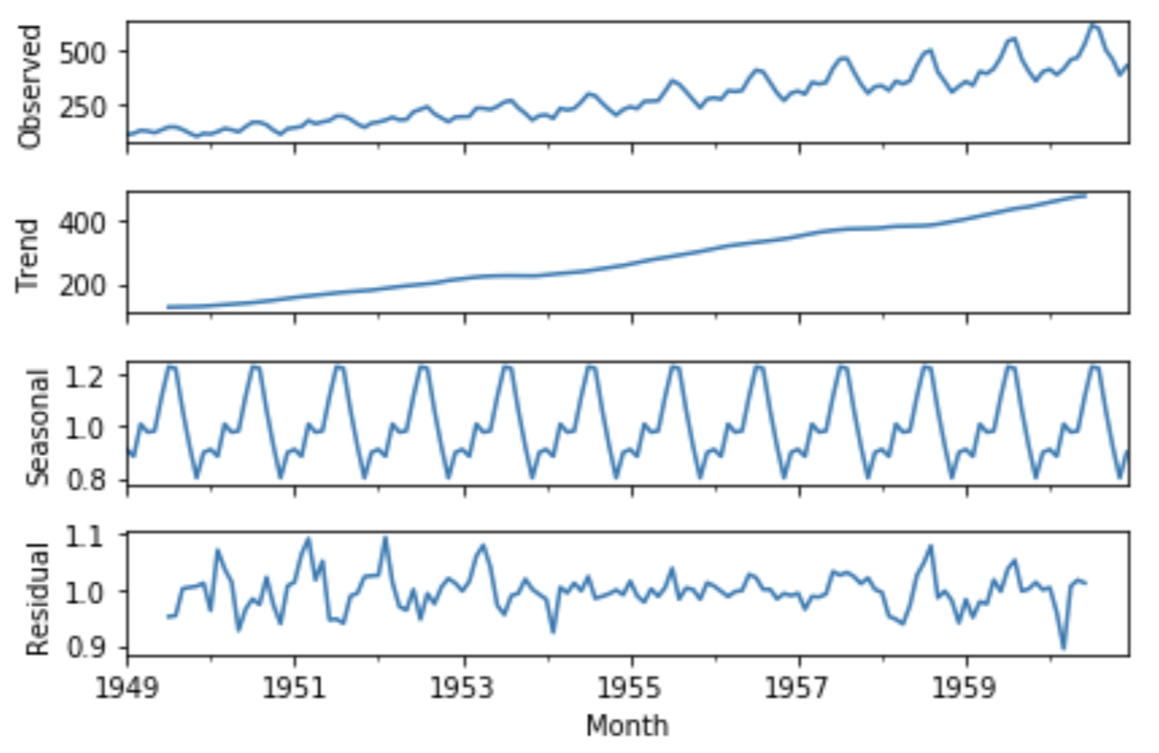
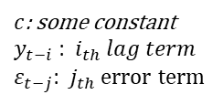
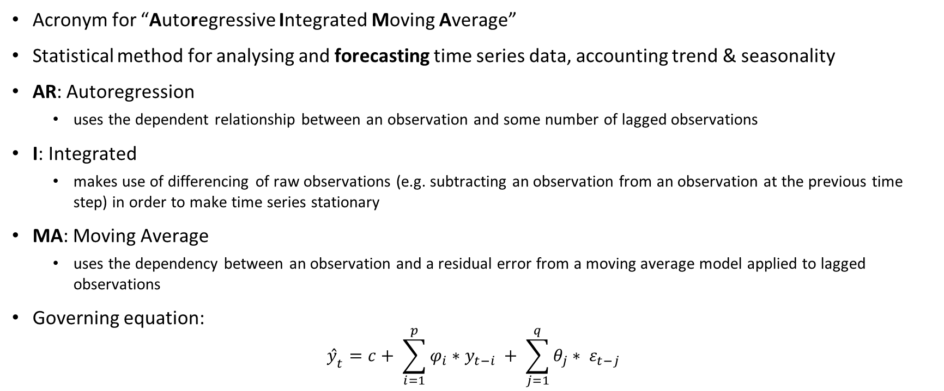
Algorithm implemented: ARIMA(p,d,q)
Acronym for “Autoregressive Integrated Moving Average”
Statistical method for analysing and forecasting time series data, accounting trend & seasonality
AR: Autoregression
uses the dependent relationship between an observation and some number of lagged observations
I: Integrated
makes use of differencing of raw observations (e.g. subtracting an observation from an observation at the previous time step) in order to make time series stationary
MA: Moving Average
uses the dependency between an observation and a residual error from a moving average model applied to lagged observations
Governing equation:
$${ŷ}_{t}=c+ \sum_{i=1}^{p}{φ_{i}∗y_{t−i}} + \sum_{j=1}^{q}{θ_{j}∗ ε_{t−j}}$$
Img source: google
$c$: some constant
$y_{t−i}$ : ${ i}_{th} lag term$
$ε_{t−j}$: ${ j}_{th} error term$
AR part; governed by parameter, p
MA part; governed by parameter, q

Slide 4
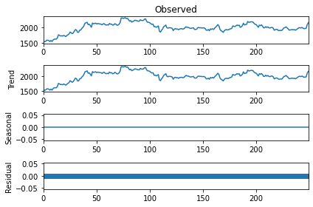
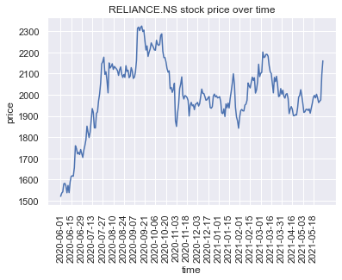
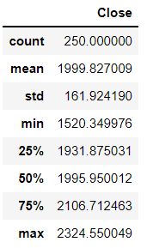
Data Visualization
An increasing trend in price values can be seen
Data doesn’t seem to be stationary!
Data being stationary mean constant mean, µ and constant standard deviation, σ
Data statistics
Reliance(NSE) Closing price plot

Slide 5
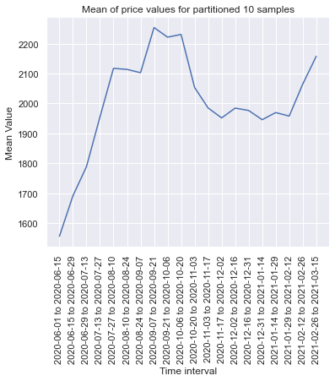
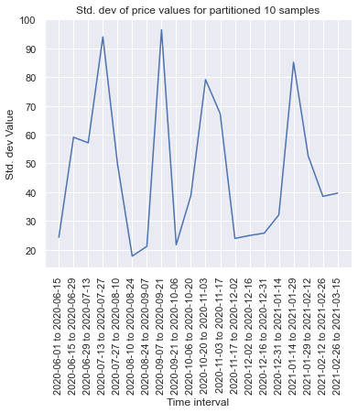
Check for stationarity
ADF statistics
ADF(Augmented Dickey-Fuller) test
Hypothesis Test for stationarity
H₀: Unit root is present and hence time-series is non-stationary
H₁: Unit root is not present and hence time-series is stationary
Data specific
Test statistics: -2.73
P-value: 0.068
Critical values:
1%: -3.46
5%: -2.87
Do not reject null hypothesis if
P-value > significance level of 0.05
And test-statistics > critical value

Slide 6
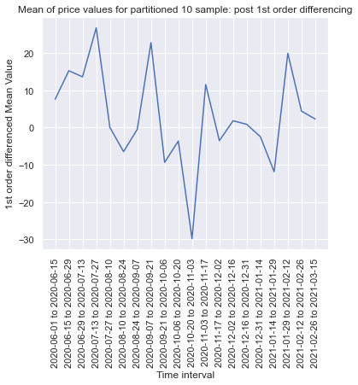
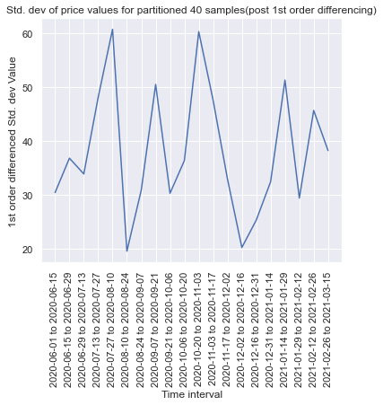
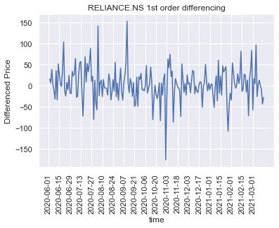
Non-Stationary to Stationary Data Conversion
ADF
test-statistics: -13.23
p-value ~ 9e-25 ~ 0
Critical values:
1%: -3.46
5%: -2.87
Reject null hypothesis when
Test-statistics < critical values
And p-value less than level of significance(0.05)
Indication to use differencing of 1st order I(1)

Slide 7
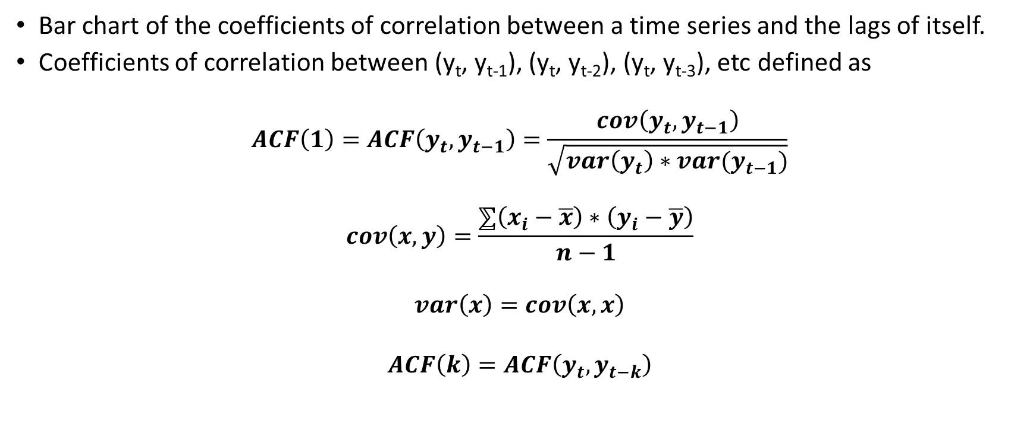
ACF(Auto-Correlation Function): MA part
Bar chart of the coefficients of correlation between a time series and the lags of itself.
Coefficients of correlation between (y_{t}, y_{t-1}), (y_{t}, y_{t-2}), (y_{t}, y_{t-3}), etc defined as
$$ACF\left(1\right)=ACF\left(y_{t},y_{t−1}\right)=\frac{cov\left(y_{t},y_{t−1}\right)}{\sqrt{var\left(y_{t}\right)∗var(y_{t−1})}}$$
$$cov\left(x,y\right)=\frac{⅀\left(x_{i}−\overline{x}\right)∗\left(y_{i}−\overline{y}\right)}{n−1}$$
$$var\left(x\right)=cov\left(x,x\right)$$
$$ACF\left(k\right)=ACF\left(y_{t},y_{t−k}\right)$$
y_{t} | ε_{t-1} | ε_{t-2}
1520.35 | NaN | NaN
1535.7 | NaN | NaN
1541.65 | -15.35 | NaN
1579.8 | -5.95 | -13.625
1581.7 | -38.15 | -41.125
1569.5 | -1.9 | -20.975
1537.15 | 12.2 | 11.25
1572.15 | 32.35 | 38.45
1537.7 | -35 | -18.825
y_{t} | y_{t-1} | y_{t-2}
1520.35 | NaN | NaN
1535.7 | 1520.35 | NaN
1541.65 | 1535.7 | 1520.35
1579.8 | 1541.65 | 1535.7
1581.7 | 1579.8 | 1541.65
1569.5 | 1581.7 | 1579.8
1537.15 | 1569.5 | 1581.7
1572.15 | 1537.15 | 1569.5
1537.7 | 1572.15 | 1537.15

Slide 8
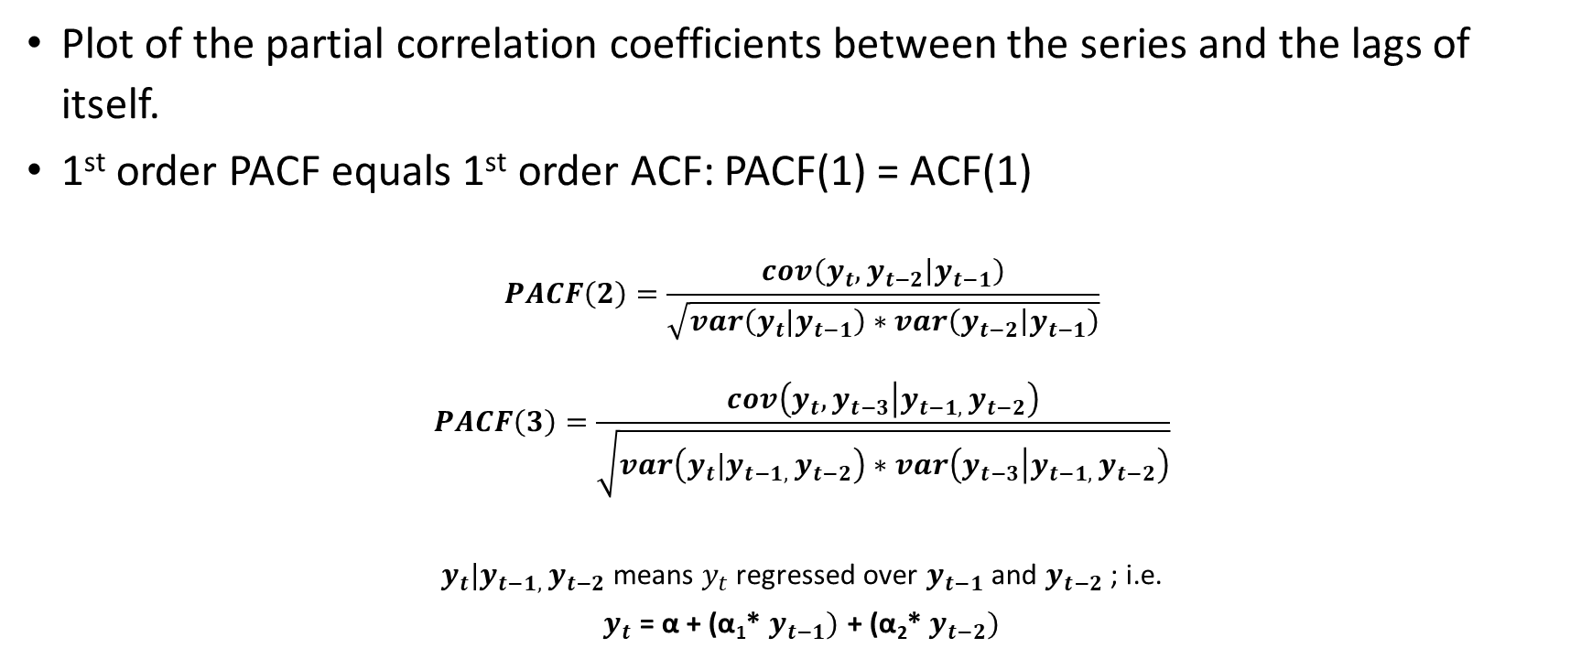
PACF(Partial Auto-Correlation Function): AR part
Plot of the partial correlation coefficients between the series and the lags of itself.
1st order PACF equals 1st order ACF: PACF(1) = ACF(1)
$$PACF\left(2\right)=\frac{cov\left(y_{t},y_{t−2} | y_{t−1}\right)}{\sqrt{var\left(y_{t}|y_{t−1}\right)∗var\left(y_{t−2} | y_{t−1}\right)}}$$
$$PACF\left(3\right)=\frac{cov\left(y_{t},y_{t−3} | y_{t−1, }y_{t−2}\right)}{\sqrt{var\left(y_{t}|y_{t−1, }y_{t−2}\right)∗var\left(y_{t−3} | y_{t−1, }y_{t−2}\right)}}$$
$y_{t}|y_{t−1, }y_{t−2}$ means $y_{t}$ regressed over $y_{t−1}$ and $y_{t−2}$ ; i.e.
$y_{t}$ = α + (α₁* $y_{t−1})$ + (α₂* $y_{t−2})$
y_{t} | y_{t-1} | y_{t-2}
1520.35 | NaN | NaN
1535.7 | 1520.35 | NaN
1541.65 | 1535.7 | 1520.35
1579.8 | 1541.65 | 1535.7
1581.7 | 1579.8 | 1541.65
1569.5 | 1581.7 | 1579.8
1537.15 | 1569.5 | 1581.7
1572.15 | 1537.15 | 1569.5
1537.7 | 1572.15 | 1537.15

Slide 9
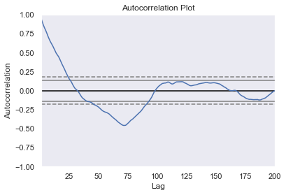
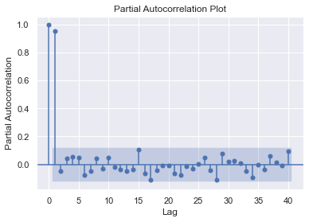
ACF & PACF plot
1
2
3
4
5
Based on crossing of function value with SL, suggested MA(q) terms ~ 25; too high!!
Indication to use AR model rather than MA: MA(0)
Lags whose partial autocorrelation is greater than significance level(SL) has been marked
Indication to use AR(5) model.

Slide 10
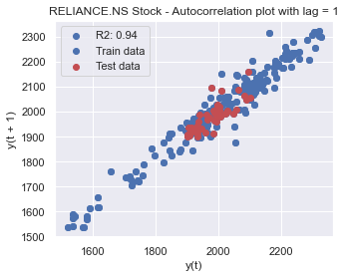
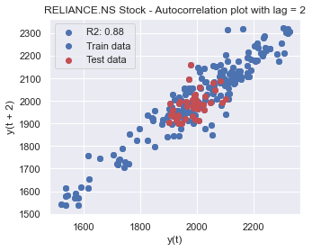
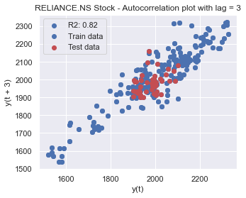
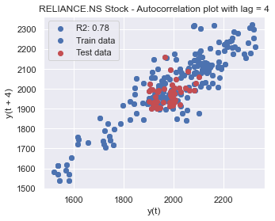
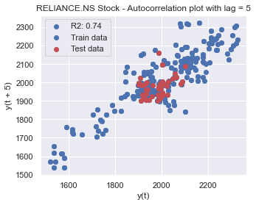
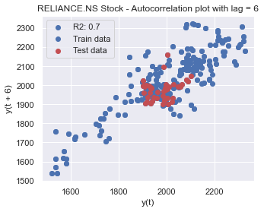
Lag plot(Train & Test data)
Train data: 01-06-2020 to 12-03-2021
Test data: 15-03-2021 to 31-05-2021
Notes:
R2: Coefficient of determination

Slide 11
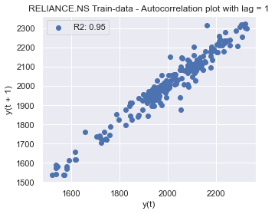
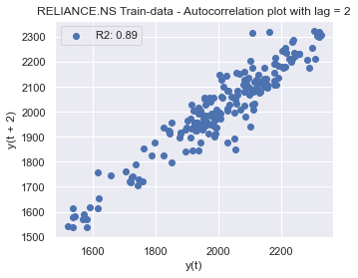
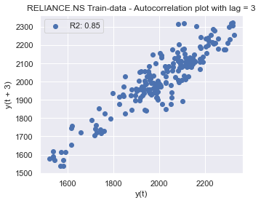
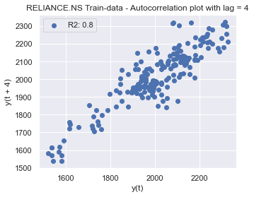
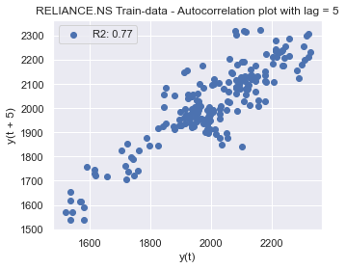

Lag plot(Training-data)

Slide 12
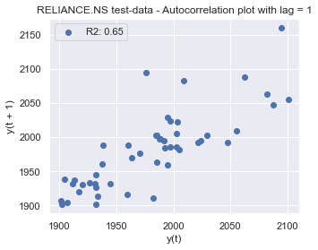
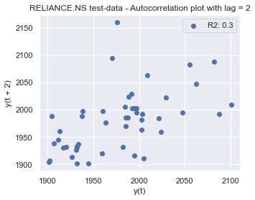
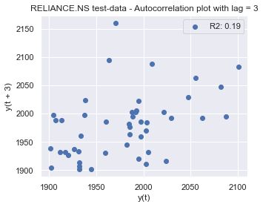
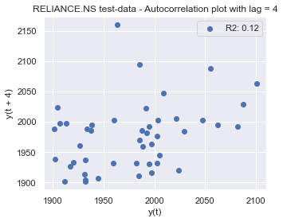
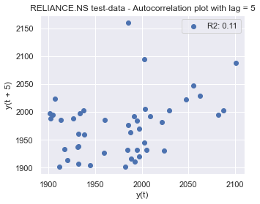
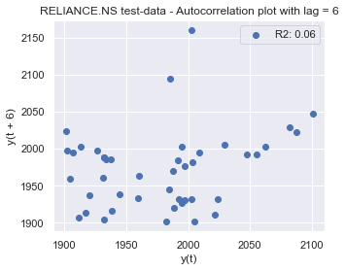
Lag plot(Testing-data)
Testing data is showing significantly less correlation with its lags!

Slide 13
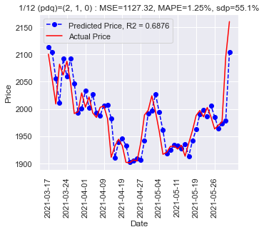
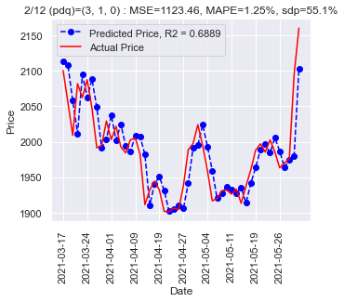

Model-hyperparameters cross-validation
(2,1,0) | (3,1,0) | (4,1,0) | (5,1,0) | (6,1,0) | (2,1,1) | (3,1,1) | (4,1,1) | (5,1,1) | (6,1,1) | (5,2,1) | (5,2,0)
sdp = cdp

Slide 14
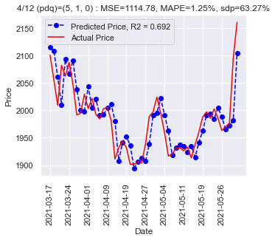


Model-hyperparameters cross-validation
(2,1,0) | (3,1,0) | (4,1,0) | (5,1,0) | (6,1,0) | (2,1,1) | (3,1,1) | (4,1,1) | (5,1,1) | (6,1,1) | (5,2,1) | (5,2,0)

Slide 15



Model-hyperparameters cross-validation
(2,1,0) | (3,1,0) | (4,1,0) | (5,1,0) | (6,1,0) | (2,1,1) | (3,1,1) | (4,1,1) | (5,1,1) | (6,1,1) | (5,2,1) | (5,2,0)

Slide 16


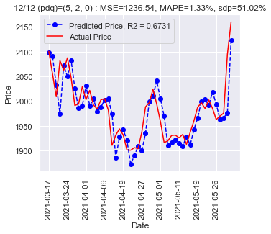
Model-hyperparameters cross-validation
(2,1,0) | (3,1,0) | (4,1,0) | (5,1,0) | (6,1,0) | (2,1,1) | (3,1,1) | (4,1,1) | (5,1,1) | (6,1,1) | (5,2,1) | (5,2,0)

Slide 17
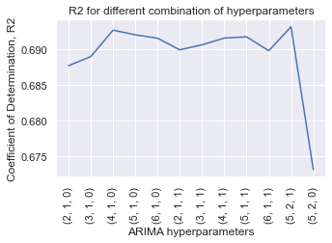
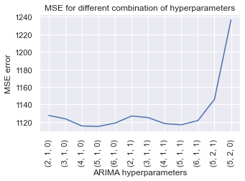
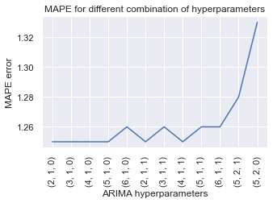
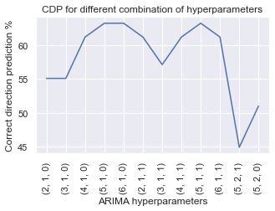
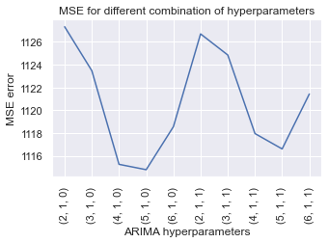
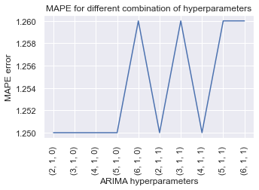
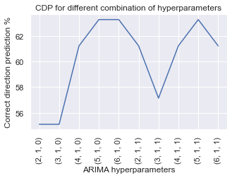
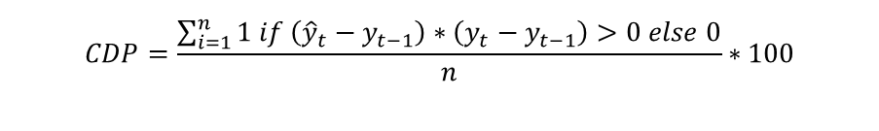
Error plot
$$CDP=\frac{\sum_{i=1}^{n}{1 if \left({\hat{y}}_{t}−y_{t−1}\right)∗\left(y_{t}−y_{t−1}\right)>0 else 0}}{n}∗100$$
Magnified as per Region of Interest
MSE: Mean Squared Error
MAPE: Mean Absolute Percentage Error
CDP: Correct Direction Percentage

Slide 18
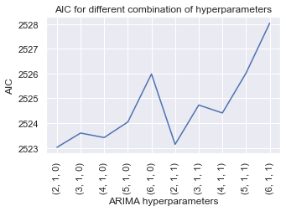
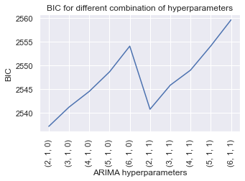
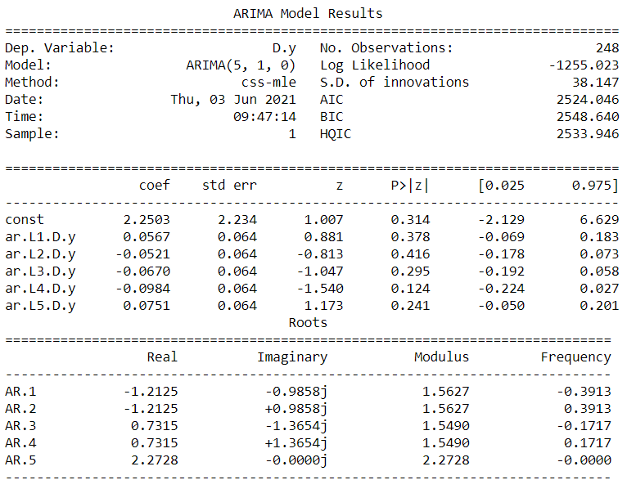
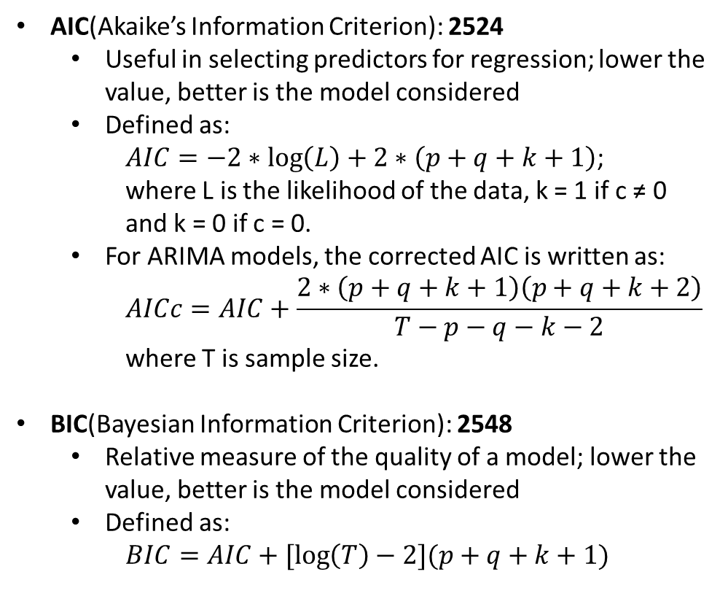
Model Summary
AIC(Akaike’s Information Criterion): 2524
Useful in selecting predictors for regression; lower the value, better is the model considered
Defined as:
$AIC=−2∗\log\left(L\right)+2∗\left(p+q+k+1\right)$;
where L is the likelihood of the data, k = 1 if c ≠ 0 and k = 0 if c = 0.
For ARIMA models, the corrected AIC is written as:
$$AICc=AIC+\frac{2∗\left(p+q+k+1\right)\left(p+q+k+2\right)}{T−p−q−k−2}$$
where T is sample size.
BIC(Bayesian Information Criterion): 2548
Relative measure of the quality of a model; lower the value, better is the model considered
Defined as:
$$BIC=AIC+[\log\left(T\right)−2](p+q+k+1)$$
ARIMA (p,d,q) = (5,1,0)

Slide 19
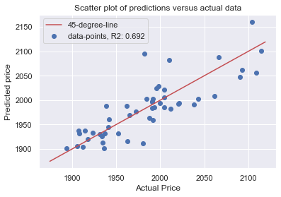
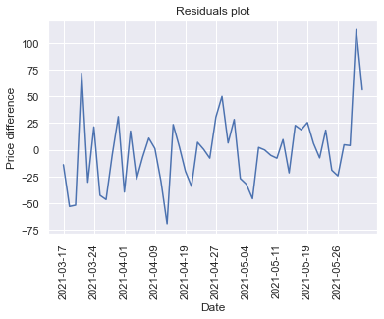


Residuals(Predicted-Actual)
KDE(Kernel Density Estimate): Analogous to histogram
Used for visualizing the distribution of observations in dataset

Slide 20


Trading strategy
Buy-sell Strategy implemented
Initial capital: ₹ 10 lac
Buy when next instance predicted price is at least 2% greater than today’s closing price using one-fifth of capital
Sell one-third of stocks when the next instance predicted price is at least 2% lower than today’s closing price
By next instance, next trading day closing price is implied
No. of transactions: 10

Slide 21


Portfolio Return Vs Idle Return
Return Analysis(50 day analysis period):
Portfolio Return(PR): $5.96 \%$
Idle Return(IR): $2.84 \%$
The above return figures for 50 day span(trading days), when translated to yearly(roughly 250 trading days), the above figures will simply get multiplied by 5 as:
Portfolio Return: $5.96 ∗5=29.8 \% p.a.$
Idle Return: $2.84 ∗5=14.2 \% p.a.$
Ratio of the two figures: $\frac{29.8}{14.2}= 2.10$
Accounting for the transaction & brokerage charges, above figure comes out to be
Portfolio Return: $\frac{\left[\frac{105.96}{100} ∗1000000 −20∗11\right]}{1000000} ∗100 ∗5=29.69 \% p.a.$
Idle Return: $\frac{\left[\frac{102.84}{100} ∗1000000 −20∗2\right]}{1000000} ∗100 ∗5=14.18 \% p.a.$
Ratio of the two: $\frac{29.69}{14.18}=2.09$

Slide 22



Simulated Trading
Sample backtest
Platform: Streak
Trades realising profit
Trades making losses, stoploss hit

Slide 23

Simulated Trading(using python)
Buy @ price-level
Sell @ price-level
Cumulative represents the net profit for the executed trades
No. of trades: S.No for the trades
Cumulative profit ranging from a maximum of Rs 1.9 to Rs -2.4 for 13 trades

Slide 24



Live Trading(using python)
Reliance* Scrip RTD
TCS scrip RTD
SBIN* scrip RTD
RTD: Real-Time Data
Meagre Rs 0.15 profit for 4 trades[conditions were relaxed to let some transactions happen during analysis period]
*: no live trades executed during the analysis period[connections seem to break too often for the service provided by smartapi from Angel Broking

Slide 25


Ongoing work:
Code deployment on cloud AWS EC2 instance
Manual Investments

Slide 26
Conclusion
Price of financial instruments are affected by numerous factors ranging from mere market sentiments to news(earnings announcement, lawsuits, M&As, potential deals, R&D outbreaks), GDP growth, Bond yields, FIIs investments, market analysts prediction going off the mark, etc.
ARIMA model does a pretty good job in predicting the price for the next instance by solely analysing the price component of it. (p,d,q) value of (5,1,0) optimally captures Reliance daily data for the period 1st June 2020 to 31st May 2021. The model rightly predicts the direction of movement 63.27% time with MSE of 1114.78 and MAPE of 1.25.
Ideated a simple strategy reaping twice as much returns as realised with idle investing.
Transaction charges & brokerages become significant compared to profit when large number of trades with small-profit margins are executed.
Stoploss and target should be appropriately planned as per risk capability of traders as traders generally loose their earnings in a single trade going wrong otherwise.
Long-term investing is the way forward to reap passive returns capable of beating inflation rate. Options include:
Stocks with good financials
Index fund investments
Mutual Funds
ETFs
Investing in commodities like gold & silver
Diversification help investors hedge their losses and limit the risk part of investments. For instance: Gold price rises when stock prices fell(say in pandemic situation).

Slide 27
References
https://people.duke.edu/~rnau/411arim2.htm
https://online.stat.psu.edu/stat510/lesson/2/2.2
https://ieeexplore.ieee.org/abstract/document/7046047
https://www.semanticscholar.org/paper/An-Effective-Time-Series-Analysis-for-Stock-Trend-Umadevi-Sundar/356879c2fc72465f5885315a16102975c6716226?p2df
https://machinelearningmastery.com/arima-for-time-series-forecasting-with-python/
https://towardsdatascience.com/advanced-time-series-analysis-with-arma-and-arima-a7d9b589ed6d
https://otexts.com/fpp2/arima-estimation.html
https://github.com/angelbroking-github/smartapi-python

Slide 28
Thank You!

