Slide 1
Parallelized
Sudoku Solver
Using openmp

Slide 2
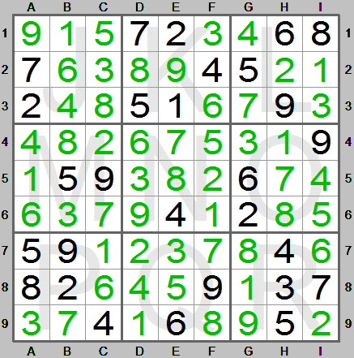
Introduction
Fill the missing digits
No repetition across any
Row
Column
Mini-grid
Time complexity of brute force algorithm: O(n^{n*n} ); where n is size of sudoku board; 9 for 9*9 board for instance: 9^81 ~ 10^77
We are so use to seeing, 9x9 sudoku puzzle, but we can have more complex puzzle for greater size as well: say 16x16, 25x25 etc.

Slide 3
Solver Algorithm
The total number of valid Sudoku puzzles of size 9x9 is equal to 6,670,903,752,021,072,936,960 or ( 6.71 x 10^21 ).
Due to the large combinations, no serial algorithms that can solve sudoku in polynomial time.
Use of heuristic approach to fill up as many empty cells as possible.
If necessary, the brute force algorithm solves the rest of the puzzle.
We have used three types of heuristic strategies to try and fill in numbers on the board.
1. Elimination - This occurs when there is only one valid value for a cell.
2. Lone Ranger - This is a number that is valid for only one cell in a row, column, or box.
3. Twins - These are a pair of numbers that appear together twice in the same two cells and only in those two cells.

Slide 4
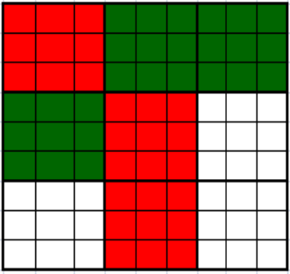
Proposed Approach
Initially, we are applying heuristics on the input grid. This gives the initial grid for creation of allotment list.
The application of heuristics is done as follows till none of the heuristics make any change:
a. Sequence of heuristics are Elimination ---> Lone-ranger ---> Twins
b. If the application of a heuristics causes some change, then the sequence is repeated from the beginning.
First, elimination is run in parallel across all boxes. Once it’s done,
then lone rangers will run in parallel across all boxes, and so on.

Slide 5
Proposed Approach
If the heuristic approach returns a grid with unfilled cells left, then we pass it to the brute force otherwise, we return the solution.
Each thread gets a grid from the allotment list and uses a local stack to execute brute force DFS on it.
Grids assigned in round-robin fashion for similar workloads on all threads.
It then repeats it till either the solution is found or the stack is empty in which case it gets the next grid.
Finally, the main thread will return either the solution, or no solution if the stack is empty.

Slide 6
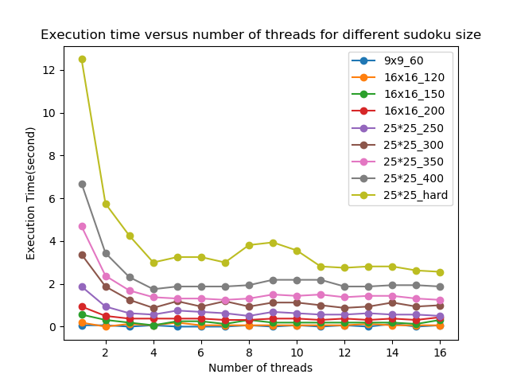
Timing Analysis
Speedup of ~4 achieved when no. of threads is 4 or greater, and more or less converges there after, as max. 4 threads are utilised at a time, hardware limit!
9x9_60: for instance represents a 9*9 sudoku with 60 missing entries, solved in “Execution time(v-axis)” using n, no. of threads(h-axis)

Slide 7
Contribution Schema
Work-distribution across team membersf
Amit Kumar (16d070034) | Sudoku algorithm code, Presentation
Saurabh Kumar (16d100018) | OpenMP parallelization, Timing Analysis
Amit Kumar (16d100023) | Code-debugging, Report
Ali Imam (16d100017) | Sudoku algorithm code , Report
Fairly equal contributions in hindsight!!

Slide 8
Hardware used for studying Timing Analysis
Code has been run on the following machine for timing analysis purpose:
Hardware details:
Local machine(Acer Nitro AN515-51)
Processor: Intel(R) Core(TM) i5-7300HQ CPU @ 2.50GHz, 2496 Mhz, 4 Core(s), 4 Logical Processor(s)
Installed RAM: 8.00 GB(7.89 GB usable)
OS details:
Linux(WSL(Windows Subsystem for Linux) session on MobaXterm) installed in Windows 10 Home Single Language

Slide 9
Thank You

