Slide 1

Music Instrument Recognition using Machine Learning
From Raw Sound to Smart Prediction
Can a computer hear music the way humans do? Can it identify whether a sound is from a guitar, flute, or piano? This project explores a powerful question: Can machines understand sound?

Slide 2
The Core Challenge
What Humans Experience
What Computers See
When we listen to music, our brains instantly recognize instruments. We perceive pitch, tone, timbre, and texture without conscious effort. A few notes are enough to distinguish a guitar from a piano or a flute from a trumpet.
Computers perceive sound fundamentally differently. To a machine, audio is just a waveform—a series of amplitude values over time like [0.002, -0.031, 0.045, 0.001...].
There's no inherent meaning, no labels, no emotional context. Without proper processing, these numbers are meaningless. The fundamental problem: How do we teach computers to recognize musical instruments from raw audio signals?
This recognition happens naturally because our auditory system has evolved to process complex sound patterns and extract meaningful information effortlessly.

Slide 3

Why This Matters
Music Streaming
Powers intelligent recommendation systems that suggest songs based on
instrumental composition and sound characteristics
Auto-Tagging
Automatically categorizes and labels massive music libraries,
making content searchable and organized
Media Production
Assists film and game developers in analyzing
and selecting appropriate sound elements for their projects
Music Analysis
Enables digital audio workstations to provide intelligent mixing suggestions
and instrument-specific effects

Slide 4
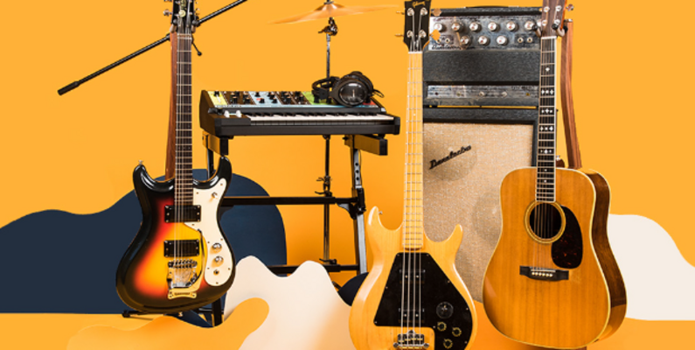
Our Dataset
Music Instrument Sounds Dataset
We used a comprehensive dataset from Kaggle containing audio recordings of 28 different musical instruments. Each audio clip is approximately 3 seconds long, providing just enough sound to capture each instrument's distinctive characteristics.
The dataset is organized into folders, where each folder represents one instrument class—Guitar, Piano, Violin, Flute, Trumpet, Drums, and more. Importantly, each audio file contains only one instrument, making it ideal for supervised learning.
01
02
Organized Structure
Clean Samples
Folders named by instrument type
3-second isolated instrument recordings
03
04
Diverse Coverage
Ready for ML
28 distinct instrument categories
Pre-labeled for supervised learning

Slide 5
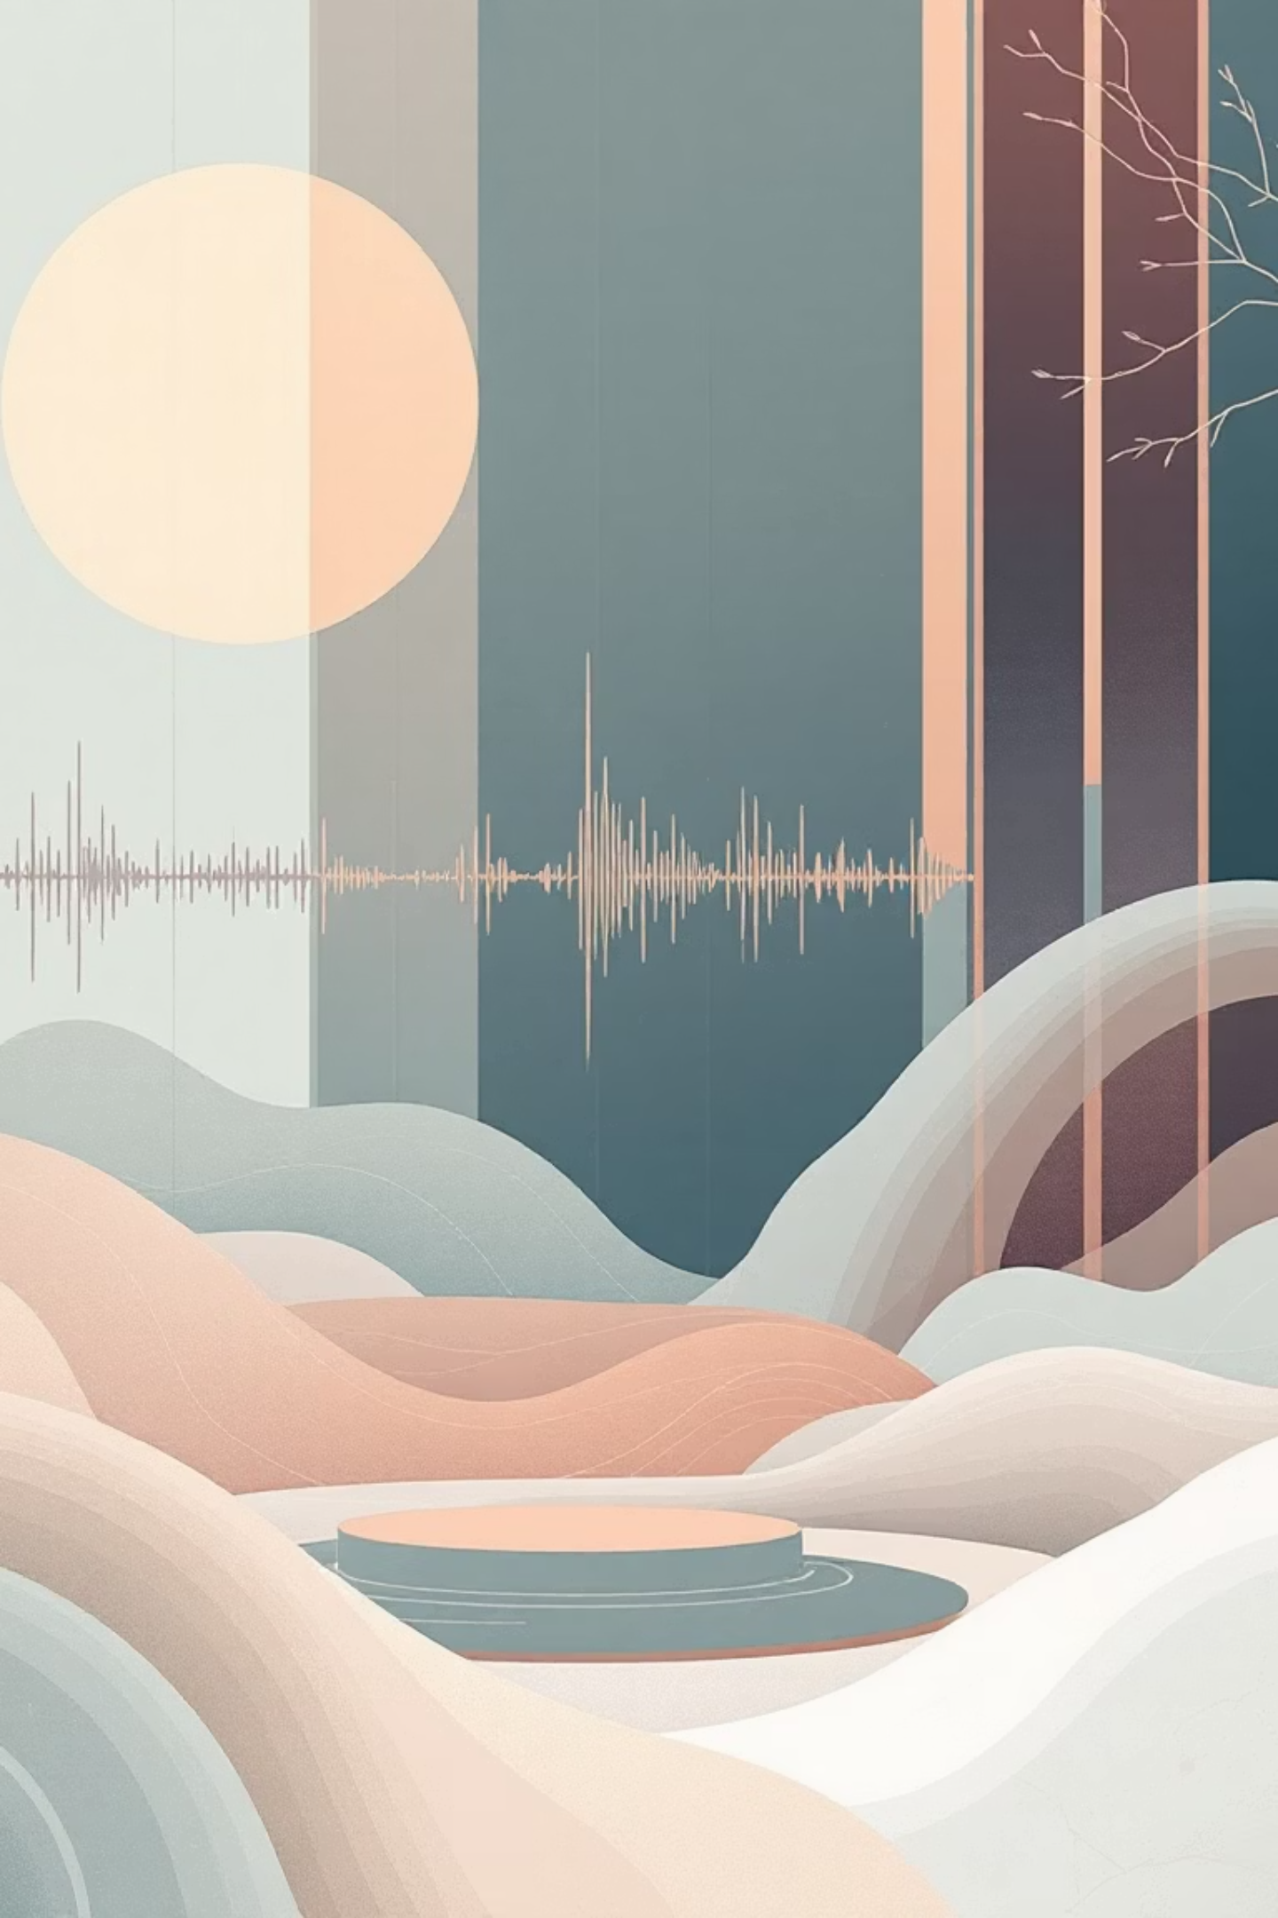



The Sound-to-Number Problem
Raw Audio File
A .wav file containing pressure waves captured by microphones
Digital Samples
Thousands of amplitude measurements per second—just numbers
Machine Learning Input
Features that capture meaningful sound characteristics
The biggest challenge in audio machine learning isn't the modeling—it's converting sound into something a machine can meaningfully understand. We need to bridge the gap between acoustic physics and computational learning.
This transformation process is called feature extraction, and it's the key to making our project work.

Slide 6
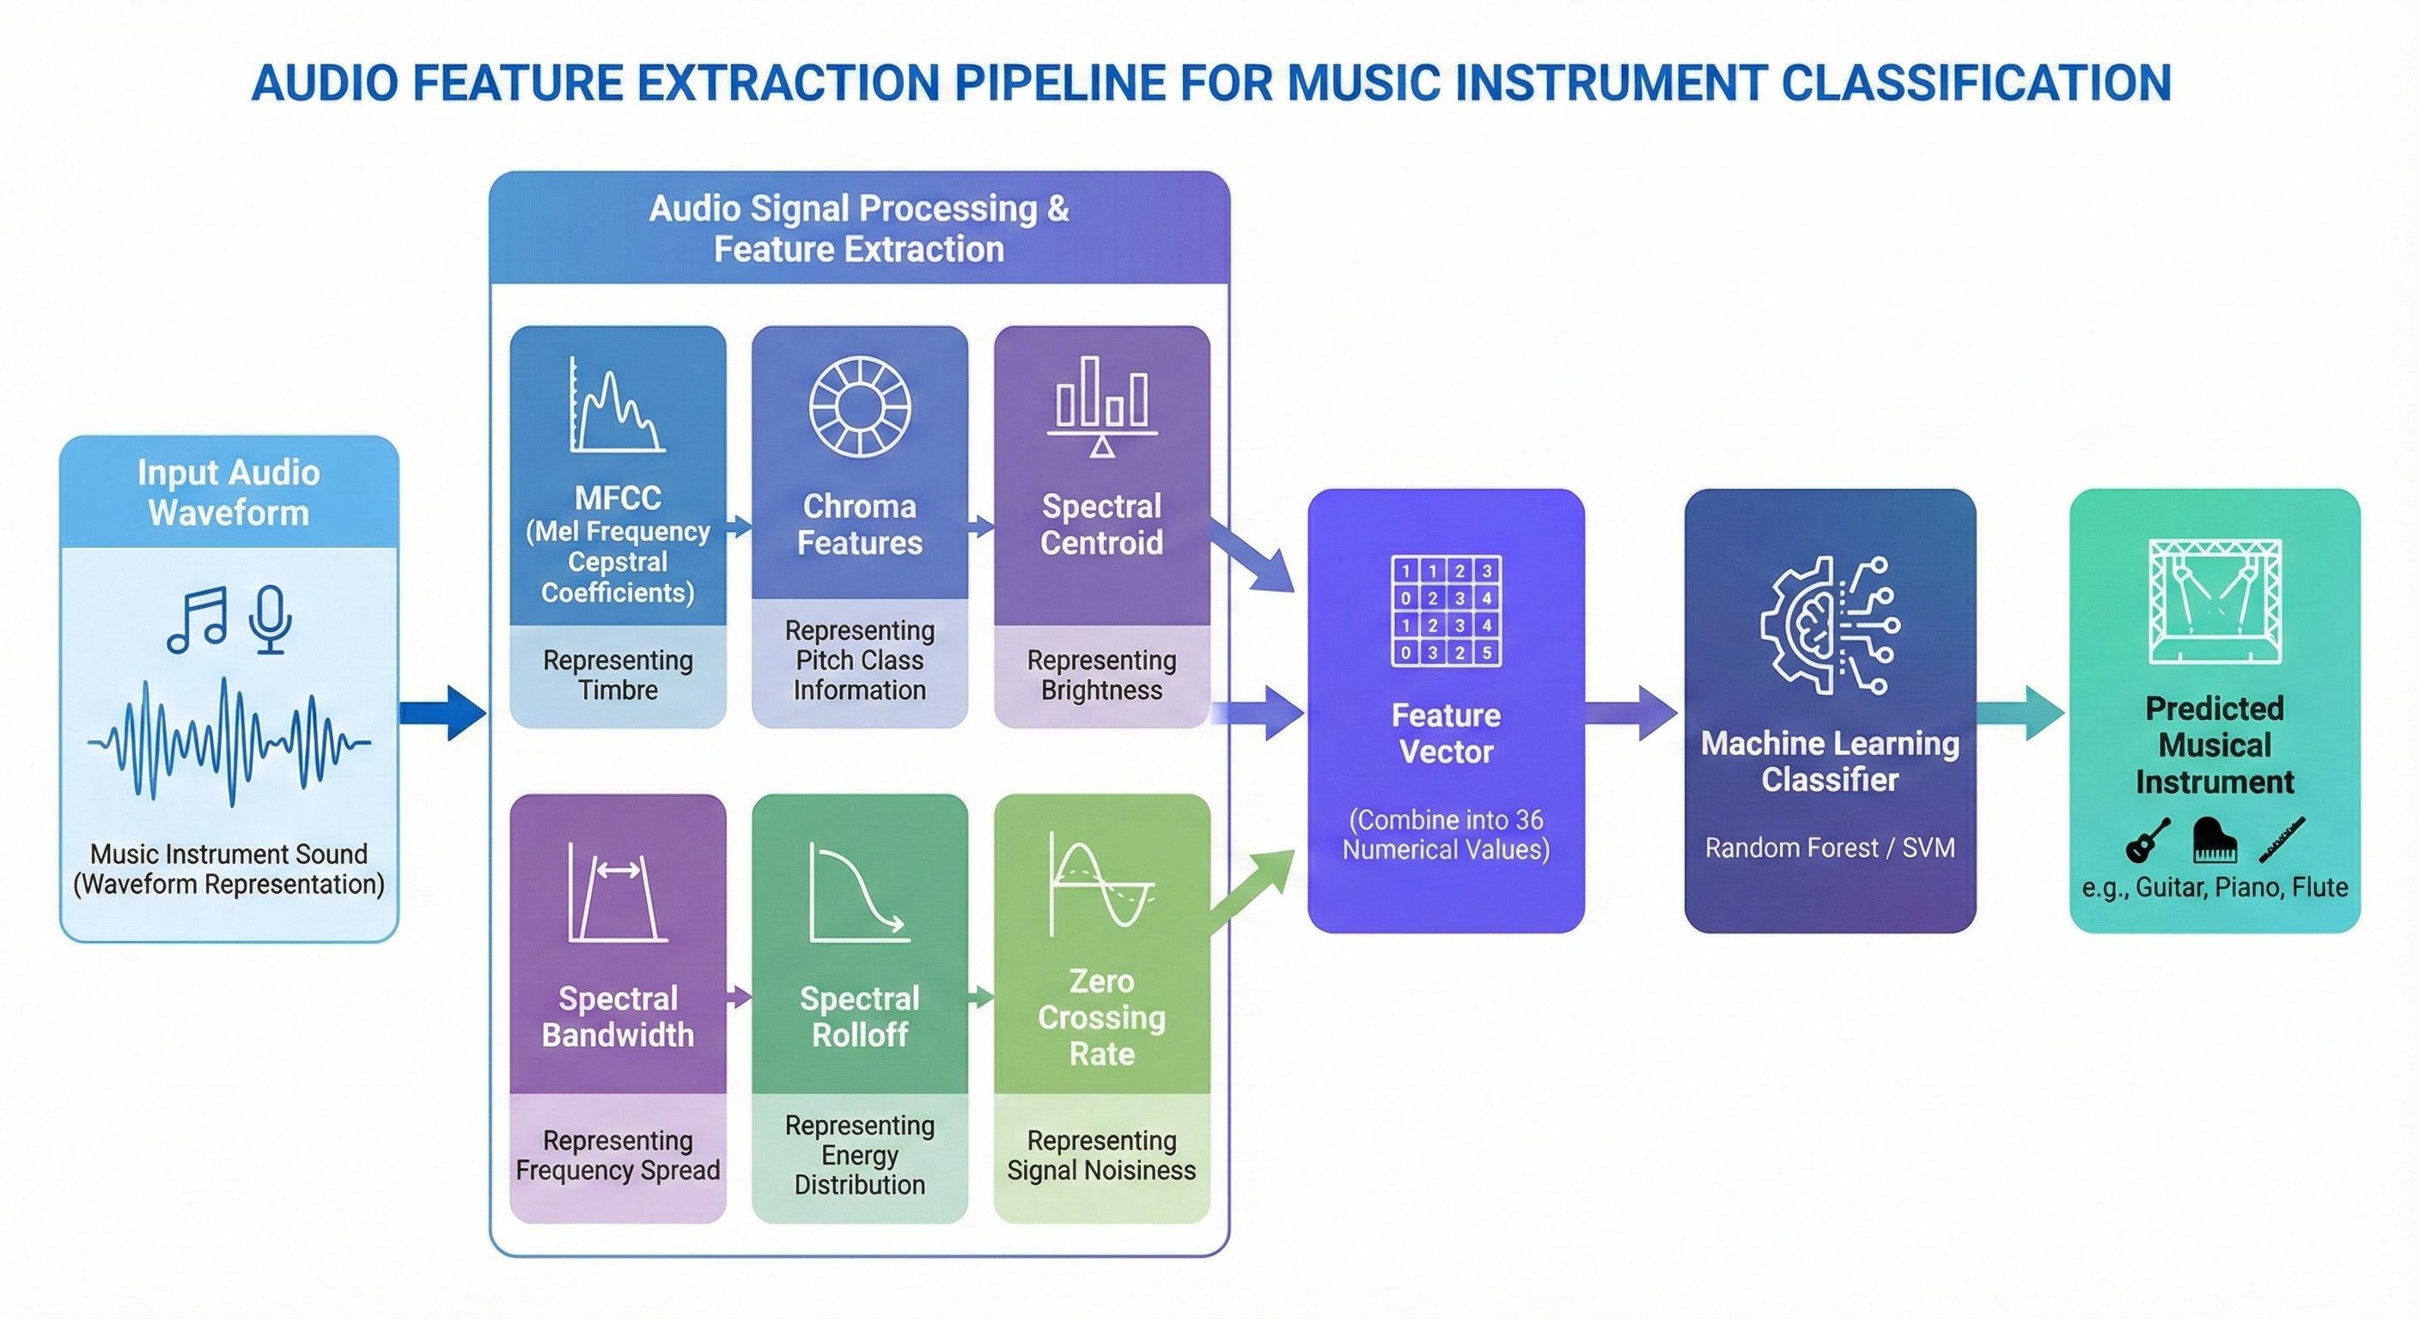
1
2
3
Reduce Complexity
Capture Essence
Enable Learning
Transform thousands of samples into dozens of meaningful numbers
Extract the acoustic properties that define each instrument
Create input that machine learning models can effectively process

Slide 7


Our Feature Toolkit
We extracted 36 distinct features from each audio file, creating a comprehensive numerical fingerprint of every instrument sound. This multi-faceted approach ensures we capture different aspects of sound characteristics.
MFCC
20 features
Mel-Frequency Cepstral Coefficients capture how humans perceive sound
Chroma
12 features
Musical note representation (C, D, E, F, G, A, B)
Spectral Features
3 features
Centroid, Bandwidth, Rolloff—frequency distribution metrics
ZCR
1 feature
Zero Crossing Rate indicates signal volatility
Together, these 36 features transform each 3-second audio clip into a point in 36-dimensional space, where instruments with similar sounds cluster together.

Slide 8
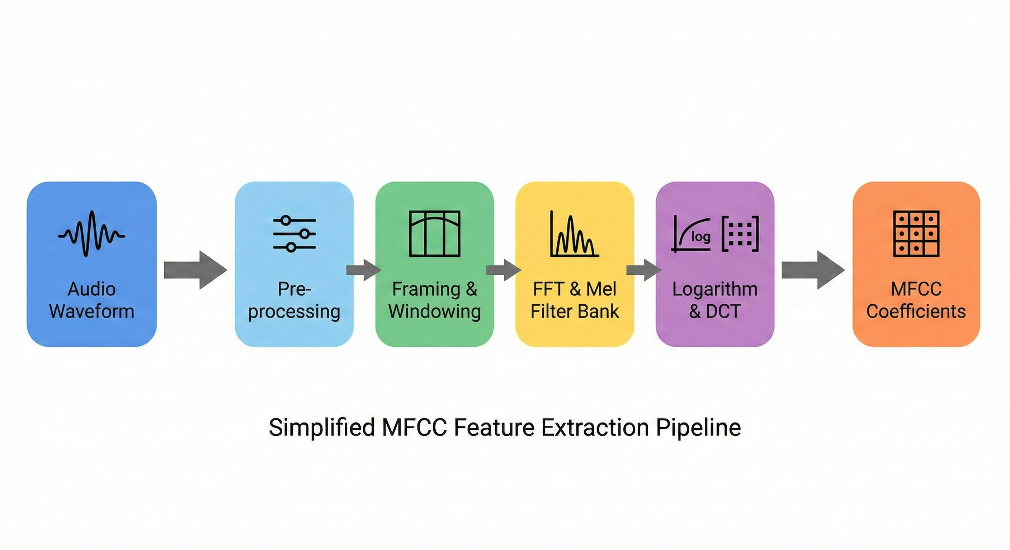
MFCC: The Backbone Feature
Mel-Frequency Cepstral Coefficients
MFCC is the most important feature in our toolkit, and for good reason—it captures timbre, the unique "color" or quality of sound that distinguishes one instrument from another.
Even when two instruments play the same note at the same volume, they sound different because of timbre. MFCC quantifies this difference by modeling how the human auditory system perceives sound, using the mel scale that mirrors our ear's frequency response.
We extract 20 MFCC coefficients per audio sample, each representing different aspects of the spectral envelope. This makes MFCC incredibly powerful for separating instruments with similar pitches but different tonal qualities.

Slide 9
Chroma & Spectral Features
Chroma Features (12 values)
Spectral Centroid (1 value)
Chroma features represent the distribution of energy across the 12 pitch classes in Western music (C, C#, D, D#, E, F, F#, G, G#, A, A#, B). They capture harmonic content regardless of octave.
Indicates where the "center of mass" of the frequency spectrum lies. Bright sounds (like cymbals) have high centroids, while dull sounds (like bass drum) have low centroids. This single number captures perceptual brightness.
This is particularly useful because instruments playing the same melody have different harmonic structures. A guitar and piano playing middle C will have distinct chroma signatures based on their overtone patterns.
Spectral Bandwidth (1 value)
Spectral Rolloff (1 value)
Measures the spread of frequencies around the spectral centroid. Narrow bandwidth suggests pure tones (flute), while wide bandwidth indicates noisy or complex sounds (snare drum).
The frequency below which 85% of spectral energy resides. Helps distinguish instruments with different energy distributions—percussive instruments have higher rolloff frequencies than sustained melodic ones.

Slide 10
The Intelligence Behind Audio Understanding
Why Machine Learning?
Pattern Recognition
After converting sound into numerical features, we need intelligent algorithms capable of understanding complex audio patterns. Raw feature vectors alone cannot distinguish between instruments—we need models that learn relationships.
Learn distinctive characteristics of different instruments from training data
Generalization
Machine learning algorithms excel at discovering non-obvious patterns in high-dimensional feature spaces. They can identify subtle differences in timbre, frequency distribution, and temporal characteristics that define each instrument's unique sonic signature.
Classify previously unseen audio samples with confidence
Robustness
Handle variations in recording quality and playing style

Slide 11
Model Selection: A Classical ML Approach
We deliberately chose traditional machine learning models over deep learning to understand fundamental classification mechanics and maintain interpretability. This approach allows for faster experimentation, clearer hyperparameter tuning, and reduced computational requirements.
01
02
03
Logistic Regression
k-Nearest Neighbors
Naive Bayes
Linear baseline for probability-based classification
Instance-based learning using similarity metrics
Probabilistic classifier with independence assumptions
04
05
Support Vector Machine
Random Forest
Margin-maximizing classifier with kernel flexibility
Ensemble method combining multiple decision trees
Each model brings unique strengths to audio classification, from computational efficiency to pattern complexity handling. Our systematic comparison reveals which classical approaches work best for this domain.

Slide 12
Logistic Regression: The Baseline
How It Works
In our project, Logistic Regression is used as a baseline classification model to identify musical instruments from audio features. After converting raw audio signals into numerical features such as MFCCs, chroma, and spectral features, each audio sample becomes a feature vector.
Logistic Regression then learns a linear relationship between these features and the instrument classes. It applies the softmax function to calculate the probability of each instrument and assigns the class with the highest probability as the prediction.
Since Logistic Regression assumes linear decision boundaries, it performs reasonably well but struggles to fully capture the complex and non-linear timbre patterns of musical instruments.
This is why it achieves lower accuracy compared to ensemble models like Random Forest, but it is still useful for understanding the dataset and comparing model performance.

Slide 13
k-Nearest Neighbors: Similarity-Based Classification
Instance-Based Learning Approach
k-NN operates without a traditional training phase, instead memorizing the entire training set. During prediction, it identifies the k most similar audio samples based on feature distance and assigns the majority class. This lazy learning approach makes it sensitive to the distance metric and neighborhood size.
Hyperparameter Tuning Strategy
We systematically explored k values from 1 to 100 with step size of 5, plotting accuracy at each point. This revealed the optimal balance between local noise sensitivity and boundary smoothness.
k = 1: Extremely sensitive to outliers and noise
k = 5: Optimal balance—selected for final model
k > 50: Over-smoothing leads to accuracy degradation

Slide 14
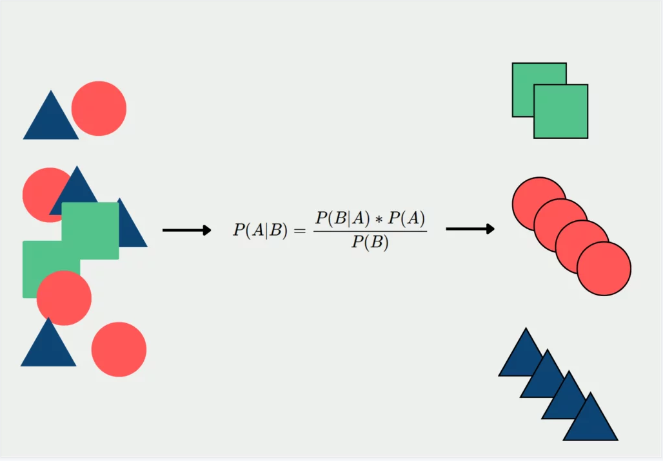
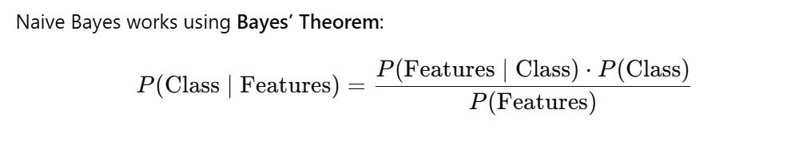
Naive Bayes: Probabilistic Speed
Bayesian Inference
In my project, Naive Bayes is used as a probabilistic classifier that predicts the instrument based on extracted audio features such as MFCC, Chroma, Spectral Centroid, Bandwidth, Rolloff, and ZCR.
- Class = Instrument (Guitar, Flute, Piano, etc.)
- Features = 36 extracted audio features
The model assumes that all features are independent of each other
During training:
The model learns the probability distribution of each feature for every instrument.
During prediction:
For a new audio file, the model computes the probability of that feature vector belonging to each instrument.
The instrument with the highest probability is selected.

Slide 15



Support Vector Machines: Maximizing Margins
Finding Optimal Separating Hyperplanes
SVMs construct decision boundaries that maximize the margin between classes, making them robust to outliers and well-suited for high-dimensional feature spaces. The kernel trick allows SVMs to capture non-linear relationships without explicitly computing transformed features.
Polynomial Kernel
Tested degrees 3–10 to capture polynomial relationships in frequency distributions
RBF Kernel
Explored gamma values 0.1–1.0 for radial basis function flexibility
Parameter Selection
Grid search identified optimal kernel and hyperparameters through cross-validation
Polynomial Kernel Performance: Degree 5 showed best balance between complexity and generalization. Higher degrees risked overfitting.
RBF Kernel Performance: Gamma = 0.3 provided optimal locality, creating appropriately sized decision regions in feature space.

Slide 16
Random Forest: Ensemble Excellence
Wisdom of the Crowd
In my project, Random Forest works by combining the decisions of many decision trees to accurately identify musical instruments from extracted audio features.
Each audio file is first converted into numerical features such as MFCC, chroma, spectral centroid, bandwidth, roll-off, and zero-crossing rate, which represent the timbre and frequency characteristics of the sound.
During training, Random Forest creates multiple decision trees, where each tree learns different patterns from randomly selected subsets of the data and features. For example, one tree may focus more on MFCC patterns to distinguish flute sounds, while another may rely on spectral features to identify drums or guitars.
When a new audio sample is given, all trees independently predict the instrument, and the final output is decided by majority voting. This ensemble approach reduces overfitting, handles non-linear relationships in audio data, and improves robustness, which is why Random Forest achieved the highest accuracy in my project.

Slide 17
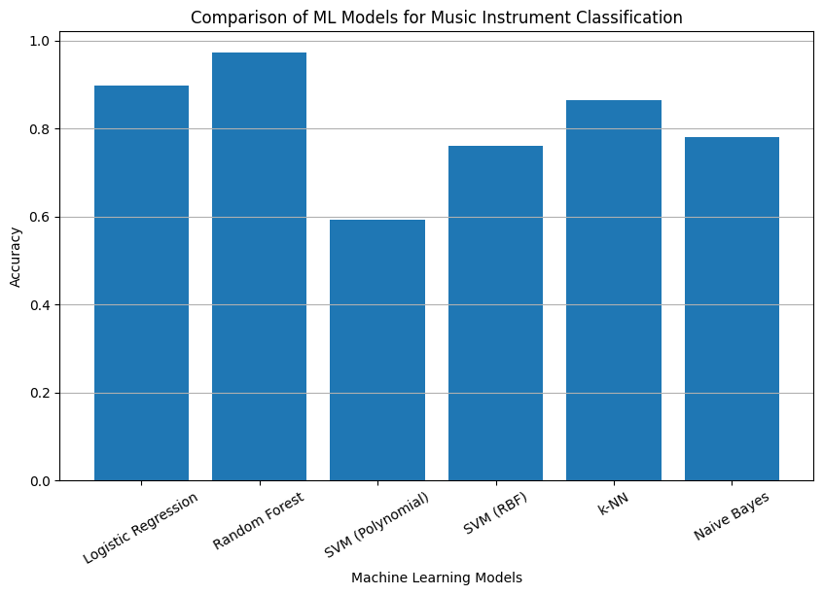
Comprehensive Model Comparison

