Slide 1

Use Case Interview
Business Case &
Project Presentation
Presenter : Saurabh Chakravorty

Slide 2
₀₁
Contents
Business Use Case
Problem
Revenue Spending
Incremental Spending
ROI
Project Presentation
Project
Methodology
Process Architecture
02

Slide 3
Business use case
Problems | Results and findings
1

Slide 4
Problem
Randomized A/B Testing
Splitting the data into two different versions
Test group ( Redeemers and non redeemers)
Control group
The class distribution after the split is very imbalanced in terms of numbers.
The null hypothesis can be defined as the group redeemers through the campaign of discount will yield in more sales revenue as compared to the control group.
Class distribution in percentage
2

Slide 5
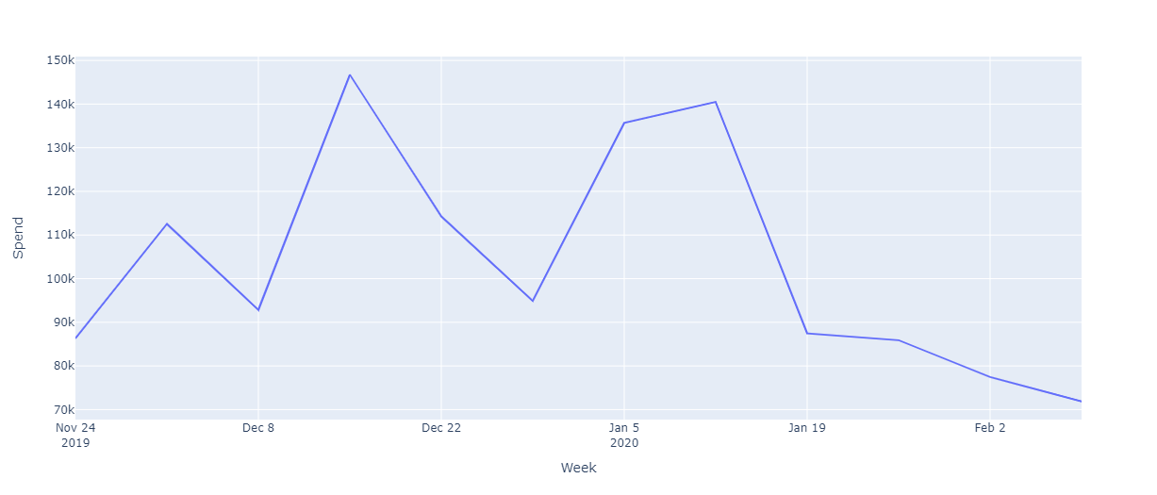
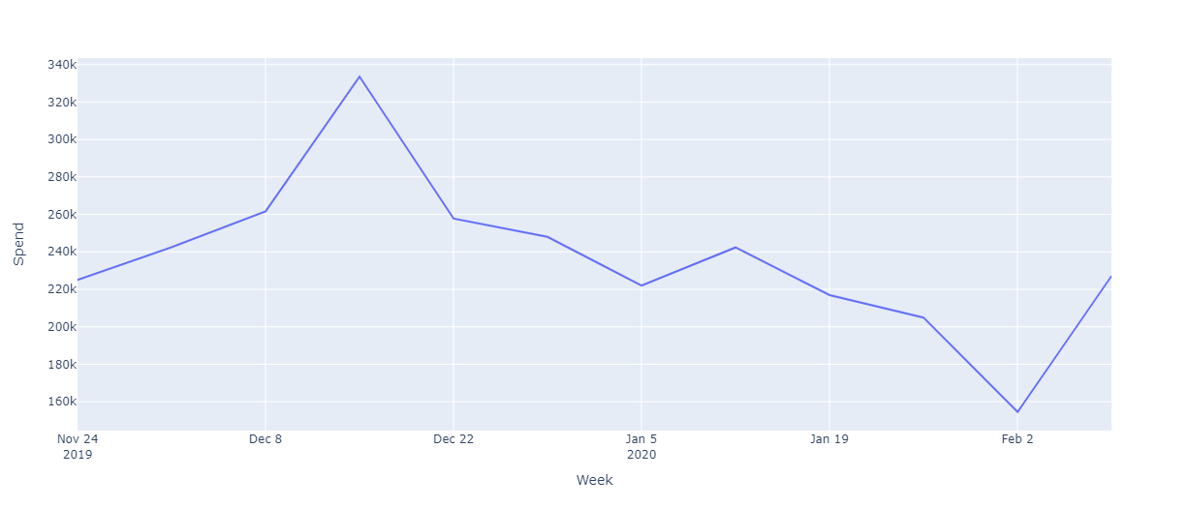
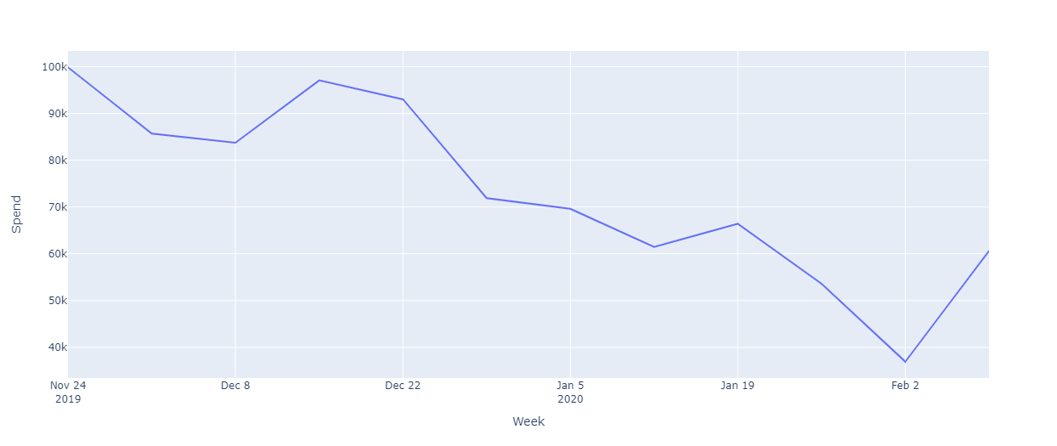
Revenue Spending
Redeemers
Non Redeemers
Control
Test Group
During this period the purchases in test group was 83% of total purchases.
The redeemer group accounted for 30% of total purchases in test group.
Observing the sales period between 5 Jan to 18 Jan 2020 the redeemers accounted for 31% of total purchases.
The non redeemers constituted for almost 53% of total sales purchases during the sale week.
Control Group
During this period the purchases in the control group was 17% of total purchases.
Observing the sales period between 5 Jan to 18 Jan 2020 the control group accounted for 15% of total purchases.
The purchase made in total period was only 20% by the control group**.
3

Slide 6
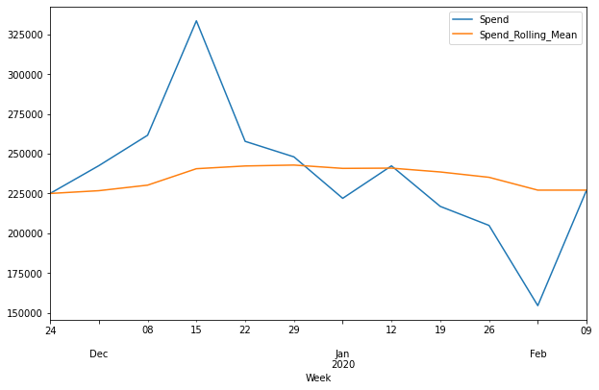
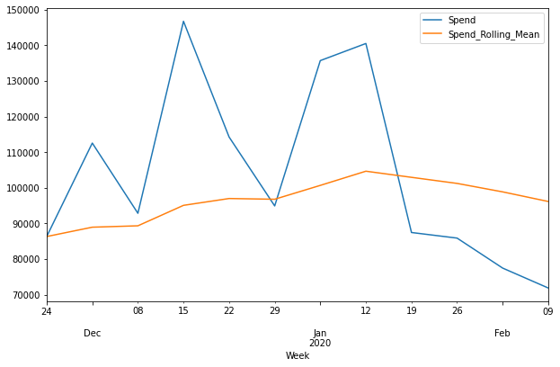
Incremental Spending
Non Redeemers
Test Group
The trend lines are plotted by rolling mean by exponential decaying factor with alpha value of 0.1.
We observe in the sale week the spend was very high in contrast to trend line in redeemer group.
The difference in incremental purchases between redeemer and non redeemer in terms of absolute value in $69682 .
The incremental purchase in redeemer is 82% of total incremental purchase in test group.
Test vs. Control Group
The incremental purchase in control group is ~1% of total incremental purchase anticipated in both the groups.
Redeemers
4

Slide 7
Return Of Investment
Sales Week
Total revenue earned in redeemer group
ROI =
Net Investment made in campaign
Investment = #Coupons * Value of coupon($10)
Total revenue = Spend * Take Rate(0.10)
112%
5

Slide 8
Project Presentation
Problem | Methodology| Process Architecture
6

Slide 9

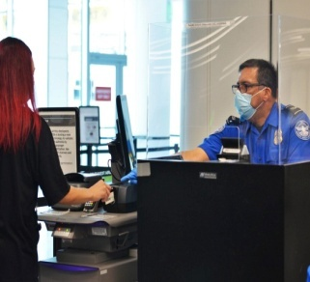
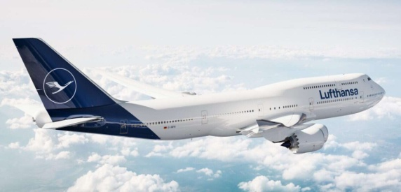



Covid-19 Documentation
Passenger Covid Docs
Regulatory check
On boarding and checking
NO
Yes
Deployed AI solution
Business Impact
Automation being the key stone in aviation helped achieve less latency and high throughput in terms of document verification.
Revenue spend for manual automation reduced and cost of operations was reduced by 10% of total expenditure.
Overall automation rate achieved for the covid documents in general was near to 52% .
Responsibility
Worked as a Data Scientist in MLOps for developing and maintaining the project lifecycle.
Communicating to stakeholders the results and findings standardized business metrics and KPIs.
Provide inputs about new cloud solutions and offerings in Microsoft Azure platform.
7

Slide 10
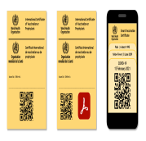


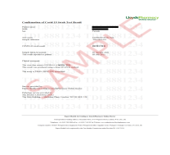
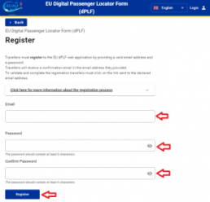


Methodology
Input Data
Solution Development
Evaluation Metrics
Model training for document
classification
Model Testing
Accuracy
F1 Score
Precision
Recall
Vaccination
certificates
Training OCR model for key
entity extraction from docs
Covid Test
Report
Post processing scripts for text
and entity match with
PLF document.
Key Performance Indicators
Passenger
Locator Form
Steps involved
Trying different model and algorithms for building classification models with evaluation.
Specifying layout for OCR extraction from documents.
Writing algorithm related for name and date match like Lavenstein distance and cyclic date.
KPIs defined on business level:
OCR mismatch rate for name, date and vaccination names.
Destination and country wise rate of error in documents.
Country and geography wise automation rate .
Border Entry
documents
Gathering data with consent to training from user and storing it for labeling and training the data
8

Slide 11






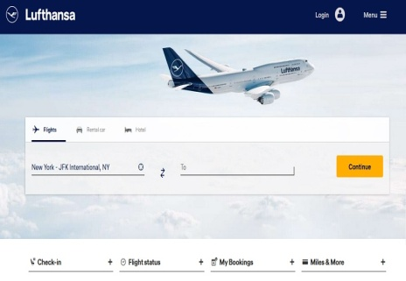





Process Architecture
Training Data
If consent to training is obtained we process the data for continuous training of our model according to GDPR regulations.
Passenger uploads the documents and the form with the help of unique Booking ID in the system. The response is received by the user in 1-3 minutes regarding the verification of docs.
3 Step document automation
Data(Bundles) uploaded by the user in portal
Email
Logs and Reports
The request made to the web server has three process pipelines where the document are verified . Firstly, the classification of documents are done. Secondly, the fields are extracted with the OCR and lastly, post processing techniques are applied to match the fields.
The logs are parsed and visualized in Kibana for daily reporting and analysis.
9

Slide 12
Thank You
10

