Slide 1

Spotify Data : Insights & Forecasting BMG | Data driven Music Intelligence -- Saurabh
Notes:
1

Slide 2





AGENDA (15 min.)
Introduction
BMG Challenge
Key Insight – 1
Track longevity to distribution
Key Insight – 2
Streaming threshold and volatility
Modelling :Features & Insights
Predict rank + 6 months streaming
Conclusion
Insights, value and next steps
2
Notes:
2

Slide 3





Introduction
GOAL : How can BMG leverage and understand the patterns that separate short-lived entries from long-term hits — and enable BMG to act early and intelligently in the track lifecycle.
Analysing Trends
Chart and stream trends help identify the difference between short-term spikes and sustained performance. Tracks with consistent weekly growth are more likely to sustain momentum in the charts. The data used is centred around streams and genres across major labels which is used week wise.
Tracking Identifiers
By tracking patterns like early growth, volatility, and stream decay, we can extract signals of a track’s long-term potential. These identifiers help flag promising tracks within their first few weeks. Dashboard created to track it.
Business Insights & Strategies
Longevity and early growth patterns inform A&R strategy, playlisting focus, and marketing timing. This enables BMG to invest early in tracks with high ROI potential. Model the data to predict rank and stream for 6 months.
"In the streaming era, success isn’t just about how loud a track debuts — it’s about how long it echoes."
Notes:
“The goal is to understand what separates short-lived entries from long-term hits — and help BMG act early and intelligently in the track lifecycle.”
“In the streaming world, tracks either climb steadily or burn out fast. By analyzing early performance signals like volatility, growth, and consistency, we can detect which tracks are worth pushing.” -> live tracking via dashboard(will switch)
“We start by analyzing streaming and chart trends, extract patterns that act as identifiers/long term predictors and convert those insights into business-facing strategies for A&R, playlisting, and marketing.”
“These insights are not only descriptive but predictive — helping BMG decide which tracks to prioritize, fund, or promote — even before they hit their peak.”

Slide 4
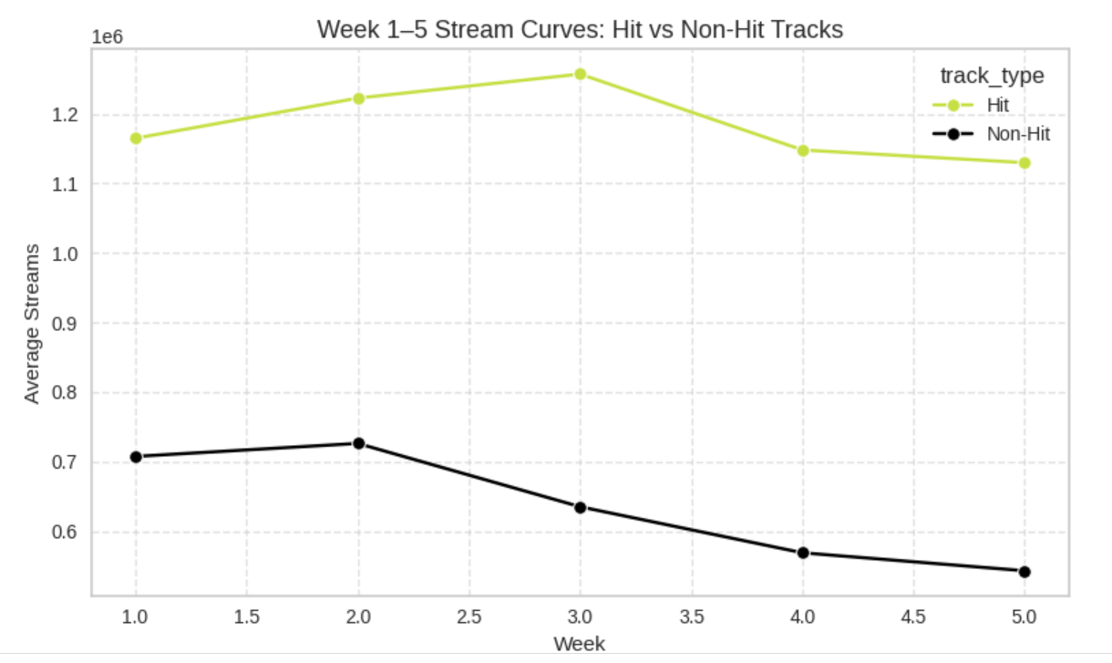
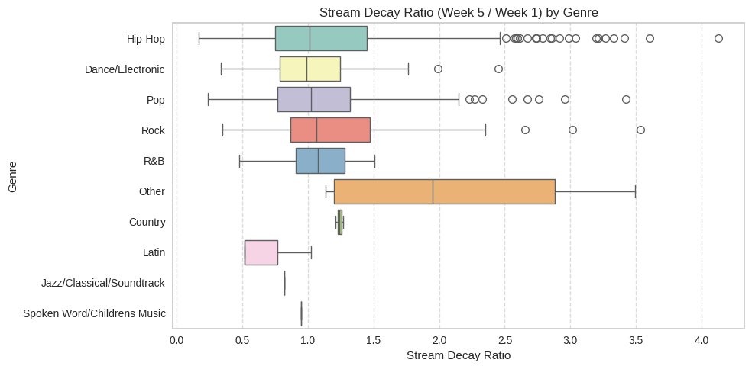
Success Lies in Early Stability and growth
Early Week Momentum
Tracks that perform well in the first 2–3 weeks — particularly those with positive growth between Week 1 and Week 3 — tend to accumulate significantly more streams over time. We see a strong “early spike” effect where breakout tracks generate 30–50% of their lifetime streams in the first 3 weeks.
Strong decline post second week
Stream Decay Ratio
Stream volatility makes us understand tracks with smoother, more stable growth patterns tend to do better than tracks with one big spike.
4
Notes:
“This analysis shows that success in the charts often hinges on early momentum and stream stability. Hit tracks typically show positive or stable growth in the first 3 weeks, while non-hits decline quickly.”
“We also measured the stream decay ratio — how much a track drops from Week 1 to Week 5. Genres like Pop and Electronic show sharper drops, while R&B and Country maintain more consistent engagement.”
“Looking at longevity by genre, we see that Dance/Electronic and Pop break into the Top 10 faster, but genres like Holiday and Country last longer in the Top 200.”
“In short: some genres spike early, others sustain. -> Distribution based on Genre varies -> what will be the distribution Understanding these patterns helps BMG tailor its strategy — whether that’s early promotion, long-term catalog support, or artist investment.”
4

Slide 5
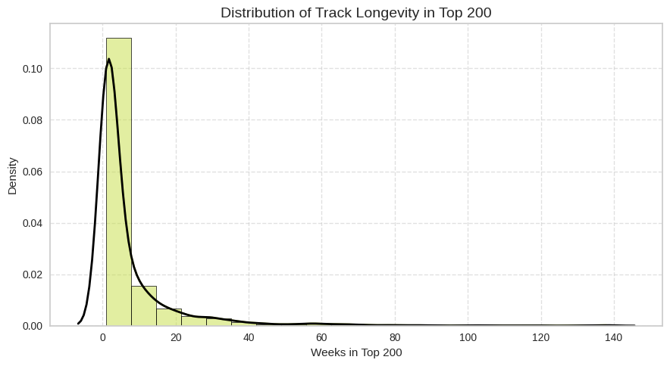
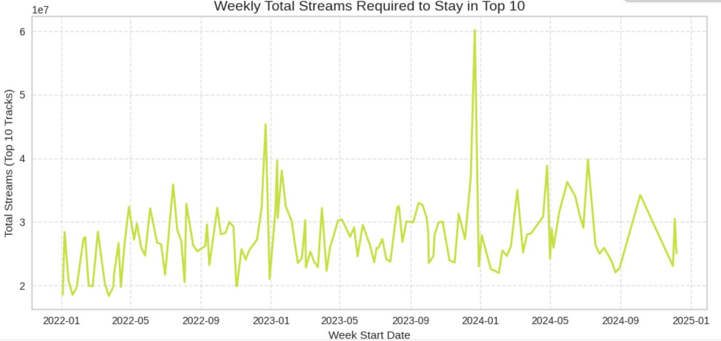
Longevity Effects captured in Ranking
Metric | Value
Mean | 2 week
Median | 7 week
Std. dev | 13 week
Strong seasonal effects observed
Long tail distribution curve
Metric | Value
Mean | 2,755,602
Median | 2,495,904
Top 25% | 3,106,299
Top 75% | 2,092,181
Average week on top
This curve illustrates that while hit tracks are few, they accumulate disproportionate exposure and streaming volume — critical for A&R and promotional investment decisions.
>2.5 Mn. streams for Spotify tracks
These trends help inform release timing, playlist placement strategy, and campaign design, enabling BMG to align marketing pushes with high-impact windows
Value for top - 10
*A&R teams use metrics like track longevity to decide which artists or tracks to invest in, promote further, or include in future projects.
5
Notes:
5

Slide 6
FEATure Engineering & Forecasting
Metric | Value
Best Model | RF Regressor
MAPE | 0.26
R2 | 0.89
Rank Prediction
Using the features underlined to predict the rank at a particular week after release
Features Engineered
Tracking Performance over 3 weeks
Temporal trends over time
Genre popularity and categorical features
Structural coverages
Metadata features : major label or not
Different models i.e. Linear regression, Tress based regressor, NN were trained and evaluated
Train regression models and evaluate with MAPE and R2
Metric | Value
Best Model | RF Regressor
MAPE | 0.11
R2 | 0.95
Streams generated
# of streams for next 6 months
Mapping the distribution to estimate ranks and streams over time

Slide 7



KEY TAKEAWAYS
Top performing tracks shows early signals of success and slow decay in stream over weeks over Genre / Era. The first 2–3 weeks of streaming data — including growth rate, volatility, and stability — provide strong signals for identifying long-term hits.
Further investigation on forecasting would require artist and track related information to accurately predict rank monetizing BMG’s success. The cold start approach would require causal characteristics to be investigated for forecasting.
The distribution of steams is heavy tailed across genres but individual characteristics varies, Model performance could further improve with access to artist-level signals (e.g. follower base, prior hits), playlist placements, and campaign metadata.
These insights can help prioritize tracks for promotion, plan release timing, and allocate resources more effectively across frontline and catalogue tracks.

Slide 8
THANK YOU
8
Notes:
8

