Slide 1
Fake News Prediction
By: Saurabh Chaudhary
Charan Raju M
Cs-675
Fall 2023

Slide 2
Introduction
Fake news is a widespread issue in the news industry and has become a global problem.
In the United States, the term and concept grew in popularity during the 2016 election but has since manifested itself in areas outside the realm of politics. A recent example of this is the COVID-19 pandemic – almost 80 percent of consumers in the United States reported having seen fake news on the coronavirus outbreak, highlighting the extent of the issue and the reach fake news can achieve.
The Fake News Prediction model aims to leverage the power of ML algorithms & data science to discern between genuine and deceptive information, offering a proactive approach to mitigate the impact of misinformation.
By analyzing textual features within news articles, headlines, or social media content, the model can learn patterns and associations indicative of false narratives. This introduction sets the stage for understanding the fundamental purpose of a Fake News Prediction model.

Slide 3
Data collection
We collect two labeled datasets that includes both real and fake news articles.
The dataset we downloaded from Kaggle and the link to the dataset is https://www.kaggle.com/datasets/clmentbisaillon/fake-and-real-news-dataset.
We ensure the dataset is representative and diverse, covering various topics and sources.

Slide 4
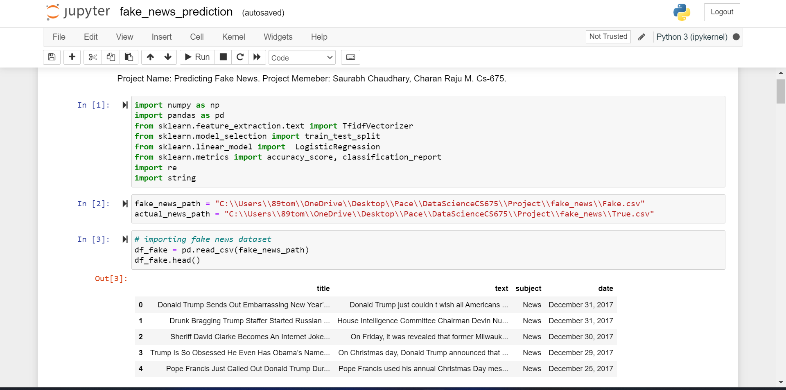

Slide 5
Data Processing
We classified the fake news as 1 and real news as 0 in our dataset.
We checked for the null values in the dataset.
We Create a method called "clean_and_lower" to Clean and process the textual data by removing irrelevant characters(Special Characters & Numbers, White spaces), stopwords using nltk.corpus library, and performing tasks such as stemming with the help of nltk.stem.porter library.

Slide 6
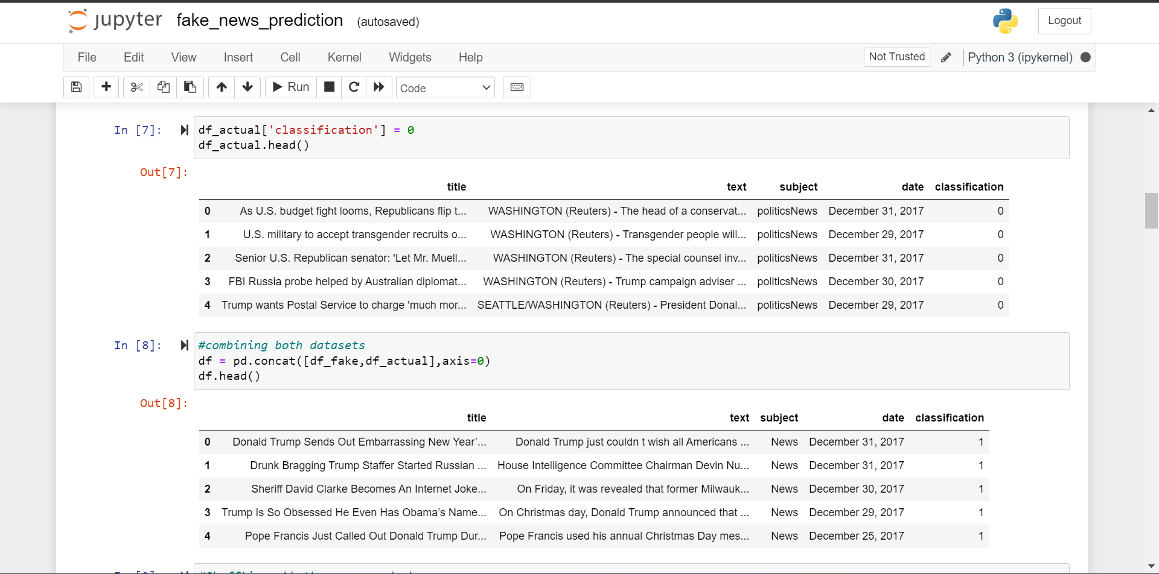

Slide 7
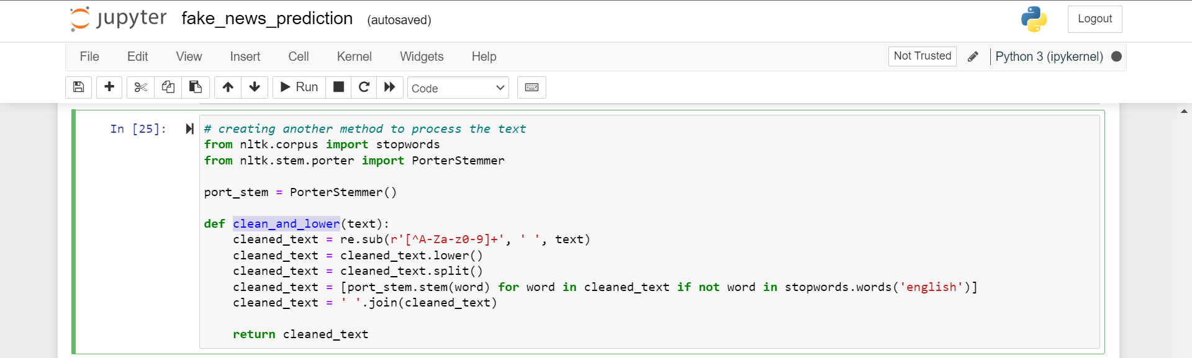

Slide 8
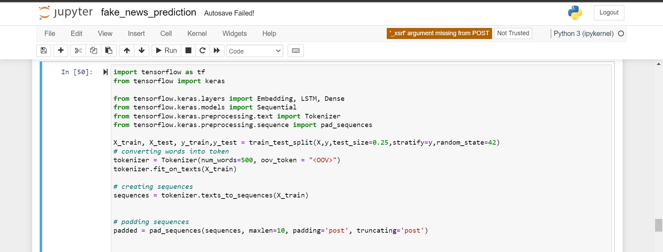
For Recurrent Neural Network we converted the text and sentences into tokens using Tokenizer from tensorflow.keras.preprocessing.text
For consistent input size we used pad sequences from tensorflow.keras.preprocessing.sequence

Slide 9
We applied our method to process the content.
We took the content column values as our Feature matrix X.
And Classification column values as our Target Vector Y.
We split our datasets into training and testing dataset using train_test_split method from sklearn.model_selection library.
We equally split the Target Vector using stratify parameter of train_test_split method to help train our model.
We converted training & testing Feature matrix into a format suitable for machine learning algorithms, such as numerical vectors using TfidfVectorizer from sklearn.feature_extraction.text

Slide 10
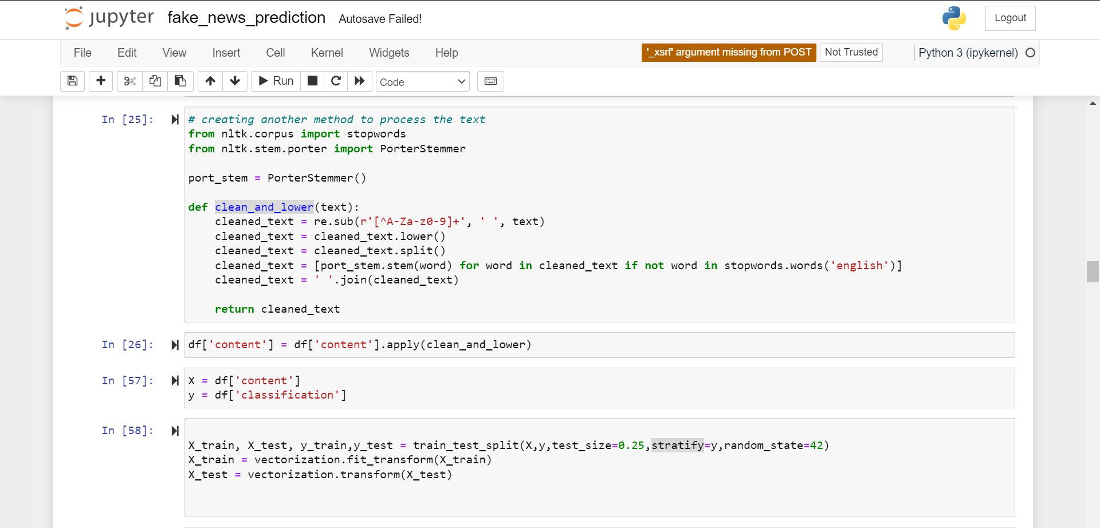

Slide 11
Model Selection, Training & Evaluation
We selected 3 Machine learning Models.
Logistic Regression from sklearn.linear_model.
DecisionTreeClassifier from sklearn.tree.
Recurrent Neural Network from tensorflow.keras.models

Slide 12
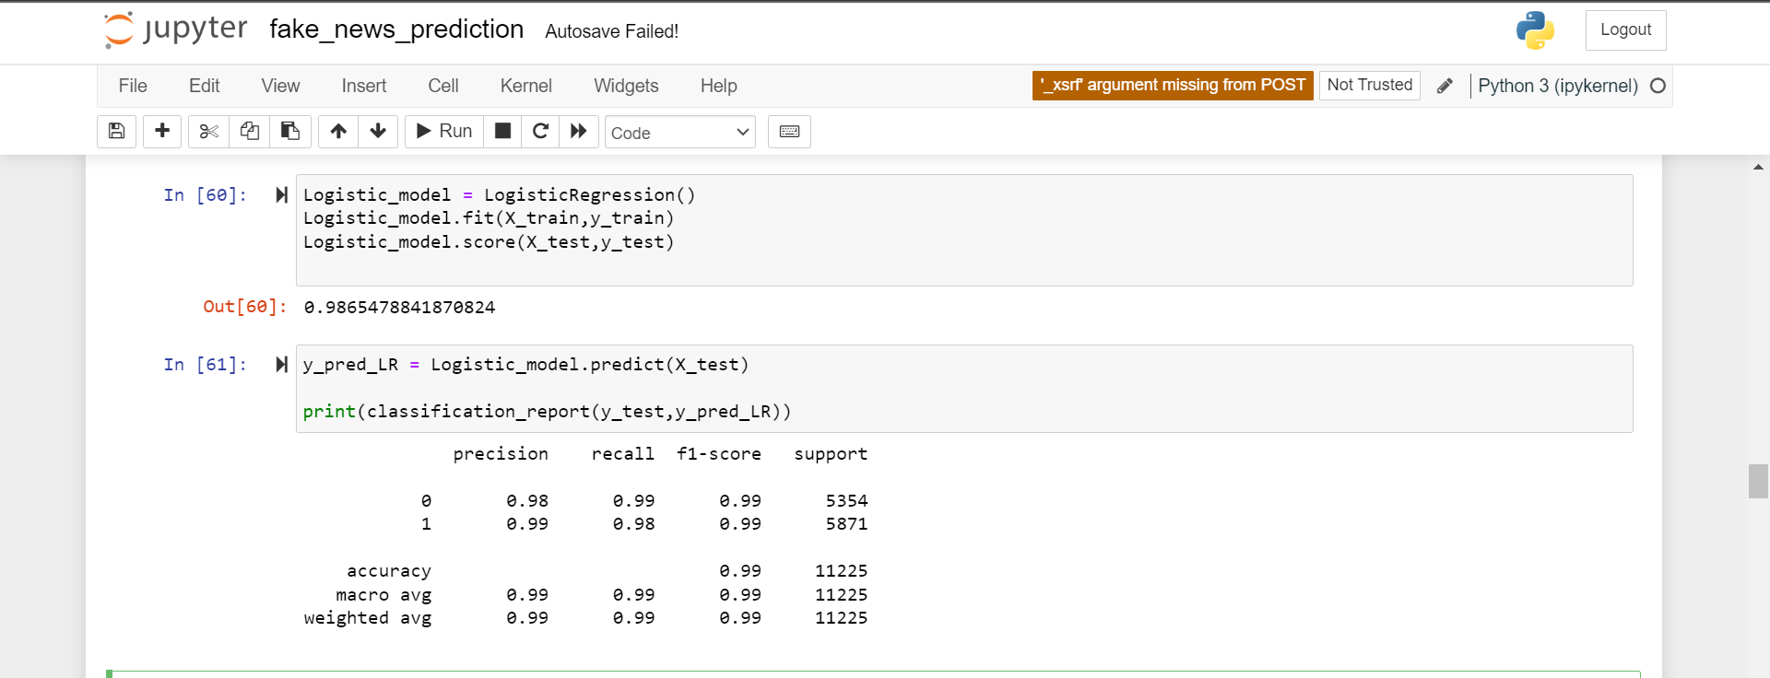
Logistic Regression

Slide 13
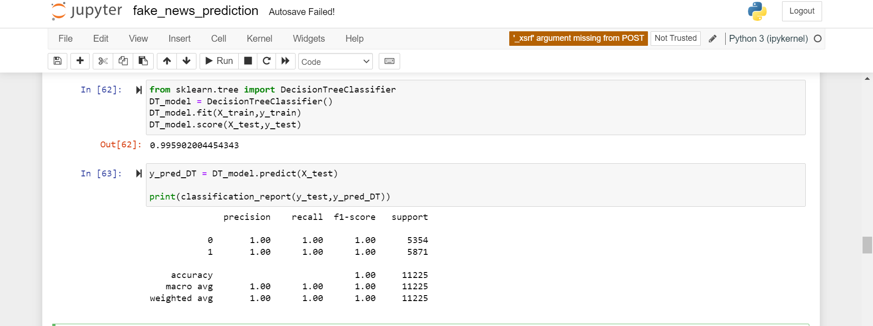
Decision Tree

Slide 14
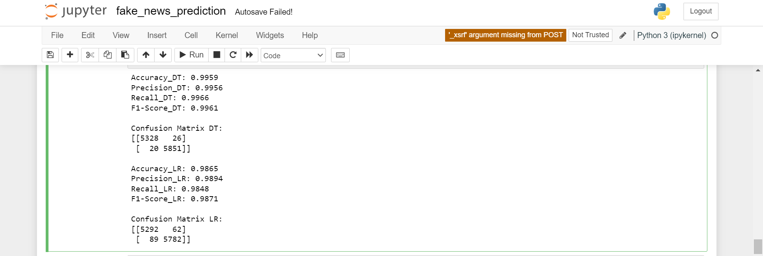
LR vs DT

Slide 15
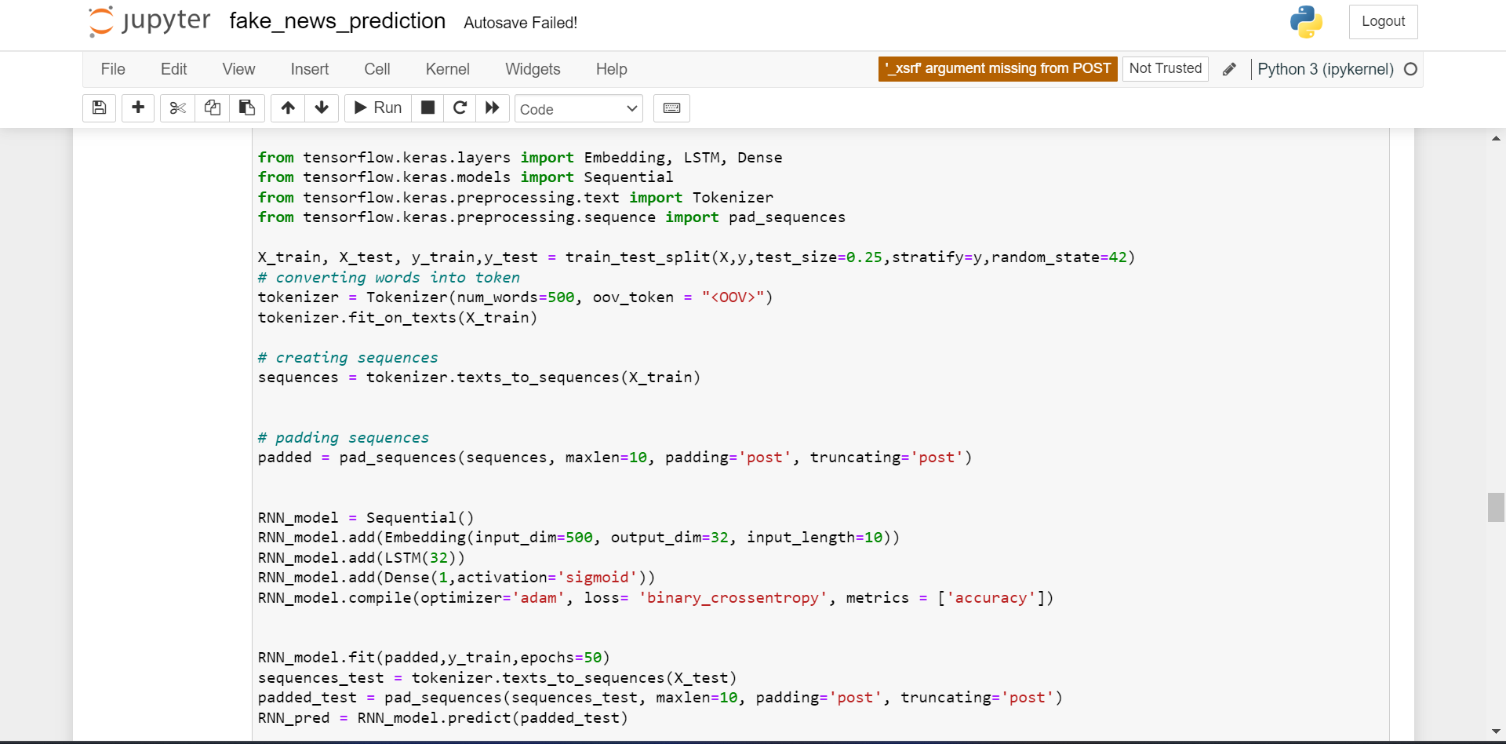
Recurrent Neural Network

Slide 16
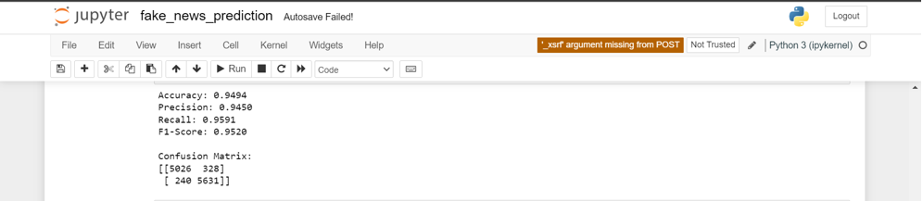
RNN Evaluation

Slide 17
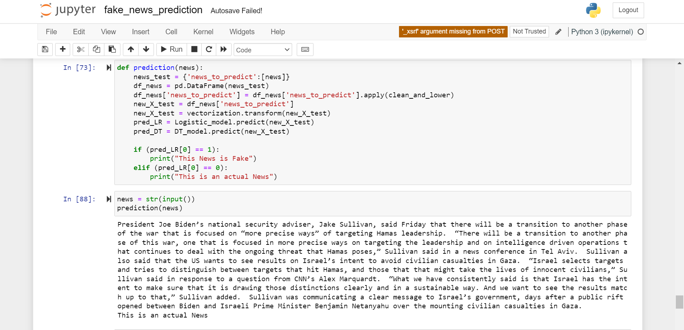
News Prediction Method

Slide 18
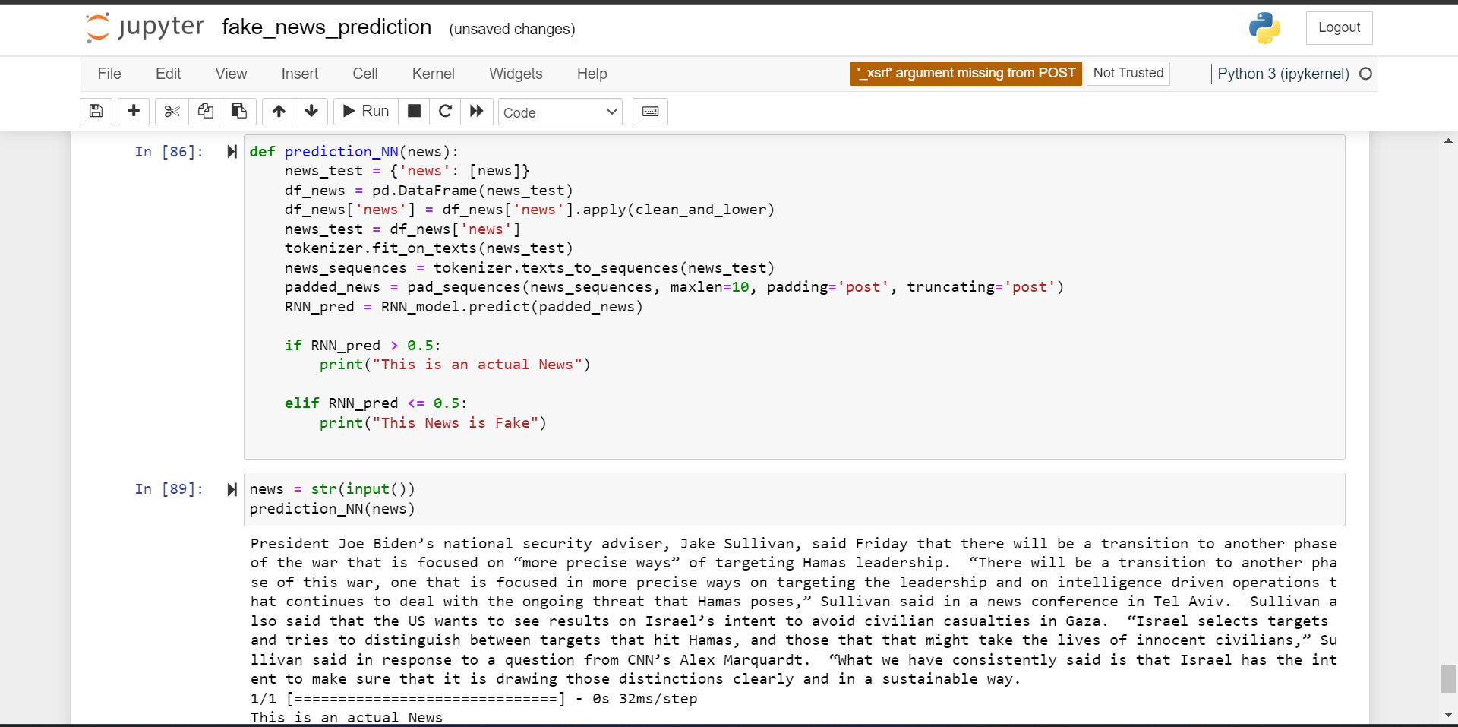

Slide 19
Challenges
Because of the size of the Data, Data processing took most of the time. Example removing English language stop words, Special Characters & Stemming.
Choosing the Long Short-Term Memory(LSTM) layers to Nural Network model.
Choosing the embedding dimensions to NN model.

Slide 20
Conclusion
The decision tree model outperformed both the RNN model and logistic regression model with an accuracy of 99%. Additionally, employing RNN for this task is somewhat overkill, considering the substantial computational resources it demands

