Slide 1

Jenkins
Pipeline as Code

Slide 2
How it basically works
Groovy scripts in library will read the parameters from Jenkins file
It will internally invoke the stages as per parameters provided in Jenkins file
Jenkins will create pipeline on the basis of parameter

Slide 3
Architectural Flow of Jenkins 2.X
Git Repo for library
Library contains all the groovy api scripts
Jenkins 2.X
ATG Git Library
Git Repo of ATG Code Base

Slide 4
Module Structure
Base Dir
Modules
WebCommerce
Endeca
Catalog
Services

Slide 5
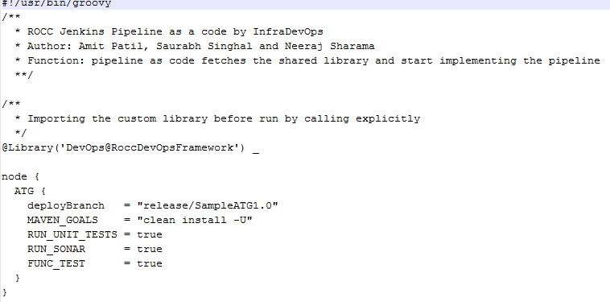
Jenkins File for User Input
User will need to provide only the required parameter in Jenkins file

Slide 6
Upload Library through Jenkins
Login -> Jenkins
Goto -> Manage Jenkins
Mandatory parameter
GIT Repo URL of Library
Username / Password
Library will be checkout in Jenkins workspace with directory name suffix as @libs

Slide 7
Basic Jenkins Jobs
Checkout
Build
Sonar
Coverage Report
Deployment
QA Integration

Slide 8
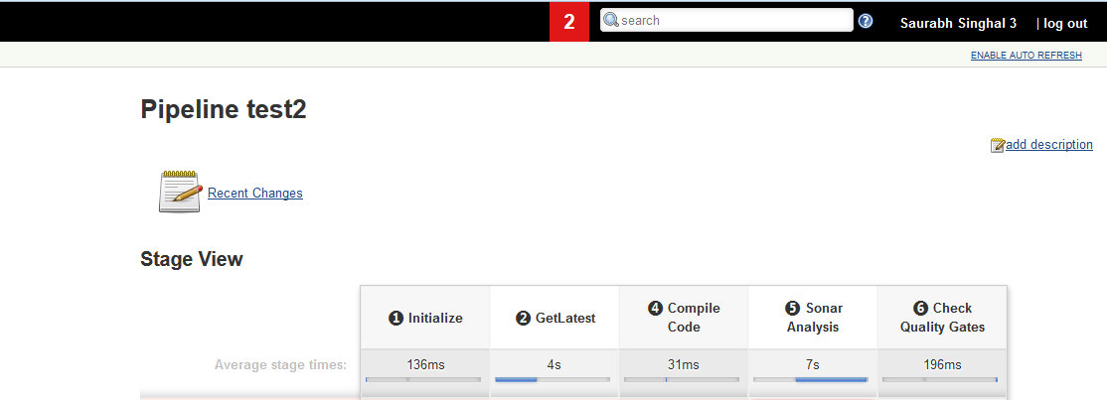
Sample output of Jenkins Pipeline

Slide 9
Conditional parameter
Any conditional parameter can be used to invoke the build
Condition Parameter
String
Boolean
Parameters will be used by groovy library to run the Jenkins pipeline

Slide 10

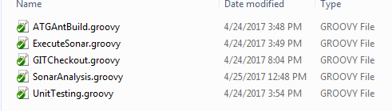
Structure in Jenkins Groovy Library
Src will contain the library code for each stage implemented as groovy
Resources will contain the scripts, properties and xml file

Slide 11
Jenkins Test
Jenkins can be tested before deployment to any environment
It will be tested by two different approach
Unit testing of groovy script
Test kitchen approach
In test kitchen approach docker file will be pulled from dcoker repository
Library and code base will be checkout from git repository

Slide 12
Q & A

