Slide 1
IVYhuts
PROPERTY PROPOSAL · LONDON
Student Accommodation Options
in London
Near City St George's, University of London
BUDGET: UP TO £200/WEEK OR £900/MONTH
Prepared for Annadurai Sir
10 curated residences · Distance-mapped to Northampton Square campus

Slide 2
LOCATION & BUDGET OVERVIEW
IVYhuts
Accommodation Near City St George's, University of London
Curated student accommodation options available through IVYHUTS.
→
→
CITY ST GEORGE'S,
UNIVERSITY OF LONDON
10 NEARBY OPTIONS
6 BUDGET-CONSCIOUS CHOICES
0.49 km – 12.94 km from campus, straight-line
At or under £200/week (or £900/month)
Northampton Sq, Islington, EC1V 0HN
STUDENT BUDGET
6 properties in this deck fall within budget. Because the closest options to campus all exceed £200/week, 4 nearby alternatives are also shown for comparison, each clearly marked “Over Budget” with its real price.
£200 / week or £900 / month (maximum)
Distances are straight-line (great-circle), calculated from each property's real coordinates to the university's Northampton Square campus.
IVYHUTS · Student Accommodation Abroad
02 / 13

Slide 3
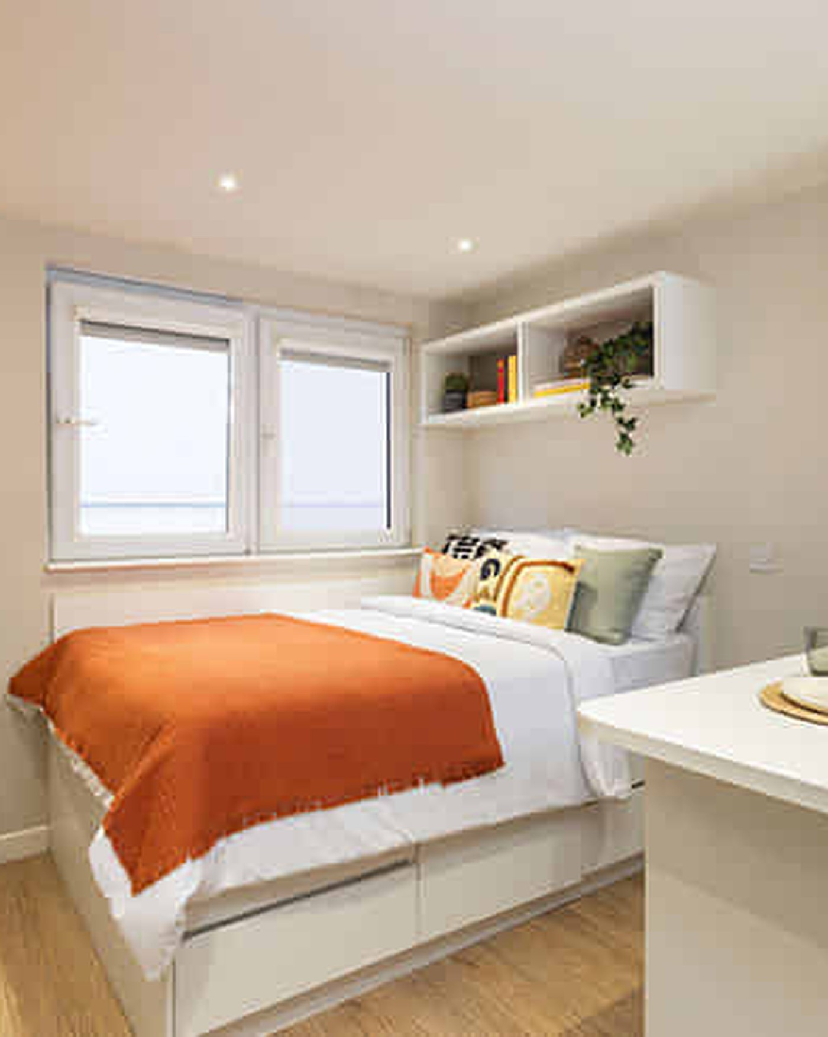
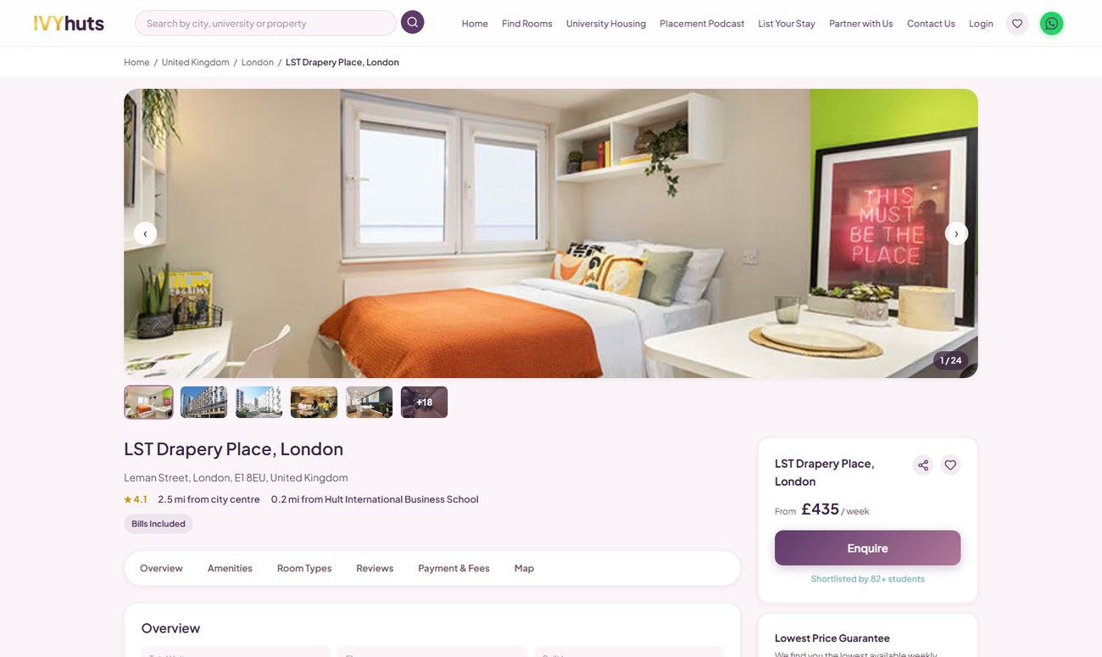
01 / 10
2.85 KM · 34 MIN WALK
✓ WITHIN BUDGET · £200/week
LST Drapery Place, London
📍 2.85 km straight-line from City St George's, University of London
🚶 Approx. 34 min walk (estimated, ~5 km/h)
Type:
Studio, Non Ensuite, Ensuite, Student Accommodation
Price:
£200 - £540 per week
Availability:
Available Now
KEY FEATURES
● Gym
● Study Spaces
● CCTV
● Laundry
LOCATION
65 Leman St, London E1 8EU, UK
Amber Property ID: 1093525
AS SEEN ON IVYHUTS.COM
VIEW PROPERTY ON IVYHUTS →
03 / 13

Slide 4
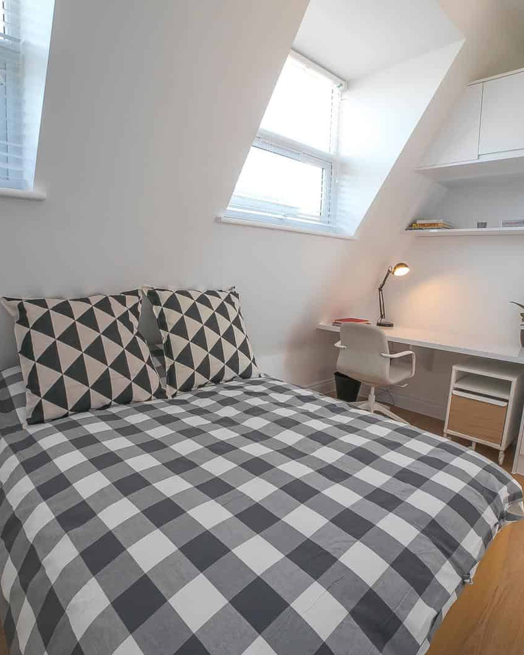
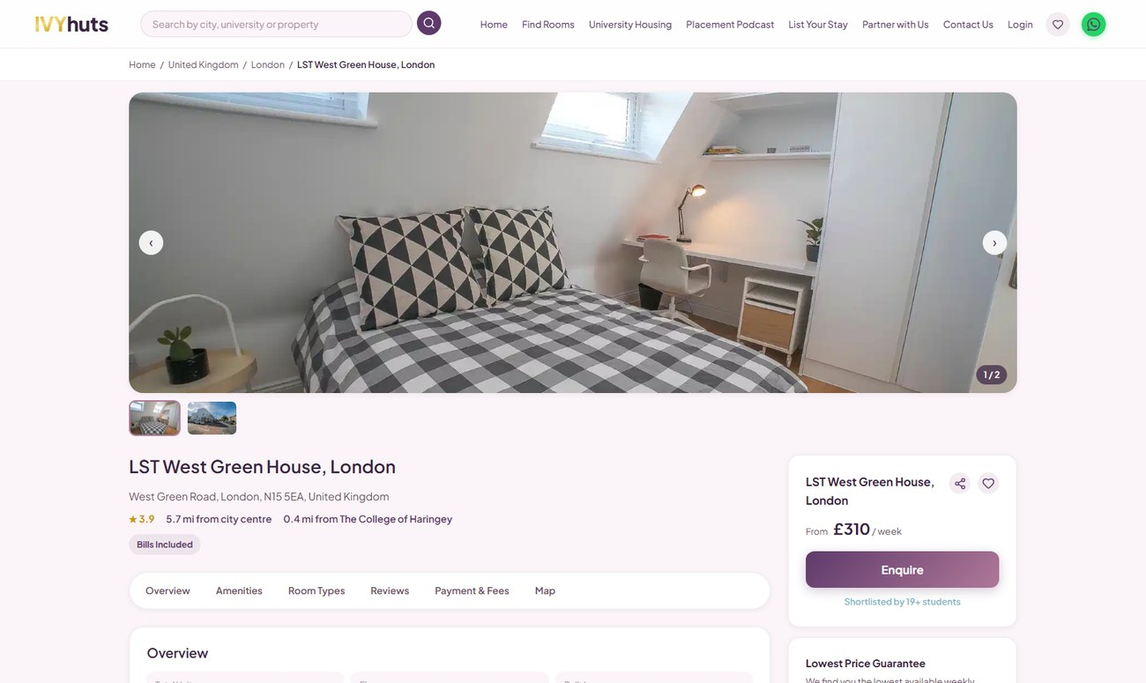
02 / 10
6.57 KM · BY TRANSPORT
✓ WITHIN BUDGET · £199/week
LST West Green House, London
📍 6.57 km straight-line from City St George's, University of London
🚇 Beyond comfortable walking distance — public transport recommended
Type:
Ensuite, Student Accommodation
Price:
£199 - £385 per week
Availability:
Available Now
KEY FEATURES
● 24hr Security
● WiFi
● Laundry
● Electricity
LOCATION
151 W Green Rd, London N15 5EA, UK
Amber Property ID: 187938
AS SEEN ON IVYHUTS.COM
VIEW PROPERTY ON IVYHUTS →
04 / 13

Slide 5
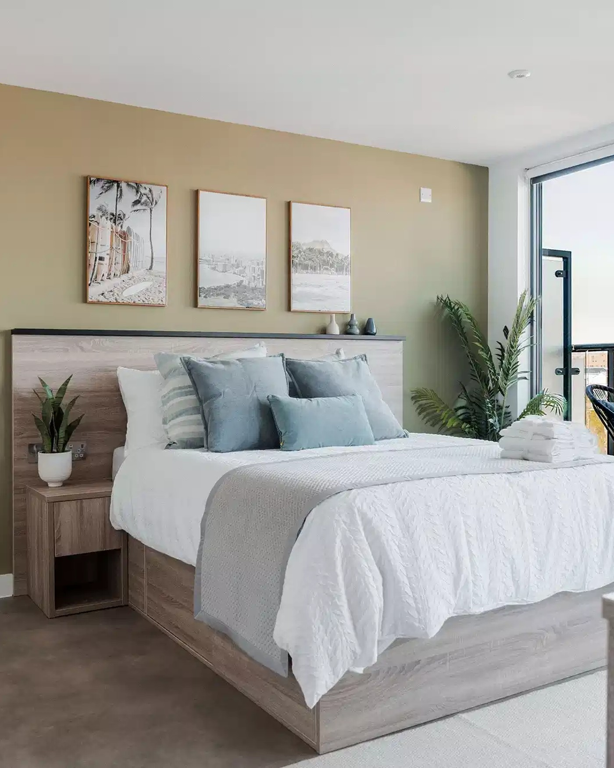
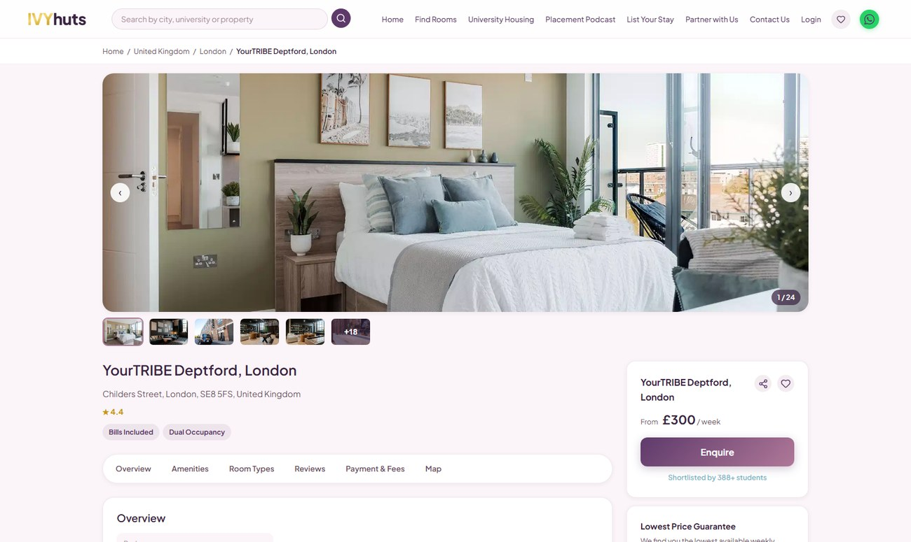
03 / 10
7.00 KM · BY TRANSPORT
✓ WITHIN BUDGET · £188/week
YourTRIBE Deptford, London
📍 7.00 km straight-line from City St George's, University of London
🚇 Beyond comfortable walking distance — public transport recommended
Type:
Ensuite, Non Ensuite, Student Accommodation
Price:
£188 - £516 per week
Availability:
Available Now
KEY FEATURES
● Cinema/movie nights
● Social programme
● Laundry Facility
● Super-Fast Wi-Fi
LOCATION
82-84 Childers St, London SE8 5FS, UK
Amber Property ID: 2061969
AS SEEN ON IVYHUTS.COM
VIEW PROPERTY ON IVYHUTS →
05 / 13

Slide 6
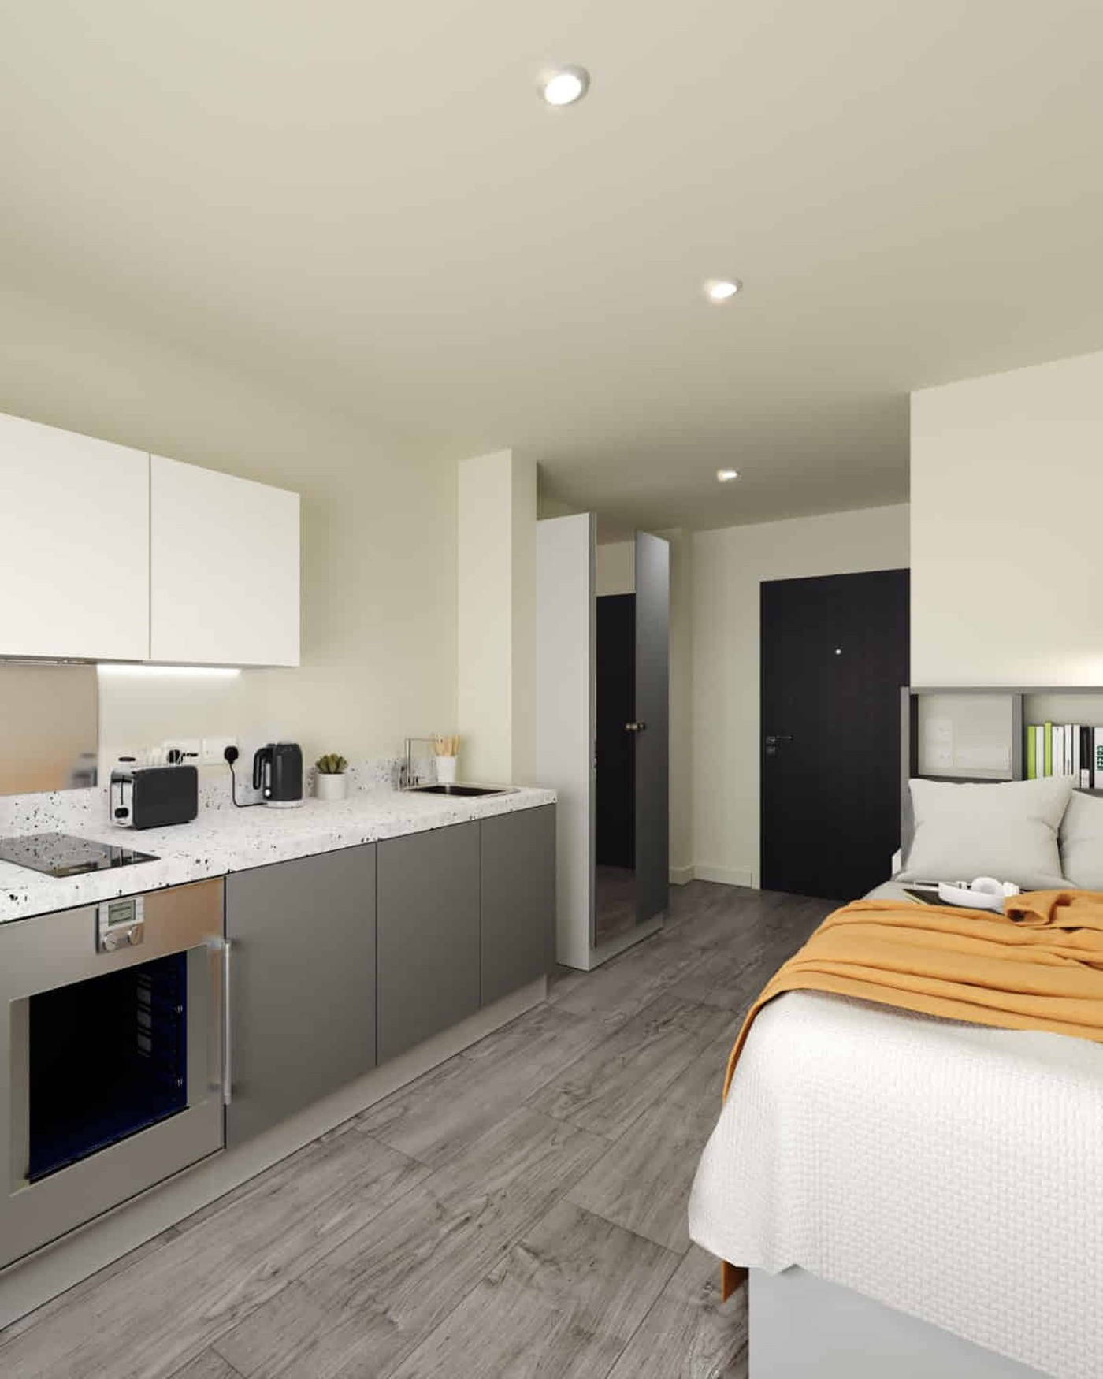
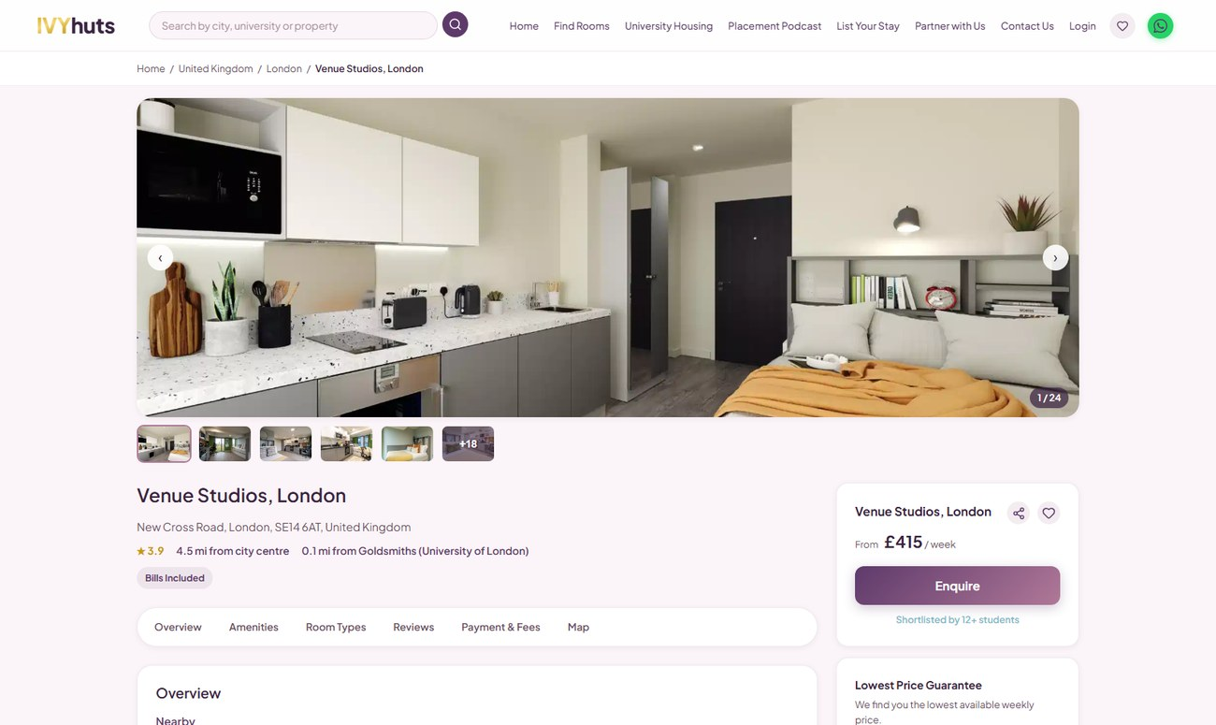
04 / 10
7.42 KM · BY TRANSPORT
✓ WITHIN BUDGET · £199/week
Venue Studios, London
📍 7.42 km straight-line from City St George's, University of London
🚇 Beyond comfortable walking distance — public transport recommended
Type:
Studio, Student Accommodation
Price:
£199 - £450 per week
Availability:
Available Now
KEY FEATURES
● Study Area
● Wifi
● Laundry Room
● Bike storage
LOCATION
333 New Cross Rd, London SE14 6AT, UK
Amber Property ID: 943993
AS SEEN ON IVYHUTS.COM
VIEW PROPERTY ON IVYHUTS →
06 / 13

Slide 7
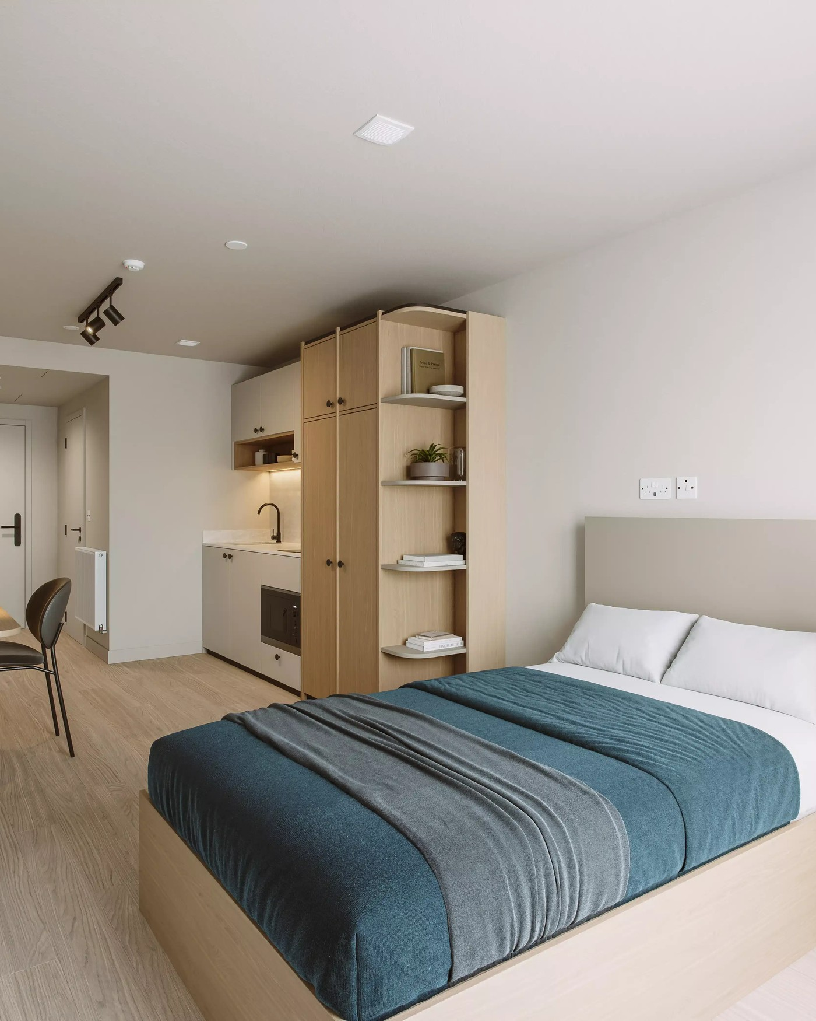
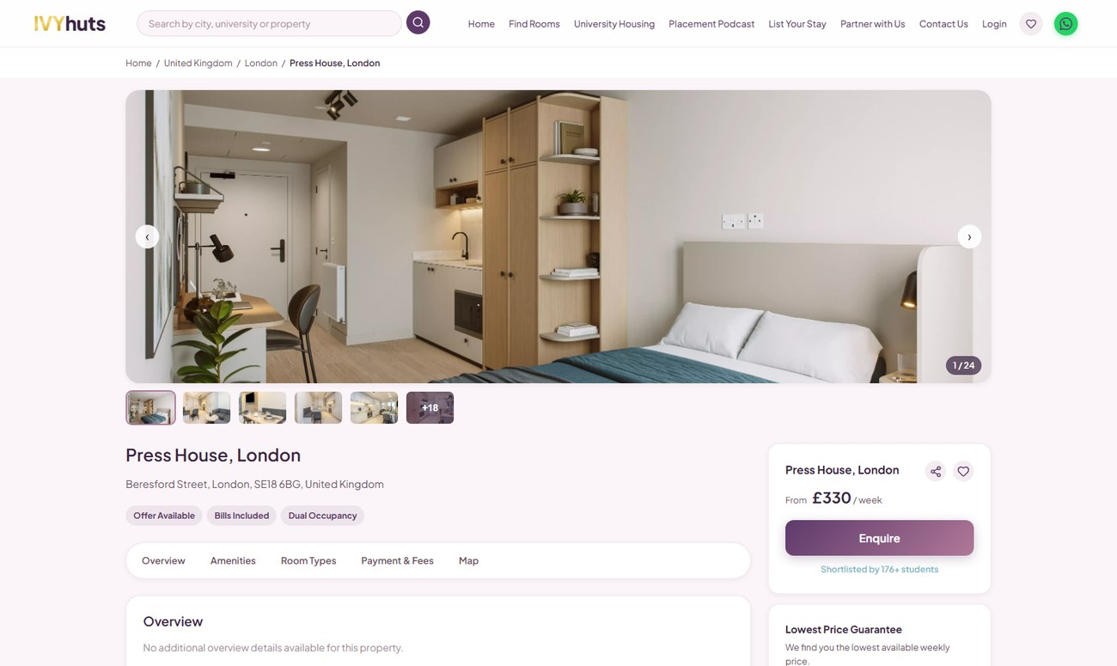
05 / 10
12.53 KM · BY TRANSPORT
✓ WITHIN BUDGET · £199/week
Press House, London
📍 12.53 km straight-line from City St George's, University of London
🚇 Beyond comfortable walking distance — public transport recommended
Type:
Ensuite, Studio, Student Accommodation
Price:
£199 - £470 per week
Availability:
Available Now
KEY FEATURES
● Gym
● Laundry Room
● Study Space
● Wifi
LOCATION
81-88 Beresford St, London SE18 6BG, UK
Amber Property ID: 2474170
AS SEEN ON IVYHUTS.COM
VIEW PROPERTY ON IVYHUTS →
07 / 13

Slide 8
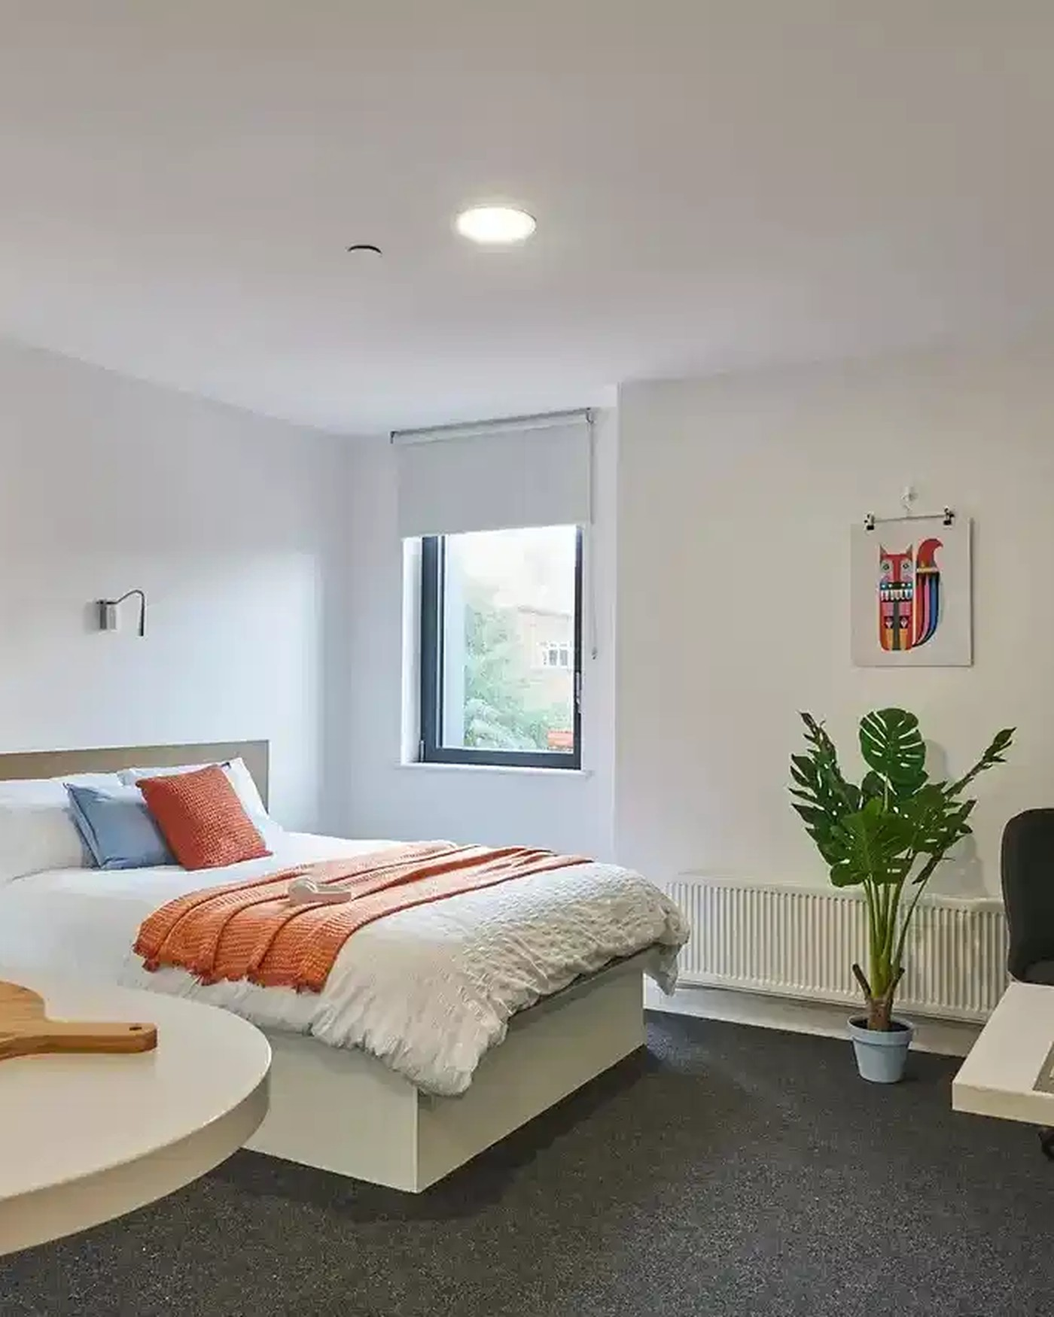
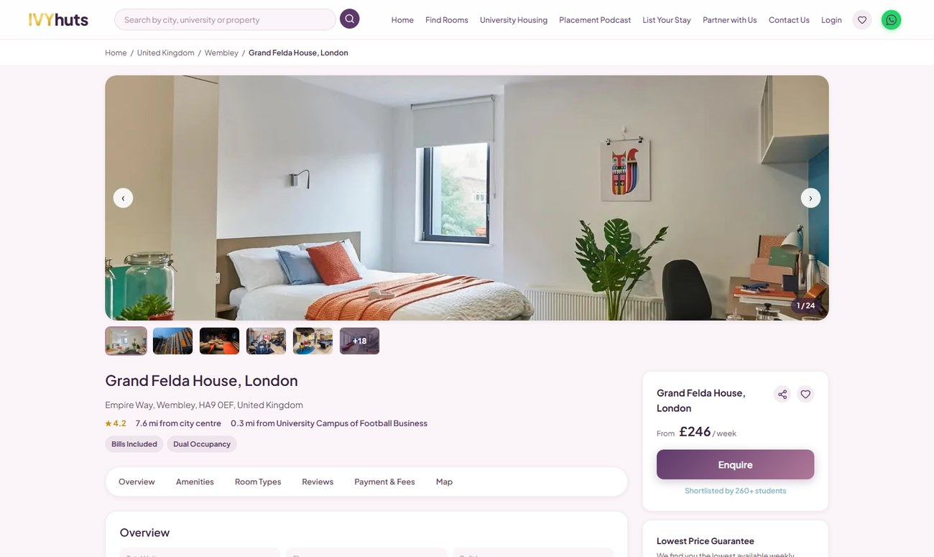
06 / 10
12.94 KM · BY TRANSPORT
✓ WITHIN BUDGET · £180/week
Grand Felda House, London
📍 12.94 km straight-line from City St George's, University of London
🚇 Beyond comfortable walking distance — public transport recommended
Type:
Studio, Non Ensuite, Ensuite, 3B, 2B, Student Accommodation
Price:
£180 - £404 per week
Availability:
Available Now
KEY FEATURES
● Free On-site Gym
● Cinema Room
● 24/7 CCTV
● Large Study Rooms
LOCATION
Grand Felda House, Empire Way, Wembley Park, Wembley HA9 0EF, UK
Amber Property ID: 133427
AS SEEN ON IVYHUTS.COM
VIEW PROPERTY ON IVYHUTS →
08 / 13

Slide 9
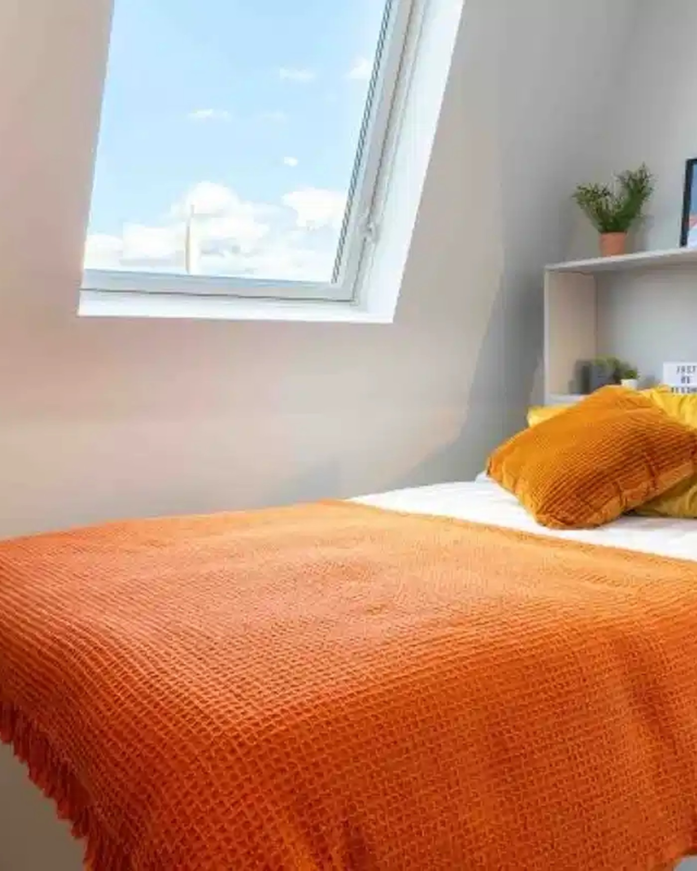
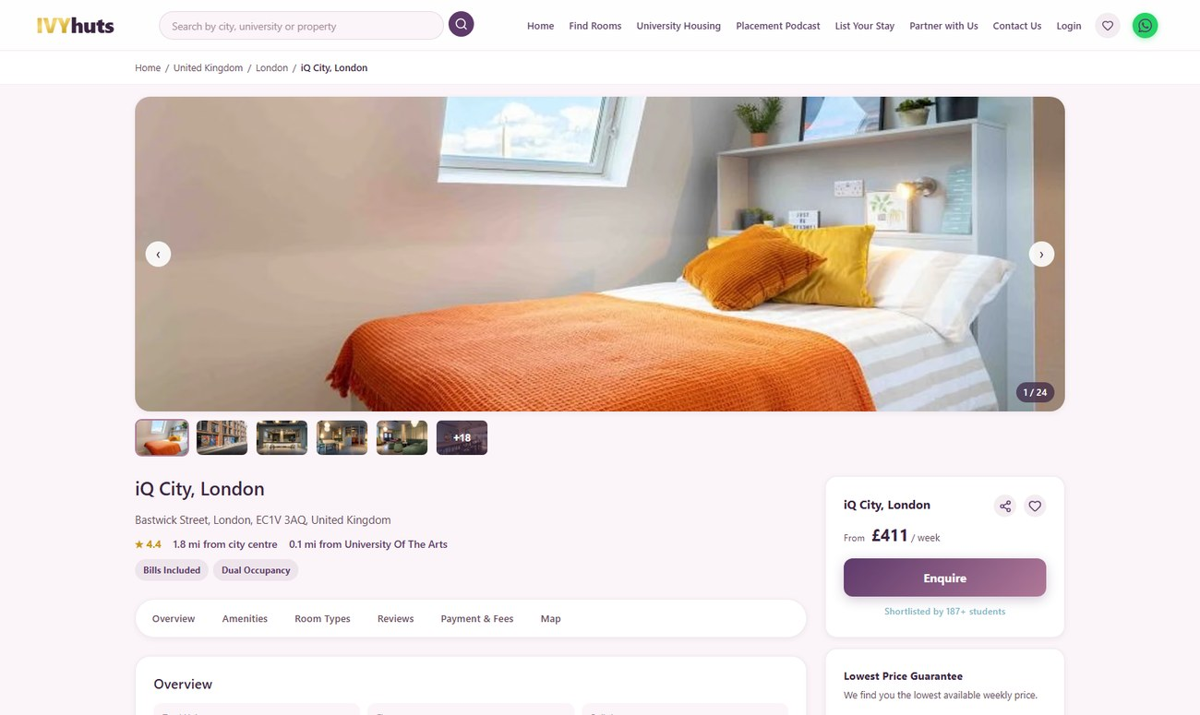
07 / 10
0.49 KM · 6 MIN WALK
! OVER BUDGET · £381/week
iQ City, London
📍 0.49 km straight-line from City St George's, University of London
🚶 Approx. 6 min walk (estimated, ~5 km/h)
Type:
2B, Ensuite, Non Ensuite, 1B, Studio, Student Accommodation
Price:
£381 - £765 per week
Availability:
Available Now
KEY FEATURES
● Onsite Gym
● CCTV
● 24/7 Security
● Cinema Room
LOCATION
11 Bastwick St, London EC1V 3AQ, UK
Amber Property ID: 143256
AS SEEN ON IVYHUTS.COM
VIEW PROPERTY ON IVYHUTS →
09 / 13

Slide 10
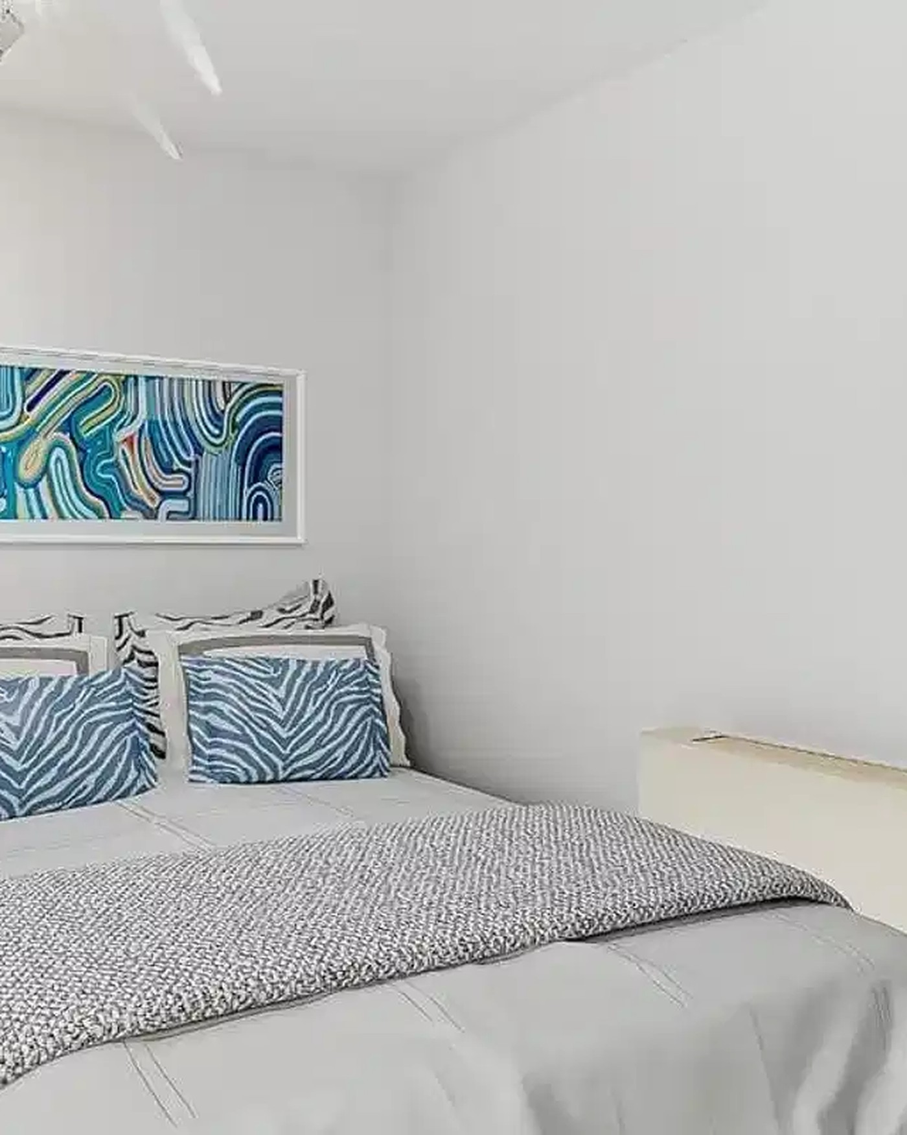
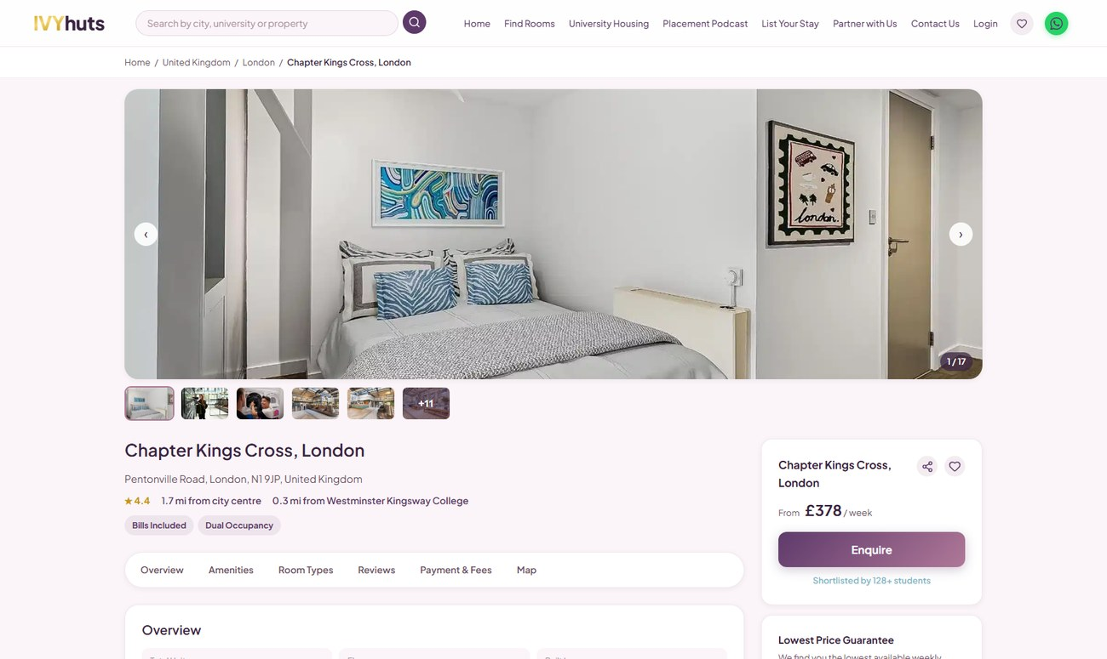
08 / 10
1.08 KM · 13 MIN WALK
! OVER BUDGET · £379/week
Chapter Kings Cross, London
📍 1.08 km straight-line from City St George's, University of London
🚶 Approx. 13 min walk (estimated, ~5 km/h)
Type:
Studio, Ensuite, Non Ensuite, Student Accommodation
Price:
£379 - £780 per week
Availability:
Available Now
KEY FEATURES
● On-Site Gym
● Study Spaces
● Cinema
● Onsite Laundry
LOCATION
200 Pentonville Rd, London N1 9JP, UK
Amber Property ID: 136672
AS SEEN ON IVYHUTS.COM
VIEW PROPERTY ON IVYHUTS →
10 / 13

Slide 11
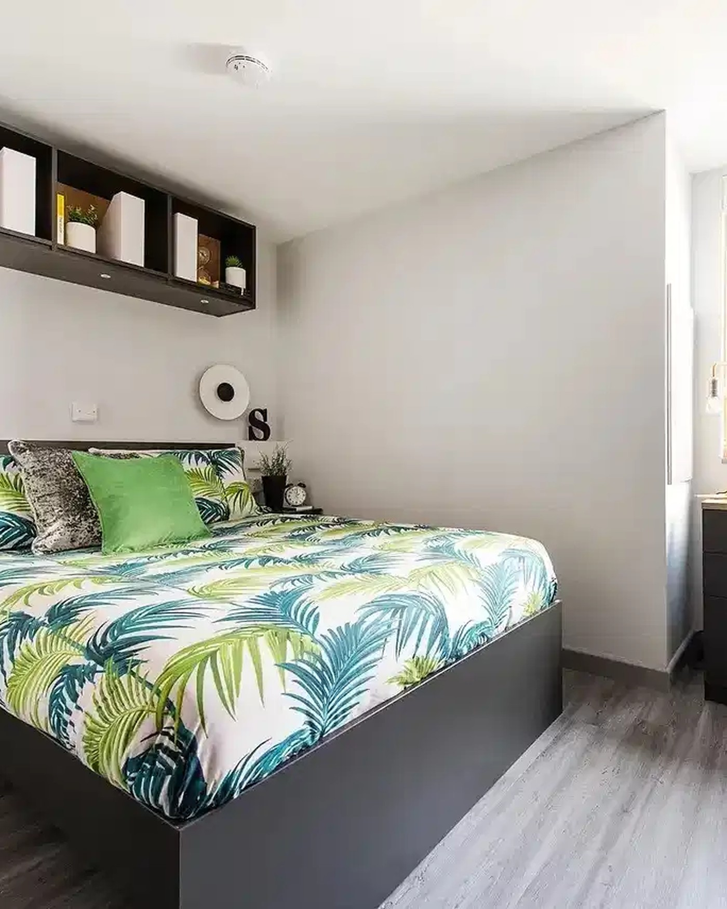
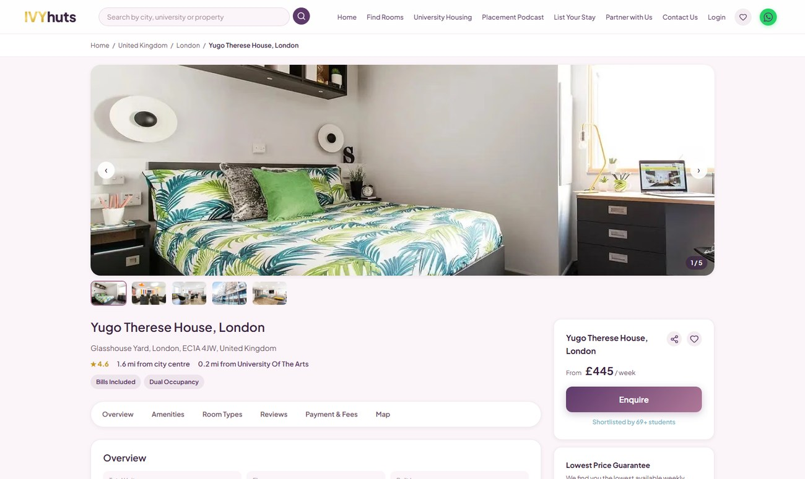
09 / 10
0.74 KM · 9 MIN WALK
! OVER BUDGET · £445/week
Yugo Therese House, London
📍 0.74 km straight-line from City St George's, University of London
🚶 Approx. 9 min walk (estimated, ~5 km/h)
Type:
Studio, Ensuite, Student Accommodation
Price:
£445 - £581 per week
Availability:
Available Now
KEY FEATURES
● 24 Hours Security
● Study Room
● CCTV
● Laundry Services
LOCATION
29-30 Glasshouse Yard, Barbican, London EC1A 4JW, UK
Amber Property ID: 145522
AS SEEN ON IVYHUTS.COM
VIEW PROPERTY ON IVYHUTS →
11 / 13

Slide 12
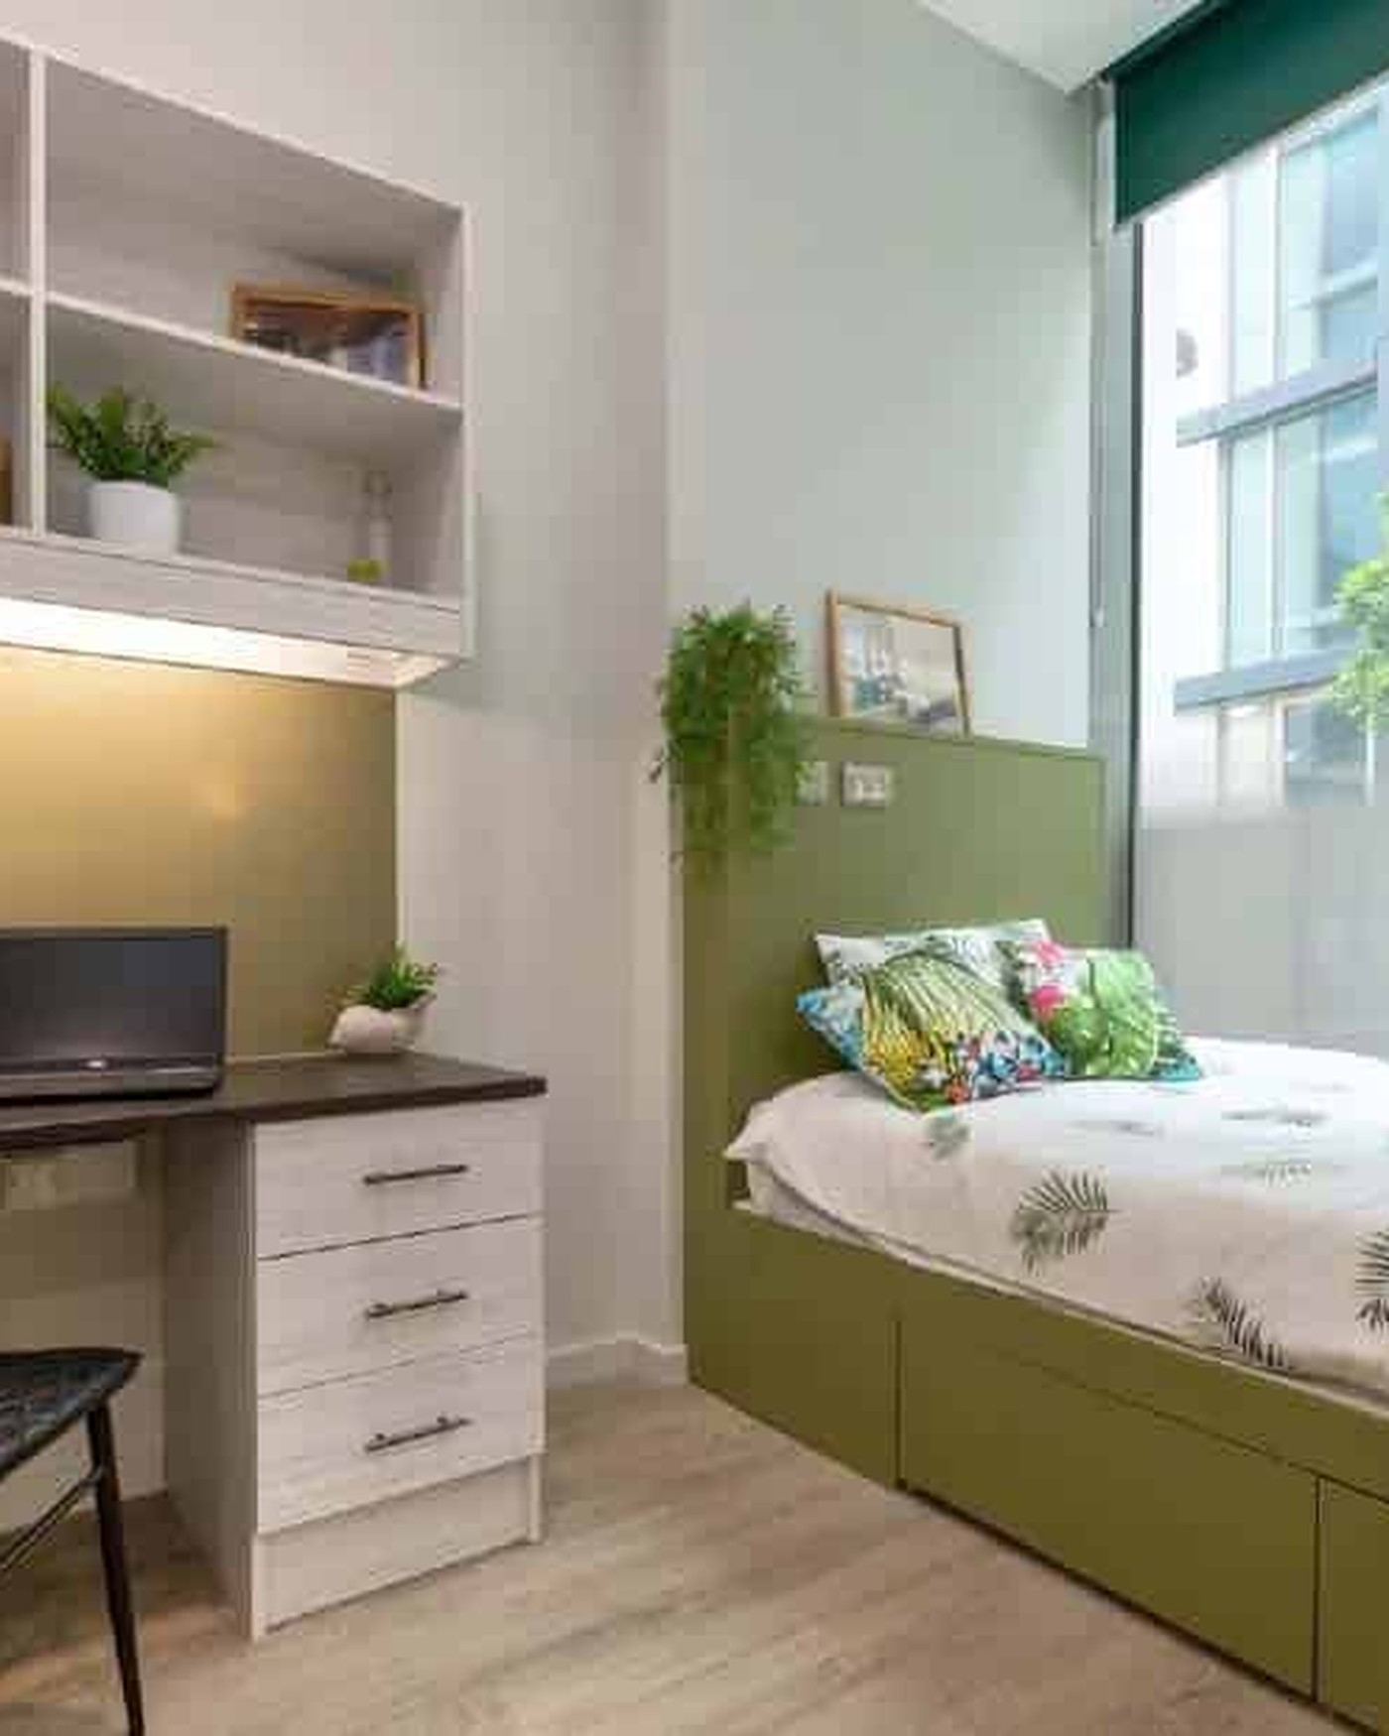
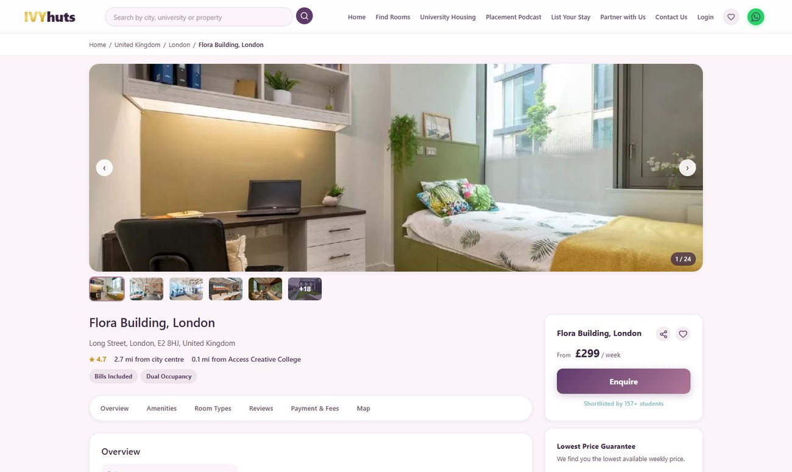
10 / 10
1.93 KM · 23 MIN WALK
! OVER BUDGET · £299/week
Flora Building, London
📍 1.93 km straight-line from City St George's, University of London
🚶 Approx. 23 min walk (estimated, ~5 km/h)
Type:
Studio, Non Ensuite, Student Accommodation
Price:
£299 - £589 per week
Availability:
Available Now
KEY FEATURES
● Gym
● CCTV
● 24 Hours Security
● Study Area
LOCATION
11-13 Long St, London E2 8HJ, UK
Amber Property ID: 149580
AS SEEN ON IVYHUTS.COM
VIEW PROPERTY ON IVYHUTS →
12 / 13

Slide 13
IVYhuts
Why IVYHUTS?
1
Curated Student Accommodation
Real, verified listings matched to City St George's, University of London.
2
Verified Property Information
Pricing, amenities and availability sourced directly from property partners.
3
Budget-Conscious Discovery
Every option checked against your £200/week or £900/month budget.
4
Location-Focused Search
Every option distance-mapped to your exact campus, not just the city centre.
5
Direct Property Exploration
One click through to the full listing, gallery and booking flow on IVYHUTS.
STUDENT BUDGET CONSIDERED: Up to £200/week or £900/month
EXPLORE MORE PROPERTIES ON IVYHUTS →
www.ivyhuts.com

