Slide 1


Real Time E-Commerce Dashboard
Guided By:
Submitted by:
Mr. Anay Tamhankar
Mr. Prasad Deshmukh
Aman Shrivastava (230943025005)
Pratik Reddy (230943025039)
Rushikesh Phapale (230943025041)
Saurabh Jambale (230943025044)

Slide 2
Introduction
In today's super competitive online shopping world, businesses have a big challenge: they need to understand lots of data quickly to make smart choices fast. Being able to figure out useful information in real-time is really important to stay ahead in this fast-changing environment.

Slide 3

Problem Statement
In this project, we've worked on solving the problem of getting useful information from the huge amount of real-time data created by online transactions. Regular ways of analyzing data often can't keep up with how much data there is and how fast it's coming in. This causes delays in making decisions and missing chances to grow. We really need a strong E-commerce Analytics Dashboard that uses advanced technology to handle, understand, and show real-time data well.

Slide 4
Objective
To develop a dynamic, data-driven visualization tool using Tableau for real-time analysis of simulated e-commerce data, aimed at assisting managers in making informed decisions. The specific goals of this project are:
Simulate Realistic E-commerce Data
Create Interactive Visualizations
Deliver Actionable Insights
Improve Manager Efficiency
Streamline Data Visualization

Slide 5
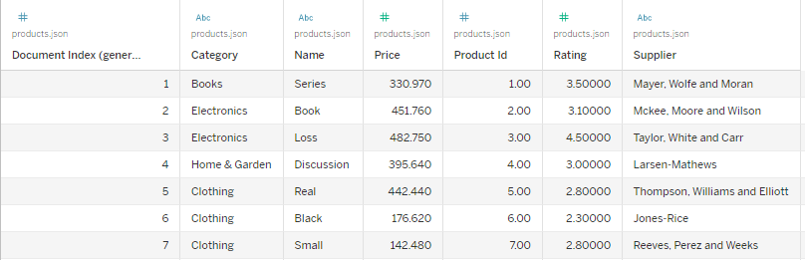
Product Dataset:-

Slide 6
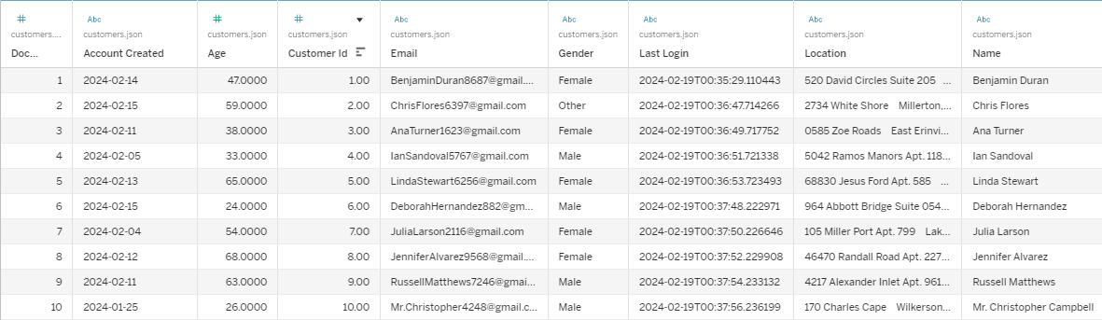
Customer Dataset:-

Slide 7
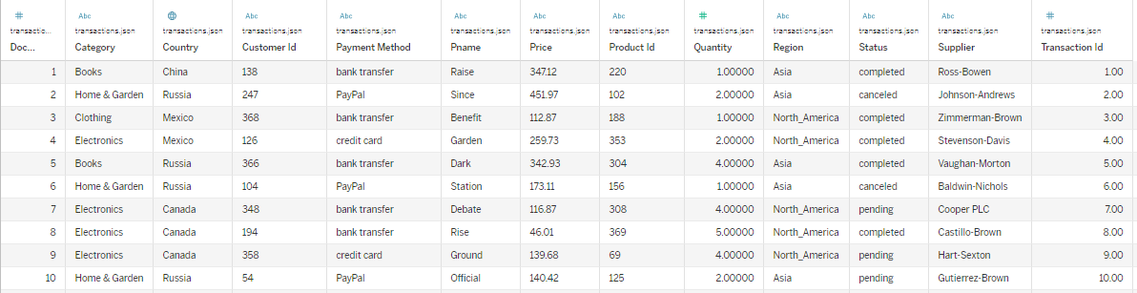
Transaction Dataset:-

Slide 8
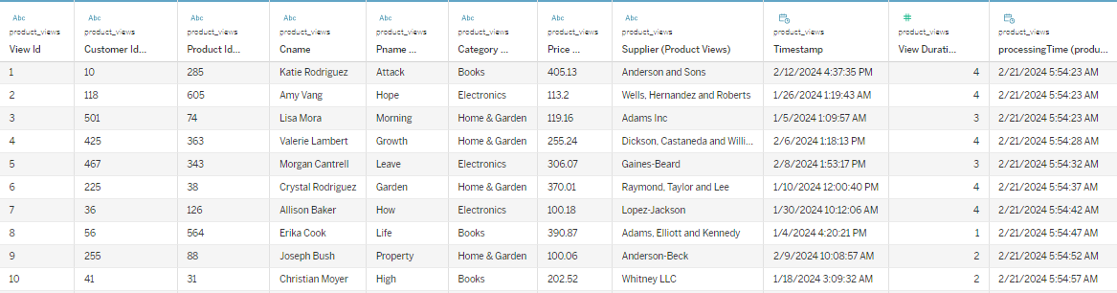
Product Views Dataset:-

Slide 9







Real Time E-Commerce Dashboard
Working Model
Utilize Python Faker to create
Realistic synthetic E-Commerce data
Python Scripts generates diverse
E-Commerce Data
Stores data in MongoDB
Tableau for
visualization
and graphs
Transaction Data
PySpark consumes the data from kafka topics
Topics to organize streams

Slide 10
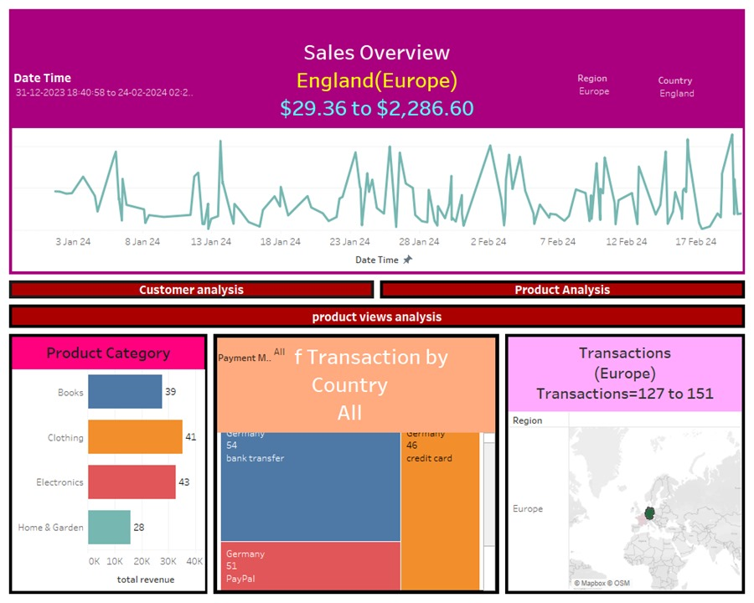
E-commerce Dashboard

Slide 11
Future Scope
The current project lays a strong foundation for real-time e-commerce analytics, but there's always room for growth. Here are some exciting possibilities for future advancements:
Auto-Refresh Functionality:
Currently, the dashboard in the Real-time E-commerce Analytics Dashboard refreshes every 5 minutes to update the displayed insights. However, in our future scope, we aim to implement an auto-refresh functionality every 10 seconds to ensure that the dashboard reflects the most recent data in real-time without any manual intervention.
Customer Segmentation:
it involves dividing a customer base into groups that share similar characteristics, behaviors, or preferences. By analyzing customer segments, businesses can tailor their marketing strategies, product offerings, and customer experiences to better meet the needs of specific groups, ultimately improving customer satisfaction and increasing sales.

Slide 12
Conclusion
This project delivers a real-time E-commerce Analytics Dashboard with strong technology. It turns data into useful information that helps businesses make smart choices, improve marketing and products, and succeed in the online shopping world. It's more than just showing data – it's a powerful tool for doing well in the digital marketplace.

Slide 13
Thank
You

