Slide 1
STEGANOGRAPHY
Presented by:
Shivani Shikha,
Surabhi Rani,
Ankit Kumar Singh,
Saurabh Kumar Jha
Under supervision of:
Ms. Alokananda Dey

Slide 2
Overview
Introduction
History
Objective of the Study
Scope
Types of Steganography
Steganography Techniques
Workflow
Execution
Applications of steganography
Advantage and disadvantage
Result and Discussion
Conclusion and further enhancement
References

Slide 3
Introduction
STEGANOGRAPHY:
The word STEGANOGRAPHY is derived from the Greek word, it means coverd or secret writing. It is a method of hiding the secret data by embedding into an audio, video, image and text file.
STEGAN-O-GRAPHY
COVERD WRITING

Slide 4
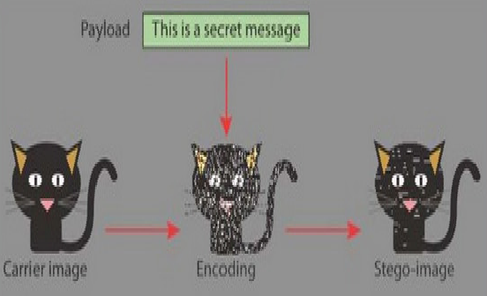
The goal of steganography is to hide message in such way that no one apart from the intended recipient even knows that a message has been sent.
This can be achieve by concealing the existence of information within simingly harmless carriers or cover.
It can be understand by the following figure.

Slide 5
History
The first recorded uses of steganography can be traced back to 440 BC in Greece, when Herodotus mentions two examples of steganography in his history.
The first description of the use of steganography dates back to the Greeks. Herodotus tells how a message was passed to the Greeks about Xerses' hostile intentions underneath the wax of a writing tablet, and describes a technique of dotting successive letters in a cover text with a secret ink, due to Aeneas the Tactician.
The used example of steganography in history is Tattoos on shaved heads, wax-covered tablets and Invisible inks-milk fruit juice.
During the “Cold-War” period, US and USSR wanted to hide their sensor in enemy’s facilities. These devices had to send data to their nation, without spotted.

Slide 6
Objective
In this project, we primarily concentrated on the data security issues when sending the data over the network using steganography techniques.
The main objectives of the project are…..
Requirement of this steganography system is that the hider message carrid by stego-media should not be sensible to human beings.
The other goal of steganography is to avoid drawing suspicion to the existence of a hidden message.
This approach of information hiding technique has recently become improtant in a number of application areas.

Slide 7
Scope
The scope of the project is to limit unauthorized access and provide better security during message transmission. To meet the requirements, we use the simple and basics approach of staganography.
This type of steganography uses a cover image in which data is to be embedded, personal information to be transmitted, and encryption decryption algorithms to embed the message into image.
The proposed approach finds the suitable algorithm for embedding the data in an image using steganography which provides the better security pattern for sending messages through a network.

Slide 8
Types of steganography
There are many types of Steganography.
Image steganography
Audio steganography
Video steganography
Text/documents steganography.

Slide 9
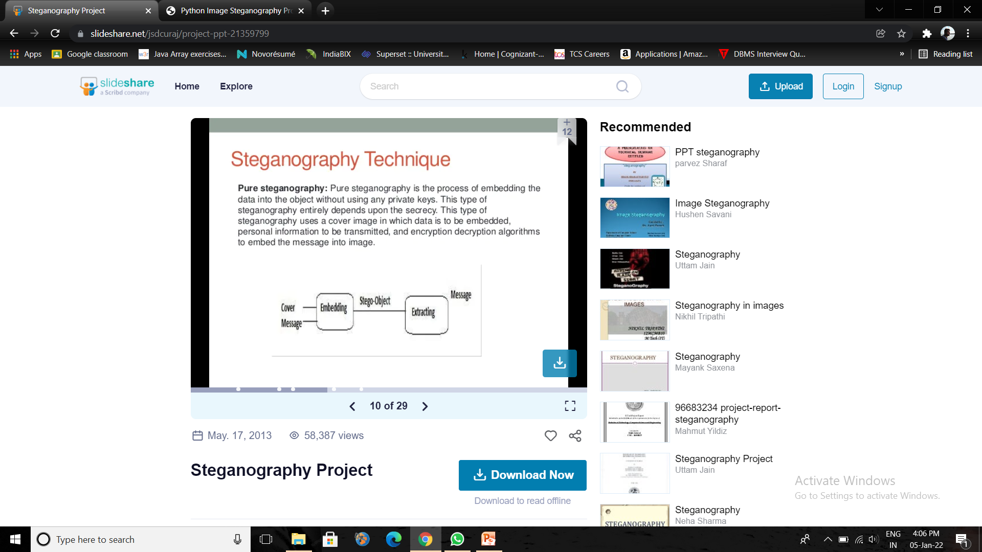
Steganography Techniques
Pure steganography: Pure steganography is the process of embadding the data into the object without using any private keys. This type of steganography entirely depends on the secrecy. This type of steganography uses a cover image in which data is to be embedded, personal information to be transmitted and encryption, decryption algorithms to embed the message into image.

Slide 10
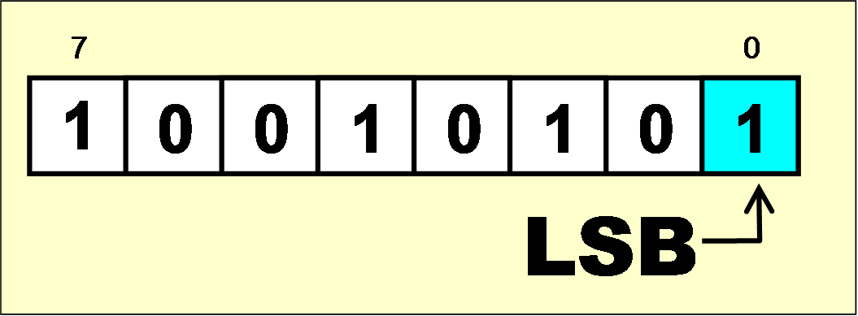
Least Significant Bit (LSB) Technique
LSB - Technique is a steganography technique in which we hide messages inside an image by replacing Least significant bit of image with the bits of message to be hidden.
LSB, the least significant bit is the lowest bit in a series of numbers in binary. which is located at the far right of a string.
For example, in the binary number: 10010101,
Here, the least significant bit is: 1.
LSB Steganography involves overwriting the bit with the lowest airthmatic value.

Slide 11
Workflow
Imported the cv2 module of opencv-python library, numpy and Image module from PIL library.
Functions.
Creating a function which converts the data into binary format.
Creating a function which hides the data(message) into a given image.
Extract the (R,G,B) pixels of image and update the pixels value.
Creating the Encoding function wihich encodes the secret message into the respective image.
Creating the Decoding function which gives encoded message after performing the decoding operations.

Slide 12
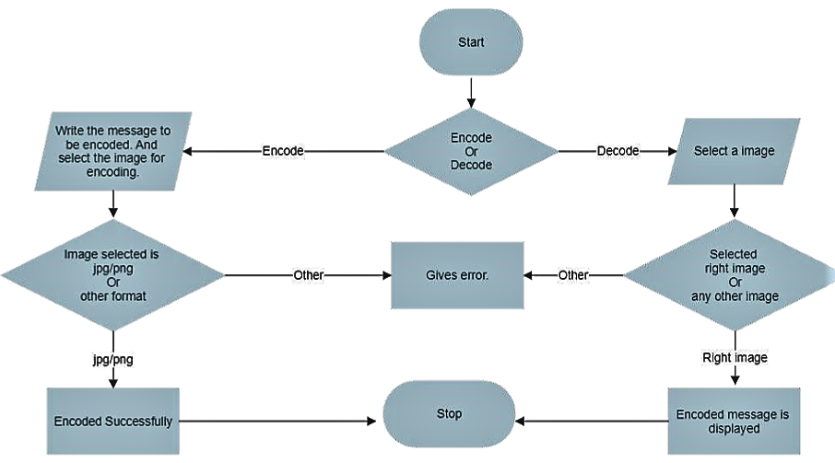
WORKFLOW DIAGRAM

Slide 13
ALGORITHM
To Encode the text into Image
Loads an image and looks at each pixels in hexadecimal value.
Converts secret text into bits and stores them in LSB of pixel bits.
A delimeter is added to the end of the edited pixel values.
Process of encoding function
Msg+Sec.key -> binary(1,0)
Img -> RGB Extraction -> LSB -> Msg
Resize the image
Fix the quality of the image.
To Decode the text from Image
While retrieving all the 0’s and 1’s extracted until delimeter is found. Extracted bits are coverted into Readable String(message).
Process of decoding function
Encd img -> RGB extracted -> LSB -> String
String -> Readable form.

Slide 14
EXECUTION
For Encoding….
Firstly we have to choose the options for encoding and decoding.
After choosing the encoding we will have to give the image name and secret message then we will have to hit the encode button.
Now, Encoding is successful.
For Decoding….
After choosing the decoding option we will have to give the encoded image name.
After clicking on the decode button then secret message will be print.
Note: In a study, it was observed that conventional LSB is not effective in the case of JPEG as the data gets manipulated on compression due to its lossy nature. Whereas for a PNG image a simple LSB is applicable without any loss of data on compression. But here we can use both PNG & JPEG images.

Slide 15
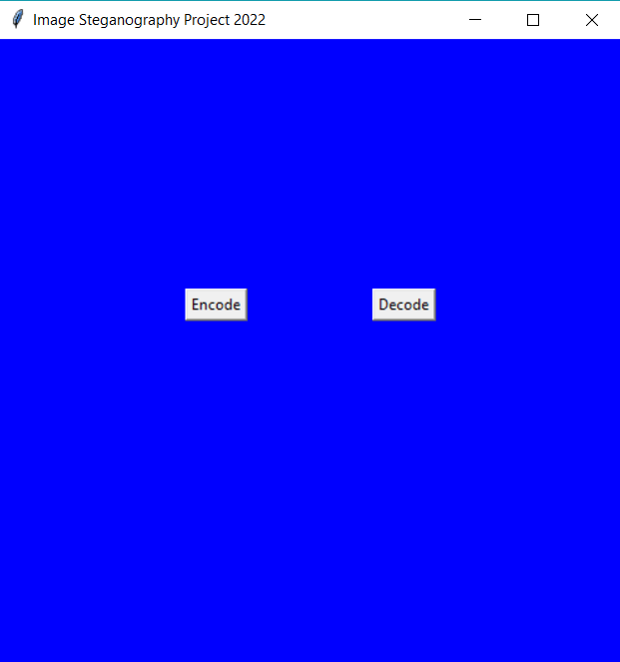
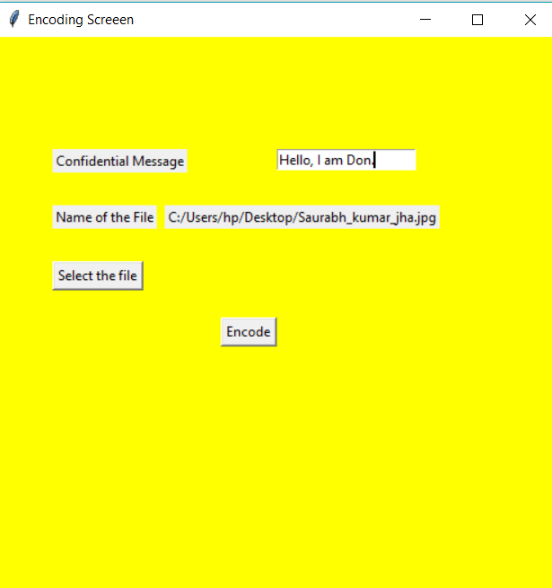
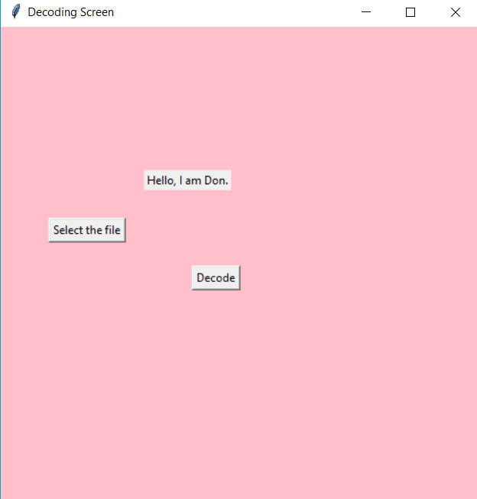
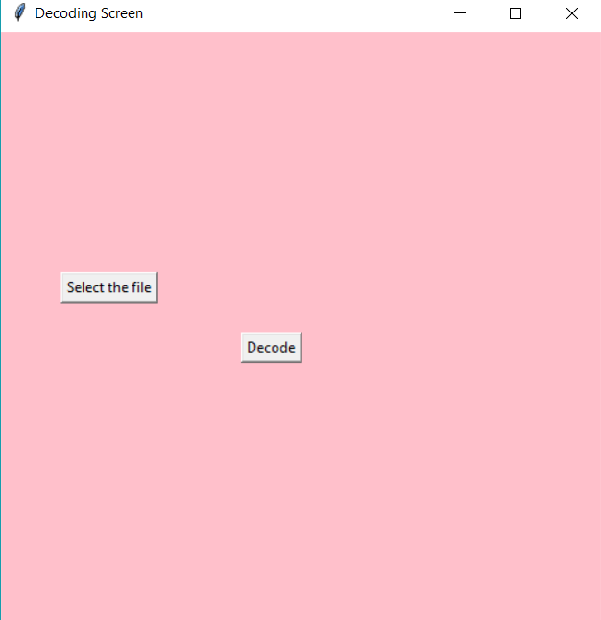
Encoding…
Decoding…

Slide 16
Applications of Steganography
Confidential communication and secret data storing.
Protection of data alteration.
Access control system for digital content distribution.
Media Database systems.

Slide 17
Advantages
Difficult to detect and only receiver can detect. It provides better security for sharing data in LAN, MAN and WAN.
This method featured security, capacity, and robustness, the three needed aspects of steganography that makes it useful in hidden exchange of information through text documents and establishing secret communication
Important files carrying confidential information can be in the server in and encrypted form No intruder can get any useful information from the original file during transmit.
It can be done faster with large number of softwares.
With the use of Steganography Corporation government and law enforcement agencies can communicate secretly.

Slide 18
Disadvantages
The confidential information is maintained by the algorithms, and if the algorithms are known then this technique is no of use.
Password leakage may occur and it leads to the unauthorized access of data.
Ii this technique is gone in the wrong hands like hackers can be very much dangerous for all.
There is large overhead to hide very tiny amounts of information. Hiding short messages within wide text is limited by the size of the extensive text.
Huge number of data, huge file size so someone can suspect about it.

Slide 19
Result and Discussion
In this project we mainly concentrated on embedding the data into an image. We have designed the steganographic application which embedded the data into the image.
Normally, after embedding the data into the image, the image may lose its resolution. In the proposed approach, the image remains unchanged in its resolution as well in size.
The speed of embedding the data into the image is also high in the proposed approach such that the image is protected and the data to the destination is sent securely.
We have used the python programming language , python modules and python functions. There are many types of module like tkinter, stegano, PIL, Messagebox and many functions are given in this presentation.
Similarly, we have used the encode function for encoding and decode function for decoding using reveal() and hide() function.

Slide 20
Conclusion and Further Enhancement
In the present world, the data transfers using internet is rapidly growing because it is so easier as well as faster to transfer the data to destination. So, many individuals and business people use to transfer business documents, important information using internet.
Security is an important issue while transferring the data using internet because any unauthorized individual can hack the data and make it useless or obtain information un- intended to him.
The future work on this project is to improve the compression ratio of the image to the text. This project can be extended to a level such that it can be used for the different types of image formats like .bmp, .jpeg, .tif etc., in the future. The security using Least Significant Bit Algorithm is good but we can improve the level to a certain extent by varying the carriers as well as using different keys for encryption and decryption.

Slide 21
THANK YOU

