Slide 1





Exploring School Applications Data – Trend Analysis
Our Team
Saurabh Kahulkar
Veenasree Ramisetty
Vikram Ramanathan
Adithyaa
Mugandagiri Anand
Notes:
Vikram

Slide 2
Agenda
01
Project Overview
02
Trend in the data and visualization
03
Conclusion

Slide 3
Project - Exploring School Applications Data
Overview:
Implement OOPS, understand and cleanup the data to solve for missing values in the dataset for producing visualizations
Key Variables
Date
The application date
Significance:
Understanding trends in school applications that can offer valuable insights into education.
Understanding data and using necessary techniques to generate visualizations.
Name
Applicant's name
School
The name of the school
Type
Categorization of schools into Stem and non-Stem
End Objective
Ratings
Applicants' ratings for the schools
1
Base data clean up and transformation
Tuition Fee
The cost of education in USD
Acceptance Rate
The likelihood of candidates being accepted
2
Summarize the main findings from the visualizations.
As we embark on this exploration, we aim to uncover interesting patterns and trends within the world of school applications. Let's dive in!
3
Highlight any significant trends, patterns, or insights.

Slide 4
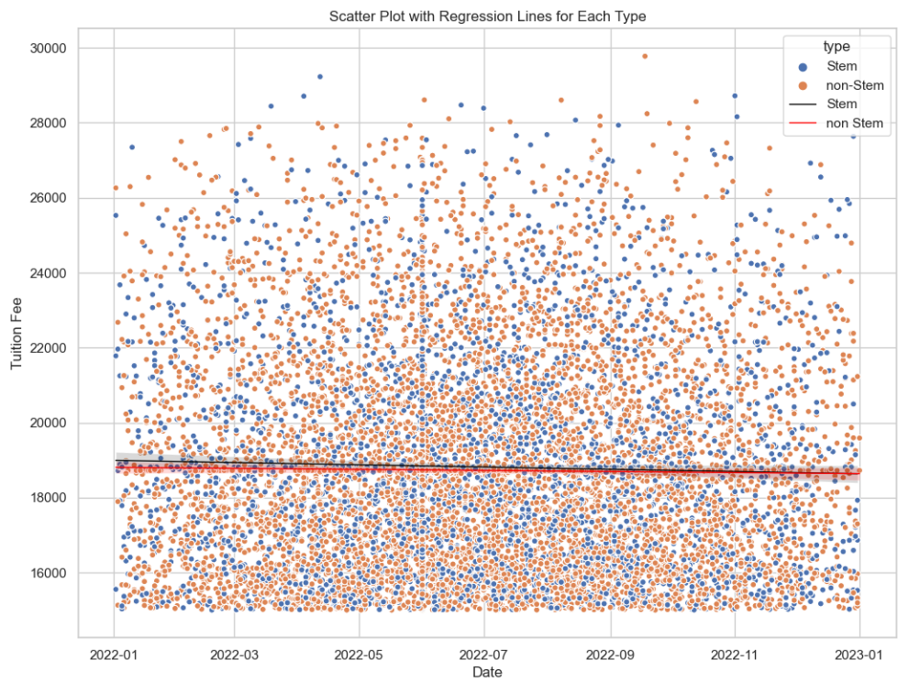
Viz 01-Scatter Plot
The scatter plot displays 'tuition_fee' vs. 'date' for Stem and non-Stem schools, with regression lines.
Stem schools exhibit a pronounced decrease over time, while non-Stem schools show a more moderate trend.
This analysis offers insights into tuition fee dynamics in different school types.

Slide 5
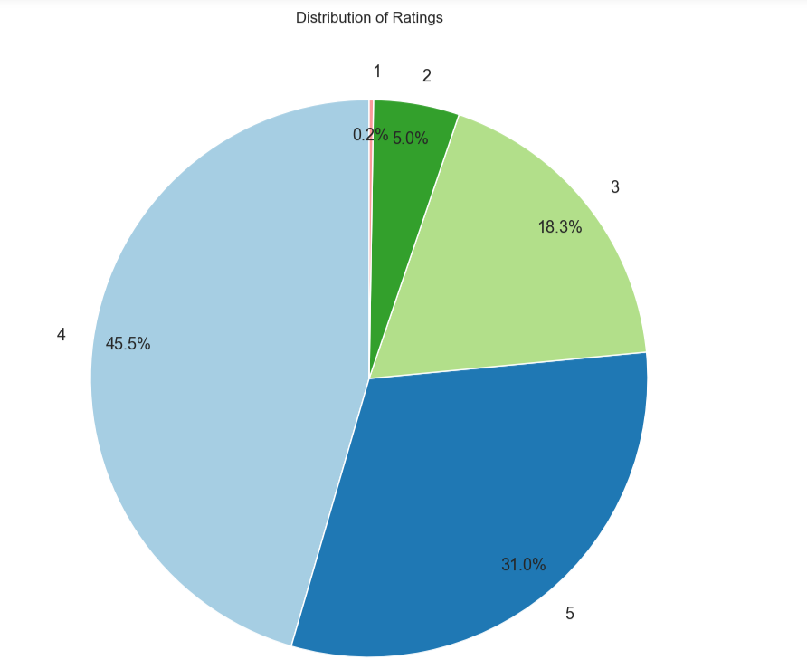
Viz 02-Pie Chart
The pie chart illustrates the distribution of ratings across different schools, indicating the prevalence of each rating category.
This visualization, along with others, provides insights into the diverse ratings of schools within the dataset.
Notably, approximately 76.5% of applications received a rating of 4 or 5, indicating high regard for all three schools.

Slide 6
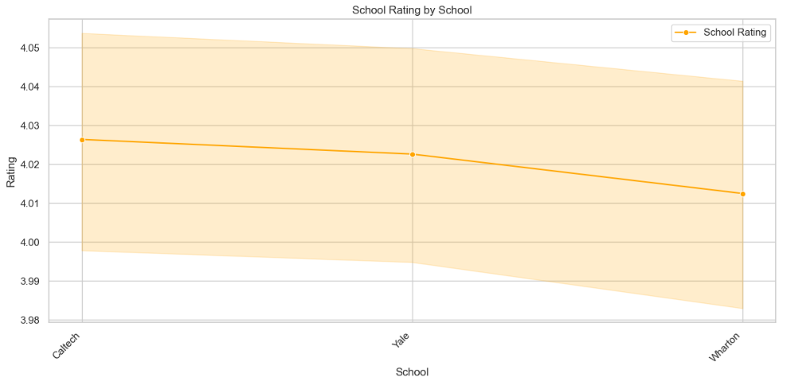
Viz 03-Line Plot
The subsequent line plot provides a visual representation of the school ratings for the specified institutions.
The Y-axis denotes the school rating, while the X-axis plots the schools.
The visualization indicates that Caltech boasts the highest rating, with Yale following closely behind.
In contrast, Wharton appears to be the least highly rated among the three schools.

Slide 7
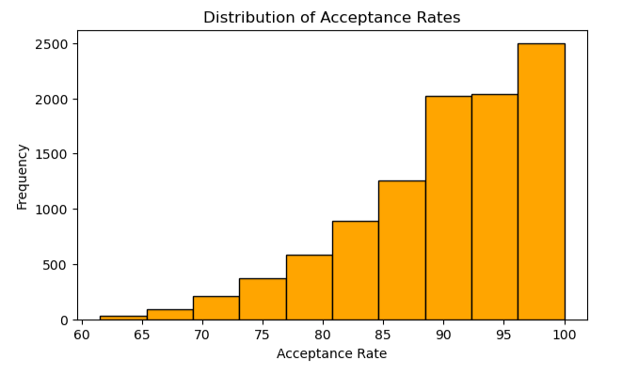
Viz 04-Histogram
Description:
The chart is a histogram illustrating the distribution of acceptance rates across school data.
The x-axis displays various acceptance rate ranges, while the y-axis represents the frequency of schools within each range.
Trend Analysis:
The histogram, skewed to the left, indicates that a significant number of institutions boast higher acceptance rates.

Slide 8
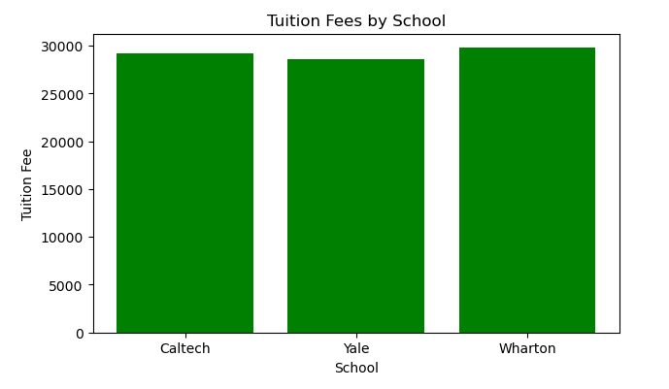
Viz 05- Bar Chart
Distribution of Tuition Fees
Description:
The below chart is a bar chart illustrating tuition fees for different schools. Each bar represents a school, and the height of the bar corresponds to the tuition fee.
Trend Analysis:
The below chart represents higher bar for Wharton, suggests higher tuition fees for Wharton and lower bar for Yale, suggests lower tuition fees for Yale.

Slide 9
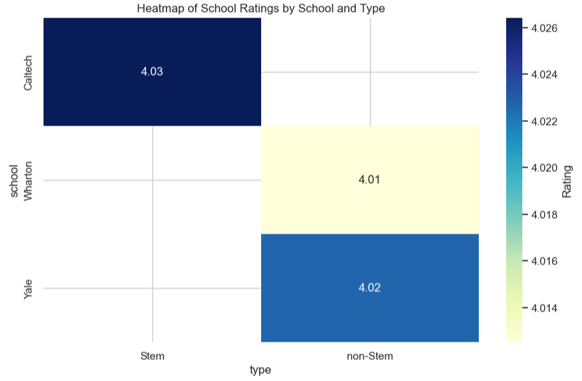
Viz 06-Heat Maps
The heatmap displays ratings for Caltech, Wharton, and Yale, categorized by STEM or non-STEM.
Darker colors represent higher ratings, indicating that STEM schools generally receive higher ratings.
Caltech has the highest overall rating (4.03), followed by STEM Yale (4.02), and non-STEM Wharton (4.01). The minimal rating difference between STEM and non-STEM Yale suggests that Yale is highly rated irrespective of the type.

Slide 10
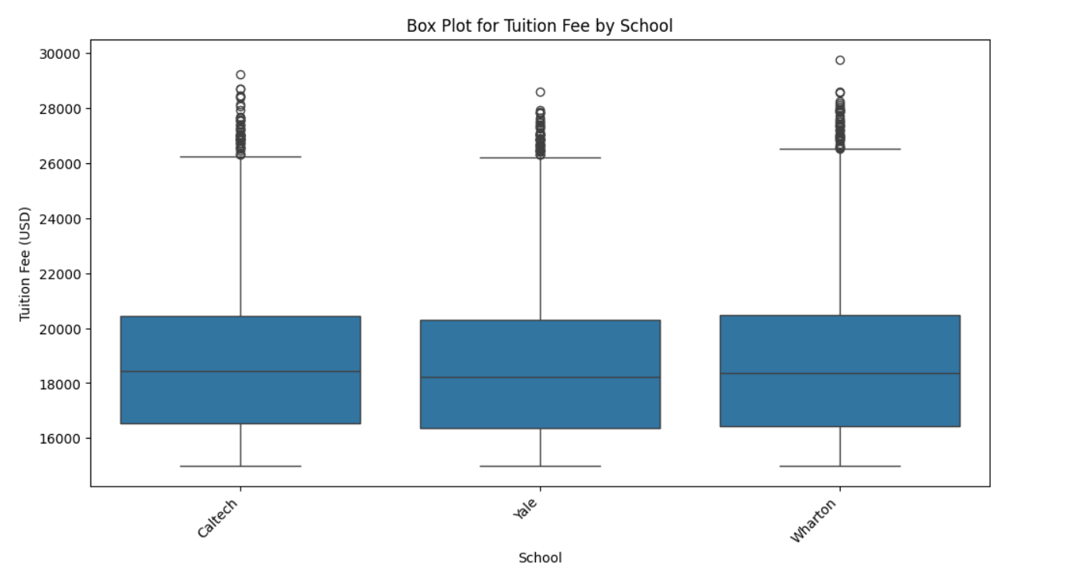
Viz 07-Box Plots
The boxplot highlights varied tuition fees across schools, with Caltech having the highest median, and Wharton and Yale showing similar median fees.
The interquartile range (IQR) is wide for all, indicating substantial fee diversity within each school.
Caltech exhibits numerous outliers, emphasizing extreme fee variations for some students.
In summary, the boxplot underscores significant tuition fee variability, especially in STEM schools like Caltech, with noteworthy variations within each school.

Slide 11
Conclusion
The dataset indicates consistent high ratings across schools, with varying tuition fees (higher for Wharton, lower for Yale) and generally higher acceptance rates.
Trends in tuition fees suggest a more pronounced decrease in Stem schools.
Additionally, higher acceptance rates are observed in non-STEM schools, particularly Yale, while Wharton remains highly selective.
Most applications prefer non-Stem types, favoring Yale or Wharton.
Overall, the findings offer valuable insights into school characteristics and user preferences.

Slide 12
Thank you!

