Slide 1
Presentation In JukeBox-Capstone-Project By Saurabh Kumar Tiwari

Slide 2
Database Implementation
First created a Database named as Jukebox.
After that created 3 different table for different operation.
First table is for Song attribute such as.
SongId,Album,Duration,SongName,Artist,Genre,SongPath.
Second table is for creating playlist.
In playlist 2 column PlayListId and PlayListName.
Third table is for PlaylistContent.
In this table 2 column PlaylistId and SongId this is used to add song in playlist.
Next page you see the table:

Slide 3
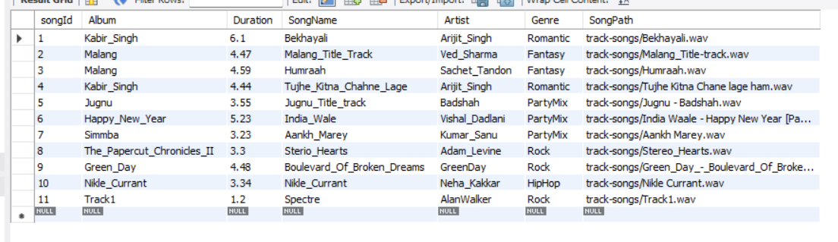
* This Is Song Table with containing some elements

Slide 4
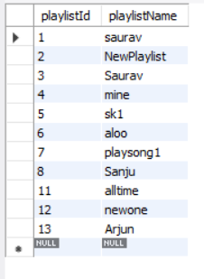
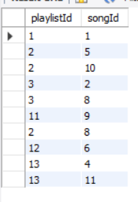
Playlist Table PlaylistContent Table

Slide 5
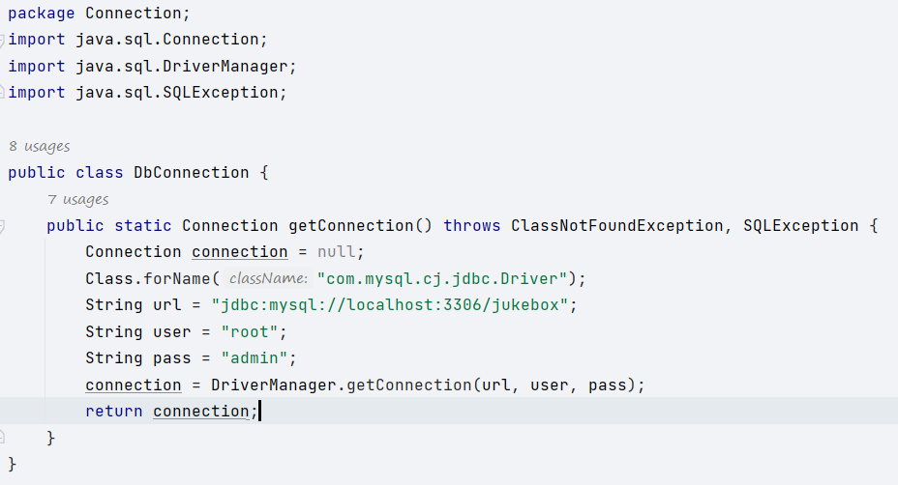
Now Database created for further process continue in Intellej
In Intellej first created a class name it as DbConnection.
In this class we establish the connection with database.
In this class a method named as public static Connection getConnection() this method return connection of database.
As you can see in below image.

Slide 6
After creating connection class work on Jukebox clasess and methods.
Now created a class named as SongCollection.
In this class I am created Jukebox useful attribute there getter and setter method , a parametrize constructor and toString override method.
In this class all attributes are encapsulated.

Slide 7
After Creating SongCollection class I am created new class name it as JukeBoxAllOperation in this class perform all jukebox operation.
In JukeBoxAllOperation class there are method to run the jukebox.
1 st method is public <List>SongCollection getAllSongs()
This method connect with database with table song .
This methos retrieve all elements in song table such as SongId,Album,Duration,SongName,Artist and Genre.
And store in a list of SongCollection class and return the list.

Slide 8
Next Method name as public List<SongCollection>Show_Search_Song()
This method help user to search particular song.
Next method name as CreateNewPlaylist()
This method create new custom playlist.
Next method name as addSongToPlaylist()
This method add song to particular playlist.
Next method is name as ExistingPlaylist()
This methos show all existing playlist.

Slide 9
After creating method created a class which implement all the method and play song.
Name of class is JukeBoxImplementation{}
In this we use AudioInputStream and Clip interface to play and manage particular song.

Slide 10


