Slide 1

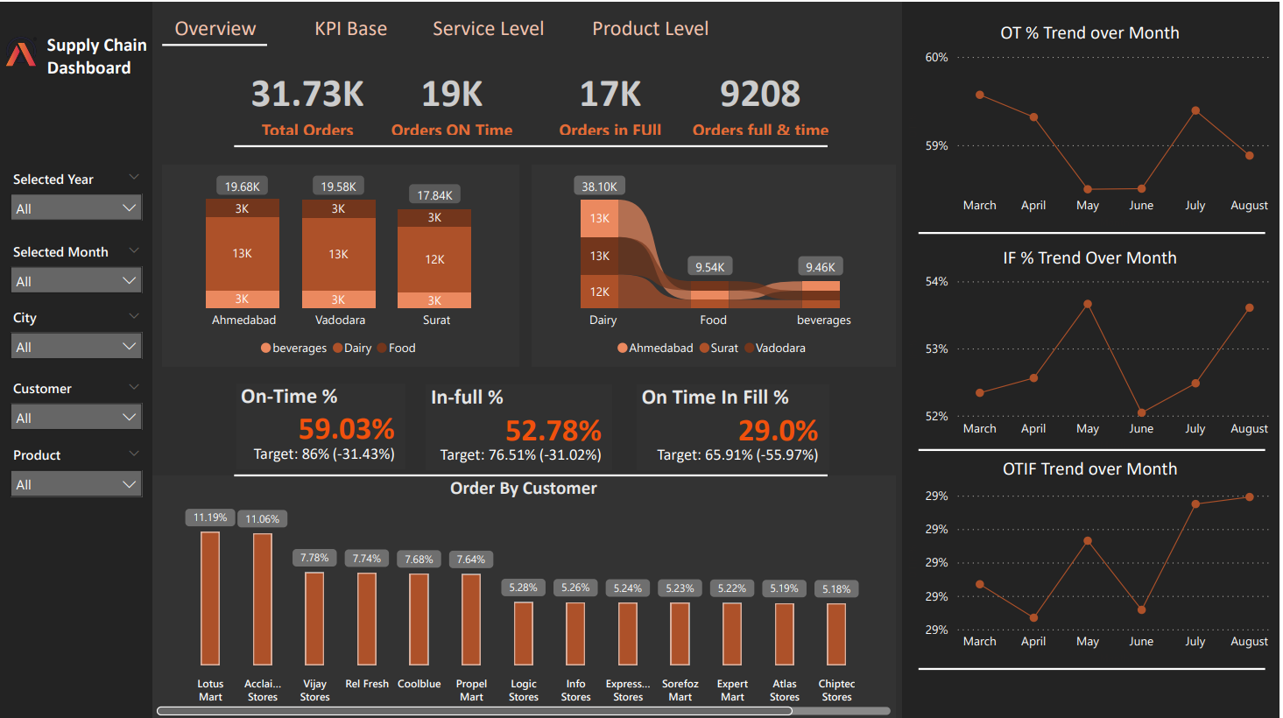
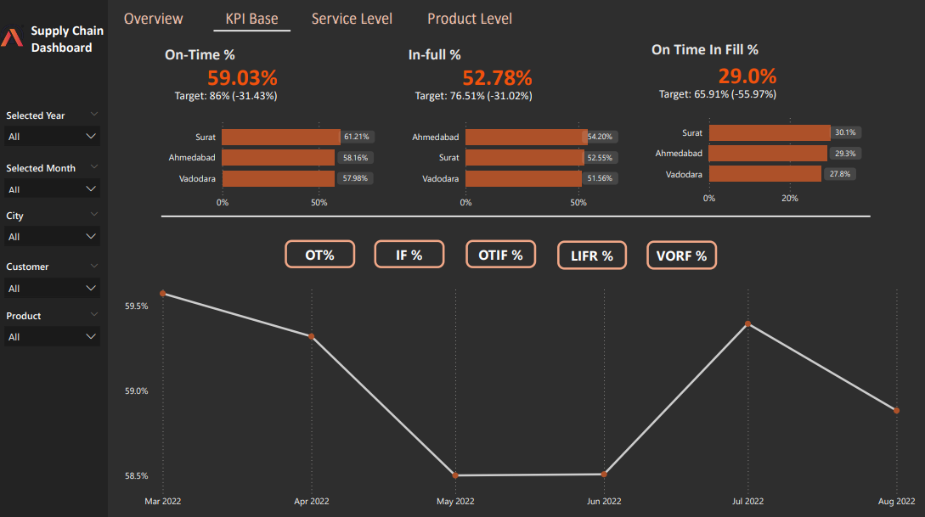
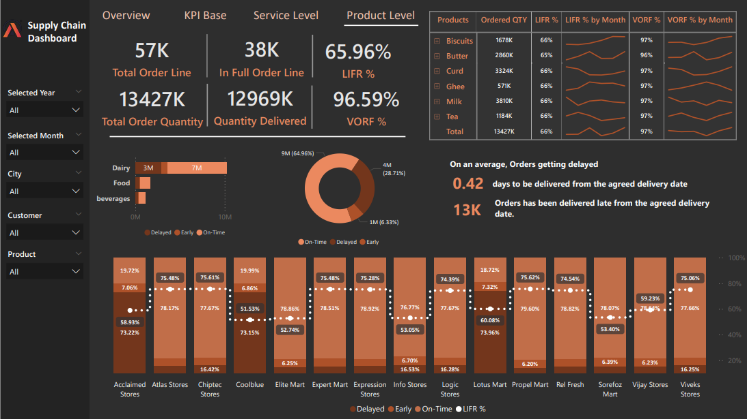
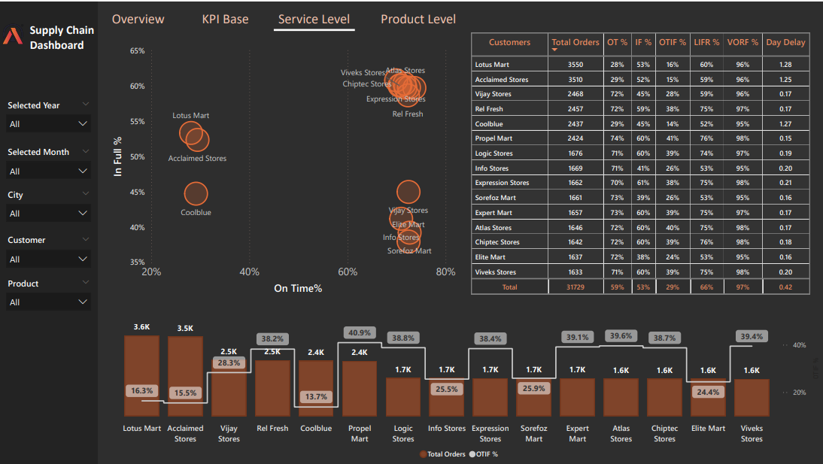
Supply Chain Service Level Data Analysis– AtliQ Mart
Improving On-Time & In-Full Delivery Performance

Slide 2
Company: AtliQ Mart – FMCG manufacturer based in Gujarat, India
Current Operations: Surat, Ahmedabad, Vadodara
Future Goal: Expand to Tier-1 cities within 2 years
Problem Statement:
Some key customers did not renew contracts due to service issues
Essential products were delivered late or incomplete
Risk of losing customers & reputation before expansion
Objective:
Track On-Time (OT %), In-Full (IF %), and On-Time In-Full (OTIF %) delivery daily
Compare service levels against customer targets
Provide insights to improve customer service & retention

Slide 3
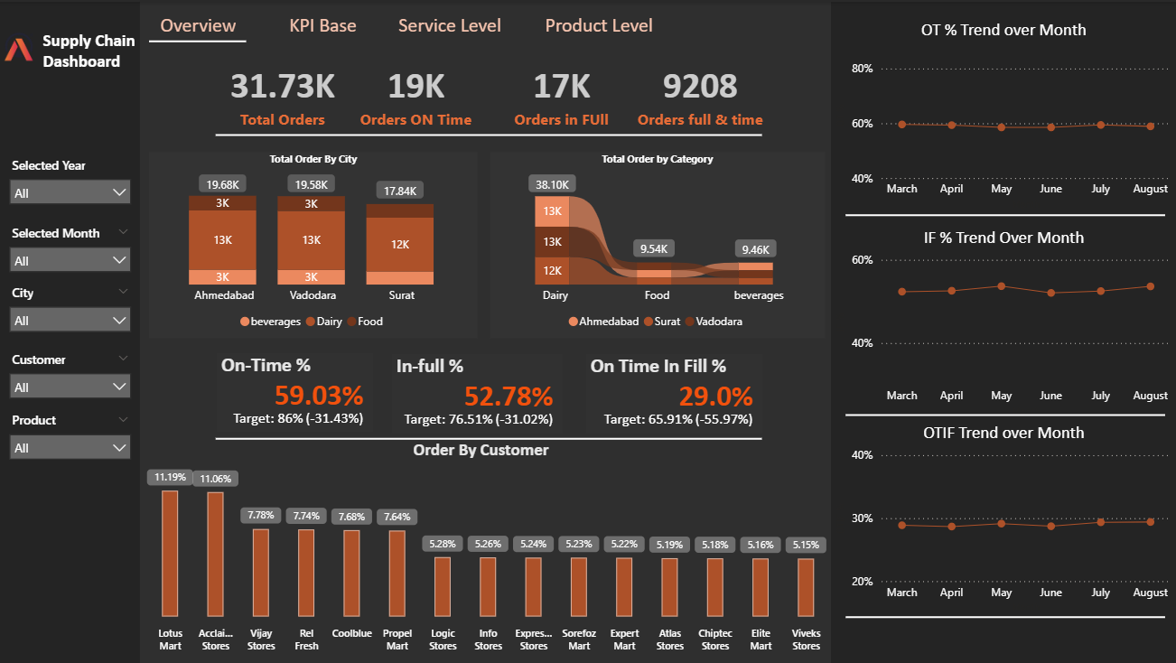
Dairy dominates with 38.1K orders, followed by Food (~9.5K) and Beverages (~9.4K).
Ahmedabad, Vadodara, Surat have almost equal orders (18K–19.6K), but fulfillment delays are consistent across.
On-time %, In-full %, and OTIF % are all below targets and flat/slightly declining across months
On-Time %, In-Full %, and OTIF are all far below targets
Lotus Mart & Acclaimed Stores contribute the most (~11% each)
Long-tail of smaller customers contributes <8% each

Slide 4
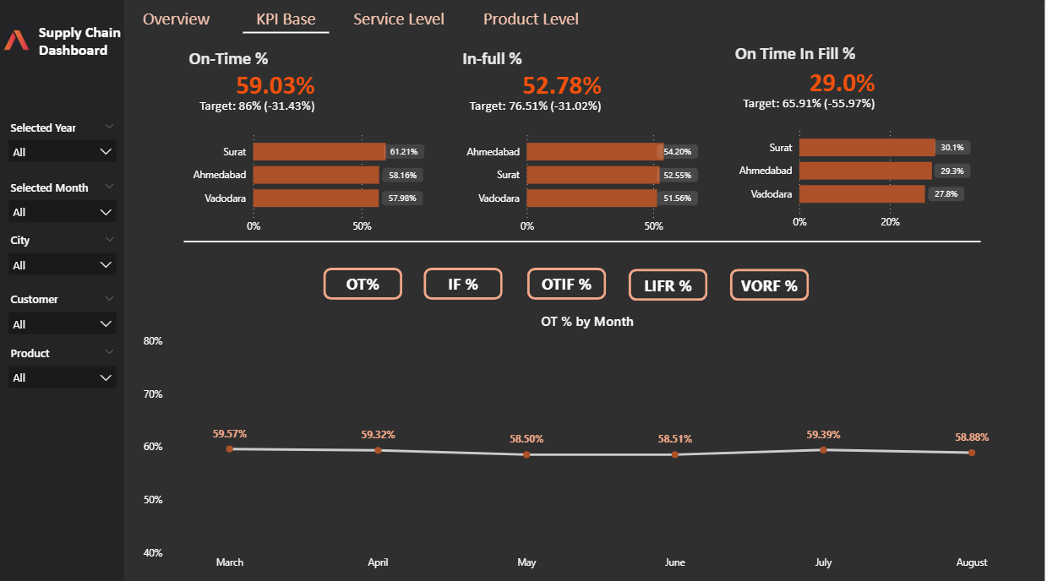
Surat (OT 61.2%) > Ahmedabad (58.1%) > Vadodara (57.9%)
Ahmedabad performs best on IF% (54.2%), Vadodara lowest (51.6%).
OTIF across cities is very poor (27–30%).
Focus improvement programs in Vadodara (lowest service performance).

Slide 5
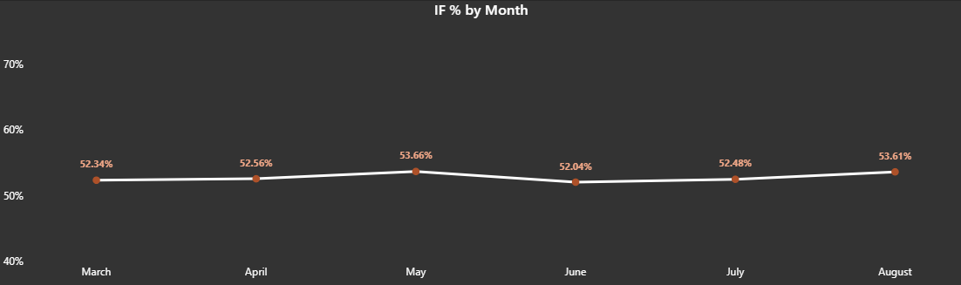
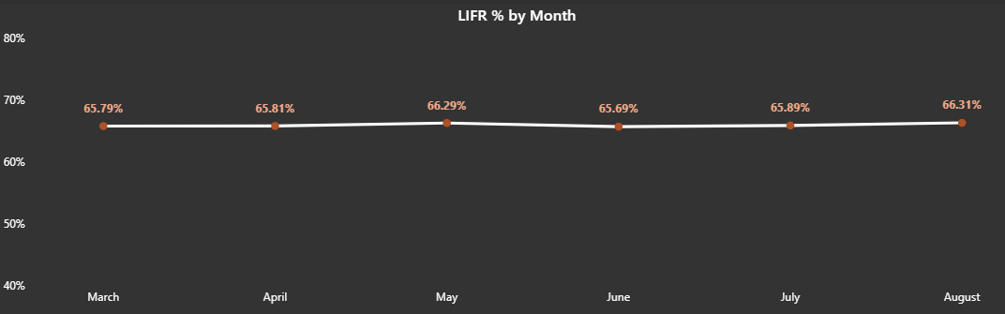
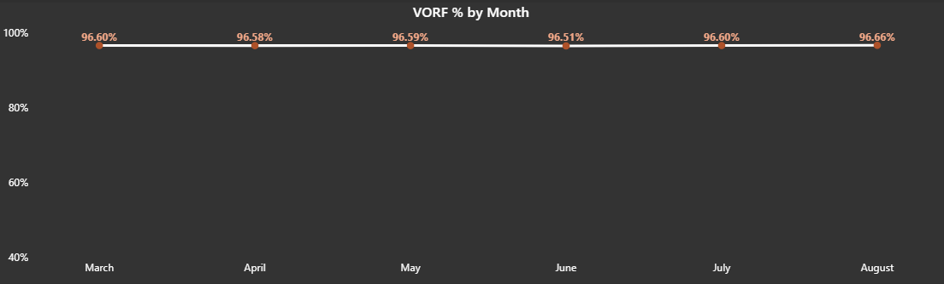
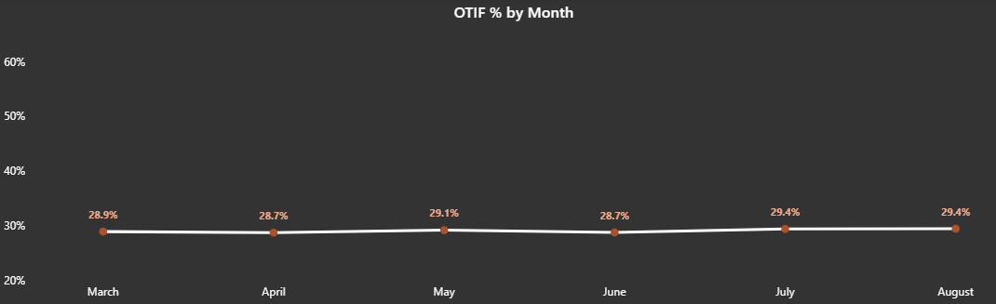
Range: 52.3% – 53.6% (March–August).
Flat and stagnant with no major improvement across 6 months.
Always 20–25% below target (76.5%), indicating chronic under-fulfillment of orders.
Range: 65.8% – 66.3%.
Stable but low (benchmark usually 85–90%).
No significant month-to-month improvement.
Range: 96.5% – 96.9% → consistently high.
This means that total quantity delivered is almost matching customer demand.
However, high VORF but low LIFR/IF indicates wrong products are being delivered in right total quantity (mismatch problem).
Range: 28.0% – 29.4%.
Consistently very low vs target of ~65%.
Almost flat, no month shows recovery

Slide 6
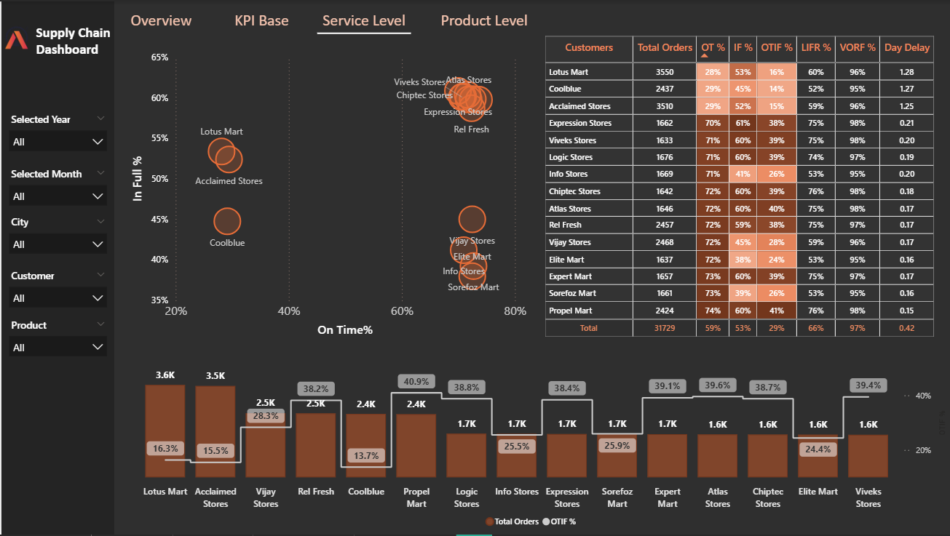
The chart reveals three customer segments:
Critical Problem Accounts (Lotus, Acclaimed, Coolblue).
Improvement Needed Accounts (on-time but not in-full).
Best Practice Accounts (high on-time, high in-full).
Customers with Poor Service Levels:
Lotus Mart (OT 28%, IF 53%) → OTIF just 15%.
Acclaimed Stores (OT 28%, IF 52%) → OTIF 15%.
Coolblue also poor (OT 29%, IF 44%).
High Performers:
Expression Stores, Atlas Stores, Chiptec, Viveks Stores → Better IF & OTIF.
Day Delay: Avg delay is 0.42 days, worst is Lotus Mart (1.28 days).
The biggest risk lies with top-volume customers in the bottom-left cluster, as they are both high order contributors and very dissatisfied.

Slide 7
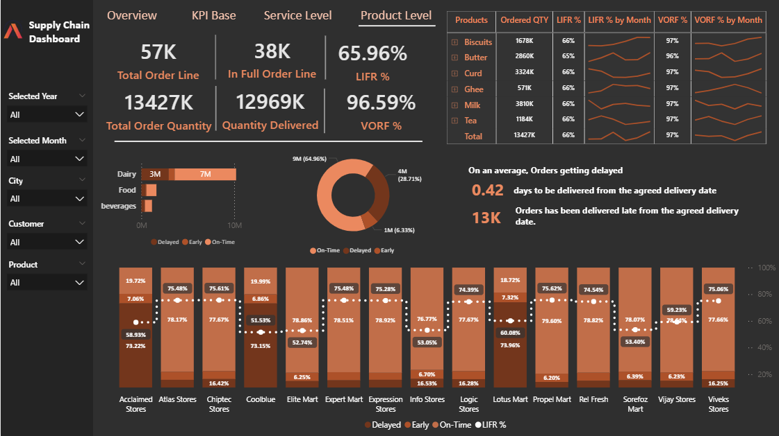
Products with higher demand (Milk, Curd, Butter) show similar fulfillment challenges as low-volume products.
While quantity-based fulfillment is high (VORF 96.59%), line-item fulfillment (LIFR 65.96%) shows many orders are not fulfilled completely as per order lines.
Delays are not huge in days but affect customer trust. Early deliveries also indicate misaligned supply planning.
Best performers: Propel Mart, Rel Fresh, Expression Stores mark High on-time deliveries, strong service.
Worst performers: Coolblue, Elite Mart, Lotus Mart → Very low LIFR, high delays.
Gap: Best stores are ~25% better than worst stores.
Action: Improve logistics and delivery process in Coolblue, Lotus, and Acclaimed; follow best practices of top stores.

Slide 8
Summary
All the Key Metrics (OT%, IF%, OTIF%) are far behind the target
On an average, orders are delayed 0.42 days from the agreed date of delivery
Lotus Mart, Coolblue, Acclaimed stores have the highest orders as well as delayed the most to deliver the products on time
Is it because we are not estimating the right delivery date?
Is it because we are receiving more orders than expected?
Ghee, curd and butter products are most delayed to deliver.
There is no noticeable improvements in any of the key metrics in the last few months
There is a huge gap in IF% for most of the customers. Is it because of less production?

Slide 9
Thank You

