Slide 1





Presented by Yatin Lokhande
AtliQ Hardwares

Slide 2
About AtliQ Hardwares and Problem Statement
AtliQ Harawares, a leading hardware company specializing in PCs, printers, mice, and computers with a global reach.
The expanding size of Excel files has led to performance problems, resulting in unresponsiveness and inefficiency. AtliQ Hardware has launched a project to tackle this issue by assembling a team of data analysts. They will utilize MySQL as their database management system to extract meaningful insights from the data. These insights will empower the company to enhance decision-making and optimize operations, ultimately boosting overall performance.
AtliQ Hardwares
Presented by - Yatin Lokhande

Slide 3
Project Overview
This project is designed to analyze and extract valuable insights from the provided database. The database contains information about sales, products, customers, and regions for Atliq Hardware. I aim to address specific questions related to sales reports, market analysis, customer behavior, and supply chain forecasting.
AtliQ Hardwares
Presented by - Yatin Lokhande

Slide 4
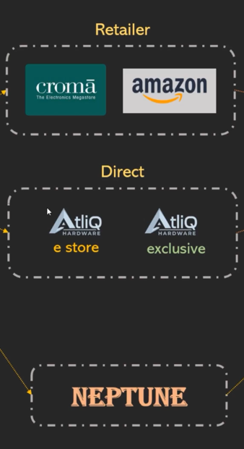
AtliQ Hardware – Business Model
Customers Channels
Customer Platforms
Brick and Mortar
E-Commerce
Croma
Best Buy
Amazon
Flipkart
Customers
Croma
Best Buy
Staples
Flipkart
AtliQ Hardwares
Presented by - Yatin Lokhande

Slide 5
AtliQ Hardware – Business Model
Product Division
PC
N&S
P&A
Personal Laptop
Gaming Laptop
Wi-Fi Extenders
USB Flash Drives
Processor
Motherboard
Keyboard
Mouse
Product Segment
Storage
Peripherals
Notebook
Desktop
Accessories
AtliQ Hardwares
Presented by - Yatin Lokhande

Slide 6
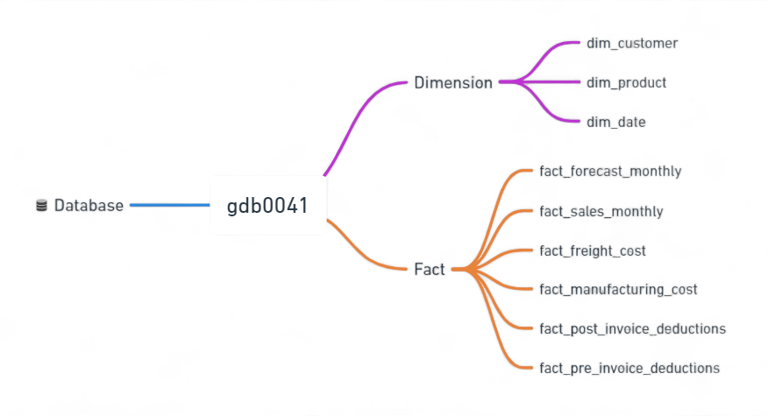
Data Sets
AtliQ Hardwares
Presented by - Yatin Lokhande

Slide 7
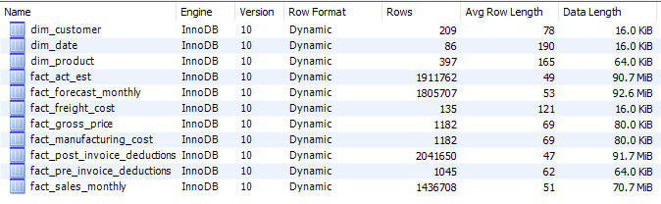
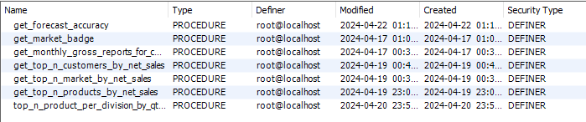

Database Overview
Tables
Stored Procedures
Functions
Views
AtliQ Hardwares
Presented by - Yatin Lokhande

Slide 8
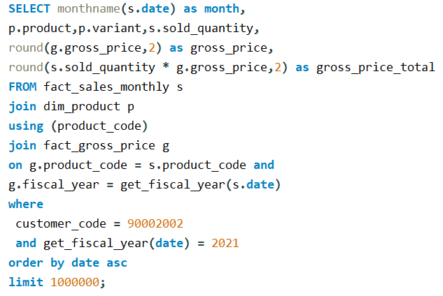
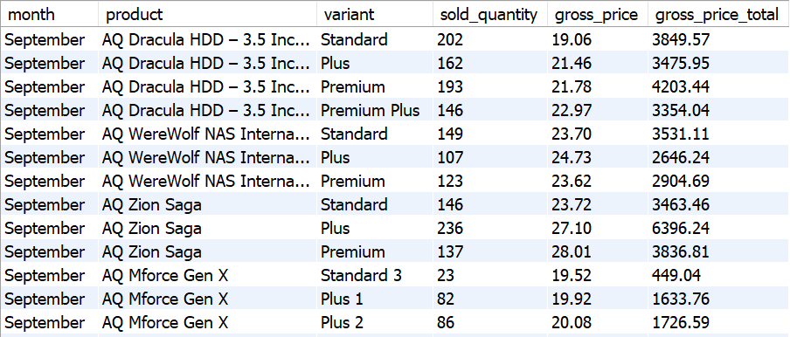
Croma India product wise sales report for fiscal year - 2021

Slide 9
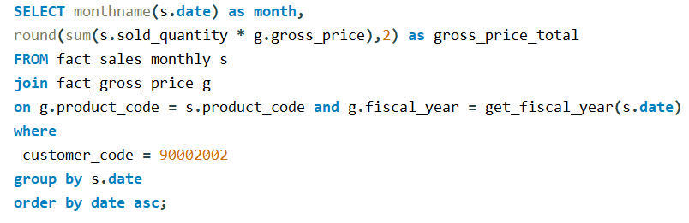
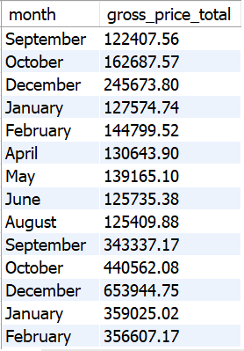
Gross monthly total sales for Croma
AtliQ Hardwares
Presented by - Yatin Lokhande

Slide 10
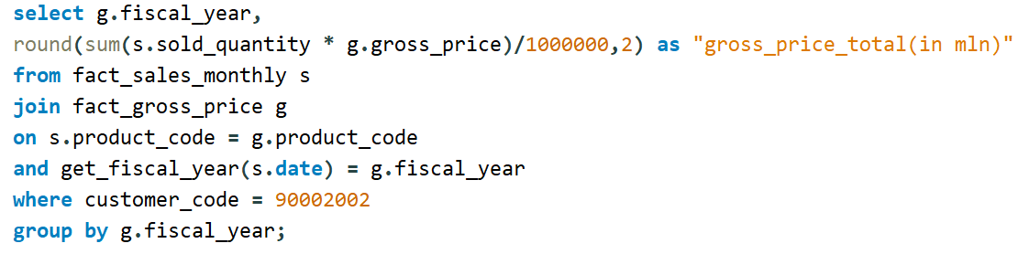
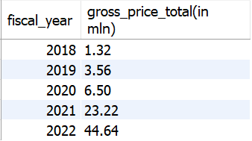
Yearly gross sales report for Croma India
AtliQ Hardwares
Presented by - Yatin Lokhande

Slide 11
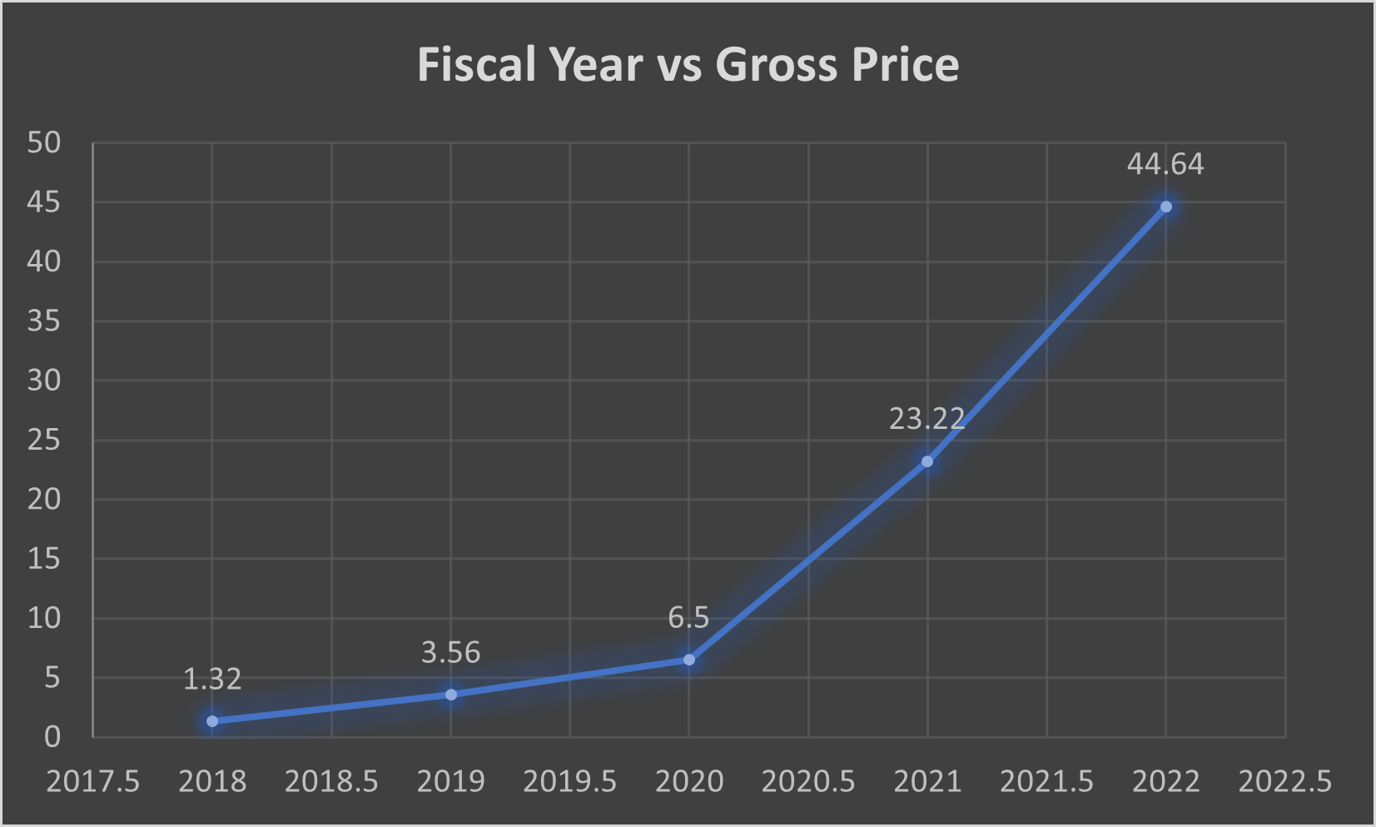
Yearly gross sales report for Croma India
AtliQ Hardwares
Presented by - Yatin Lokhande

Slide 12
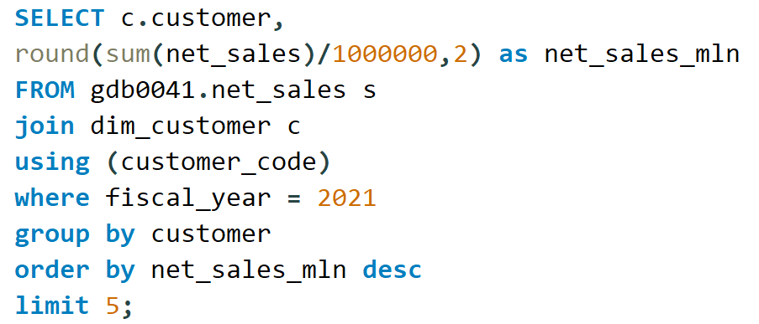
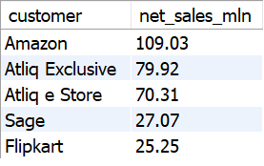
Top Market and Customers for a Financial Year 2021
Customer
AtliQ Hardwares
Presented by - Yatin Lokhande

Slide 13
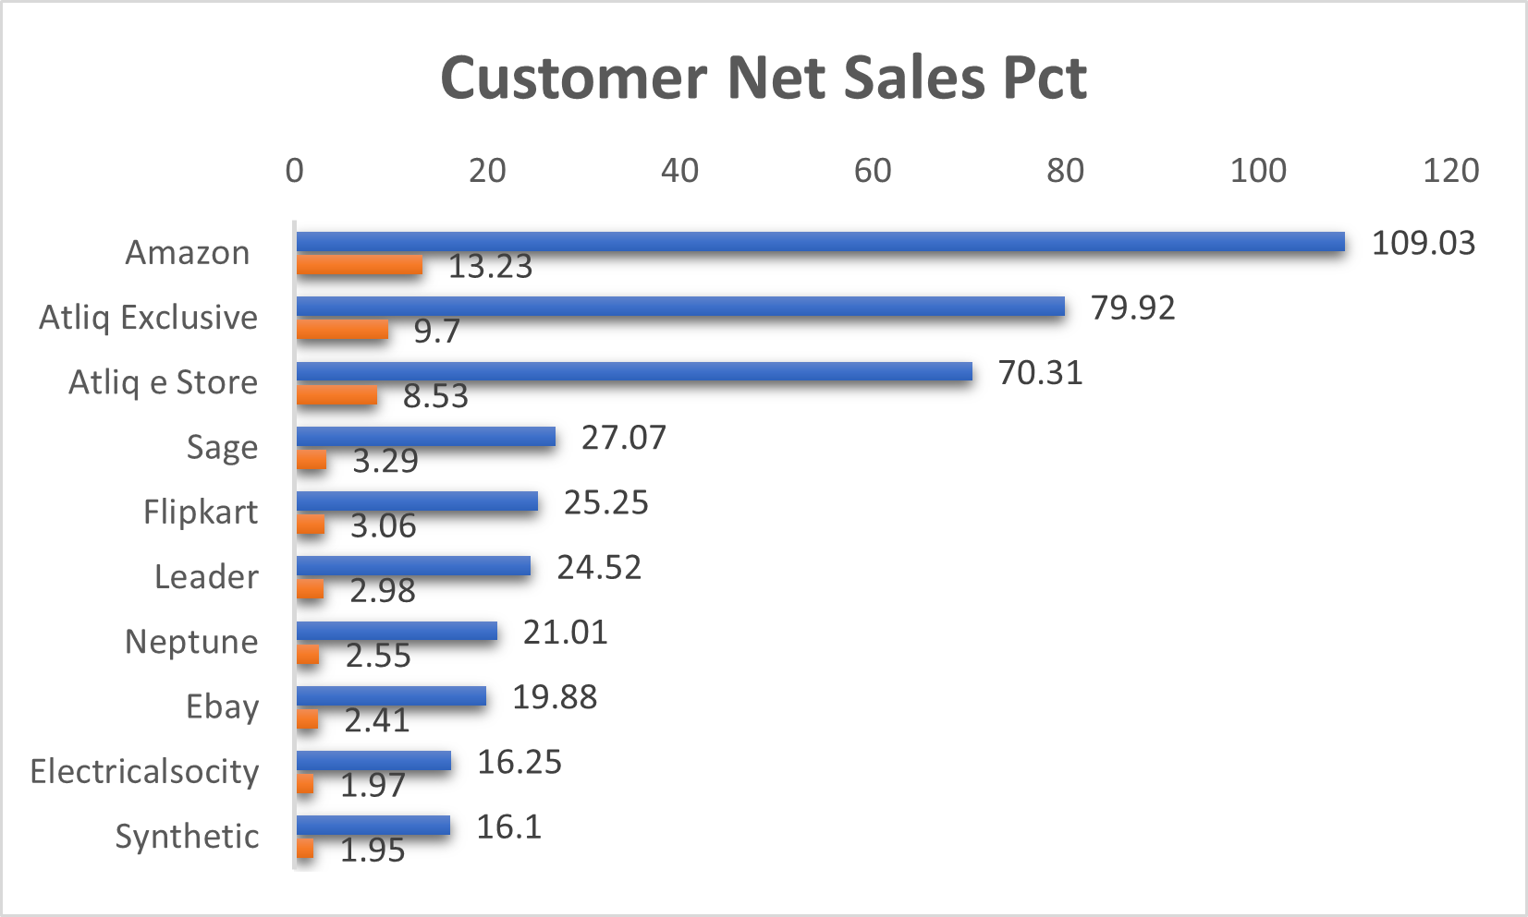
Top Market and Customers for a Financial Year 2021
Customer
AtliQ Hardwares
Presented by - Yatin Lokhande

Slide 14
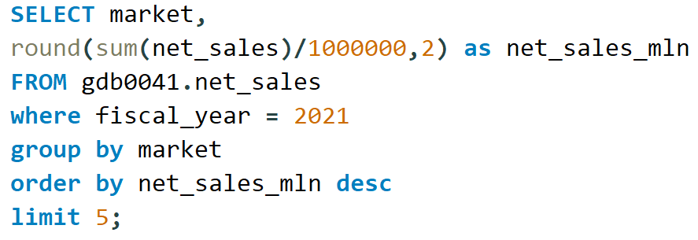
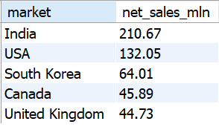
Top Market and Customers for a Financial Year 2021
Market
AtliQ Hardwares
Presented by - Yatin Lokhande

Slide 15
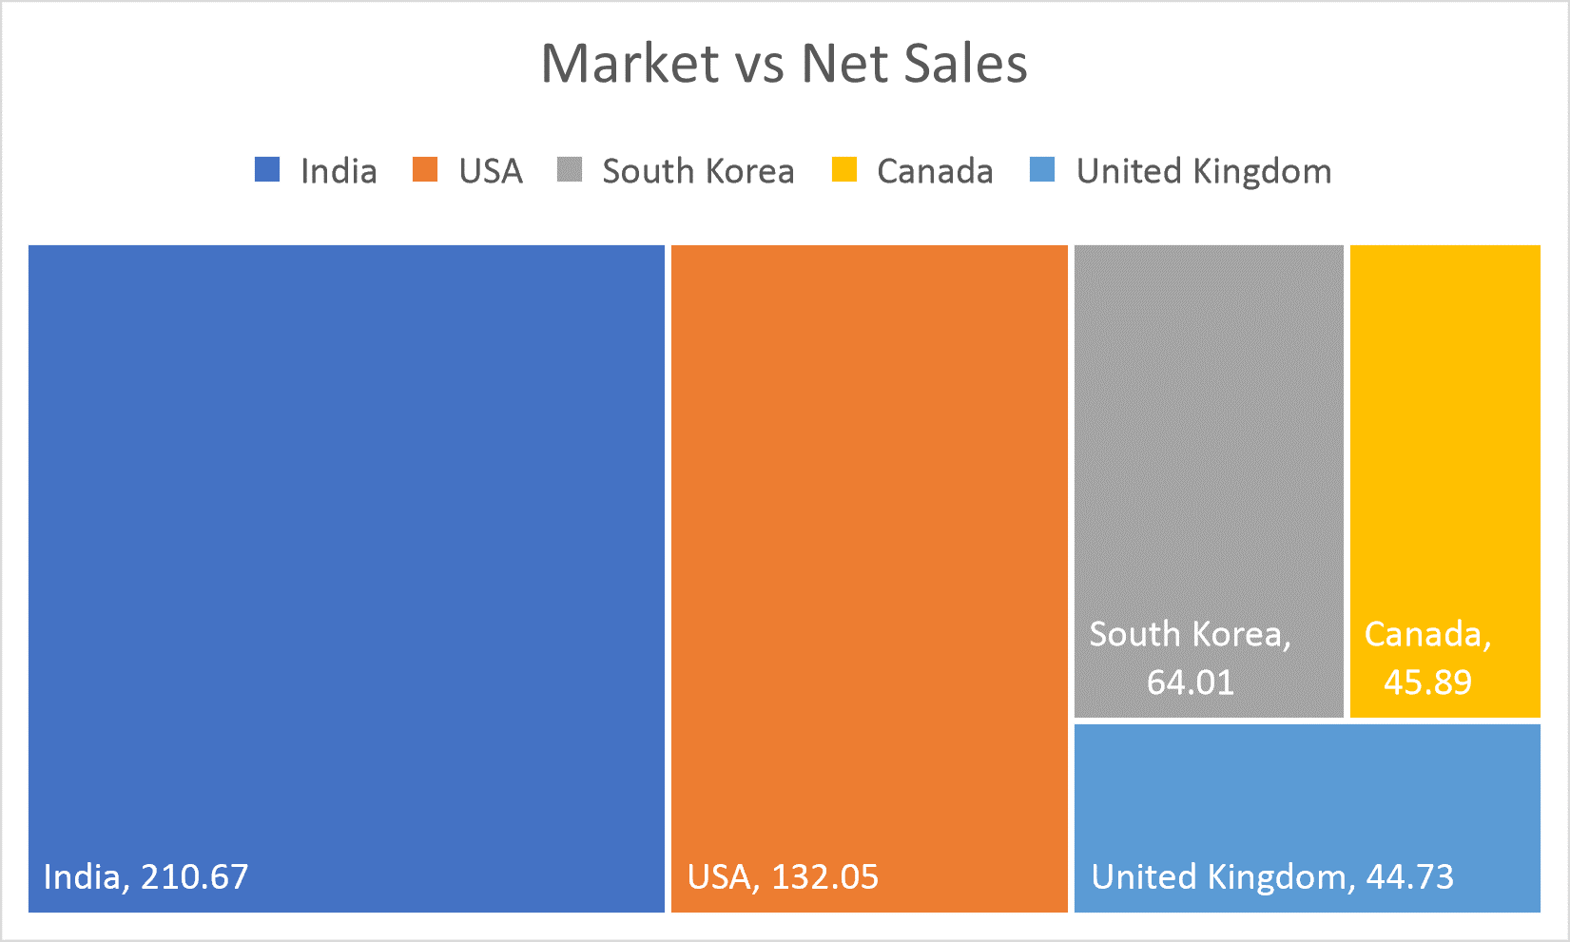
Top Market and Customers for a Financial Year 2021
Market
AtliQ Hardwares
Presented by - Yatin Lokhande

Slide 16
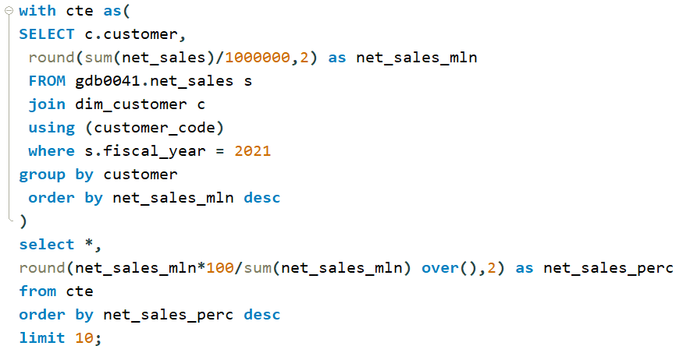
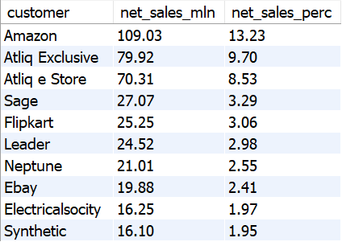
Net sales % share by Customers
AtliQ Hardwares
Presented by - Yatin Lokhande

Slide 17
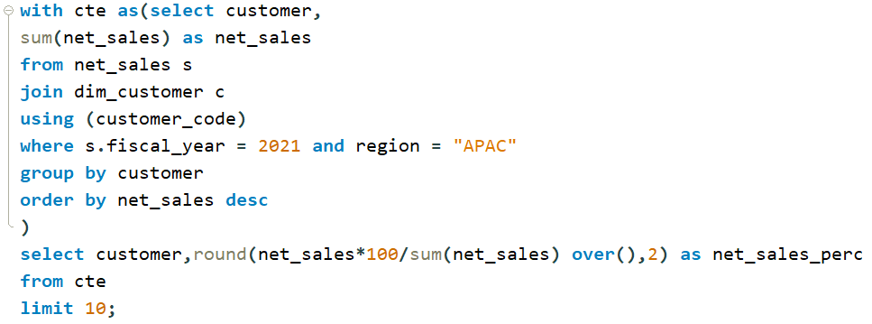
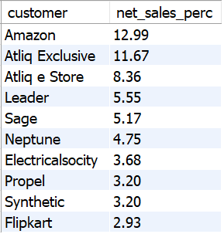
Net sales % share by Region - APAC
AtliQ Hardwares
Presented by - Yatin Lokhande

Slide 18
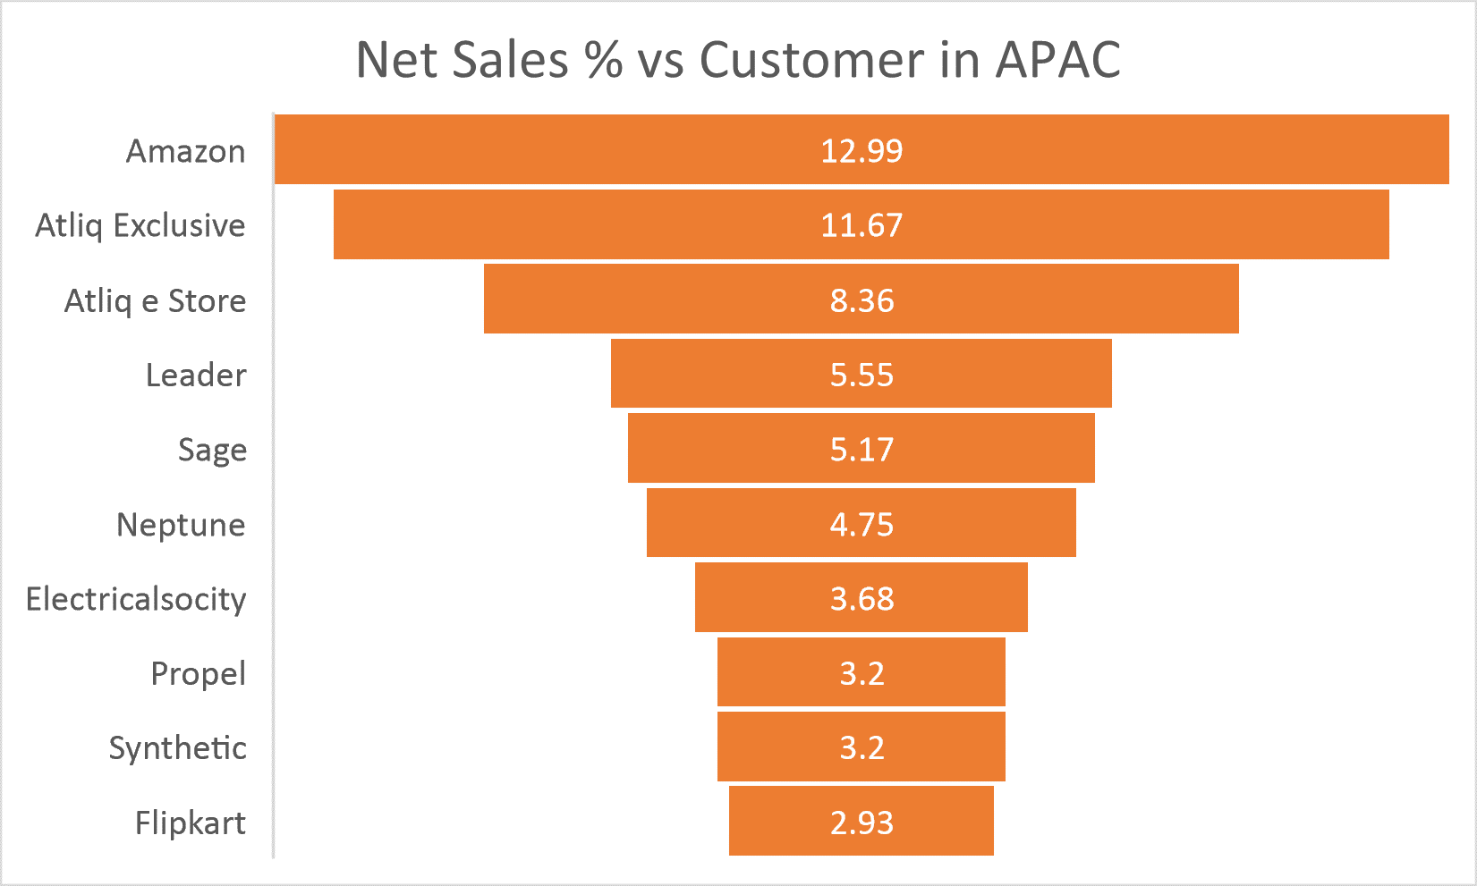
Net sales % share by Region - APAC
AtliQ Hardwares
Presented by - Yatin Lokhande

Slide 19
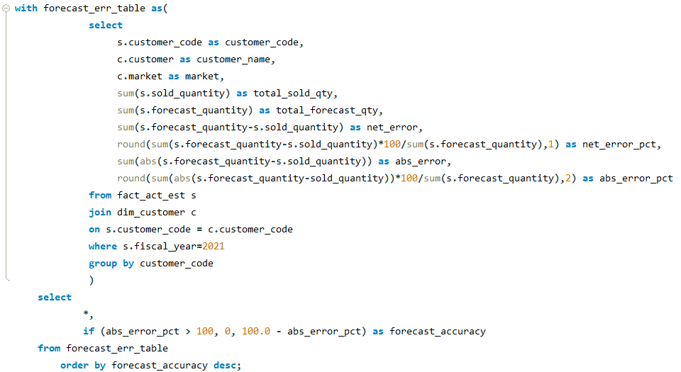
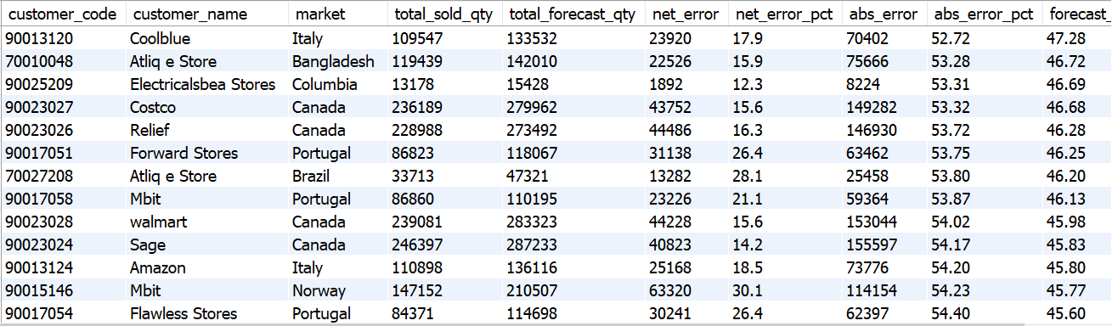
Supply Chain – Forecast Quantity
AtliQ Hardwares
Presented by - Yatin Lokhande

Slide 20
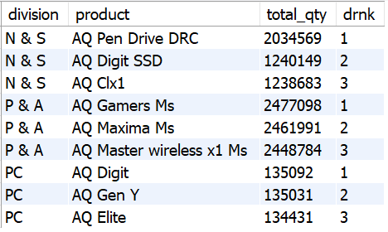
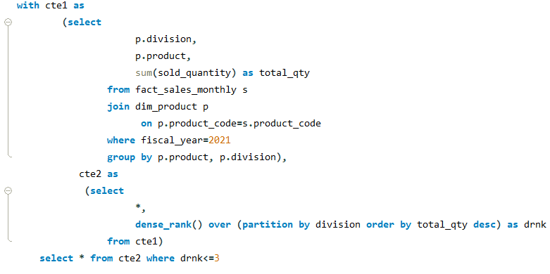
Top 3 products from each division by total quantity sold in a given year
AtliQ Hardwares
Presented by - Yatin Lokhande

Slide 21
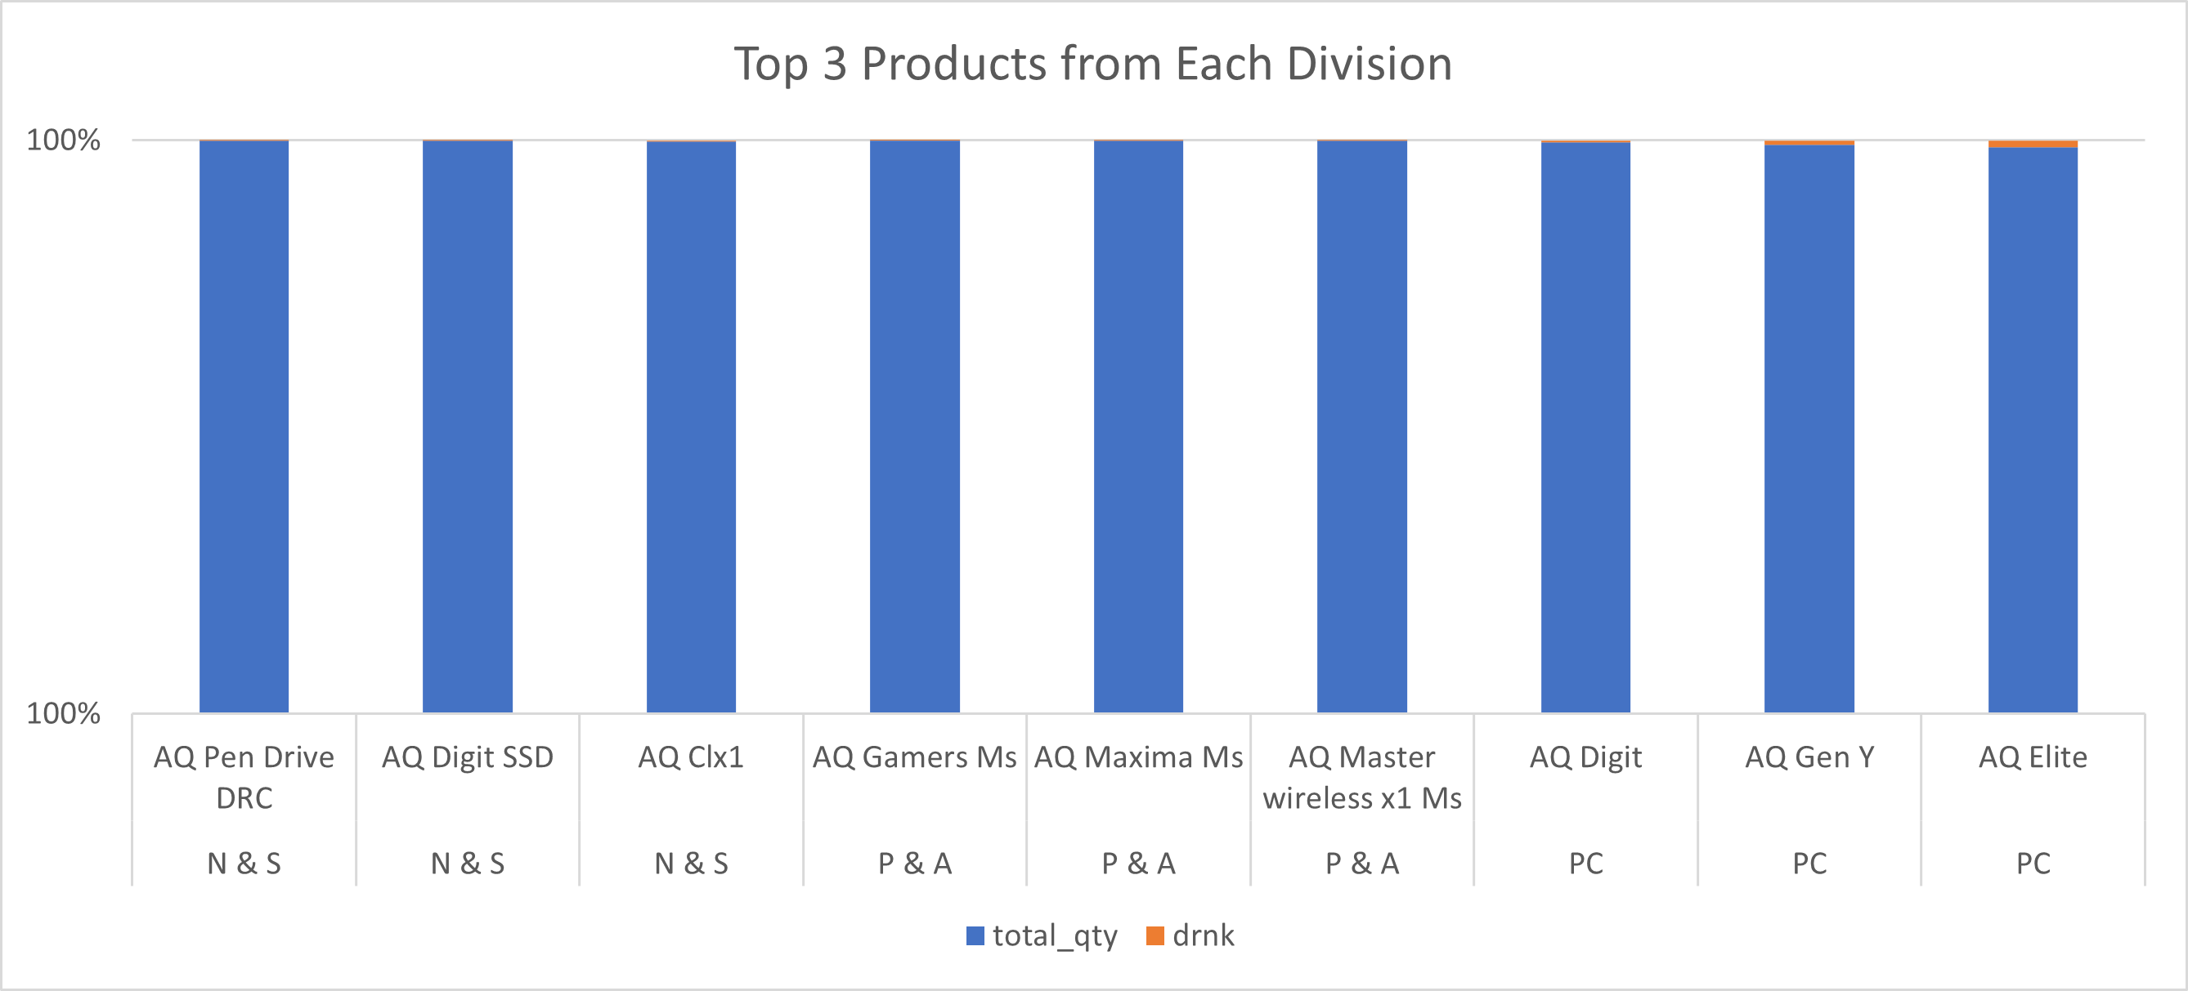
Top 3 products from each division by total quantity sold in a given year
AtliQ Hardwares
Presented by - Yatin Lokhande

Slide 22
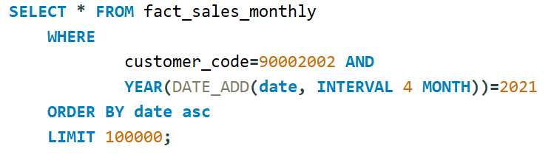
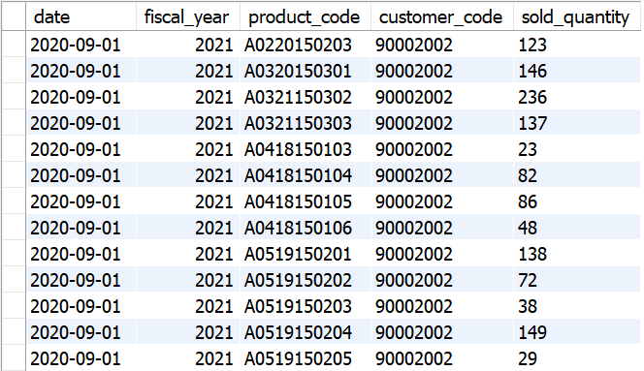
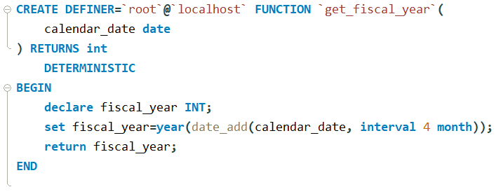
Get all the sales transaction data from fact_sales_monthly table for that customer(croma: 90002002) in the fiscal_year 2021
Create function for fiscal_year
AtliQ Hardwares
Presented by - Yatin Lokhande

Slide 23
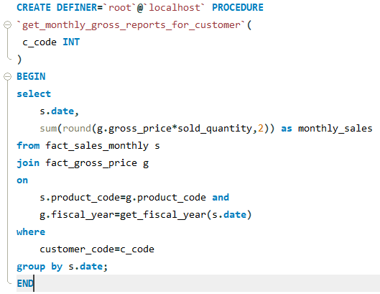
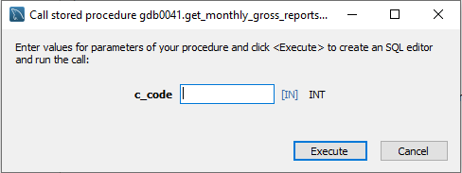
Generate monthly gross sales report for any customer using stored procedure
AtliQ Hardwares
Presented by - Yatin Lokhande

Slide 24
Thank You
AtliQ Hardwares
Presented by - Yatin Lokhande

