Slide 1
Kafka

Slide 2
Outline
What and Why Kafka?
Kafka Internals
Kafka Core API’s
Producer
Consumer
Connect
Streams

Slide 3
How it starts
Source System
Simple at first!
Data
Target System

Slide 4
After a while
Source
Source
Source
Target
Target
Target
Very complicated!

Slide 5
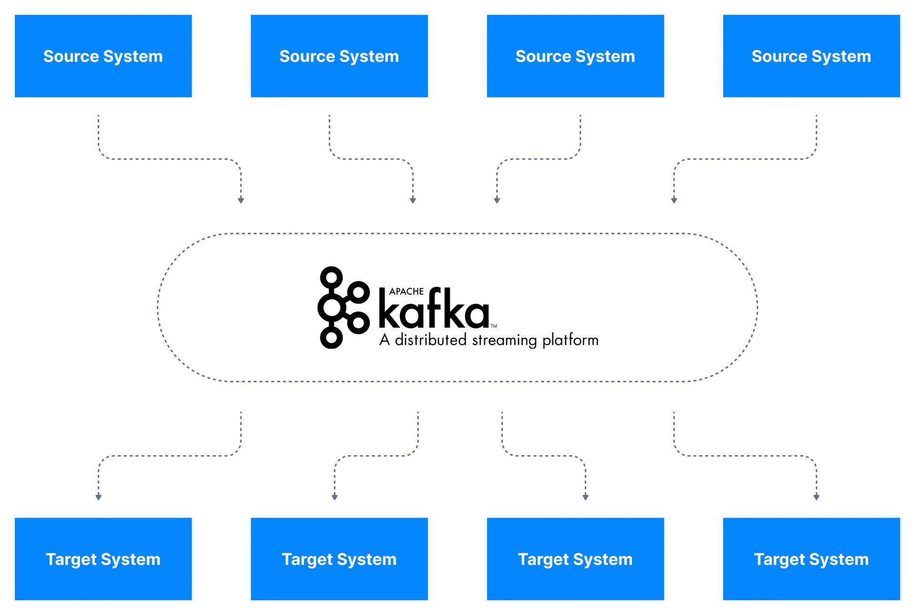
Why Apache Kafka: Decoupling of data streams and systems

Slide 6
What is Apache Kafka
Created by LinkedIn, now Open-Source Project mainly maintained by Confluent
Since being created and open sourced by LinkedIn in 2011, Kafka has quickly evolved from messaging queue to a full-fledged event streaming platform.
Distributed, resilient architecture(reliable)
Horizontal Scalability
High Performance(latency is less – real time)

Slide 7
What is an event stream
Streams are unbounded and ever growing
Event streams are ordered
Immutable: Events once occurred, can never be modified
Event streams are repayable

Slide 8
Apache Kafka: Use Cases
Messaging system
Activity Tracking
Stream Processing
Integration with Spark, Hadoop and other Big Data technologies

Slide 9
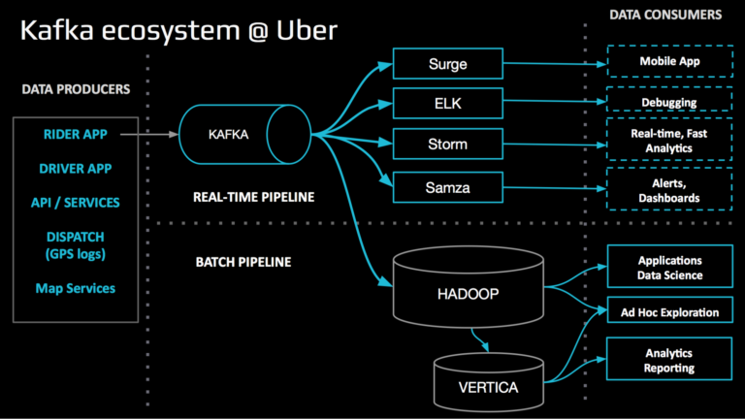
For example: Uber’s Analytics Pipeline
https://eng.uber.com/ureplicator-apache-kafka-replicator/

Slide 10
Architecture
Zookeeper
Connect
Source
Kafka Cluster
Streams app 1
Broker 1
Streams app 2
Broker 2
Target
Producer
Consumer

Slide 11
Kafka Internals

Slide 12
Topics, Partitions and Offsets
Topics: a particular stream of data
We can have as many topics as we want
Each topic identified by its name

Slide 13
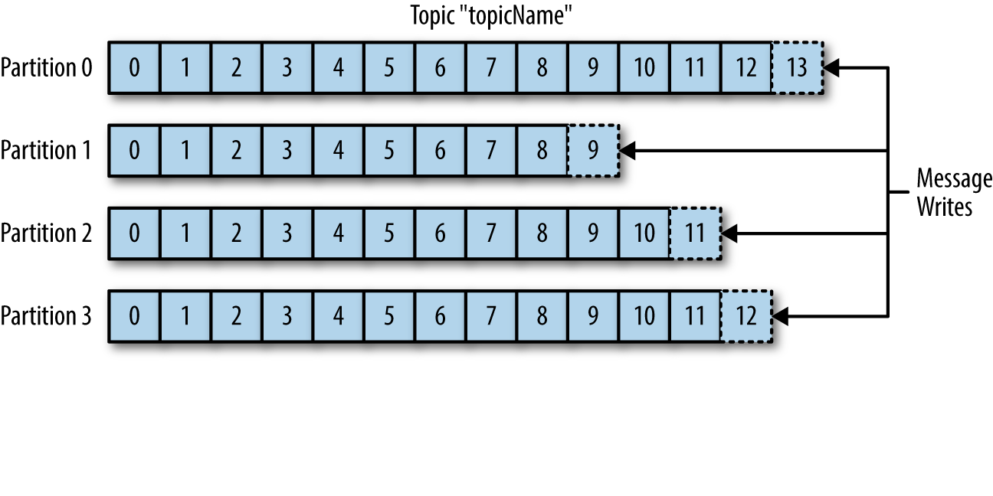
Topics, Partitions and Offsets
Topics are split into partitions
Each message within a partition gets an incremental id called offset
Order is guaranteed within partitions and not across partitions
Message with the same key will go to same partition
Kafka topics are immutable: once data is written to a partition, it cannot be changed
Neha Narkhede, Gwen Shapira, Todd Palino - Kafka_ The Definitive Guide_ Real-Time Data and Stream Processing at Scale-O’Reilly Media (July 2017)

Slide 14
Brokers
A Kafka cluster is composed of multiple brokers
Each broker is identified by an integer id
Each broker contains certain topic partitions

Slide 15
Brokers and topics
Topic A with 3 partitions
Topic B with 2 partitions
Broker 1
Broker 2
Broker 3
Topic A
Partition 0
Topic A
Partition 1
Topic A
Partition 2
Topic B
Partition 0
Topic B
Partition 1

Slide 16
Topic replication factor
Topic replication factor should be >1 for reliability
So, if one broker is down, another can serve the data
Topic A with 2 partitions and replication factor of 2
Broker 1
Broker 2
Broker 3
Topic A
Partition 0
Topic A
Partition 0
Topic A
Partition 1
Topic A
Partition 1

Slide 17
Leader for a partition
At a time only one broker can be leader for a partition
Only that leader can receive and serve data for that partition
Other brokers will synchronize the data
Each partition has one leader and multiple replicas
If leader goes down, then another broker becomes leader -> determined by Zookeeper

Slide 18
Producer
Producers write data to topics
Partition determined by message key
If we send message without key, then data is load balanced using round robin algorithm
We can also specify partition when sending the data
Producers can wait for acknowledgement
acks=0: Producer won’t wait for acknowledgement
acks=1: Producer waits for leader acknowledgement
acks=all: Producer waits for acknowledgement from leader+replicas

Slide 19
Consumer
Consumers read data from topic
Data is read in order within partition

Slide 20
Consumer Groups
Say we have single Consumer reading from a topic and rate at which producers write messages to the topic exceeds the rate at which your application can process them?
Just like multiple producers can write to the same topic, we need to allow multiple consumers to read from the same topic, splitting the data between them.
Each consumer in a group reads data from an exclusive partition
Consumer groups ensure high availability and scalability

Slide 21
Consumer Groups
Neha Narkhede, Gwen Shapira, Todd Palino - Kafka_ The Definitive Guide_ Real-Time Data and Stream Processing at Scale-O’Reilly Media (July 2017)

Slide 22
Consumer offsets
Kafka stores offsets at which consumer group has been reading
Offsets committed to a topic called __consumer_offsets
When consumer in a group has processed the data, it will commit the offset
If a consumer dies it will be to read back from where it left off

Slide 23
Zookeeper
Manages brokers
Leader election for partition
Notifies Kafka in case of changes(like new topic added, broker dies, broker comes up,..)
Kafka can’t work without Zookeeper

Slide 24
Kafka Core API’s
Producer
Consumer
Connect
Streams

Slide 25
Kafka Streams
Producer, Consumer API’s do not provide abstractions for complex operations like aggregations, time-based windowing
Kafka Streams provides abstractions for processing and transformation of real time events

Slide 26
Kafka Streams: Features
A high-level DSL that looks and feels like Java’s streaming API. The DSL provides a fluent and functional approach to processing data streams that is easy to learn and use.
A low-level Processor API that gives developers fine-grained control when they need it.
Convenient abstractions for modeling data as either streams or tables.
The ability to join streams and tables, which is useful for data transformation.
Operators and utilities for building both stateless and stateful stream processing applications.
Support for time-based operations, including windowing and periodic functions.

Slide 27
Scaling Kafka Streams
application-id: Name of our stream application, the same id is used for generating consumer group id for stream
So, by leveraging consumer groups, the total amount of work being handled by a Kafka Streams application can be distributed across multiple instances of your application.
If a streams app dies, then work will be rebalanced among other apps in consumer group(Reliable)

Slide 28
References
https://www.conduktor.io/kafka/kafka-topics

