Slide 1
FASTAG 2.0
An improved Ecosystem for smoother commute
Team: JUST_DO_IT

Slide 2





Team
Akshata Kulkarni
[back-end, data-architecture]
Saurabh R Nayak
[back-end, data-architecture]
Kanchan Pal
[back-end, data-architecture]
Gaurav Kumar
[back-end, data-architecture]
Nikhil Ranjan Sinha
[back-end, data-architecture]

Slide 3
Use Cases:
Vehicle Class Verification at the Scanning point. The problem we are tackling in our project is to eradicate the possibility of the vehicle owner using a Fastag Sticker belonging to a lower vehicular class instead of the vehicle’s actual class to get a deduction in the toll charge.

Slide 4
Solutioning
We have thought of merging two methods to create a solution with high efficiency.
Building an ML based Image classifier module to detect the vehicular class.
Retrieving vehicle class by using its Numberplate.

Slide 5
Total Block Diagram
vehicle
Number Plate Recognition Module
RFID Scanner
Image Classifier Module
Get vehicle category based on the type of tag scanned.
store
Extract number
Class matched
?
YES
NO
Confidence value>70%
API handler
Acquirer
Bank
NO
API call/response
YES
Charge for the higher vehicular class
Get vehicle category
Store for enquiry
Vahan.nic.in
(https://vahan.nic.in/nrservices/faces/user/searchstatus.xhtml)
Enable SOS option for toll operator
Notify NHAI

Slide 6
In the above Block diagram we have combined both our approaches in such a way that it creates a fast and error free solution. The ML based approach would be our primary method of class detection, to increase its efficiency we use the numberplate detection module to get the class using NIC database.
We have given each of the module’s functioning separately in the upcoming slides.

Slide 7
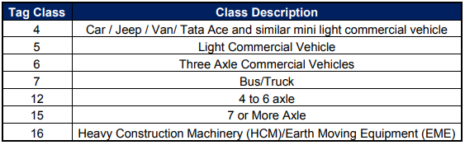
Building an ML based Image classifier module to detect the vehicular class:
As we know there are 7 Fastag classes based on which the vehicle mapper classes are grouped and are charged the fares accordingly. The solution we are providing would be using a machine learning based image classifier model which could map the vehicles in their respective class by taking a snap of them.

Slide 8
vehicle
Confidence value>70%
RFID Scanner
Training data
YES
Image Classifier Module
Get vehicle category based on the type of tag scanned.
NO
Training Module
Class matched
?
YES
store
Acquirer
Bank
NO
Replace the model
Testing the model
(v1)
Charge for the higher vehicular class
Testing the model (v2)
Accuracy
V2>V1
Store for enquiry
Enable SOS option for toll operator
Notify NHAI

Slide 9
We are planning to use a semi supervised machine learning model for this solution. We can divide the flowchart in two parts
The vehicle Class finder part
The module versioning part
The vehicle Class finder part :
The parts colour coded with green, orange, red belong to this batch. The process begins when a vehicle enters the toll, two actions are triggered simultaneously. One would be the RFID scan bit where the scanner scans the tag and gets the car details, this would give a vehicle class value which we would use later.
The second would be taking a snap of the vehicle and sending it to the image classifier module, which was trained with datasets having vehicle class category as its labels. The classifier gives us the vehicle class category. If the confidence value of the detection is greater than 70% we would store it in training set input, if less we would call the NumberPlate module to find the vehicle class .
Now as we have obtained the vehicle class value from both the scanner and the classifier model we check whether both the values are matching, if so then we would proceed to usual flow to the acquirer and so on. On the other hand if it doesn’t match then we would be going with the higher class among the both to calculate the fare, and also store all the data captured from the vehicle for future enquiry.

Slide 10
The module versioning part:
The parts colour coded with gray belongs to this batch. This part is to continuously train the model with a base check which gives us full surety that the model is not trained with contaminated data. For achieving this we use the snaps which were giving an accuracy of 70+ percent and store them in the folder to be used as training data set. On the other hand the one with a lower accuracy could also be stored to be used as a testing data set. Our current model gives us an accuracy of about 85+ percent.
A copy of the active version would be taken and this model would be trained with the training dataset achieved from the previous step. This portion could be scheduled to run on a specific time per week or on a monthly basis. Once the model is trained we would test both the models ie the actively used model and the copy version of the model if we find that the newly trained version has a better performance then we make this as the active model.
By doing so we could get an ever incremental growth in accuracy of our and don’t need to have a panic of accuracy reduction obtained through few unsupervised models.

Slide 11
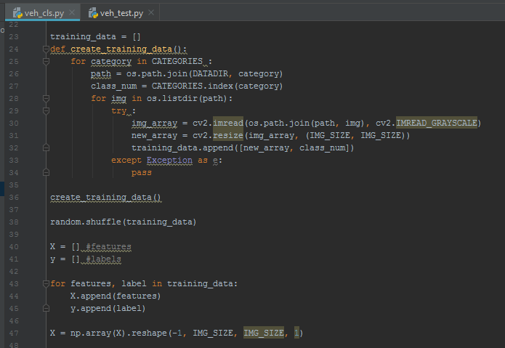
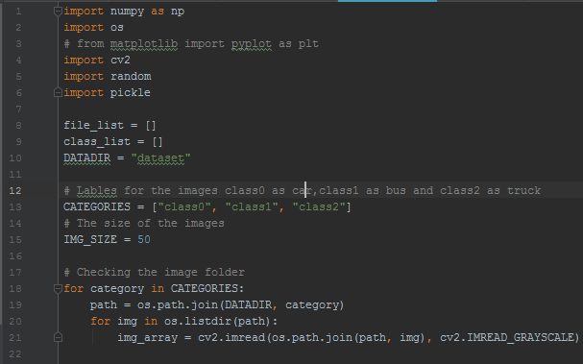
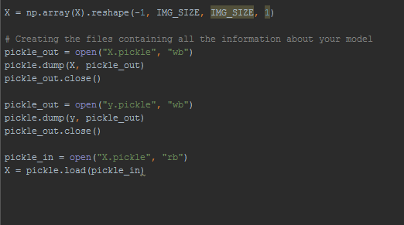
Screenshots
Dataset cleansing

Slide 12
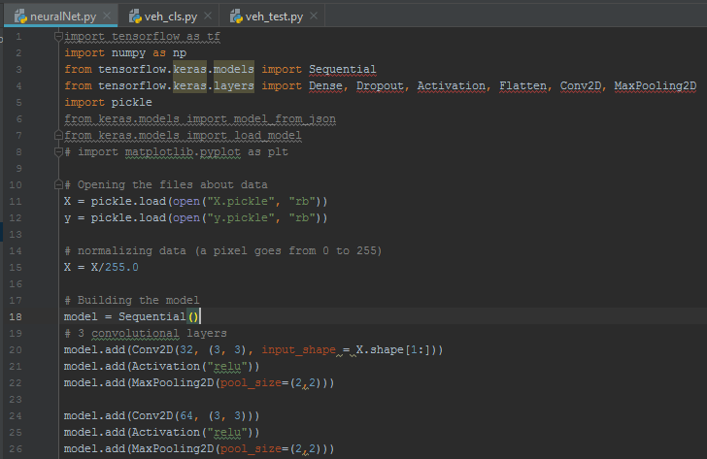
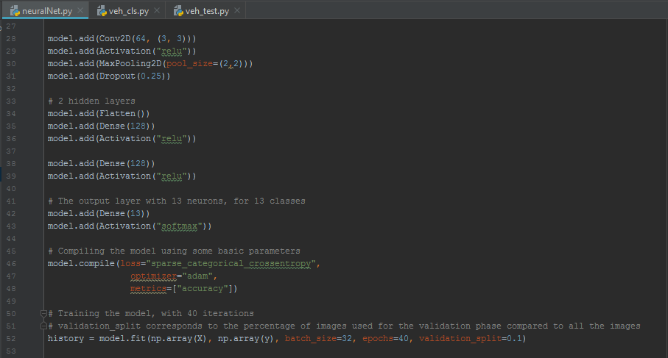
Training

Slide 13
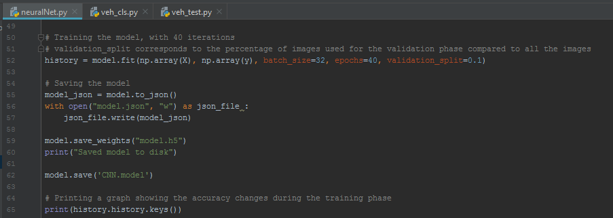
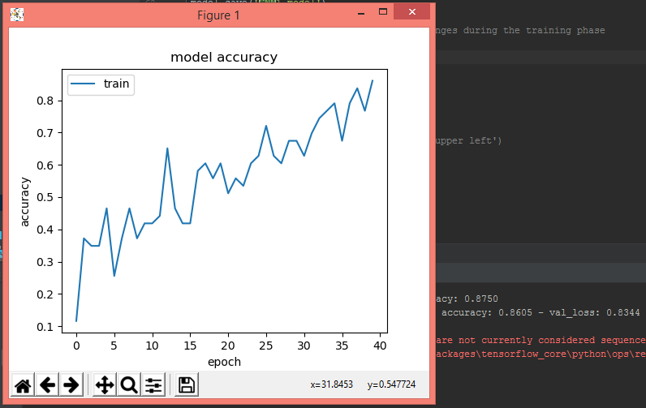
Training (contd)

Slide 14
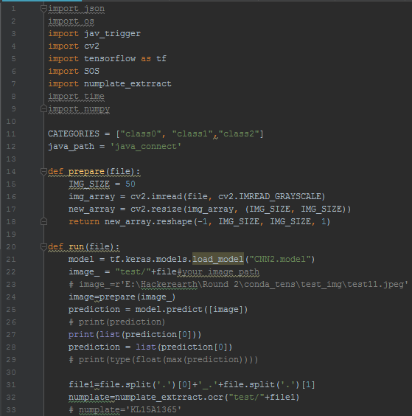
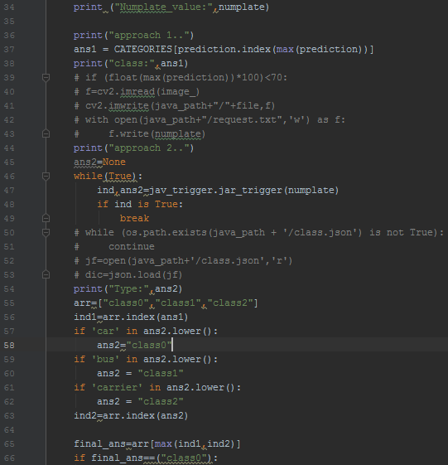
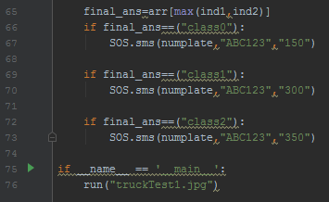
Testing

Slide 15
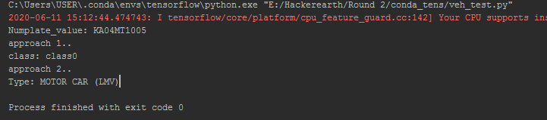
Output

Slide 16
Retrieving vehicle class by using its Numberplate :
We could make use of the government’s VAHAN Services. A set of services involving vehicle registration, getting permit details, vehicle fitness certificate and much more. Among these services they are also offering a service to get the vehicle registration status. While exploring the same we found that it also gives the vehicle class information of any vehicle once we provide the Number plate value input. We could make use of our number plate value extraction module we created to extract the number from the vehicles entering the toll and use that as an input to the goverment’s already available service.

Slide 17
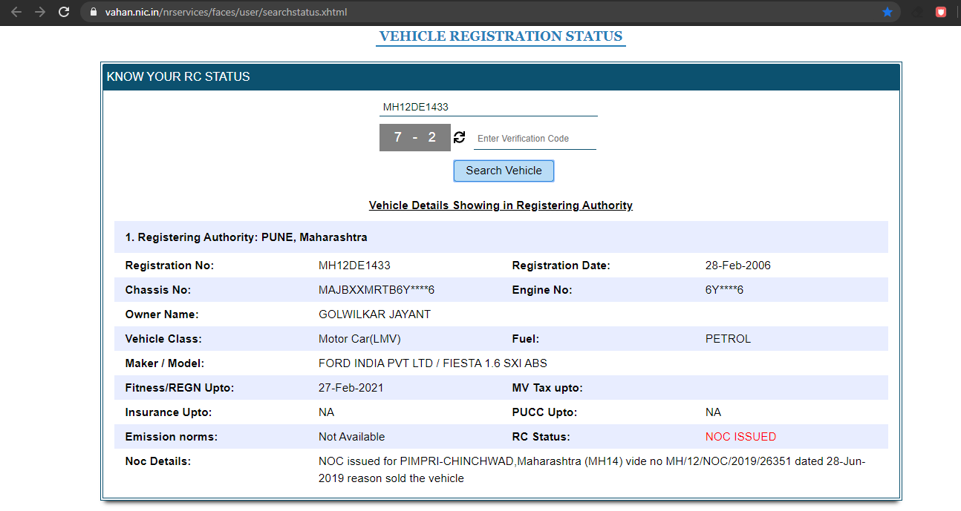
The website snapshot
Number plate value
Vehicle Class
Vehicle model details
Link: https://vahan.nic.in/nrservices/faces/user/searchstatus.xhtml

Slide 18
vehicle
Number Plate Recognition Module
RFID Scanner
Extract number
Get vehicle category based on the type of tag scanned.
Match?
YES
API handler
API call/response
NO
Acquirer
Bank
Get vehicle category
Charge for the higher vehicular class
Vahan.nic.in
(https://vahan.nic.in/nrservices/faces/user/searchstatus.xhtml)
Store for enquiry
Enable SOS option for toll operator
Notify NHAI

Slide 19
The above slide shows the flow of execution. When the vehicle enters the toll gate the ML based class detection would be done, simultaneously it would be calling the numberplate reading module and passing the frontal snap of the vehicle as input, the content of numberplate is extracted and passed to the next action.
Now we would pass the number plate value to the VAHAN services portal via an API call, the response we receive would contain all the details of the vehicle. From these information we could parse the vehicle-class and its make.
Finally we can compare the vehicle class value from both the methods, if they both are matched then the user would be charged as per the tag class price band. On the contrary if the vehicle class values don’t match then we would store that entry in a DB for enquiry of the user and for the toll charge collection we would charge with the higher vehicle class among the two detected.
By using this method we could use the existing government’s service and build our module extending its functionalities.

Slide 20
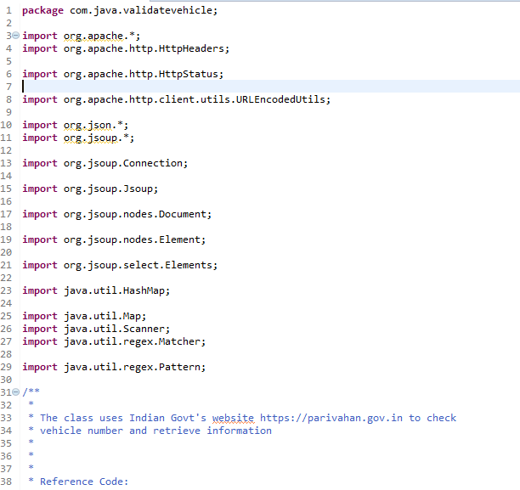
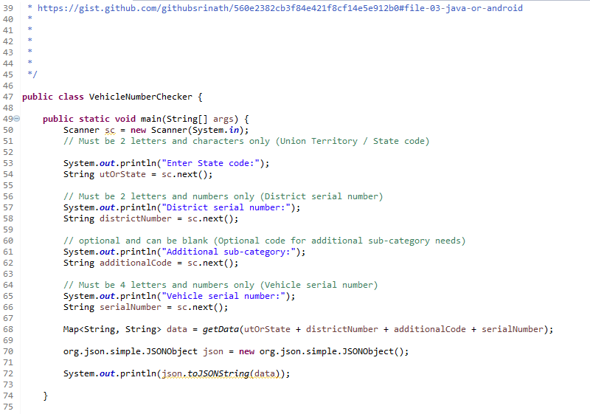
Snapshots
Code Snips

Slide 21
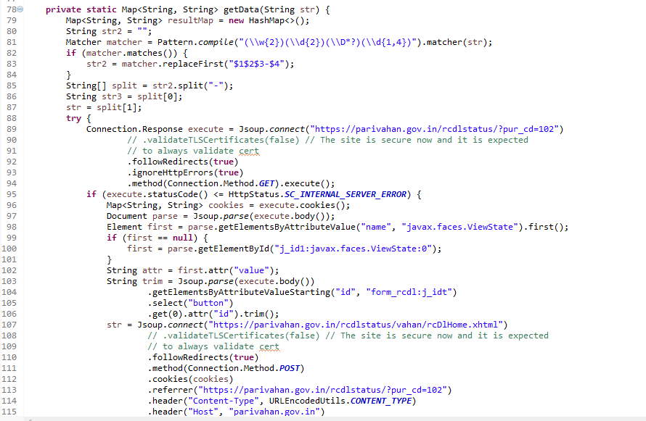
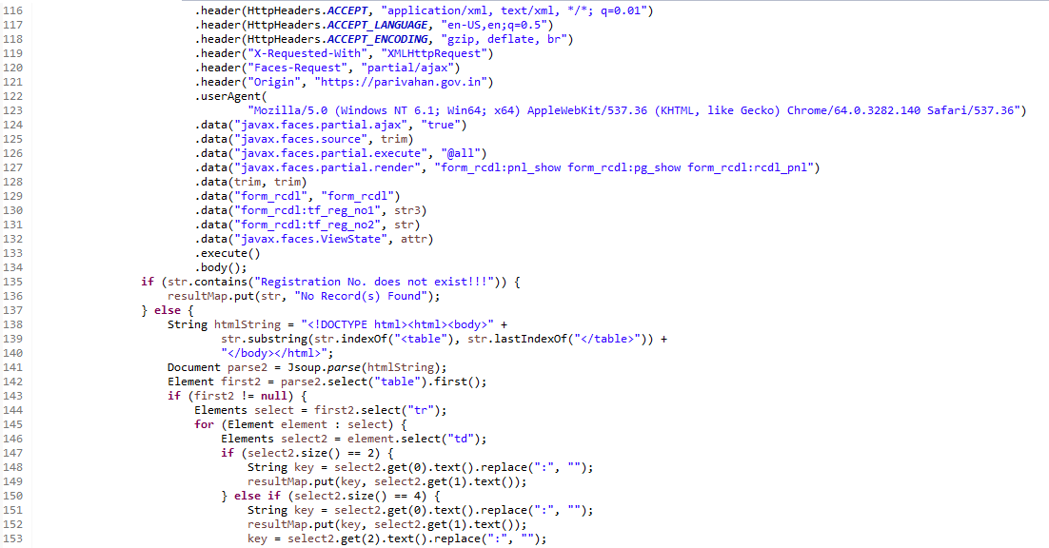
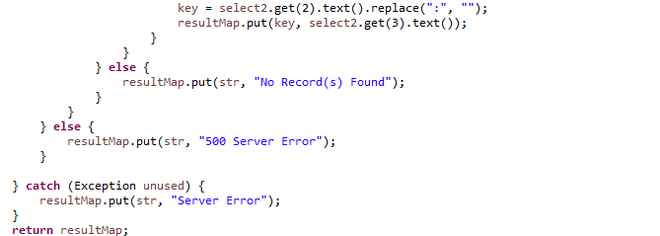
Code Snips (contd)

Slide 22
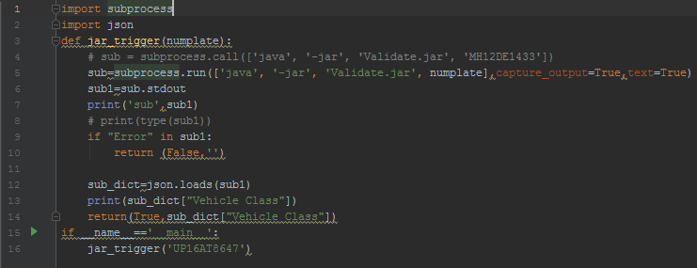
The scraping of the vehicular details are done using java and the complete program handling it is converted into a java archive file so that it could be used as a module. We use a small python wrapper to convert it as a utility that can be easily accessed in any part of a py file just by making a function call.
Currently we are taking a web scrapping kind of approach where we take the response from the website and extract the tabular data representing the vehicular information using its page tags and ids. So sometimes due to improper connectivity or some other issues we get a server error. To tackle this we have kept a check to retrigger the function call if an error occurs.
However while this feature gets implemented by NETC we could create a bridge between the module and NIC’s repository through direct API calls since both are governmental organizations.

Slide 23
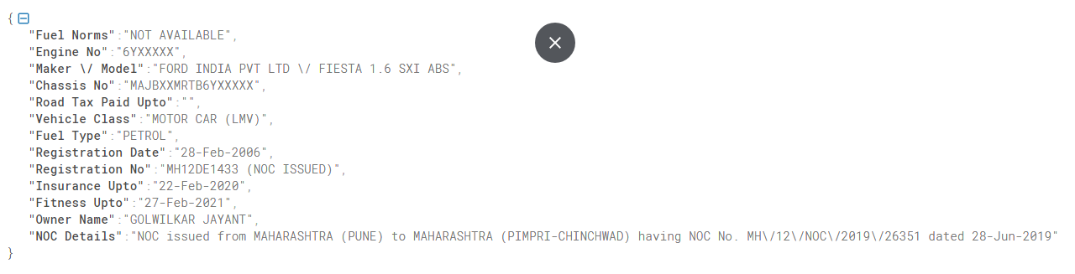
Output sample

Slide 24
Notification Module:
Once we find that the classes of vehicle detected as per the Fastag and our method are different then we may need to pass on this notification to NHAI or to the highway police patrol. Also if any chaos occurs at the toll plaza caused by the civilian rider due to misbehavior or for any other reason toll operator would be wanting to send an SOS. So for these situations we have created a module that can notify both on mail and via SMS to NHAI or police with just a click of button.
In addition to it we have used the sms utility to send the passenger an invoice after he passes through the toll plaza to get amount charged and other information.
We have created a python module for it which would be sending mail notifications using open-source modules and also sms notification by means of third party module.

Slide 25
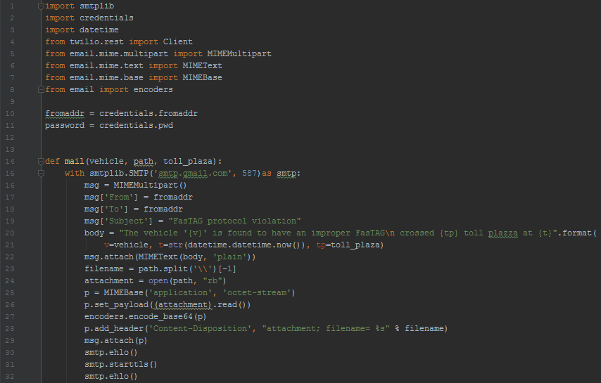
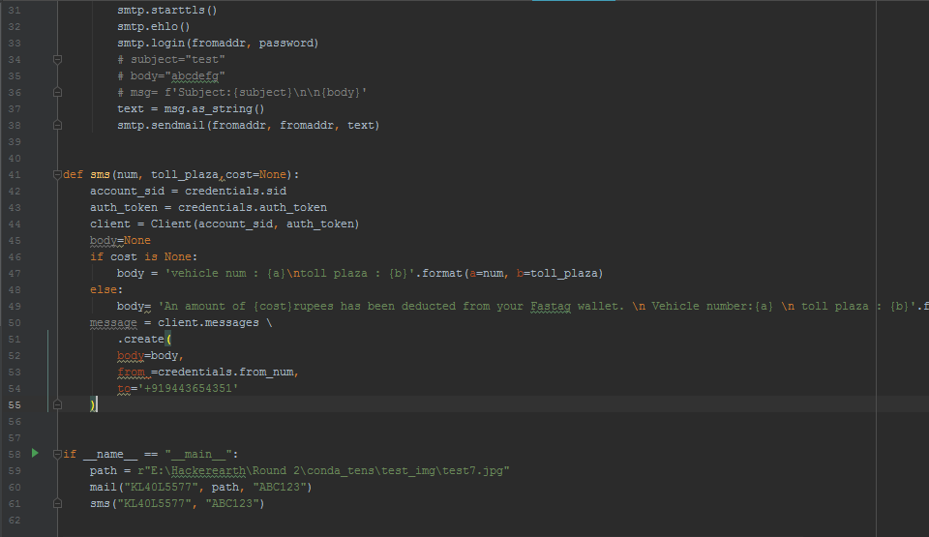
S.O.S Code Snips

Slide 26
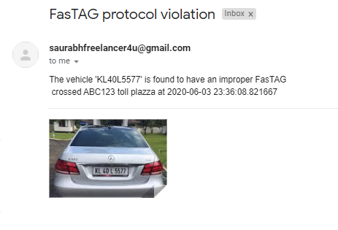
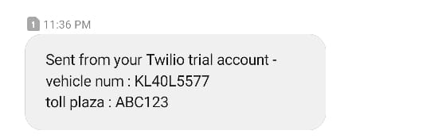
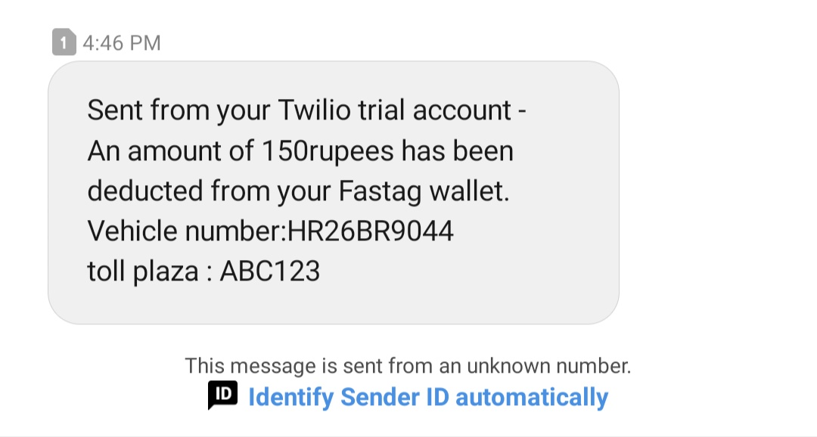
Mail Output
SMS output
SMS invoice

Slide 27
Initial Implementation Phase:
While beginning the data collection phase we faced the challenge of finding the training data. We have few websites to get the training sets, but they are not in a ready to use format and also we don’t have data sets for few vehicle classes.
So we figured out that when we are in a real time implementation phase we could tackle this by using the current fastag functionality to create our own data set. Currently we use RFID scanners to get the class of the vehicles, we map these classes with their image as entries for dataset. Yes, these may contain the rides involving proxy tags but the valid data ratio will be higher than the invalid data and we would later bring our previous flow chart in action to increase the efficiency.
Vehicle
RFID Scanner
Cam
Get vehicle class
Data set

Slide 28
GitHub link: https://github.com/SaurabhRNayak/FasTAG_2.0

