Slide 1
FASTAG 2.0
An improved Ecosystem for smoother commute
Team: JUST_DO_IT

Slide 2
Team Details
Akshata Kulkarni
[back-end, data-architecture]
Gaurav Kumar
[back-end, data-architecture]
Kanchan Pal
[back-end, data-architecture]
Nikhil Ranjan Sinha
[back-end, data-architecture]
Saurabh R Nayak
[back-end, data-architecture]

Slide 3
Problem Statement
Improper implementation of hardware at tolls leading to duplicate proximity payments and depleting the customer satisfaction.
Inappropriate lane selection by confused public creating discomfort for the toll collectors to bear the impact of angry road users.
Fraudulence committed by few by emulating other the users FASTag barcode.
Some toll operator swindle the user by misguiding them that the RFID/Scanner had failed scanning and charge cash for the toll.
Improving user experience and providing the users with proper guidelines and feedback.

Slide 4
Use Cases:
Fastag amount deducted without visiting toll plaza:
There are multiple occurrences of this issue in the internet filed by the users. An event had been recorded where the money from the user was deducted without installation of the fastag in his vehicle. Also several other issues stating the deduction of money from their e-wallet without visiting the toll plaza.
Source: https://www.complaintboard.in/complaints-reviews/paytm-fastag-l698203.html

Slide 5
Multiple charges made for a single scan:
It has been found that people are getting charged multiple times for a single scan during their journey. This would either be due to the faulty quality of the scanners or would be due to interference of adjacent scanners.
Source: https://www.consumercomplaints.in/fastag-deducted-twice-c2547231

Slide 6
Solutioning
Duplicate proximity payments:
This can be possibly due to two reasons.
Interference between scanners.
Multiple scans of the same tag.
The interference issue could be since all the scanners in the toll plaza are functioning for a common frequency. We could be bringing in scanners with different frequency range for dedicated lanes for different TAG classes. But this would be inducing a change for the people currently owning a FASTag . The other way to avoid this is by providing good shielding between the adjacent scanners by using some absorbing or reflecting materials. This method would only be making change at the inventory.
To avoid the multiple scans of the same tag we could create a sleep time that restricts the tag from getting scanned consecutively in the same toll booth. We can also increase the distance of the regulatory barrier governing the vehicle, and add a relay switch to it so that only when the current scanned vehicle has travelled desirable distance and barricade is lifted the scanner would be turned on for the next vehicle. Another approach to tackle this is by governing the vehicles gps values and restricting the scanner from recording the tag after initial scan for a until the vehicle has crossed few area.

Slide 7
Inappropriate lane selection by confused public :
Its found that people are unable often get confused whether the lane is for their vehicle type or not. This would be creating unnecessary confusion at the toll collection region. Another issue faced by many are that after entering the lane its found that the lane is not functioning or under maintenance.
We are handling this problem by creating an app giving the user a complete idea of the current status of the tolls. This would give them info about the following facts:
=>Number of active lanes.
=>Lane status functioning/under maintenance.
=>Lane type FASTag/Cash.
=>Lane category heavy vehicle/light vehicle

Slide 8
Technology Stack
Backend solutioning
-Python 3.7
Web framework
-Flask 1.1
Frontend
-HTML 5
-Javascript
Database
-Flatfile,Mongo DB
API
-Rest API

Slide 9
Dynamic Barcode verification workflow
Webapp login
DB
End
verify
verified
success
Display Response
(Success/failed)
Collect user info
Display for scanning
Scanner
Generate barcode
Get the toll info from user/GPS
Generate a hash value with user info and time stamp making it unique
USER End
TOLL PLaza

Slide 10
This app brings the feature of generating unique barcode every time for the user, it’s a way to combat the outcome of poor functioning of RFID verification. Inour app once the user is logged in the portal every time he approaches the tollbooth his app would detect the toll location by from his gps and generate a unique barcode with the users info along with the timestamp.
These data is hashed and encrypted making it unique and for one time usage. This encrypted data is stored in the silo for future referencing. One the other end the toll plazas will be equipped with barcode readers whose functioning in our POC is done by our web cam. These scanners will scan the barcode and verify the data with that in silo and determine whether the read hash is mapped to the particular user or if it’s a fraudulent one. Once the check is done it next verifies whether the user’s journey is one way or is it a return journey (within 24hr period).
Depending on the type of journey an entry is made and the required cash deduction request is triggered.

Slide 11
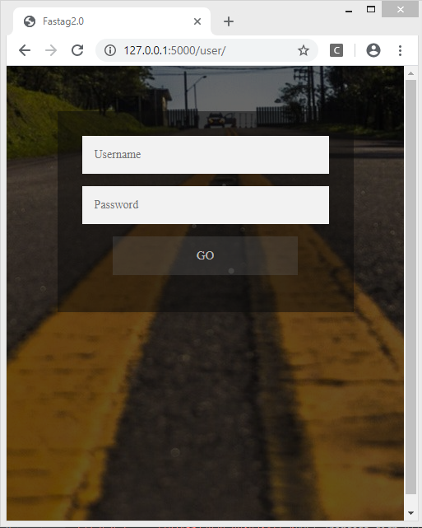
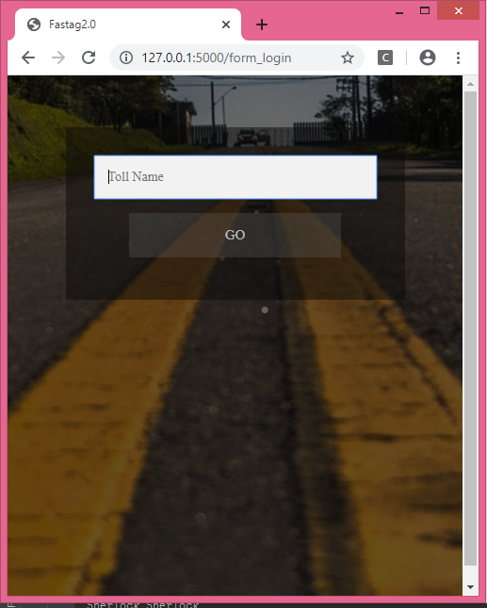
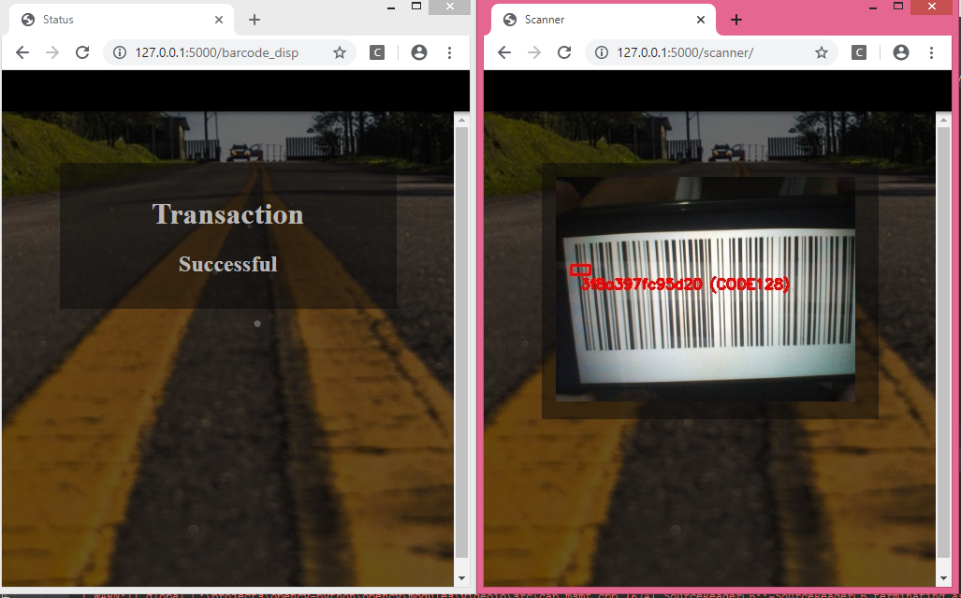
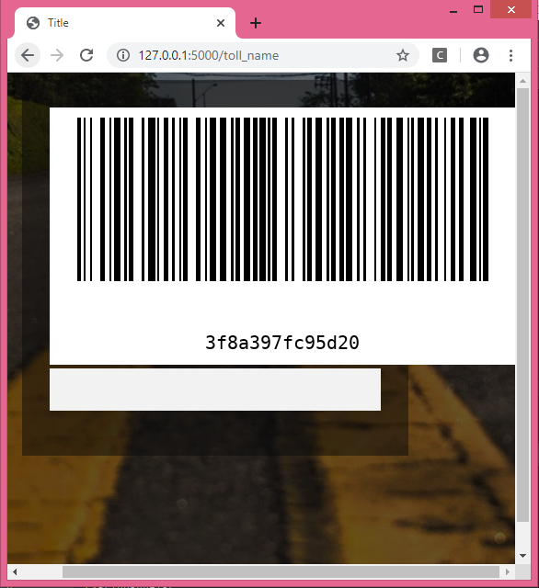
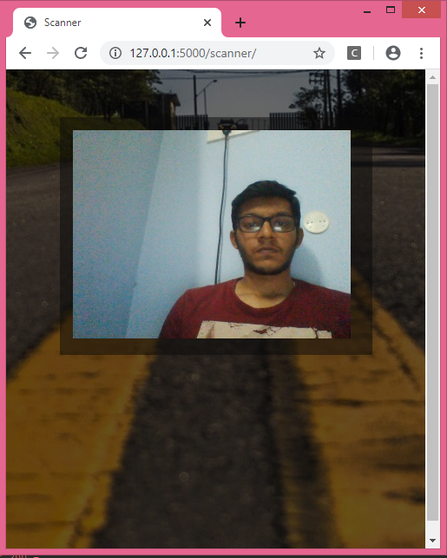
Real-time snaps
Log in
Toll detail
Scanning the code
Status
USER End
TOLL PLaza
Barcode Creation
Demo:
https://youtu.be/r1tgGqac0vE
Web cam feed

Slide 12
Lane info webapp
MASTER
coordinator
Toll plaza location/id
Fetch the required data
Webapp
Information cleansing
Source code of web page
Webpage describing the toll plaza
info
DB
Modify
data
The webpage contains the search bar.
The user can enter the toll name/id to get details.
(html,css)
The data about the lane will be present in a DB.
The data will be read from the sheet. Will b parsed in a way we want.
(python)
In the source code the data about info of tollgates will be replaced with latest one.
(python)

Slide 13
This is a simple webapp that gives the user the complete info of any toll he/she wants. The user just needs to enter the toll name or the id he/she wants and submit the same. This comes in handy for the user and helps to avoid any confusion in choosing a lane depending on his vehicle type and also lets the user the information about any lane under maintenance way before entering it.
We could also integrate this feature in the previous app and give a notification to the user prior approaching the (approx 500meters) toll by fetching the gps data of the user.

Slide 14
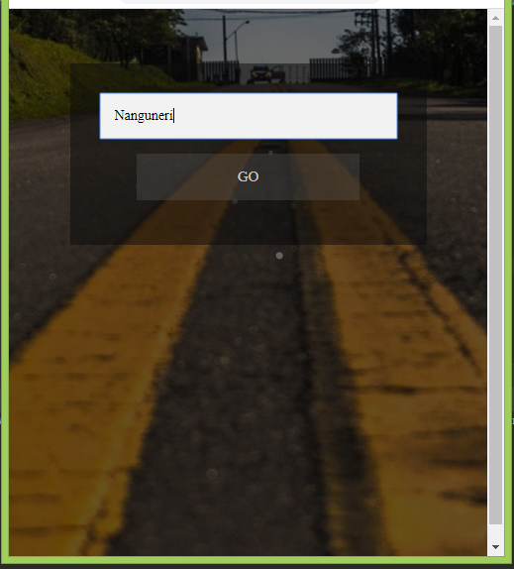
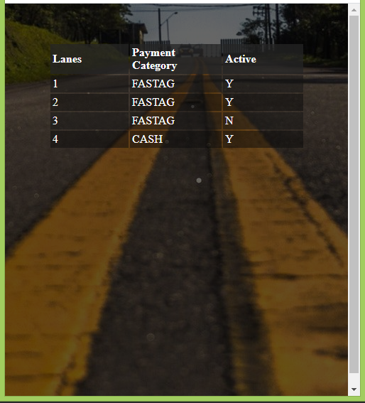
Enter the Toll location
real-time info

Slide 15
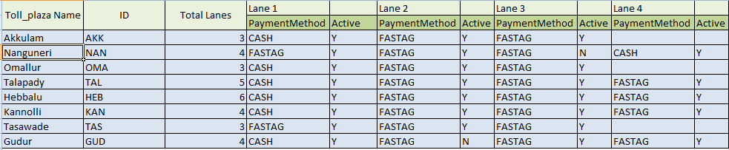

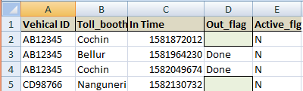

Data sample snaps
Toll Plaza Details
User data created for testing
Toll-plaza visit history infp
Users and their volatile hashcode

Slide 16
Resources
Github link:
https://github.com/SaurabhRNayak/Just_Do_It-NPCI_HACK
Youtube link:
https://youtu.be/r1tgGqac0vE
References:
https://www.complaintboard.in/complaints-reviews/paytm-fastag-l698203.html
https://www.consumercomplaints.in/fastag-deducted-twice-c2547231
https://flask.palletsprojects.com/en/1.1.x/

