Slide 1
Power Analysis
Presented by:
Saurabh Ramteke

Slide 2
Table of Contents:
Basics of power consumption.
Switching activity files.
Tool used.
Input Require For Power Analysis.
Things To Check after performing Power Analysis.

Slide 3
Basics of Power Consumption:
CMOS Circuit Power Consumption
Power = Pstatic + Pdynamic
Static Power
Power is consumed when circuit is at steady state.
Dynamic Power
Power is consumed when circuit is switching.

Slide 4

Dynamic Power Consumption:
Pswitching = Cload && Cwire
Pswitching = CL * VDD² * F
CL = Cwire + $Σ$ CIN
PINTERNAL = CINT && ISHORT-CKT
Internal Power can be looked up from, energy table from library

Slide 5
Static Power Components:
Pstatic = Ileakage * VDD
Static power can be looked up from, energy table from the library
Static Probability (Sp)
Time of signal
SP =
Total simulation time
Toggle Rate (Tr)
Number of Transitions
Tr =
Total Simulation Time

Slide 6
Switching Activity Files:
Switching Activity Interchange Format (SAIF) && Fast Signal Database (FSDB)
Both can be use for power estimation. But FSDB is used in waveform debug & with waveform viewer.
File size of SAIF is small as compared to FSDB.
SAIF stores only signal transition counts, such as how often a signal toggles ( 1 -> 0 0r 0 -> 1).
FSDB have large file size, It contains precise waveforms for every signal.
SAIF files are used to determine power consumption without storing waveforms.

Slide 7
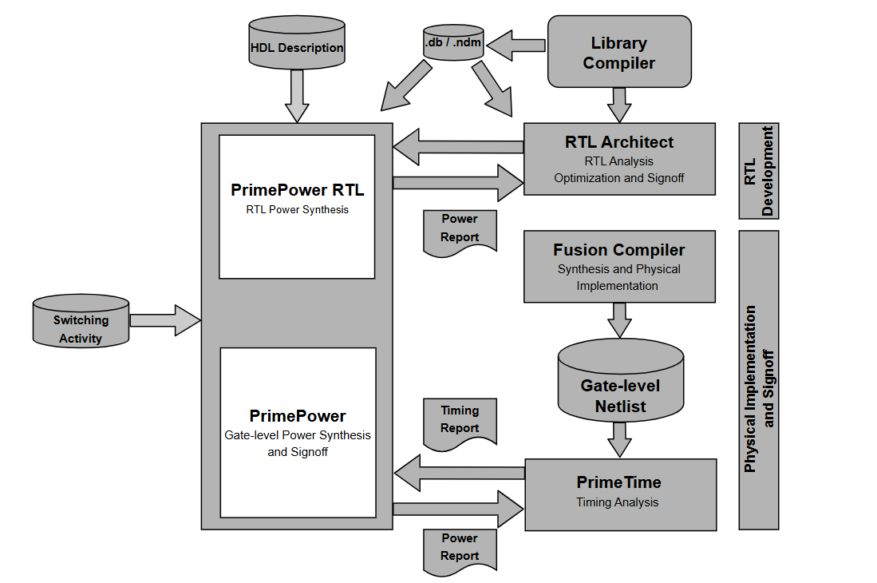
Tool Used :
Prime Power / Prime Time - PX

Slide 8
Input Require For Power Analysis:
Gate Level Netlist.
Unified Power Format (UPF).
PTSI Session.
FSDB or SAIF.
Name of TP Corner.
Name of Main Clock and Frequency.

Slide 9
Things To Check after performing Power Analysis:
Net Switching Power.
Cell Internal Power.
Cell Leakage Power.
Total Power.
Switching Activity Annotation.
Logic power.
Memory power.

Slide 10
Thank You

